Slide 1

TECHNOVISION 2K26
Department of Computer Science and Engineering
EDUFACE: AN AI-POWERED PERSONALIZED LEARNING PLATFORM FOR ACCESSIBLE AND ENGAGING LEARNING
Team Members
1.Suresh Bharathi B(22ucs009)
2.Sam Prasith R(22ucs027)
3.Santhosh Kumar S(22ucs133)
Project Guide
Dr. A. Meenakshi, M.E., Ph.D
Professor & Head of Department

Slide 2
Motivation for the Project
Providing quality education remains a challenge, especially for students in rural and economically weaker regions with limited access to teachers and learning resources. Traditional materials such as textbooks, PDFs, and PowerPoint slides are static and often fail to engage different learning styles.
Advancements in Artificial Intelligence, Natural Language Processing, and Computer Vision provide new opportunities to improve digital education.
EduFace aims to transform traditional study materials into interactive AI-generated video lessons with virtual instructors, making learning more engaging, accessible, and personalized.

Slide 3
Project Proposal Document
Project Description EduFace is an AI-powered platform that converts study materials such as notes or PowerPoint slides into interactive educational videos using a virtual AI instructor with voice narration and lip synchronization.
Project Objective
• To develop an AI-based system that generates personalized educational videos automatically.
• To summarize learning materials using transformer-based language models.
• To generate natural speech narration using neural text-to-speech technology.
• To create realistic avatars with accurate lip synchronization.
• To provide a user-friendly platform for automated learning content creation.

Slide 4
Innovation
Integration of AI content generation, speech synthesis, facial animation, and automated video rendering into a single educational system.Applications
Application
Online learning platforms
Digital classrooms
Remote education systems
Self-learning platforms for students
Educational content creation tools

Slide 5
Literature Survey
Author Name | Name of the Journal | Title of the Paper | Year of Publication | Inference
Vaswani A., Shazeer N., Parmar N. | Advances in Neural Information Processing Systems (NeurIPS) | Attention Is All You Need | 2017 | • Introduced Transformer architecture for NLP tasks • Enables efficient text summarization and content generation
Oord A., Dieleman S., Zen H. | Speech Synthesis Workshop | WaveNet: A Generative Model for Raw Audio | 2016 | • Neural network based speech synthesis model • Produces natural and high-quality voice narration
Prajwal K. R., Mukhopadhyay R., Namboodiri V. | ACM Multimedia Conference | Wav2Lip: Accurately Lip-Syncing Videos to Any Speech | 2020 | • Deep learning model for accurate lip synchronization • Generates realistic talking-face videos

Slide 6
Design Document
A. Development Plan
Deliverable
The development of the EduFace system follows a modular architecture consisting of multiple stages.
Work Breakdown Structure
AI-based content generation module
• Automatic PowerPoint slide generation module
• Neural text-to-speech narration system
• AI avatar generation using facial image
• Lip synchronization using Wav2Lip model
• Final video rendering system using multimedia processing tools

Slide 7
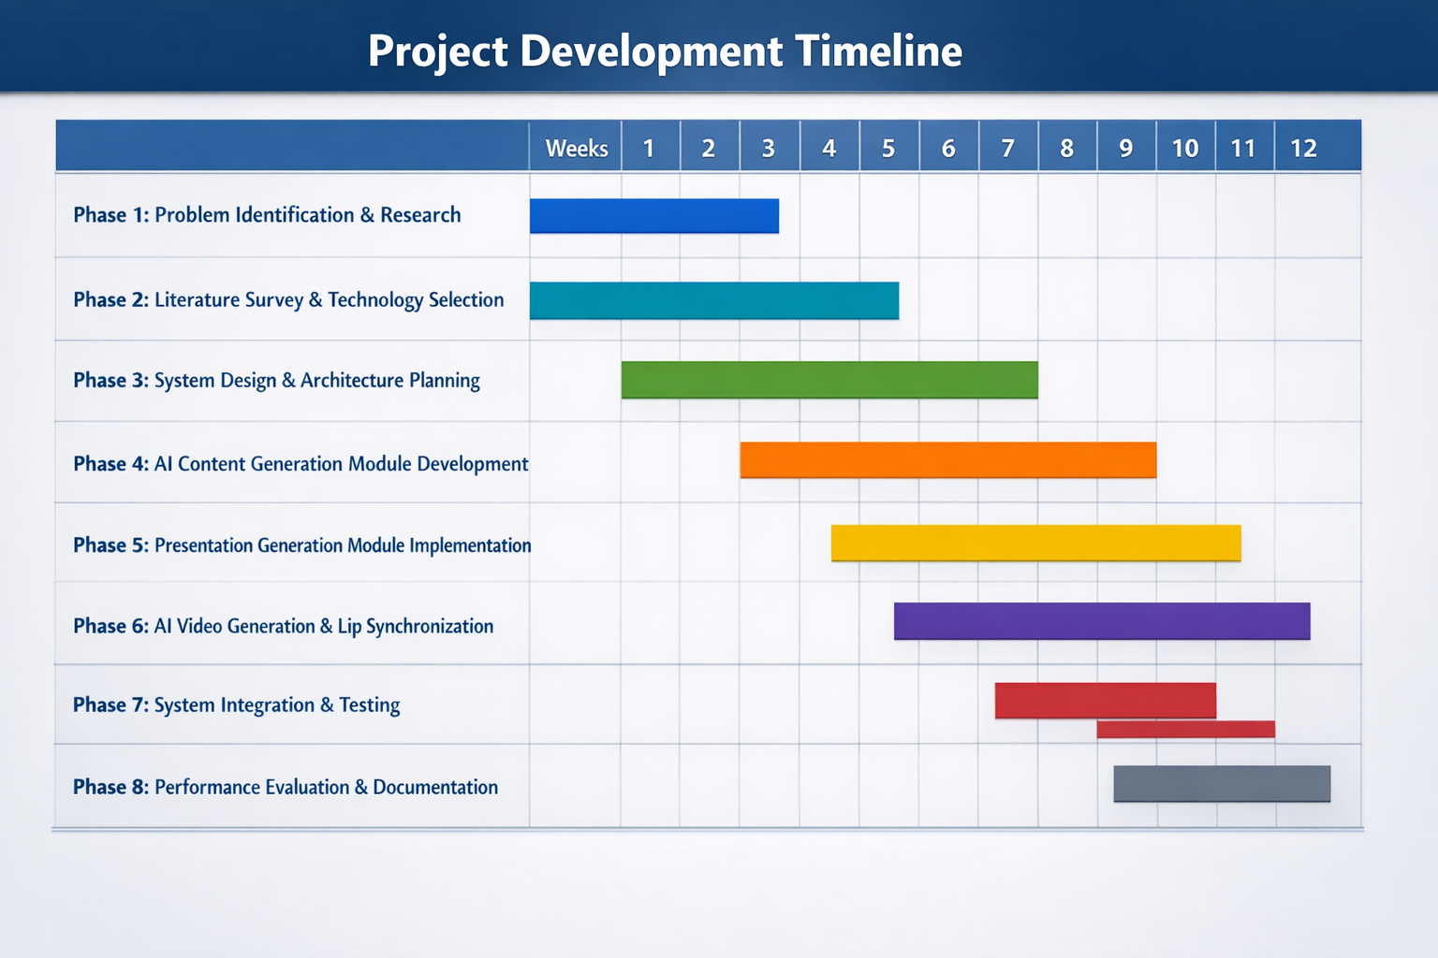
GANTT CHART

Slide 8
B. Design
Project Requirements
Hardware Requirements
• Intel Core i5 / AMD Ryzen 5 Processor
• Minimum 8 GB RAM (16 GB recommended)
• NVIDIA GPU (optional for AI acceleration)
Software Requirements
• ReactJS (Frontend Interface)
• Flask Framework (Backend API)
• Ollama for Local AI Model Execution
• Wav2Lip Deep Learning Model
• OpenCV and MediaPipe for Computer Vision
• MoviePy and FFmpeg for Video Rendering
These technologies collectively support the development of a scalable AI-powered educational platform.

Slide 9
System Design Description
The EduFace system follows a web-based architecture integrating multiple AI modules to automatically generate educational videos.
Frontend: A React-based interface where users upload learning materials and a facial image of the AI teacher.
Backend: A Flask server that manages system operations and handles communication between different modules.
AI Modules:
• Mistral (Ollama) – Generates educational content
• Text-to-Speech – Produces voice narration
• Wav2Lip – Synchronizes lip movements with speech
• OpenCV / MediaPipe – Performs facial detection and processing
Multimedia Processing:MoviePy and FFmpeg combine slides, narration audio, and the animated avatar to generate the final educational video.

Slide 10
C. Acceptance Plan
The system was evaluated using multiple academic topics to ensure proper functionality.
Testing Parameters
• Accuracy of AI-generated educational content
• Quality of automatically generated presentation slides
• Naturalness of speech narration
• Precision of lip synchronization
• Overall video rendering performance
Validation Process
Upload learning materials or topic prompts
Verify AI-generated educational content
Validate slide formatting and structure
Check synchronization accuracy between speech and avatar
Evaluate final video output quality
Successful completion of these tests confirms system reliability.

Slide 11
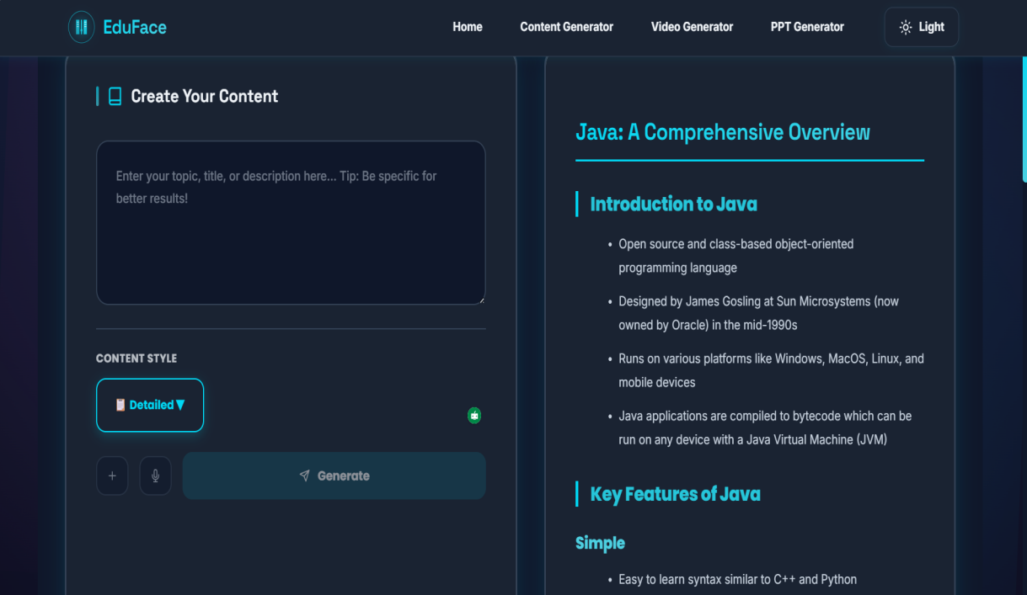
D. Results

Slide 12
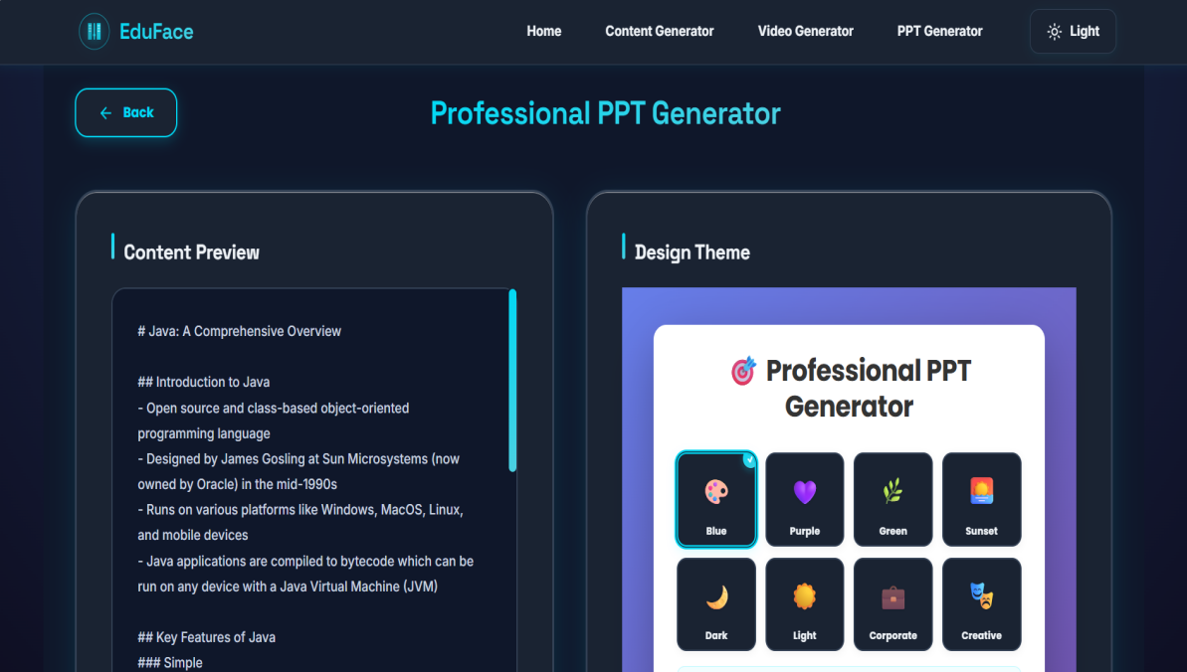
D. Results

Slide 13
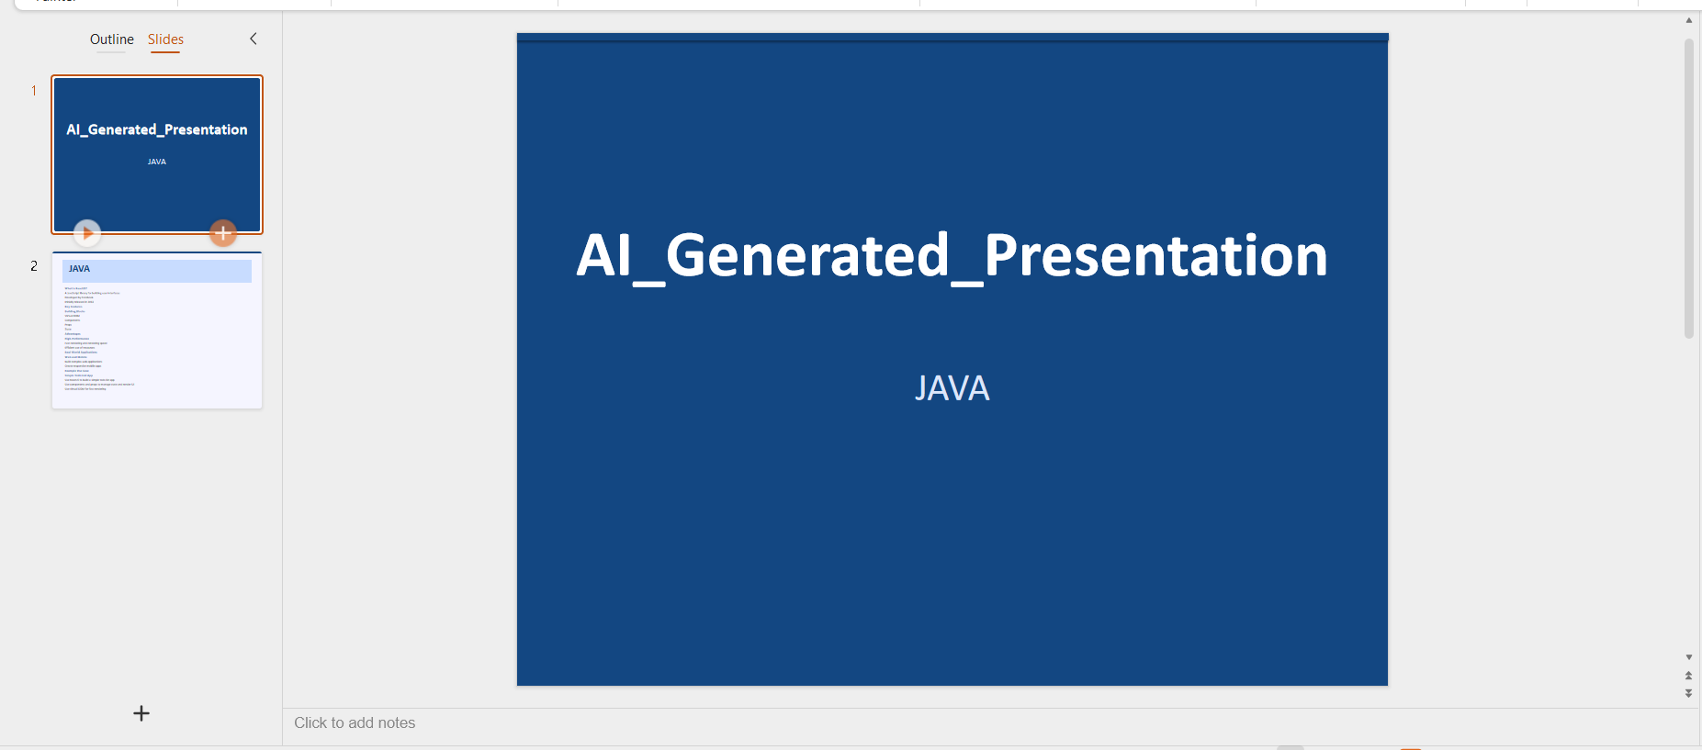
D. Results

Slide 14
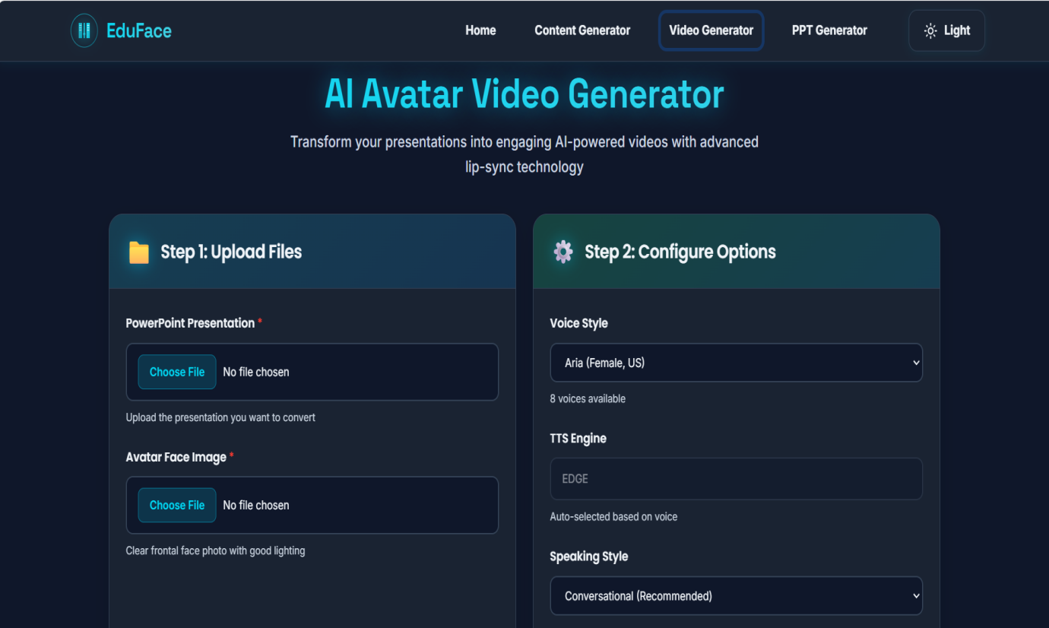
D. Results

Slide 15
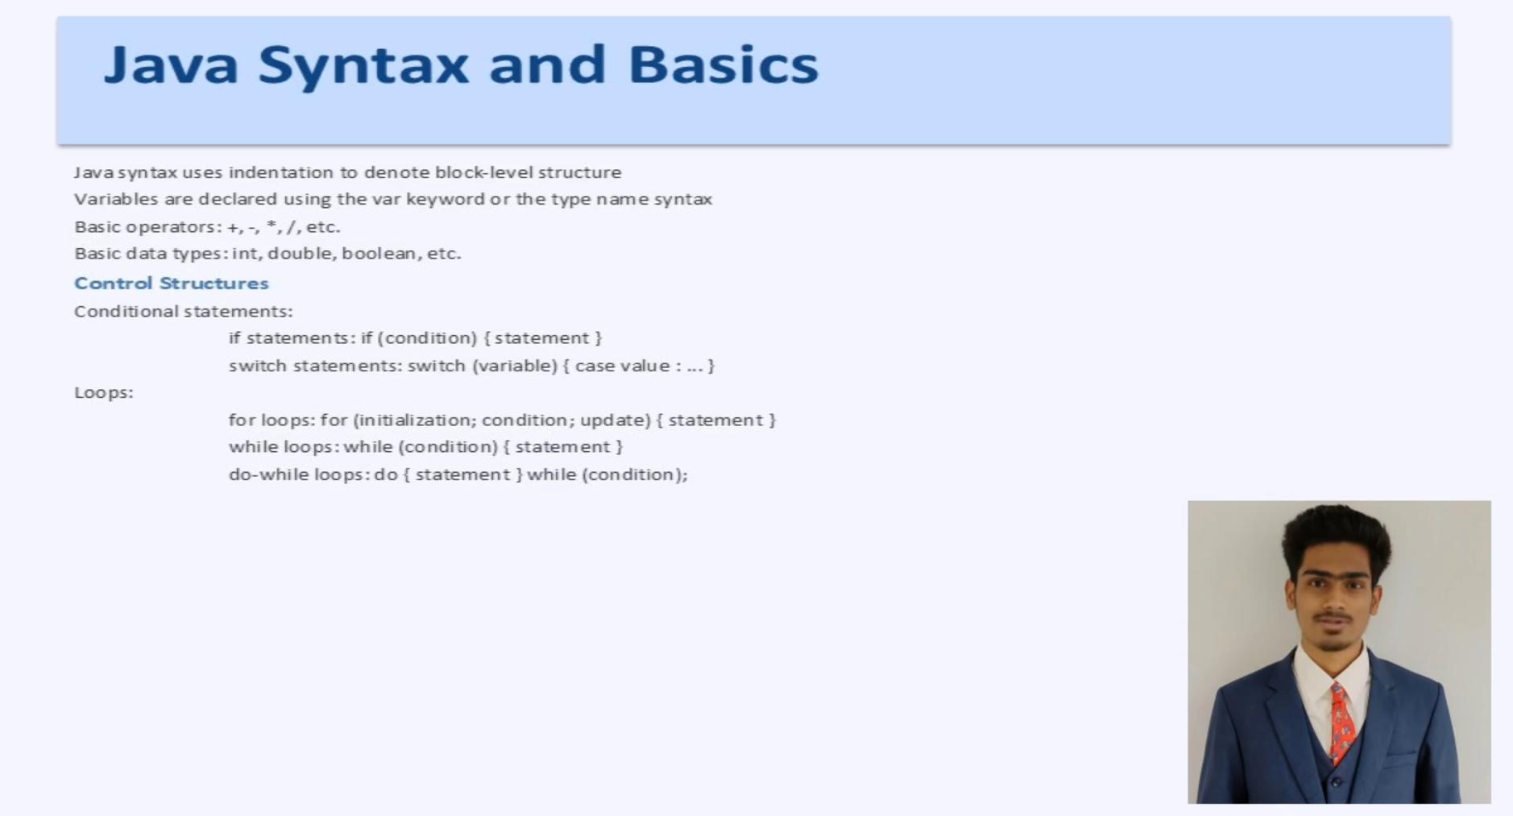
D. Results

Slide 16
References
[1] A. Vaswani, N. Shazeer, N. Parmar, et al., “Attention Is All You Need,” Proceedings of the 31st Conference on Neural Information Processing Systems (NeurIPS), pp. 5998–6008, 2017.
[2] J. Devlin, M. Chang, K. Lee, and K. Toutanova, “BERT: Pre-training of Deep Bidirectional Transformers for Language Understanding,” Proceedings of NAACL-HLT, pp. 4171–4186, 2019.
[3] T. Brown, B. Mann, N. Ryder, et al., “Language Models are Few-Shot Learners,” Proceedings of the 34th Conference on Neural Information Processing Systems (NeurIPS), 2020.
[4] A. van den Oord, S. Dieleman, H. Zen, et al., “WaveNet: A Generative Model for Raw Audio,” Proc. Speech Synthesis Workshop, 2016.

Slide 17
Thank You

