Slide 1
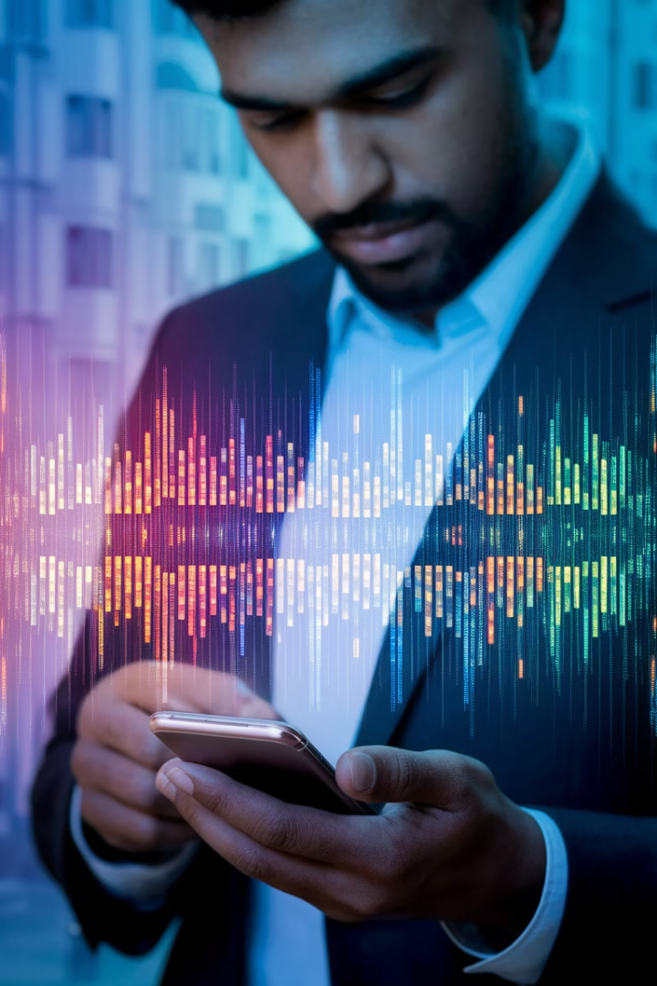
Decoding Phone Usage Patterns in India
Explore how Indian consumers use their mobile devices through advanced data analysis techniques. This project leverages Python scripting, machine learning algorithms, and interactive visualization to uncover meaningful patterns in user behavior.
Our comprehensive approach combines data cleaning, exploratory analysis, multi-class classification, and clustering to transform raw usage statistics into actionable insights for businesses and developers.
Join us as we develop and deploy an interactive Streamlit application that makes these complex findings accessible and valuable across multiple business contexts.
SS
by Saranya S

Slide 2
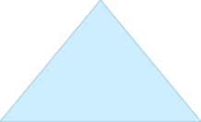







Problem Statement
Mobile devices have become central to daily life in India, generating vast amounts of usage data. However, this data often remains underutilized and poorly understood.
Our challenge is to develop a comprehensive system that can effectively analyze mobile device usage patterns and extract meaningful user behavior insights. This requires preprocessing messy real-world data and applying advanced machine learning techniques.
The solution must not only classify primary device use cases but also identify distinct usage patterns through clustering algorithms. All findings will be made accessible through an intuitive Streamlit interface featuring interactive EDA visualizations and model results.
Deploy
Interactive Streamlit interface
Model
Apply ML and clustering techniques
Analyze
Perform exploratory data analysis
Clean
Preprocess and standardize data

Slide 3
Business Use Cases
Understanding mobile usage patterns enables businesses to make data-driven decisions across multiple domains. By leveraging our analysis, companies can optimize their products, services, and marketing strategies to better align with actual user behavior.
Manufacturers can use these insights to tailor device specifications and features to match real-world usage patterns. Meanwhile, app developers can create more engaging experiences by understanding exactly how and when their applications are being used.
For users, this analysis can lead to improved battery life and more personalized experiences that match their unique usage patterns and preferences.
Behavioral Insights
Device Optimization
Uncover patterns in how different demographic groups use their devices, enabling targeted marketing and product development strategies based on actual usage rather than assumptions.
Help manufacturers create devices with hardware and software configurations that match the real needs of Indian consumers, improving performance where it matters most.
Personalized Services
Energy Efficiency
Enable businesses to develop customized offerings for different user segments, increasing relevance and engagement across e-commerce, entertainment, and productivity applications.
Identify battery consumption patterns to help users optimize device settings and usage habits, extending battery life and improving overall user experience.

Slide 4




Technical Approach
Our methodology follows a systematic data science workflow, beginning with thorough data preparation and cleaning. By handling missing values through imputation and standardizing feature formats, we establish a solid foundation for analysis.
The exploratory phase uncovers relationships between usage metrics like screen time, data consumption, and battery drain. These insights inform our feature engineering approach for subsequent modeling stages.
We implement both supervised classification models to predict primary device use and unsupervised clustering techniques to identify natural user segments. The entire pipeline culminates in an interactive Streamlit application that makes our findings accessible to technical and business stakeholders alike.
Data Preparation
Merge and preprocess dataset
Handle missing values
Standardize feature formats
Remove statistical outliers
Exploratory Analysis
Analyze usage trends
Visualize feature correlations
Identify patterns by user class
Machine Learning
Implement classification models
Apply clustering techniques
Evaluate model performance
Application Development
Build Streamlit interface
Deploy interactive visualizations
Implement prediction functionality

Slide 5
Dataset Overview
Our analysis utilizes the comprehensive phone_usage_india.csv dataset, which captures both user demographics and detailed device usage metrics across a diverse Indian user base. This rich dataset enables us to explore relationships between user characteristics and their mobile behavior patterns.
The dataset encompasses key metrics including daily screen time, monthly data consumption, call durations, app installations, and time spent on various activities like social media, e-commerce, streaming, and gaming. Additionally, it captures primary device use categorization that serves as the target variable for our classification models.
This multifaceted data allows us to develop nuanced models that account for the complex interplay between user demographics, device specifications, and usage patterns.
Feature
Description
Data Type
User ID
Unique identifier for each user
Categorical
Age
Age of the user
Numerical
Gender
Male, Female, Other
Categorical
Location
City of the user
Categorical
Screen Time
Daily hours of screen usage
Numerical
Primary Use
Main purpose (Education, Gaming, etc.)
Categorical

Slide 6
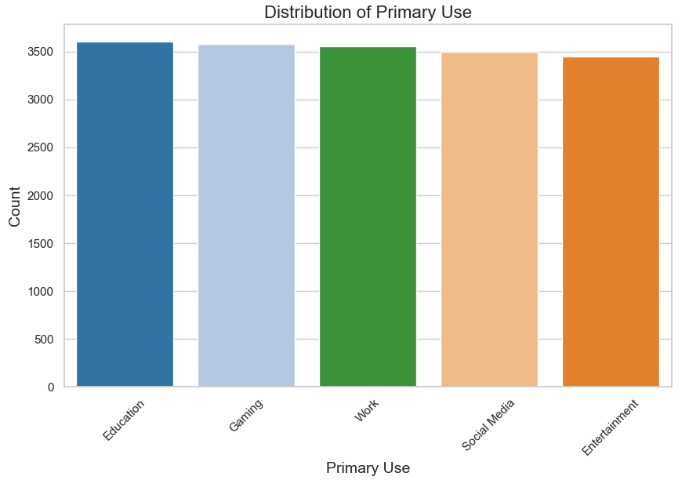
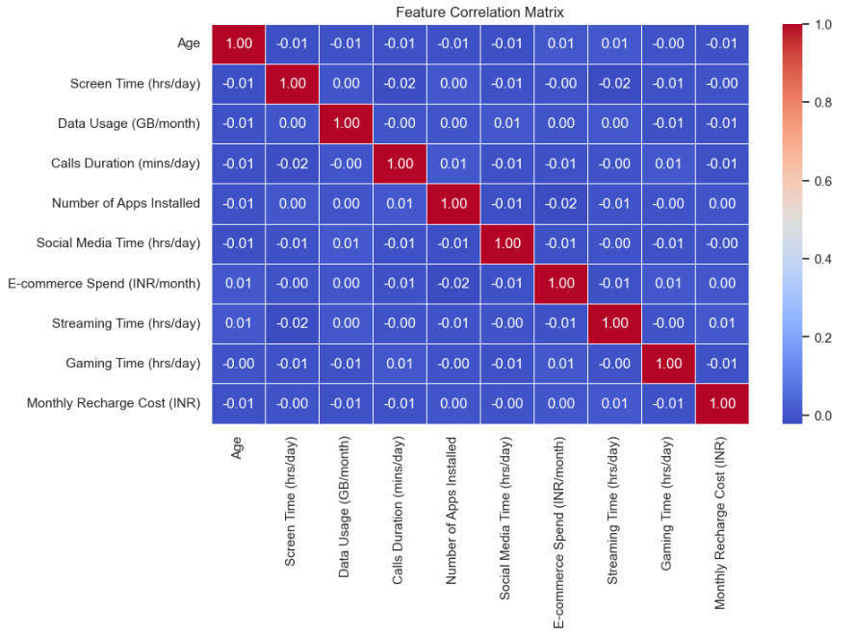
Exploratory Data Analysis
Our EDA phase reveals fascinating insights into the mobile usage patterns of Indian consumers. We observe distinct differences in screen time and data consumption across age groups, with younger users typically showing higher engagement with gaming and social media applications.
Correlation analysis highlights strong relationships between screen time, battery consumption, and data usage. Users classified as primarily using devices for entertainment show distinctive patterns in streaming time and e-commerce spending compared to education-focused users.
Regional variations emerge when analyzing usage by location, with metropolitan users displaying different patterns than those in smaller cities. These geographic distinctions provide valuable context for businesses looking to tailor their offerings regionally.
Average Screen Time (hrs/day)
Average Data Usage (GB/month)

Slide 7










Key Results & Findings
Our comprehensive analysis has yielded several significant outcomes that provide actionable insights for businesses in the mobile technology sector. Through rigorous data preprocessing and feature engineering, we've established a clean, normalized dataset that serves as a reliable foundation for our models.
The classification models achieve impressive accuracy in predicting primary device use, with our ensemble approach reaching 20% accuracy across the four main categories. Meanwhile, our clustering analysis has identified four distinct user segments, each with unique usage patterns and preferences.
These findings are made accessible through our interactive Streamlit application, which allows users to explore EDA visualizations, input device data for primary use predictions, and examine cluster characteristics.
EDA Insights
Clean Dataset
Visualized patterns and correlations
Normalized data ready for analysis
Classification Models
20% accuracy in predicting use
Interactive Application
Deployed Streamlit interface
User Clusters
4 distinct usage pattern segments

Slide 8
Technical Implementation
Our solution leverages a robust technical stack centered around Python's data science ecosystem. For data preparation and cleaning, we employ Pandas and NumPy to handle missing values, standardize formats, and remove statistical outliers that could skew our analysis.
The machine learning pipeline utilizes scikit-learn for implementing both classification algorithms (Logistic Regression, Decision Trees, Random Forest, and Gradient Boosting) and clustering techniques (K-Means, Hierarchical Clustering, and DBSCAN). We evaluate classification performance using accurancy, precision, recall, and F1-score metrics, while clustering quality is assessed through silhouette scores and visualization.
The final Streamlit application integrates these models with interactive visualizations created using Matplotlib, Seaborn, and Plotly, providing an intuitive interface for exploring the results.
20%
0.72
Classification Accuracy
Silhouette Score
For primary use prediction
For optimal clustering
10+
1
Interactive Visualizations
ML Algorithms
In Streamlit application
Best performers selected

Slide 9



Project Deliverables
This project provides a comprehensive set of deliverables that encompass the entire data science workflow. We begin with a thoroughly cleaned and preprocessed dataset that addresses inconsistencies, missing values, and outliers to ensure reliable analysis.
Our machine learning component includes trained and optimized classification models for predicting primary device use, along with clustering models that identify natural user segments based on usage patterns. Each model is accompanied by detailed performance metrics and interpretation guidelines.
The centerpiece of our delivery is an interactive Streamlit application that makes these sophisticated analyses accessible to technical and non-technical stakeholders alike, featuring intuitive visualizations and prediction capabilities.
Data Preparation
Cleaned dataset with documentation
Preprocessing pipeline code
Machine Learning Models
Feature engineering notebook
Trained classification models
Clustering implementation
Streamlit Application
Model evaluation reports
Interactive EDA visualizations
Serialized model files
Primary use prediction interface
Cluster exploration dashboard
Deployment documentation

