Slide 1
A brief introduction to pyro
Sarah Schwöbel
Wednesday, May 25, 2025

Slide 2
Overview
What is pyro
Backend: torch
Inference with pyro

Slide 3
What is pyro

Slide 4
Pyro: python probabilistic programming language (PPL)
Probabilistic programming is a high level tool.
Allows to specify a probabilstic model similar to the mathematical notation
Many pre-defined distributions
Comes with built-in inference methods
You can define a model, feed in data and run inference in a couple of lines of code
Custom model outside of built-in distributions possible
Perfect state-of-the-art tool for Bayesian data analysis, from Bayesian linear regression to custom model fitting for behavioral data
BUT: many things happen under the hood, very hard to get started

Slide 5
Backend: torch

Slide 6
Torch tensors
Library provides array data types (like numpy):
So-called tensors
Besides storing data, tensors know what mathematical operations they can do
Matrix product, exponentiation, …
Tensors store additional information about themselves
Size, shape, …
Dependency structure, history, and gradients
Tensors know, from what other tensors they were created, and exactly how.

Slide 7

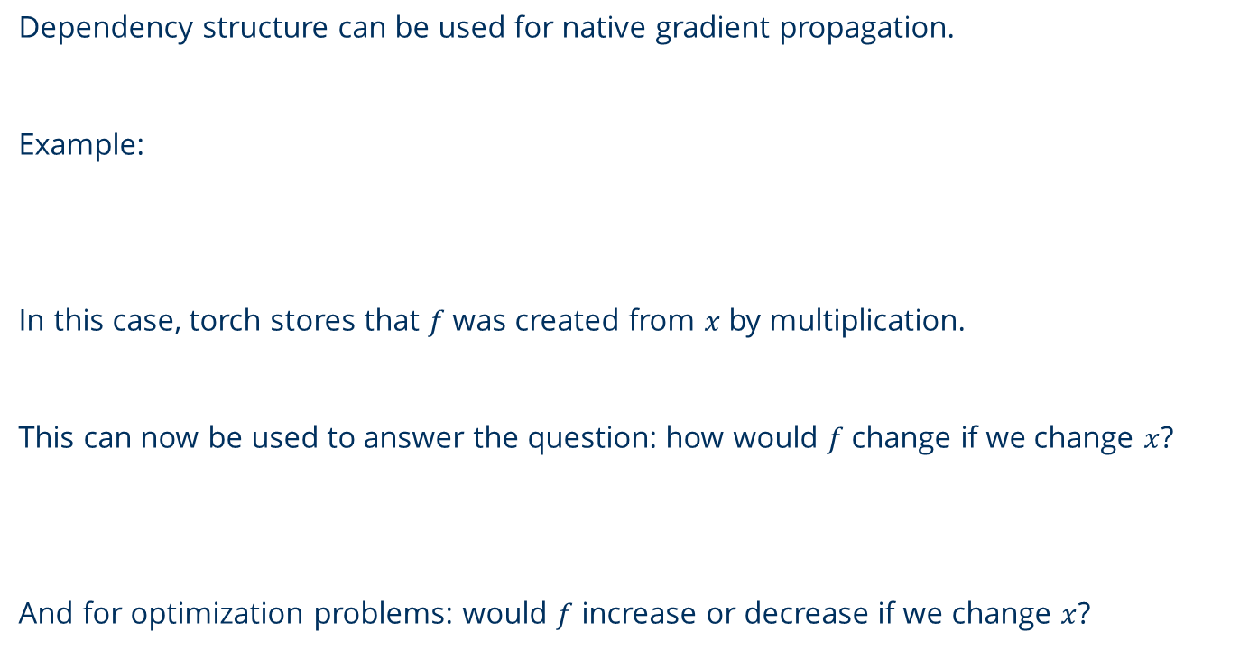


Gradients
Dependency structure can be used for native gradient propagation.
Example:
In this case, torch stores that $f$ was created from $x$ by multiplication.
This can now be used to answer the question: how would $f$change if we change $x$?
And for optimization problems: would $f$ increase or decrease if we change $x$?
$$x=torch.tensor(2)$$
$$f=3x+5$$
$${grad}_{x}f=3$$

Slide 8













In-place operations
In-place operations change parts of data after it has been created, by writing into the place where the data is stored.
For torch to evaluate gradients, NO IN-PLACE OPERATIONS are allowed.
Example: $[0, 1, 0, 0]$ Solutions:
$$a=torch.zeros(4)$$
$$[0, 0, 0, 0]$$
$$a=[ ]$$
$$a=torch.eye(4)[1]$$
$$a[1]=1$$
$$[0, 1, 0, 0]$$
$$for i in range\left(4\right):$$
$$if i==1:$$
$$a.append(1)$$
$$else:$$
$$a.append(0)$$
$$a=torch.stack(a)$$

Slide 9
Inference with pyro

Slide 10









Inference
$$p(toss, x|α)$$
Put causal structure of hidden variables into a model.
Use model to infer hidden variables from observed data.
Example: Coin toss
$$p(x|α,toss)$$
$$α$$
$$x \sim Beta(α)$$
$$p\left(x | α\right)=\frac{1}{B(α)}x^{α_{1}}{(1−x)}^{α_{2}}$$
x
$$toss \sim Bernoulli(x)$$
$$p\left(toss=heads|x\right)=x$$
$$p\left(toss=tails|x\right)=1−x$$
toss
$$toss=head, tails$$

Slide 11
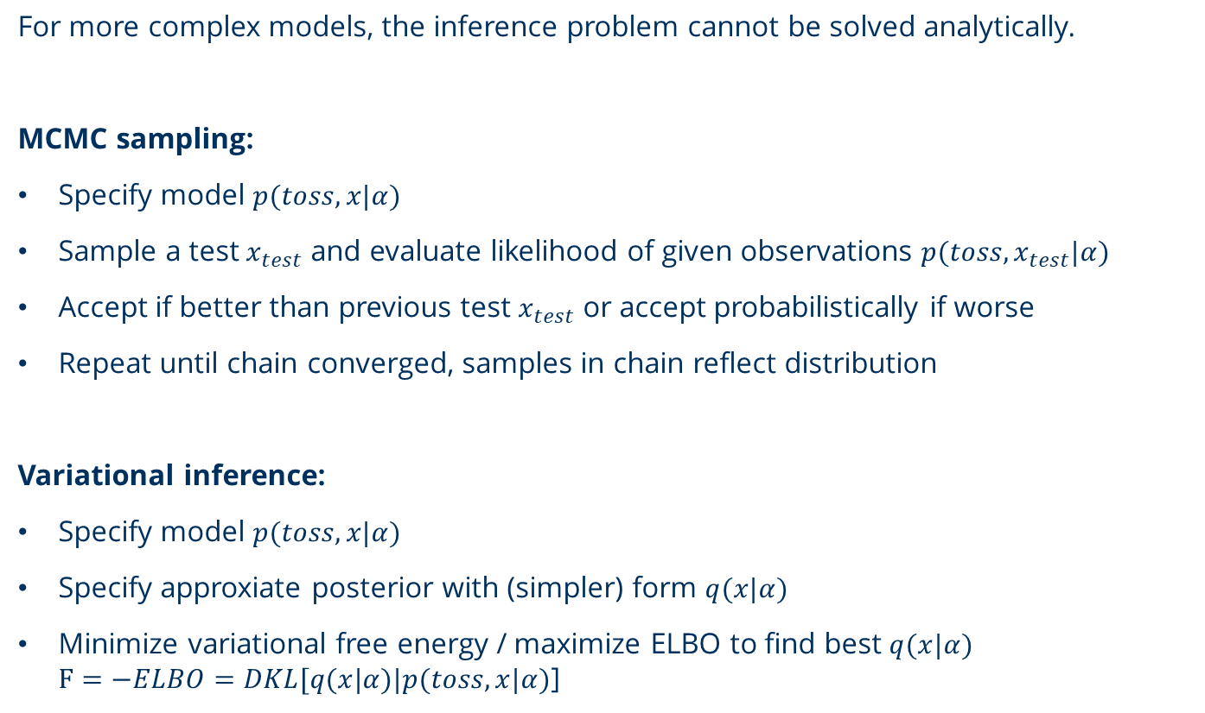
Approximate inference
For more complex models, the inference problem cannot be solved analytically.
MCMC sampling:
Specify model $p(toss, x|α)$
Sample a test $x_{test}$ and evaluate likelihood of given observations $p(toss,x_{test}|α)$
Accept if better than previous test $x_{test}$ or accept probabilistically if worse
Repeat until chain converged, samples in chain reflect distribution
Variational inference:
Specify model $p(toss, x|α)$
Specify approxiate posterior with (simpler) form $q(x|α)$
Minimize variational free energy / maximize ELBO to find best $q(x|α)$ $F=−ELBO=DKL[q(x|α)|p(toss, x|α)$]

Slide 12
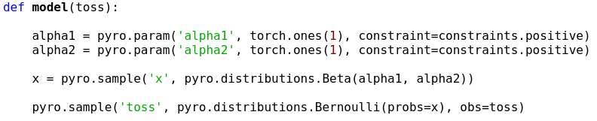





Defining a model
Coin toss
uniform prior
constraint
hyper
parameters
hidden variable
observable
actual observed data
$$x \sim Beta(α)$$
$$p\left(x | α\right)=\frac{1}{B(α)}x^{α_{1}}{(1−x)}^{α_{2}}$$
$$toss \sim Bernoulli(x)$$
$$p\left(toss=heads|x\right)=x$$
$$p\left(toss=tails|x\right)=1−x$$

Slide 13
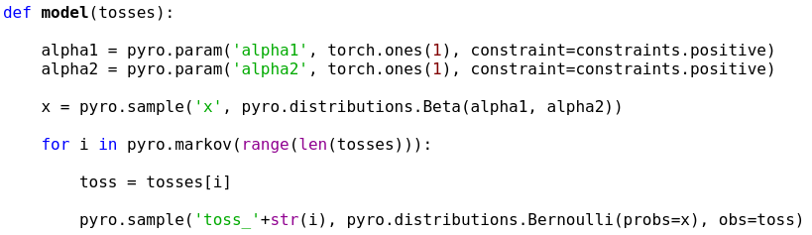
Defining a model
Several tosses
For loops have to be declared markov
$$x \sim Beta(α)$$
$$p\left(x | α\right)=\frac{1}{B(α)}x^{α_{1}}{(1−x)}^{α_{2}}$$
$$toss \sim Bernoulli(x)$$
$$p\left(toss=heads|x\right)=x$$
$$p\left(toss=tails|x\right)=1−x$$

Slide 14
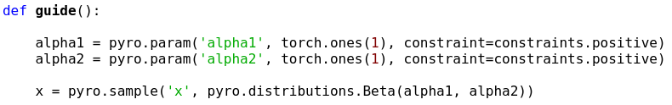
Approximate posterior: the guide

Slide 15
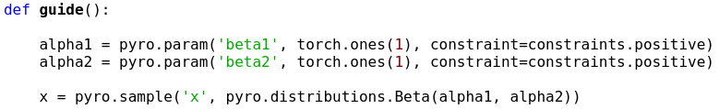
Approximate posterior: the guide
Different parameters!
Pyro optimizes with respect to all parameters in guide and model, and these can be different. Different structures are also allowed!

Slide 16
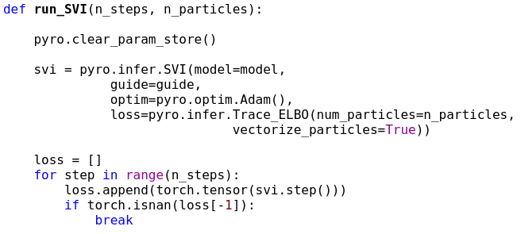
Run stochastic variational inference
stochastic (sampling-based) optimizier: finds gradients using torch tensors
ELBO/FE as loss:
optimization objective
Particles:
Draws n samples in each
pyro.sample statement.
Reduces noise
Can run vectorized

Slide 17
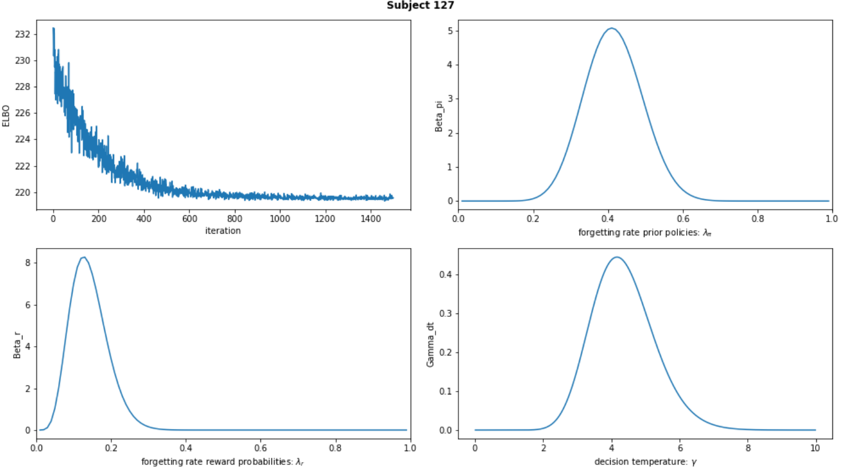
ELBO minimization – good ELBO, bad ELBO
Plotting the ELBO after iterating tells us about convergence
Good ELBO: stabilizies, white noise around stable mean

Slide 18
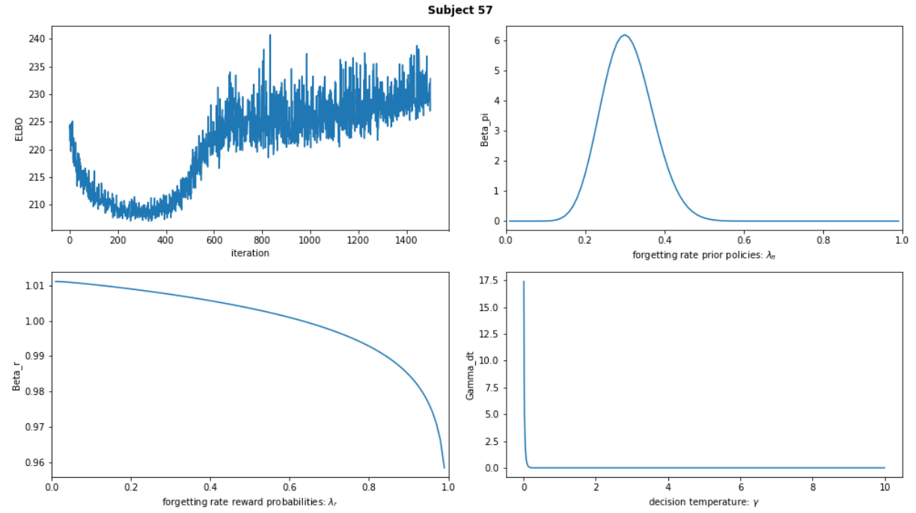
ELBO minimization – good ELBO, bad ELBO
Plotting the ELBO after iterating tells us about convergence
Bad ELBO: does not stabilize

Slide 19
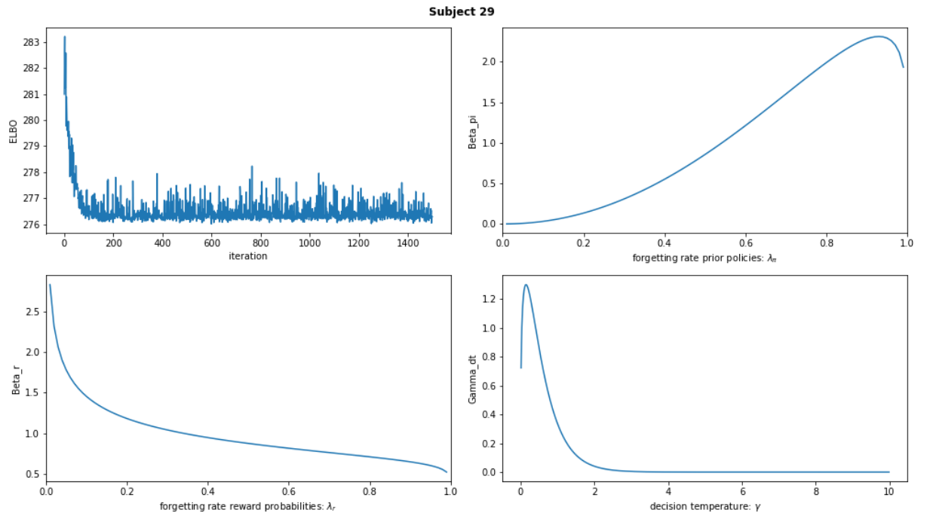
ELBO minimization – good ELBO, bad ELBO
Plotting the ELBO after iterating tells us about convergence
Bad ELBO: no white noise -> local minimum

Slide 20
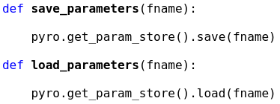
Results – estimates parameters
Pyro saves the current state of the parameters in the so-called global parameter store.
This allows saving and loading of intermediate results:
And always think about clearing the parameter store before running new inference!

Slide 21
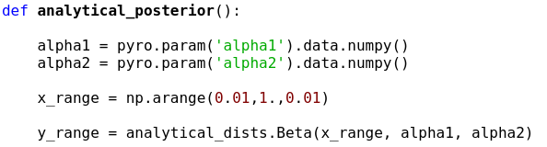
Results - posteriors
There are two methods to access inferred distributions of hidden variables:
Analytical posteriors via the inferred parameters:

Slide 22
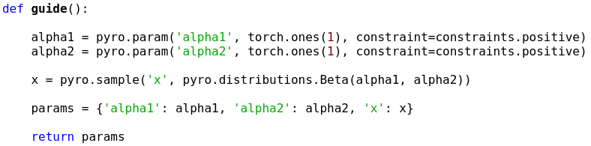
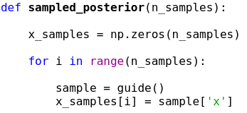
Results - posteriors
There are two methods to access inferred distributions of hidden variables:
Sampled posteriors via the sampled hidden variables in the guide:
Calling the guide produces samples based on the most recent state of pyro

Slide 23
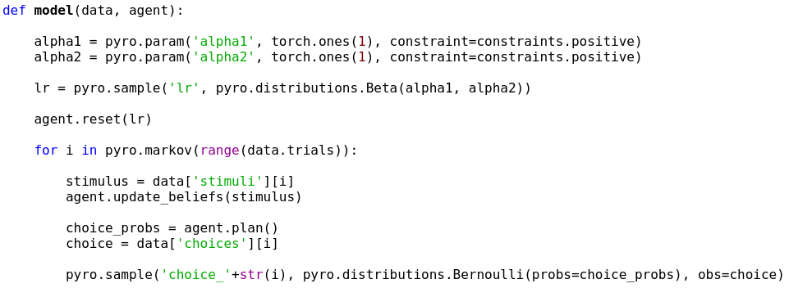
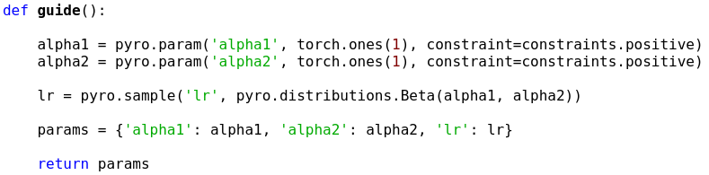
Custom models

Slide 24
Wrap up
Pyro allows for very straight forward setup of Bayesian models and running inference
Torch tensors are very knowledgeable arrays
Not covered: group inference
pyro.plate allows for fast and vectorized setup

Slide 25
Thank you! Questions, remarks?

