Slide 1
Sampling and approximation methods in Bayesian inference
"Variational inference is that thing you implement while waiting for your Gibbs sampler to converge.
Taken from a random post on quora :D

Slide 2
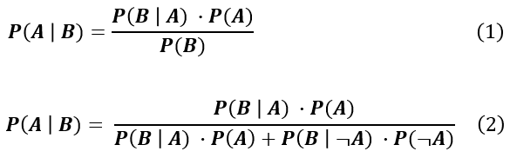
What problem are we trying to solve?
Pyro – state of the art probabilistic programming package that enables easy Bayesian inference
  Computing marginal is expensive
  Combinatorial explosion

Slide 3
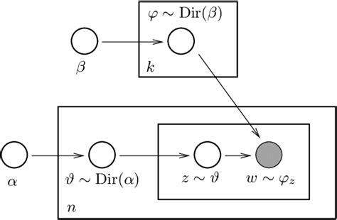
What problem are we trying to solve?

Slide 4
Approximate Bayesian inference
Sampling Methods
Approximation Methods
Markov Chain Monte Carlo (MCMC)
Exact but expensive and slow
Variational inference
Approximate but cheaper and faster

Slide 5
Sampling Methods

Slide 6
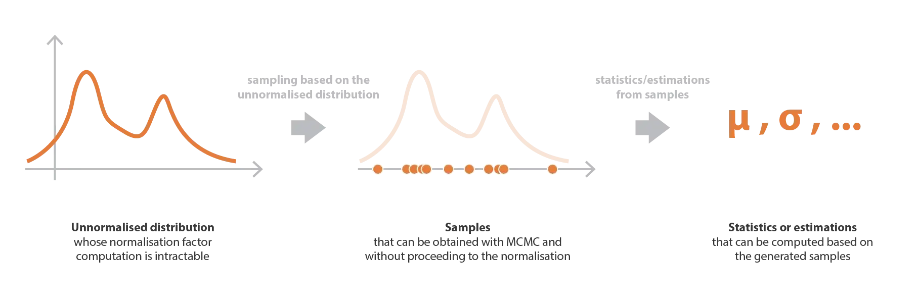
Markov Chain Monte Carlo
  Fundamental concept
    Approximate complex distributions via sampling

Slide 7
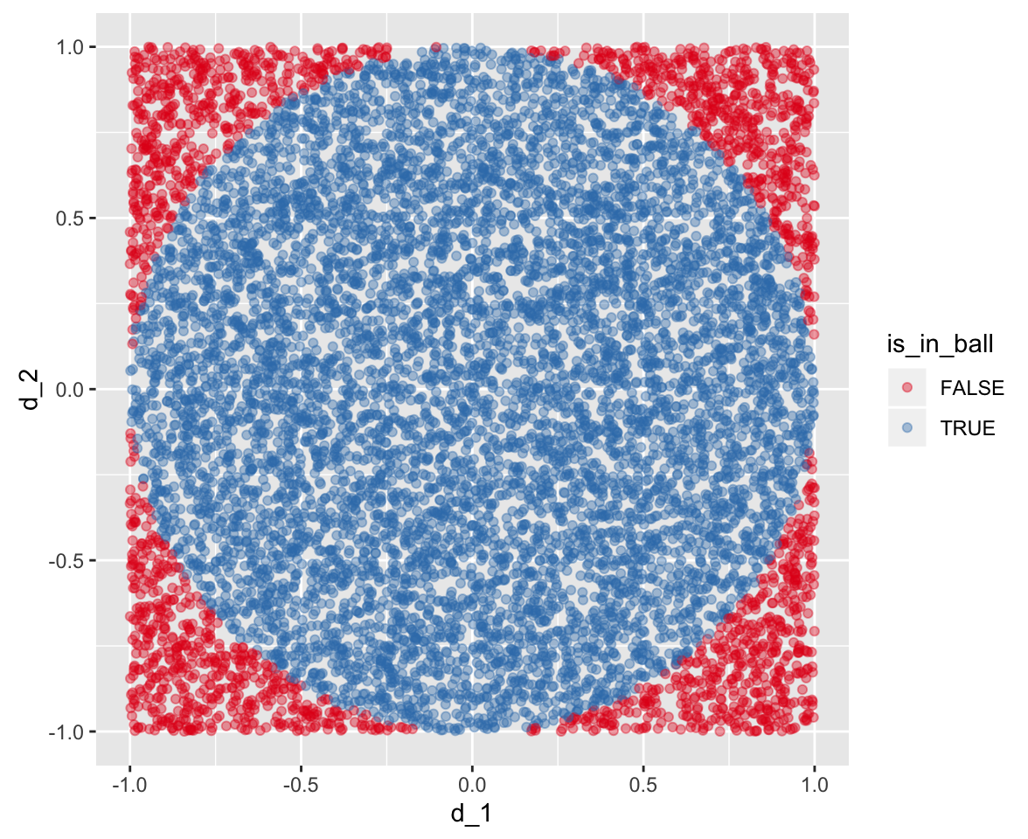
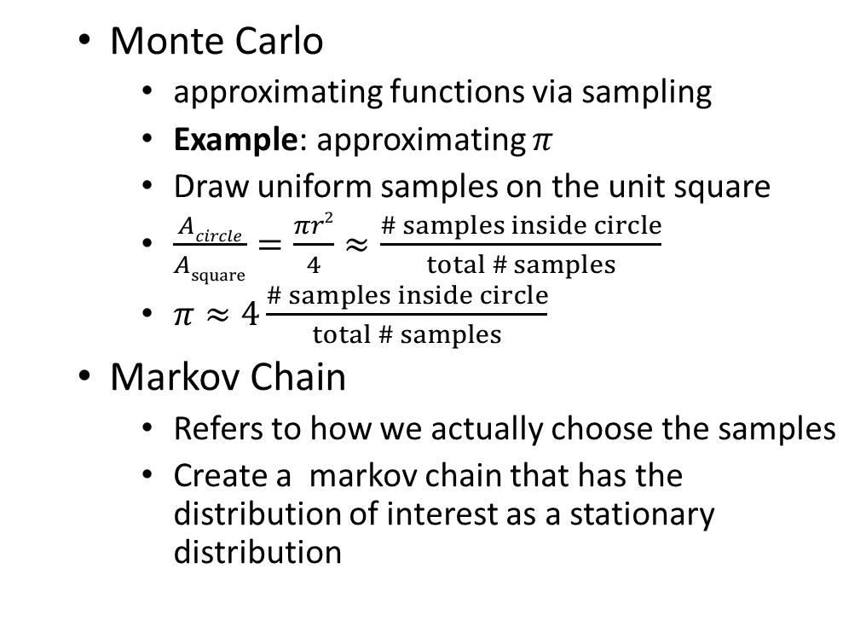
Markov Chain Monte Carlo
  Monte Carlo
    approximating functions via sampling
    Example: approximating $π$
    Draw uniform samples on the unit square
    $\frac{Acircle}{Asquare}=\frac{πr2}{4}≈\frac{\# samples inside circle}{total \# samples}$
    $π≈4\frac{\# samples inside circle}{total \# samples}$
  Markov Chain
    Refers to how we actually choose the samples
    Create a markov chain that has the distribution of interest as a stationary distribution

Slide 8
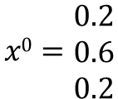
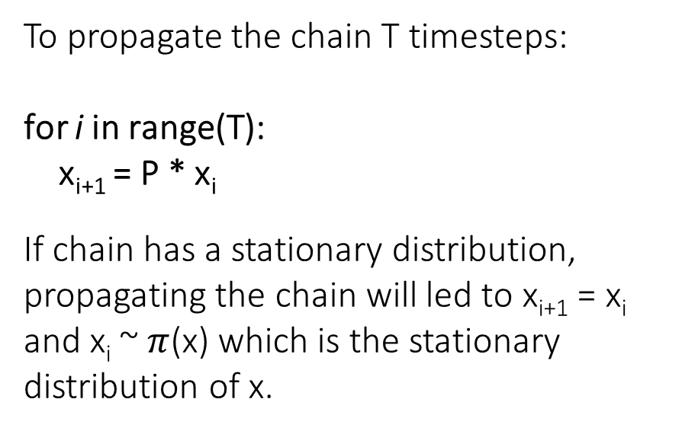
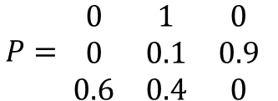
Markov Chain Monte Carlo
0.1
X^{t-1}
X^{t}
X^{t+1}
X₁
1
0.9
0.4
To propagate the chain T timesteps:
for i in range(T):
x_{i+1} = P * x_{i}
If chain has a stationary distribution, propagating the chain will led to x_{i+1} = x_{i} and x_{i} ~ $π$(x) which is the stationary distribution of x.
X₀
X₂
0.6
$$x0=\begin{matrix}0.2 \\ 0.6 \\ 0.2\end{matrix}$$
$$P= \begin{matrix}0 & 1 & 0 \\ 0 & 0.1 & 0.9 \\ 0.6 & 0.4 & 0\end{matrix}$$

Slide 9
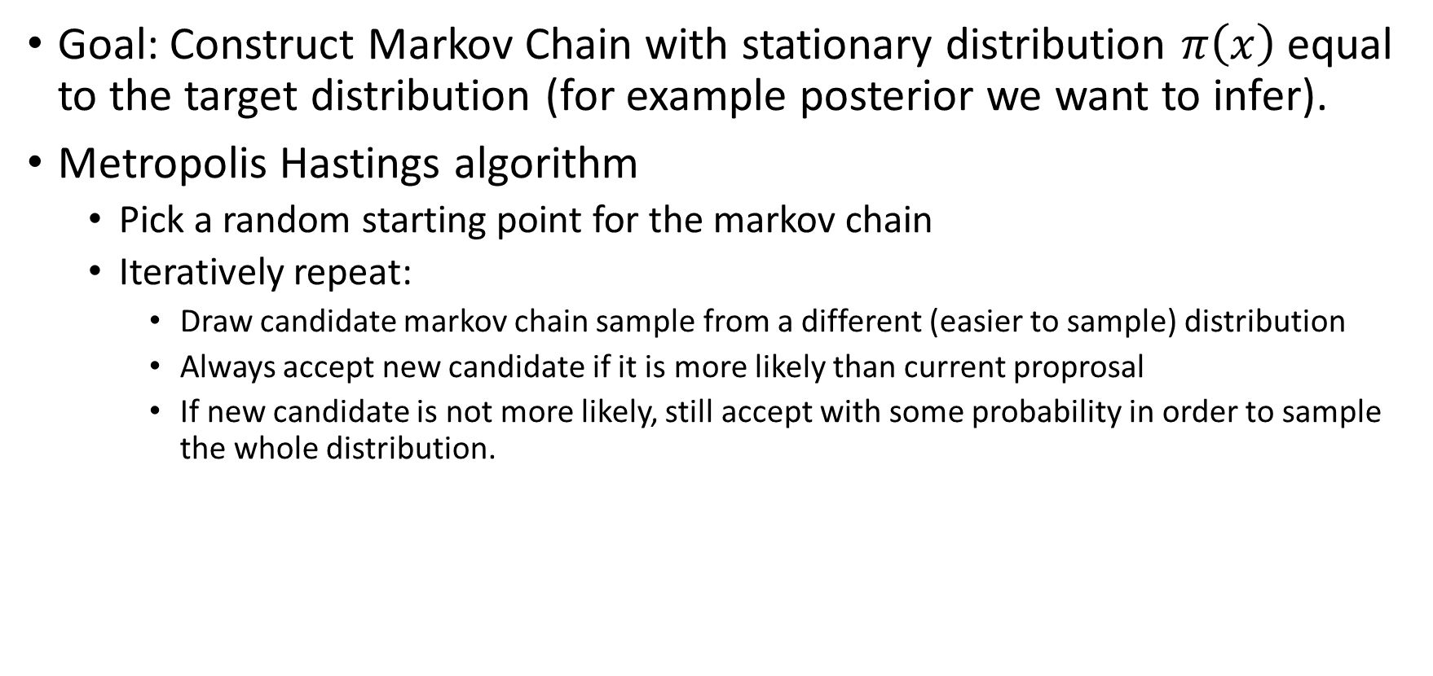
Markov Chain Monte Carlo
Goal: Construct Markov Chain with stationary distribution $π\left(x\right)$equal to the target distribution (for example posterior we want to infer).
Metropolis Hastings algorithm
  Pick a random starting point for the markov chain
  Iteratively repeat:
    Draw candidate markov chain sample from a different (easier to sample) distribution
    Always accept new candidate if it is more likely than current proprosal
    If new candidate is not more likely, still accept with some probability in order to sample the whole distribution.
Notes:
- Ergodic – no absorbing states for example; no cycles etc;

Slide 10
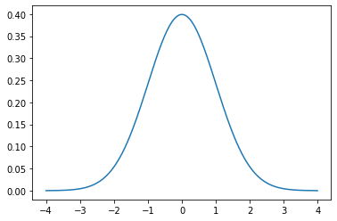
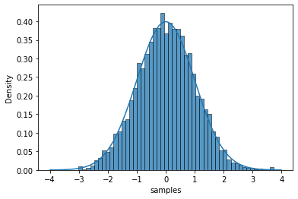
Sampling from N(0,1) using Metropolis Hastings
steps = 10000 # number of iterations
current_mu = 0.5 # chain starting point
sample_log = [] # simulation log
for i in range(steps):
new_mu ~ N(current_mu,0.5) # draw new sample candidate
ratio = L(new_mu) /L(current_mu) # calculate likelihood ratio
r ~ U(0,1) # draw uniform random number
if r < np.min([1, ratio]): # if ratio > 1 always accept
mu0 = mu1 # if ratio < 1 accept with probability r
sample_log.append(mu0) # extend chain

Slide 11
Approximating posteriors using Metropolis Hastings
for i in range(n_steps):
new_mu ~ N(current_mu,0.5) # draw new sample candidate
posterior(current_mu) = likelihood(D|current_mu) * prior(current_mu) # calculate posterior under current guess
posterior(new_mu) = likelihood(D|new_mu) * prior(new_mu) # calculate posterior under new guess
ratio = posterior(current_mu) / posterior(new_mu) # calculate ratio
r ~ U(0,1) # draw uniform random number
if r < np.min([1, ratio]): # if ratio > 1 always accept
mu0 = mu1 # if ratio < 1 accept with probability r
sample_log.append(mu0) # extend chain

Slide 12
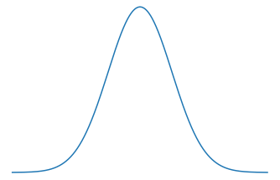
Next generation MCMC algorithms
Hamiltonian Monte Carlo
Like Metropolis Hasting but much smarter and less wasteful.
Rather than doing a RW over the probability space
  Recast problem as the movement of a particle
    Current parameter estimate – particle position
H = PE + KE

Slide 13
Next generation MCMC algorithms
Hamiltonian Monte Carlo
Like Metropolis Hasting but much smarter and less wasteful.
Rather than doing a RW over the probability space
  Recast problem as the movement of a particle
    Current parameter estimate – particle position
    Sample momentum (direction and speed of movement)
    Simulate particle movement
    Take final position as next sample
Much more efficient at sampling
For sampling examples, go to this link: https://chi-feng.github.io/mcmc-demo/app.html?algorithm=RandomWalkMH&target=banana
H = PE + KE

Slide 14
Pyro - General Purpose Hamiltonian MCMC
data = [0,1,1,1,1,0,1,1,1,1]
def model():
alpha = tensor(1.0) # Beta prior parameter 1
beta = tensor(1.0) # Beta prior parameter 2
theta = pyro.sample("theta", dist.Beta(alpha,beta))
return pyro.sample("outcome", dist.Bernoulli(theta))
conditioned_model = pyro.condition(model,data)

Slide 15
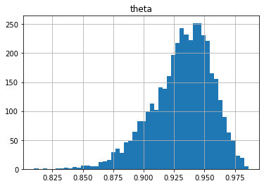
Pyro - General Purpose Hamiltonian MCMC
def run_inference():
mcmc_kernel = NUTS(conditioned_model)
mcmc = MCMC(mcmc_kernel, num_samples, warmup_steps=1000)
mcmc.run()
samples = mcmc.get_samples()
# bin samples to obtain posterior

Slide 16
mcmc.summary()
effective sample size
correlated samples; since not i.i.d have to correct for sampling bias
not all samples are useful/used; effective sample size is a measure of how much are your samples worth
Split Gelman Rubin test
start multiple parallel chains with different starting values
all shoud eventually converge to the stationary distribution.
compare variation between chains to the variation within chains.
If all are “the same”, then between chain variation should be close to zero.
Notes:
Both monitor convergence

Slide 17
Summary
MCMC
  powerful way to approximate distributions and perform inference
  Can sample unnormalized distributions
  Guarantees exact inference if chain converges
  Can be very slow and costly
  No sure way to assess convergence; autocorrelation of samples
  Should always report estimator variance since this is a sampling method. Each run will give different value
Pyro
  Out of the box MCMC inference with state of the art version of MCMC such as Hamiltonian Monte Carlo and NUTS (no U-turns sampler)

Slide 18
Approximation Methods

Slide 19
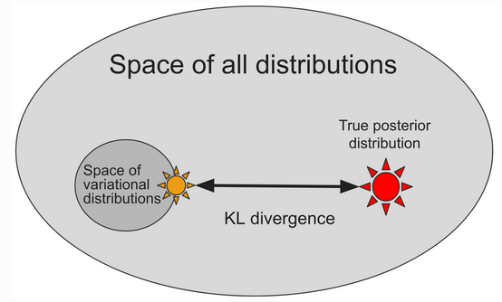
Stochastic Variational Inference
Best supported algorithm in pyro
Unified scheme for finding most likely parameters and computing tractable approximations to the posterior
Converts intractable integrals into an optimization problem

Slide 20




Stochastic variational inference (some math)
What we have:
What we want:
Parameter estimatate that best explain our data
$$θ$$
z
x
N
Posterior distributions
of hidden variables

Slide 21






Stochastic variational inference (some math)
Log model evidence
Evidence Lower bound
Log model evidence
Approximating distribution (guide)
Multiply by q(z)/q(z) and rearrange
$$= KL\left[pθ(x,z) \right| qφ\left(z\right)]$$
Notes:
So how do we get there? We start with the model evidence, or how likely our data is given our current beliefs or parameter estimates. Specifically, we look at the log model evidence and we try to sort of approximate or bound this quantity. Specifically we want a lower bound. So if this is how much the evidence of the data is, we want a quantity that is always to lower or equal to the true model evidence.
We get this bound by introducing an approximating distribution. This is the guide that sarah talked about last week. This is usually a simpler distribution that we can easily sample from and importantly that does not actually depend on the observed data. So we multiply and divide by this approximating distribution q(z) do some rearrangement and get our evidence lower bound.
And you can see the evidence lower bound is essentially an expectation of the difference between our model and the approximate distribution. In simpler terms the evidence lower bound is the distance between the our model and the guide. But you can see basically, we have removed here the dependence on the data, because we now longer have that marginal we can’t compute, so we can basically play with the parameters that define the guide to try and bring this ELBO as close as possible to the model evidence.
Additionally since the ELBO is a lower bound, maximizing the ELBO also maximizes the probability of our data. And this now gives us a way to basically solve our problem above of finding the posterior. We can find the posterior by basically maximizing the ELBO and correspondingly the model evidence. To do this we take the gradient of this ELBO as a function of the distribution parameters and essentially take steps along the gradient in the direction of increasing evidence in order to find appropriate parameter estimates.
And through some further rearrangement we can see that when the distance between the approximate posterior and the posterior is zero, the ELBO is exactly equal to the model evidence.

Slide 22
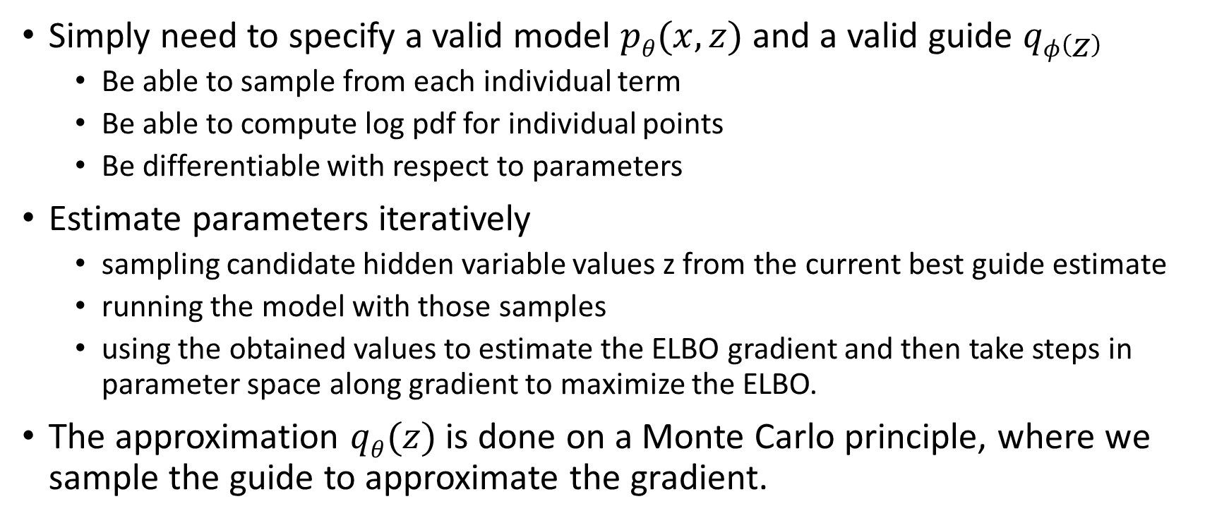
SVI in Pyro
Simply need to specify a valid model $pθ(x,z)$ and a valid guide $qφ\left(z\right)$
  Be able to sample from each individual term
  Be able to compute log pdf for individual points
  Be differentiable with respect to parameters
Estimate parameters iteratively
  sampling candidate hidden variable values z from the current best guide estimate
  running the model with those samples
  using the obtained values to estimate the ELBO gradient and then take steps in parameter space along gradient to maximize the ELBO.
The approximation $qθ(z)$ is done on a Monte Carlo principle, where we sample the guide to approximate the gradient.

Slide 23
SVI Summary
  SVI is much faster than MCMC and for some problems works much better
  Quick and efficient way to test different models
  Not guaranteed to ever find true posterior unlike MCMC.

Slide 24
Thank you for listening
Questions?

