Slide 1
Context inference A workshop with a Bayesian perspective on contexts Sarah Schwöbel
Chair for Cognitive Computational Neuroscience
Faculty of Psychology
Technische Universität Dresden
Context in Cognition Symposium
Tübingen, April 7, 2025

Slide 2
Questions that are hopefully answered in 2 hours Context from a Bayesian computational perspective
What is context? What is it not? E.g. is context an action-outcome contingency? Is it a prior? Is it a state? Or are those parts of a context? What about renewal and conditioning? Internal and environmental states?
What drives our believes about which context we are in? How do we know which context we are in, and how can we do it when we are uncertain?
What’s the idea of a Bayesian model? Computational perspective rests on conceptualizing the type of model.
And how does that help to understand to context inference? How different parts of the model deliver structure and evidence for contexts

Slide 3
Outline for today
Introduction [5 min]
The Bayesian brain and the action-perception loop How to model perception and decision making from a Bayesian perspective
Presentation [25 min]
Codebook [25 min]
Goal-directed behavior and Bayesian habits Planning as inference and habitual behavior as a prior
Presentation [5 min]
Codebook [10 min]
Context-dependent action-perception loop and context inference What is a context and how do we know which context we’re in?
Presentation [10 min]
Codebook [35 min]
Concluding remarks [5 min]

Slide 4
Codebooks and materials
Materials:
All materials are publicly available on github here: https://github.com/SSchwoebel/context_workshop
We will use python jupyter notebooks
Supports text, figures, equations, and python code
There are two didactic notebooks with a lot of figures and examples and code
There are two coding focused notebooks with the same code but for playing around
How to get active:
If you just want to read, you can open the tutorial codebooks on github in the browser
If you want to run code without installing anything you can run it in the browser with google drive and colab!
Google drive link: https://tinyurl.com/4ypur7vx
If you have python (and jupyter) installed, download or clone the repo from github

Slide 5
The Bayesian brain and the action-perception loop How to model perception and decision making from a Bayesian perspective

Slide 6
The Bayesian brain
Idea:
Information processing in the brain can be described mathematically using probability theory.
Why?
Firing rates of neurons encode stimulus probabilities
Events in the real world cannot be predicted with certainty
Human behavior is stochastic
Statistical physics of large systems uses probability theory
Importantly:
The brain has to continually form beliefs about hidden information based on limited available information.
Clark (2013)

Slide 7


The Bayesian brain
Inference: Draw conclusions based on observations and knowledge
Bayes’ theorem: allows to perform inference by using probability theory!
The brain learns rules and relations in order to use them for inference!
observation
perception
planning
state
action

Slide 8
The Bayesian brain
Learn the rules of the world (if-then, contingencies, …) as probabilities
state => observation => action => state …..
Perception and action: Inversion of reasoning using Bayesian inference!
observation => state => action
observation
perception
planning
state
action

Slide 9
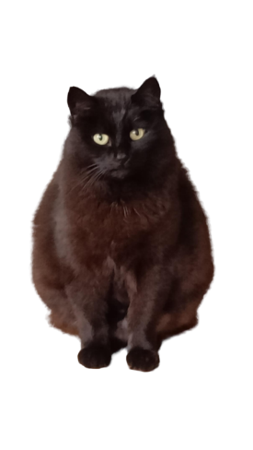
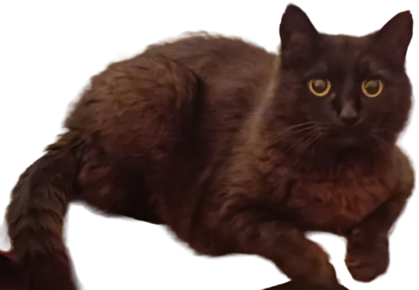

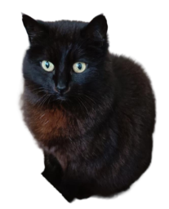
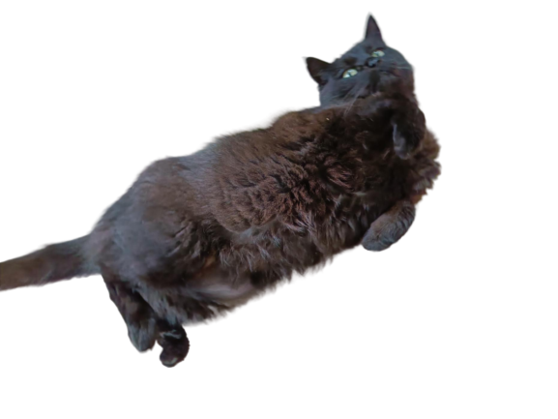
Inference: How does Schmüffie feel?

Slide 10
Bayesian inference: Perception
Hidden state: Schmüffie’s mood
observation
???
state:
mood
perception

Slide 11

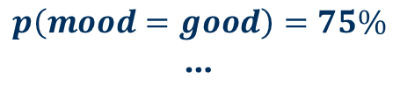
Bayesian inference: Perception
Prior knowledge:
What is her typical mood?
Did something happen just now?
$$p\left(mood=good\right)=75\%$$
…
observation
state:
mood
perception
$$p\left(mood\right)$$

Slide 12
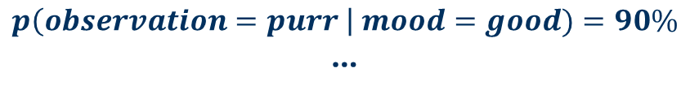
Bayesian inference: Perception
Observation likelihood: Relation between state and observation
Probability of Schmüffie’s behavior given her mood: Walk away, purr, ...
$$p\left(observation=purr \right| mood=good)=90\%$$
…
observation:
purr
$$p\left(observation\right|mood)$$
state:
mood
perception
$$p\left(mood\right)$$

Slide 13
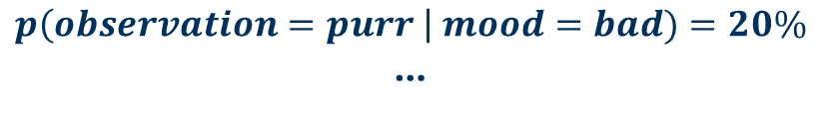
Bayesian inference: Perception
Observation likelihood: Relation between state and observation
Probability of Schmüffie’s behavior given her mood: Walk away, purr, ...
$$p\left(observation=purr \right| mood=bad)=20\%$$
…
observation:
purr
$$p\left(observation\right|mood)$$
state:
mood
perception
$$p\left(mood\right)$$

Slide 14
Bayesian inference: Perception
Inversion: What was Schmüffie’s mood?
=> Bayes’ theorem! Use to reason about her mood given my observation
$$p\left(mood\right|observation)∝p\left(observation\right|mood)∗p\left(mood\right)$$
observation:
purr
???
$$p\left(observation\right|mood)$$
state:
mood
$$p\left(mood\right)$$
$$p\left(mood\right|observation)$$

Slide 15
Bayesian inference: Perception
Inversion: What was Schmüffie’s mood?
=> Bayes’ theorem! Use to reason about her mood given my observation
$$p\left(mood=good\right|observation=purr)=93\%$$
$$p\left(mood=bad\right|observation=purr)=7\%$$
observation:
purr
$$p\left(observation\right|mood)$$
state:
mood
conclusion:
mood = good
$$p\left(mood\right)$$
$$p\left(mood\right|observation)$$

Slide 16
Bayesian inference: Action
Behavior: Can change hidden state!
state:
mood
choose behavior
action

Slide 17
Bayesian inference: Action
Behavior: Can change hidden state!
state: new
mood
choose behavior
action

Slide 18
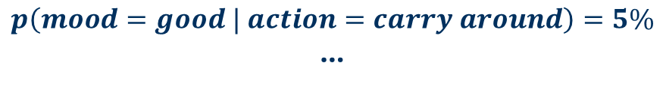
Bayesian inference: Action
Consequences of actions and behavior:
Represented using probabilities of outcomes
$$p\left(mood=good | action=pet\right)=80\%$$
$$p\left(mood=good | action=carry around\right)=5\%$$
…
state:
mood
choose behavior
$$p\left(mood\right|action)$$
action

Slide 19

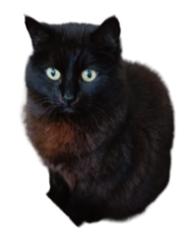

Bayesian inference: Action
Planning:
Again inversion! Which actions lead to my goal, given my knowledge?
$$p\left(action\right|mood=good)= ??$$
?
state:
mood
planning
$$p\left(mood\right|action)$$
$$p\left(action\right|mood=good)$$
action

Slide 20
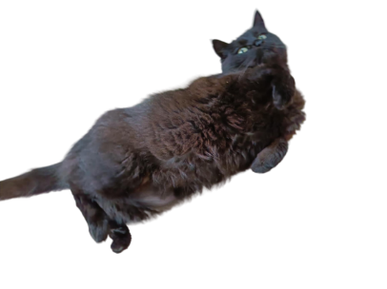
Bayesian inference: Action
Mental simulation:
Predict the consequences of one’s own behavior
Compare with goals and desired outcomes
purr
state:
mood
planning:
simulation &
comparison
$$p\left(mood\right|action)$$
$$p\left(action\right|mood=good)$$
action

Slide 21
Bayesian inference: Action
Decision:
Choose an action to execute
$$p\left(action=pet\right|mood=good)=94\%$$
state:
mood
planning:
simulation &
comparison
action:
pet
$$p\left(mood\right|action)$$
$$p\left(action\right|mood=good)$$

Slide 22








The Bayesian brain: Cognitive modeling
Generative model:
$$a_{t}$$
$$a_{t+1}$$
$$s_{t}$$
$$s_{t+1}$$
$$s_{t+2}$$
: Variable
: Rule
$$o_{t}$$
$$o_{t+1}$$
$$o_{t+2}$$
Parr et al. (2018)

Slide 23
The Bayesian brain: Cognitive modeling
Generative model:
Inversion: Reverse arrows
$$a_{t}$$
$$a_{t+1}$$
$$s_{t}$$
$$s_{t+1}$$
$$s_{t+2}$$
: Variable
: Rule
$$o_{t}$$
$$o_{t+1}$$
$$o_{t+2}$$
Parr et al. (2018)

Slide 24
The Bayesian brain: Cognitive modeling
Generative model:
Policy: Sequence of actions
$$a_{t}$$
$$a_{t+1}$$
$$s_{t}$$
$$s_{t+1}$$
$$s_{t+2}$$
: Variable
: Rule
$$o_{t}$$
$$o_{t+1}$$
$$o_{t+2}$$
Da Costa et al. (2020)
Friston et al. (2016)

Slide 25







The Bayesian brain: Cognitive modeling
Generative model: Active inference representation
$$s_{t}$$
$$s_{t+1}$$
$$s_{t+2}$$
$$π$$
$$o_{t}$$
$$o_{t+1}$$
$$o_{t+2}$$
: Variable
: Rule
Da Costa et al. (2020)
Schwöbel et al. (2018)

Slide 26
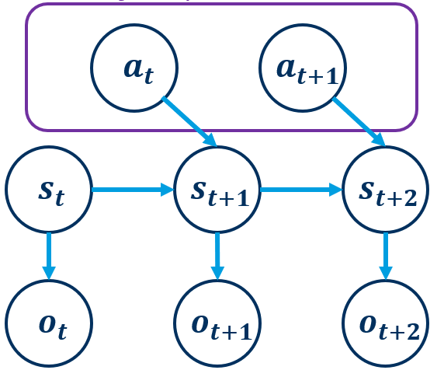
The Bayesian brain: Long term planning
Planning as inference:
Use the network of rules and outcome probabilities to infer outcomes and own actions
observation
perception
planning
state
action
Attias et al. (2003)
Botvinick & Toussaint et al. (2012)

Slide 27
The Bayesian brain: Summary
Learn the rules of the world as probabilities in a generative model
Perception and action as Bayesian inference by model inversion
observation
perception
planning
state
action
For a good summary: Butz (2016)

Slide 28
Codebook session 1

Slide 29
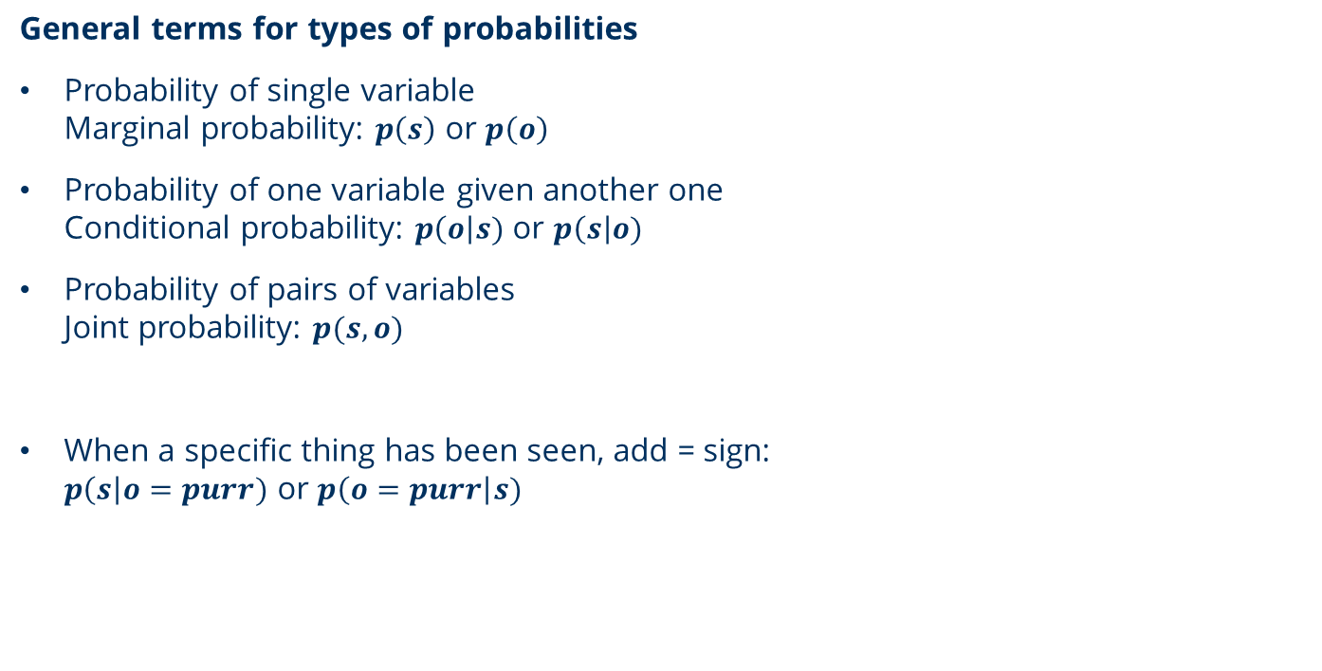
A note on probability theory terms and notation
General terms for types of probabilities
Probability of single variable Marginal probability: $p\left(s\right)$ or $p\left(o\right)$
Probability of one variable given another one Conditional probability: $p\left(o\right|s)$ or $p\left(s\right|o)$
Probability of pairs of variables Joint probability: $p(s,o)$
When a specific thing has been seen, add = sign: $p\left(s\right|o=purr)$ or $p\left(o=purr\right|s)$

Slide 30


A note on Bayes’ theorem terms and notation
Generative model: $p\left(s\right)p\left(o\right|s)$
Prior: $p\left(s\right)$ A priori probability of hidden state before getting any information
Observation likelihood: $p\left(o\right|s)$ Probability (~table) of receiving an observation in a state
$$p\left(o\right|s)p\left(s\right)$$

Slide 31
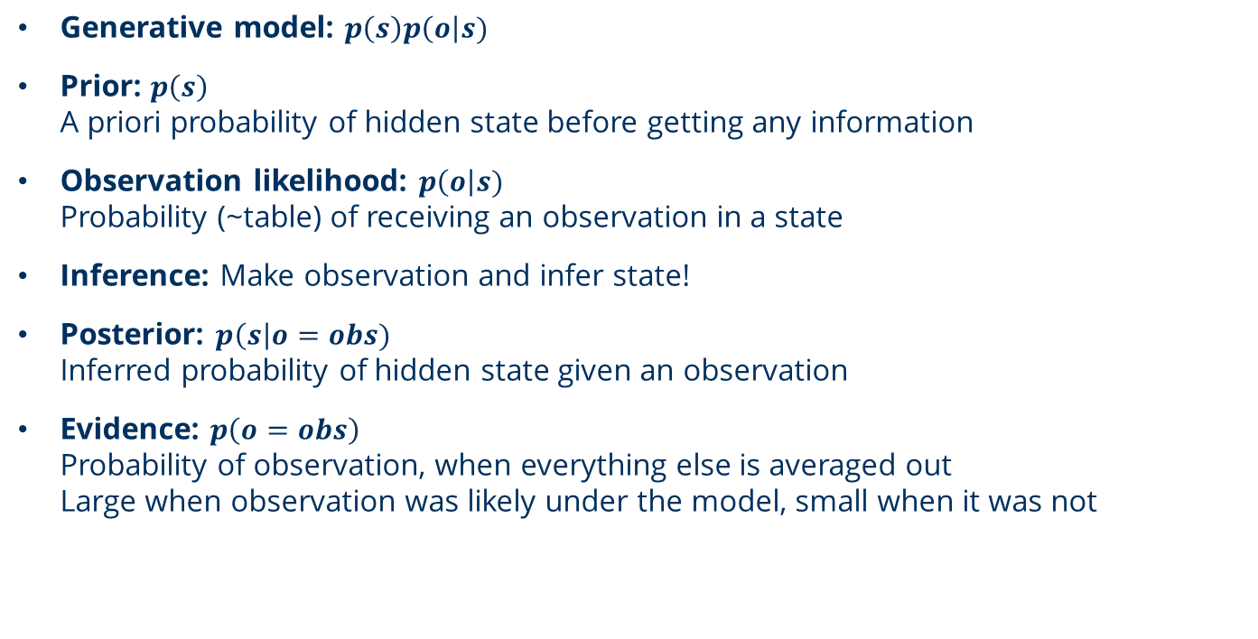




A note on Bayes’ theorem terms and notation
Generative model: $p\left(s\right)p\left(o\right|s)$
Prior: $p\left(s\right)$ A priori probability of hidden state before getting any information
Observation likelihood: $p\left(o\right|s)$ Probability (~table) of receiving an observation in a state
Inference: Make observation and infer state!
Posterior: $p\left(s\right|o=obs)$ Inferred probability of hidden state given an observation
Evidence: $p\left(o=obs\right)$ Probability of observation, when everything else is averaged out Large when observation was likely under the model, small when it was not
$$p\left(o=obs\right|s)p\left(s\right)$$
$$p\left(s\right|o=obs)=$$
$$p\left(o=obs\right)$$
$$const$$

Slide 32
Codebook session 1

Slide 33
Goal-directed behavior and Bayesian habits Planning as inference and habitual behavior as a prior

Slide 34
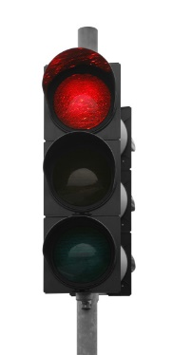
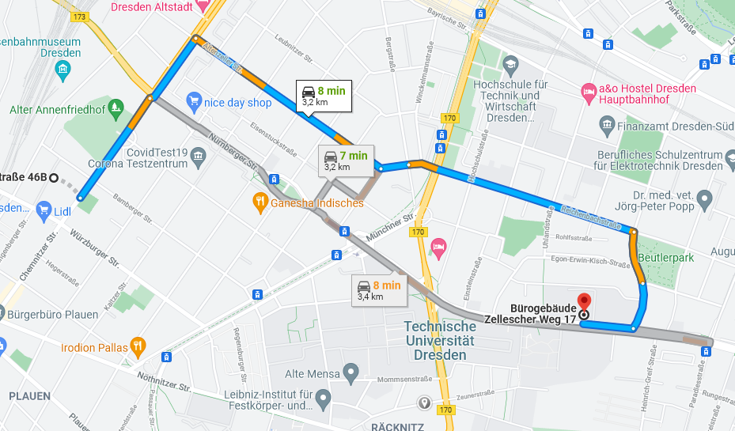



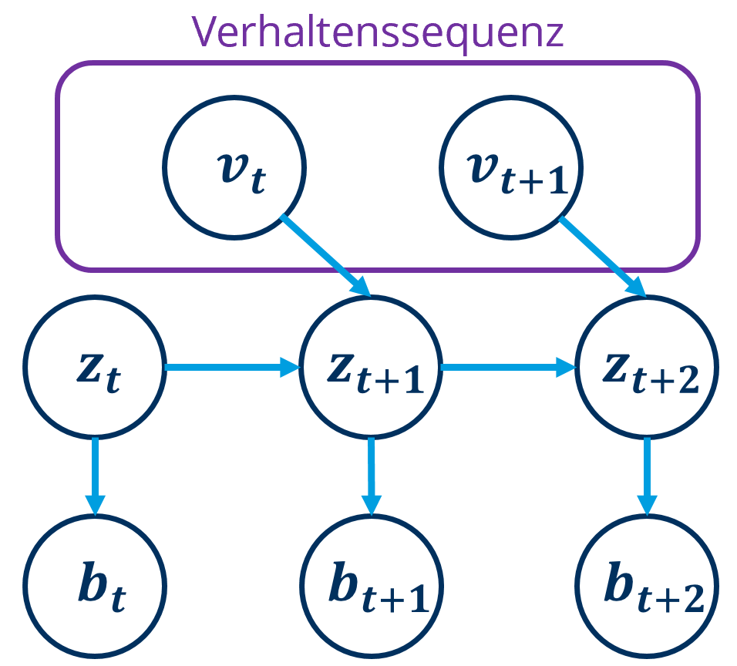

Every-day life behavioral strategies
Goal-directed behavior
Rules and cognitive map
Prediction of outcomes
Costly and slow
Exact and adaptive
Habits & automatisms
Stimulus-response association
Independent of outcomes
Fast and resource efficient
Robust
Wood & Rünger (2016)

Slide 35
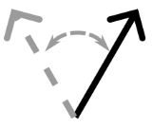
Every-day life behavioral strategies
Goal-directed behavior
Rules and cognitive map
Prediction of outcomes
Costly and slow
Exact and adaptive
Habits & automatisms
Stimulus-response association
Independent of outcomes
Fast and resource efficient
Robust
Humans are masters at generating fast yet accurate behavior
=> dynamic balancing between modes
Wood & Rünger (2016)

Slide 36
Bayesian habits
Idea:
Habits as priors over actions!
$$p\left(action\right|goal)∝p\left(action\right) ∗ p\left(goal\right|action)$$
observation
perception
planning
state
action
Schwöbel et al. (2021)

Slide 37

Bayesian habits
Idea:
Habits as priors over actions!
$$p\left(action\right|goal)∝p\left(action\right) ∗ p\left(goal\right|action)$$
Decision:
Choose and execute action
Past:
What did I do before?
Future:
Achieving goals & rewards
Balance via Bayes’ theorem
Repetition prior
Planning as inference
Schwöbel et al. (2021)

Slide 38








Bayesian habits
Use prior for whole action sequences!
Prior over sequence of actions
$$a_{t}$$
$$a_{t+1}$$
$$s_{t}$$
$$s_{t+1}$$
$$s_{t+2}$$
$$o_{t}$$
$$o_{t+1}$$
$$o_{t+2}$$

Slide 39
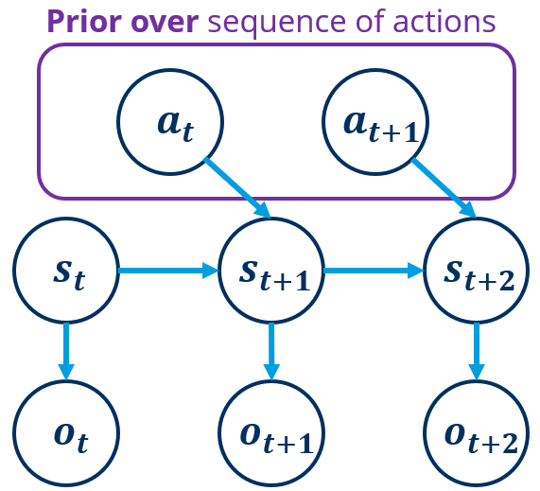
Bayesian habits
After a lot of experience:
Things that you never do don’t have to be planned!
Saves cognitive resources due to reducing planning.
But: Habits can influence our very thought patterns.
observation
perception
planning
state
action

Slide 40
Codebook session 1 … continued

Slide 41
Context-dependent action-perception loop and context inference What is a context and how do we know which context we’re in?

Slide 42
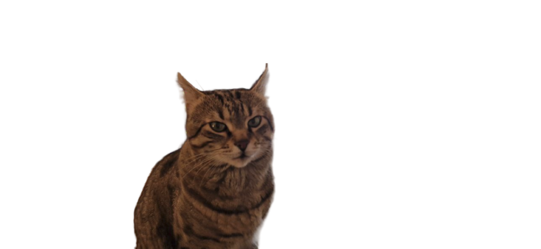
Context
What about Sir Hidesalot?
Different cat reacts differently: Sir Hidesalot likes being carried but not being pet!
Learn new rules and habits!
observation
perception
planning
state
action

Slide 43
















Context
Learn context-specific priors and rules!
Context 1
Context 2
Prior over sequence of actions
Prior over sequence of actions
$$a_{t}$$
$$a_{t+1}$$
$$a_{t}$$
$$a_{t+1}$$
$$s_{t}$$
$$s_{t+1}$$
$$s_{t+2}$$
$$s_{t}$$
$$s_{t+1}$$
$$s_{t+2}$$
$$o_{t}$$
$$o_{t+1}$$
$$o_{t+2}$$
$$o_{t}$$
$$o_{t+1}$$
$$o_{t+2}$$

Slide 44








Context: Generative model
Context-dependent:
Outcome rules
State prior & transition rules
Policy prior
$$a_{t}$$
$$a_{t+1}$$
$$s_{t}$$
$$s_{t+1}$$
$$s_{t+2}$$
$$o_{t}$$
$$o_{t+1}$$
$$o_{t+2}$$

Slide 45

Context: Generative model
$$c$$
Hidden context variable
…
$$a_{t}$$
$$a_{t+1}$$
$$s_{t}$$
$$s_{t+1}$$
$$s_{t+2}$$
$$o_{t}$$
$$o_{t+1}$$
$$o_{t+2}$$

Slide 46

Context: Generative model
$$c$$
Hidden context variable
Context cue
$$o_{c}$$
$$a_{t}$$
$$a_{t+1}$$
$$s_{t}$$
$$s_{t+1}$$
$$s_{t+2}$$
$$o_{t}$$
$$o_{t+1}$$
$$o_{t+2}$$
Schwöbel et al. (2024)

Slide 47









Context: Generative model
Active inference representation
$$c$$
$$o_{c}$$
$$s_{t}$$
$$s_{t+1}$$
$$s_{t+2}$$
$$π$$
$$o_{t}$$
$$o_{t+1}$$
$$o_{t+2}$$
Schwöbel et al. (2024)

Slide 48










Context inference
$$c$$
Context prior &
Inverted arrows
Cue surprise
$$o_{c}$$
$$a_{t}$$
$$a_{t+1}$$
$$s_{t}$$
$$s_{t+1}$$
$$s_{t+2}$$
$$o_{t}$$
$$o_{t+1}$$
$$o_{t+2}$$
Schwöbel et al. (2024)

Slide 49










Context inference
$$c$$
Context prior &
Inverted arrows
Cue evidence
Outcome evidence
State evidence
Policy/action evidence
$$o_{c}$$
…
$$a_{t}$$
$$a_{t+1}$$
$$s_{t}$$
$$s_{t+1}$$
$$s_{t+2}$$
$$o_{t}$$
$$o_{t+1}$$
$$o_{t+2}$$
Schwöbel et al. (2024)

Slide 50
Codebook session 2

Slide 51
Concluding remarks

Slide 52
Context-specific behavioral repertoires
Learning and recognizing situations
Differentiate between different contexts
Learn properties of context
Infer context based on available information
Reaction times
based on uncertainty
Learning behavioral repertoire for a specific context
Trial and error
Learn based on repetition
Automatize behavior selection
Choose between few previously successful strategies
Sometimes appropriate context may be hidden!
This Framework allows us to study how humans are able to make fast yet accurate decisions!
Mittenbühler et al. (2024)
Schwöbel et al. (2024)
Butz et al. (2024)
Schwöbel et al. (2021)

Slide 53
Questions? Answers!
What is context? What is it not? Context is a higher level hidden variable that determines lower level rules and priors. It is not “a state transition” or “a prior” but encompasses those as features.
What drives our believes about which context we are in? Evidence (~prediction errors) send signals how well experience fits to the features of known contexts, or even whether a new context should be learned from scratch.
What’s the idea of a Bayesian model? A Bayesian cognitive model encodes rules, outcomes, and priors in a probabilistic generative model. It allows to infer hidden variables like states, actions, and contexts.
And how does that help to understand to context inference? Having an overview of what goes into perception and planning helps to conceptualize how to perceive and plan in a context-dependent way.

Slide 54
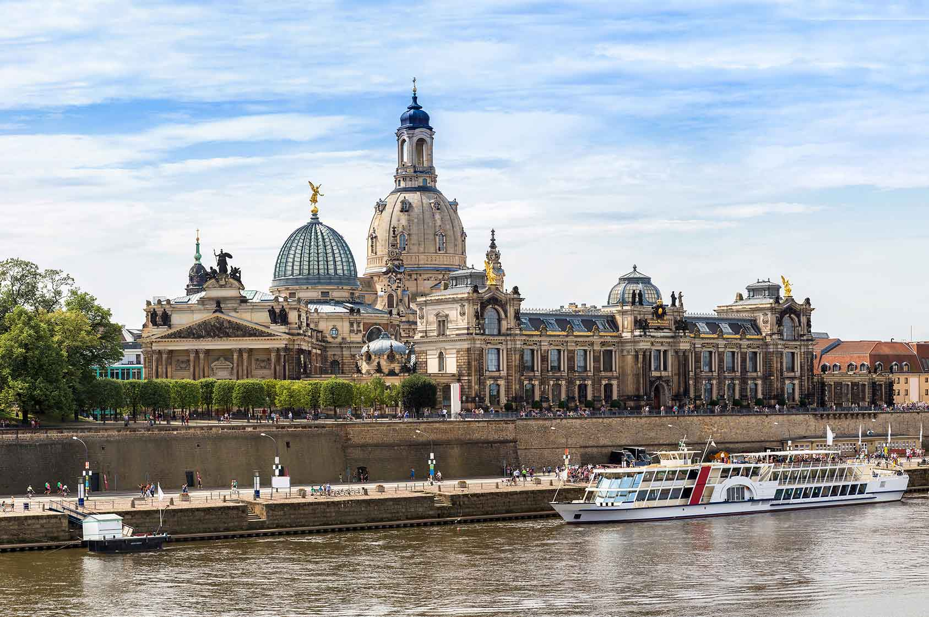

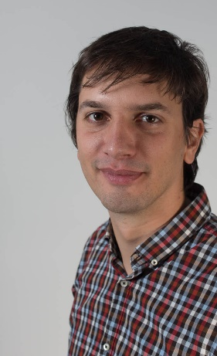
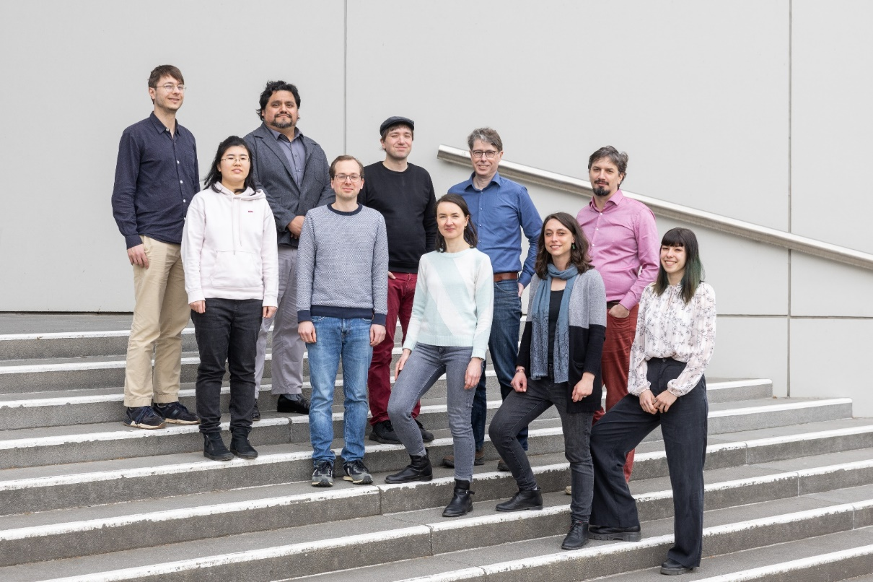
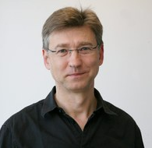
Special thanks to
Cognitive computational neuroscience group
Stefan Kiebel
Dimitrije Markovic
Michael Smolka

Slide 55
Selected references
Bayesian Brain
Clark, A. (2013). Whatever next? Predictive brains, situated agents, and the future of cognitive science. Behavioral and brain sciences, 36(3), 181-204.
Parr, T., Rees, G., & Friston, K. J. (2018). Computational neuropsychology and Bayesian inference. Frontiers in human neuroscience, 12, 61.
Butz, M. V. (2016). Toward a unified sub-symbolic computational theory of cognition. Frontiers in psychology, 7, 925.
Planning as inference
Attias, H. (2003). Planning by probabilistic inference. In International workshop on artificial intelligence and statistics (pp. 9-16). PMLR.
Botvinick, M., & Toussaint, M. (2012). Planning as inference. Trends in cognitive sciences, 16(10), 485-488.

Slide 56
Selected references
Active inference
Da Costa, L., Parr, T., Sajid, N., Veselic, S., Neacsu, V., & Friston, K. (2020). Active inference on discrete state-spaces: A synthesis. Journal of Mathematical Psychology, 99, 102447.
Schwöbel, S., Kiebel, S., & Marković, D. (2018). Active inference, belief propagation, and the bethe approximation. Neural computation, 30(9), 2530-2567.
Friston, K., Rigoli, F., Ognibene, D., Mathys, C., Fitzgerald, T., & Pezzulo, G. (2015). Active inference and epistemic value. Cognitive neuroscience, 6(4), 187-214.

Slide 57
Selected references
Habits
Wood, W., & Rünger, D. (2016). Psychology of habit. Annual review of psychology, 67(1), 289-314.
Bayesian habits
Schwöbel, S., Marković, D., Smolka, M. N., & Kiebel, S. J. (2021). Balancing control: A Bayesian interpretation of habitual and goal-directed behavior. Journal of mathematical psychology, 100, 102472.
Context-specific behavioral repertoires
Schwöbel, S., Marković, D., Smolka, M. N., & Kiebel, S. (2024). Joint modeling of choices and reaction times based on Bayesian contextual behavioral control. PLOS Computational Biology, 20(7), e1012228.
Mittenbühler, M., Schwöbel, S., Dignath, D., Kiebel, S., & Butz, M. V. (2024). A rational trade-off between the costs and benefits of automatic and controlled processing. In Proceedings of the Annual Meeting of the Cognitive Science Society (Vol. 46).
Butz, M. V., Mittenbühler, M., Schwöbel, S., Achimova, A., Gumbsch, C., Otte, S., & Kiebel, S. (2024). Contextualizing predictive minds. Neuroscience & Biobehavioral Reviews, 105948.

Slide 58
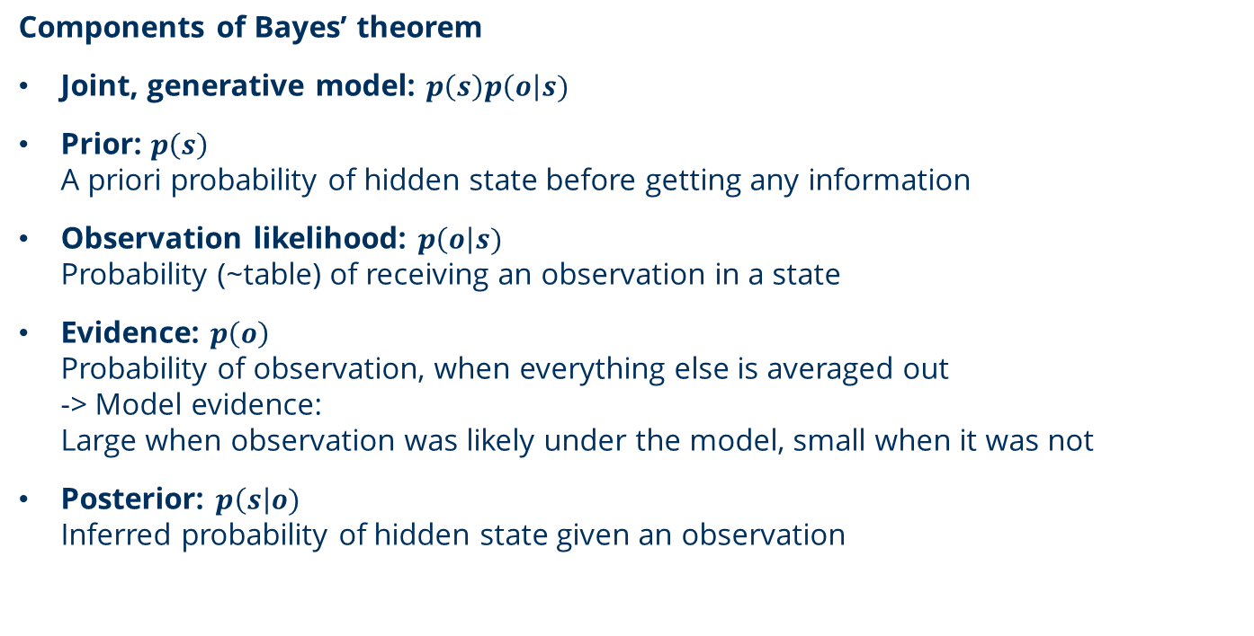
A note on Bayes’ theorem terms and notation
Components of Bayes’ theorem
Joint, generative model: $p\left(s\right)p\left(o\right|s)$
Prior: $p\left(s\right)$ A priori probability of hidden state before getting any information
Observation likelihood: $p\left(o\right|s)$ Probability (~table) of receiving an observation in a state
Evidence: $p\left(o\right)$ Probability of observation, when everything else is averaged out -> Model evidence: Large when observation was likely under the model, small when it was not
Posterior: $p\left(s\right|o)$ Inferred probability of hidden state given an observation

Slide 59




A note on Bayes’ theorem terms and notation
Joint, generative model: $p\left(s\right)p\left(o\right|s)$
Prior: $p\left(s\right)$ A priori probability of hidden state before getting any information
Observation likelihood: $p\left(o\right|s)$ Probability (~table) of receiving an observation in a state
Posterior: $p\left(s\right|o)$ Inferred probability of hidden state given an observation
Evidence: $p\left(o\right)$ Probability of observation, when everything else is averaged out -> Model evidence: Large when observation was likely under the model, small when it was not
$$p\left(o\right|s)p\left(s\right)$$
$$p\left(s\right|o)=$$
$$const$$
$$p\left(o\right)$$

Slide 60




Context inference
$$c$$
$$p(o_{c}|c)$$
Invert arrows
Cue surprise
Outcome surprise
State surprise
Policy surprise
$$o_{c}$$
…
$$p(a_{t}|c)$$
$$a_{t}$$
$$a_{t+1}$$
$$s_{t}$$
$$s_{t+1}$$
$$s_{t+2}$$
$$p(o_{t}|s_{t},c)$$
$$p(s_{t+1}|s_{t},a_{t},c)$$
$$o_{t}$$
$$o_{t+1}$$
$$o_{t+2}$$

Slide 61




Context inference
Invert arrows
Cue surprise
Outcome surprise
State surprise
Policy surprise
$$p(o_{c}|c)$$
$$p(o_{t}|s_{t},c)$$
$$p(s_{t+1}|s_{t},a_{t},c)$$
$$p(a_{t}|c)$$

