Slide 1

Studdies
Quick and easy connections for like-minded students across all platforms.
http://13.211.164.1/
Facebook
https://www.facebook.com/studdies/
Twitter
https://twitter.com/StuddiesConnect
Reddit
https://www.reddit.com/r/Studdies/

Slide 2
What is it?
Studdies is a platform agnostic study-buddy connection tool. No sign-in required.
Regardless of location or choice of social network platform, Studdies connects students on common interests and topics.

Slide 3
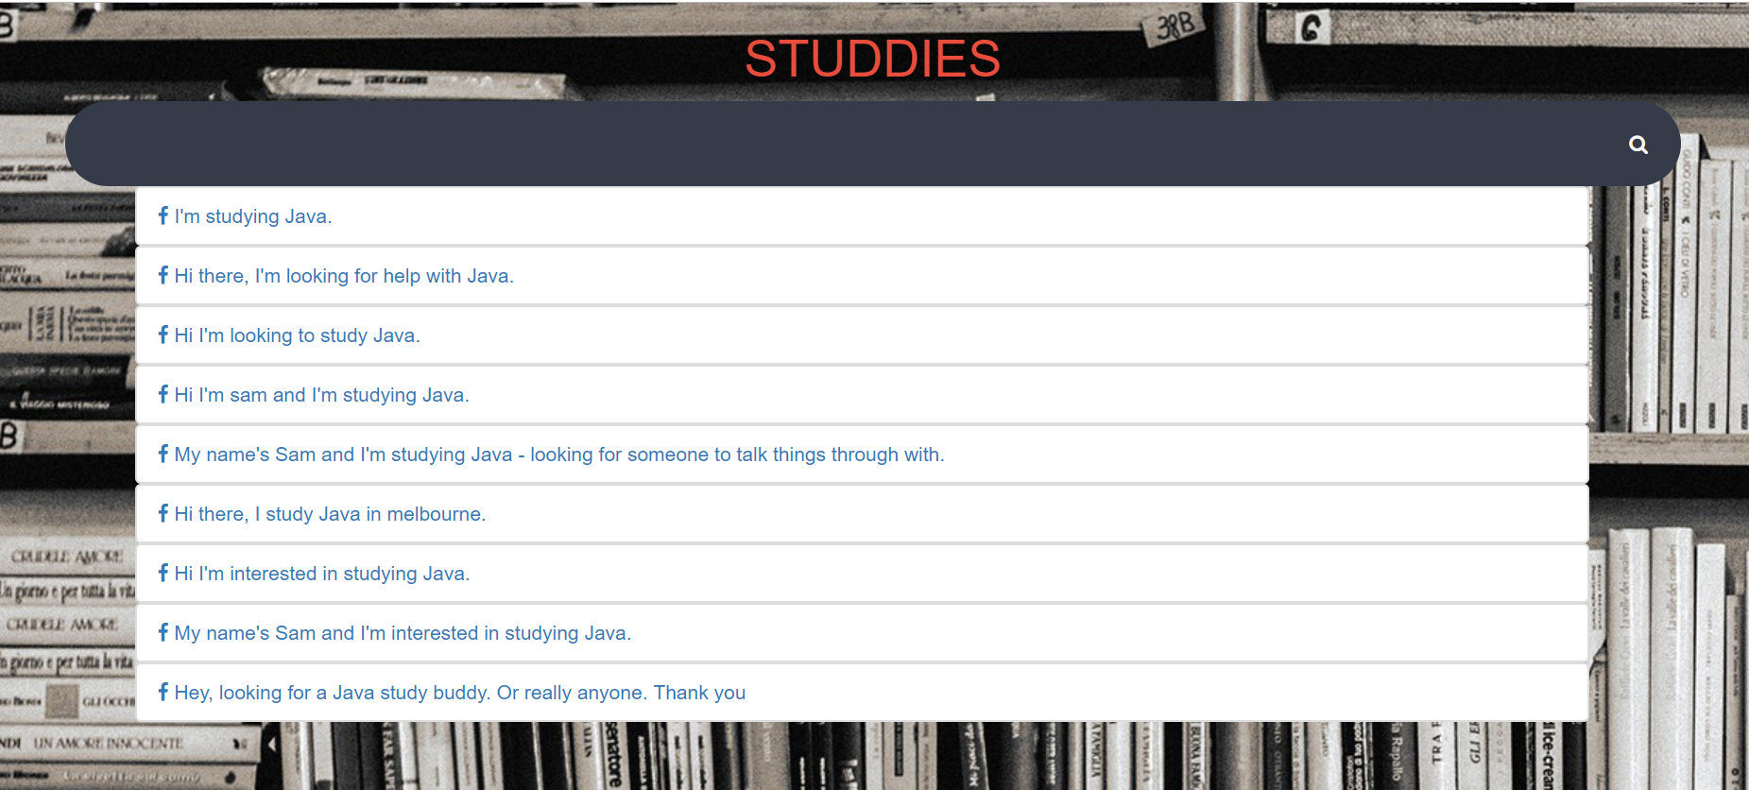
How will it work?
You’ll go to our website and enter the topic you’d like to study. You’ll then be given a list of others studying the same topic, and links to their social media posts where you can get in touch.

Slide 4

How will it work?
If your search returns no results, you’ll be prompted to post your topic on the platform of your choice, where the next person who searches this topic will be directed to your post.

Slide 5
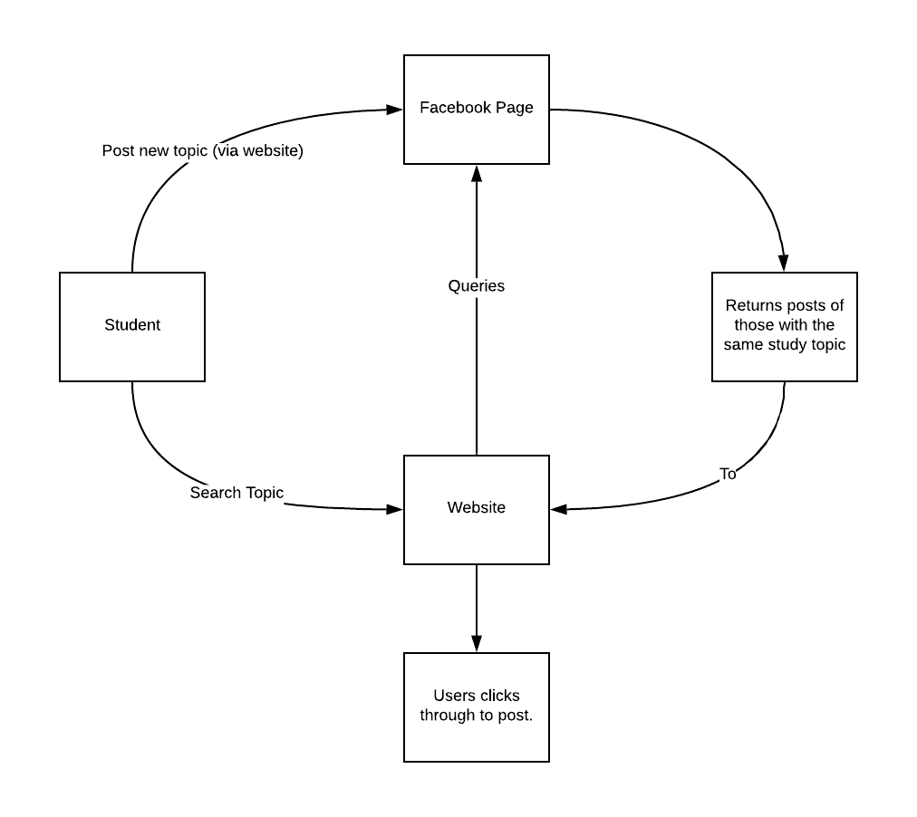
Program Flow

Slide 6
Our current iteration of Studdies uses Facebook’s graph API to create and connect our first online community.
In future iterations, Studdies can be scaled up to encompass Twitter, Reddit, LinkedIn, Canvas and more.

Slide 7
Studdies is simple and lightweight, requiring no dedicated sign in, providing users with the flexibility to connect using the social networks they’re already a part of.
We believe Studdies is an elegant solution which empowers students to improve their own learning experiences by connecting with others.

Slide 8
Studdies Hackathon Team
Harpreet Singh
Ian Nguyen
Josiah Miranda
Sam King

