Slide 1
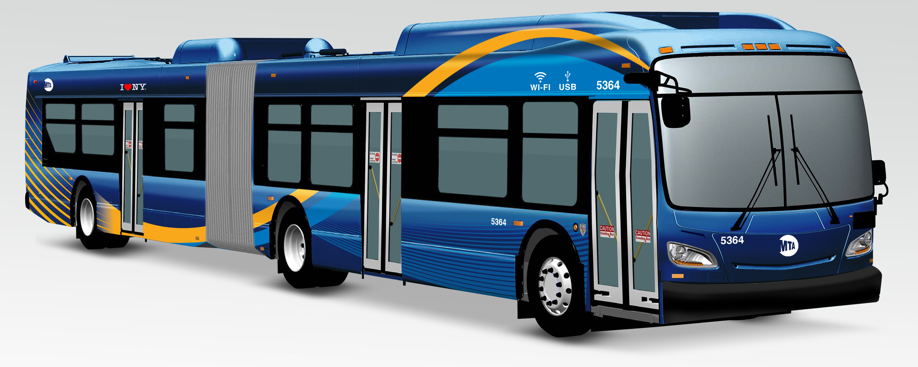
By Safa Shafat
MTA'S RIDERSHIP;
NEW YORK CITY'S MAJOR PUBLIC TRANSPORTATION

Slide 2
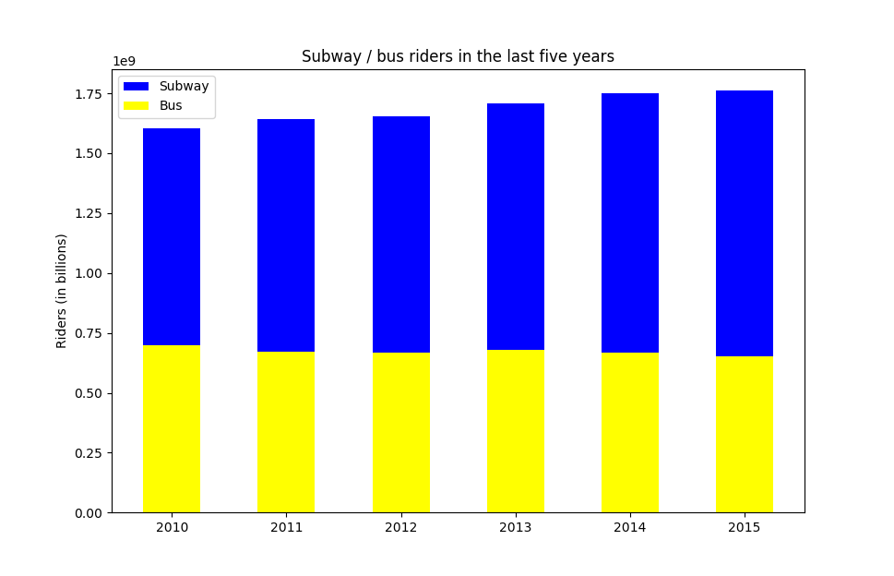
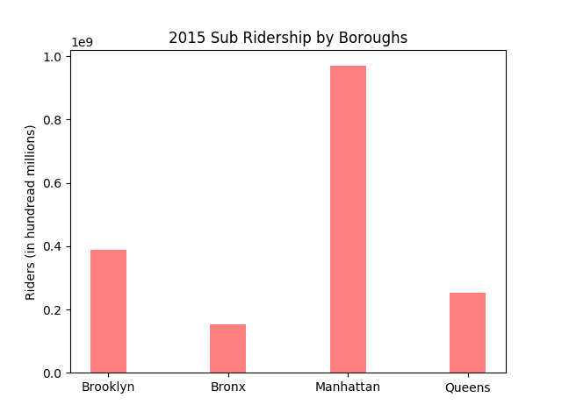
Discoveries
Brooklyn has the highest number of bus riders
Manhattan has the highest number of overall MTA riders, with the highest in the Subway
The annual bus ridership has gone down significantly in the last 5 years, as opposed to the subway ridership, which sees a steady growth.

Slide 3
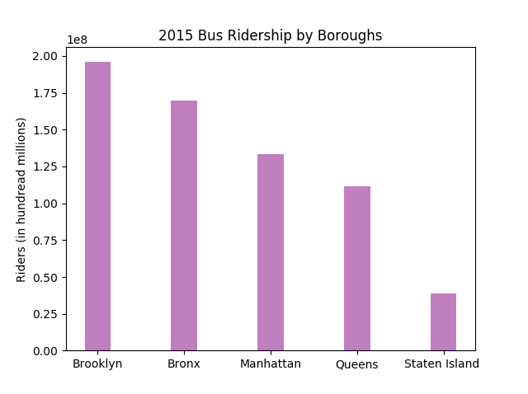
Conclusion
There are millions of bus riders every year. Even though the bus ridership is not as large as Subway ridership, simply because subways cover a lot more distance with the same fare and most people use transportation to go to work, etc. which is mostly away from the borough they live in. Manhattan being the busiest borough has the most riders.
But Brooklyn and The Bronx has many people taking the bus which shows that people who stay within these boroughs commute a lot. The busiest bus line suggests the boroughs being very active and independent meaning, it has jobs, schools to be a busy location.

