Slide 1

Total number of images: 14,197,122
38%
SENets
AlexNet
ZF
GoogLeNet
23%
ResNet
Ensemble
Feature Engineering
CNN
Notes:
2010, 2011, traditional: shallow
2012, AlexNet: University of Toronto, 8 layers, became the gold standard choice. Krizhevsky and his advisor, AI pioneer Geoffrey Hinton, both now work at Google's AI lab.)
2013, Zeiler-Fergus (ZF): New York University, 8 layers
2014, GoogLeNet : Google entered the competition with a team called GoogleNet, 22 layers
2015, ResNet: Team at Microsoft, 152 layers
2016, Ensemble: over > 200 layers
2017, SENets: researchers from Momenta (Beijing) and University of Oxford

Slide 2
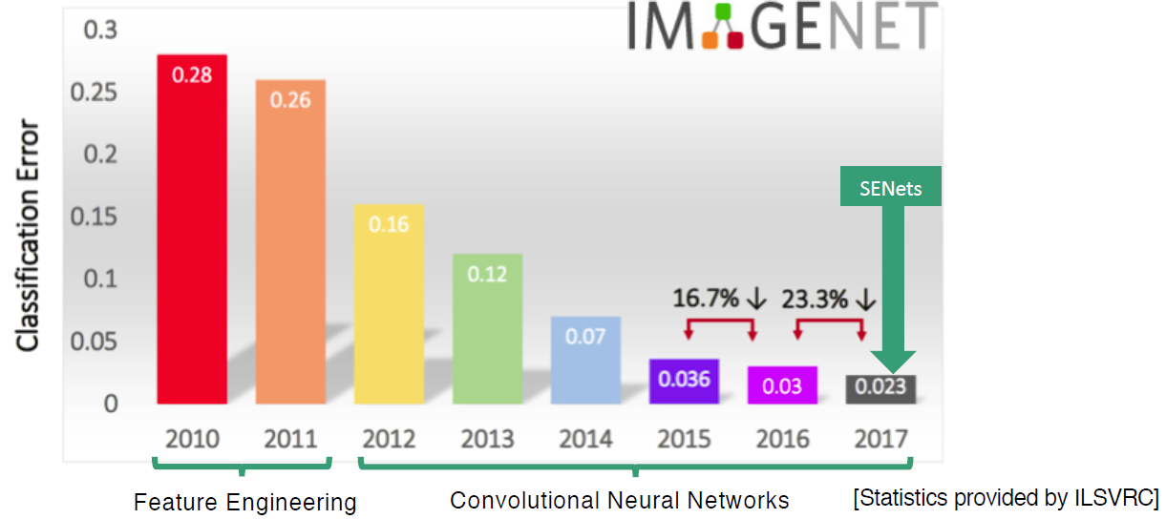

Slide 3
A group of researcher from prinction to
22K categories and 15M images
• Animals
• Bird
• Fish
• Mammal
• Invertebrate
• Plants
• Tree
• Flower
• Food
• Materials
• Structures
• Artifact
• Tools
• Appliances
• Structures
• Person
• Scenes
• Indoor
• Geological Formations
• Sport Activities
Around the time 1999-2000 machine learning techniques, specially statistical machine learning techniques start to gain momentum such SVM, boosting, graphical models and first wave of neural network.
One particular work that made a lot of contribution in face detection in near real time was AdaBoost 2001 by Viola & Jones. There is a lot to admire by this work it was done when computer chips were very slow.
In 2006 Fuji rolled out the first digital camera with real time face detector.

Slide 4
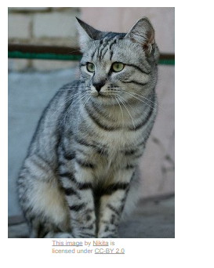
Image Classification:
When you are doing image classification your system receives some input image which is this cute dog for example and the system is aware of some predetermine set of lables
{dog, cat, car, …}
This seems as an easy problem because of so much of your vision is hard wared to your brain, this is not easy for computer

Slide 5
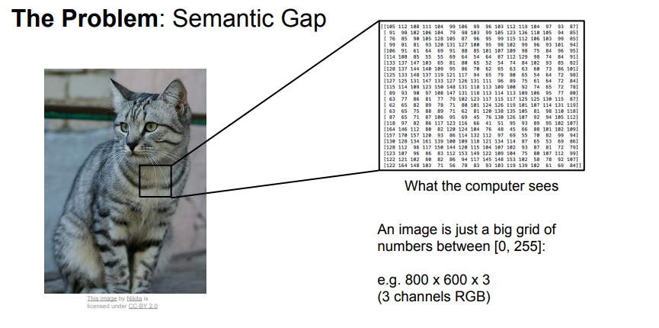
What a computer see is numbers (Semantic Gap)
http://cs231n.stanford.edu/slides/2017/cs231n_2017_lecture2.pdf
https://www.youtube.com/watch?v=OoUX-nOEjG0&list=PL3FW7Lu3i5JvHM8ljYj-zLfQRF3EO8sYv&index=2

