Slide 1
Keeping WellCo Members
Who's at risk of leaving — and who to call first
20%
10,000
4,369
of members churn each period
members analysed
members we recommend calling
WellCo Member Retention Analysis · July 2025

Slide 2
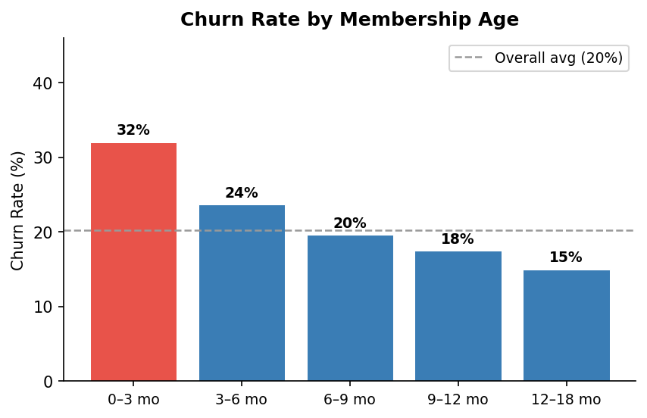
The Problem
1 in 5 members leaves within two weeks
Across the observation period, 20% of members churned — that's roughly 2,000 people per cohort.
New members are three times more likely to churn
Someone who joined last month is far more at risk than someone who has been a member for a year.
Disengagement is the clearest warning sign
Falling app usage, fewer health page visits, and inconsistent logins all predict churn well in advance.

Slide 3
What Predicts Churn?
Six signals drive the model — all based on observable member behaviour
📅 Membership age
💻 Health content browsing
📱 App consistency
New members churn 3× more. The longer someone has been with WellCo, the safer they are.
Reading WellCo articles on diabetes, sleep, nutrition or exercise is a strong signal of engagement.
It's not just total logins — members who log in sporadically are more at risk than regular users.
🩺 Health conditions on file
📉 Declining activity
🌐 Health topic variety
Diabetes, hypertension, or nutrition counseling records are protective. WellCo's programs are working for these members.
A drop in app sessions or health browsing in the second week is an early churn signal.
Members who explore multiple health topics (sleep AND nutrition AND fitness) are much more engaged.

Slide 4
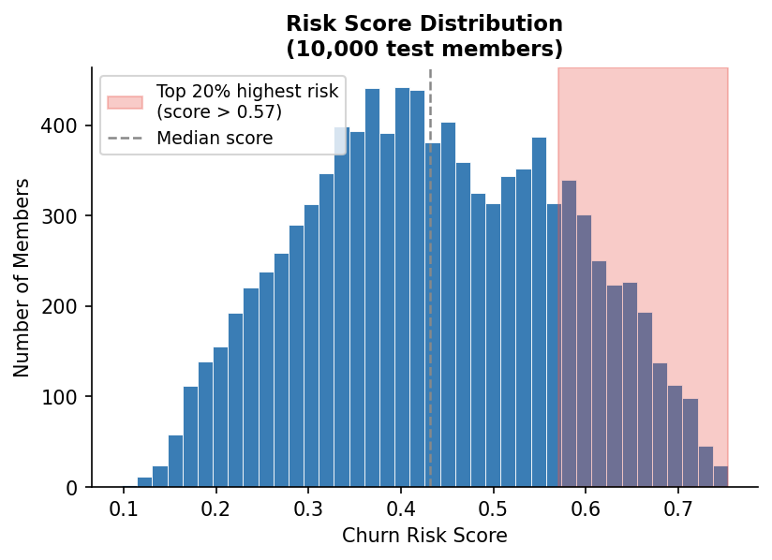
How We Rank Members
Every member gets a Risk Score from 0 to 1
1
We collected 14 days of behaviour for all 10,000 members — app sessions, web visits, and health records.
2
A machine-learning model combined 35 behavioural signals to give each member a single churn risk score.
3
Members are ranked 1–10,000. Rank 1 is the person most likely to leave.
4
The model was tested on held-out data and correctly ranks at-risk members well above chance.

Slide 5
Our Recommendation
Why this number?
Start with the top
4,369
Every outreach has a cost. We only recommend contacting someone when the expected benefit of keeping them exceeds the cost of the outreach. At 4,369 members, every contact pays for itself — beyond that, the benefit drops below the cost. ⚠ Note: the exact n depends on your cost-per-outreach and retention value. 4,369 assumes cost ≈ 2% of retention value — a reasonable baseline for digital outreach, but WellCo should substitute their actual numbers.
members
~79
44%
1.5×
churns expected to be prevented
of members targeted
more effective than random outreach
How to use the list
The attached file ranks all 10,000 test members by churn risk. Start at rank 1 and work down. Members who have recently joined and show low app engagement are highest priority. For members with health conditions on file (diabetes, hypertension), a condition-specific message may be more effective than a generic one.

