Slide 1
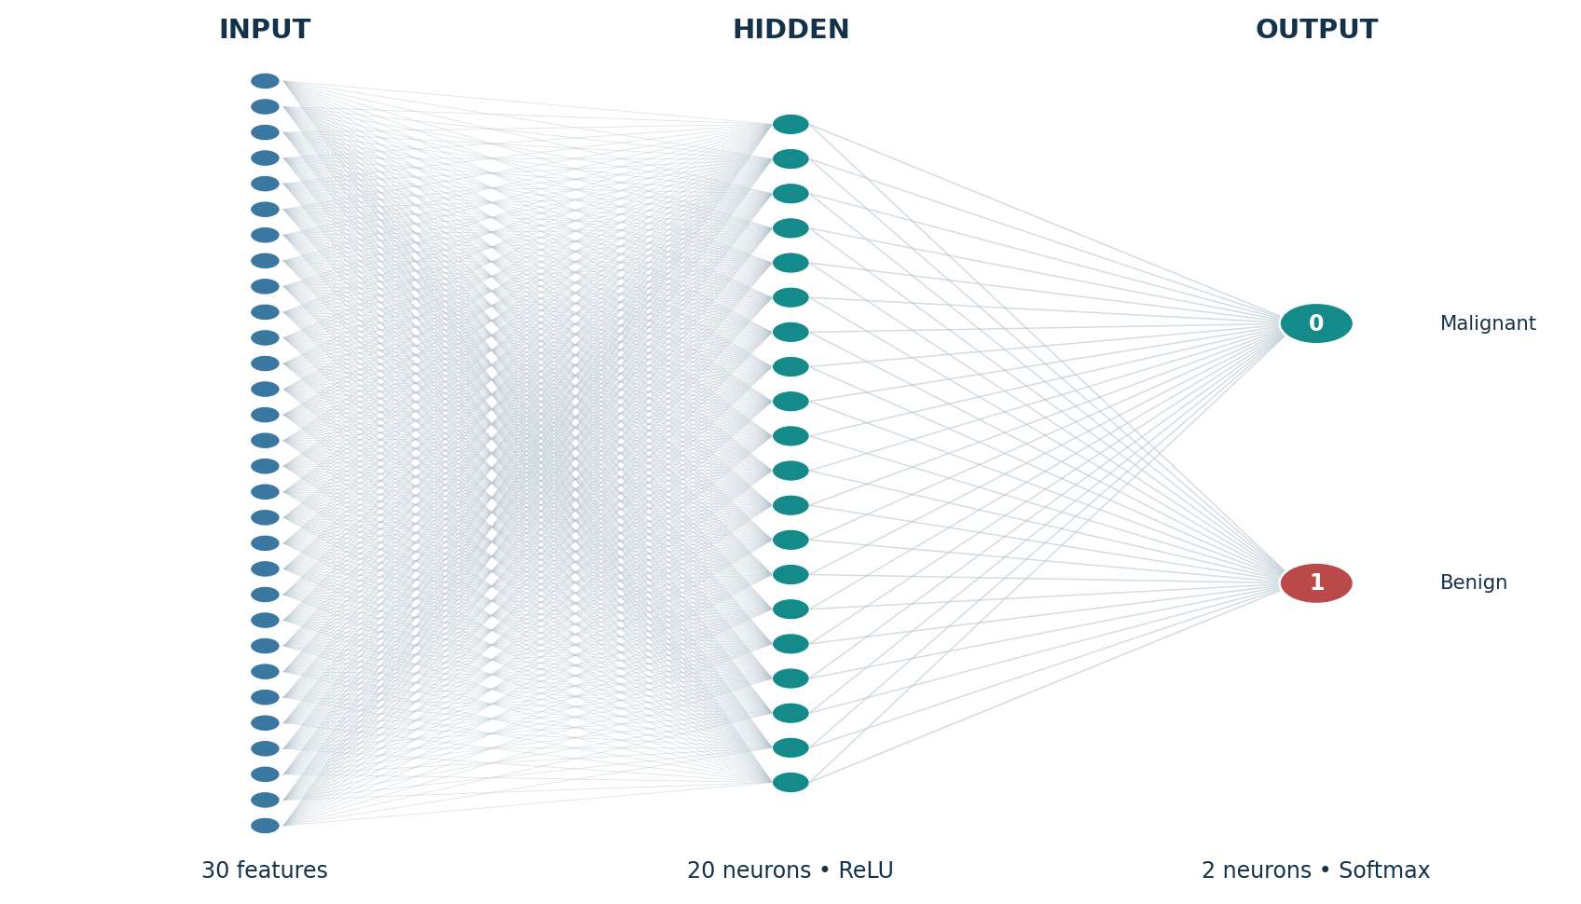
ARTIFICIAL INTELLIGENCE • MACHINE LEARNING
CANCER CLASSIFICATION
AND PREDICTION
Using Artificial Neural Networks
PROJECT PRESENTATION
SANKET KISHOR SUTAR
Breast Cancer Wisconsin (Diagnostic) Dataset
CANCER CLASSIFICATION AND PREDICTION USING NEURAL NETWORKS
01

Slide 2
01 • PROJECT OVERVIEW
Problem Statement & Objectives
THE PROBLEM
PROJECT OBJECTIVES
Breast tumor samples are described by multiple numerical measurements. The project explores whether a supervised neural network can learn patterns in these measurements and classify samples as malignant or benign.
The aim is an educational prediction prototype—not a clinical diagnostic tool.
• Build an intelligent two-class classifier
• Explore and prepare the diagnostic dataset
• Apply feature scaling and a neural network
• Evaluate with accuracy, precision, recall, F1-score and confusion matrix
• Build an interactive prediction interface
CANCER CLASSIFICATION AND PREDICTION USING NEURAL NETWORKS
02

Slide 3
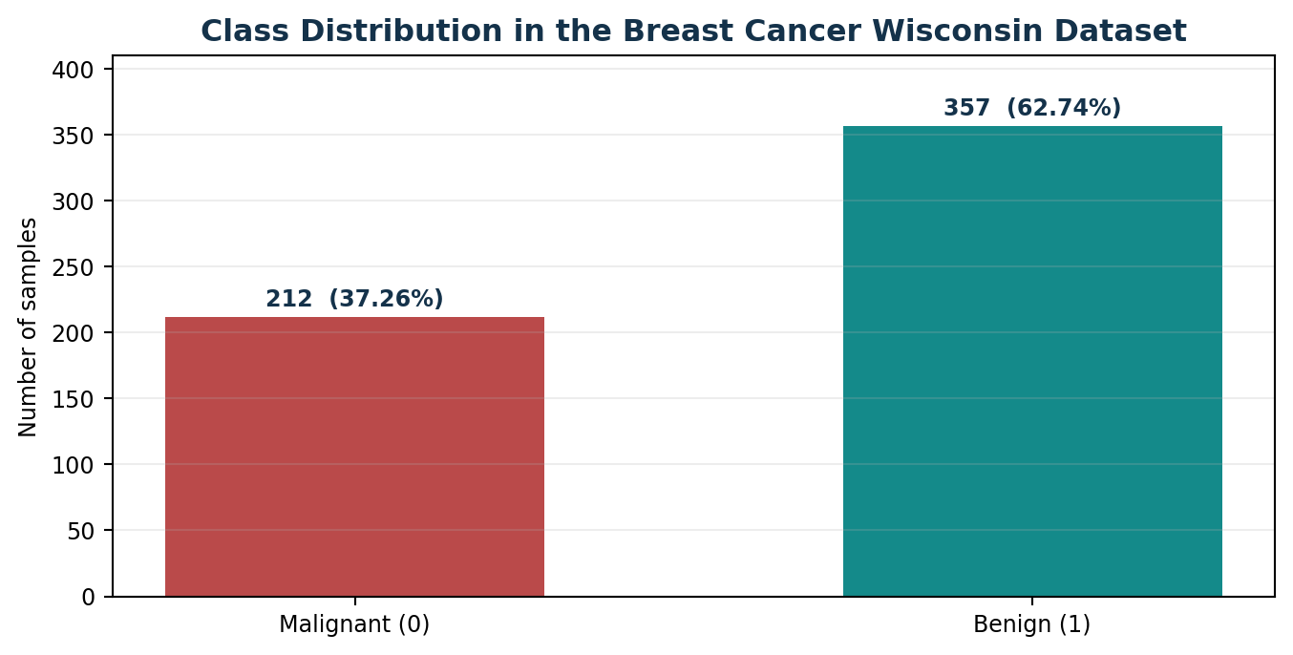
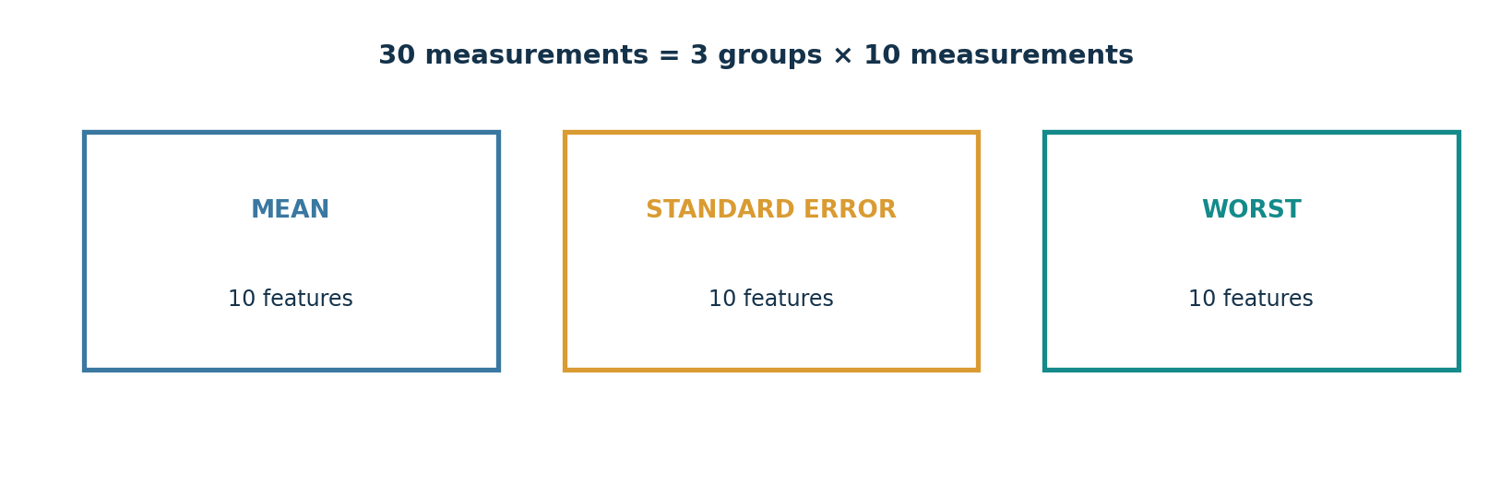
02 • DATA
Dataset at a Glance
569 SAMPLES
30 FEATURES
2 CLASSES
Breast Cancer Wisconsin (Diagnostic)
Real-valued measurements of cell nuclei
Malignant (0) • Benign (1)
Class distribution in the dataset
Three measurement groups: mean, standard error, worst
CANCER CLASSIFICATION AND PREDICTION USING NEURAL NETWORKS
03

Slide 4
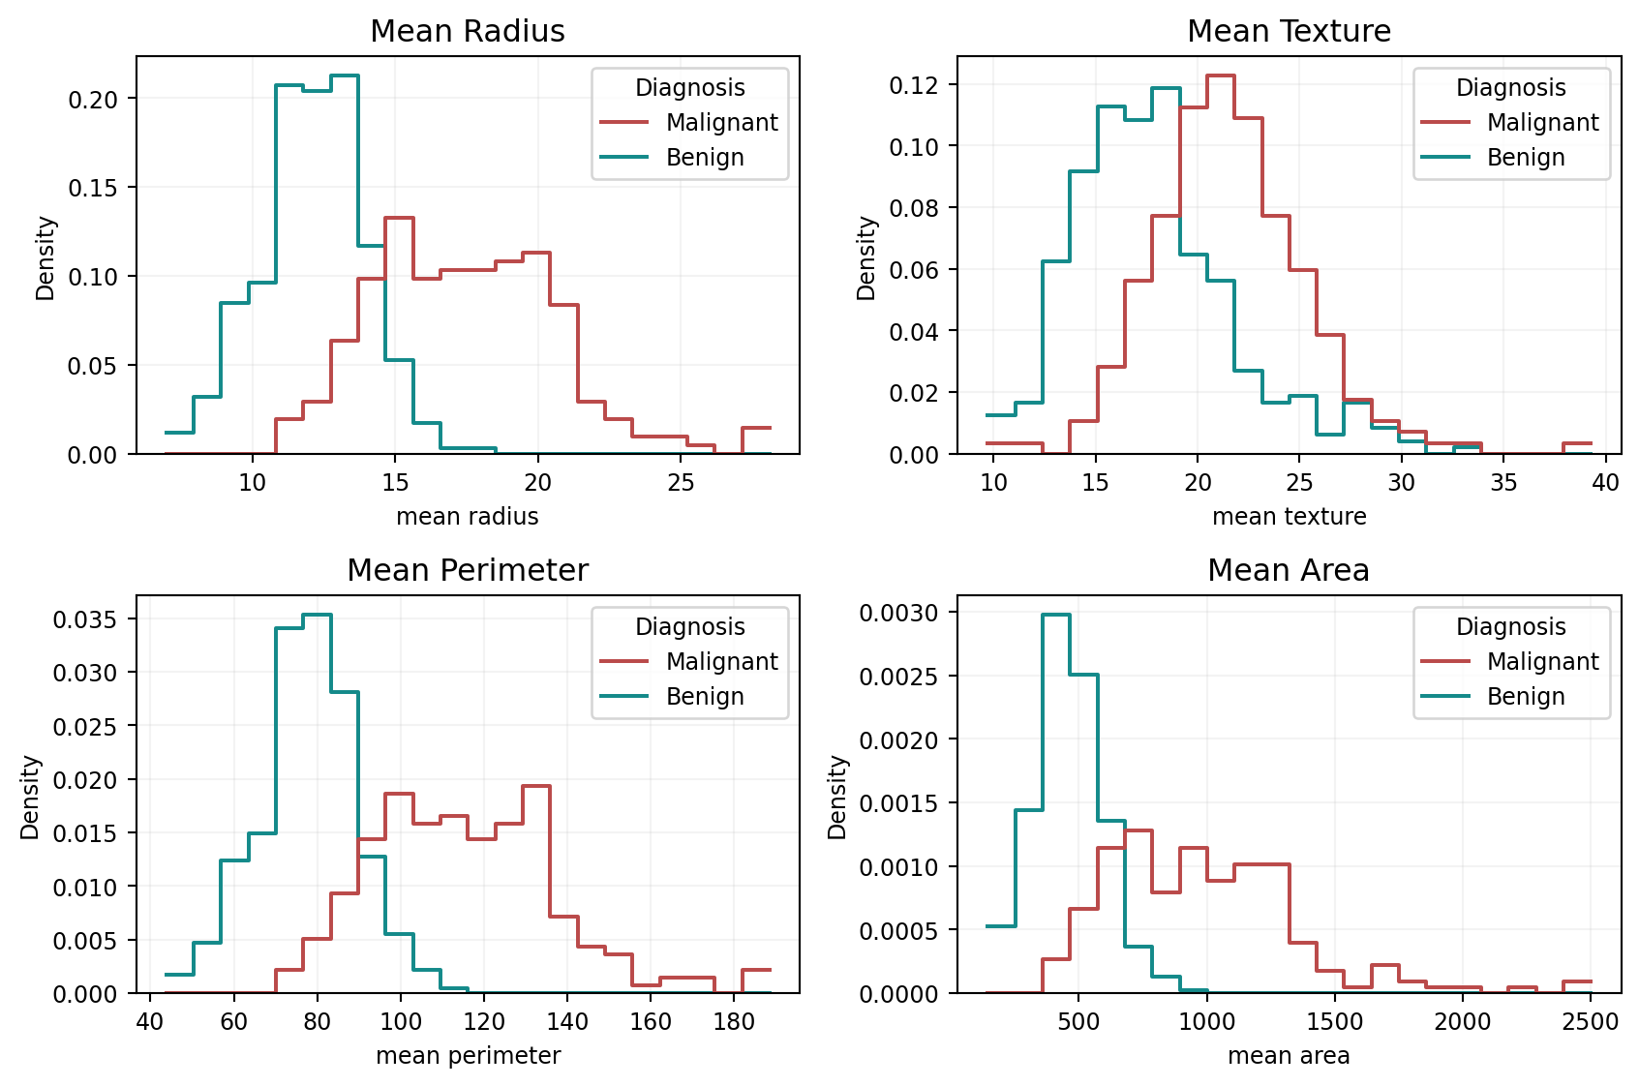
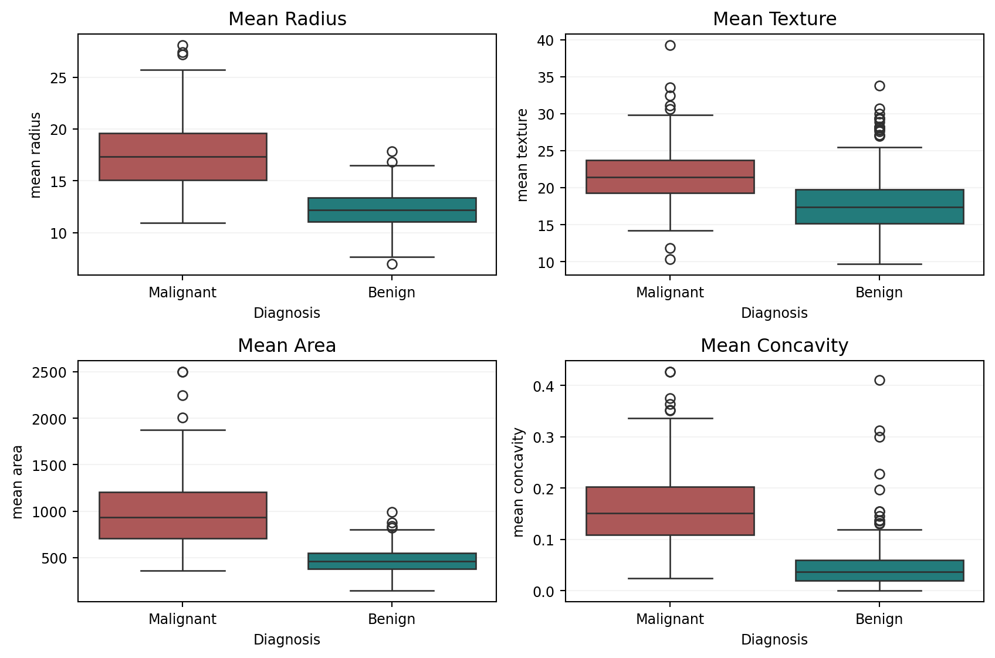
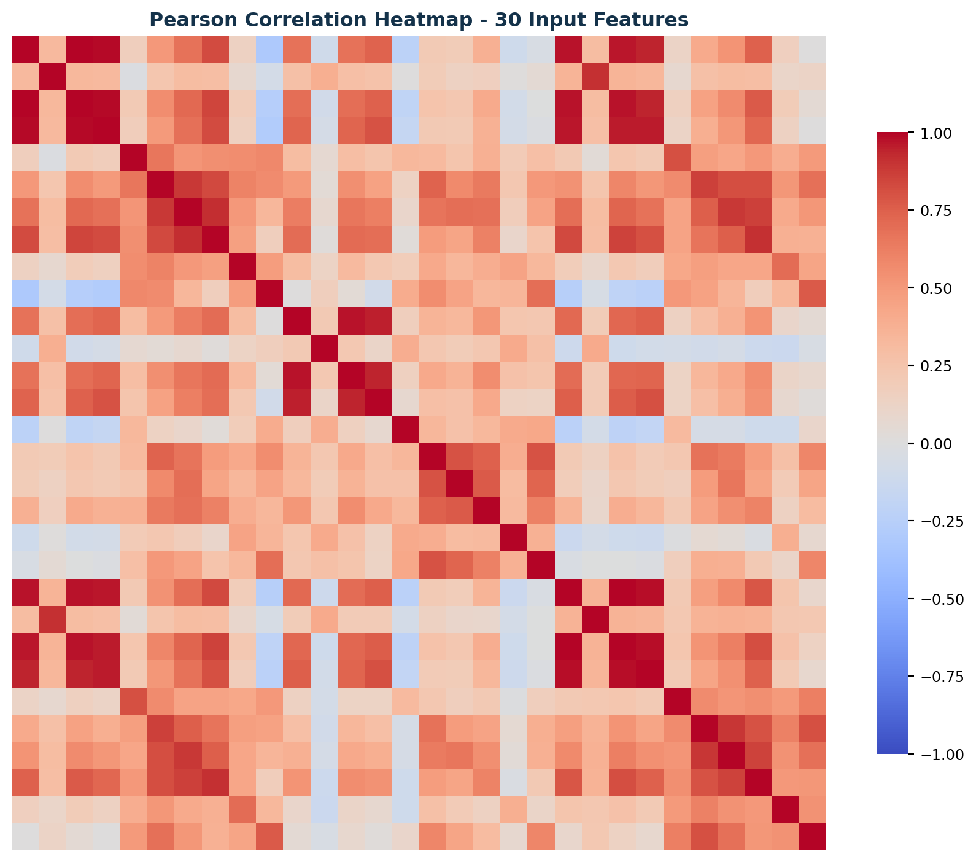
03 • UNDERSTANDING THE DATA
Exploratory Data Analysis
KEY OBSERVATIONS
• Feature distributions differ between the two target classes.
• Several measurements show class-separating patterns.
• Correlation analysis helps identify relationships among the 30 features.
CANCER CLASSIFICATION AND PREDICTION USING NEURAL NETWORKS
04

Slide 5
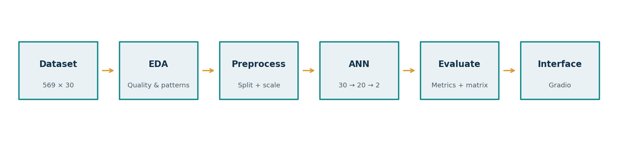
04 • PROJECT WORKFLOW
End-to-End Methodology
1. Collect
2. Explore
3. Prepare
4. Build
Load 569 × 30 data
EDA & quality checks
Split, encode, scale
ANN architecture
5. Train
6. Evaluate
7. Deploy demo
8. Save
10 epochs
Test metrics
Gradio interface
Model & artefacts
Stratified splitting and train-only scaler fitting help reduce evaluation leakage.
CANCER CLASSIFICATION AND PREDICTION USING NEURAL NETWORKS
05

Slide 6
05 • RELIABLE EVALUATION
Data Preparation & Preprocessing
DATA SPLIT
TRAIN / VALIDATION
STANDARDIZATION
569 total samples
80% development / 20% held-out test
455 development samples
114 test samples
455 development samples split into:
409 training samples
46 validation samples
Stratified by target class
StandardScaler fitted on the 409 training samples only.
The fitted scaler transforms training, validation and test features.
Same scaler is reused by the Gradio app.
Why this matters: the test set remains separate from model fitting, and the scaler does not learn from validation or test data.
CANCER CLASSIFICATION AND PREDICTION USING NEURAL NETWORKS
06

Slide 7
06 • MODEL DEVELOPMENT
Neural Network Architecture
INPUT LAYER
30 numerical features
HIDDEN LAYER
20 neurons • ReLU activation
OUTPUT LAYER
2 neurons • Softmax
Malignant / Benign
Adam • learning rate 0.001
Sparse categorical cross-entropy
CANCER CLASSIFICATION AND PREDICTION USING NEURAL NETWORKS
07

Slide 8
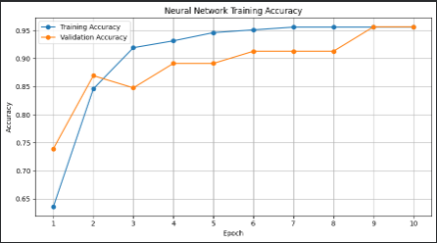
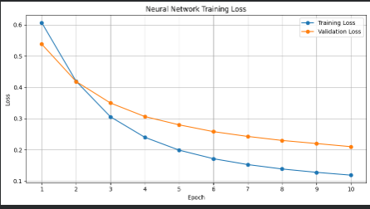
07 • 10 TRAINING EPOCHS
Model Training & Learning Curves
ACCURACY
TRAINING SETUP
Training: 95.60% • Validation: 95.65%
10 epochs • Adam optimizer
CANCER CLASSIFICATION AND PREDICTION USING NEURAL NETWORKS
08

Slide 9
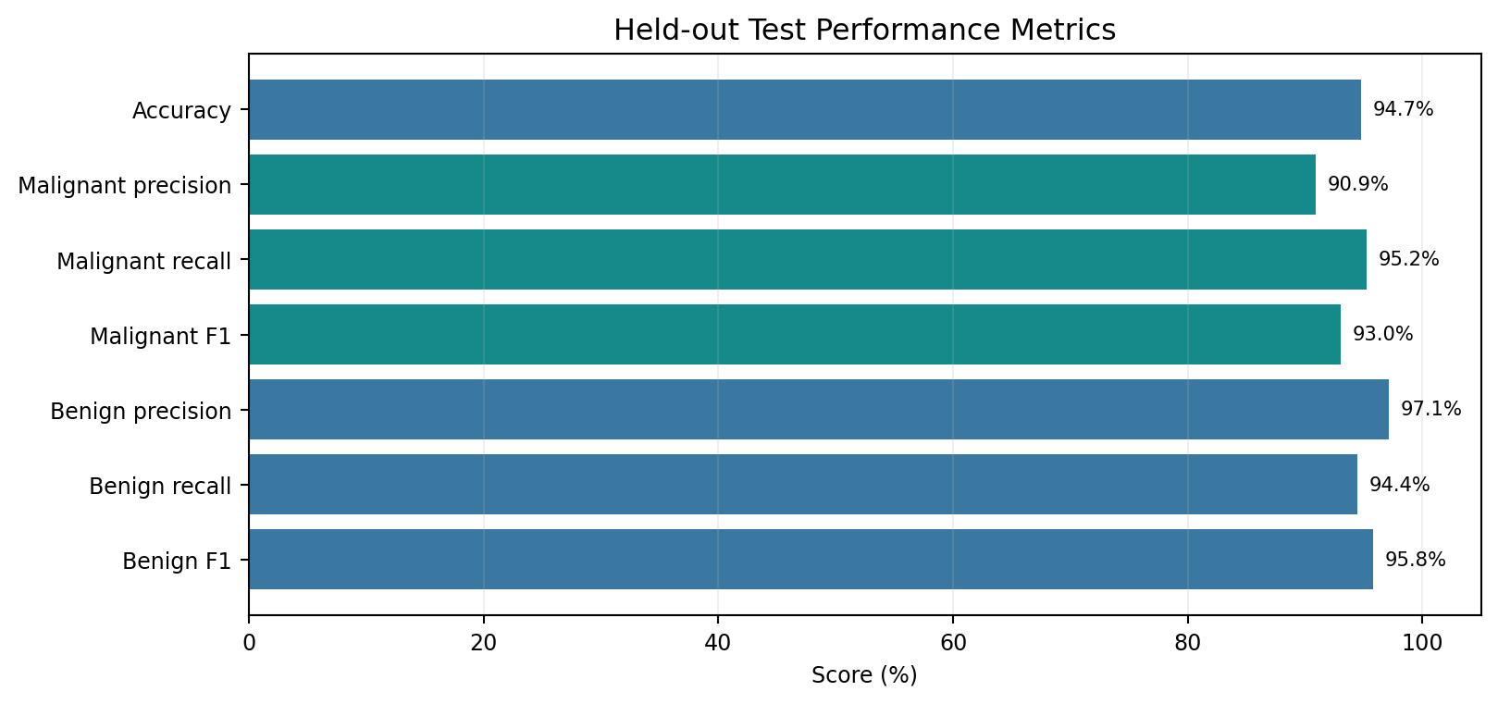
08 • MEASURED PERFORMANCE
Held-Out Test Results
TEST ACCURACY
TEST LOSS
TEST SAMPLES
93.86%
0.1408
114
CLASS-WISE PERFORMANCE
Malignant precision
92.68%
Malignant recall / sensitivity
90.48%
Malignant F1-score
91.57%
Benign precision
94.52%
Benign recall
95.83%
Benign F1-score
95.17%
Specificity
95.83%
CANCER CLASSIFICATION AND PREDICTION USING NEURAL NETWORKS
09

Slide 10
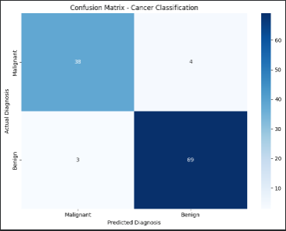
09 • TEST SET
Confusion Matrix & Error Analysis
107 CORRECT PREDICTIONS
38 malignant + 69 benign samples correctly classified
7 INCORRECT PREDICTIONS
4 malignant samples predicted benign; 3 benign samples predicted malignant
The confusion matrix shows both correct classifications and the two types of error. Overall accuracy alone does not describe these class-specific patterns.
CANCER CLASSIFICATION AND PREDICTION USING NEURAL NETWORKS
10

Slide 11
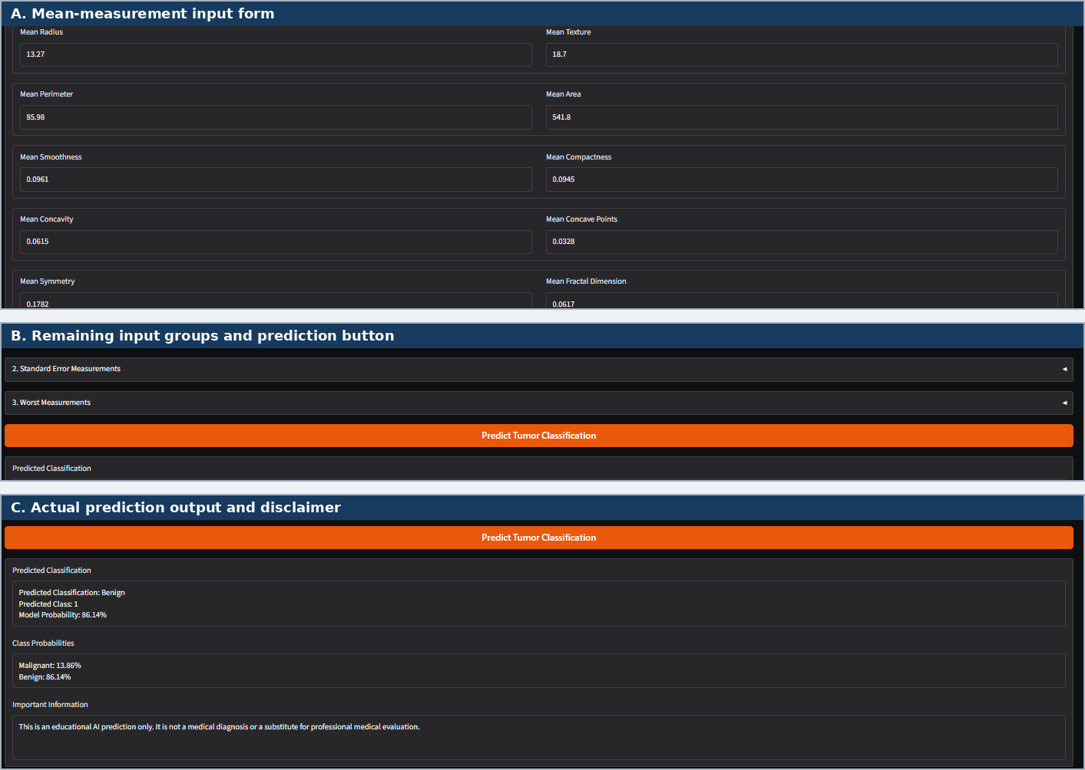
10 • IMPLEMENTATION
Interactive Prediction Application
INPUT
30 numeric measurements in three groups
PROCESS
Saved scaler → trained ANN → class probabilities
OUTPUT
Predicted class and probability for each class
Example demonstration: Benign (class 1), 86.14% model probability.
CANCER CLASSIFICATION AND PREDICTION USING NEURAL NETWORKS
11

Slide 12
11 • TAKEAWAYS
Conclusion, Limitations & Future Scope
KEY FINDINGS
LIMITATIONS
FUTURE SCOPE
• ANN achieved 93.86% held-out test accuracy.
• Both classes were evaluated with precision, recall and F1-score.
• A working Gradio demo accepts measurements and returns predictions.
• Small, fixed public benchmark dataset.
• Single stratified train/test split.
• No independent external or prospective validation.
• Not clinically validated; not for medical decisions.
• Evaluate on independent datasets.
• Use cross-validation and calibration.
• Compare with other classifiers.
• Improve interface usability and model monitoring.
The project demonstrates an end-to-end educational machine-learning workflow—from dataset exploration to an interactive prediction prototype.
Thank you
CANCER CLASSIFICATION AND PREDICTION USING NEURAL NETWORKS
12

