Slide 1
2
PROJECT PRESENTATION
0
Handwritten Digit
Recognition Using
Neural Networks
1
3
8
(MNIST Dataset)
An image-classification project for recognizing handwritten digits 0–9.
7
5
70,000 images
28 × 28 grayscale
10 digit classes
MNIST • PYTHON • TENSORFLOW / KERAS
01

Slide 2
PROJECT BRIEF
Project overview & objectives
PROJECT OVERVIEW
PROJECT OBJECTIVES
A beginner-friendly AI and machine-learning project for recognizing handwritten digits from 0 to 9.
1
Understand the fundamentals of Neural Networks.
2
Learn image classification techniques.
The model learns from labelled MNIST grayscale images and is evaluated on unseen test images. The project covers image processing, model training, testing and performance evaluation.
3
Train a model using the MNIST dataset.
4
Evaluate model accuracy and performance.
5
Deploy a simple digit recognition system.
HANDWRITTEN DIGIT RECOGNITION • MNIST
02

Slide 3
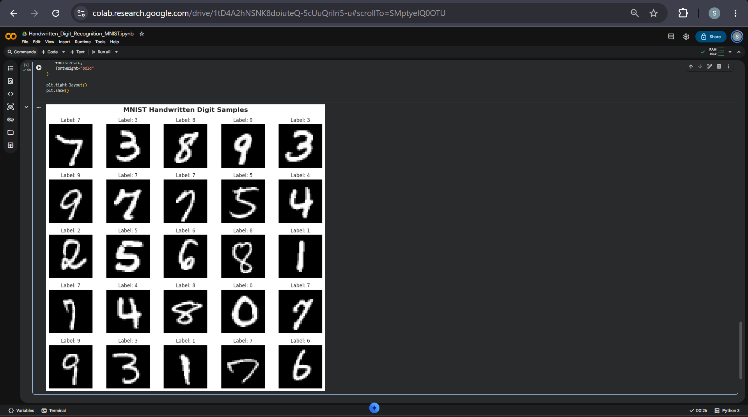
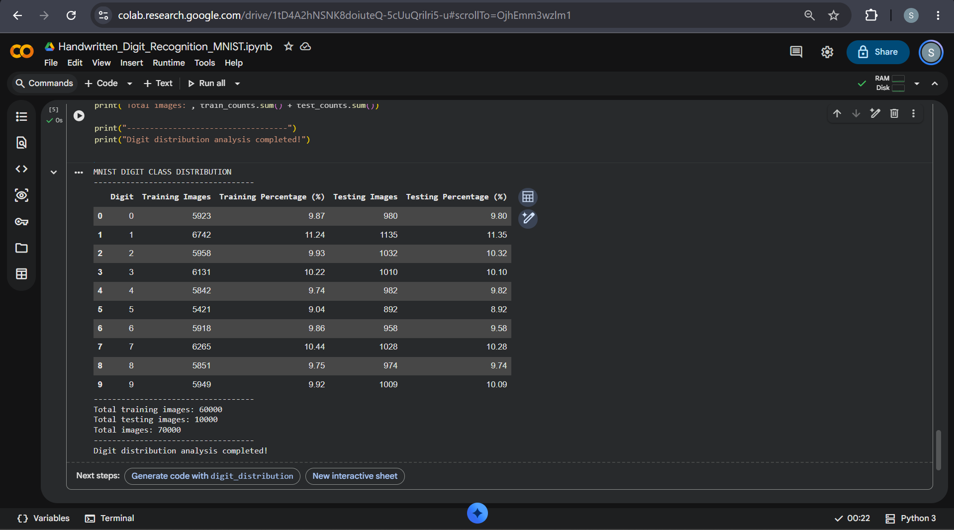
DATASET INFORMATION
MNIST handwritten digits dataset
70,000
60,000
10,000
28 × 28
0–9
Total digit images
Training images
Testing images
Image dimensions
Digit classes
Each sample is a 28 × 28 pixel grayscale image representing one handwritten digit.
MNIST sample images with their digit labels
Distribution of digit classes in training and testing sets
HANDWRITTEN DIGIT RECOGNITION • MNIST
03

Slide 4
PROJECT TOOLS
Technologies required
PROGRAMMING LANGUAGE
LIBRARIES
DEVELOPMENT ENVIRONMENTS
Python
NumPy
Jupyter Notebook
Pandas
Google Colab
Matplotlib
Visual Studio Code (VS Code)
TensorFlow
Keras
Scikit-learn
The tools above are the programming language, libraries and development environments listed in the Project 1 manual.
HANDWRITTEN DIGIT RECOGNITION • MNIST
04

Slide 5
SIX PHASES FROM THE MANUAL
Project workflow
01
DATA COLLECTION
02
DATA PREPROCESSING
03
MODEL DEVELOPMENT
Load the MNIST dataset.
Explore image samples.
Normalize image values.
Reshape dimensions if required.
Design a neural-network architecture.
Configure input, hidden and output layers.
04
MODEL TRAINING
05
TESTING & EVALUATION
06
PREDICTION
Train using training data.
Monitor accuracy and loss.
Test on unseen images.
Generate performance metrics.
Allow users to input handwritten digits.
Display the predicted output.
HANDWRITTEN DIGIT RECOGNITION • MNIST
05

Slide 6
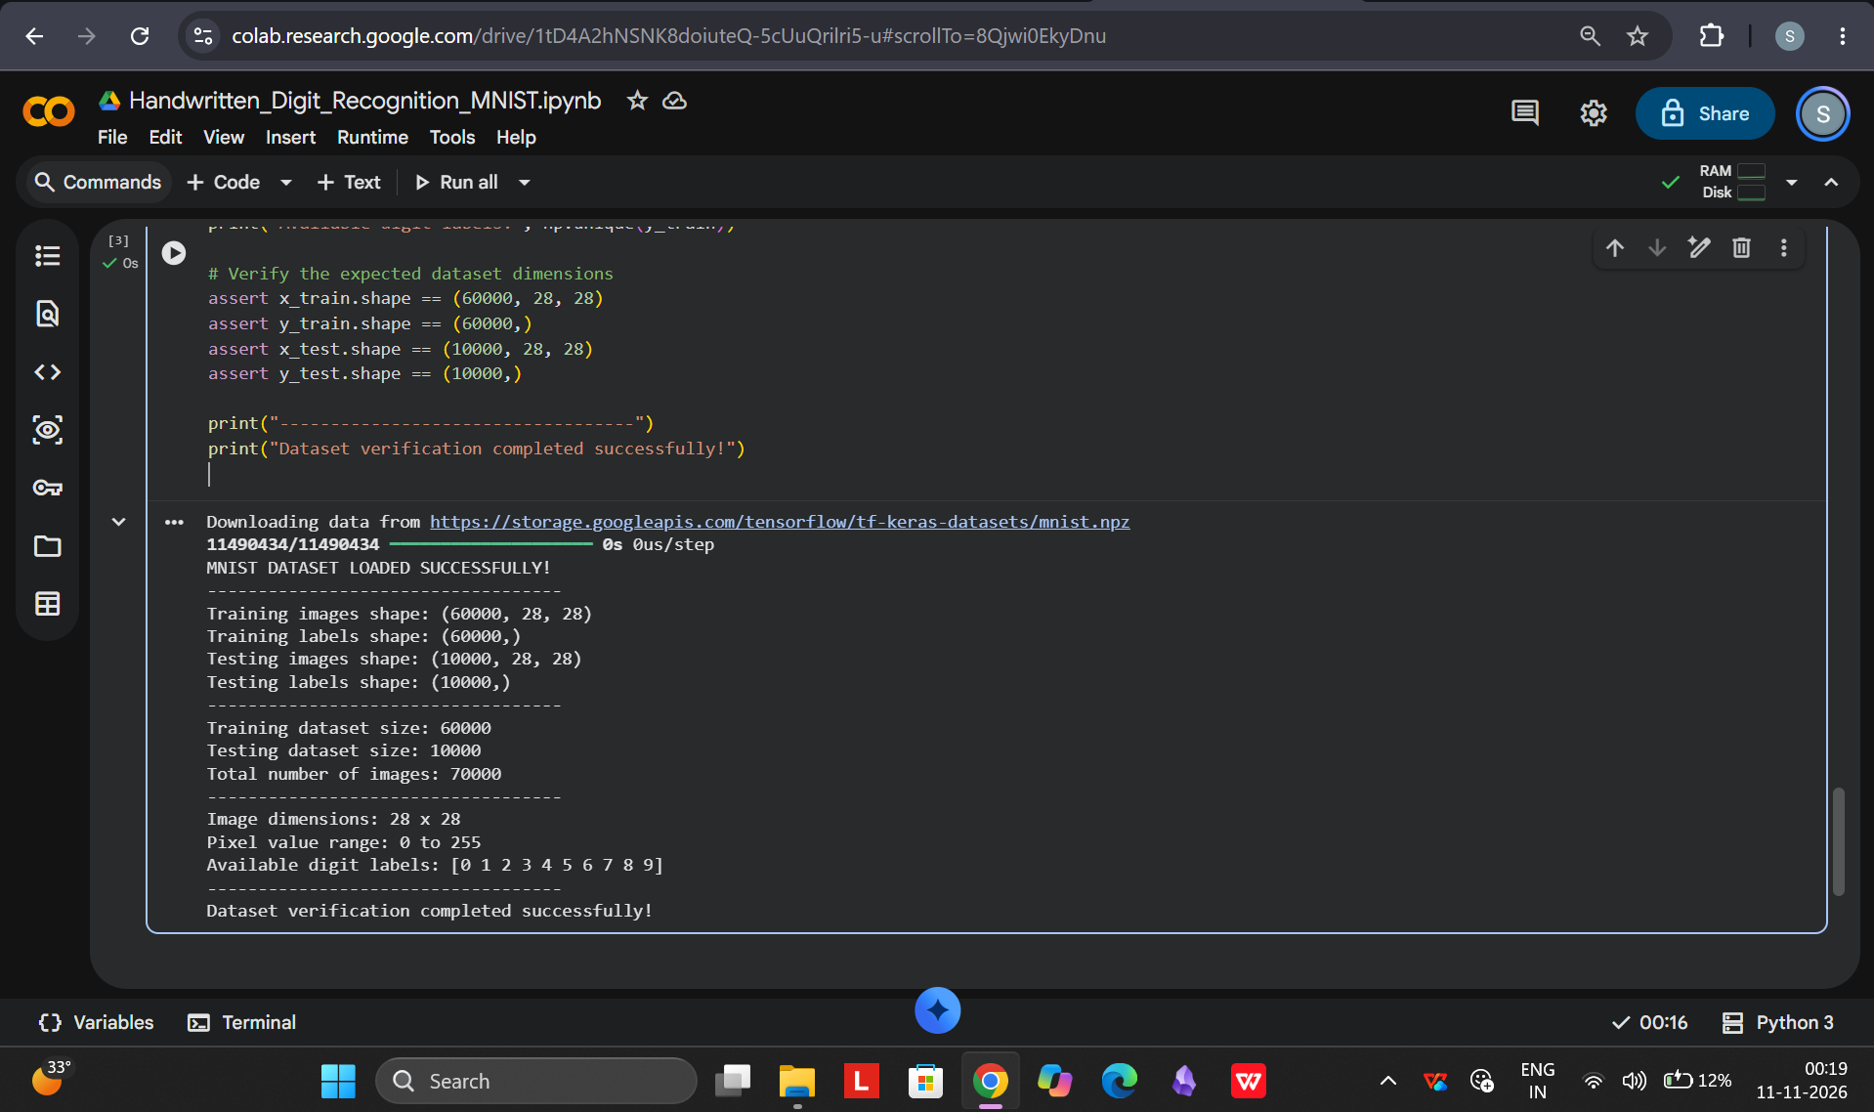
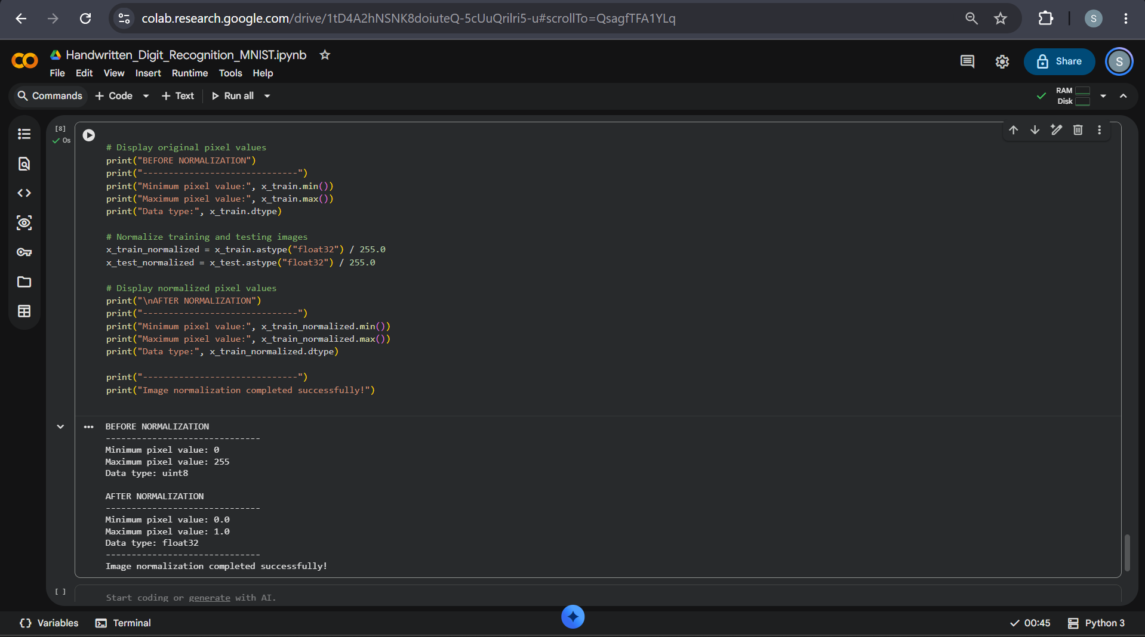
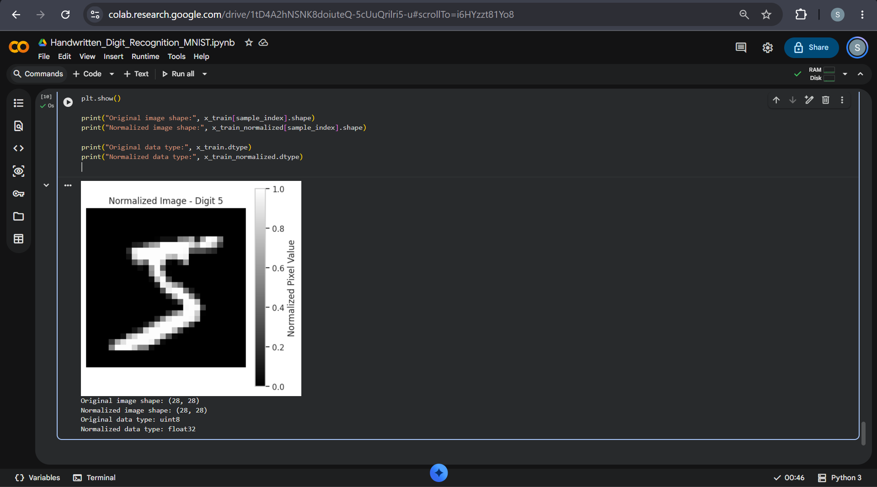
PHASES 1 AND 2
Data collection & preprocessing
• Loaded the MNIST handwritten digits dataset.
• Explored sample images and digit labels.
• Normalized pixel values from the original 0–255 range to 0–1.
• Reshaped image dimensions for the convolutional neural-network input.
Dataset loading and verification
Pixel normalization to the 0–1 range
CNN input format: 28 × 28 × 1
Example normalized 28 × 28 handwritten digit image
HANDWRITTEN DIGIT RECOGNITION • MNIST
06

Slide 7
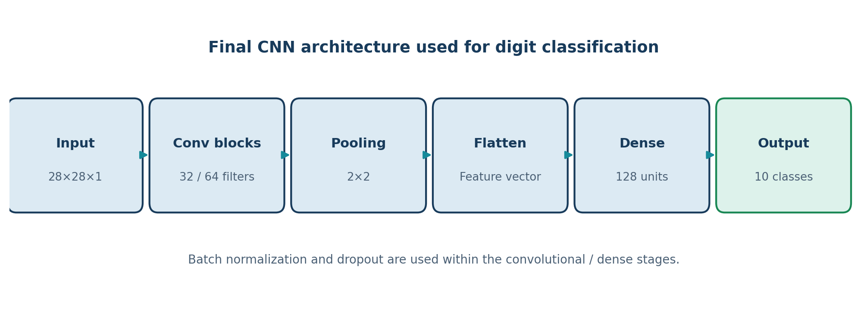
PHASE 3
Neural-network model development
The implemented model uses a Convolutional Neural Network (CNN) for image classification.
Overview of the final CNN architecture used in the project
INPUT
FEATURE LEARNING
CLASSIFIER
OUTPUT
28 × 28 × 1
Convolution + pooling
Dense layer
10 digit classes
The network is configured to classify the ten digit labels, 0 through 9.
HANDWRITTEN DIGIT RECOGNITION • MNIST
07

Slide 8
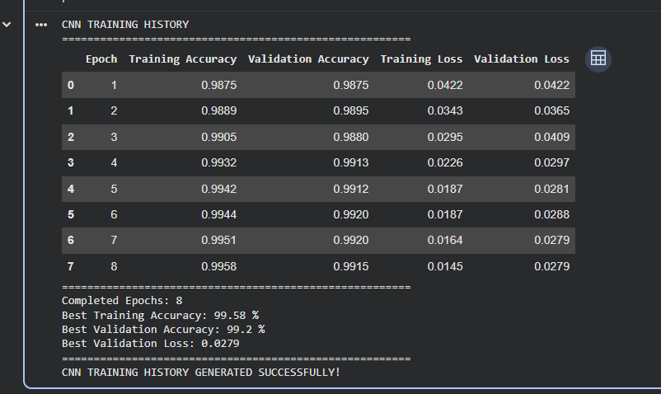
PHASE 4
Model training & learning progress
99.58%
99.20%
Best training accuracy
Best validation accuracy
TRAINING OBSERVATIONS
• Accuracy increased during training.
• Validation accuracy remained close to training accuracy.
• The best recorded validation accuracy was 99.20%.
CNN training history recorded across eight epochs
HANDWRITTEN DIGIT RECOGNITION • MNIST
08

Slide 9
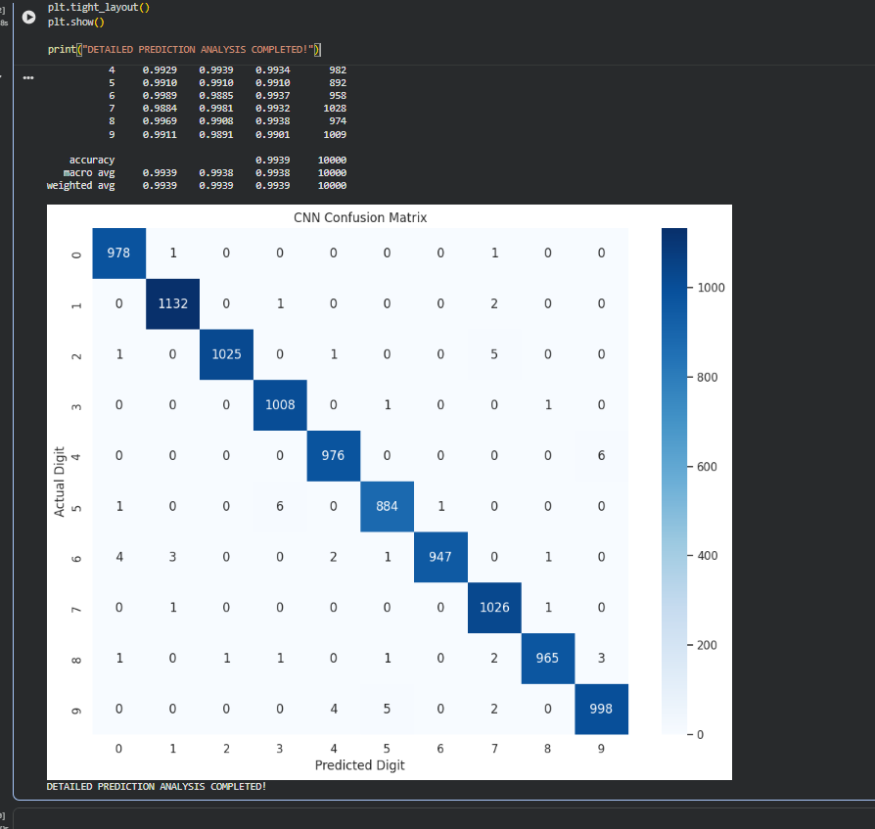
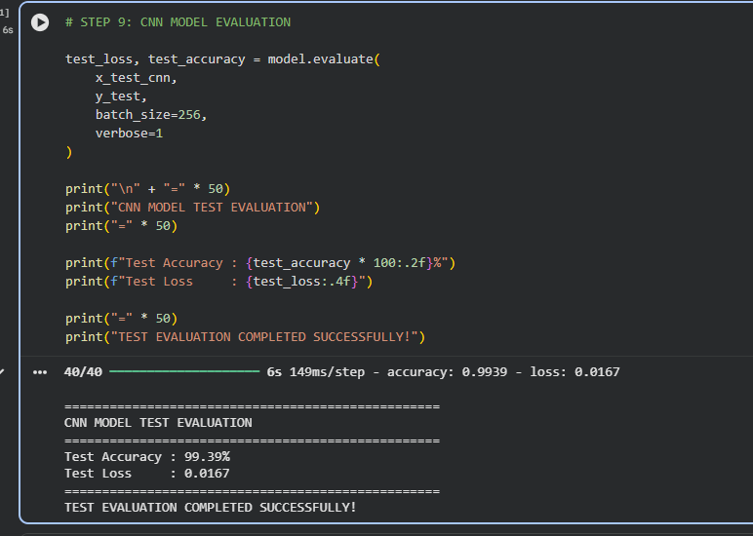
PHASE 5
Testing & evaluation
99.39%
0.0167
10,000
99.39%
Test accuracy
Test loss
Unseen test images
Weighted F1-score
The confusion matrix summarizes correct and incorrect classifications for each digit class.
Test-set evaluation output: 99.39% accuracy and 0.0167 loss
Metrics shown are from the documented CNN evaluation run.
CNN confusion matrix and classification summary
HANDWRITTEN DIGIT RECOGNITION • MNIST
09

Slide 10
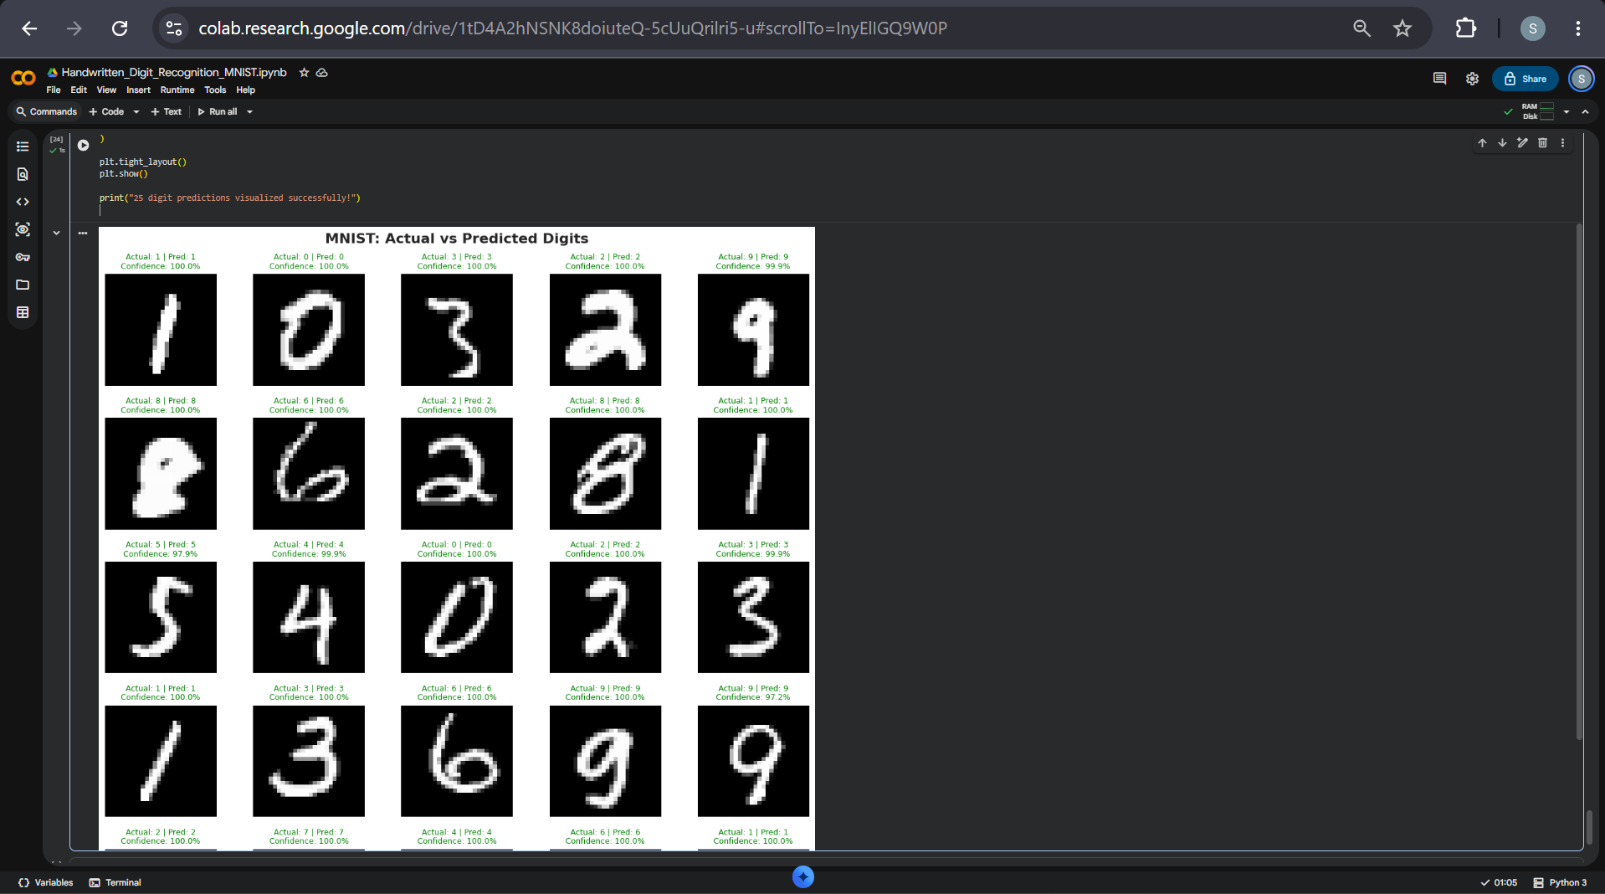
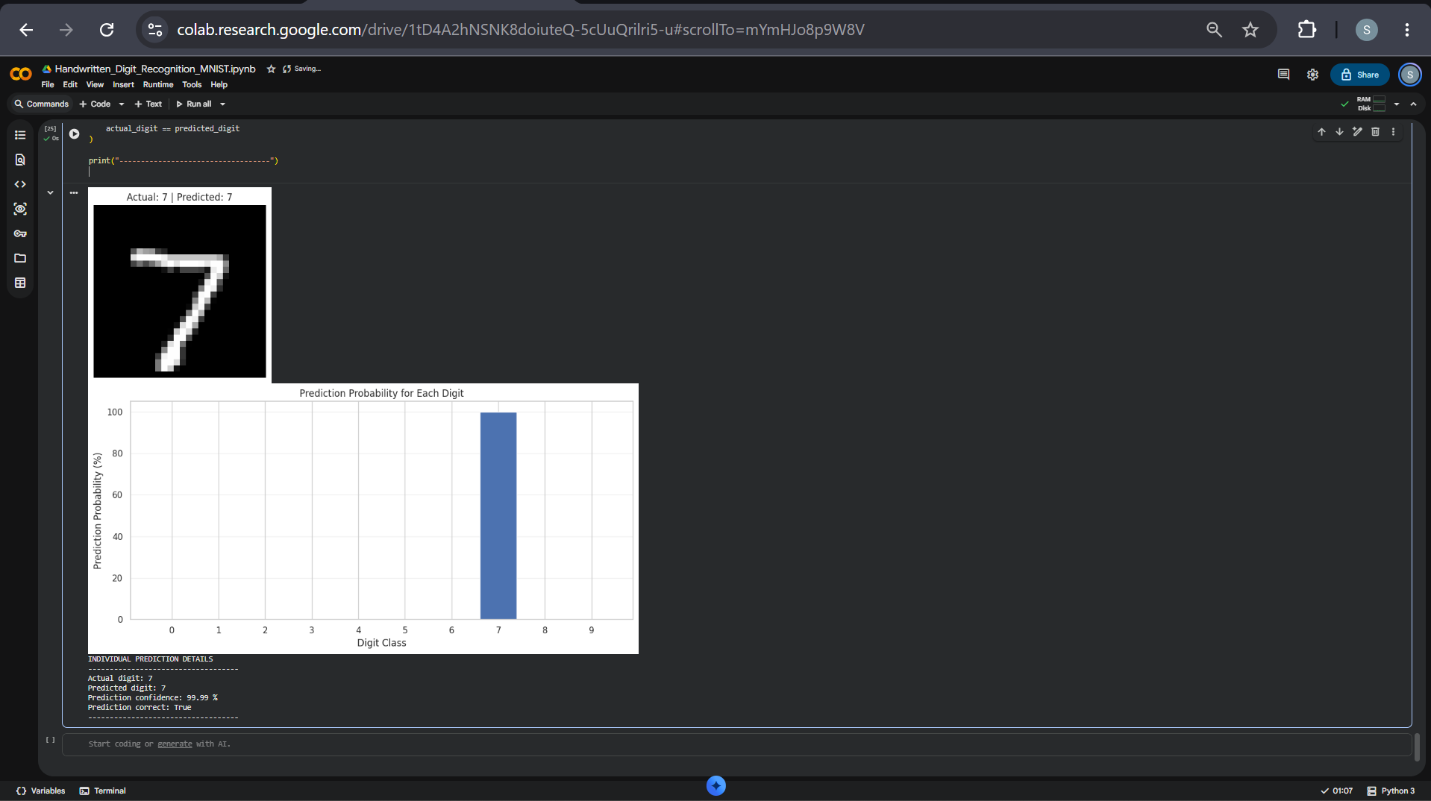
PHASE 6
Prediction outputs
The system predicts a digit label and provides a confidence score for the selected image.
Prediction probability for the ten digit classes
Individual example
Actual: 7 • Predicted: 7
Confidence: 99.99%
Examples comparing actual and predicted digit labels
HANDWRITTEN DIGIT RECOGNITION • MNIST
10

Slide 11
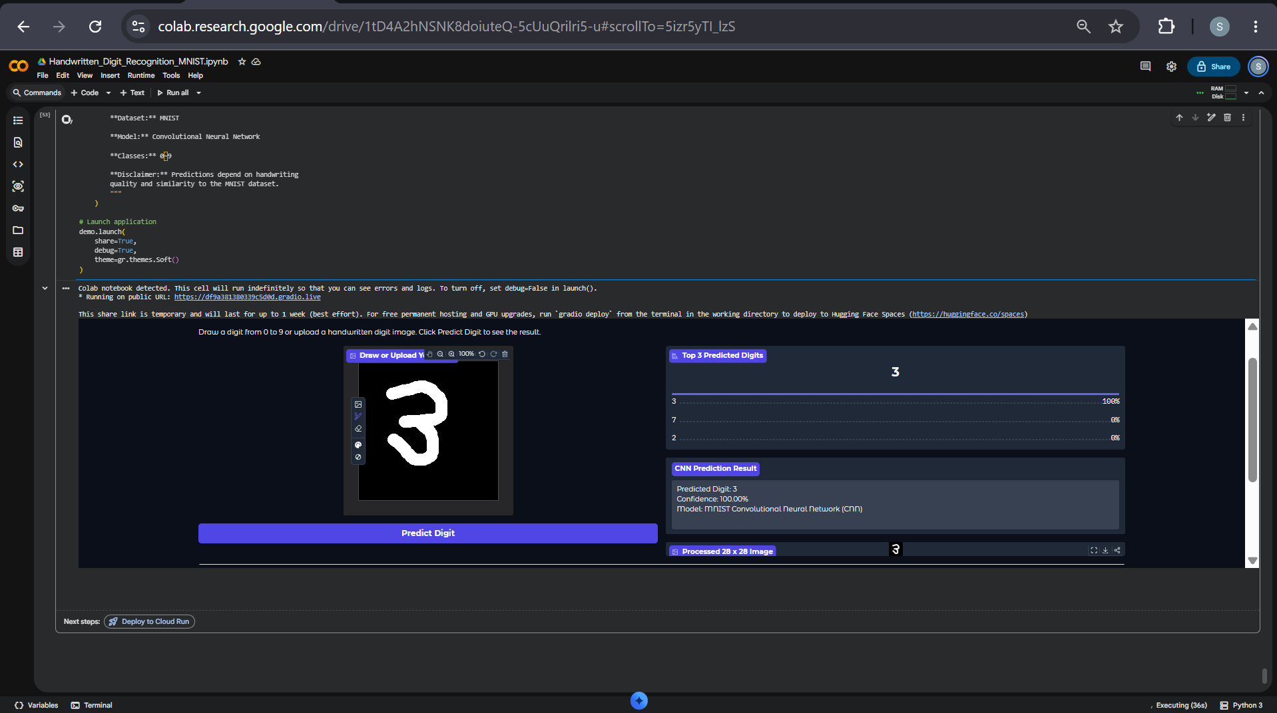
PHASE 6 • EXPECTED OUTCOMES
Interactive prediction system & applications
EXPECTED OUTCOMES
• Digit recognition accuracy above 95%.
• Practical understanding of image classification.
• Experience working with deep-learning frameworks.
APPLICATIONS
•
Bank cheque processing
•
Postal code recognition
Gradio interface for drawing or uploading a handwritten digit
•
OCR systems
•
Educational tools
•
Automated form processing
The project demonstrates the complete workflow from MNIST data collection through preprocessing, neural-network training, evaluation and digit prediction.
HANDWRITTEN DIGIT RECOGNITION • MNIST
11

