Slide 1

AIRLINES DELAYS
GROUP MEMBERS
Shiva Siddharth Yedla,
Sasi Kumar Karumuri ,
Sathvik Reddy Kommidi
Introduction
Objective
Approach
Recommendation
1
Results

Slide 2

Business Objective
Airline delays impact traveller schedules, airline costs, and customer satisfaction.
This project aims to analyse delay patterns, optimize operations, and enhance on-time performance using data-driven insights.
By addressing root causes, it supports efficiency, sustainability, and inclusivity in air travel.
Introduction
Objective
Approach
Recommendation
2
Results

Slide 3

Exploratory Analysis
Selecting final variables
Models
Results
Recommendations
Introduction
Objective
Approach
Recommendation
4
Results

Slide 4

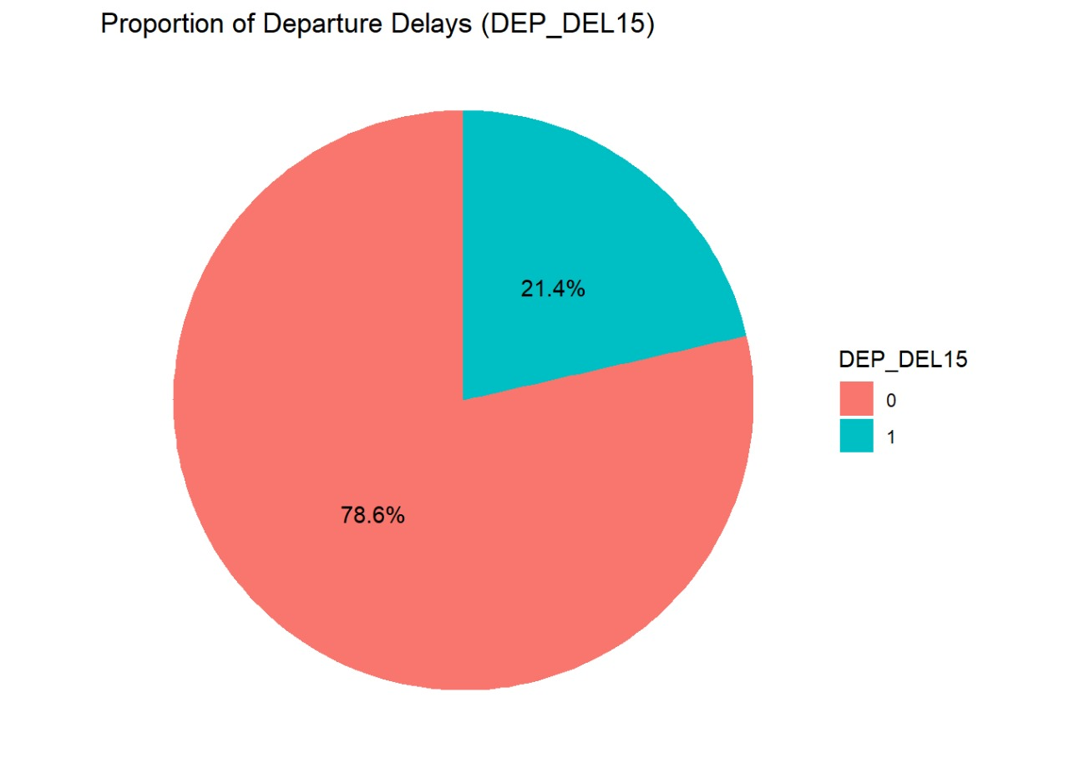
DESCRIPTIVE ANALYTICS
Original Data
3156348 observations
Data Dimension Techniques
Random forest
Final Data
2814786 observations
10 variables
26 variables
Logistic Regression
Decision tree.
0- Delivery of Product On Time
1- Delay in Delivery of Product
Introduction
Objective
Approach
Recommendation
5
Results

Slide 5
Variables
Numerical variables
Categorical variables
Concurrent flights
DEP_DEL15
DEP_TIME_BLK
Number of seats
DAY_OF_WEEK
Plane age
CARRIER_NAME
PRCP: Preciptation
Introduction
Objective
Approach
Recommendation
6
Results

Slide 6


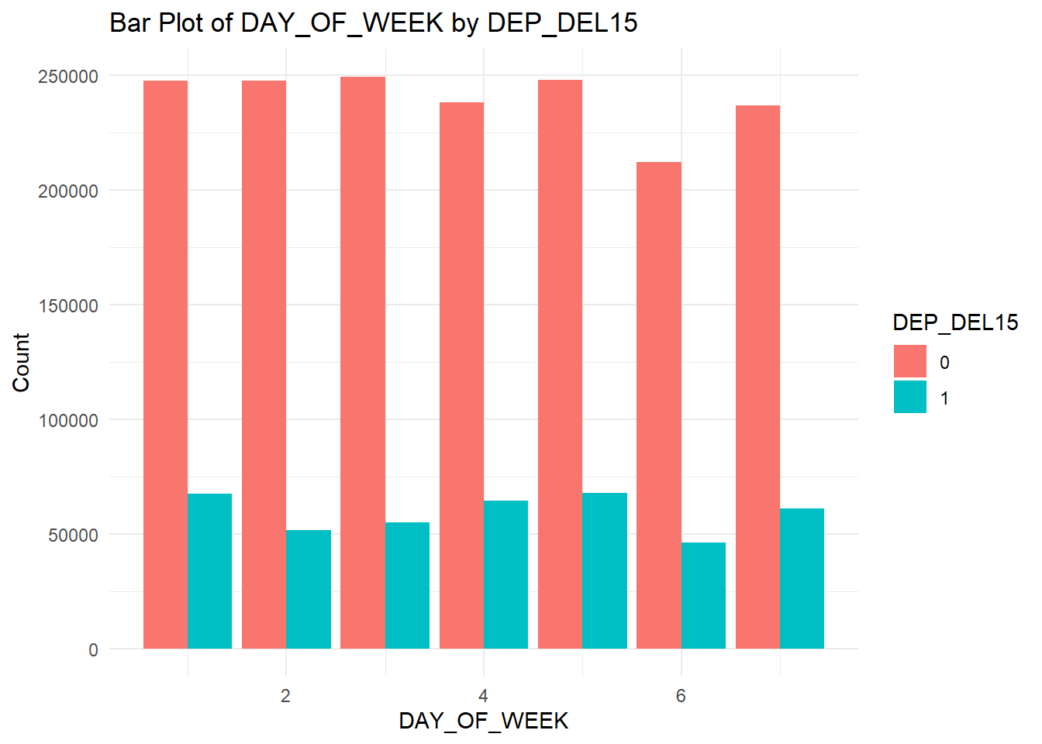
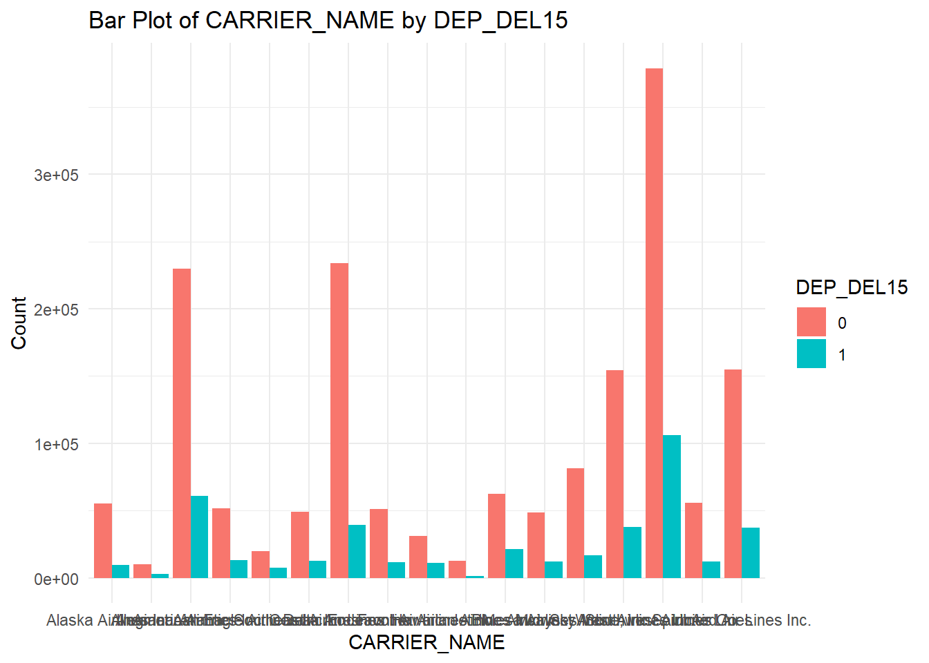


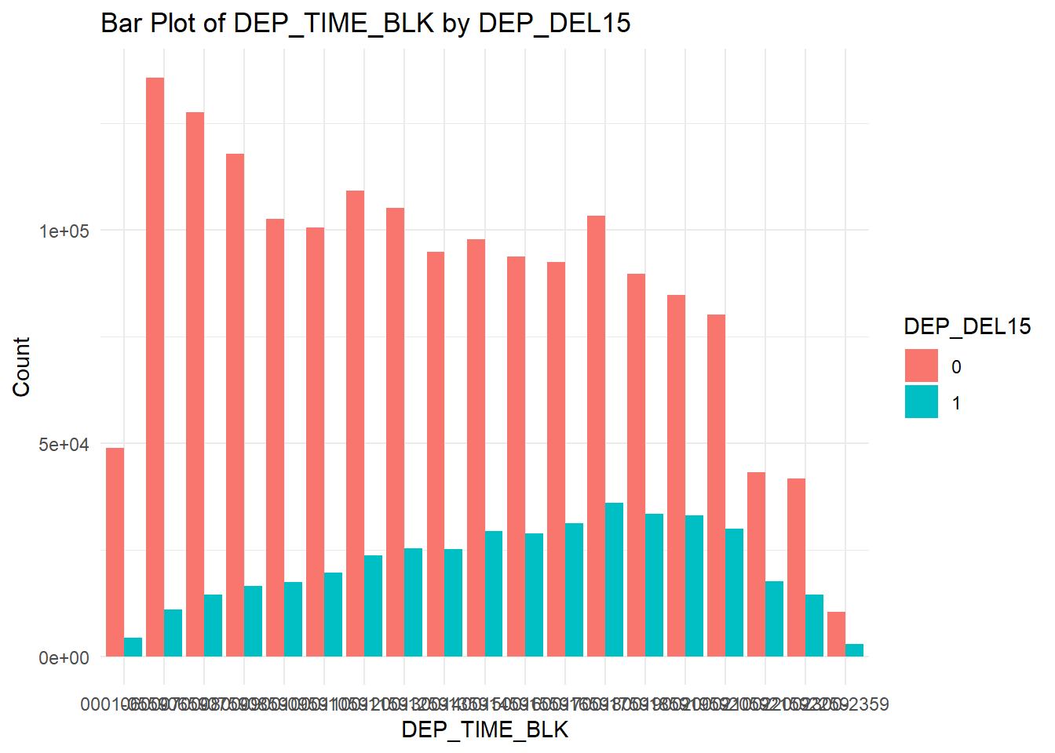
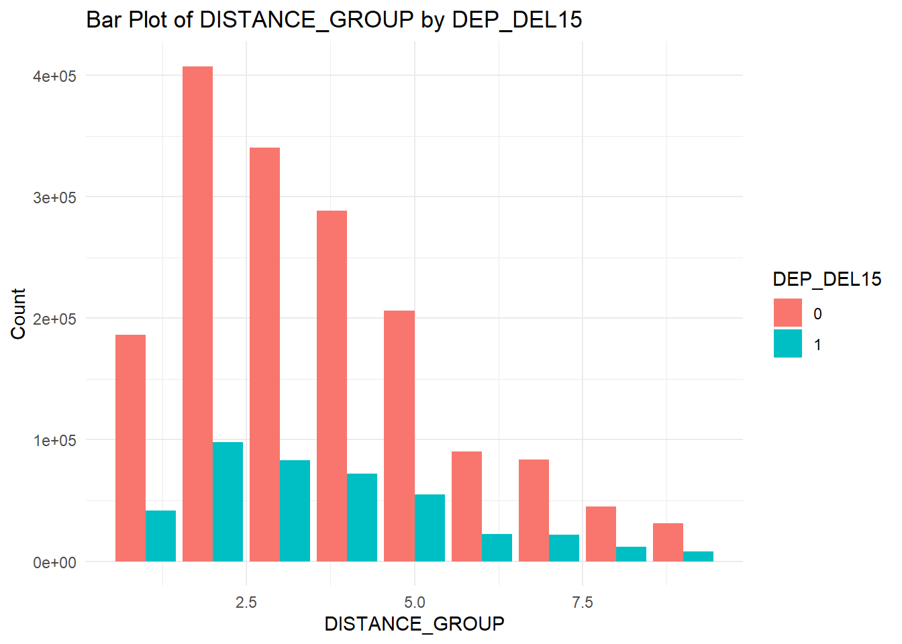

Introduction
Objective
Approach
Recommendation
7
Results

Slide 7
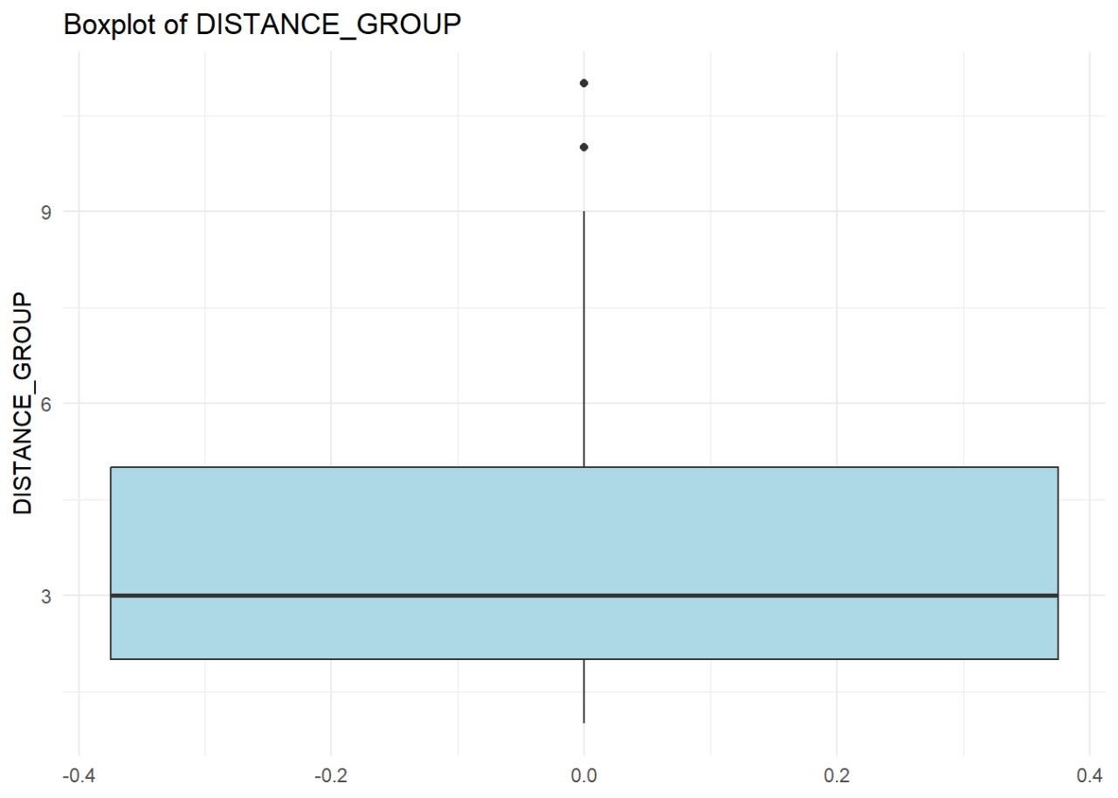
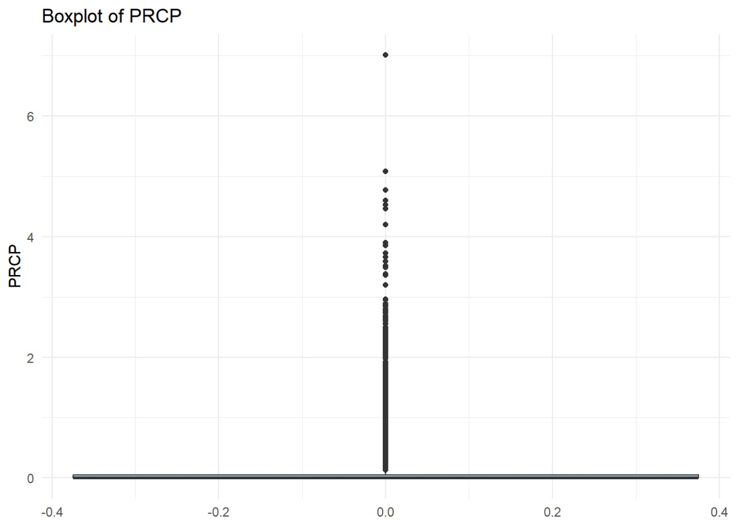
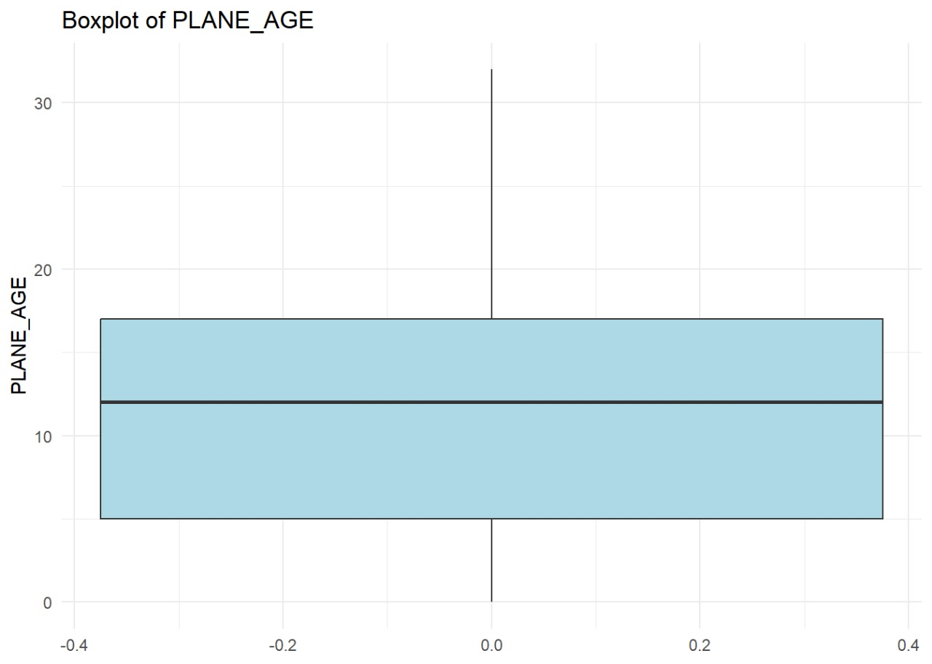
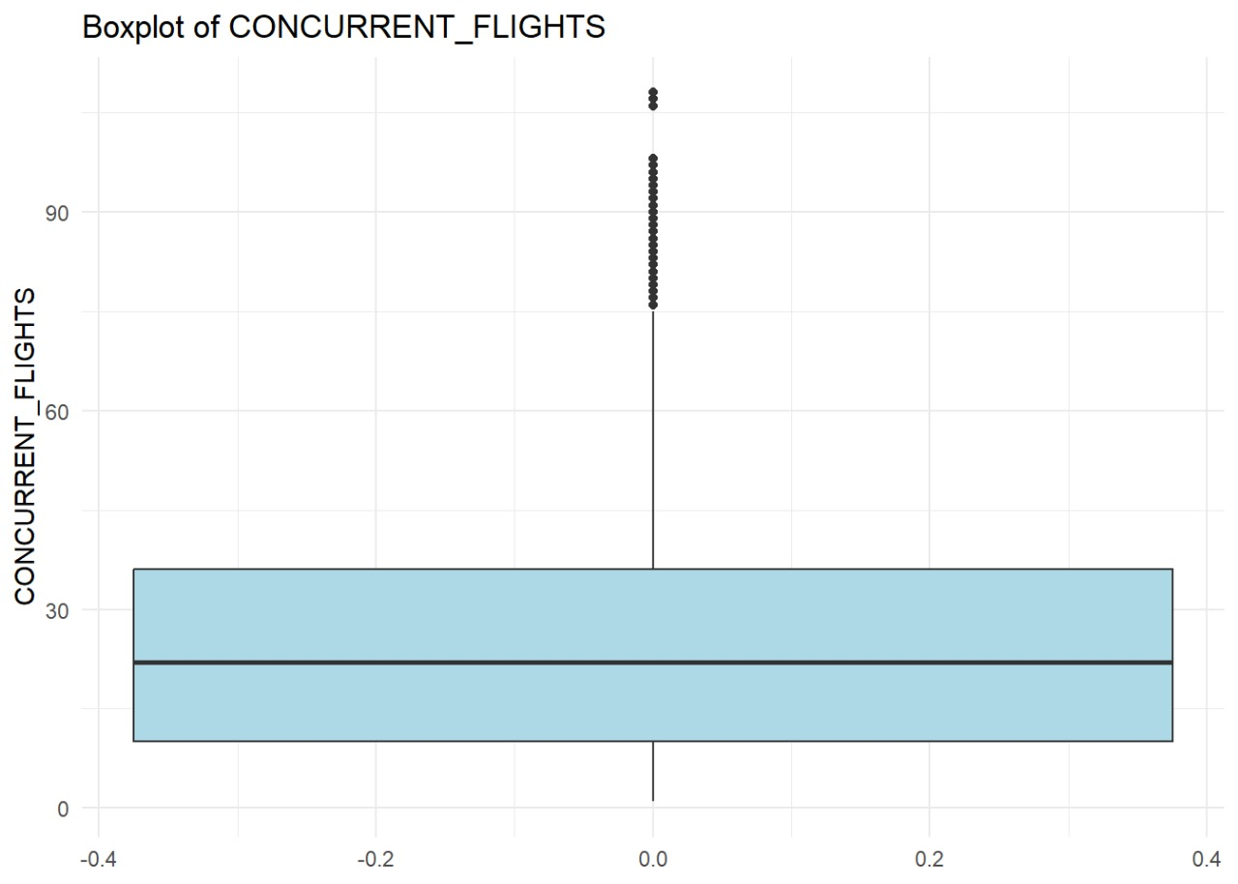

Slide 8
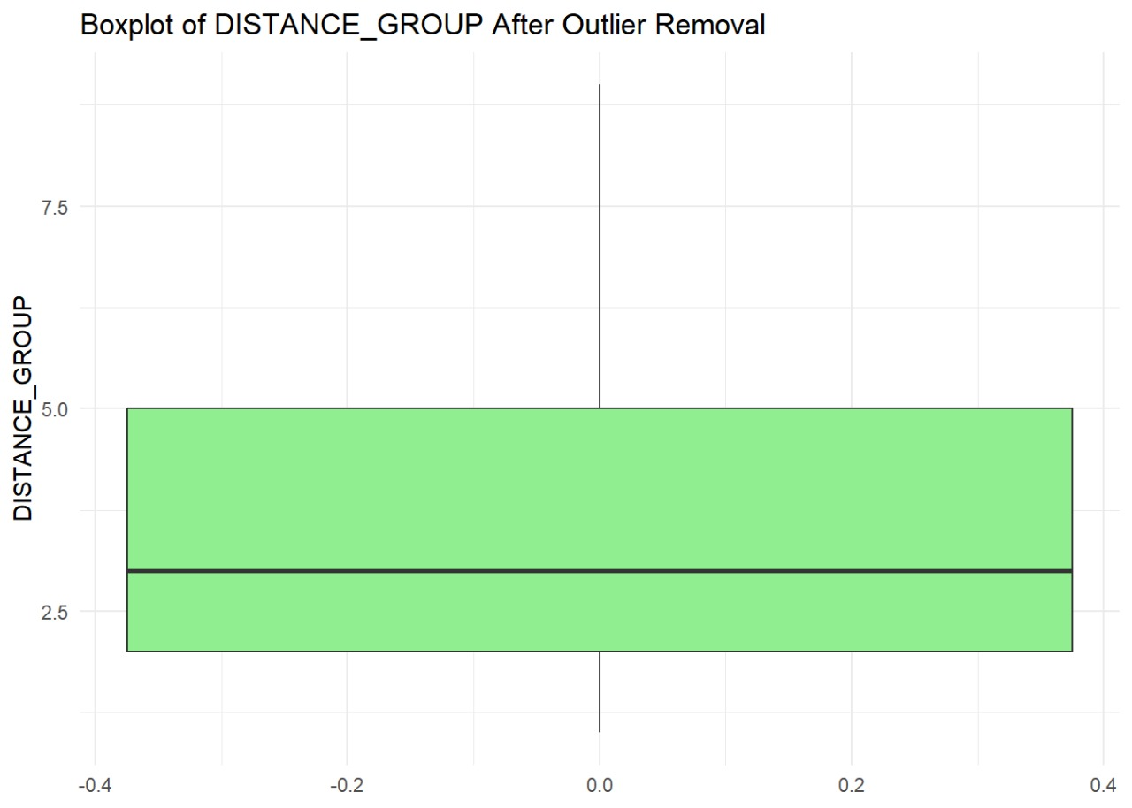
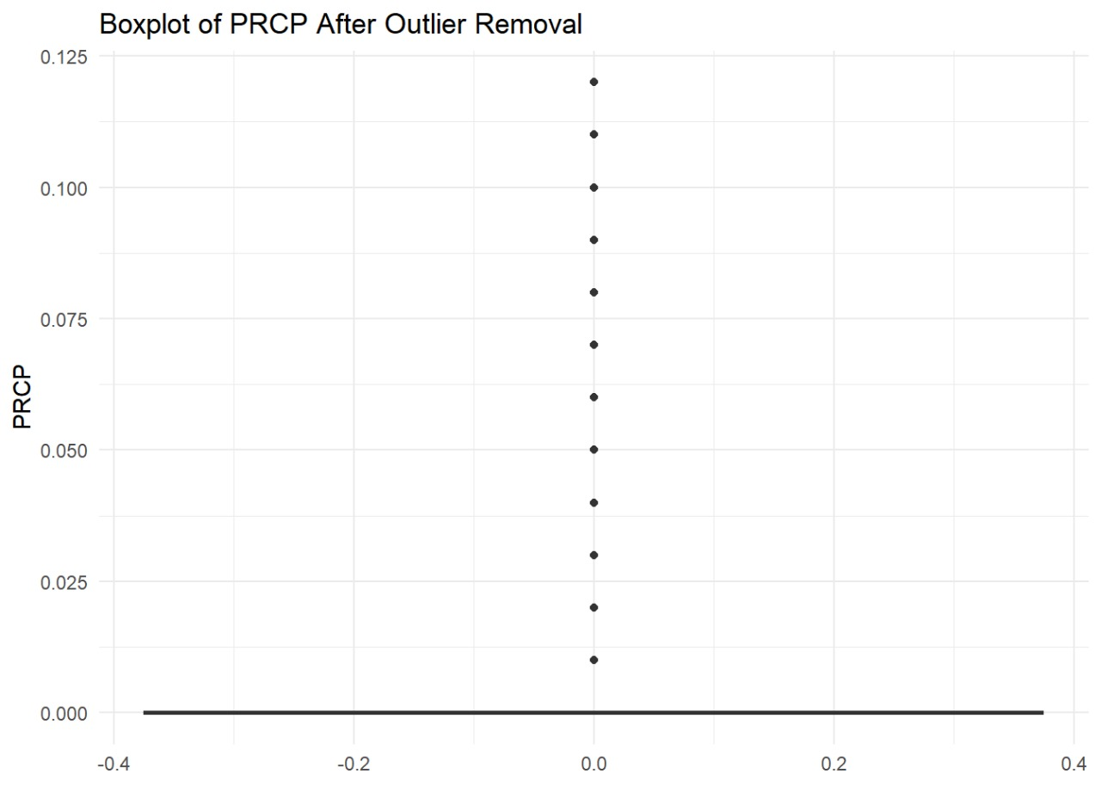
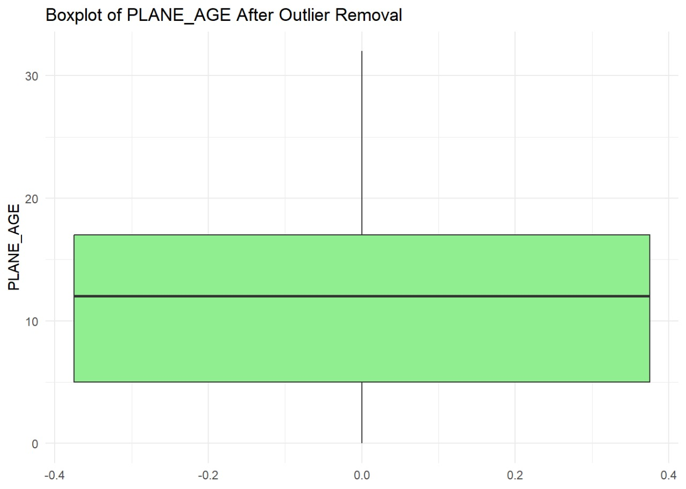
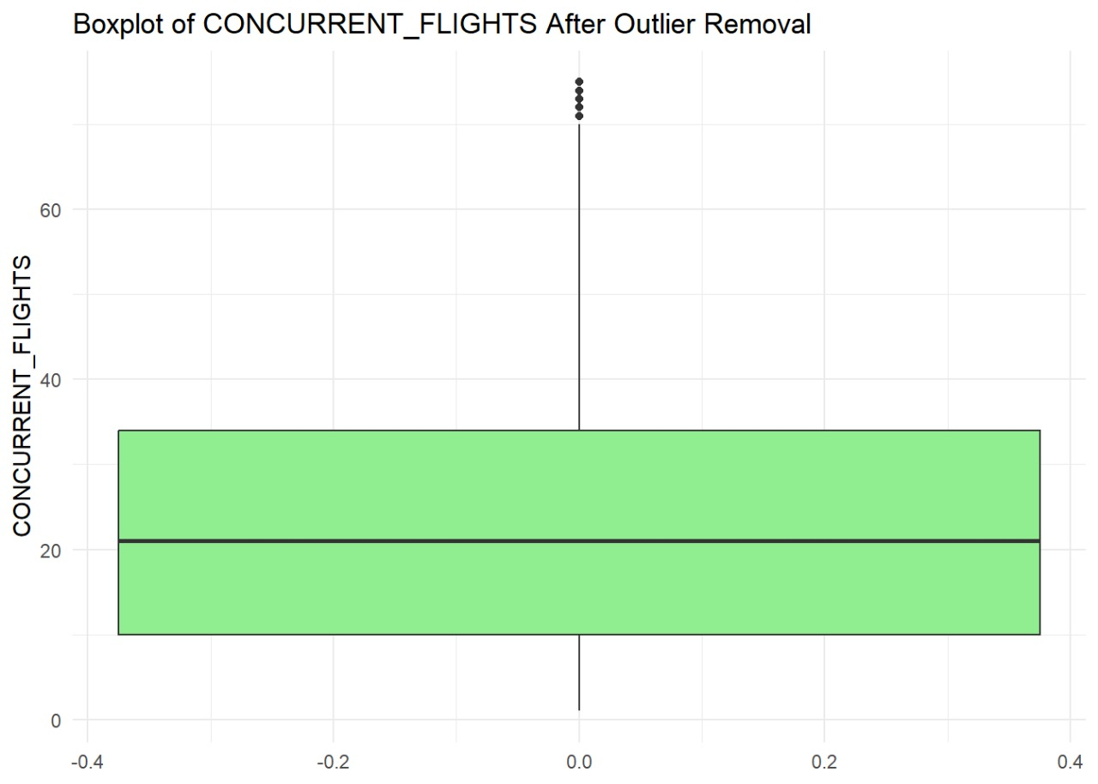

Slide 9
Reducing Dimensions: Models used to get Accuracy
LOGICAL REGRESSIONS
DECISION TREE
RANDOM FOREST

Slide 10
LOGISTIC REGRESSION
Confusion Matrix and Statistics
Reference
Prediction 0 1
0 128133 114401
1 28521 42208
Accuracy : 0.5438
95% CI : (0.542, 0.5455)
No Information Rate : 0.5001
P-Value [Acc > NIR] : < 2.2e-16
Kappa : 0.0875
Mcnemar's Test P-Value : < 2.2e-16
Sensitivity : 0.2695
Specificity : 0.8179
Pos Pred Value : 0.5968
Neg Pred Value : 0.5283
Prevalence : 0.4999
Detection Rate : 0.1347
Detection Prevalence : 0.2258
Balanced Accuracy : 0.5437
'Positive' Class : 1

Slide 11
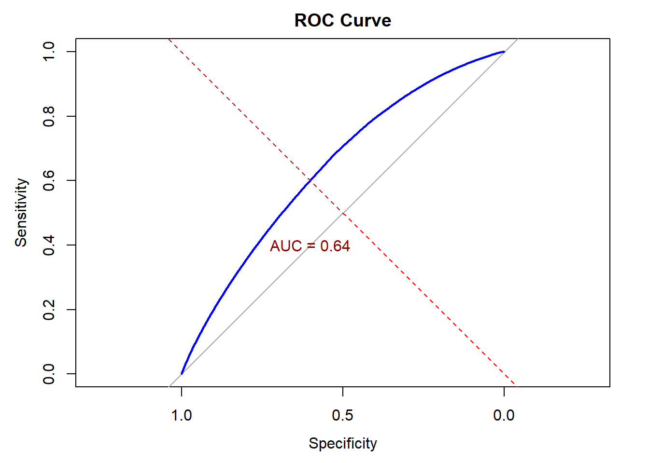
The ROC curve shows the performance of a classification model, with an AUC of 0.64 indicating moderate discriminatory power.

Slide 12
DECISION TREE
Prediction 0 1
0 114336 97671
1 42318 58938
Accuracy : 0.5531
95% CI : (0.5514, 0.5549)
No Information Rate : 0.5001
P-Value [Acc > NIR] : < 2.2e-16
Kappa : 0.1062
Mcnemar's Test P-Value : < 2.2e-16
Sensitivity : 0.3763
Specificity : 0.7299
Pos Pred Value : 0.5821
Neg Pred Value : 0.5393
Prevalence : 0.4999
Detection Rate : 0.1881
Detection Prevalence : 0.3232
Balanced Accuracy : 0.5531
'Positive' Class : 1

Slide 13
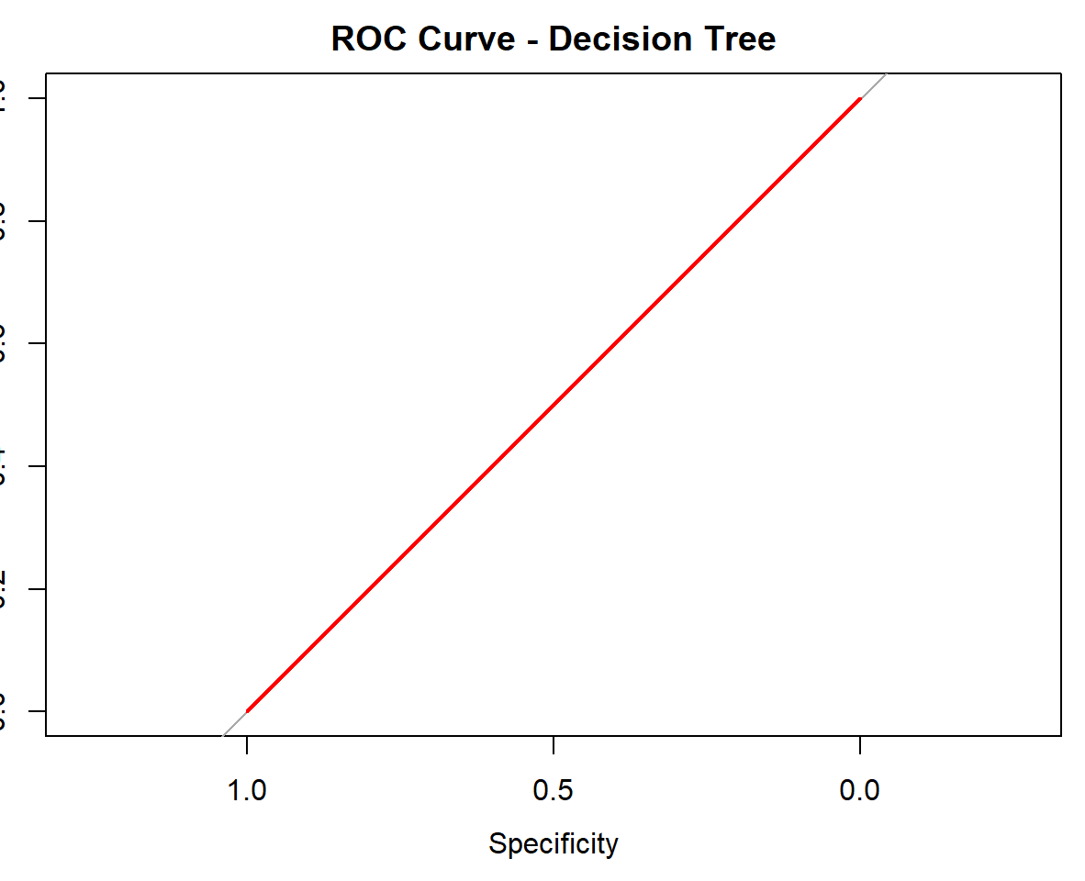
The ROC curve for the decision tree model follows the diagonal, indicating no predictive power (AUC = 0.5), equivalent to random guessing

Slide 14
Random Forest
Reference
Prediction 0 1
0 115058 87713
1 41596 68896
Accuracy : 0.5872
95% CI : (0.5855, 0.5889)
No Information Rate : 0.5001
P-Value [Acc > NIR] : < 2.2e-16
Kappa : 0.1744
Mcnemar's Test P-Value : < 2.2e-16
Sensitivity : 0.4399
Specificity : 0.7345
Pos Pred Value : 0.6235
Neg Pred Value : 0.5674
Prevalence : 0.4999
Detection Rate : 0.2199
Detection Prevalence : 0.3527
Balanced Accuracy : 0.5872
'Positive' Class : 1

Slide 15
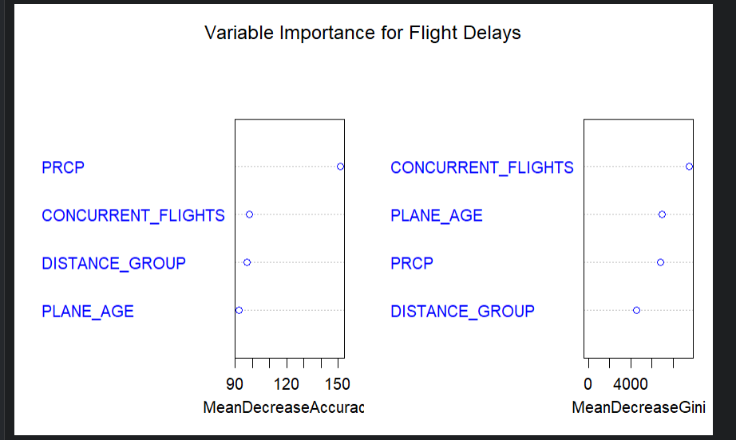

Slide 16
MODEL EVALUATION AND PERFORMANCE
Model | Accuracy | Precision | Recall | F1 score | AUC
LOGISTIC REGRESSION | 0.54 | 0.5968 | 0.2695 | 37.10% | 0.642
DECISION TREE | 0.55 | 0.5821 | 0.3763 | 45.62%. | 0.5
RANDON FOREST | 0.58 | 0.6235 | 0.4399 | 51,52% | 0.551

Slide 17
Strategies to Minimize Delays and Improve Operations
Optimize Operations: Adjust flight schedules, reduce airport congestion during peak times, and implement preventive maintenance for older aircraft.
Leverage Technology: Use advanced weather forecasting, predictive models, and real-time delay notifications to minimize disruptions.
Enhance Customer Experience: Provide proactive communication, rebooking options, and compensatory services to improve passenger satisfaction during delays.

Slide 18
Recommendations
Random Forest shows the highest accuracy (82.23%) and precision (84.75%) but has a slightly lower AUC (0.551) compared to Logistic Regression.
Logistic Regression has a higher AUC (0.642) but slightly lower accuracy and precision.
Decision Tree performs poorly overall, with an AUC of 0.5, indicating no predictive power.
Random Forest is the recommended model because it offers the highest accuracy and precision, which are critical for
correctly identifying delayed flights. However, its slightly lower AUC suggests room for improvement in balancing sensitivity and specificity.

Slide 19
References
Ensure the dataset source is cited properly. Common datasets include:
The Bureau of Transportation Statistics (BTS) Airline On-Time Performance Dataset.
Kaggle's Flight Delay datasets.
Government or regional aviation authority databases.
Provide links to the dataset source, license details, and version number.
Include relevant academic papers or official documentation if the dataset is used in research.
• Provide links to

