Slide 1
Predictive and Analytical Modeling for Health Risk Assessment Using Vital Signs
Guided by:
Professor Nik Volkov, Ph.D., CVA, MAFF
AJAY KATTA - 11055284 SHIVA SIDDHARTH YEDLA - 11062197
SHRAVANI VEMULA - 11053292

Slide 2
Table of contents
01
02
03
04
05
06
Introduction
Problem Statement
Data Collection
Exploratory Data Analysis (EDA)
Conclusion
Model Building & Evaluation

Slide 3
INTRODUCTION
BACKGROUND
Early detection of patient deterioration is critical in modern healthcare.
This project uses regression models to analyze vital signs: heart rate, respiratory rate, blood pressure, and oxygen saturation.
The goal is to help healthcare professionals identify at-risk patients earlier than traditional methods.

Slide 4
01
Business Question
How can hospitals use real-time patient vitals to automatically identify high-risk patients and prioritize care?"

Slide 5
Process Flow
Data Collection
Data Preparation
Exploratory Data Analysis (EDA)
Model Building
Model Evaluation
Deployment
Conclusion & Future Scope

Slide 6
Data Dictionary
Variable Name | Description
Patient_ID | Unique identifier for each patient.
Heart_Rate | Number of heartbeats per minute (bpm).
Respiratory_Rate | Number of breaths per minute.
Timestamp | Recorded time of vital measurement.
Body_Temperature | Body temperature measured in degrees Celsius.
Oxygen_Saturation | Percentage of oxygen-saturated hemoglobin relative to total hemoglobin.
Systolic_Blood_Pressure | Maximum arterial pressure during heart contraction (mmHg).
Diastolic_Blood_Pressure | Minimum arterial pressure between heartbeats (mmHg).
Age | Age of the patient in years.
Gender | Biological sex of the patient (Male/Female).
Weight_.kg. | Body weight of the patient in kilograms (kg).
Height_.m. | Height of the patient in meters (m).
Derived_HRV | Derived Heart Rate Variability measure.
Derived_Pulse_Pressure | Difference between systolic and diastolic blood pressure (mmHg).
Derived_BMI | Body Mass Index calculated as weight/(height²).
Derived_MAP | Mean Arterial Pressure, calculated average blood pressure.
Risk_Category | Predicted health risk category (e.g., Low, Medium, High, Extreme).

Slide 7
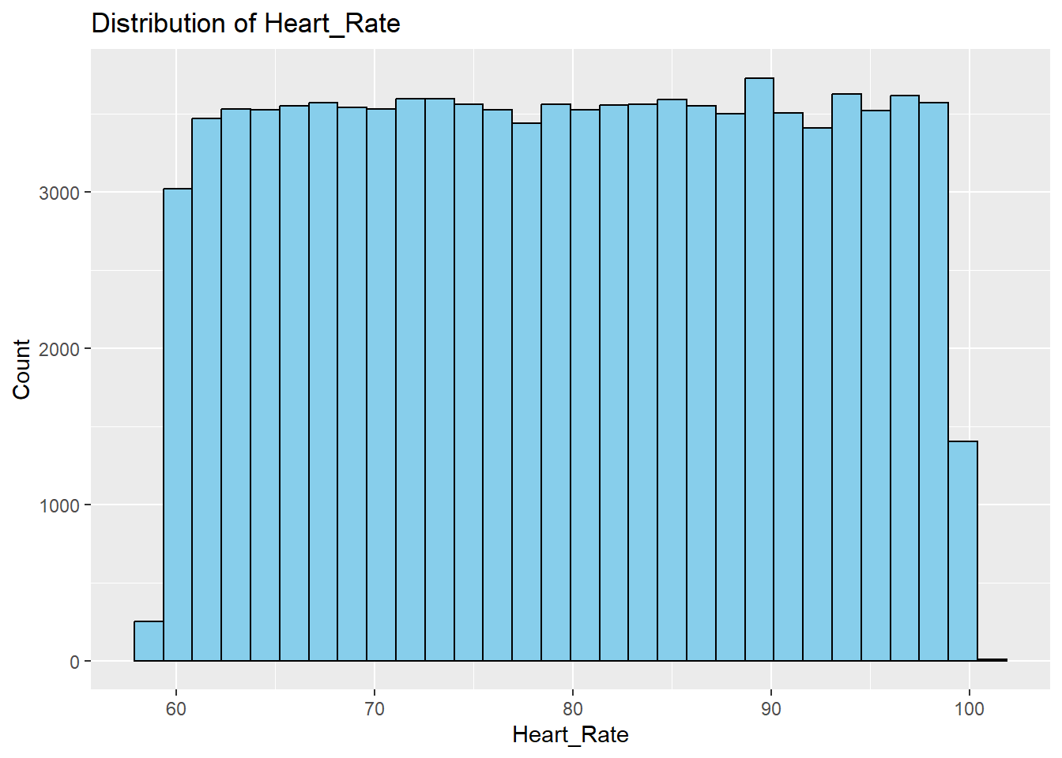
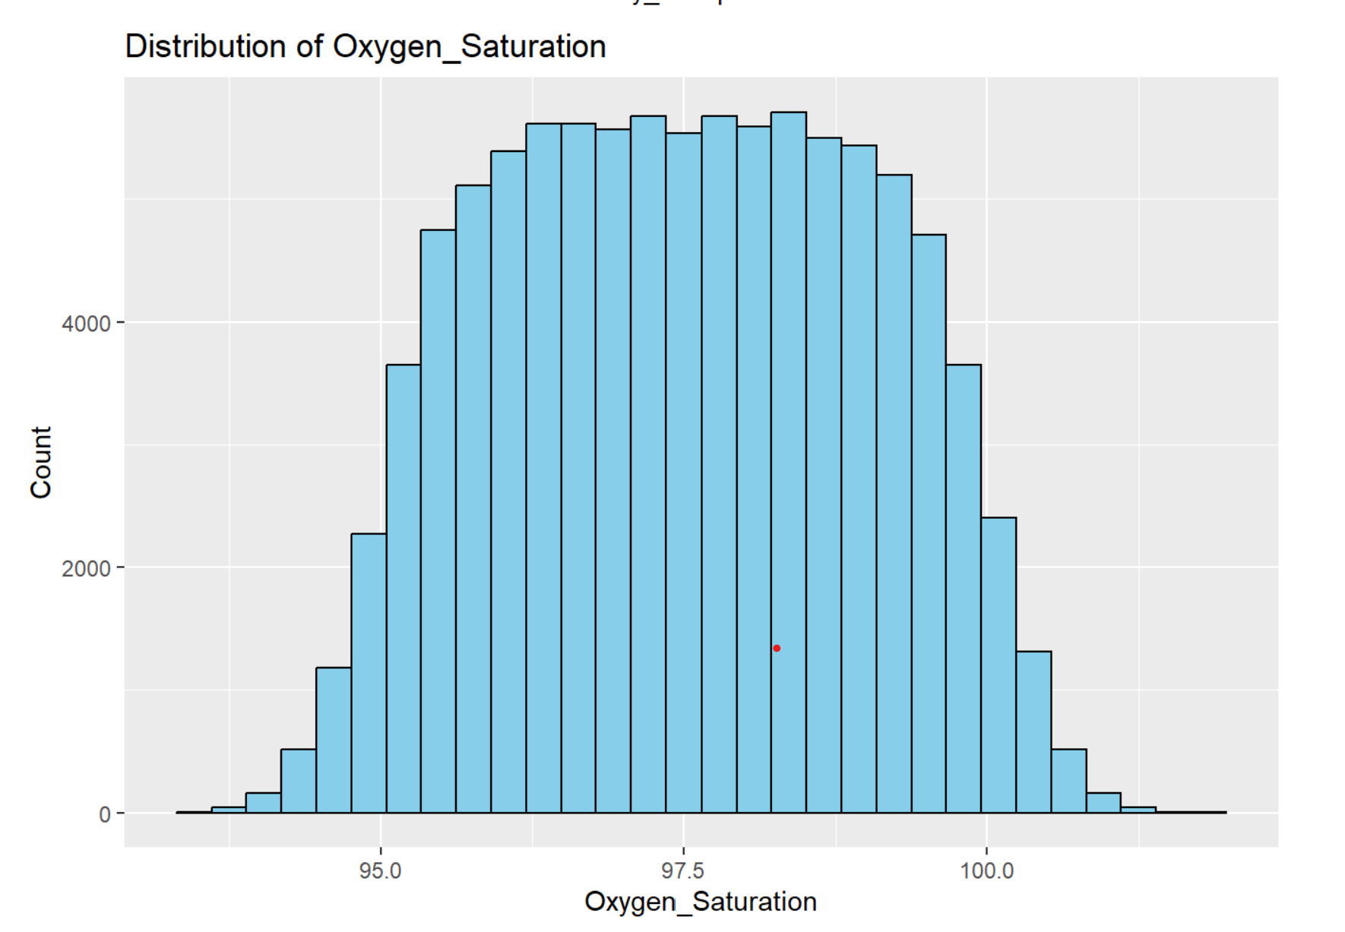
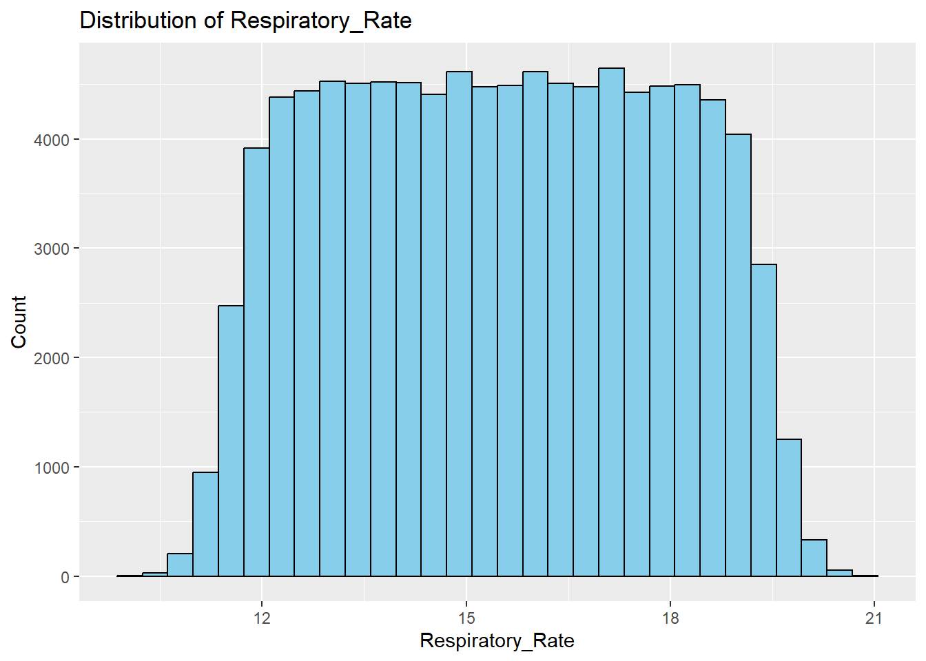
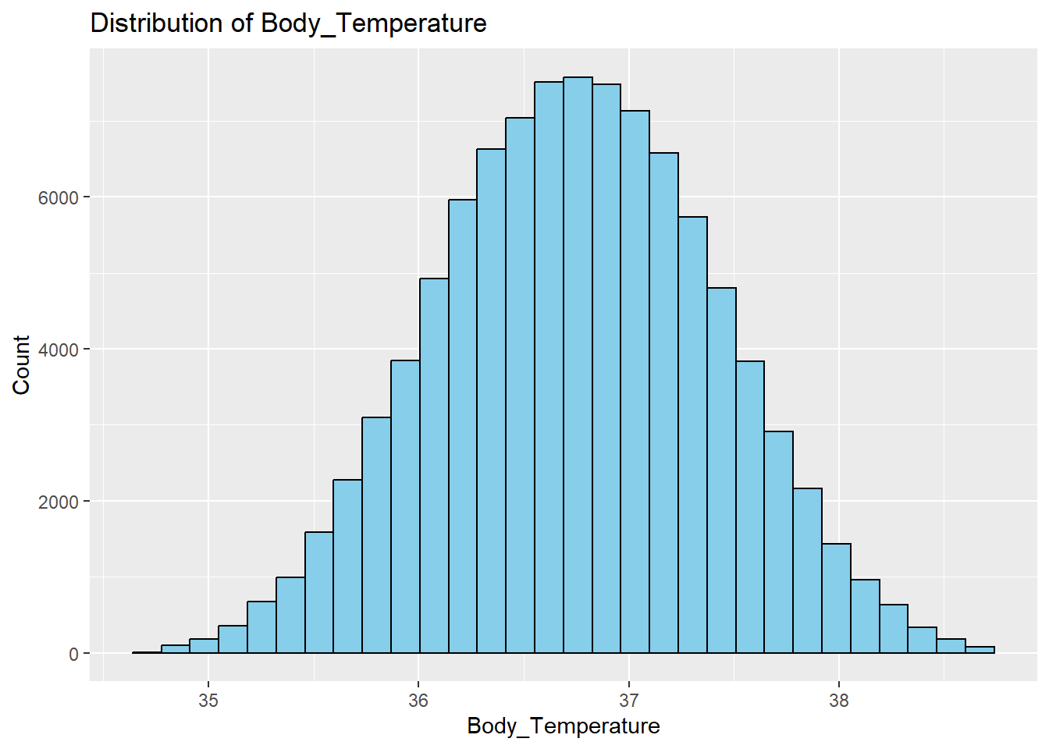
Exploratory Data Analysis (EDA)
Distribution of numerical variables

Slide 8
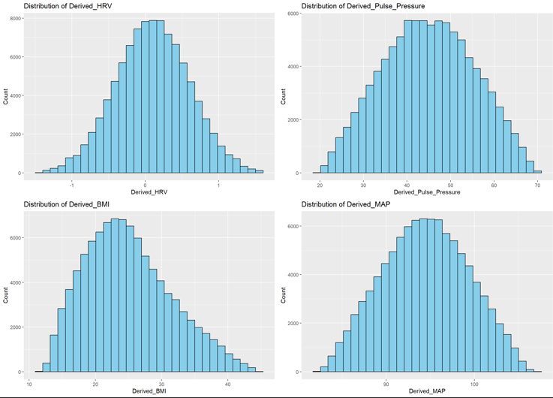
Exploratory Data Analysis (EDA)
Distribution of numerical variables

Slide 9
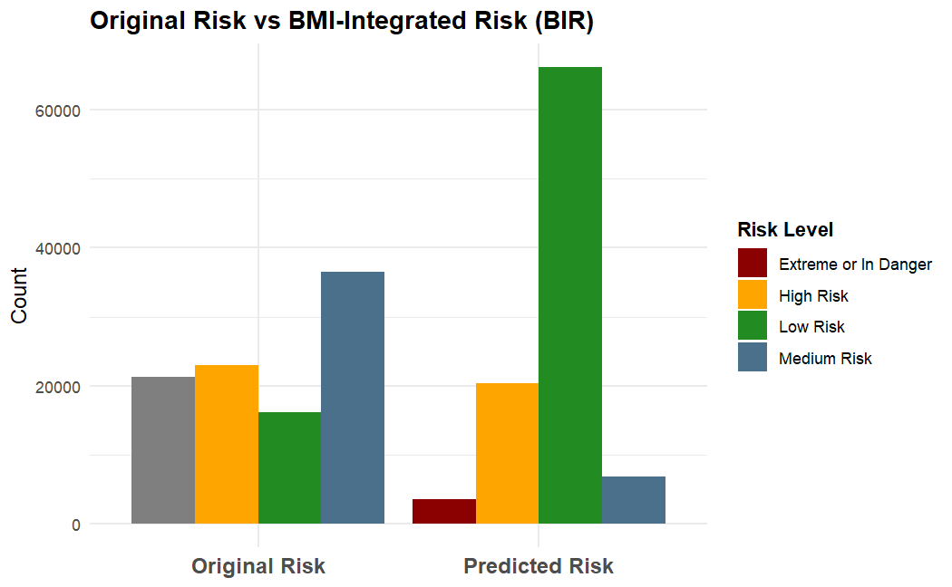
Comparison of Original and Predicted Risk Categories
Bar chart compares Original Risk categories with Predicted Risk after BMI integration.
"Original Risk" shows the initial patient distribution.
"Predicted Risk" reflects reclassification based on the BMI-Integrated Risk (BIR) model.
Noticeable shifts observed across risk levels (Extreme, High, Medium, Low) after applying BIR.

Slide 10
Comparison of Original and Predicted Risk Categories
Count of Original VS Predicted
Risk Category | ORIGINAL RISK | PREDICTED RISK
LOW RISK | 16189 | 66164
MEDIUM RISK | 36537 | 6874
HIGH RISK | 22958 | 20315
EXTREME RISK | 21316 | 3647
Table compares original risk categories with predicted risk categories after applying the new model.
Example: Originally 16,189 patients were "Low Risk"; model now predicts 66,164 patients as "Low Risk."
Notable shifts seen across "Medium," "High," and "Extreme" risk groups.
Highlights changes in patient risk assessment under the new method.

Slide 11
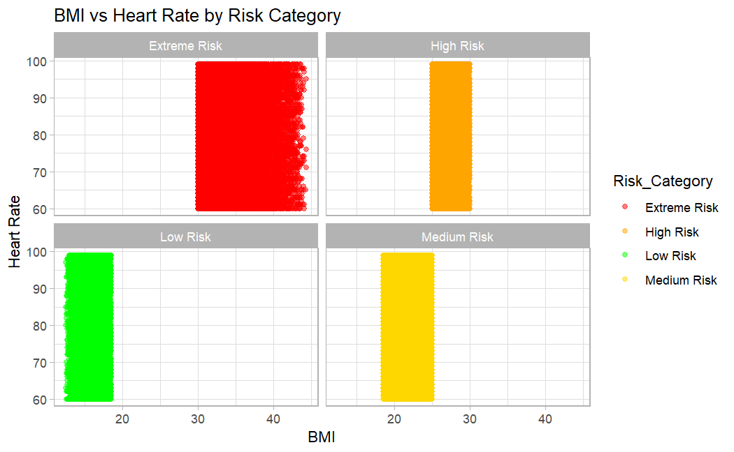
Constructing the Risk Index: BMI and Heart Rate Analysis
Extreme Risk (Red) contains individuals with the highest BMI values (over 30).
Low Risk (Green) has individuals with the lowest BMI values (under 18.5).
Medium and High Risk fall between those extremes.
The distribution of Heart Rate looks fairly dense but doesn't vary drastically by category in this plot.

Slide 12
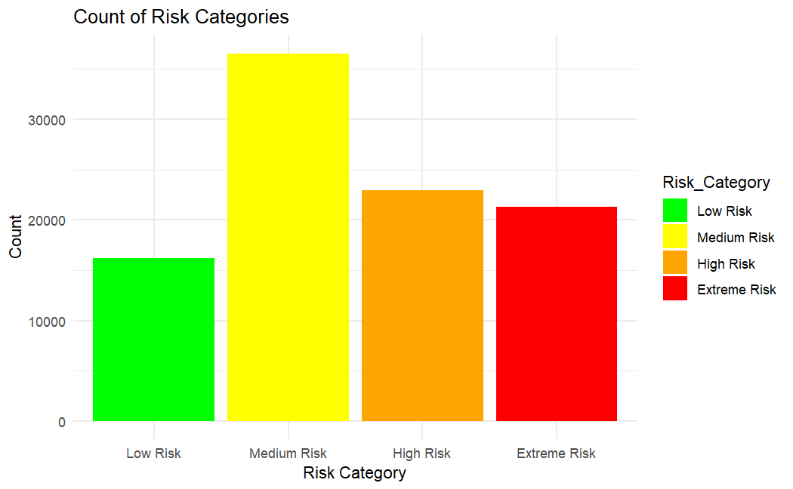
Distribution of Risk Categories: BMI & Heart Rate
Key observations from the graph:
The Medium Risk category has the highest count, with the bar extending well above 30,000.
The High-Risk category has the second-highest count, with a bar around the 23,000 mark.
The Extreme Risk category has a slightly lower count than High Risk, also around the 21,000-22,000 range.
The Low-Risk category has the lowest count, with a bar reaching approximately 16,000.

Slide 13
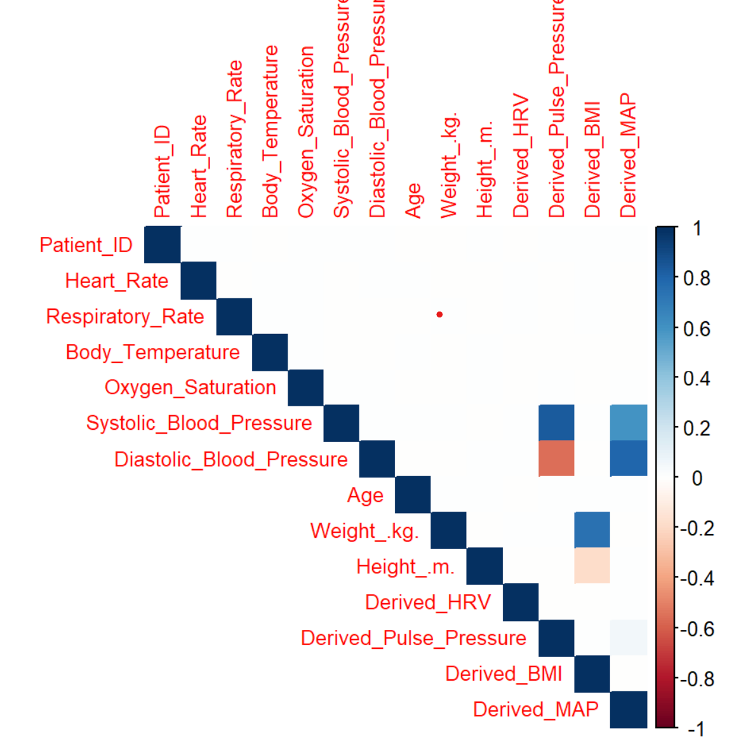
Correlation Matrix
Systolic and Diastolic Blood Pressure show a strong positive correlation (0.83).
Weight and Height are positively correlated (0.75); taller people tend to weigh more.
Pulse Pressure and Systolic Blood Pressure show a moderate positive correlation (0.60).
Derived MAP is strongly correlated with both Systolic (0.79) and Diastolic Blood Pressure (0.95).
Other variables show weak or near-zero correlations (e.g., Patient ID, Heart Rate, Body Temperature).

Slide 14
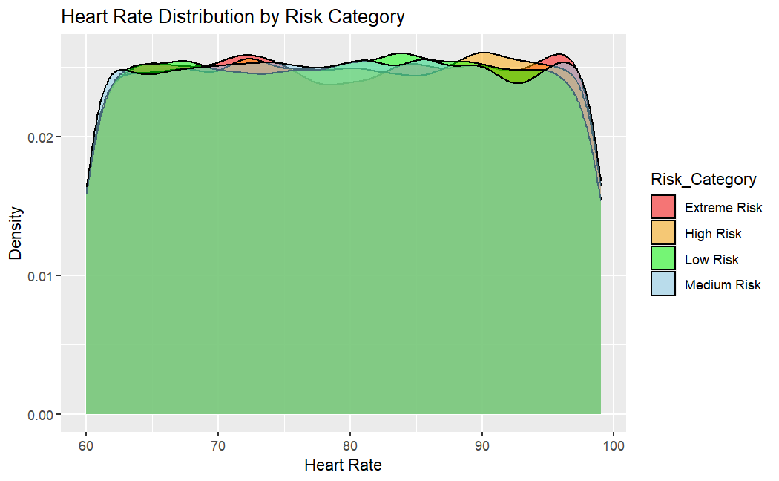
Exploring Heart Rate Distribution by Risk Level
Low Risk (Green): Shows the broadest heart rate distribution with a peak around 85-90 bpm and extends across a wider range.
Medium Risk (Blue): Exhibits a heart rate distribution similar to Low Risk, peaking around 75-80 bpm with a comparable spread.
High Risk (Orange): Displays a heart rate distribution shifted slightly higher than Low and Medium Risk, with increased presence in the 85-90 bpm range.
Extreme Risk (Red): Presents the highest heart rate distribution, with the density notably higher in the 95-100 bpm range.

Slide 15
Model Development
Developed a unique 4-category risk classification system using vital signs, BMI, and height data.
Tested a range of classification models, performing detailed hyperparameter tuning to optimize results.
Used cross-validation techniques to ensure the models were reliable and robust.
Assessed model performance based on accuracy, precision, and recall to determine the best overall approach.

Slide 16
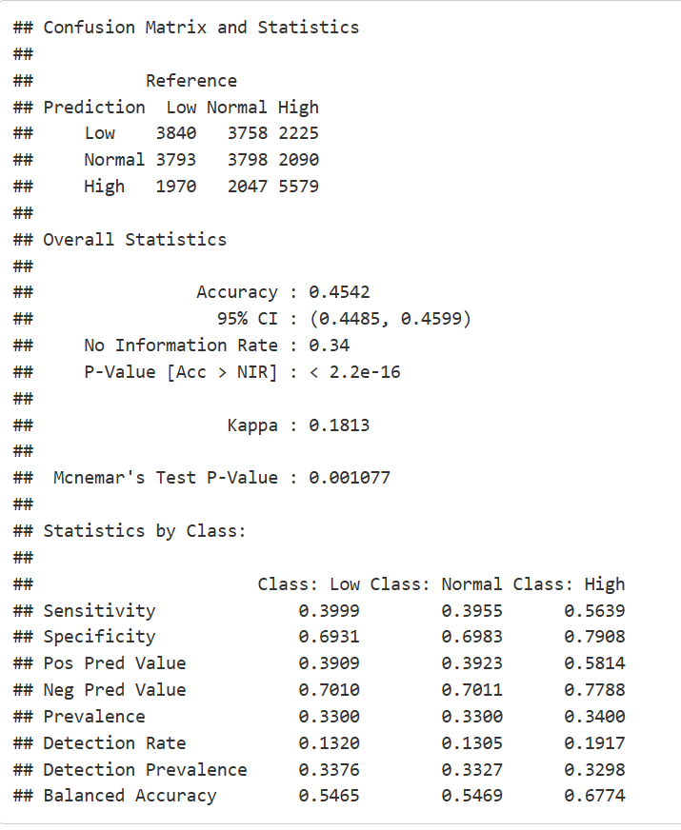
Random Forest
The model correctly predicted: • 3840 "Low" cases • 3798 "Normal" cases • 5579 "High" cases
Overall accuracy achieved: 45.42% — correctly classified less than half the cases.
Sensitivity varied by category: • 39.99% for "Low" • 39.55% for "Normal" • 56.39% for "High"
The model struggled more in detecting "Low" and "Normal" risk patients.

Slide 17
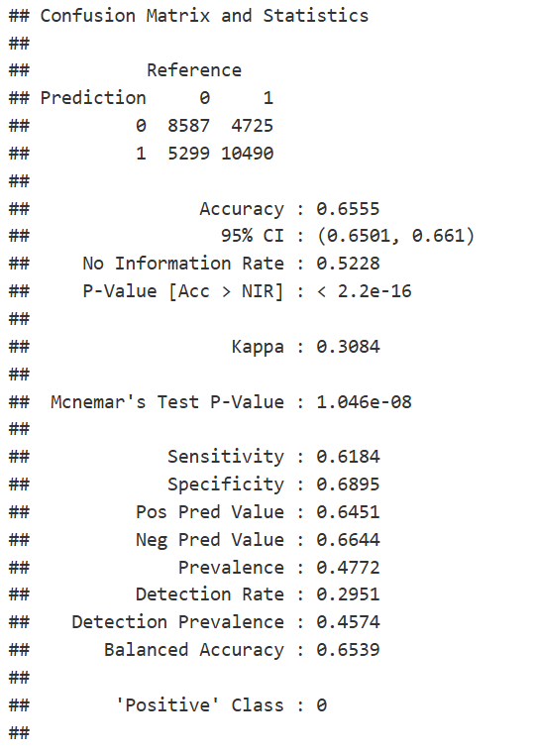
XG Boost
Correctly predicted: • 8587 instances as '0' • 10490 instances as '1'
Overall model accuracy: 65.55% (correct prediction for about two-thirds of the data).
Sensitivity for '0': 61.84% — correctly identified ~62% of '0' cases.
Specificity for '1': 68.95% — correctly identified ~69% of '1' cases.

Slide 18
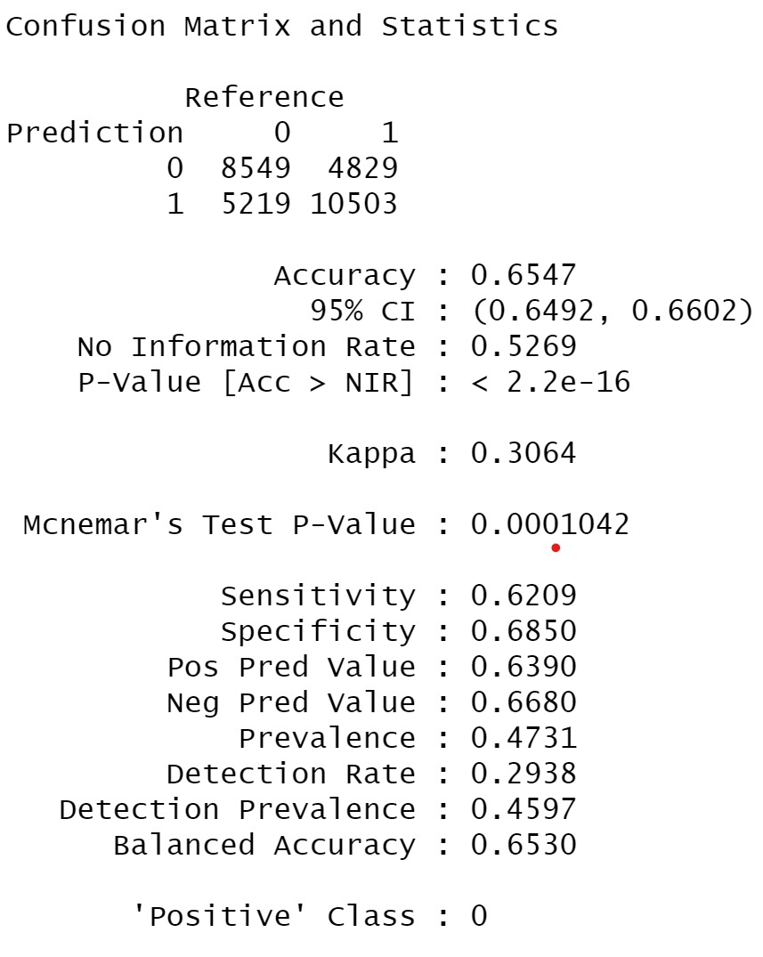
Logistic Regression
The logistic regression model was able to predict all three risk categories but showed moderate overall accuracy.
It performed better at identifying "High" risk patients compared to "Low" and "Normal" risk groups.
The model struggled to accurately detect lower-risk cases, indicating room for improvement in sensitivity for these categories.
Overall, logistic regression gave basic predictive power but lacked precision, suggesting a need for stronger models.

Slide 19
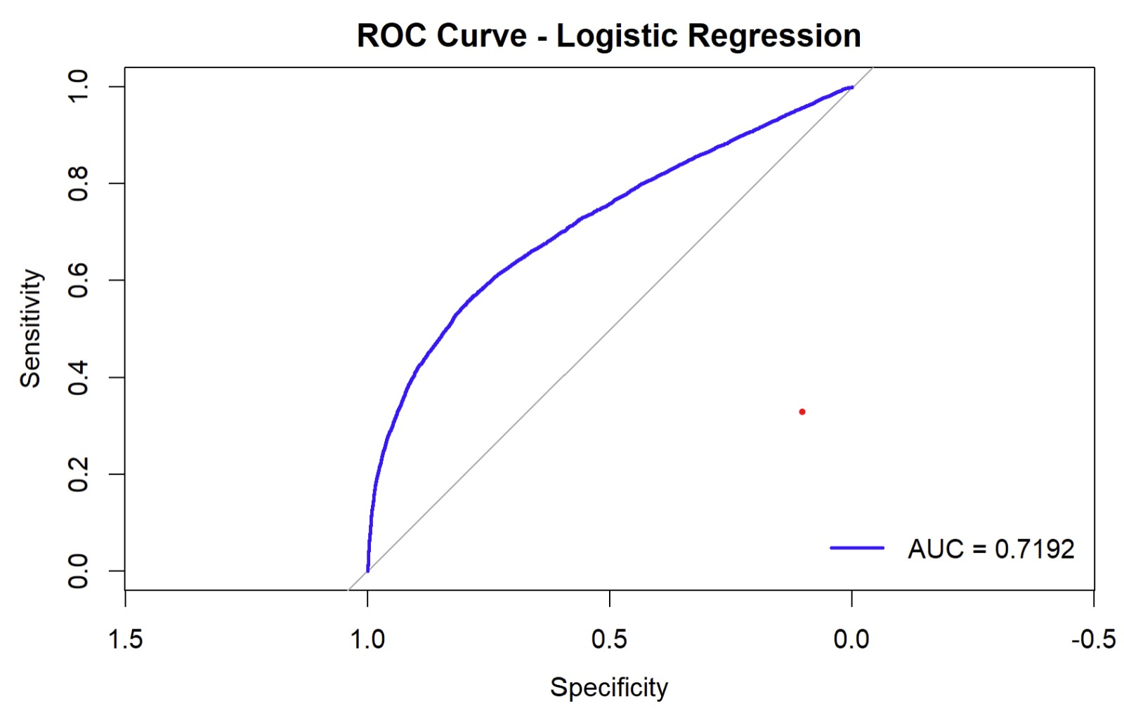
Logistic Regression
The ROC curve shows the between sensitivity (true positive rate) and specificity (false positive rate) for the logistic regression model.
The model achieved an AUC (Area Under the Curve) of 0.72, indicating moderate discriminative ability.
AUC of 0.72 means the model can distinguish between high-risk and low-risk patients about 72% of the time.
The curve lies above the diagonal baseline, confirming the model is better than random guessing but still has room for improvement.

Slide 20
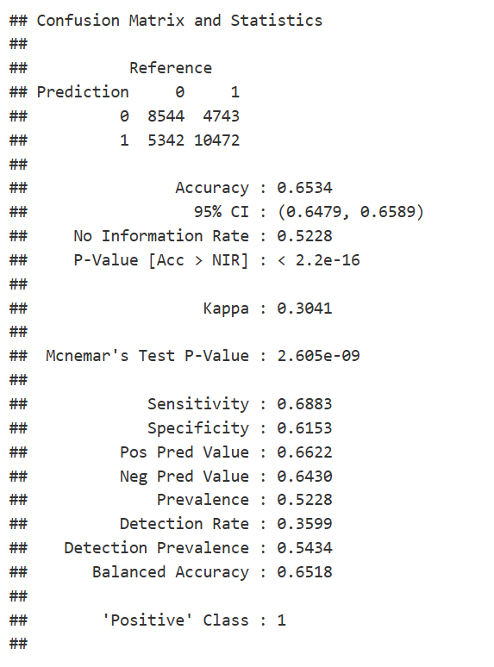
K-Means Clustering
Correctly predicted: • 8544 instances as '0' • 10472 instances as '1'
Overall model accuracy: 65.34% (correctly classified about 65% of observations).
Sensitivity for '1' (recall for positive class): 66.83%
Specificity for '0' (recall for negativ class): 64.15%

Slide 21
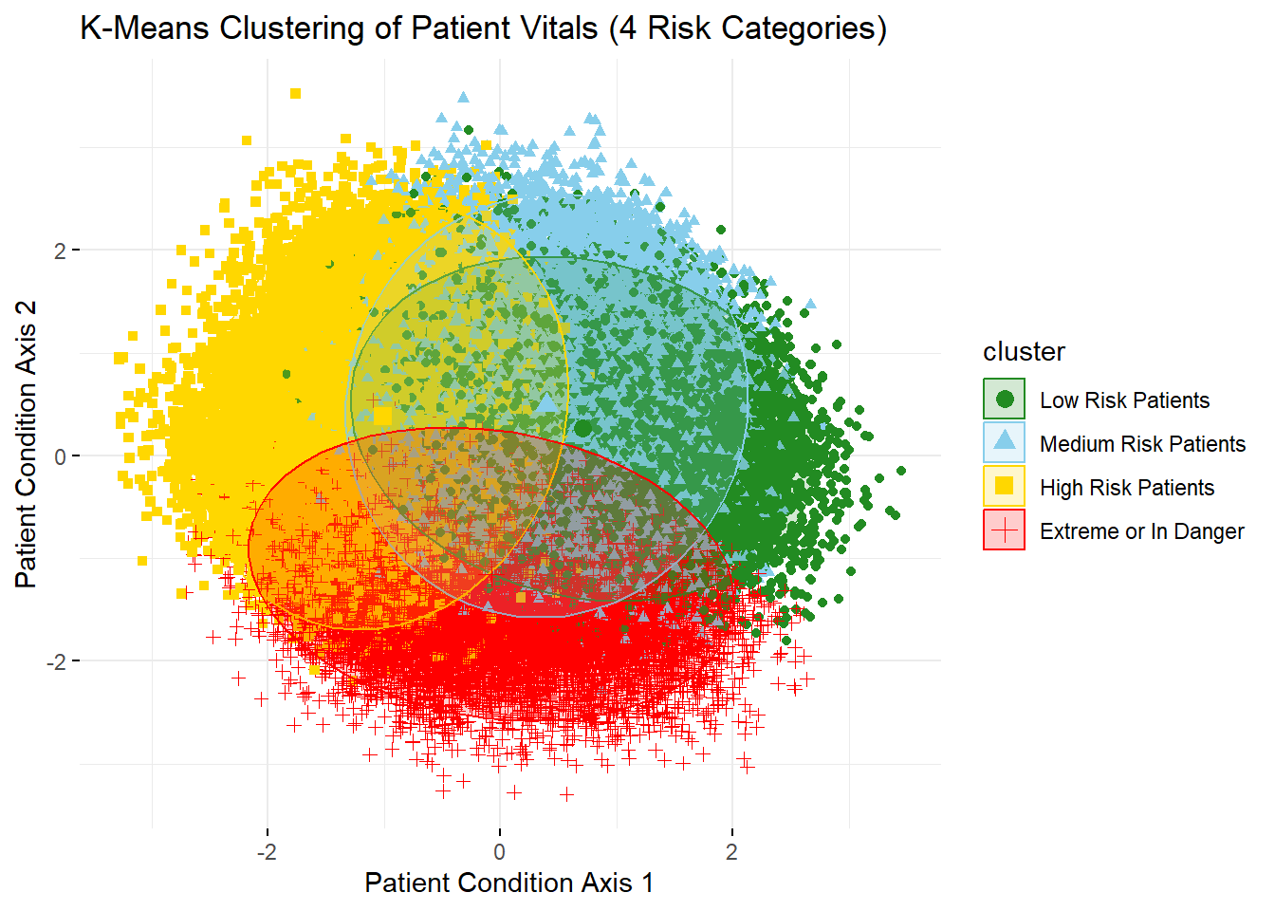
K-Means Clustering
Applied K-Means to vitals data, identifying four distinct risk clusters.
Each patient is plotted and colored by cluster: • Green – Low Risk • Blue – Medium Risk • Yellow – High Risk • Red – Extreme/In Danger
Ellipses highlight the spread and density of patients within each risk group.

Slide 22
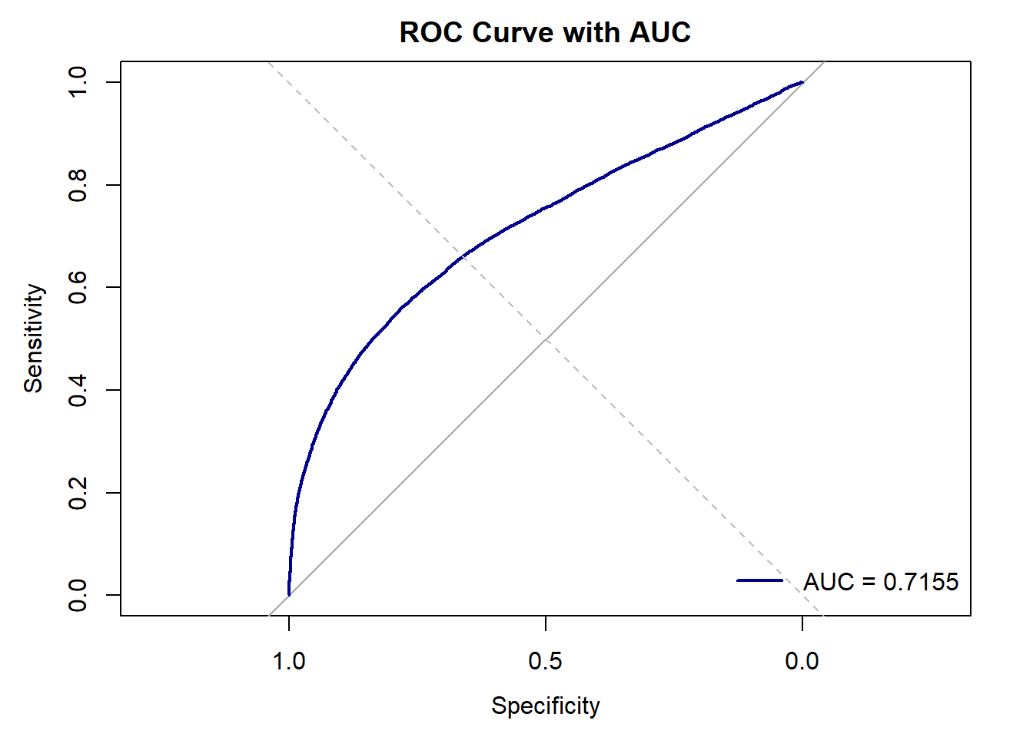
K-Means Clustering
The ROC curve shows the model's trade-off between Sensitivity (y-axis) and 1 - Specificity (x-axis).
The blue curve tracks performance across different thresholds.
AUC = 0.7155, indicating good discriminatory ability between positive and negative classes.
A higher AUC reflects stronger model performance.

Slide 23
Performance evaluation
Model | Sensitivity | Specificity | Accuracy
Logistic Regression | 0.6883 | 0.6153 | 0.6534
K-mean Clustering | 0.6888 | 0.6144 | 0.6534
Random Forest | 0.5639 | 0.7908 | 0.4542
XGBoost | 0.6184 | 0.6895 | 0.6555
Compared four models: Logistic Regression, K-Means, Random Forest, and XGBoost.
Logistic Regression and K-Means both showed ~65% accuracy with strong sensitivity.
XGBoost had the highest accuracy (65.5%) and good balance overall.
Random Forest had high specificity (79%) but lower accuracy (45%).
K-Means was chosen as the best model for its strong performance and clear risk grouping.

Slide 24
Conclusion
Enabled automatic identification of high-risk patients to support faster triage.
Improved care prioritization by integrating predictive modeling into hospital workflows.
Added BMI to improve prediction accuracy and achieve more meaningful classifications.
Demonstrated strong model performance with validated accuracy and reliability.
Highlighted potential to enhance patient outcomes and streamline emergency response.

Slide 25
Future Work
Add more health data: Include cholesterol, activity level, and smoking history for better predictions
Fix class imbalance: Use SMOTE or weighted loss functions to balance the data
Improve models: Try advanced tuning, stacking, and ensemble techniques
Explore deep learning: Use CNNs or RNNs to detect complex patterns in vital signs
Make models explainable: Use SHAP or LIME so doctors understand the predictions

Slide 26
Thank You!

