Slide 1

project proposal
Group K
Pilutti filippo Simonitti Samuele Alessandro Fioritto

Slide 2
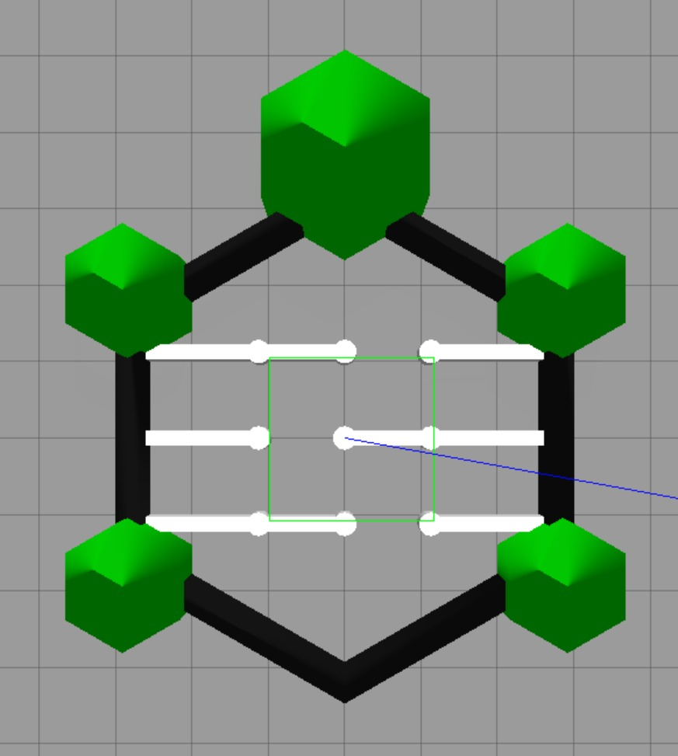
enviROnment
We decided to use the normal turtlebot 3 arena with some changes: we added 3 pairs of walls to form a simple maze that the robot should navigate without hitting said walls or any other solid object

Slide 3
tASK
Primary task:
The chosen task is for the robot to navigate the maze without hitting the walls, the columns or the perimeter of the arena and after that, at the end of the arena, there is a specific position the robot should go towards until it reaches it.
Optional task:
After reaching the first given position, the turtlebot should navigate the maze backwards, back to the starting position.

Slide 4
Input and sensor
For the visual input of the robot we want to scrap the camera and use exclusively a laser sensor: this is because we figured that the laser would be less burdensome than image processing.
We also changed the number of scannings, from 5 scans (one every 72°) to 24 scans (one every 15°) to hopefully solve some problems with the original model, mainly the tendency to crash on the columns.

Slide 5
Drl algorithm
We intend to use DQN algorithm as its fast training time could allows us to try different combination of weights and parameter values in a relatively short amount of time.
If we are not able to obtain good results, we plan to try Policy Optimization Algorithms (Reinforce or Actor Critic) which would require much more training time.

Slide 6
Reward structure and curriculum
We aim to use a more sparse reward scheme, specifically want to use curriculum based rewards, meaning that we start from a simple objective (e.g. pass the first line of walls) and build up to a more complex one (reach the coordinates on the other side of the arena) and balance this with an exploration bonus; to optimize the maze navigation time and smoothness we also plan to implement factorized rewards (collision avoidance, time to target).
We want the robot to perform the maze navigation precisely and, with limited outside information, the exploration bonus could provides adaptability to different types of mazes.

Slide 7
Training strategy
In the past months, as we made some trainings on the different models provided we understood that a good choice of parameters and reward weights is crucial if we want to have good results: we want to train different models with less episodes to infer on what’s the best combination of parameters for these specific objectives (mainly the decay rate, the batch size, learning rate and the reward function).
Also, choosing a good network architecture is pivital in ensuring the best outcome for the training so we plan to explore different types (e.g. Fully connected, Residual, RNN) to find the best suited one for our goals.

Slide 8
Evaluation metrics
Having a number of clear objectives makes it easy to evaluate the success of the overall training process and, in addition to avoiding obstacles and reaching the final coordinates, we want to use the number of steps, meaning the time needed, to reach the final objective as another evalution metric.
This has also the purpose of helping us troubleshooting, as a slower time helps us to evaluate if we need to change our trainig strategy.

