Slide 1
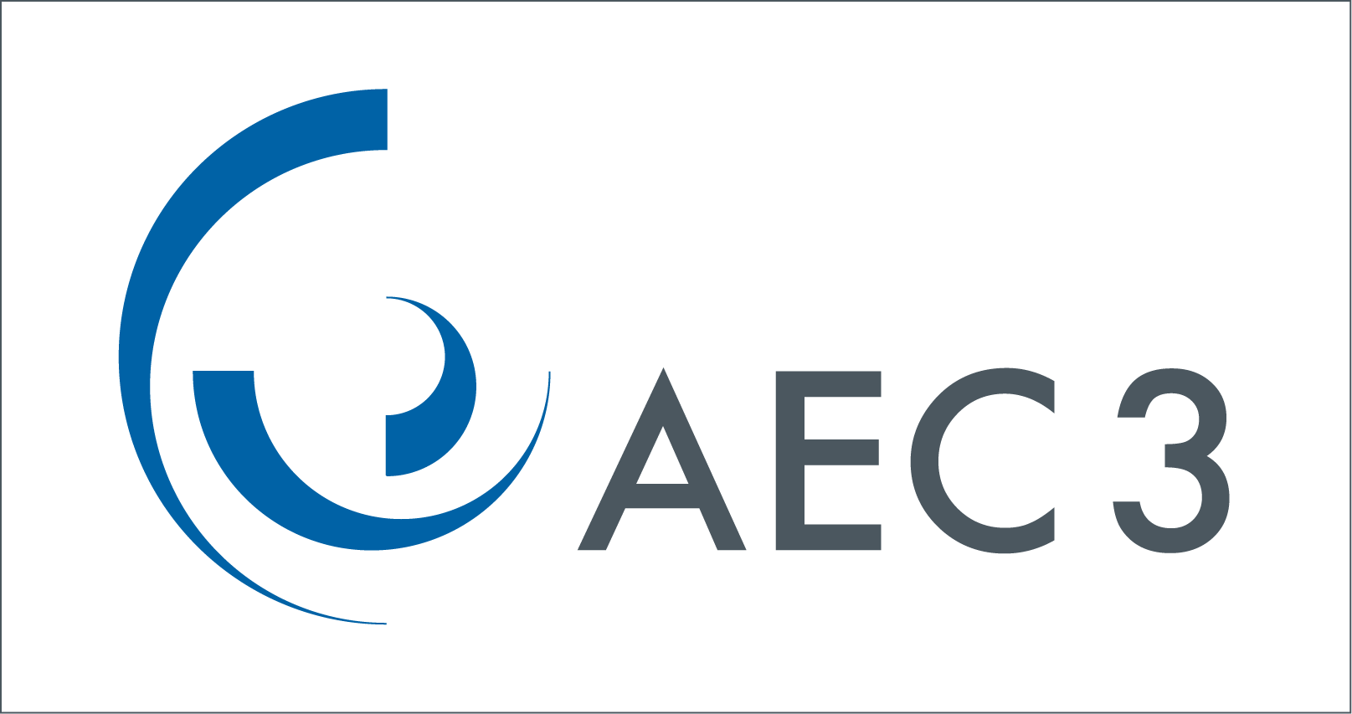
Ontology-based Compliance Checking
SW
RegulationM
(HTML, RIF)
Global Dictionary
(XML)
ProjectP
ProjectQ
ProjectR
(IFC)
normative
Compliance checking is the “ultimate” challenge for automation in the construction sector
Good quality building models
Good quality prescriptive (and performance) regulations.
Good quality dictionary/thesaurus
descriptive
definitive

Slide 2
Ontology-based Compliance Checking
Challenges
Handling three kinds of knowledge
Normative regulation
AND, OR, NOTAND, NOTOR
Definitive dictionary
Applicable and equivalent terms
Descriptive project
Direct and inherited attributes
Detecting
Agreement
Insufficient information
Disagreement
Steps
convert the datasets into ontologies
find a suitable set of links for the datasets.
explore the information
Is project P, Q or R
a pass,
a fail
or undecidable?

Slide 3
