Slide 1

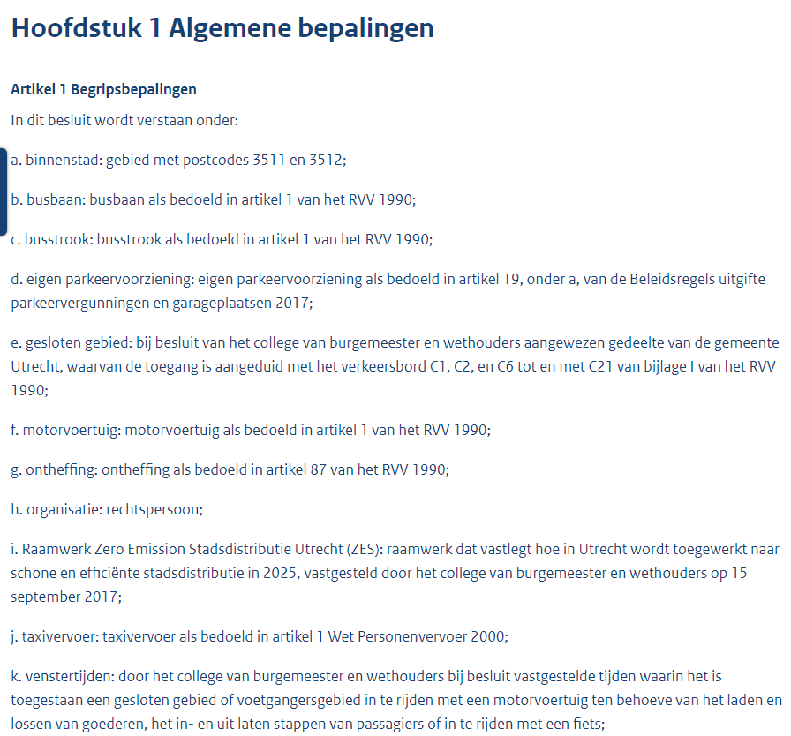
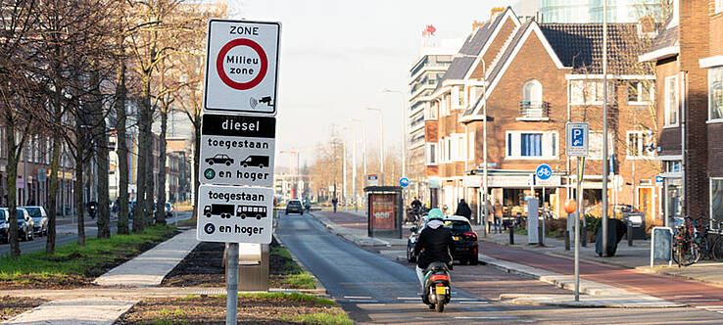
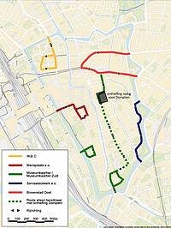
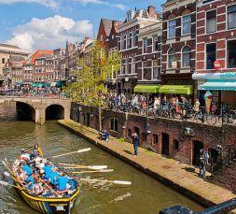
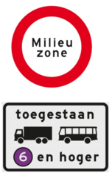
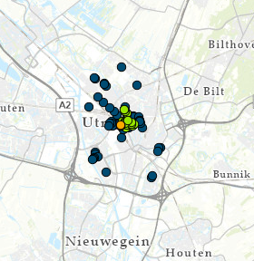
Dynamic Asset Management
How can we manage and visualize asset management data in the built environment using semantic web technology if some of this data is dynamic in time and location?
Sub question 1: How can semantic web technologies be used to manage assets if some of the data is dynamic in time and location?
Sub question 2: Is it possible to automatically restrict vehicles from entering certain zones in the city? What are the rules and requirements for this?
Sub question 3: How can SHACL be implemented in the information model behind the tooling? Is it possible to activate certain restrictions for trucks based on their time-stamp data?
Sub question 4: What are the steps needed for aligning different sets of data that originate from several sources, including written text-based documents?
Sub question 5: How can we visualize newly gained information that results from linking certain datasets? How can SPARQL and possibly OWL help with this and how does this work in a user-friendly manner?
Sub question 6: In case of inferencing new information using OWL, how does this work in combination with SHACL restrictions? Open world vs. closed world?

