Slide 1
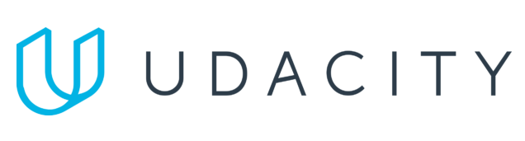
Data Lake Value Proposition
Medical Data Processing Company
SONIA FOGARI
Udacity IPS Version 1.0
Notes:
Hi, my name is sonia and in this video I will briefly explain the advantages of adopting a data lake solution to meet the business and technical requirements of the medical data processing company

Slide 2
Agenda
What is a Data Lake
Components of a Data Lake
Data Lake vs Data Warehouse
Proposed Data Lake Architecture for Medical Data Processing system
Business Value of Data Lake Solution
Udacity IPS Ver. 1 2/2020
Notes:
We will go through the following points: we will start with a definition of the datalake andwe will list, . Then, we will compare. After that we will have a depp dive into and finally we will discuss.

Slide 3
What is a Data Lake
Executive summary
A data lake is a centralized data repository for storing and processing large amount of data in its raw format, without a predefined structure or schema.
From a technical point of view, a data lake uses a flat architecture and an object storage to store the data.
This brings several advantages, such as the ability to scale easier to larger data volumes and the usage of an open storage format.
Notes:
According to a public avaiable definition, 1 leggere fino a format. Data on data lakes can be stored physically on a proprietary hardware (on premise) or on the cloud, where they are managed by a cloud provider. The second is more typical. In a datalake, data is stored as objects instead of files or folders. Leggere fino a data volumes, cloud providers indicate that the maximum scaling capacity is basically infinite. This e adoption of an open storage prevends the vendor lock-in effect which makes migrations from one system to the other hard . In data lakes, migration of objects between cloud providers is easy.

Slide 4
Components of Data Lake
Layers:
Ingestion layer
Storage layer
Processing layer
Serving layer
Notes:
The ingestion layer is responsible for collecting data from various data sources—IoT devices, data lakes, databases, and SaaS applications—into a target data storage
Data storage is the layer, responsible for storing the data in a format that can be easily accessed and analyzed. Data processing is the third layer, responsible for collecting, cleaning, and preparing the data for analysis. The serving layer is responsible for creating visualizations of the data that humans can easily understand. This layer is important for making the data accessible.

Slide 5
Data Warehouse
Data Lake
Structured data is stored
Purpose of the data known form the beginning
Supports decision making across business lines
Information accessibile to business users and business analysts
More complicated and costly to make changes
Raw data (structured and semi-structured data) is stored
Purpose of the data undetermined
Data inconsistencies require intepretation
Information accessible to users with a technical background (data scientists, data engineers)
Highly accessible and quick to update
Udacity IPS Ver. 1 2/2020
Notes:
Let´s have a deep dive into the differences. The first one…. If you decide sto store the data according to a given structure, … whereas. Data warehouses are better are supporting overarching since they provide a single source of tugh, whereas. Due to the structures, infformation to run ad hoc analyses. The last effect of structured data is on the storage cost and the avaiablily of the system:

Slide 6
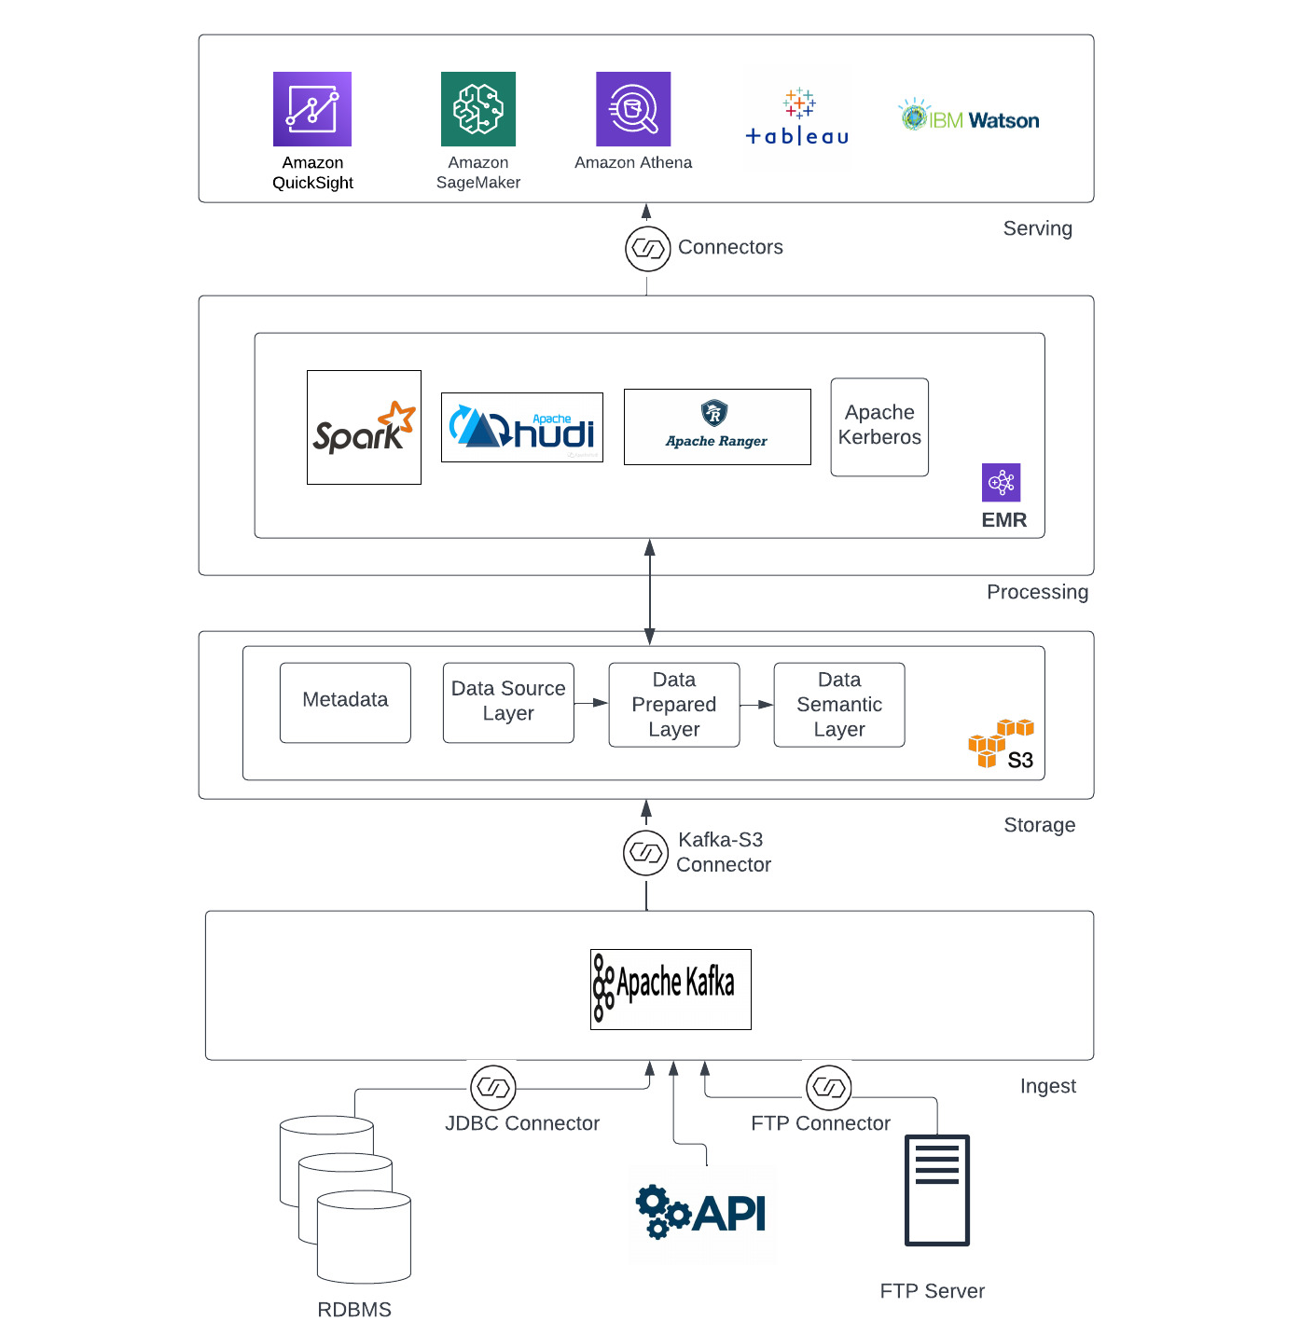
Data Lake Architecture
Notes:
Let´s have a deep dive into the proposed data lake architecure designed for the medical. You will see from the bottom to the top the 4 layers mentioned before.

Slide 7
Business Value of Data Lake
The data lake is an enabler for getting new insights from the data and leveraging new business models
The data lake has a higher availability, ensuring business continuity with fewer interruptions
The data lake offers cost-effective storage and scalability due to the absence of structure in the data, leading to lower maintenance costs
If there is a specific business request, relevant data can still be extracted, filtered, refined and exported into a business intelligence service to deliver easy-to-understand business insights.
Notes:
Let´s conclude by mentioning some of the major benefits from the adotiomn of a data lake. First of all, such as ML to pdetect frauds or predict bed avialabily. Secondly, … availabily is a distributed system consisting of several nodes, fault tolerant to the failure f some nodes. This grants business continuity. As we have explained before, ….. But don´t be afraid of the lack of structure in the data: this characterizes only the storage level. …BI services or even data warehouses … to all the stakeholders.

Slide 8
THANK YOU
Udacity IPS Version 1.0
Notes:
Having said this, let me thank you for your attention wish you best luck in implementing whatever solution you decide to adopt to ensure the greatest success of your company.

