Slide 1


Tech ABC Corp - HR Database
Sonia Fogari -20th December 2022

Slide 2
Business Scenario
Business requirement
Tech ABC Corp saw explosive growth with a sudden appearance onto the gaming scene with their new AI-powered video game console. As a result, they have gone from a small 10 person operation to 200 employees and 5 locations in under a year. HR is having trouble keeping up with the growth, since they are still maintaining employee information in a spreadsheet. While that worked for ten employees, it has becoming increasingly cumbersome to manage as the company expands.
As such, the HR department has tasked you, as the new data architect, to design and build a database capable of managing their employee information.
Dataset
The HR dataset you will be working with is an Excel workbook which consists of 206 records, with eleven columns. The data is in human readable format, and has not been normalized at all. The data lists the names of employees at Tech ABC Corp as well as information such as job title, department, manager's name, hire date, start date, end date, work location, and salary.
IT Department Best Practices
The IT Department has certain Best Practices policies for databases you should follow, as detailed in the Best Practices document.

Slide 3
Step 1
Data Architecture Foundations

Slide 4
Step 1: Data Architecture Foundations
Hi,
Welcome to Tech ABC Corp. We are excited to have some new talent onboard. As you may already know, Tech ABC Corp has recently experienced a lot of growth. Our AI powered video game console WOPR has been hugely successful and as a result, our company has grown from 10 employees to 200 in only 6 months (and we are projecting a 20% growth a year for the next 5 years). We have also grown from our Dallas, Texas office, to 4 other locations nationwide: New York City, NY, San Francisco, CA, Minneapolis, MN, and Nashville, TN.
While this growth is great, it is really starting to put a strain on our record keeping in HR. We currently maintain all employee information on a shared spreadsheet. When HR consisted of only myself, managing everyone on an Excel spreadsheet was simple, but now that it is a shared document I am having serious reservations about data integrity and data security. If the wrong person got their hands on the HR file, they would see the salaries of every employee in the company, all the way up to the president.
After speaking with Jacob Lauber, the manager of IT, he suggested I put in a request to have my HR Excel file converted into a database. He suggested I reach out to you as I am told you have experience in designing and building databases. When you are building this, please keep in mind that I want any employee with a domain login to be have read only access the database. I just don't want them having access to salary information. That needs to be restricted to HR and management level employees only. Management and HR employees should also be the only ones with write access. By our current estimates, 90% of users will be read only.
I also want to make sure you know that am looking to turn my spreadsheet into a live database, one I can input and edit information into. I am not really concerned with reporting capabilities at the moment. Since we are working with employee data we are required by federal regulations to maintain this data for at least 7 years; additionally, since this is considered business critical data, we need to make sure it gets backed up properly.
As a final consideration. We would like to be able to connect with the payroll department's system in the future. They maintain employee attendance and paid time off information. It would be nice if the two systems could interface in the future
I am looking forward to working with you and seeing what kind of database you design for us.
Thanks,
Sarah Collins
Head of HR

Slide 5
Data Architect Business Requirement
Purpose of the new database:
The database has been requested by the Head of HR of the Tech ABC Corp. Due to the growth of the company and the resulting growth of the HR department, a new database shall be implemented to meet the requirements about data integrity and data security rising from the existence of an HR team instead of a single person responsible for the data.
Describe current data management solution:
The current data is stored in an Excel sheet
Describe current data available:
Currenty following data is availble:
- Master data about employees of the Tech ABC Corp (ID, name, email, hire date, education level)
- Data related to their job history (job, manager, start and end date of the job, salary and deparment)
- Master data about departments of the ABC Corp (name, location, address, city, state)

Slide 6
Data Architect Business Requirement
Additional data requests:
The user requests to be able to connect the HR database with the payroll department's system in the future. This database contains employee attendance and paid time off information.
Who will own/manage data
The HR department of the Tech ABC company will own the data. The HR department and the management employees will maintain the data of the database.
Who will have access to database
According to the request, all employess of the Tech ABC company will be able to access all data, so all users will have read access to the database. But only employees from the HR department and management level employees will have access to the salary information. Management and HR employees should also be the only ones with write access.

Slide 7
Data Architect Business Requirement
Estimated size of database
The database consists of approx. 206 Excel rows (each of them with 11 columns). This corresponds to about 24kB, obtained copying the content of the columns to a .txt file in the Notepad.
Estimated annual growth
The expected growth of the database is +20% for each year in the next 5 years.
Is any of the data sensitive/restricted
Since only managers and HR department employess will have access to the salary information, salary is restricted.

Slide 8
Data Architect Technical Requirement
Justification for the new database
1)Data integrity: ensure consistent and correct data even if the meinatenence of the data is performed by a team
2)Retention: fulfill the data retention requirements enforced by federal regulations to maintain this data for at least 7 years; additionally, since this is considered business critical data, make sure it gets backed up regularly.
Database objects
Tables: Employee, Education, Job, Job History, Job History Info (table holding salary information with restricted access), Department and Location.
Data ingestion
Since the data is already maintained in an Excel file, the data ingestion method applied in this case is the ETL: data from the Excel file is extracted and put in a stoaging area, transformed to meet the requirements of the destination and finally loaded into the destination database.

Slide 9
Data Architect Technical Requirement
Data governance (Ownership and User access)
Ownership: HR deparment and managers
User Access: all employees
Scalability
Data growth: this in uncritical because even considering the max. expected growth of data (when every employee would change the job every year and the employee number is rising by 20% yearly), the storage for the data on the database is far less than the 1GB offered by the standard partition of the server group from the IT department ant the rows of data would not exceed 10k rows.
User growth: if growth of the number of users (including technical users from other ITS systems) will cause performance issues, then we should consider a database replication. In this business scenario the reading demand is higher than the writing demand (suggesting a sharding approach instead)

Slide 10
Data Architect Technical Requirement
Flexibility
To ensure future data integration the database might offer an API to access the data from other systems (such as the payroll department IT systems) and touchpoints (such as to make the data visible to the employee on the company app or intranet page).
Storage & retention
Storage (disk or in-memory): check IT best practices document
Disk, because of the limited data volume and expected accesses (internal employees), and the absence of additional reporting and analytics requirement. These simple requirements would not justify the cost of using a RAM.
Retention: 7 years
Backup
The backup schedule must be implemented and must have priority Critical because the HR database is a business critical application: in case of the outage of the database, data no older than one day must be retrieved. The costs of business loss due to the process of restoring data older than one day manually would largerly outweight the maintenance costs of implementing the database with priority Critical.

Slide 11
Step 2
Relational Database Design

Slide 12
Step 2: Relational Database Design
This step is where you will go through the process of designing a new database for Tech ABC Corp's HR department. Using the dataset provided, along with the requirements gathered in step one, you are going to develop a relational database set to the 3NF.
Using Lucidchart, you will create 3 entity relationship diagrams (ERDs) to show how you developed the final design for your data.
You will submit a screenshot for each of the 3 ERDs you create. You will find detailed instructions for developing each of the ERDs over the next several pages.

Slide 13
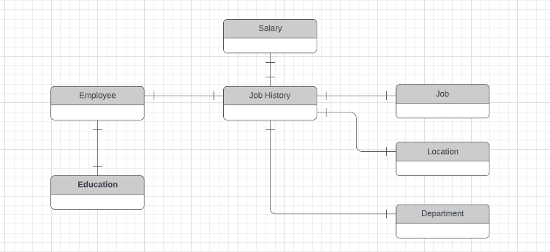
ERD
Conceptual

Slide 14
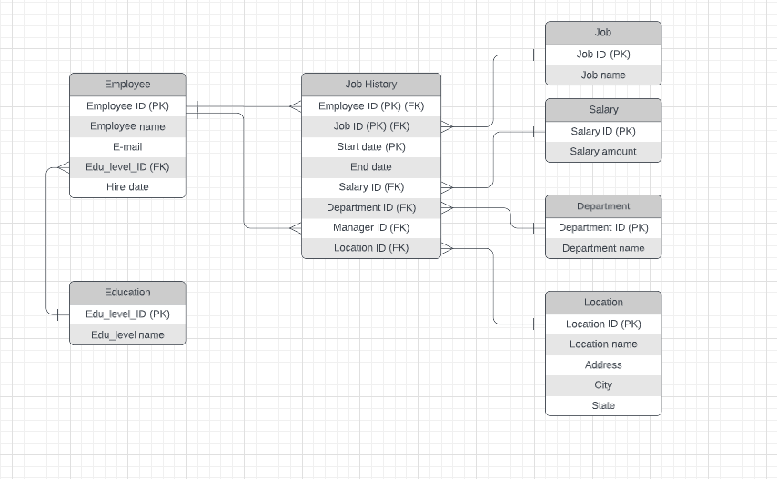
ERD
Logical

Slide 15
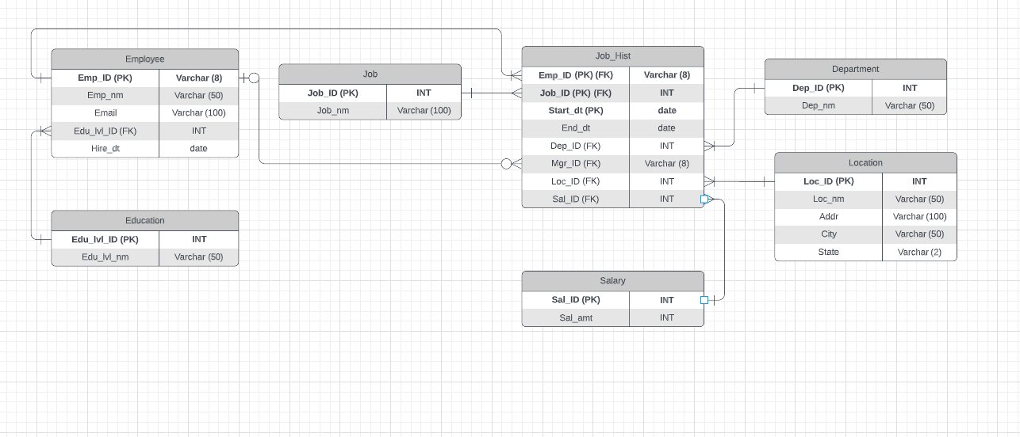
ERD
Physical

Slide 16
Step 3
Create A Physical Database

Slide 17
Step 3: Create A Physical Database
In this step, you will be turning your database model into a physical database.
You will:
Create the database using SQL DDL commands
Load the data into your database, utilizing flat file ETL
Answer a series of questions using CRUD SQL commands to demonstrate your database was created and populated correctly
Submission
For this step, you will need to submit SQL files containing all DDL SQL scripts used to create the database.
You will also have to submit screenshots showing CRUD commands, along with results for each of the questions found in the starter template.
Hints
Your DDL script will be graded by running the code you submit. Please ensure your SQL code runs properly!
Foreign keys cannot be created on tables that do not exist yet, so it may be easier to create all tables in the database, then to go back and run modify statements on the tables to create foreign key constraints.
After running CRUD commands like update, insert, or delete, run a SELECT* command on the affected table, so the reviewer can see the results of the command.

Slide 18
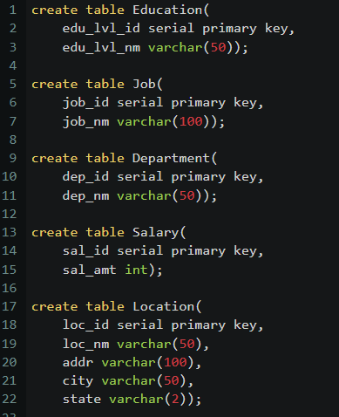
DDL
Create a DDL SQL script capable of building the database you designed in Step 2

Slide 19
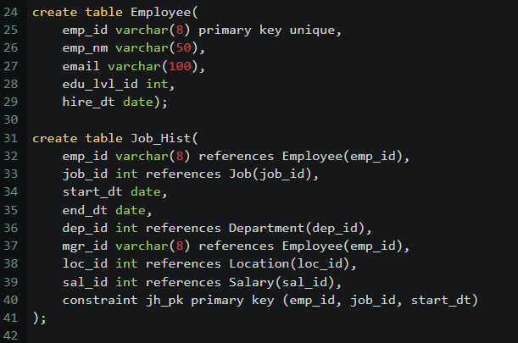
DDL

Slide 20
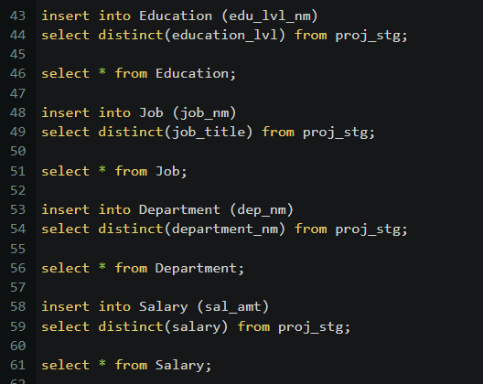
DDL

Slide 21
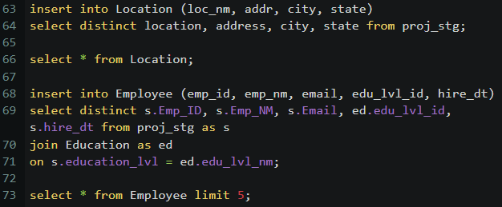
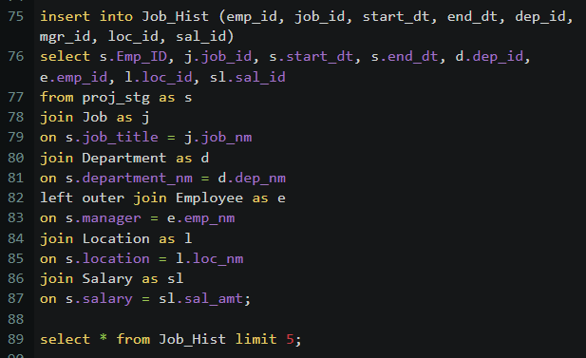
DDL

Slide 22
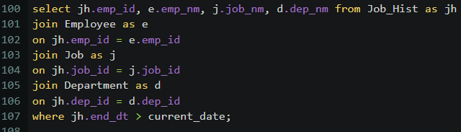
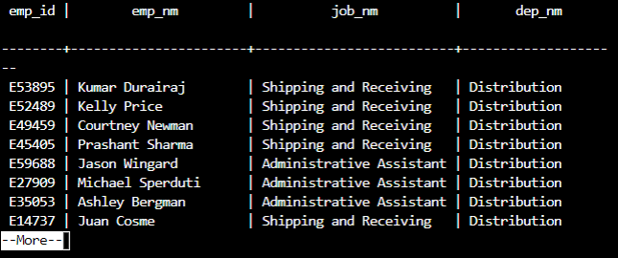
CRUD
Question 1: Return a list of employees with Job Titles and Department Names

Slide 23
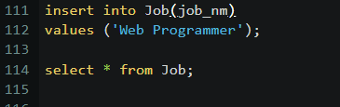
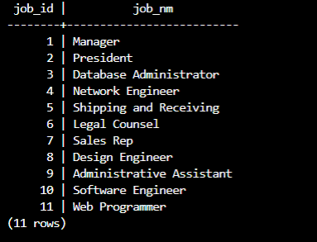
CRUD
Question 2: Insert Web Programmer as a new job title

Slide 24
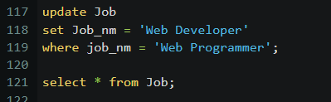
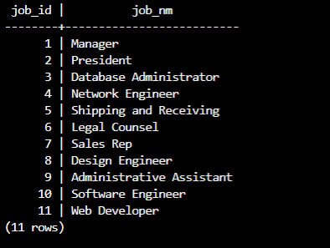
CRUD
Question 3: Correct the job title from web programmer to web developer

Slide 25
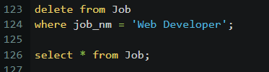
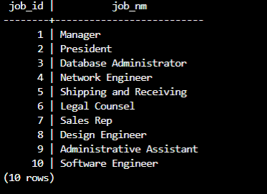
CRUD
Question 4: Delete the job title Web Developer from the database

Slide 26
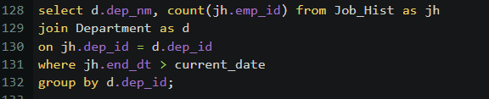
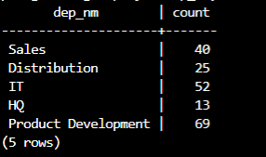
CRUD
Question 5: How many employees are in each department?

Slide 27
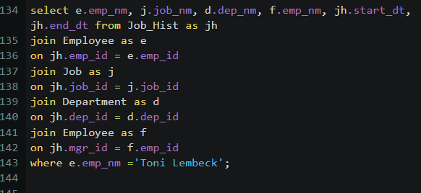
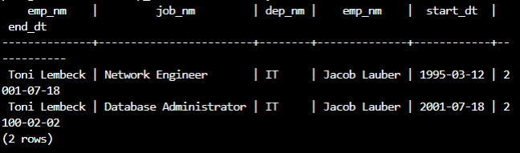
CRUD
Question 6: Write a query that returns current and past jobs (include employee name, job title, department, manager name, start and end date for position) for employee Toni Lembeck.

Slide 28
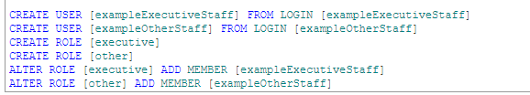
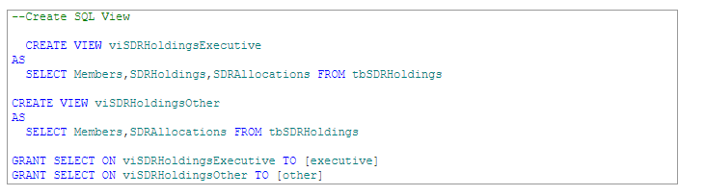
CRUD
Question 7: Describe how you would apply table security to restrict access to employee salaries using an SQL server.
Reference: https://www.sqlshack.com/restricting-and-monitoring-data-access-with-views-and-procedures/
I would first create 2 user groups having different level of access (one for the managers and HR members, the other for employees) and add the members to the users, similarly to:
Order: from the highest to the lowest level while restricting each level as much as possible.
Then I would create an object such as views on top of other objects, such as tables, similarly to:

Slide 29
CRUD
In our example I would create one view for all employees containing all tables except Salary (with view only access), and a second view for the managers and HR employees containing all tables (with read and write access).
Using roles or even adding permissions directly to the user, I would grant the roles or users access to the higher-level objects, while keeping the underlying objects restricted.

