Slide 1


Data Governance @ SneakerPark
Prepared by: Sonia Fogari
Submitted on: 27 Feb 2023

Slide 2
Background
SneakerPark is an online shoe reseller that allows people to buy and sell used and new shoes. Buyers can bid for shoes or buy them outright, and sellers can set a price or sell to the highest bidder.
Each buyer and seller must have an active account in order to sell, bid, or purchase sneakers using SneakerPark’s website.
SneakerPark authenticates the shoes before shipping them to the buyer, so before listing an item, the seller must ship it to SneakerPark’s warehouse. Upon receipt, SneakerPark assigns an item number to each pair of sneakers and notifies the seller that they are now free to list their item. If the item is not listed within 45 days, SneakerPark returns it to the seller and sends an invoice to the seller for the shipping cost.
If the item is found to be inauthentic or in an unacceptable condition, it is also returned back to the seller in a similar fashion.
When the item sells, the buyer’s account is credited with the purchase price minus the SneakerPark service fee and shipping fees to deliver the item to the buyer.
Currently, SneakerPark only supports sales within the United States.

Slide 3
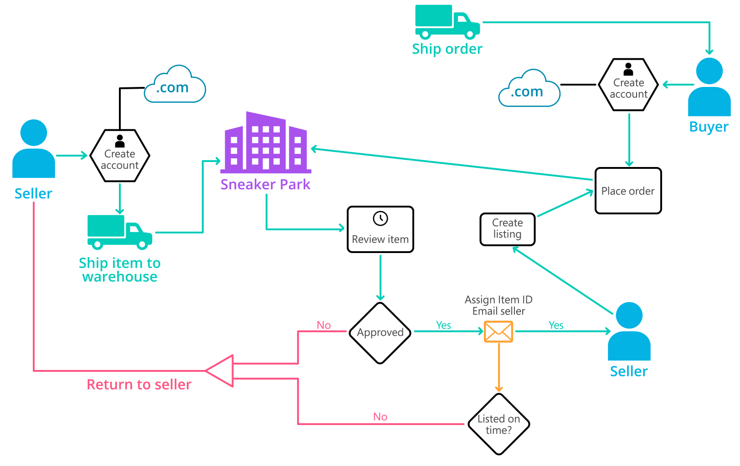
Background (cont’d)
Below you can see a diagram that will hopefully help you visualize some of SneakerPark's business processes. Keep in mind that it does not capture ALL processes and every nuance, but simply serves as another artifact to use in your project.

Slide 4
Step 1
Enterprise Data Catalog Part 1: Enterprise Data Model

Slide 5
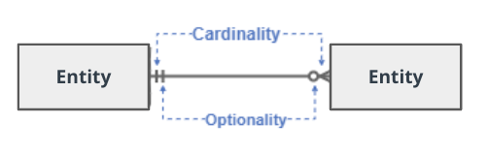
Create a conceptual data model that will provide SneakerPark with a holistic view of its data systems and help you grasp the organization's important entities and relationships, which will be instrumental as you move further in the project. You can use Lucidchart or any other diagramming tool of your choice, but please use the Crow’s Foot/IE Notation and please be sure to indicate both cardinality (the type of a relationship such as 1:N or N:N) and optionality (whether the relationship is optional or mandatory).

Slide 6
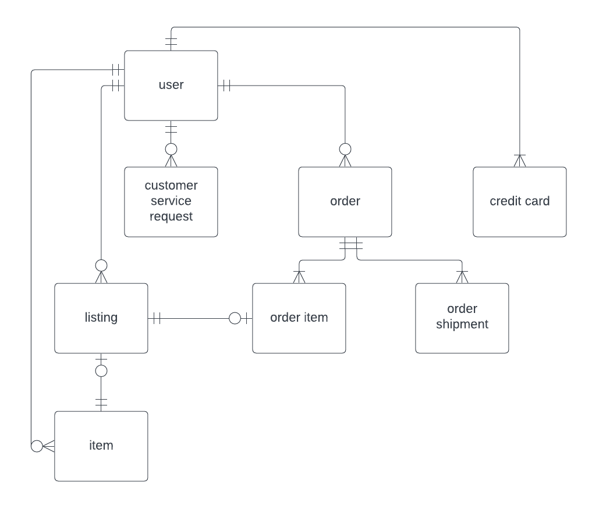
Replace the example below with your own solutions (obviously feel free to take more space):

Slide 7
Step 2
Enterprise Data Catalog Part 2: Metadata

Slide 8
Create the first version of the Metadata Catalog by documenting the metadata from all systems in the "Data Dictionary" and the “Enterprise Data Catalog” tabs of the provided Sheets template.
Please note that you are required to fill out all fields in both tabs.

Slide 9
Step 3
Data Quality
Part 1: Profiling and Cleansing

Slide 10
Profile the data to identify at least 3 data quality issues you see in the data. Also provide at least 1 data quality issue that you haven’t yet seen in the data, but can foresee occurring in the future. Based on the issues you’ve identified, come up with the data quality rule for each data quality issue, including for the one that you foresee.
Make sure you fill out all columns in the "Data Quality Issues" tab with your answers in the provided Sheets template.

Slide 11
Step 4
Data Quality
Part 2: Monitoring

Slide 12
Using the metrics you've created in the last step, please create a mock-up of a data quality monitoring dashboard that will be used to monitor the data to ensure compliance with your data quality rules.
Please make sure to label your metrics clearly on your mock-up.
1. Evaluation of the data quality metrics for each quality rule:

Slide 14
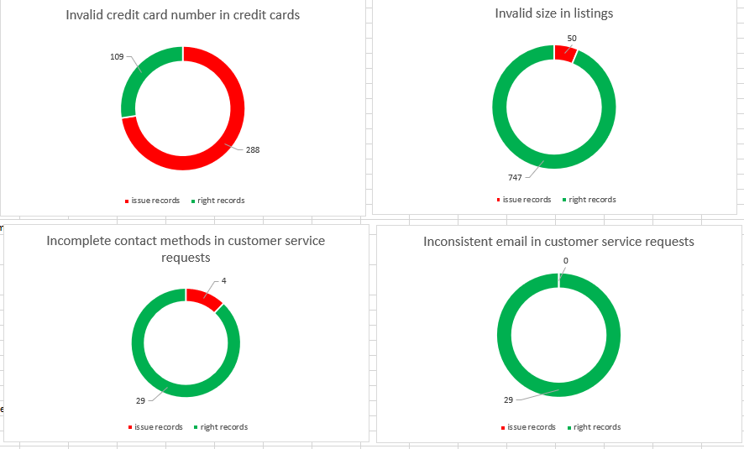
2. Dashboards

Slide 15
Step 5
Master Data Management
Part 1: MDM Architecture

Slide 16
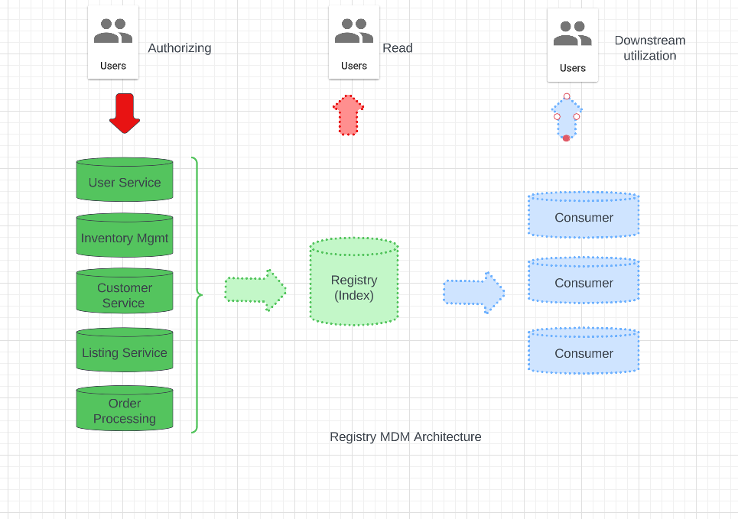
Based on what you’ve read about SneakerPark’s systems and business model, sketch out a proposed MDM implementation architecture, and write a detailed explanation of why you chose this specific approach.

Slide 17
Explanation:
The Sneakerpark Company is starting the MDM journey. At the moment they have 3 types of master data: vendor master data, product master data and customer master data. The Product master data is stored at the moment both in the Inventory Management System and in the Ordering System. The customer master data is stored at the moment both in the User Service, Customer Service and Ordering Systems. In order to implement a low cost solution, without big intrusions / disruptions to the current IT solution but still to profit from the first advantages of having a structured master data management approach, the Registry MDM Architecture is recommended. This approach can be evolve to a Centralized MDM solution in the future.

Slide 18
Step 6
Master Data Management
Part 2: Master Record

Slide 19
In this step, you will define a set of matching rules that will be used by the SneakerPark's MDM Hub to match item and customer entities between the company's different systems.
Please come up with 4 rules - 2 for Items and 2 for Customers and list them below.
The items need to be matched between the Inventory Management and the Listing Service.
The first matching rule for the items is based on the ItemID. This identifier is available in both systems and matches the multiple datasets with the highest confidence.
The items can also be identified in the 2 systems by the following attributes: item type, brand, color, sex, size and condition. The second matching rule should consider all these attribute, provided that a mathing between the values in the 2 systems for each of them is reasonable.
Item type: in the listing system, 69/430 records have NULL item type and can´t be matched, in the inventory management system all items type are populated. The item type attribute is a category variable, and the 4 possible categories can be matched between the 2 systems after standardization (renaming of the categories).
Brand: 10/430 records have NULL values in the listing system, whereas in the inventory management system all records are populated. The brand name is a category variable with about 20 different values, therefore the brands can be reasonably matched between the 2 systems after standardization.

Slide 20
Color: 12/430 records have NULL values in the listing system, whereas in the inventory management system all records are populated. The color is a category variable with about 10 different values, therefore the colors can be reasonably matched between the 2 systems after standardization.
Size: 25/430 records have zero values in the listing system, whereas in the inventory management system all records are populated. The size is a category variable with about 15 different values, therefore the colors can be reasonably matched between the 2 systems after standardization.
Sex: all records are populated in the 2 systems. The sex is a category variable with 2 different values, therefore it can be reasonably matched between the 2 systems after standardization (“Female” → “F”).
Condition: all records are populated in the 2 systems The condition is a category variable with 3 different values, therefore the condition can be reasonably matched between the 2 systems after standardization (renaming).
Since all the additional attributes to identify the items provide a reasonable matching quality, all of them shall be considered in the second matching rule. A heuristic must be created to evaluate the quality of the matching (all attributes match, all except one match and so on), so that records having a matching value below a given threshold can be checked manually by a data steward.
The Customers need to be matched among the 3 systems: User Service, Service Request System and Ordering System
The first matching rule for the customers is based on the UserID (named as BuyerID in the Ordering System). This identifier is available in all the 3 systems and matches the multiple datasets with the highest confidence.
Other possible unique identifier of the Customers are the combination of:
first name, last name and email (matching is possible between User Service and Customer Service Request systems)
first name, last name, address and zip code (matching is possible between the User Service and the Ordering systems)
first name, last name and phone number (matching is not possible because the attribute phone number is only available in the Customer Service Request System).

Slide 21
As a second matching rule for the Customers, the combination of first name, last name and email shall be used, because the email is a single word and is easier to match rather than the address, which would require a standardization first.
The combination of first name, second name and address and zip code could be used as a third matching rule to identify the Customers.

Slide 22
Step 7
Data Governance:
Roles and Responsibilities

Slide 23
Write 1-2 paragraphs discussing what data governance roles and responsibilities will be necessary to oversee this new Data Management initiative. Please be sure to discuss the responsibilities in the context of at least 3 different aspects of Data Governance (such as Data Quality Management, Metadata Management, MDM, etc). Based on what you know, do SneakerPark's current employees have the necessary skills for these roles or should the company make new hires?
At the moment there are 2 employees at Sneakerpark, a man with IT support background and a senior business analyst.
A metadata management system is not avaiable at the moment, and for this reason the Entersprise Data Catalogue is only avaiable as an Excel file as a result of this project. Even though, the Enterprise Data Catalogue that has been created needs to be maintained, extended and updated by a person to be beneficial to the company. After the completion of the second part of the project, aimed at building out an Enterprise Data Warehouse solution, most of the metadata will be updated automatically (via APIs) by other IT application, avoiding manual work of updating the Enterprise Data Catalogue and reducing errors.

Slide 24
But even then, there will be a need for a resource to maintain and extend this new IT application and for a main user with a business background responsible for the quality of metadata and to maintain a subset of the metadata such as the metadata releated to the roles and organization (i.e. current data owners and data stewards) and compliance aspects of the data (i.e. confidentiality of data).
Regarding the data quality, it is recommended to hire one data steward for each business domain (customers, inventory, orders, listings), starting from the most critical processes, to ensure the quality of the data within their domain. At the moment, since only 27% of the data about credit cards have the correct length, the customer area is the most critical, because the insufficient quality of the customer master data already causes severe issues in the billing processes, which costs more than hiring a new resource taking care of the customer data quality. In the future the company should consider adding a fifth business domain related to vendors and vendor master data to unlock additional business opportunities, and to dedicate an additional data steward to this domain.

Slide 25
The creation of the MDM registry needs to be considered and a resource with IT skills should be dedicated to this task. Since Jake will support the implementation of the Enterprise Data Warehouse solution in the near future in addition to his current tasks, a good idea would be to hire a student with IT / Databases background to support Jack on the creation of the MDM registry.
In general the data stewards could perform at the beginning several tasks within their data domain such as data cleansing, data quality assessment, data documentation, creating queries to analyse the data to support business decisions and as soon as the company grows the generic data stewards roles could be split in more specialized roles, such as data quality experts, data engineers, data analysts, data scientist, and so on.
But at least at the beginning, it is important that these people gain a deep understanding of the data within their data domain to exploit synergies in the various tasks they are assigned to, so it is fundamental to assign a data steward for each domain, and to assign this role to somebody with a deep business understanding. A good idea would be to hire a student with expertise in SQL and curiosity and let him/her work in the same team as Jessica, the senior business analyst.

Slide 26
Standout Suggestions

Slide 27
Create a Business Glossary for SneakerPark and define common terms such as Item, Buyer, etc. Think and discuss how SneakerPark can improve on the consistency of the terms that its systems currently use. (You can use the “Business Glossary” tab of the same Sheets template you’ve been using for the other parts of this project to get you started.)
Document SneakerPark’s current naming conventions. Can you think of any improvements? (You can use the “Standard Naming Conventions” tab of the same Sheets template you’ve been using for the other parts of this project to get you started.) Some examples of Naming Conventions include;
Do not use spaces or special characters.
Use only LOWERCASE.
All identifier fields should end in “_id”.
Avoid acronyms and abbreviations.
Write SQL scripts for the matching rules that you’ve created in Step 6.

