Slide 1
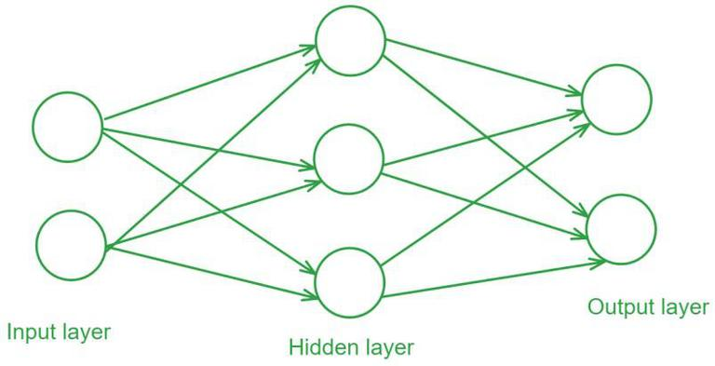
INTRODUCTION TO PARALLEL COMPUTING · 2025–2026
Parallel Feedforward Neural Network
Locality, OpenMP and single-node MPI Rowan Li Tangalin · ID 242920
https://www.geeksforgeeks.org/deep-learning/feedforward-neural-network/
Notes:
Target: 0:20.
Introduce the project as a controlled systems study of a compact two-layer neural network. The focus is not a new model: it is how locality, thread-level work, and MPI synchronization change training time.
[Sources]
- /Users/rowantangalin/Desktop/parco_prep/Project report/p2d_report_conference_corrected.tex
- Cover visual generated with built-in ImageGen for this presentation; prompt recorded in .pptx_build/source-notes.txt

Slide 2
The same training loop is implemented four ways
Direct sequential
Reference execution
Tiled sequential
Cache-aware GEMM with packed logical transposes.
OpenMP
Threads divide regular work inside the current mini-batch.
MPI
Replicated models sum gradients across distinct data slices.
2
Notes:
Target: 1:10.
The arithmetic and training loop remain the same across four implementations. The direct version is the reference. Tiling and transpose packing improve the local kernel. OpenMP adds shared-memory work sharing inside one mini-batch. MPI gives each process a data slice and a complete model, then synchronizes gradient sums.
This structure lets the results answer three linked questions: how much locality helps, how the available work limits OpenMP, and how MPI synchronization changes the meaning of a batch.
[Sources]
- /Users/rowantangalin/Desktop/parco_prep/Project report/p2d_report_conference_corrected.tex
- /Users/rowantangalin/Desktop/parco_prep/Project Code/README.md

Slide 3
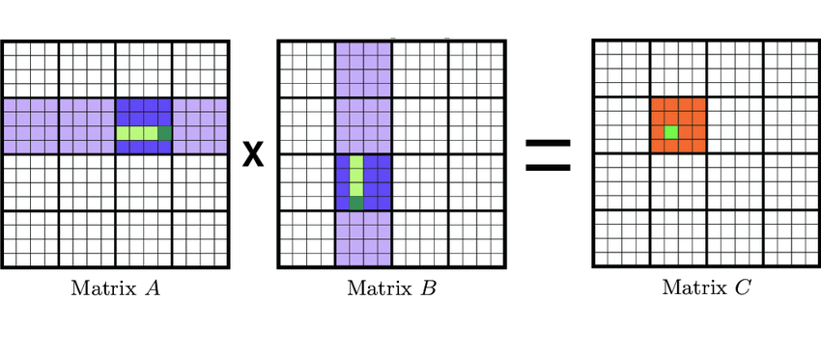
https://www.researchgate.net/figure/Tiled-matrix-multiplication-pseudocode-2_fig1_395338903

Slide 4
Training advances one mini-batch at a time
One epoch
64 samples
64 samples
64 samples
…
final batch
Batches stay sequential because every update changes the weights used by the next batch.
(Besides MPI)
1 · FORWARD
2 · BACKWARD
3 · UPDATE
Predict
Run the current batch through the two-layer network.
Accumulate
Sum sample contributions into one batch gradient.
Change the model
Apply one update, then move to the next batch.
3
Notes:
Target: 1:05.
Define mini-batching in plain language. An epoch visits every sample. Instead of waiting until the whole dataset is finished, the program takes a small group, performs a forward pass, accumulates the backward gradients, and updates the weights once.
The next mini-batch sees the updated weights, so batches are sequential. If the dataset does not divide evenly, the shorter final batch still produces one correctly normalized update.
For 5,000 samples and batch 64, sequential and OpenMP perform 79 updates per epoch.
[Sources]
- /Users/rowantangalin/Desktop/parco_prep/Project Code/src/train_seq.c
- /Users/rowantangalin/Desktop/parco_prep/Project Code/src/train_omp.c
- /Users/rowantangalin/Desktop/parco_prep/Project report/p2d_report_conference_corrected.tex

Slide 5
Tiling improves locality; OpenMP divides work inside each batch
The optimized kernel assigns each output tile to one thread owner.
Output matrix C
one tile → one owner
• Packed logical transposes improve contiguous access.
• Static scheduling distributes regular output tiles.
• The tile owner covers the full reduction dimension—no atomics are needed.
OpenMP parallelizes matrix work—not separate mini-batches.
T0
T1
T2
T3
4
Notes:
Target: 1:15.
The first optimization is local: tile the matrix operations and pack the required logical transposes so the innermost loops access contiguous data more effectively.
OpenMP then divides output tiles among threads inside the current mini-batch. Each tile has exactly one owner, and that owner covers the full reduction dimension. This avoids atomics and private partial matrices.
The amount of useful parallel work is therefore related to the shape and number of output tiles. A large reduction dimension alone does not guarantee that every thread has an output tile to own.
[Sources]
- /Users/rowantangalin/Desktop/parco_prep/Project Code/src/math_omp.c
- /Users/rowantangalin/Desktop/parco_prep/Project Code/src/train_omp.c
- /Users/rowantangalin/Desktop/parco_prep/Project report/p2d_report_conference_corrected.tex

Slide 6
MPI combines local mini-batches into one global update
4 ranks × local batch 64 = global batch 256
Local compute
Each rank owns a data slice and a complete model. Forward and backward produce local gradient sums.
Allreduce
Sum the sample count and four gradient arrays. Every rank receives the same global results.
Identical update
The model replicas remain synchronized.
1 · LOCAL BATCH
2 · SYNCHRONIZE
3 · UPDATE
5
Notes:
Target: 1:35.
Rank 0 creates the dataset and scatters a balanced contiguous slice to each rank. Every process holds a complete model initialized identically.
In each synchronized round, every rank computes a gradient sum over one local mini-batch. One Allreduce sums the actual sample counts; four more Allreduces sum the hidden weights, hidden biases, output weights, and output biases. All ranks receive the same global sums and apply the same update, so the replicas stay synchronized.
The command-line batch is local. With four ranks and local batch 64, one update uses up to 256 samples. This is the key semantic difference from sequential and OpenMP.
[Sources]
- /Users/rowantangalin/Desktop/parco_prep/Project Code/src/main_mpi_train.c
- /Users/rowantangalin/Desktop/parco_prep/Project Code/src/train_mpi.c
- /Users/rowantangalin/Desktop/parco_prep/Project report/p2d_report_conference_corrected.tex

Slide 7
525 runs test optimization, scaling and configuration choices
Experimental design
Two network shapes on individual HPC3 compute nodes. The seven experiments cover sequential optimization, fixed-problem scaling, two weak-scaling rules, tile sensitivity and batch sensitivity.
525
105
5
timed runs
configurations
repeats each
6
Notes:
Target: 1:10.
The study uses two shapes: a canonical 1024–1536–10 network and a large-input 178608–448–10 network. Every configuration has two warmups followed by five timed repetitions, producing 525 measurements from 105 configurations.
Training time is summarized by the median, with the interquartile range describing the middle half of the runs. Setup and the final evaluation are outside the training timer. MPI time is the maximum across ranks because the slowest process determines completion.
All supplied MPI experiments run on one compute node; they are not multi-node scaling results.
[Sources]
- /Users/rowantangalin/Desktop/parco_prep/Project report/p2d_report_conference_corrected.tex
- /Users/rowantangalin/Desktop/parco_prep/Project Code/results/
- /Users/rowantangalin/Desktop/parco_prep/Project Code/README.md

Slide 8
Locality produces roughly 3× improvement before parallelism
The optimized local kernel lowers the cost inherited by every parallel backend.
Tiling and packed-transpose handling were introduced together, so this experiment measures their combined effect.
3.08×
3.00×
Canonical workload
269.184 s → 87.423 s
direct → tiled sequential
Large-input workload
1114.349 s → 371.809 s
direct → tiled sequential
7
Notes:
Target: 1:10.
Before adding threads or MPI processes, the cache-aware sequential path is already about three times faster.
On the canonical workload, the median falls from 269.184 seconds to 87.423 seconds, a 3.08-times improvement. The large-input workload falls from 1114.349 seconds to 371.809 seconds, a 3.00-times improvement.
Tiling and packed-transpose handling were added together, so the experiment does not attribute a separate gain to either technique.
[Sources]
- /Users/rowantangalin/Desktop/parco_prep/Project Code/results/exp1_seq_baseline.csv
- /Users/rowantangalin/Desktop/parco_prep/Project report/p2d_report_conference_corrected.tex

Slide 9
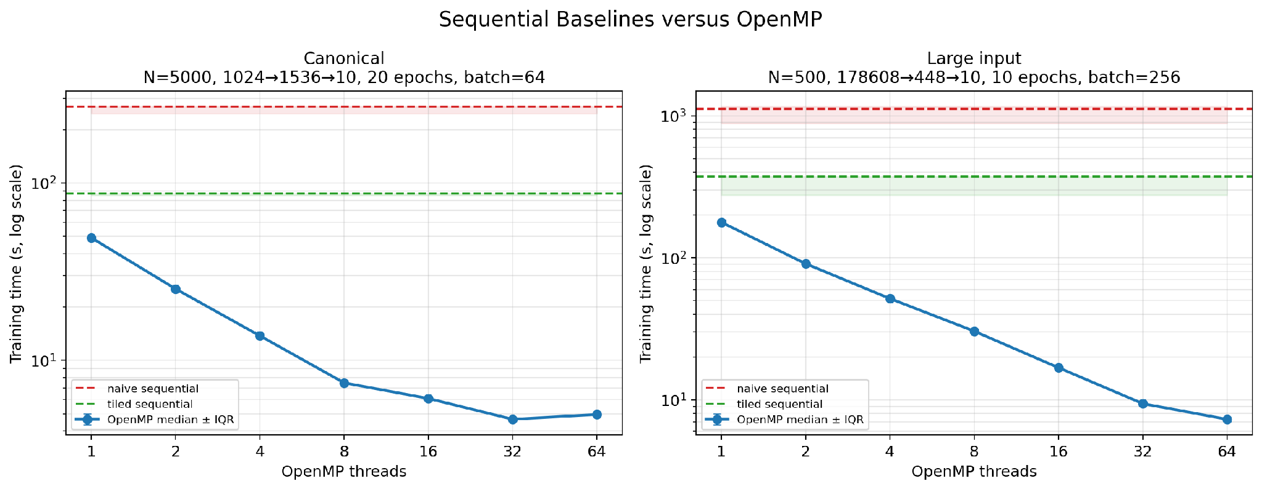
OpenMP’s best thread count depends on matrix shape
10.58×
Canonical workload
best at 32 threads
24.43×
Large-input workload
continues through 64 threads
Output-tile shape determines how much useful work can be shared.
8
Notes:
Target: 1:30.
The canonical workload improves until 32 threads, reaching 4.647 seconds and a 10.58-times self-speedup. At 64 threads it becomes slightly slower.
The large-input workload continues to improve through 64 threads, where it reaches 7.289 seconds and a 24.43-times self-speedup.
The implementation assigns output tiles to threads. A small batch or narrow output matrix can expose too few tiles, leaving some threads with no tile even when the reduction dimension is large. The useful thread count therefore depends on the actual matrix shape.
[Sources]
- /Users/rowantangalin/Desktop/parco_prep/Project Code/plots/cross_experiment/seq_vs_omp.png
- /Users/rowantangalin/Desktop/parco_prep/Project Code/results/exp2_omp_strong.csv
- /Users/rowantangalin/Desktop/parco_prep/Project report/p2d_report_conference_corrected.tex

Slide 10
The two network shapes expose radically different tile counts
Full mini-batch B = 64 · tile width T = 64
Canonical workload
Large-input workload
1024 → 1536 → 10
178608 → 448 → 10
Operation | Output shape | Tiles
Hidden forward | 64 × 1536 | 24
Output forward | 64 × 10 | 1
Hidden-delta calculation | 64 × 1536 | 24
Output-weight gradient | 10 × 1536 | 24
Hidden-weight gradient | 1536 × 1024 | 384
Operation | Output shape | Tiles
Hidden forward | 64 × 448 | 7
Output forward | 64 × 10 | 1
Hidden-delta calculation | 64 × 448 | 7
Output-weight gradient | 10 × 448 | 7
Hidden-weight gradient | 448 × 178608 | 19,537
The largest gradient operation exposes 384 tiles versus 19,537—enough extra parallel work to keep the larger team useful.
9
Notes:
Target: 1:10.
This table explains the previous scaling result at operation level. The tile count is the number of independent output tiles produced by ceil(rows divided by 64) times ceil(columns divided by 64).
In the canonical workload, several kernels expose only 24 tiles and the output forward pass exposes only one. The hidden-weight gradient is the most parallel operation, with 384 tiles.
In the large-input workload, the narrow hidden layer gives only seven tiles in several batch-shaped operations, but the enormous 448 by 178608 hidden-weight gradient exposes 19,537 output tiles. That operation provides much more parallel work and helps amortize the overhead of 64 threads.
The result should still be described as a combination of tile-level parallelism and overhead, not as proof that tile count alone determines runtime.
[Sources]
- /Users/rowantangalin/Desktop/parco_prep/Project Code/src/train_omp.c
- /Users/rowantangalin/Desktop/parco_prep/Project Code/src/math_omp.c
- /Users/rowantangalin/Desktop/parco_prep/Project Code/results/exp2_omp_strong.csv
- /Users/rowantangalin/Desktop/parco_prep/Project report/p2d_report_conference_corrected.tex

Slide 11
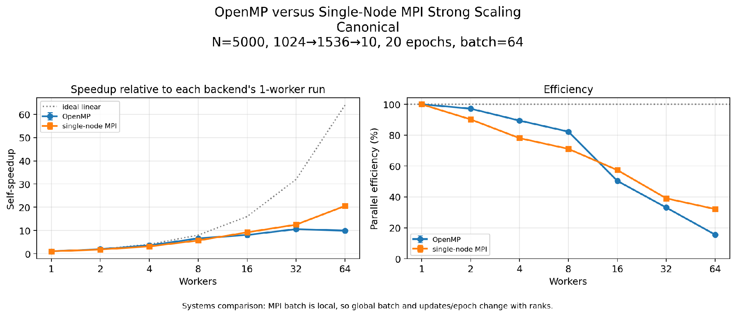
MPI reaches 20.55× while also changing the update schedule
20.55×
MPI self-speedup at 64 ranks
79 → 2
updates per epoch
64 → 4096
effective global batch
10
Notes:
Target: 1:35.
MPI training time falls from 73.683 seconds at one rank to 3.586 seconds at 64 ranks, producing a 20.55-times self-speedup.
But the local batch remains 64 per rank. The effective global batch therefore rises from 64 to 4096, while updates per epoch fall from 79 to 2.
The entire dataset is still processed every epoch, but it is grouped into far fewer synchronized updates. The result is valid for the implemented configuration, yet it is not pure strong scaling of an unchanged training schedule and should not be read as a direct MPI-versus-OpenMP ranking.
[Sources]
- /Users/rowantangalin/Desktop/parco_prep/Project Code/plots/cross_experiment/omp_vs_mpi_strong.png
- /Users/rowantangalin/Desktop/parco_prep/Project Code/results/exp3_mpi_strong.csv
- /Users/rowantangalin/Desktop/parco_prep/Project Code/src/train_mpi.c
- /Users/rowantangalin/Desktop/parco_prep/Project report/p2d_report_conference_corrected.tex

Slide 12
Weak scaling uses two different workload-growth rules
OpenMP · wider model
MPI · larger dataset
Efficiency (%)
Efficiency (%)
100
100
80
80
60
60
40
40
20
20
0
0
1
2
4
8
16
32
64
1
2
4
8
16
32
64
Workers
Workers
17.12%
5.764 → 33.661 s · hidden width = 128p
40.77%
7.458 → 18.294 s · 500 samples per rank
Different workload-growth rules → not a backend ranking
11
Notes:
Target: 1:20.
Weak scaling asks whether runtime remains close to constant as workers and total work grow.
The OpenMP experiment widens the hidden layer with the thread count. Runtime rises from 5.764 to 33.661 seconds, giving 17.12 percent endpoint efficiency.
The MPI experiment keeps the model fixed and adds 500 samples per rank. Runtime rises from 7.458 to 18.294 seconds, giving 40.77 percent endpoint efficiency.
These percentages answer different questions. Growing a model changes parameter count, matrix shapes, memory behavior, and arithmetic per sample. Growing a dataset keeps the model fixed but adds data and collective participants. They should not be used to rank OpenMP and MPI.
[Sources]
- /Users/rowantangalin/Desktop/parco_prep/Project Code/results/exp4_omp_weak.csv
- /Users/rowantangalin/Desktop/parco_prep/Project Code/results/exp5_mpi_weak.csv
- /Users/rowantangalin/Desktop/parco_prep/Project report/p2d_report_conference_corrected.tex

Slide 13
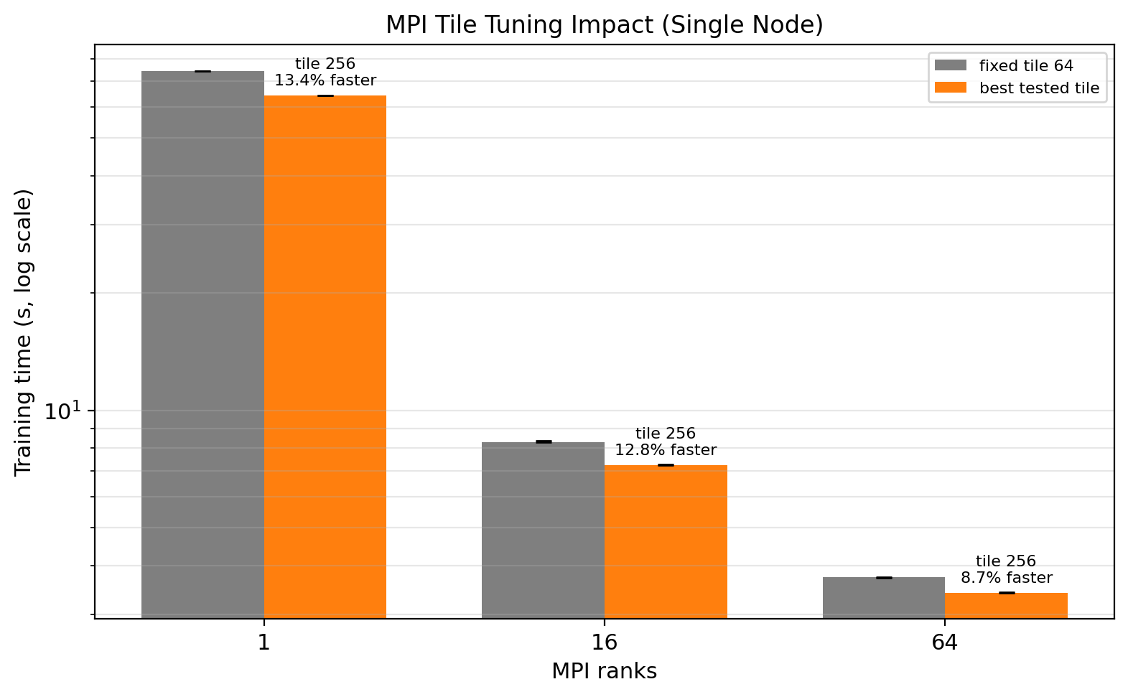
Tile and batch choices reshape runtime
tile 256
fastest tested at 1, 16 and 64 ranks
8.66–13.37%
faster than tile 64
larger batch
fewer update and synchronization rounds
Configuration choices are part of the experiment—not neutral implementation details.
12
Notes:
Target: 1:10.
Across the tested 1-, 16-, and 64-rank cases, tile 256 is the fastest tested value. It improves training time by between 8.66 and 13.37 percent relative to tile 64.
Larger mini-batches also often reduce runtime because they produce fewer updates and amortize fixed thread-team or collective costs. In MPI, remember that the batch argument is local, so increasing it also increases the effective global batch.
The broader point is that tile size and batch convention are part of the experimental configuration. They must be stated when a speedup is interpreted.
[Sources]
- /Users/rowantangalin/Desktop/parco_prep/Project Code/plots/cross_experiment/mpi_tile_tuning_impact.png
- /Users/rowantangalin/Desktop/parco_prep/Project Code/results/exp6_mpi_tile.csv
- /Users/rowantangalin/Desktop/parco_prep/Project Code/results/exp7_batch_seq_omp.csv
- /Users/rowantangalin/Desktop/parco_prep/Project Code/results/exp7_batch_mpi.csv
- /Users/rowantangalin/Desktop/parco_prep/Project report/p2d_report_conference_corrected.tex

Slide 14
CONCLUSION
The locality provided by tiling leads to speedup, which can be furthered through multi-threading
≈3× from locality before parallelism
OpenMP depends on matrix shape
MPI rank count also changes batch semantics
Next experiment
hybrid MPI + OpenMP
Notes:
Target: 1:20.
Close with the methodological lesson. Locality produces the first major improvement before parallelism. OpenMP scaling depends on the amount and shape of work exposed inside a batch. MPI reduces elapsed time, but its local-batch convention also changes the effective global batch and the number of updates.
A speedup becomes meaningful only after stating what stayed fixed, what grew, and how often synchronization occurred.
A stricter next comparison would keep the global batch and updates per epoch fixed, use equal core counts and placement, collect hardware and communication profiles, and then compare pure OpenMP, pure MPI, and a hybrid design.
[Sources]
- /Users/rowantangalin/Desktop/parco_prep/Project report/p2d_report_conference_corrected.tex
- /Users/rowantangalin/Desktop/parco_prep/Project Code/README.md

