Slide 1

Healthy Life Solutions
By
Spencer Stewart & Jacob Ashcraft

Slide 2
Contextual Inquiry
We started out with the idea in mind to ask people about a room scheduler application and how people incorporate this concept into their life.

Slide 3
Room Scheduler Vs. Personal Scheduler
After interviewing a handful of people we thought would use a room scheduler application, we saw a different, greater need to develop a personal scheduler instead.

Slide 4
Mission Statement
Life Trax is a useful tool for personal and work scheduling.
Provide the option to share schedules between family, friends, and coworkers.
Can create events and tasks with reminders.
It will allow you to create template schedules to be applied to any day.
It will allow you to drag and drop templates or tasks into your schedule.
It will give you color code options to help organize your day.
Be able to differentiate between personal life and work life.
It will combine multiple schedules and determine a time that works best for everyone.
Features can be turned on and off to adjust the simplicity of Life Trax.

Slide 5
Personas
In our personas, we were clearly able to identify what we needed for our scheduler program. We based our requirements off of two very general personas.

Slide 6
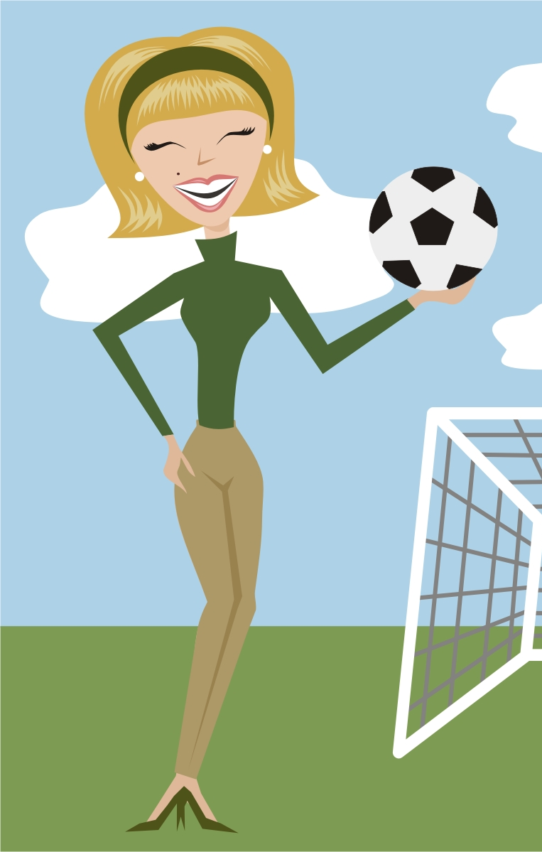
The Typical Soccer Mom
Suzy Robinson is your stereotypical soccer mom. She is in her mid 30’s, happily married to her husband. They both have 3 kids. Ages 12, 10, and 7. Each of her kids are engaged in school, private music lessons, and community soccer teams. On top of this, Suzy is on her local PTA board. Between all of these events, her schedule gets pretty packed. She knows that all of these events are good for her and her children. But things can get a little heckteck sometimes.
In her spare time she likes to quilt and sew. She enjoys making new friends and talk to all those around her. In every opportunity, she helps someone else. She enjoys being with her family and likes doing birthday parties.
Complements of thenonconsumeradvocate.com

Slide 7

The Typical Breadwinner
Garren Detroit is your average breadwinner. Goes to work and brings home the bacon to his wife and kids. He goes to the office each day from 8-5. Monday through Friday. He wears a buttoned up shirt and tie. Sometimes a suit coat if his boss requires it. He drives his car to a tall office building in the middle of downtown Detroit. Convenient to his name. He takes the elevator up, with a bunch of his coworkers. All getting ready to do another day’s worth of work. He steps out of the over crowded elevator, only to move through the maze driven floor to his cubicle where he will often not see another face until he takes his 5 minute coffee break.
He comes home from work and enjoys seeing his family. Come home to his wife and two kids. In his spare time he works on his remote control airplane hobby. Getting to go to conventions on the weekend and fly his remote control planes that he builds during the week in his spare time.
Complements of freepix.com

Slide 8
Primary Features
Being able to simply create an event.
Seamlessly and easily connect others to one or more calendars.
Easily collaborate with others regarding events.
Something simple and easy to use. Not too complicated.

Slide 9
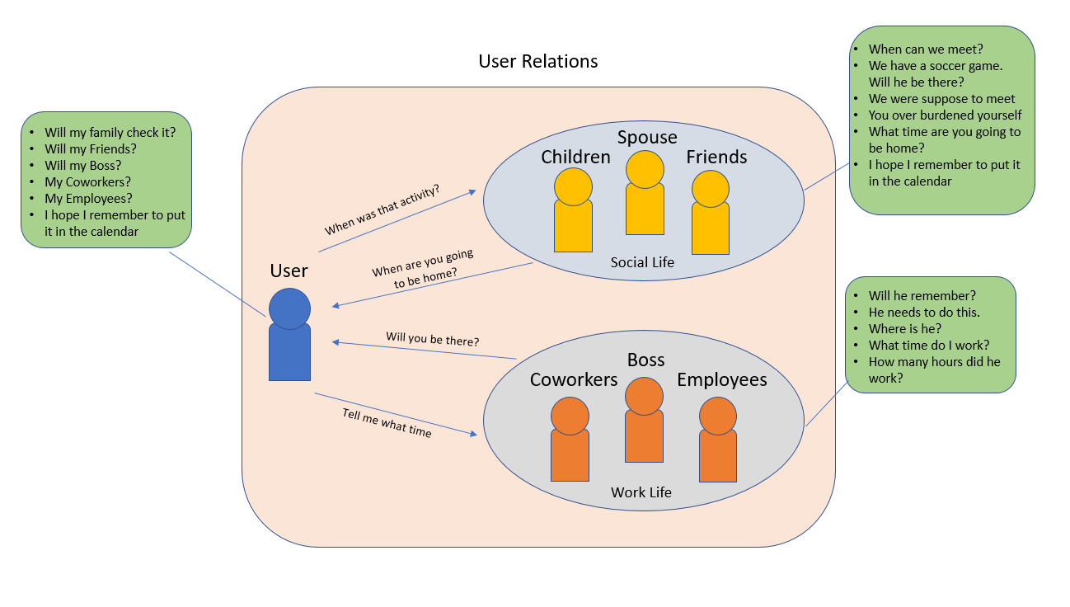
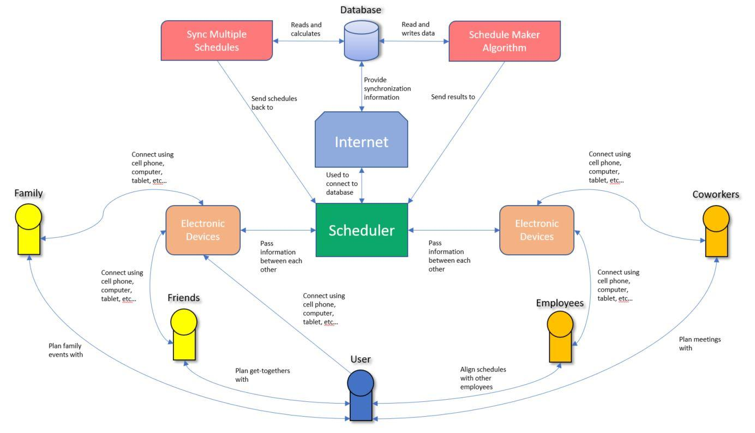
Interactive Flowcharts

Slide 10
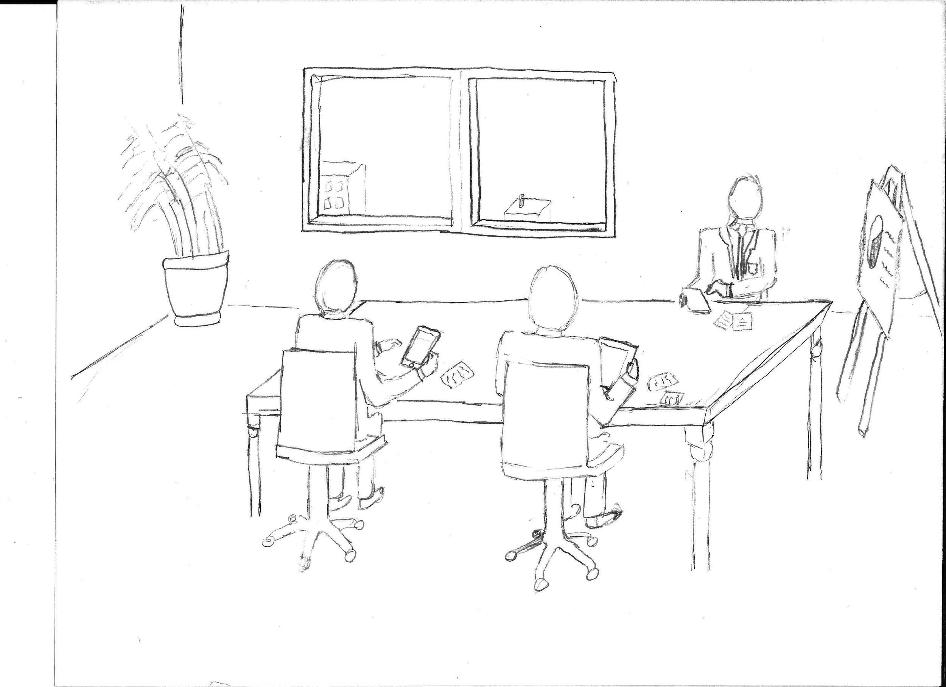
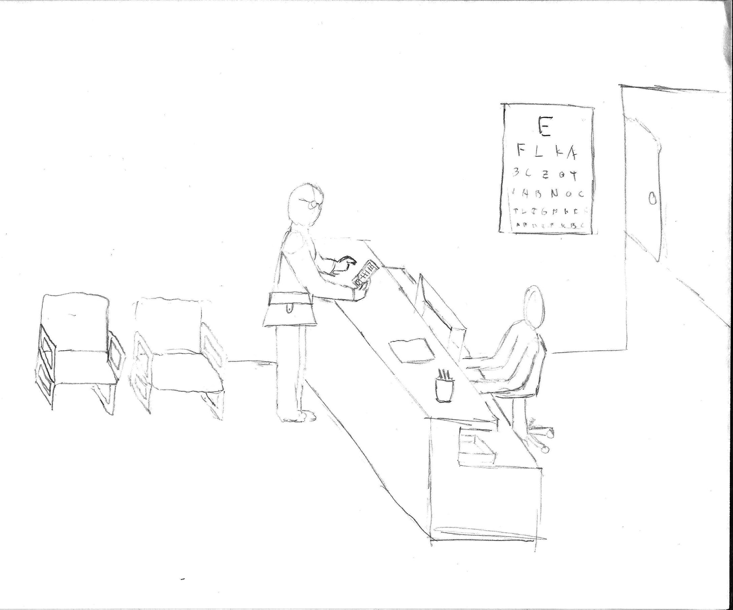
Environment

Slide 11
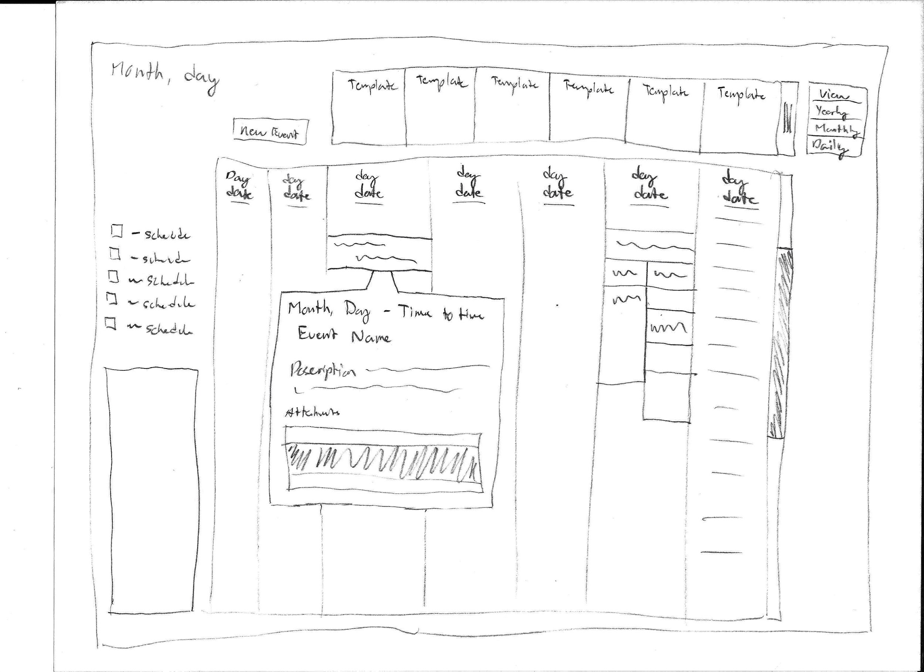
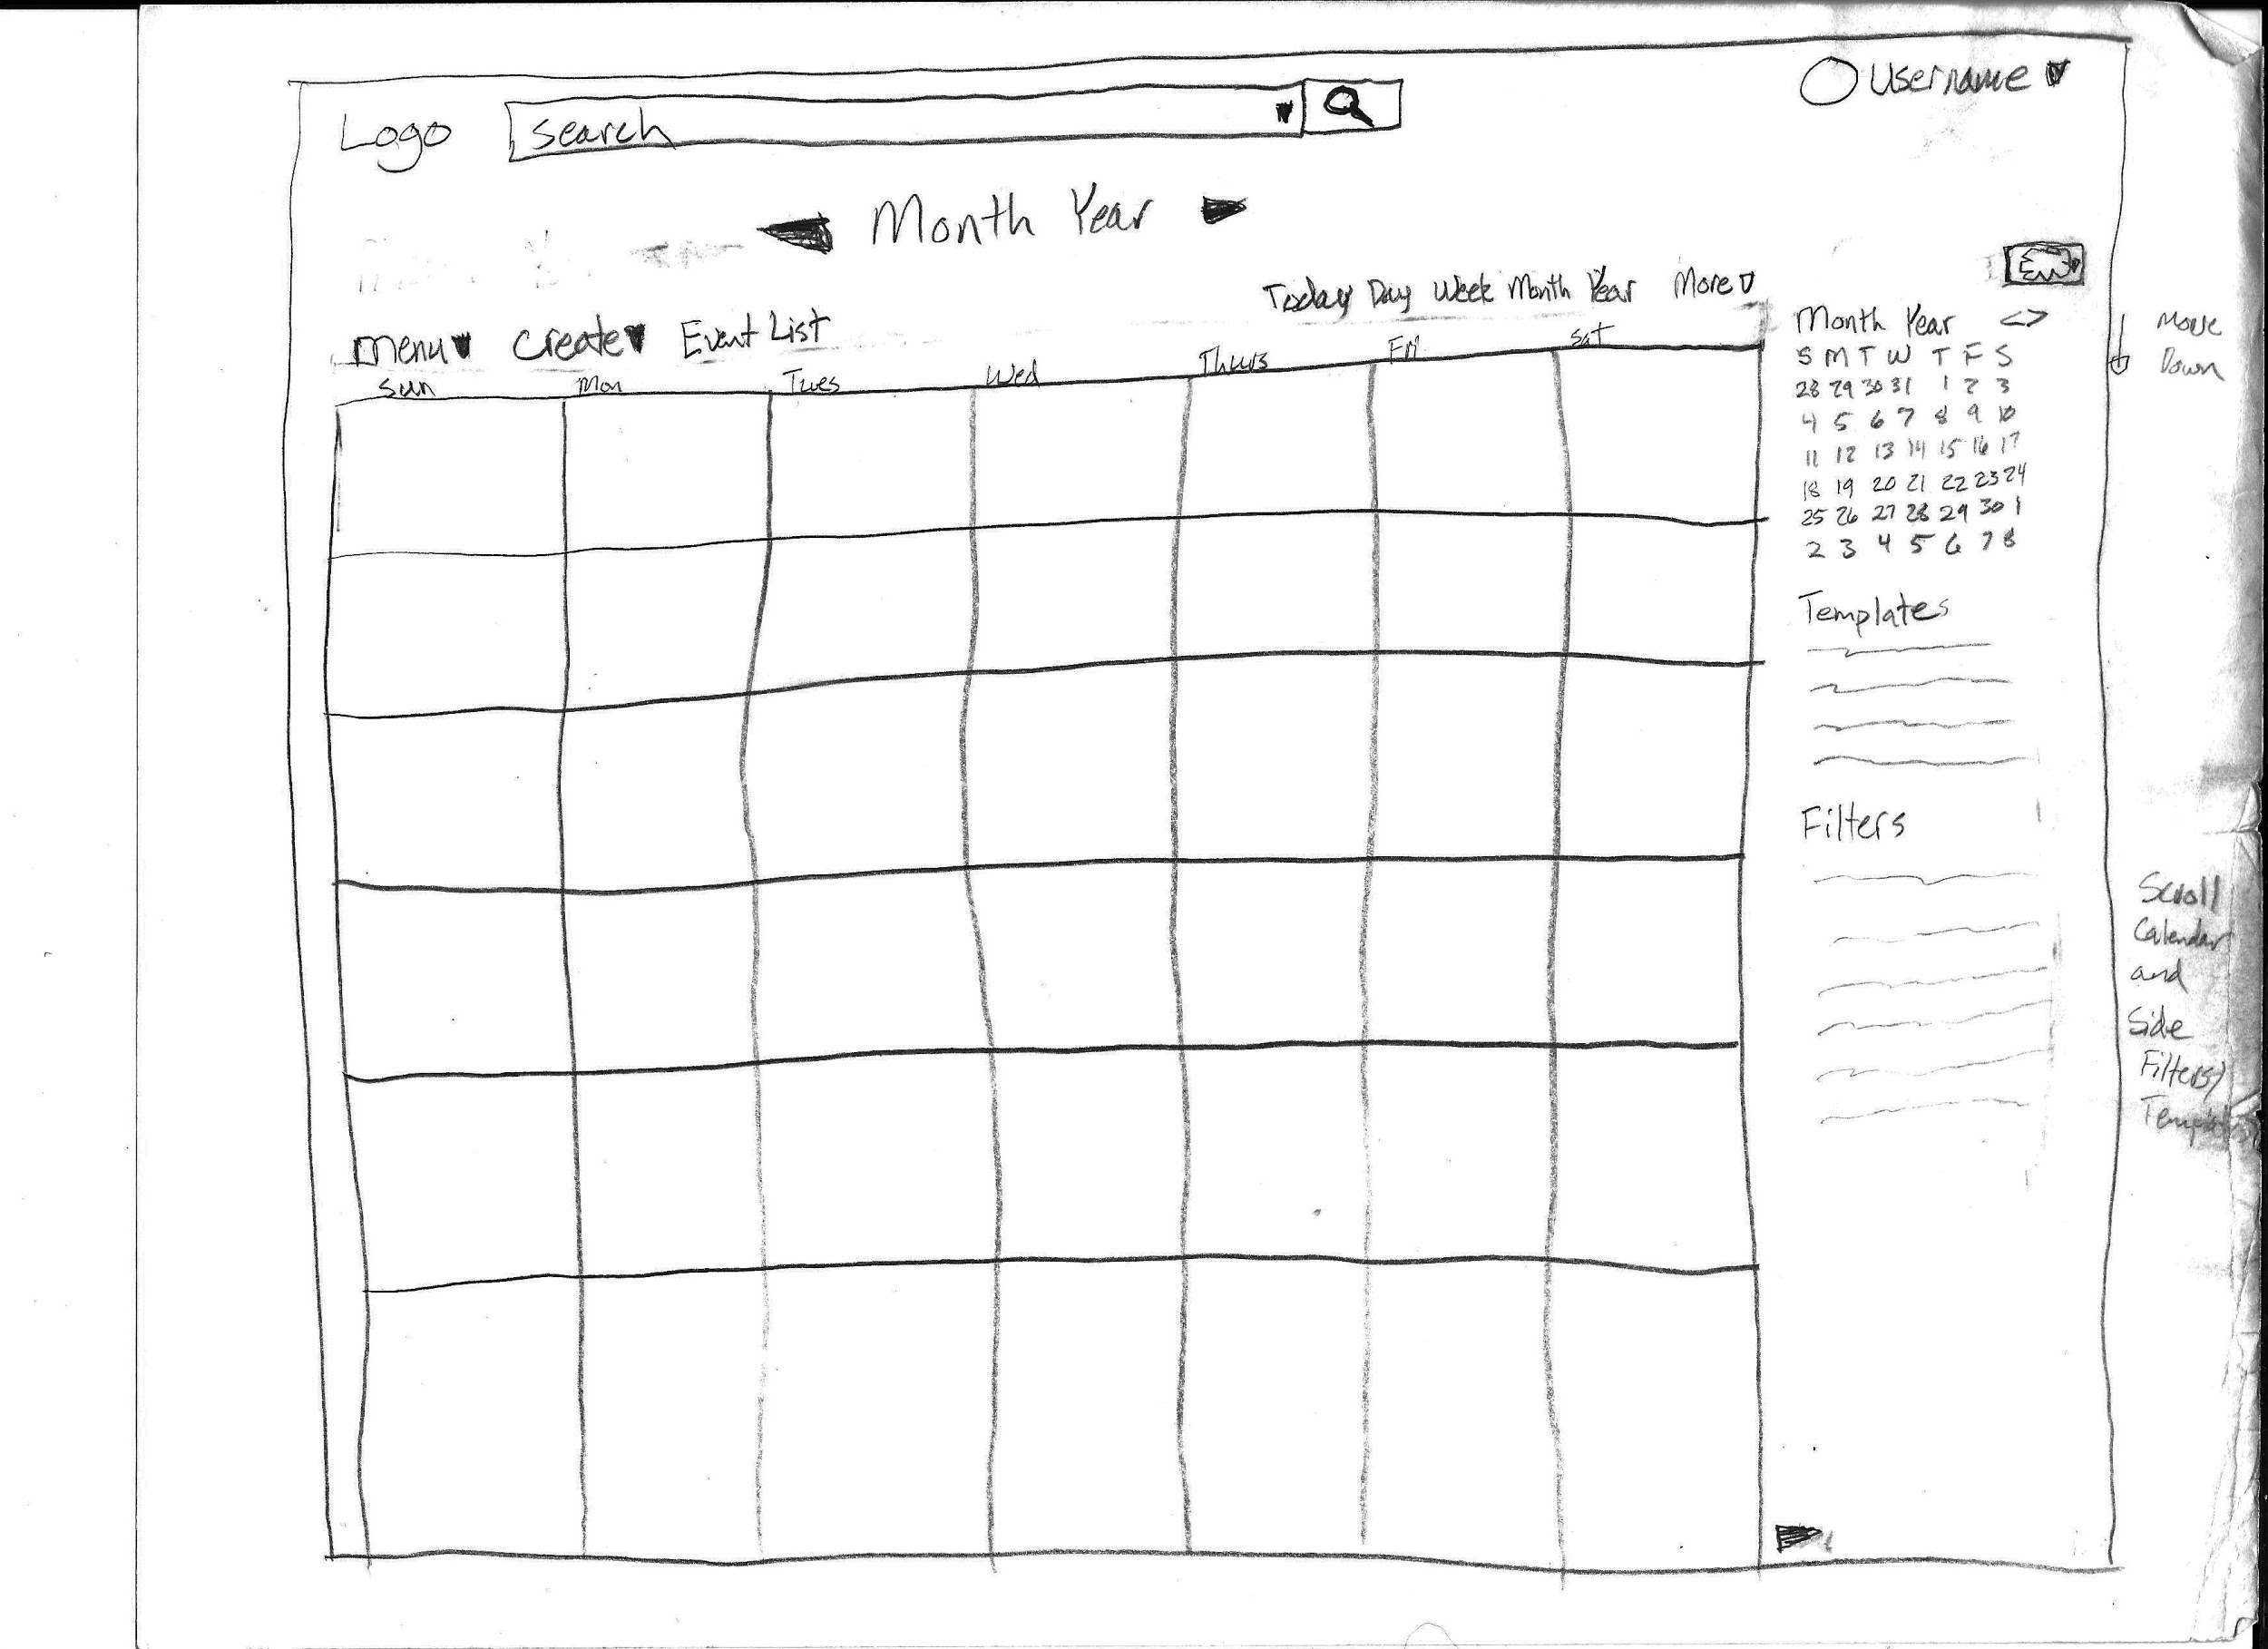
Ideation Sketching

Slide 12
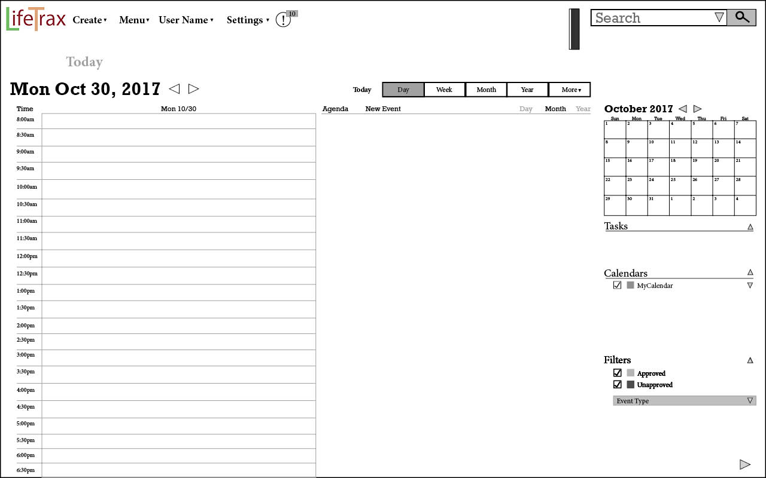
Prototype Version 1

Slide 13
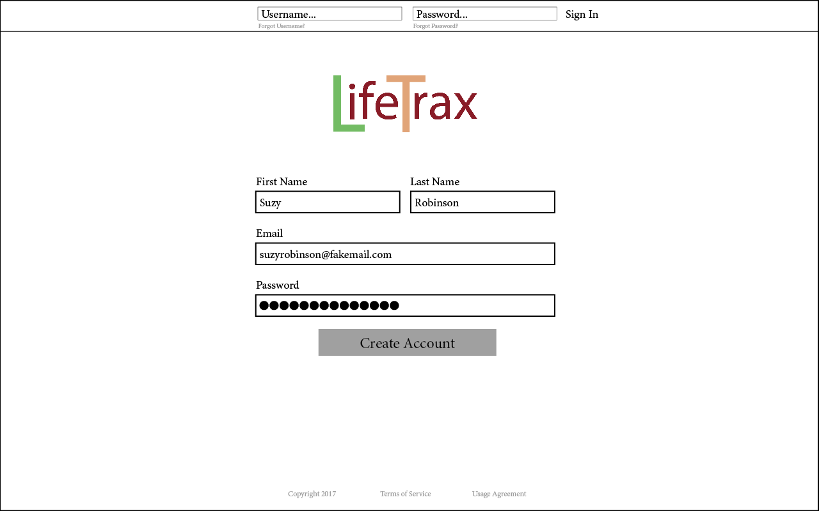
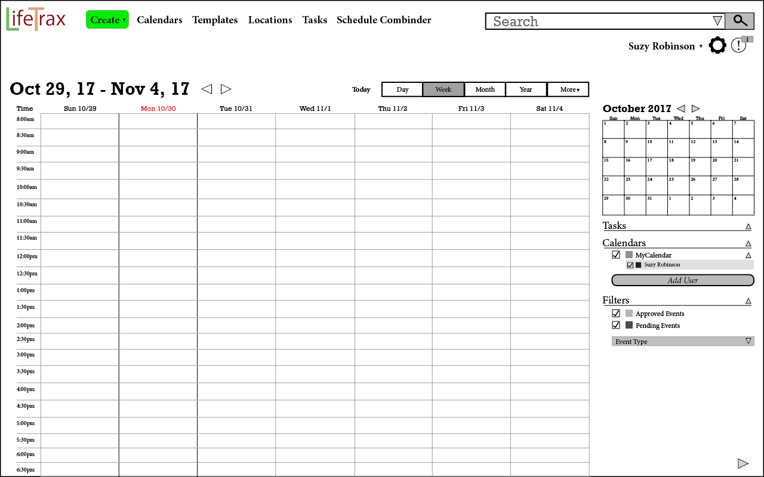
Prototype Version 3

Slide 14
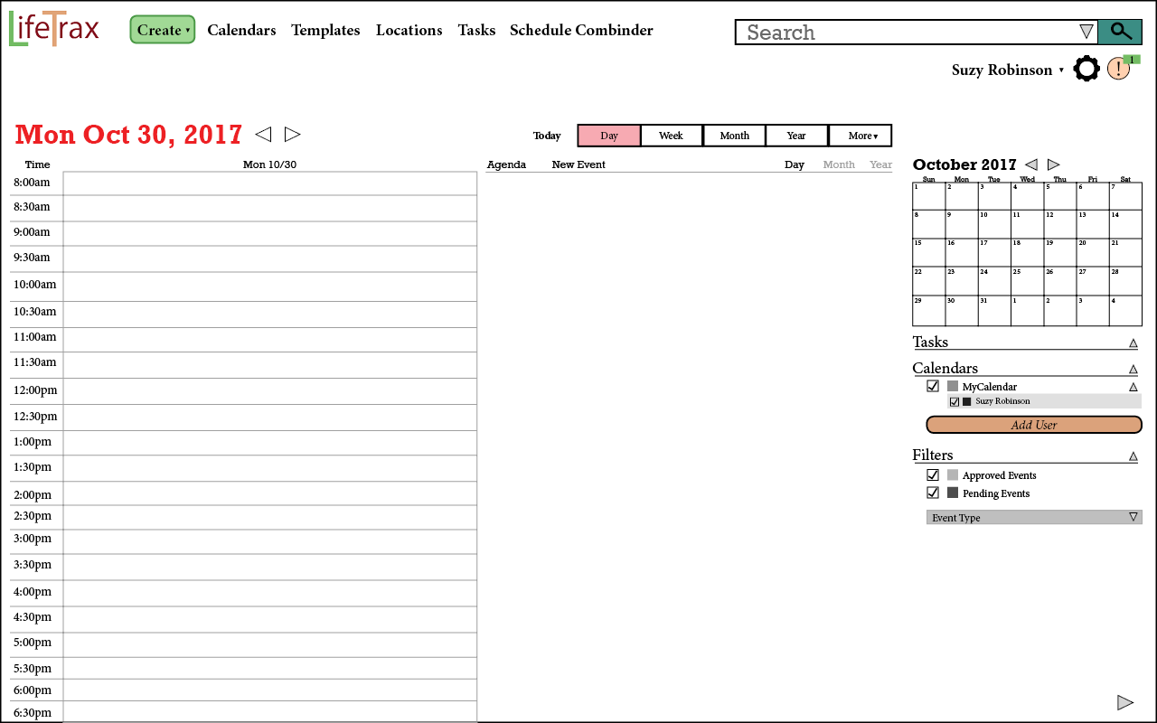
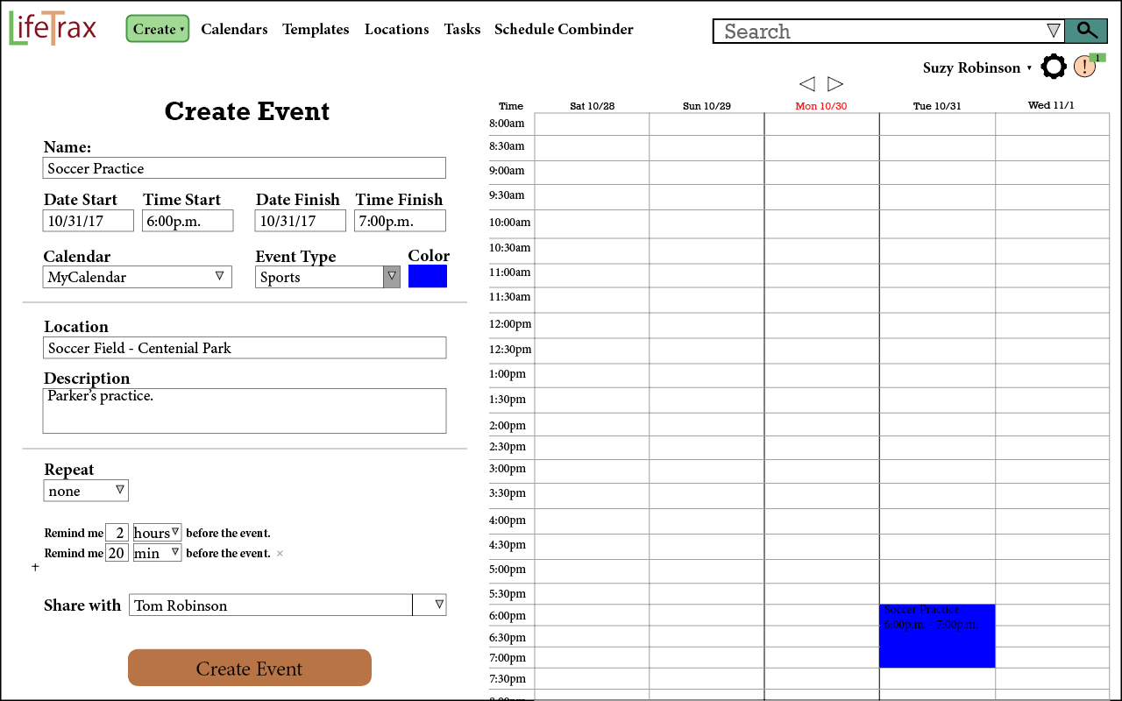
Prototype 4

Slide 15
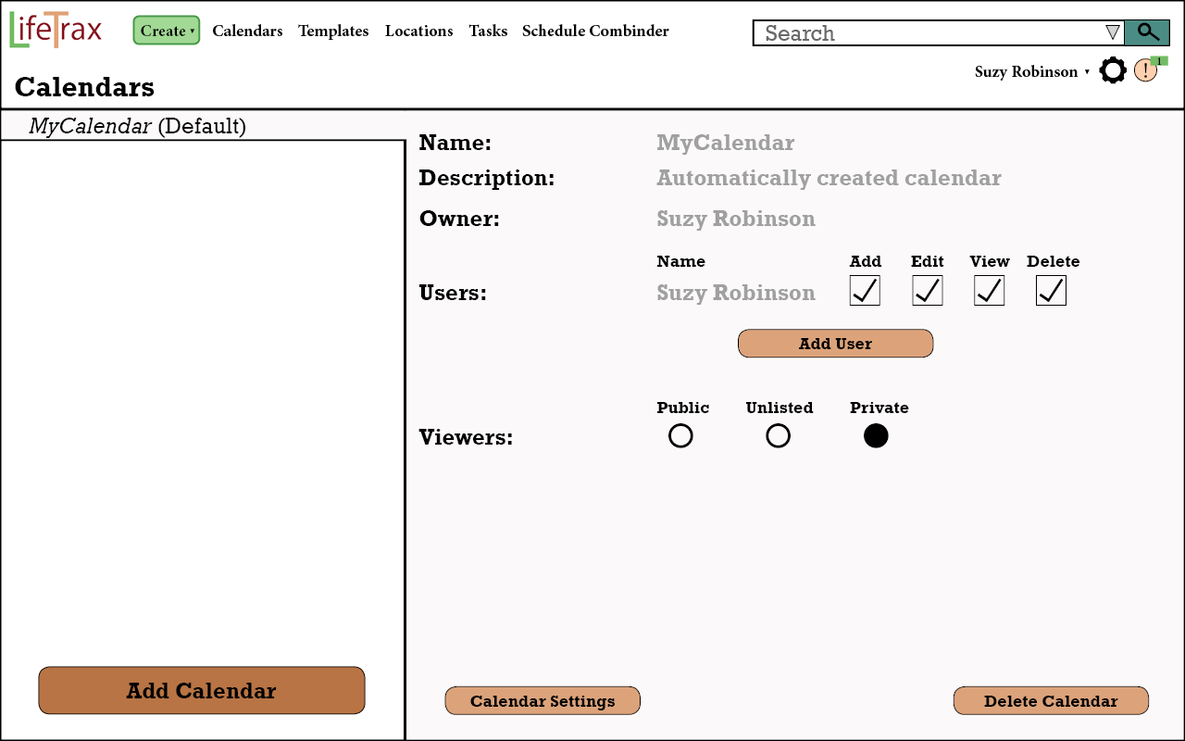
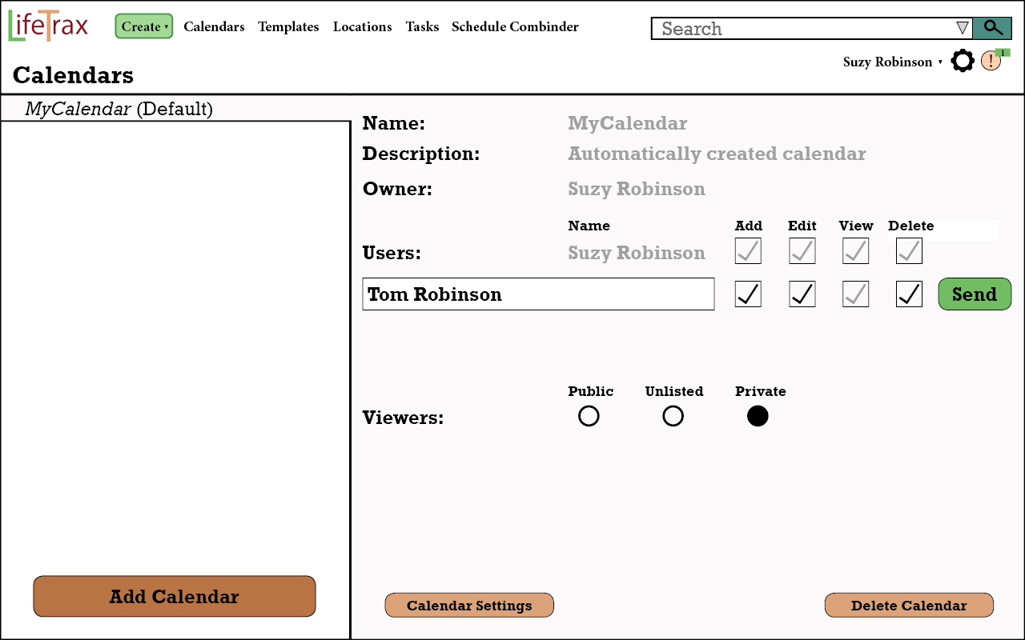
Prototype 4 Continued

Slide 16
Cost Importance Analysis Top 5
Problem | Solution | Importance to Fix | Cost | Prio. Ratio | Prio. Rank | Cuml. Cost | Resolution
Difficulty Finding Create Event Button | Surround in color. Alternatives to finding | M | 1 | M | 1 | 1 | Fixed in v2.0
Difficulty with finding Add User Page | Add additional options to find | M | 1 | M | 2 | 2 | Fixed in v2.0
Crucial Buttons weren't obvious | Add color and shapes to these | 5 | 1 | 5000 | 4 | 3.5 | Fixed in v4.0
Difficulty identifying today | Add color to certain sections | 3 | 0.75 | 4000 | 5 | 4.25 | Fixed in v4.0
Font is too small | Increase Font Size | 2 | 0.5 | 4000 | 6 | 4.75 | Fixed in v4.0

Slide 17
Emotional Impact
We wanted this application to be easy for our users to use. So our main focus is providing an easy way for them to navigate through our application. As we interviewed our individuals, we noted what negative impacts they had with their current scheduling applications. We took these ideas, designed a way to make it easier and then implemented it into our scheduler.
The general consensus for our scheduler is that people enjoyed it and that it was simple. We made a few mistakes in our different prototypes. But we quickly corrected these problems.
We received feedback that it was easy to use, it looked nice, wasn’t cluttered or complicated, and it was simple.

Slide 18
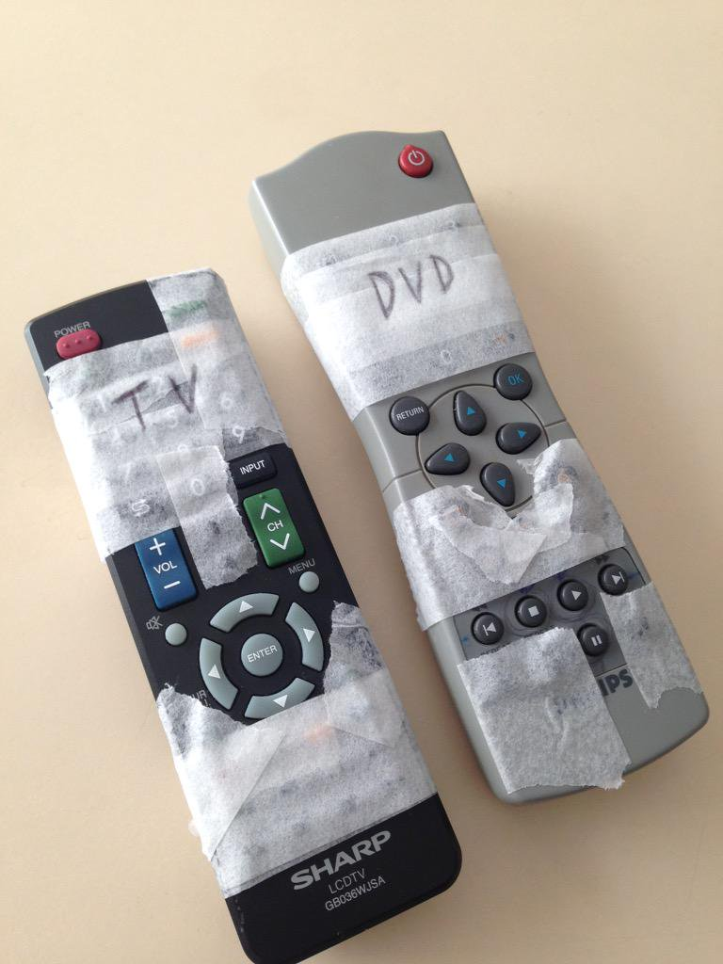
Lessons Learned
^{The Grandma remote principle.}

Slide 19
Additional Lessons Learned
The user won’t do what you think they will do
Iteration is key to finding and solving problems
Interviews are important to generation of ideas and design
Design with the user and personas in mind.
^{Be flexible to change.}
What may be simple to one person may be complex to another.

Slide 20
Evaluation
Throughout this project, we both came together and continually reviewed our project. Noting different mistakes that were made in the prototype and readjusting things that would improve it. Our processes went as such.
We would have people try our prototype and ask them questions to better understand it.
Based on their input and feedback we would adjust our prototype and improve on it, then have more people try it and rinse and repeat.
We spent hours discussing different features and positioning to give our users the best experience possible for this scheduler.

