Slide 1
The 2024/25 Rosenheim Alzheimer's Detection Challenge (RAD-C)
Stefanie Maierhofer Christian Kehrer

Slide 2
Agenda
Problem
Domäne
Daten
Vorgehensweise
Diskussion/Interpretation
Ergebnisse

Slide 3
Problem

Slide 5
Domäne

Slide 6
Alzheimer

Slide 7
Alzheimererkennung
Your task is to classify the patients in the dataset as either having Alzheimer's or not and to predict the MMSE score of the patients using the speech and text samples provided to you.
Classification: This task is aimed at identifying those with different cognitive impairments and dementia from healthy volunteers through the processing of their speech.
Regression: This task is to predict the corresponding Mini Mental Status Examination (MMSE) score of speakers from their speech.

Slide 8
Daten

Slide 9
Daten
157 Datensätze mit je einer
Sprachdatei
Textdatei (Transskript)
zu den Tasks:
CTD
PFT
SFT
Sprache Englisch
dem-info.csv
Record-ID
TrainOrDev
Class
Gender
Age
Converted-MMSE

Slide 10
Read_Me
The "dem-info.csv" file contains the labels and metadata for all the subjects. The columns in this CSV file are:
"Record-ID": the subject identifiers that are the folder names
"TrainOrDev": if the subject belong to the train or development (dev) set
"Class": three classes represented by the subjects that are either Dementia, MCI or HC
"Gender": if the subject is male or female
"Age": age of the subject while participating in the study. For participants without a known age, we have provided the average age across the corpus and marked this with an asterisk (66*)
"Converted-MMSE": Mini-Mental State Exam (MMSE) score for the subjects, if available, otherwise the MMSE value has been converted from Moca (Fasnacht et al, 2023) and ACE-III (María-Guiu, 2018).

Slide 11
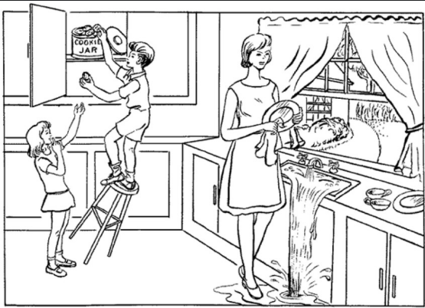
Tasks
CTD = Coockie Theft Picture description
„Please describe this picture.“
PFT = Phonemic Fluency
„Please say as many words beginning with the letter ‚P‘ as you can. Any word begin with ‚P‘ except for names of people such as Peter , or countries such as Portugal.“
SFT = Semantic Fluency
„Please name as many animals as you can in a minute.“

Slide 12
Sprachdaten

Slide 13
Textdaten (Transkripte)
Bsp: Process-rec-011
Dem-info.csv:
CTD:
PFT:
SFT:
Pat: There’s a boy on a chair and he looks like he’s tipping over cos he’s trying to get the cookie jar out the top shelf, and the girl on the left is er trying to get the, get him to get her some cookies probably. And the mum’s washing pots and she looks like she’s (1 second) er daydreaming and the sink is overflowing (1 second) and can’t tell what’s happening outside, if it’s, what the weather’s like, and the water’s going everywhere over the floor, and the boy’s just, and the boy’s, on the left’s just about to fall on the floor.
Pat: Er, peas, porpoises, potatoes, er (2 seconds) parasites, er (12 seconds) pneumonia, er (3 seconds) physics, er (9 seconds) portable (3 seconds) um. (12 seconds)
Pat: Antelope, spider, snake, dinosaur, lion, tiger, giraffe (1 second) sealion, fish, shark, er (4 seconds) er tortoise, cat, dog, snake (3 seconds) er (1 second) birds, er wasp, bees, er (1 second) fleas, er (2 seconds) caterpillars (1 second) er (12 seconds) elephants (1 second) gir.
Notes:
MCI = leichte kognitive Beeinträchtigung

Slide 14
Vorgehensweise

Slide 15

Vorgehensweise
Preprocessing
Feature Engineering
Modellierung
Evaluation
Hyperparameter Tuning
Datenalalyse
Empirischer Ansatz

Slide 16
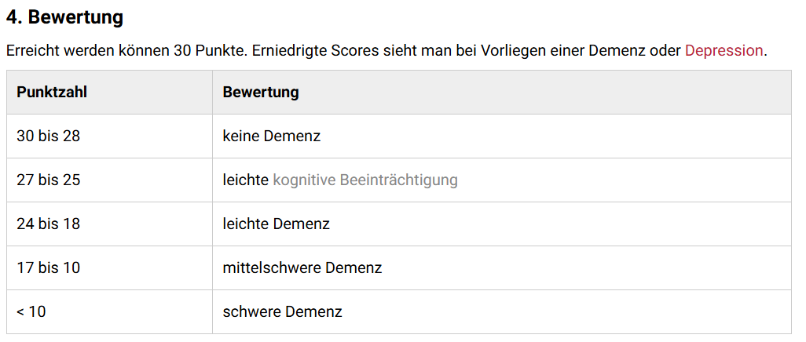
Preprocessing Textdaten
In dem-Info.csv:
Bei Age „*“ entfernt, sodass es ein Int/Double ist und kein String
Fehlende MMSE-Scores aufgefüllt mit:
MCI = 27
Dementia = 24
HC = 30
Quelle: https://flexikon.doccheck.com/de/Mini-Mental-Status-Test

Slide 17
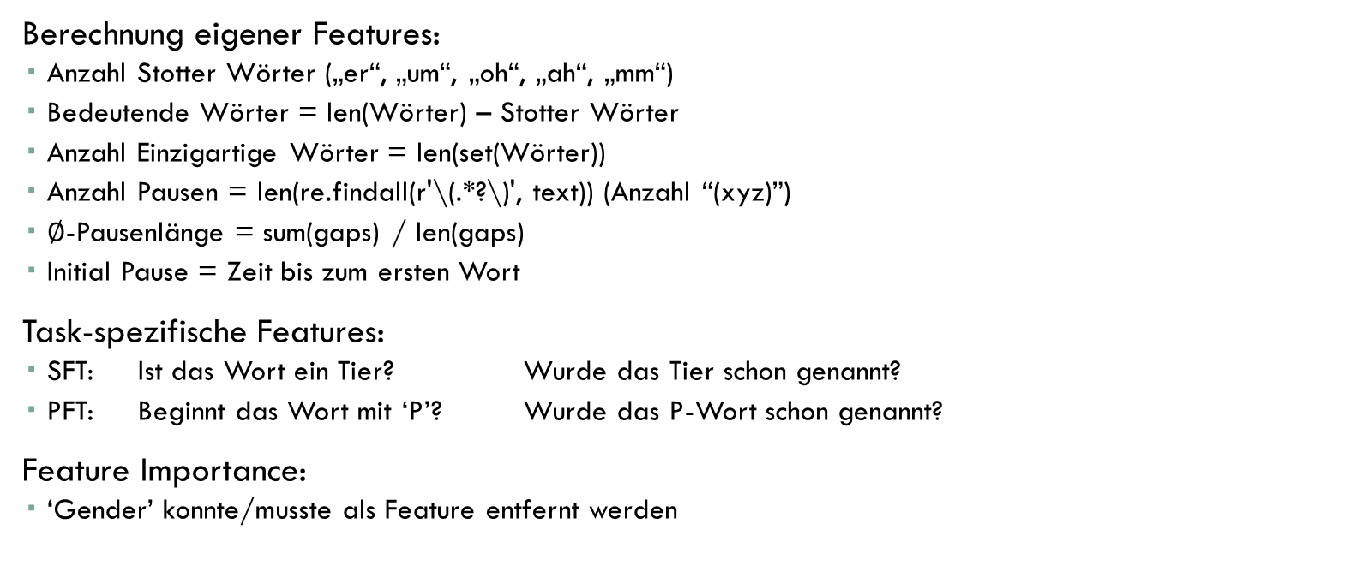
Feature Engineering Textdaten
Berechnung eigener Features:
Anzahl Stotter Wörter („er“, „um“, „oh“, „ah“, „mm“)
Bedeutende Wörter = len(Wörter) – Stotter Wörter
Anzahl Einzigartige Wörter = len(set(Wörter))
Anzahl Pausen = len(re.findall(r'\(.*?\)', text)) (Anzahl “(xyz)”)
$∅$-Pausenlänge = sum(gaps) / len(gaps)
Initial Pause = Zeit bis zum ersten Wort
Task-spezifische Features:
SFT: Ist das Wort ein Tier? Wurde das Tier schon genannt?
PFT: Beginnt das Wort mit ‘P’? Wurde das P-Wort schon genannt?
Feature Importance:
‘Gender’ konnte/musste als Feature entfernt werden

Slide 18
Ergebnisse
Classification
Regression

Slide 19
Classification

Slide 20
PFT
PFT | Text | Dem-Info | Calculated Features | Grid Search | Feature Importance | Weighted Avg F1-Score
DistilBERT | x | x | x |  |  | 24 %
DistilBERT | x |  |  |  |  | 48 %
LSTM | x | x |  |  |  | 53 %
LSTM | x | x | x |  |  | 47 %
Naive Bayes | x |  |  |  |  | 48 %
Naive Bayes |  | x |  |  |  | 72 %
Gradient Boosting | x | x |  |  |  | 82 %
Gradient Boosting | x | x |  |  |  | 82 %
Gradient Boosting | x | x | x | x |  | 82 %
Gradient Boosting | x | x | x | x | x | 85 %
XGBoosting | x | x |  | x | x | 88 %
XGBoosting | x | x | x | x | x | 88 %

Slide 21
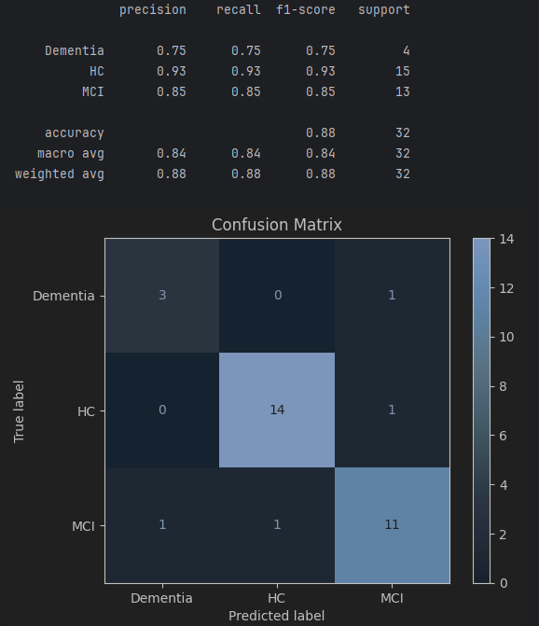
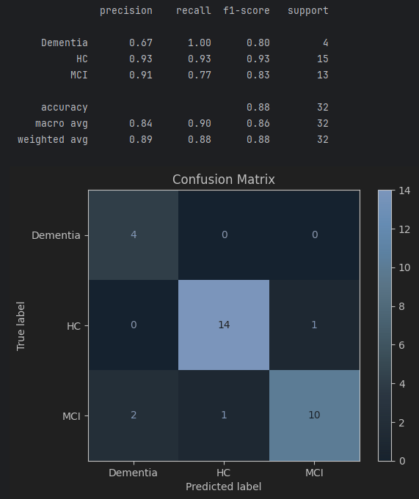
PFT XGBoost
mit Calculated Features
ohne Calculated Features

Slide 22
PFT
CTD | Text | Dem-Info | Calculated Features | Grid Search | Feature Importance | Weighted Avg F1-Score
BERT | x |  |  |  |  | 51 %
DistilBERT | x | x |  |  |  | 51 %
DistilBERT | x |  |  |  |  | 56 %
Naive Bayes | x | x |  |  |  | 30 %
Naive Beyes | x |  |  |  |  | 48 %
Random Forest | x | x |  |  |  | 64 %
Random Forest | x |  |  |  |  | 45 %
Logistic Regression | x | x |  |  |  | 71 %
XGBoosting | x | x |  | x |  | 77 %
Gradient Boosting | x | x |  |  |  | 80 %
Gradient Boosting | x | x |  | x |  | 91 %

Slide 23
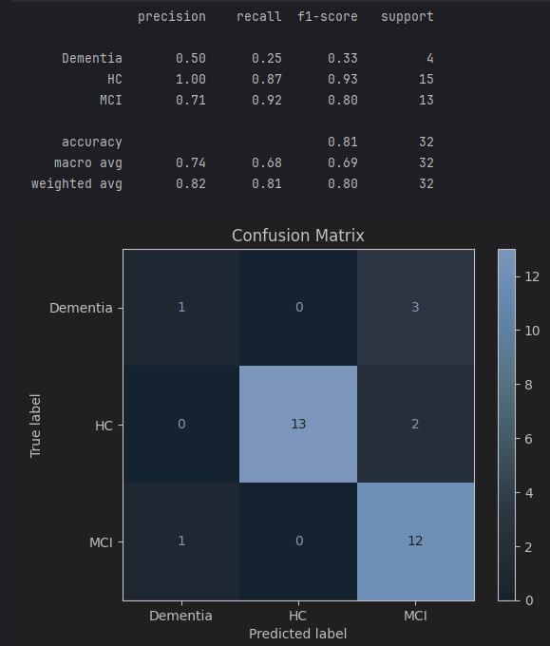
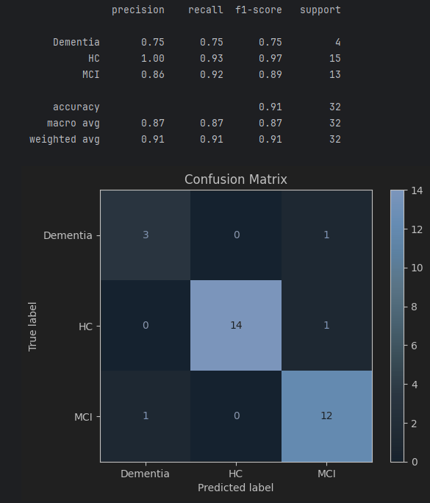
CTD GradientBoosting
Ohne GridSearch
Mit GridSearch

Slide 24
PFT
SFT | Text | Dem-Info | Calculated Features | Grid Search | Feature Importance | Weighted Avg F1-Score
Naive Bayes | x |  |  |  |  | 60 %
Random Forest | x |  |  |  |  | 61 %
Naive Bayes |  |  | x |  |  | 54 %

Slide 25
CTD + PFT + SFT kombiniert

Slide 26
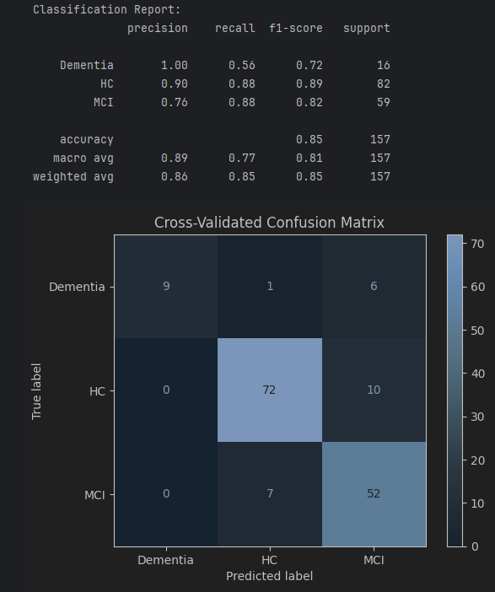
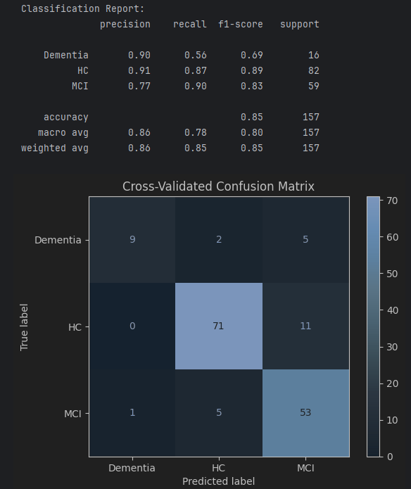
Gradient Boost + GS + Text + Info + ohne Gender + Cross Validation(5)
Mit Calculated Features
Ohne Calculated Features

Slide 27
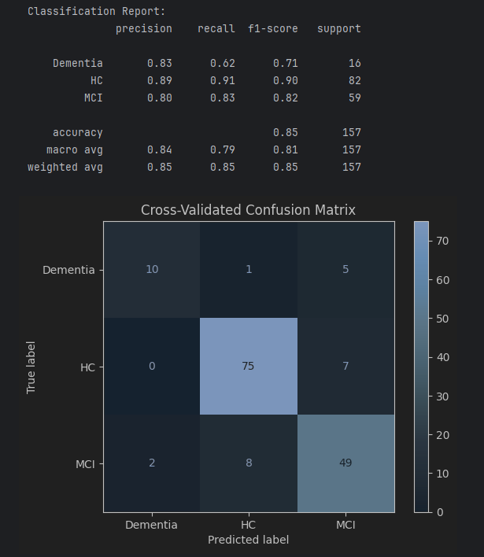
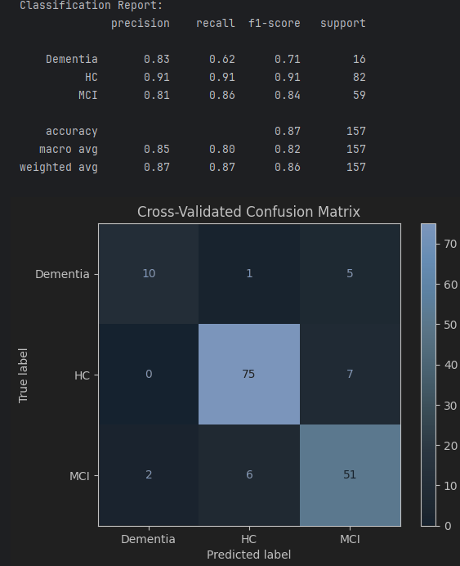
XGBoost + GS + Text + Info + ohne Gender + Cross Validation(5)
Mit Calculated Features
Ohne Calculated Features

Slide 28
Regression

Slide 30
PFT XGBoosting + GS + Text + calculated + info + featureimportance + ohne Gender
Mean Squared Error (MSE): 5.772566709481453
Mean Absolute Error (MAE): 1.763038158416748
R-squared (R²): -0.3686289211643916
Explained Variance Score: -0.3619481378027132

Slide 31
PFT XGBoosting + GS + Text + calculated + info + featureimportance + ohne Gender + word2vec
Mean Squared Error (MSE): 4.9320872543463565
R-squared (R²): -0.16935803390846704

Slide 32
Diskussion/Interpretation

