Slide 1
GELATO-BAR website
CSE 3100: Software Development Project II
Submitted By
Sumaiya Islam Suchi Roll: 210201031
Bangladesh Army University of Science and Technology (BAUST)

Slide 2
Contents
Introduction
Objectives of the Project
Scope of the project
Used Tools
Main Features
Drawing Tool- UI Analysis & Working Process
Future Works
Conclusion
Reference

Slide 3
Introduction:
. The Ice Cream Bar website is ”GELATO-BAR” Through intuitive navigation, captivating visuals, and user-friendly functionalities, the website invites visitors to embark on a delightful journey into artisanal ice cream, whether they’re seeking

Slide 4
Objectives of this project
Development the website making
Using of html and css markup language

Slide 5
Scope of the Project
Create web pages- home page ,about page, services page

Slide 6
Used Tools & Libraries
Html and css used as a Programming Language
Notepad
UI design(figma)

Slide 7
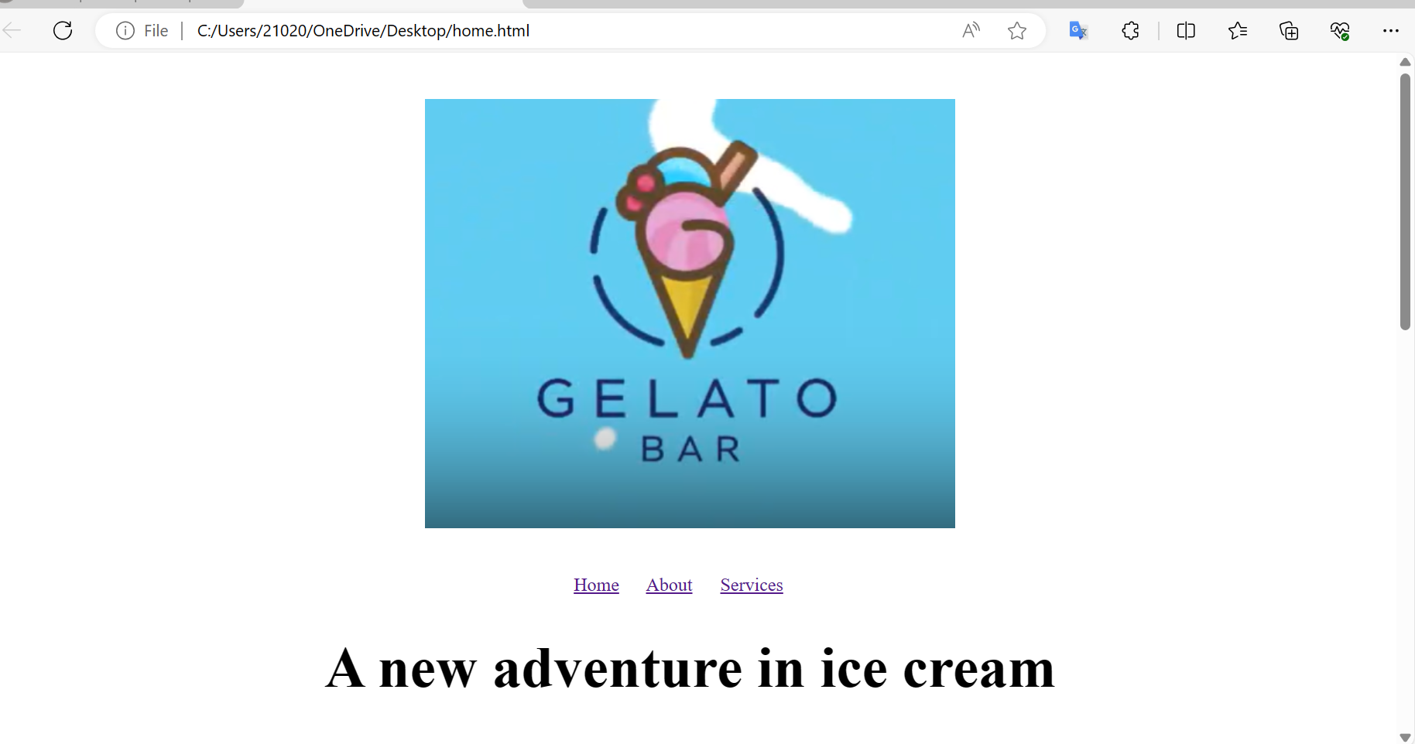
Main Features of The Project

Slide 8
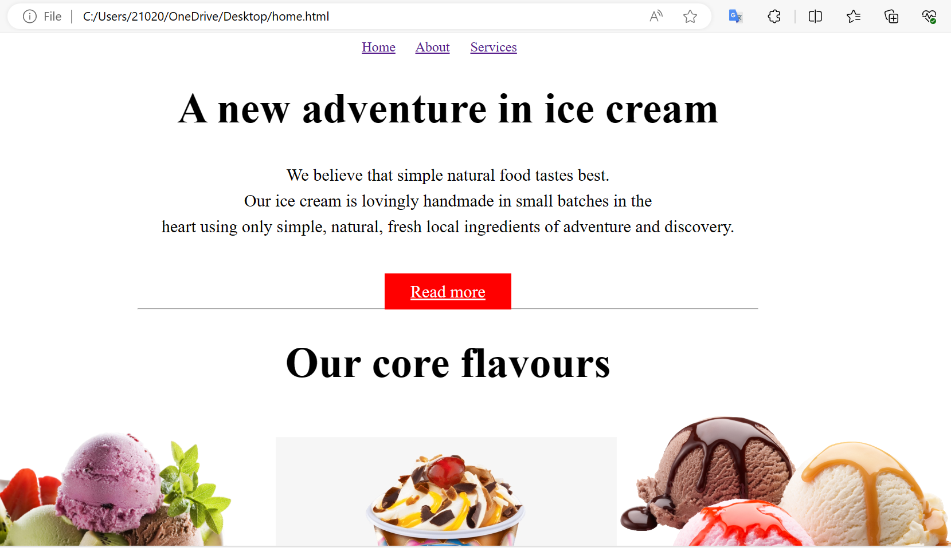

Slide 9
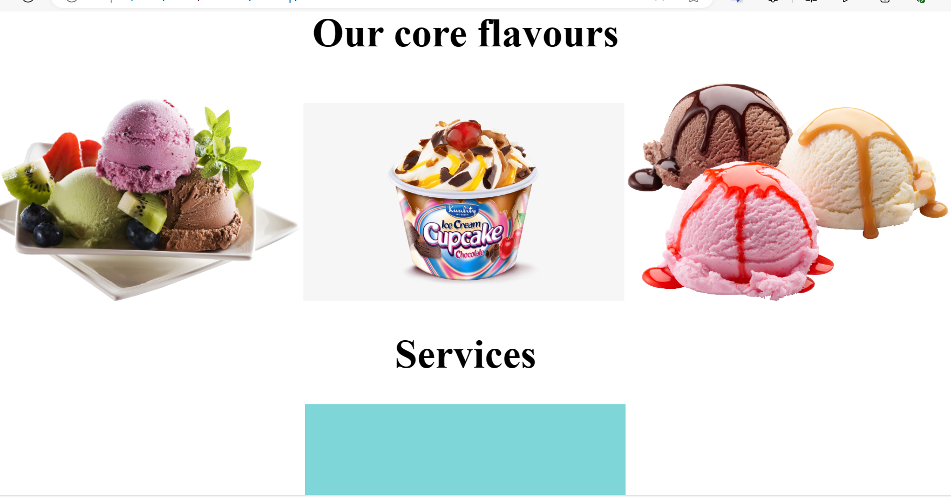

Slide 10
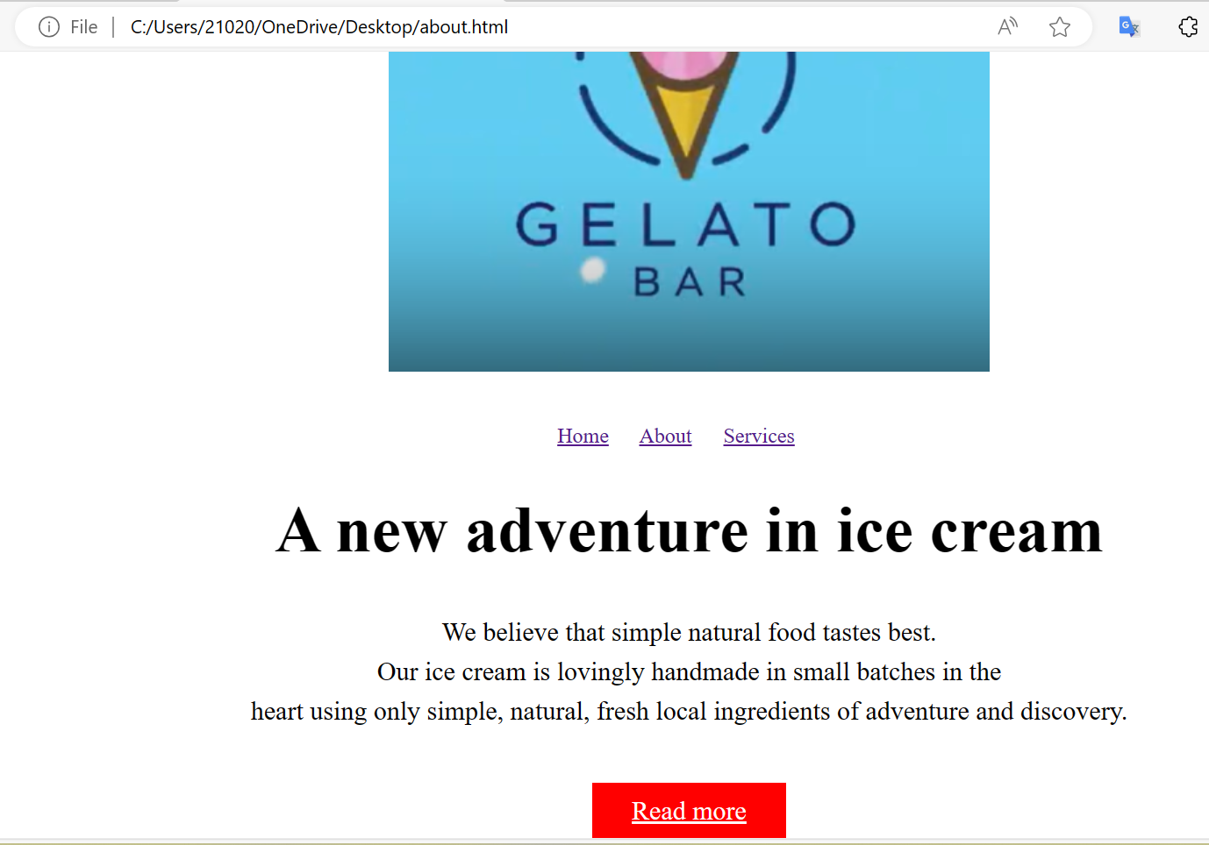

Slide 11
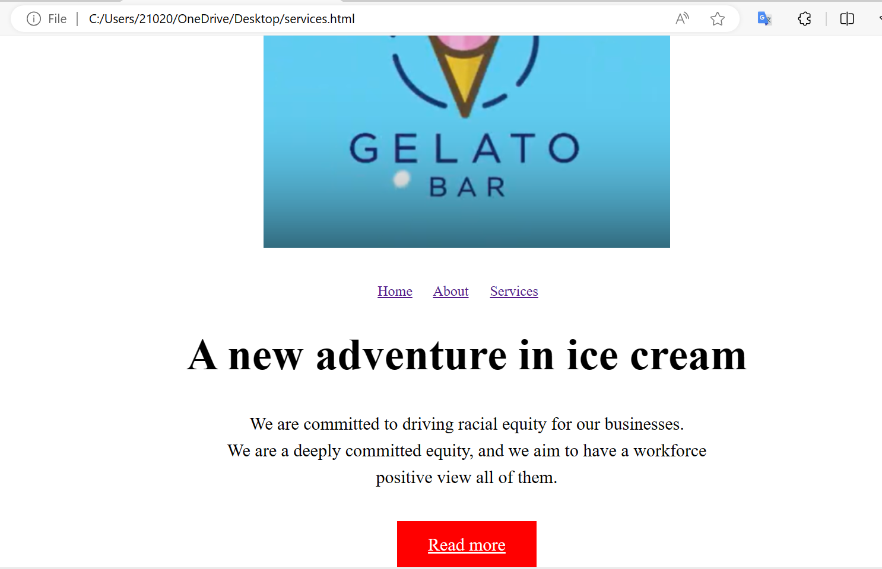

Slide 12
FUTURE WORKS:
My project has been completed. I have a plan for this website to be bigger. I want to complete this project for future business.

Slide 13
CONCLUSION:
I learn how to use Notepad for HTML and CSS
How to project management system for the web.
Uses of ui/ux design.
Developing and creativity

Slide 14
REFERENCE:
https://github.com/SSuchi24/GELATO-BAR.git

Slide 15
THANK YOU

