Slide 1
Syeda Sundas
Week 3

Slide 2
DOCTYPE
<!DOCTYPE HTML>
The DOCTYPE declaration is an instruction to the web browser about what version of HTML the page is written in

Slide 3
Html tag
<html>------</html>
It contains the entire HTML document.

Slide 4
Head
<head>------</head>
Used for meta data of website

Slide 5

Title
<title>----</title>
It is used to declare the title of HTML document.It sets the title in browser toolbar.
Example:

Slide 6
Body
<body>-----</body>
It contains all the code for structure of website

Slide 7
Comment
<!– comment-->
It is used to write text in HTML document that is not included in the code.

Slide 8





Heading
<h1>-----</h1>
<h2>-----</h2>
<h3>-----</h3>
<h4>-----</h4>
<h5>-----</h5>
<h6>-----</h6>
Used to show heading. Heading size decreases from h1 to h6.

Slide 9

Paragraph
<p>------</p>
Used to write a paragraph or text.
Example:

Slide 10

Image
<img src=“abc.jpg” alt=“picture” width=“150” heigth=“100”>
It is used to insert an image in HTML document.
Example:

Slide 11

Link Attribute
<a href=“www.google.com”> ----- </a>
It is used to insert a hyperlink in an HTML document.
Example:

Slide 12

Unordered List
<ul> <li>-----</li> </ul>
It is used to create an unordered list.
Li is used to insert items into list.
Example:

Slide 13

Ordered List
<ol> <li>-----</li> </ol>
It is used to create an ordered list.
Li is used to insert items into list.
Example:

Slide 14
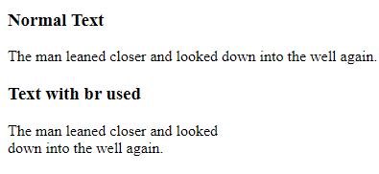
Br
<br>
It is used to break the text line.
Example:

Slide 15
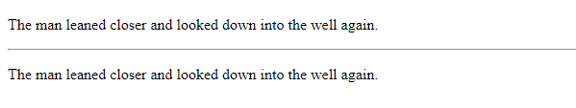
Hr
<hr>
Hr stands for horizontal rule. It creates a horizontal line in HTML document.
Example:

Slide 16
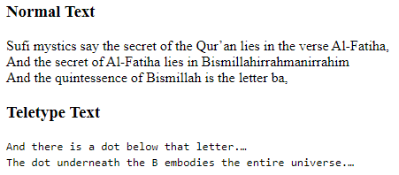
Teletype Text
<tt> ----</tt>
It stands for teletype.It is used to show user input.
Example:

Slide 17

Text Color
Style=“color:pink;”
It is used to change color of text.
Example:

Slide 18

Background Color
<style=“background-color:black;”
It is used to change background color.
Example:

Slide 19

Font Style
style="font-family:Arial;”
It is used to change font Style.
Example:

Slide 20

Font Size
style="font-size:200px;”
It is used to increase or decrease font size.
Example:

Slide 21
Text-align
style=“text-align:center;”
It is used to change position of text.
Example:

Slide 22

Bold Text
<b>------</b>
It is used to bold the text.
Example:

Slide 23

Italic Text
<i>------</i>
It is used to change font style to Italic.
Example:

Slide 24

Deleted Text
<del>------</del>
It is used to mark text as deleted.
Example:

Slide 25

Inserted Text
<ins>-----</ins>
It is used to show inserted text.
Example:

Slide 26

Marked Text
<mark>------</mark>
It is used to show marked text.
Expamle:

Slide 27

Emphasized Text
<em>-----</em>
It is used to show emphasized text.
Example:

Slide 28

Strong Text
<strong>------</strong>
It is used to show Strong or bold text.
Example:

Slide 29

Subscript Text
<sub>----</sub>
It is used to show Subscripted text.
Example:

Slide 30

Superscript Text
<sup>----</sup>
It is used to show superscripted text.
Example:

Slide 31

Link for Audio
<audio control>
<source src=“address\name.format">
</audio>
This is used to show an audio on web page.
Example:

Slide 32

Link for Video
<video width=“350” height=“300” controls>
<source src=“address\name.format”>
</video>
This is used to enter/show video in web page.
Example:

Slide 33

Graphics Circle
<svg width=“100” height=“100”>
<circle= cx=“50” cy=“50” r=“40” stroke=“green” stroke-width=“7” fill=“yellow”/>
</svg>
Example:

Slide 34

Graphics Rectangle
<svg width=“400” height=“100”>
<rect width=“400” height=“100” style=fill:rgb(0,0,255); stroke-width:10; stroke:rgb(0,0,0,)”/>
</svg>
Example:

Slide 35
Graphics rectangle
<svg width=“400” height=“100”>
<rect width=“400” height=“100” style=fill:green); stroke-width:10; stroke:rgb(0,0,0,)”/>
</svg>
*using color name instead of rbg value for fill.

