Slide 1
Cardiac Data Analysis
Rohan Desai
Tanvi Zunjarao
Manee Upadhyaya

Slide 2
Introduction
Part I

Slide 3
OVERVIEW
Heart diseases is one of the leading causes of death.
Heart diseases are more prevalent in men than women.
Various factors such as Age, gender, smoking, family history, cholesterol are considered as risks for heart diseases.

Slide 4
DATASOURCE
https://archive.ics.uci.edu/ml/machine-learning-databases/heart-disease/
The dataset has been divided into a training set and a test set, and individual techniques have been trained using the training dataset.
The efficiency of the technique is tested with the test dataset. The working of the techniques is as follows.

Slide 5
PROBLEM STATEMENT
Cardiovascular diseases are one the most fatal diseases in the world
This project attempts to solve the problem to make predictions on whether a person is suffering from Heart Disease
Visualization of the obtained results along with the comparison of the models is presented for better representation of the results.
2 Machine Learning models for this prediction

Slide 6
DATASET DESCRIPTION
The salient features of the dataset are as follows -
Age (age in years)
Sex (1 = male; 0 = female)
CP (chest pain type)
TRESTBPS (resting blood pressure (in mm Hg on admission to the hospital))
CHOL (serum cholesterol in mg/dl)
FPS (fasting blood sugar > 120 mg/dl) (1 = true; 0 = false)
RESTECH (resting electrocardiographic results)

Slide 7
DATASET DESCRIPTION
THALACH (maximum heart rate achieved)
EXANG (exercise induced angina (1 = yes; 0 = no))
OLDPEAK (ST depression induced by exercise relative to rest)
SLOPE (the slope of the peak exercise ST segment)
TARGET (1 or 0)

Slide 8
Visualisation
PART - II

Slide 9
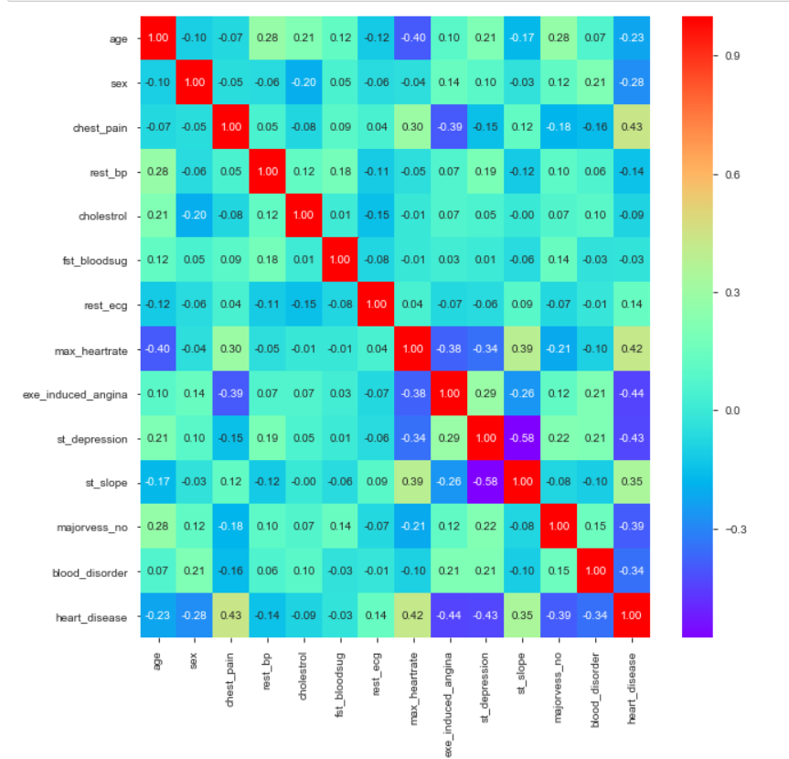
Correlation Matrix

Slide 10

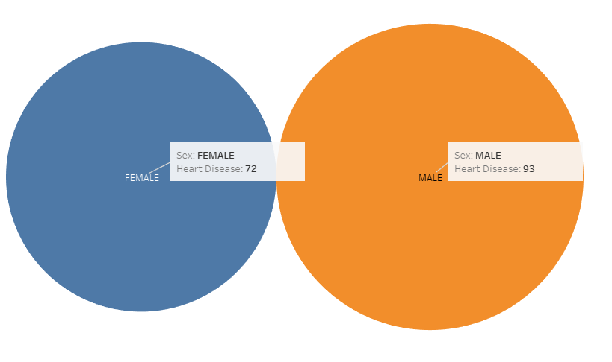
Visualization

Slide 11
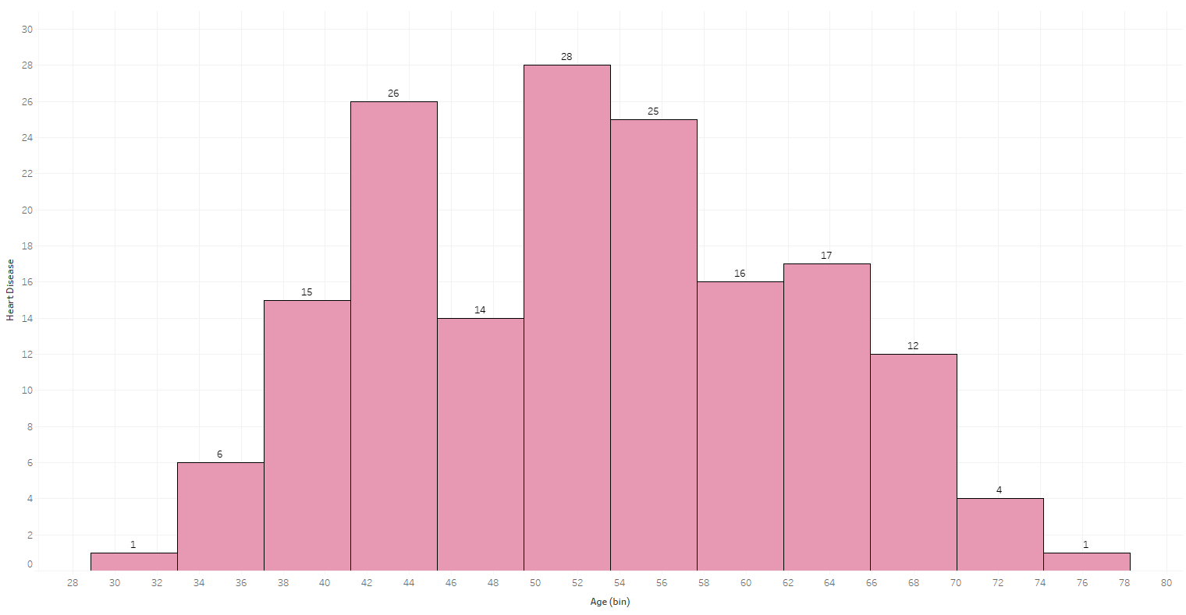
Age vs Heart Disease

Slide 12
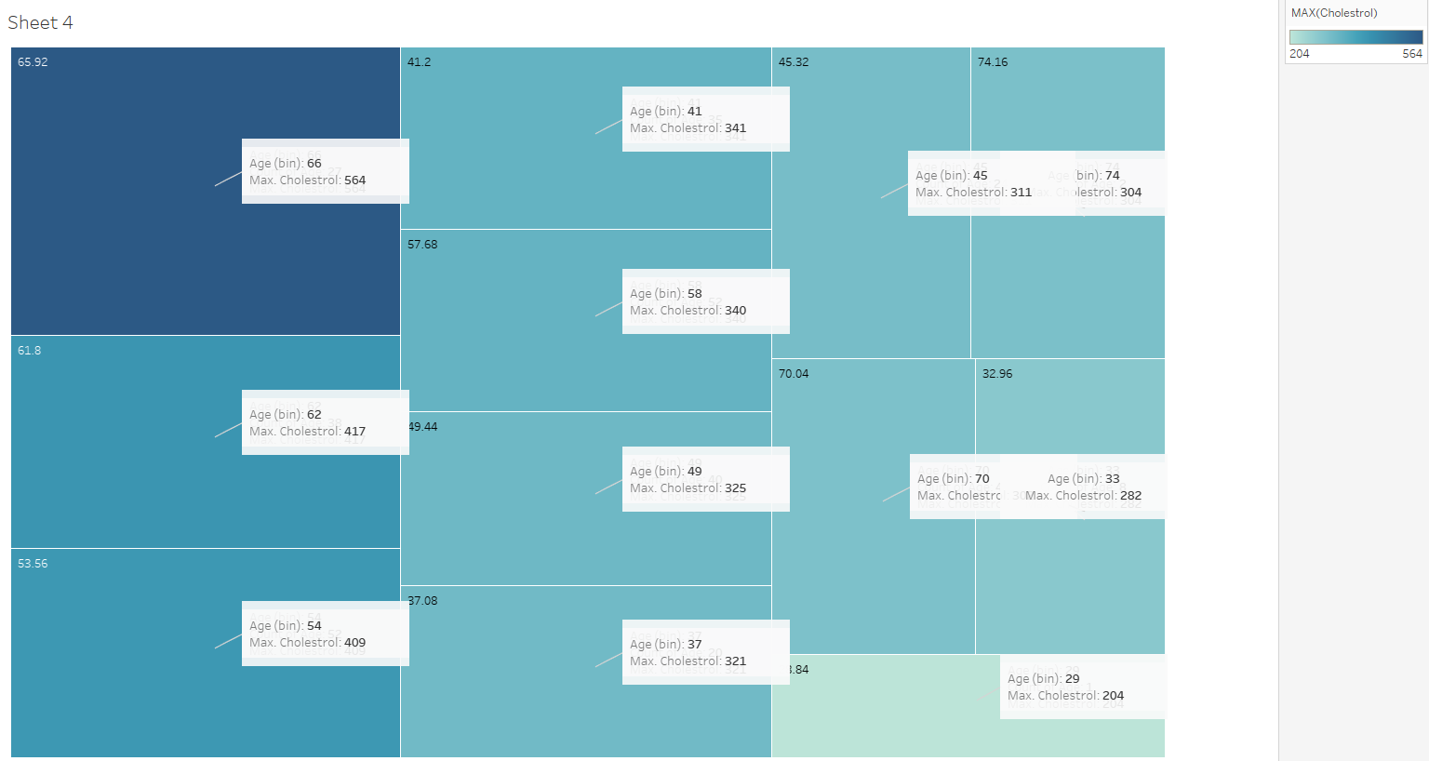
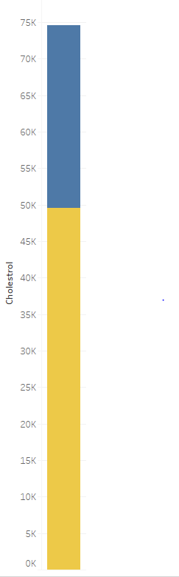

Level of Cholesterol

Slide 13
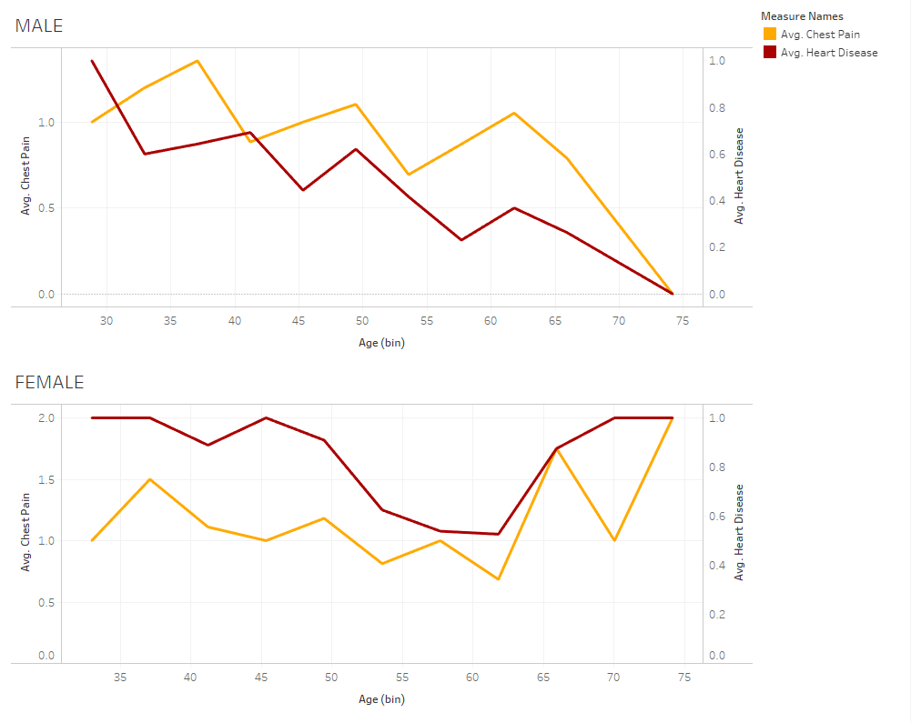
Relationship between Chest pain and Heart Disease

Slide 14
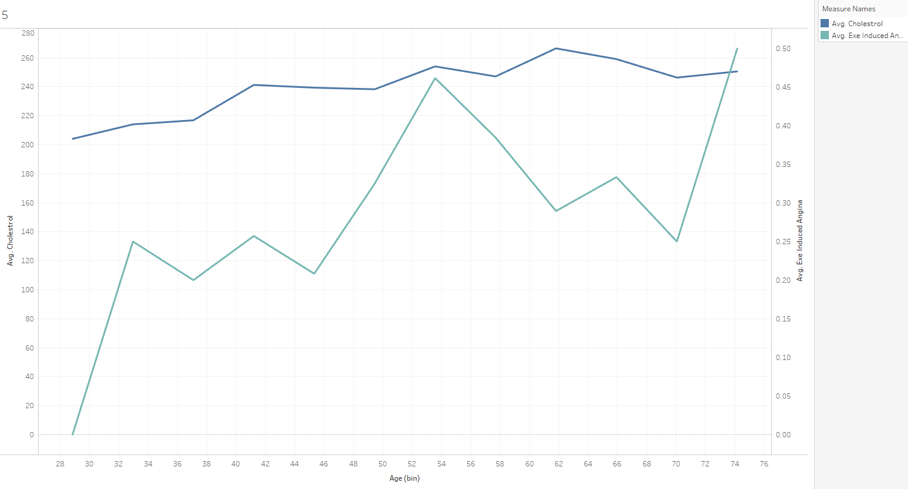
Relationship between Induced Angina and Cholesterol

Slide 15
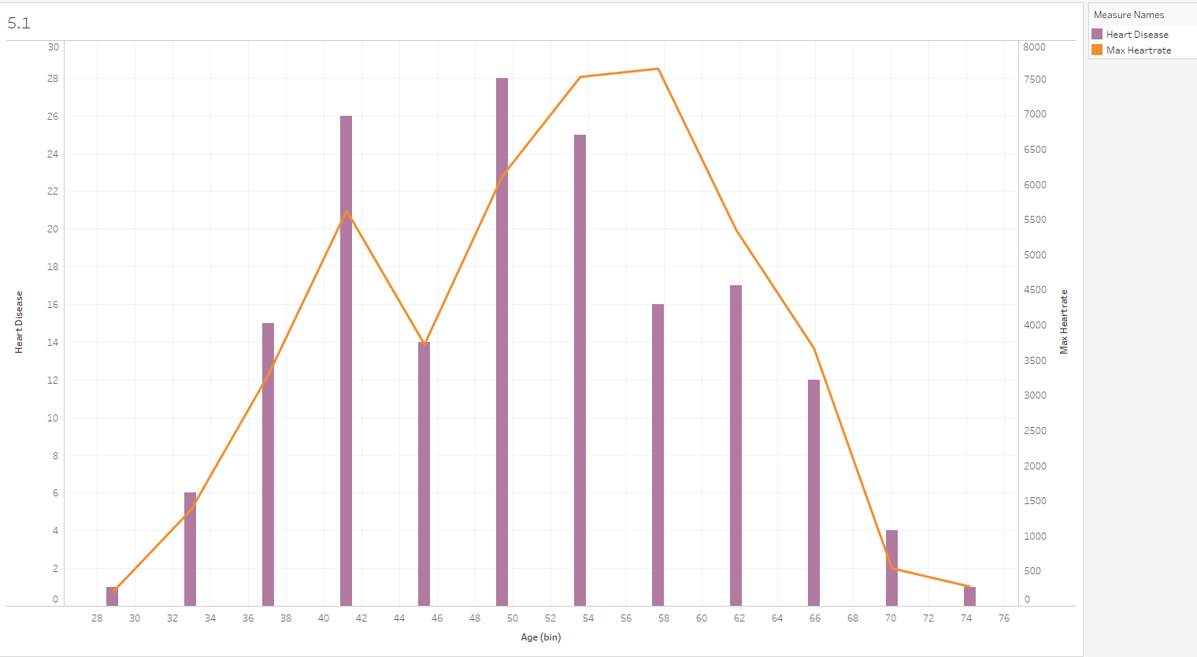
Relationship between Heart disease and Heart-rate

Slide 16
Machine Learning Models
PART-III

Slide 17
Classification Technique
We used 2 machine learning models for this project.
Logistic Regression
Support Vector Machine

Slide 18
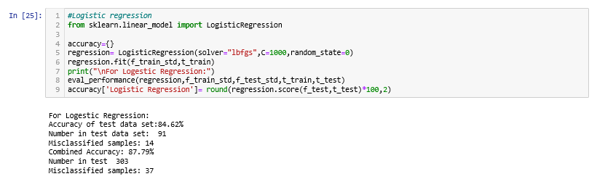
Logistic Regression

Slide 19
Support Vector Machine
A support vector machine (SVM) is machine learning algorithm that analyzes data for classification and regression analysis.
SVM is a supervised learning method that looks at data and sorts it into one of two categories. An SVM outputs a map of the sorted data with the margins between the two as far apart as possible.
SVMs are used in text categorization, image classification, handwriting recognition and in the sciences.

Slide 20
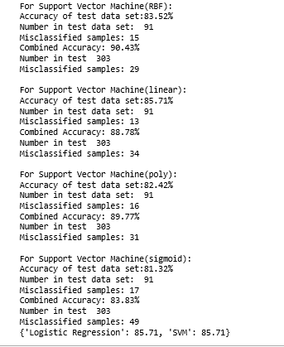
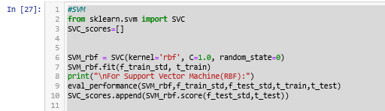
Support Vector Machine

Slide 21
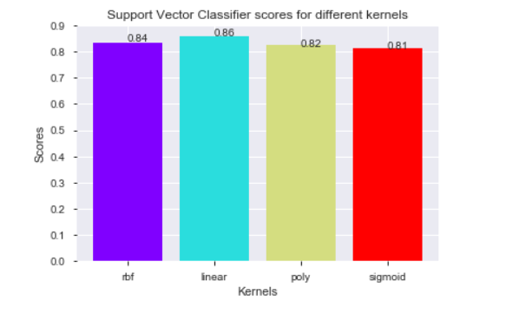
Support Vector Machine

Slide 22
Conclusion
PART-IV

Slide 23
Conclusion
Heart Disease is one of the major concern for the society today.It is difficult to manually determine the odds of getting heart disease based on risk factors. However, machine learning techniques are useful to predict the output from existing data.

Slide 24
Future Scope
More Machine Learning Models can be implemented to check on Accuracy of data to fit best Model.

Slide 25
Thank You

