Slide 1
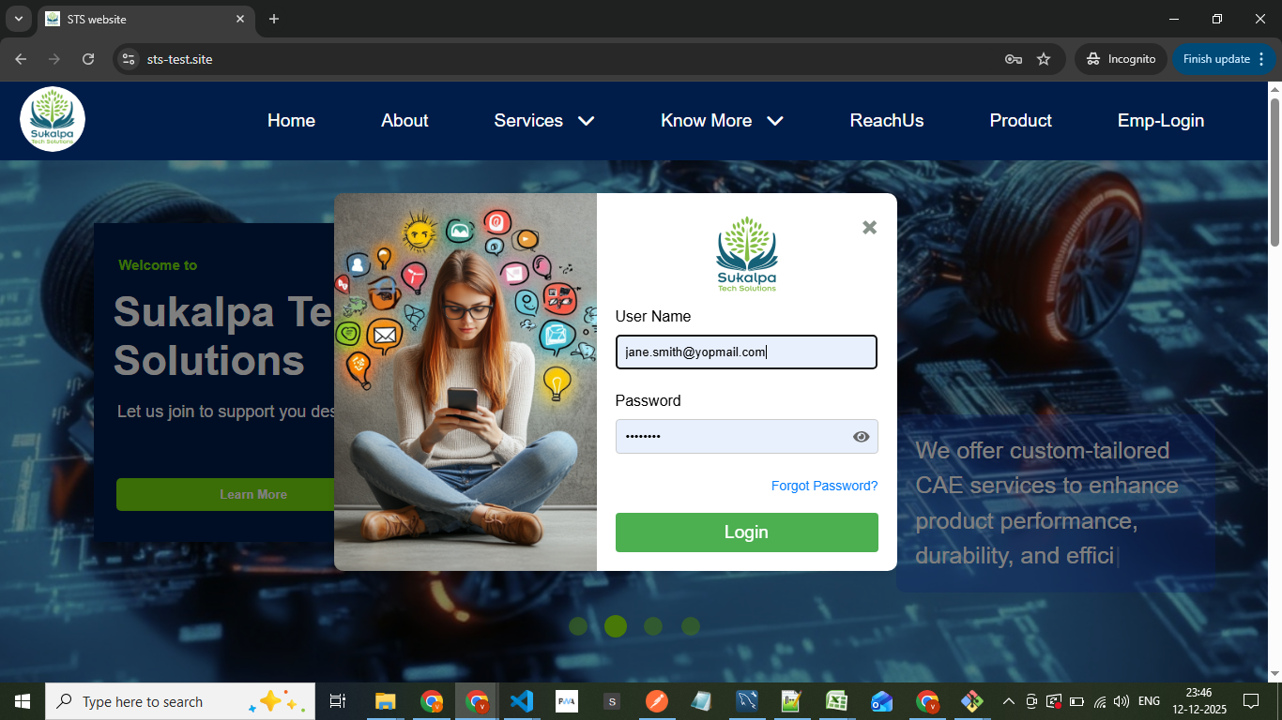
Login using Admin credentials

Slide 2
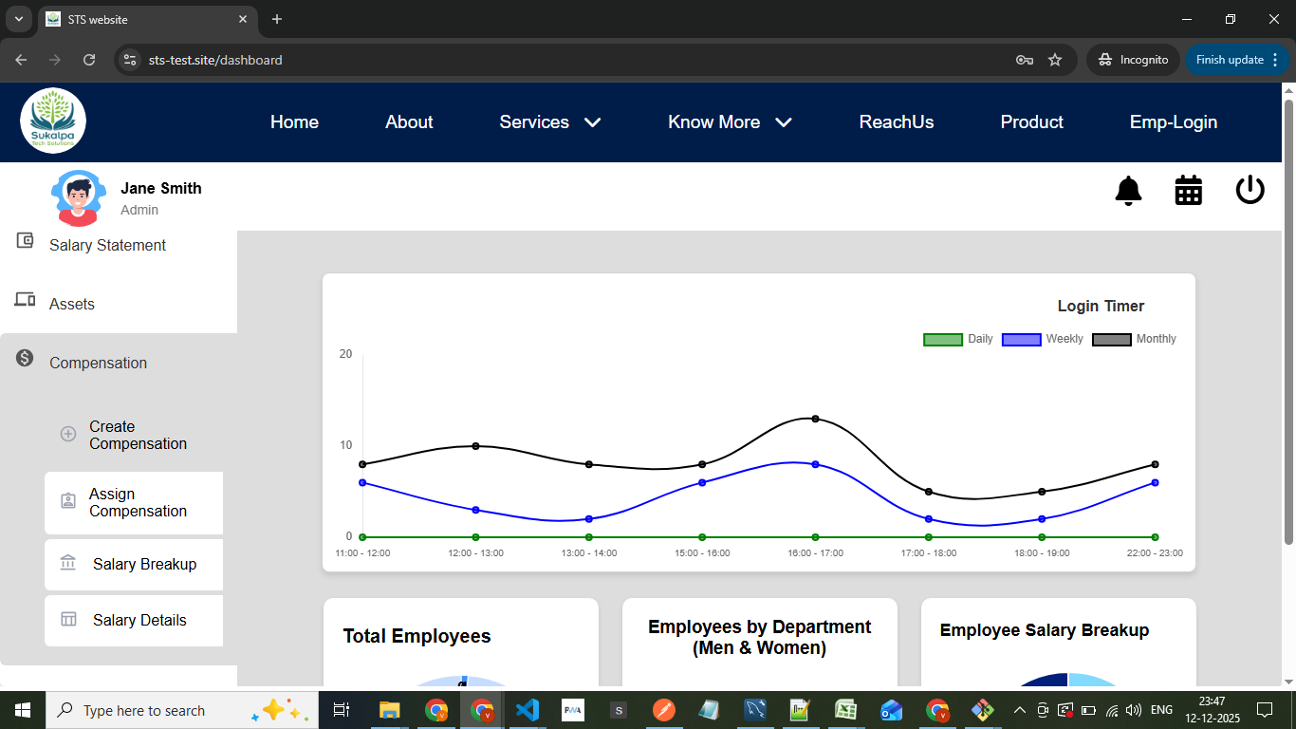
Choose the compensation option
Create compensation
Assign compensation
Salary breakup
Salary details

Slide 3
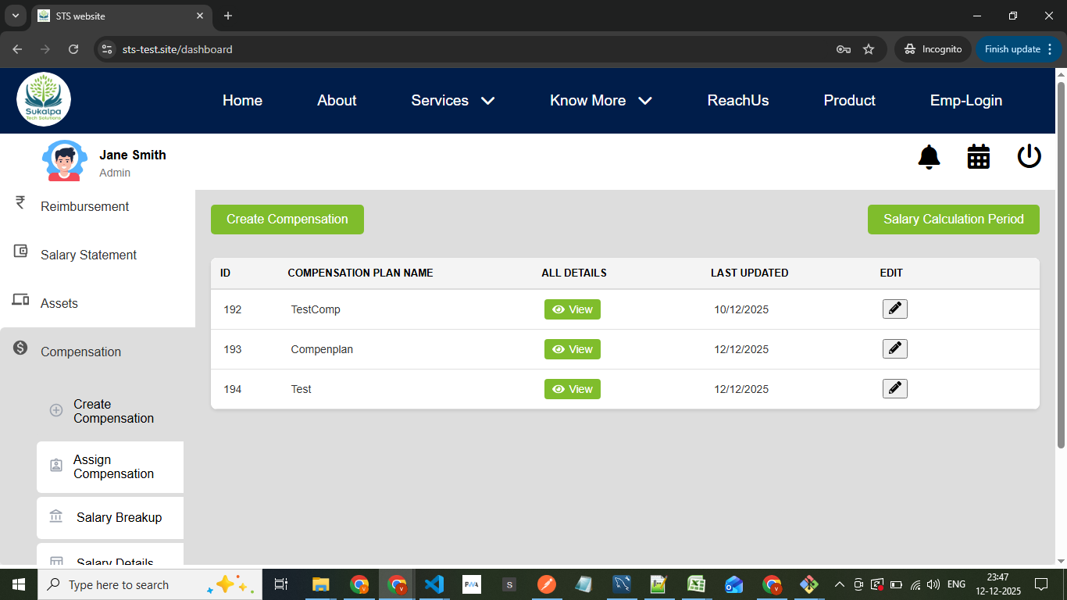
you will have two options button here
Create compesnation
Salary calculation period

Slide 4
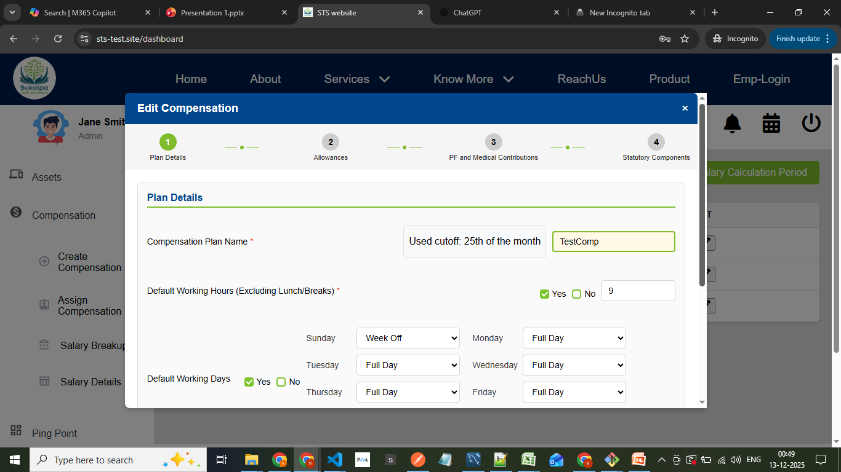
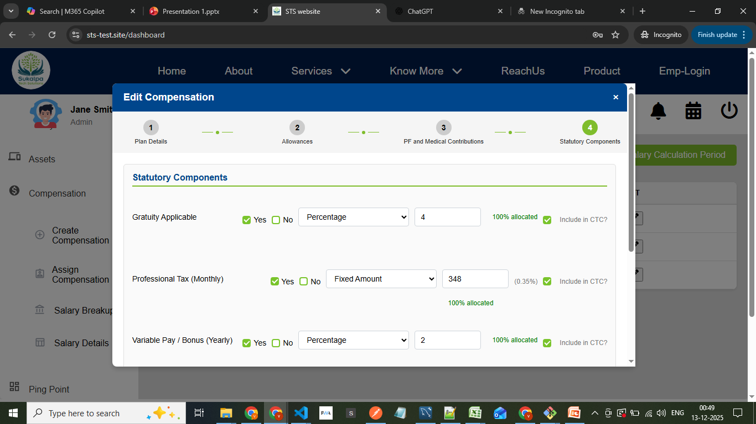
1. Create Compensation Plan
In this section, you design and configure salary structure plans for employees.
You can define components such as:
1.Allowances (e.g., HRA, Travel, other, etc.)
2.PF and Medical Contributions
3.Statutory Components (like ESI, TDS, PT, etc.)
4.Other components
After entering all these fields and proceeds here for 3 and 4 components have include in ctc checkbox if we click checkbox as yes then it will calculate amount in net salary otherwise it will show amount in others
Once finalized, click “Save Plan” to store the compensation plan for future assignments.

Slide 5
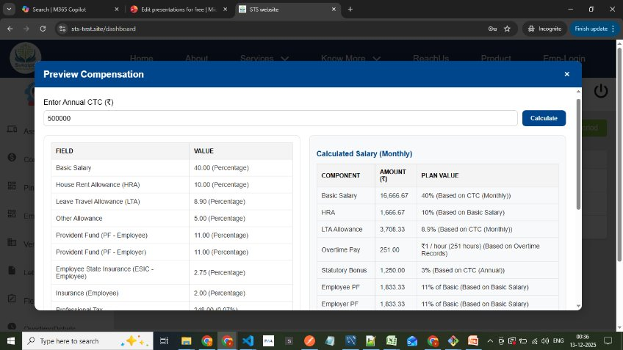
Preview of compensation
A preview section lets you test how the CTC (Cost to Company) is distributed among these components
by entering different amounts.
You can adjust component values, recalculate instantly, and fine-tune the structure before saving.

Slide 6
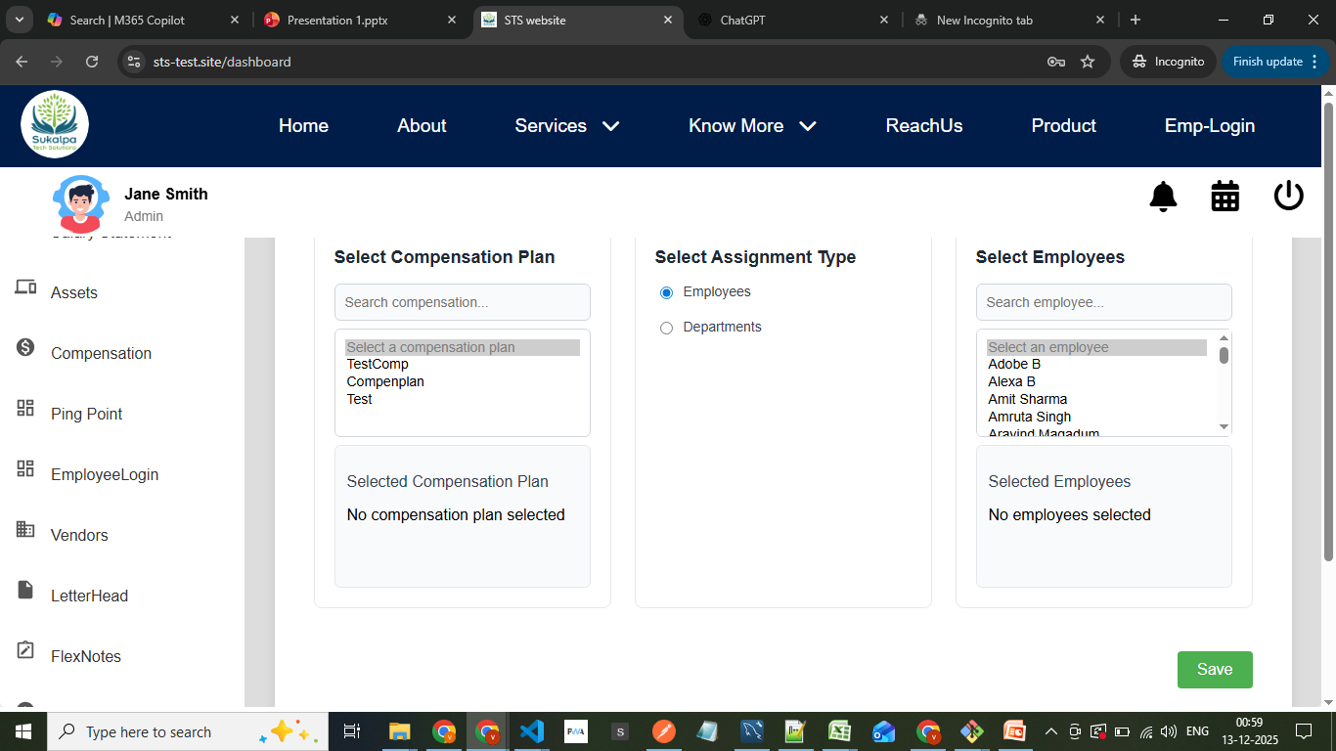
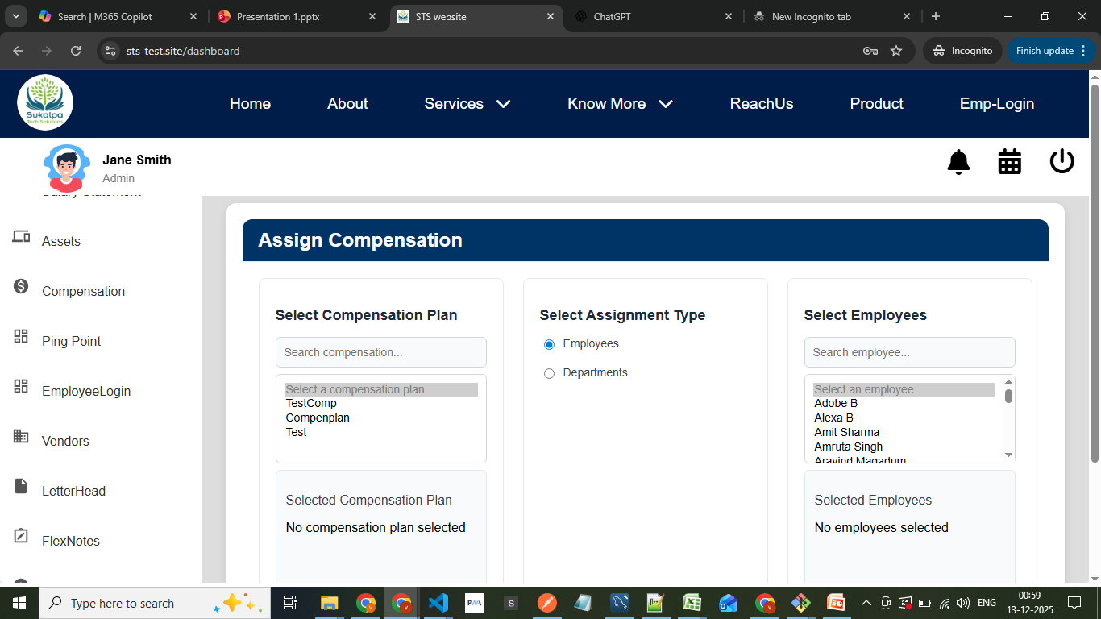
2. Assign Compensation This section is used to assign the created compensation plan to employees.
You can assign plans individually (per employee) or by department (bulk assignment).
Once a plan is assigned, it cannot be reassigned — ensuring data consistency and avoiding duplication.

Slide 7
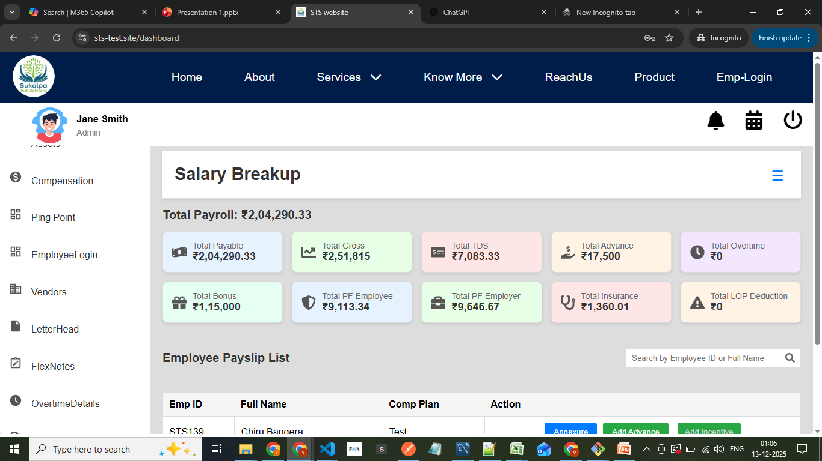
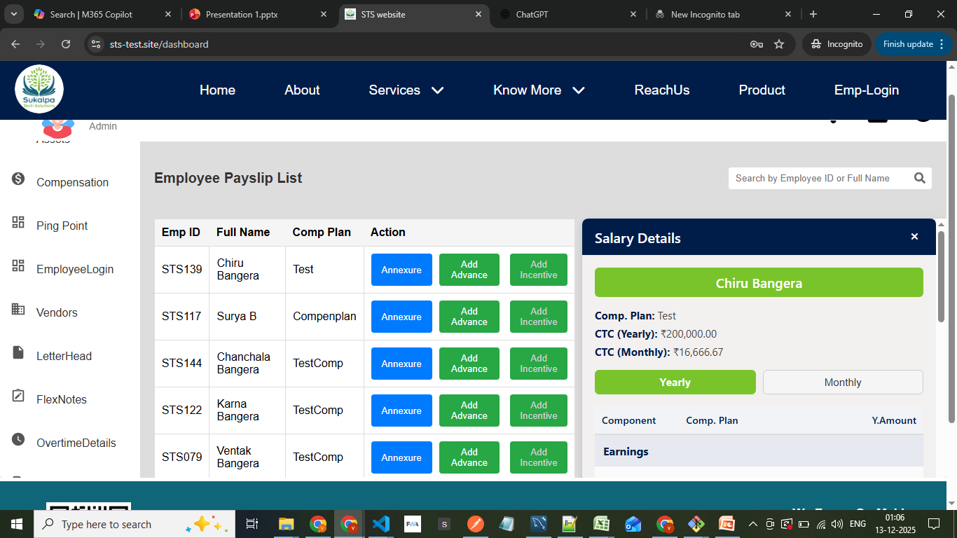
3.Salary breakup
In this section, you manage monthly salary adjustments and additions for each employee.
A totals section displays the summarized view of all amounts (earnings, deductions, contributions).
Each employee also has an Annexure View, showing a detailed salary breakdown:
Earnings (Basic, HRA, Allowances)
Deductions (PF, TDS, PT)
Employer Contributions (PF, ESI, etc.)
This view helps verify the final net salary and total CTC for the current month. With annexure button we have add advance button if a employee want to take advance we can add here At top right we have a bar menu button in that we can see two options 1. employee without compensation plan list there we can go assign plan easily 2. Add Bonus here we can add bonus for employees it will apply for all the employees

Slide 8
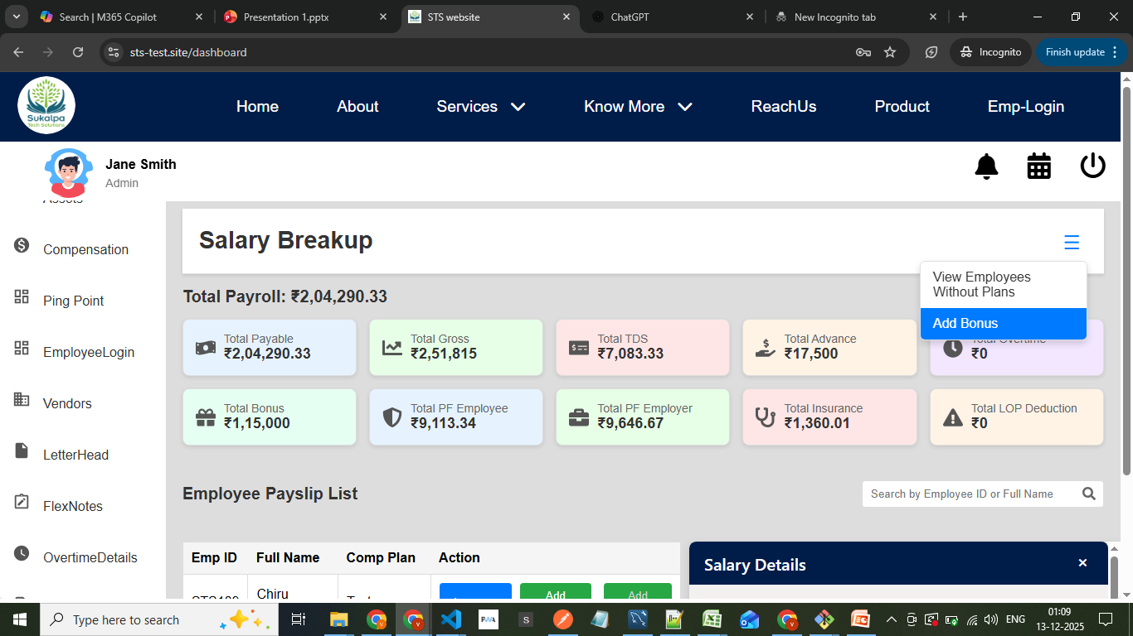
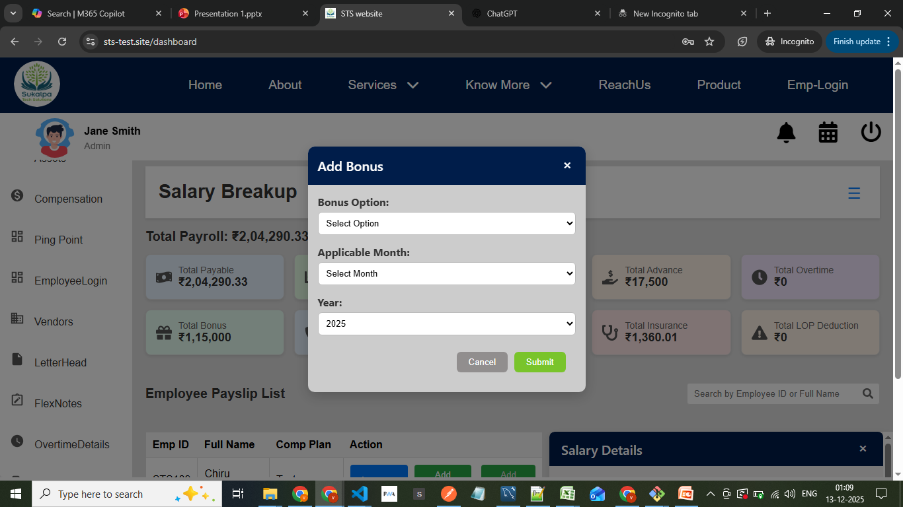
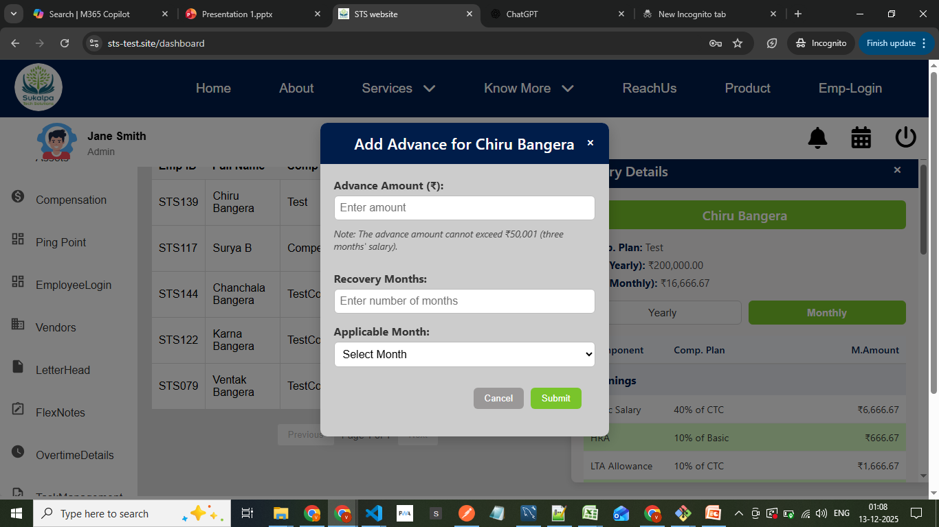
1. Add Advance 1.First we have to enter advance amount 2. In how many months he can recover the amount add that number divided amount for each month also we can see 3. applicable month we have we have two months option current month and next month if we select current month deduction willl start from current month 2. Add Bonus 1. For bonus also we have 3 options a. We can add fixed amount b. We can add no of monthly salary if we add no as 2 double salary of that employee will given c. We can add percentage according to percentage that amount will added

Slide 9
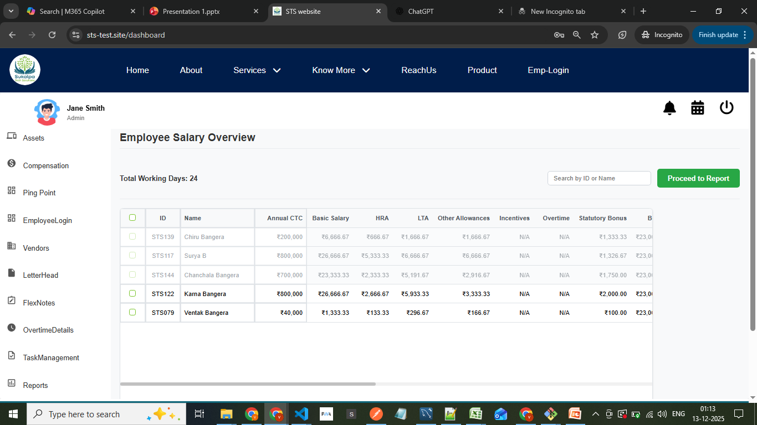
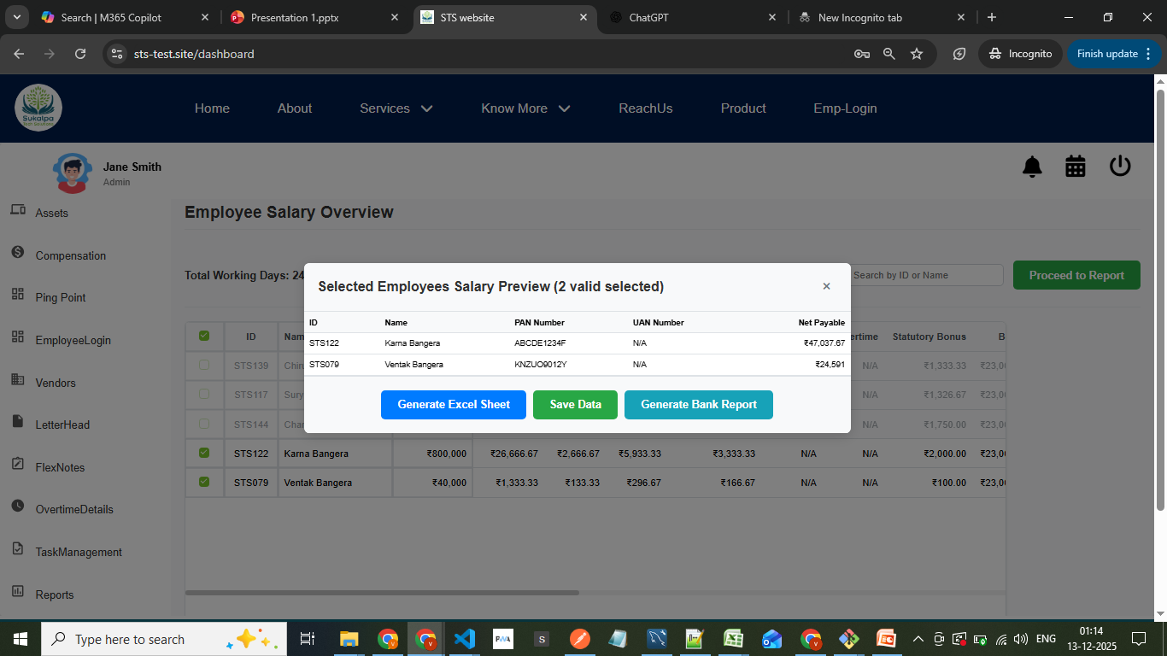
4. Salary Details
This is the review and reporting section.
You can view salary details for all employees in one place.
here we can save selected person data and generate a bank report in pdf and excel both format one pdf for all employees data save data saves data That saved data of employee we can see that data in salary statement

Slide 10
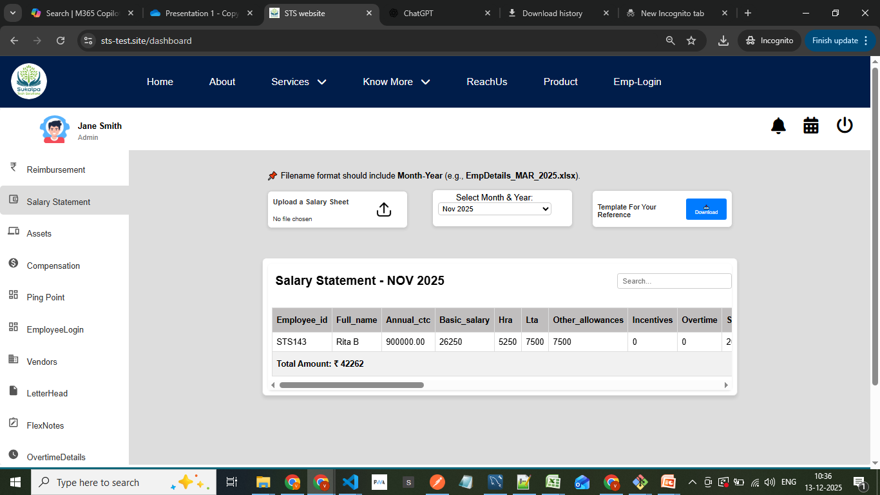
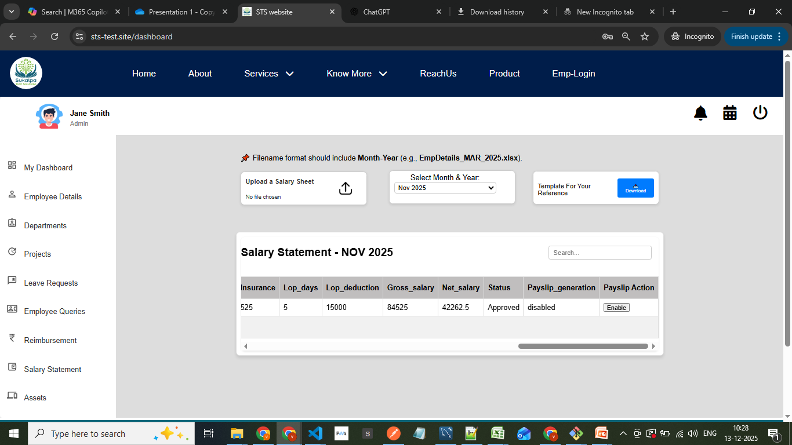
Salary statement
Here we can select the month and data all which we have saved we can see there at last column of the table we have an button as enable if we enable that button download payslip option we can see for that perticular employee download payslip option

Slide 11
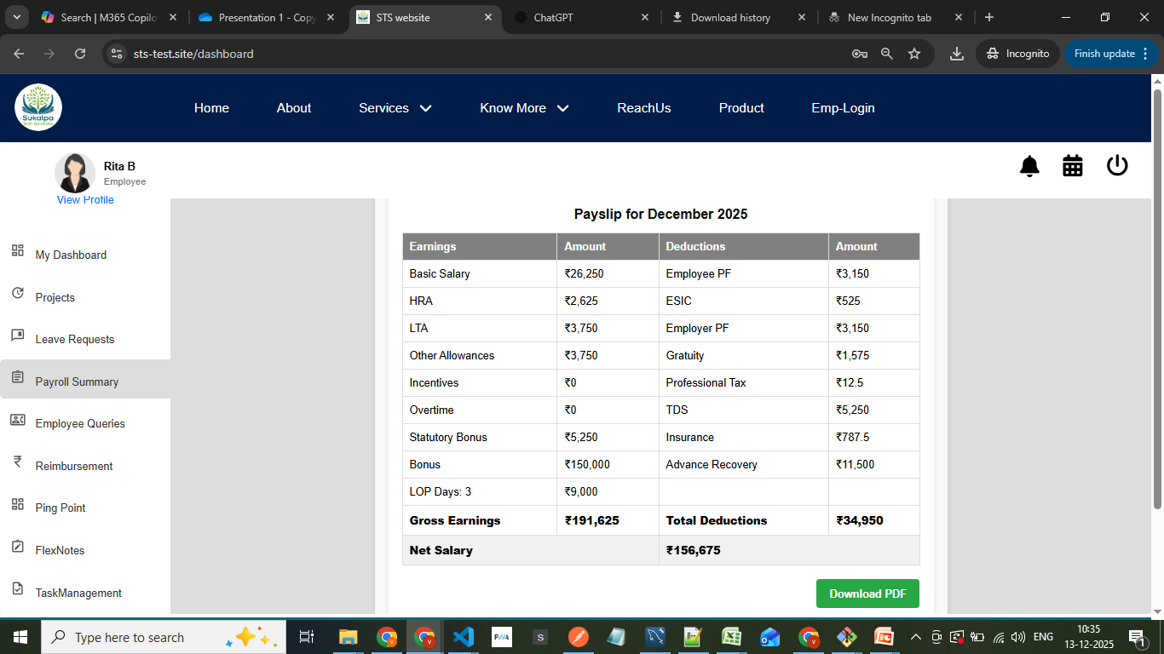
payrollsummary
Here emloyee can download payslip

Slide 12
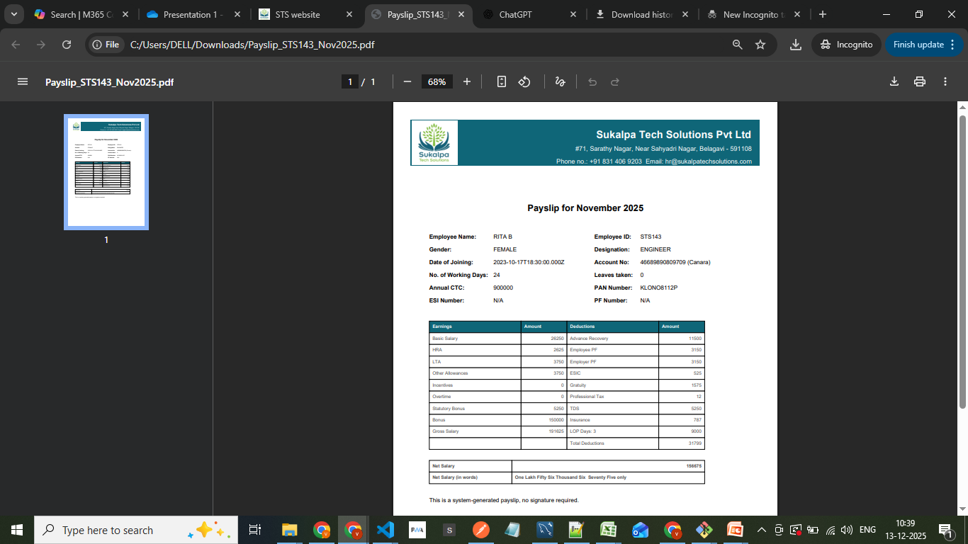
Final payslip

