Slide 1

STS WEBSITE

Slide 2
INTRODUCTION
Sukalpa Tech Solutions Established in 2018–19, Sukalpa Tech Solutions was founded on the philosophy of Support, Succeed, and Grow Stronger Together. Our website is a comprehensive platform designed to introduce Sukalpa Tech Solutions, showcase our core services, and support efficient internal operations. It features an employee portal with functions such as attendance tracking (including punch in/out and location-based monitoring), leave applications, reimbursements, payroll access, asset requests, and direct query communication with managers. The system also includes project tracking, document access (offer and relieving letters), and a dashboard for daily insights. The admin panel allows management of employees, project updates, attendance monitoring, query handling, and approval of leaves and reimbursements—ensuring smooth and transparent operations for both employees and administrators.

Slide 3
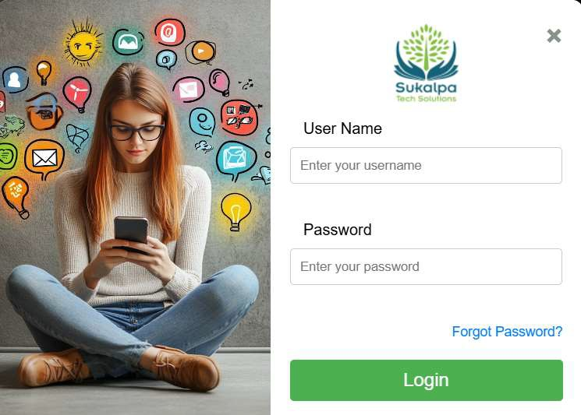
Login functionality
After opening the website, the Home Page displays our company overview and services. Users can access the system via the "Employee Login" button. After entering their credentials, the system verifies the user and redirects them to either the Employee or Admin Dashboard based on their role.

Slide 4
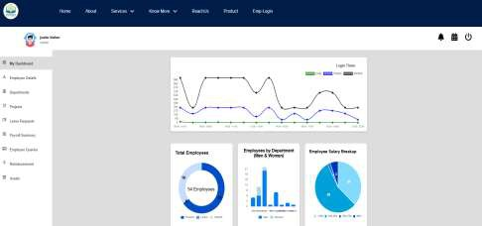
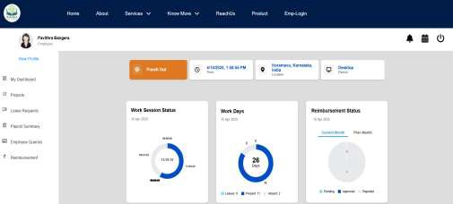
DASHBOARD(ADMIN/EMPLOYEE)
ADMIN DASHBOARD EMPLOYEE DASHBOARD
The Admin Dashboard opens with the admin profile and provides a clear overview of key metrics. It includes:
Login Time Tracker (Daily, Weekly, Monthly)
Employee Attendance – Present, Absent, Leave Requests
Gender Distribution Chart – Department-wise male and female count
Salary Insights – Pie chart of salary breakup, previous month’s total
payout, and reimbursement claims
Displays employee profile, real-time punch in/out, and location/device
Info using Face Recognization Feature
Tracks daily work hours, login sessions, and attendance status
Shows leave summary and reimbursement status
Includes visual charts for workdays and daily work hours
Sidebar menu for quick access to projects, leave requests, payroll,
queries, and reimbursements

Slide 5
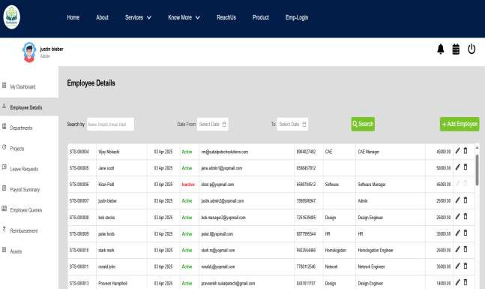
EMPLYEE DETAILS IN ADMIN VIEW
Centralized Dashboard to
manage all employee records.
Allows adding, editing, deleting
employee details.
Quick search by Name, Email, Emp ID, Department.
Track employee status (Active/Inactive) instantly.
View key info like department, designation, CTC, email, contact.
Simple and clean form for adding new employees with all essential fields.

Slide 6
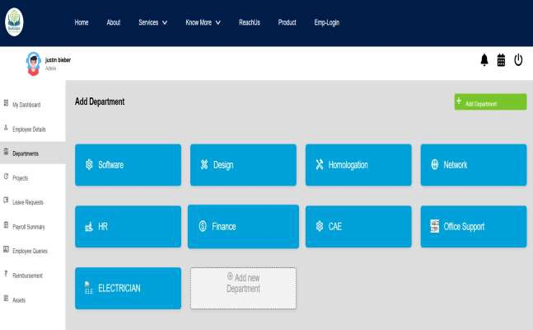
DEPARTMENT Page IN ADMIN SIDE
View & Manage Departments: Admin can view all existing departments in a grid layout.
Add New Department: Click "Add
Department" to open a pop-up form.
Admin Access Only: Department addition and updates are secured under admin role.

Slide 7
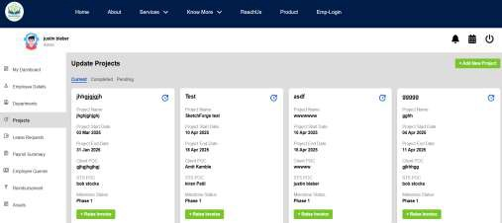
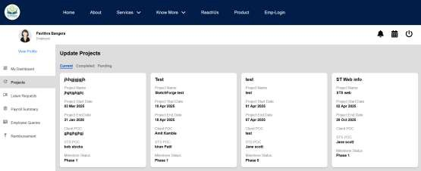
PROJECT PAGE(ADMIN/EMPLOYEE)
ADMIN SIDE EMPLOYEE SIDE
Centralized Dashboard for viewing all projects categorized as Current, Completed, or Pending.
Quick Access to key project details: name, timeline, client/STS
POC, milestone phase.
Raise Invoice button available directly under each project card for
fast billing.
Effortless Project Creation with a structured step-by-step form (Project Details → STS Owners → Milestone).
Fields include all essentials: company info, project scope, service
location, and document attachment.
Displays all projects assigned to the employee under Current, Completed, and Pending tabs.
Key details shown: Project Name, Start & End Dates, Client POC, STS
POC, and Milestone Phase.
Helps employees track progress and stay updated on their assigned
projects.
Clean card layout ensures quick visibility of each project’s status and timelines.
Promotes transparency and accountability within the team.

Slide 8
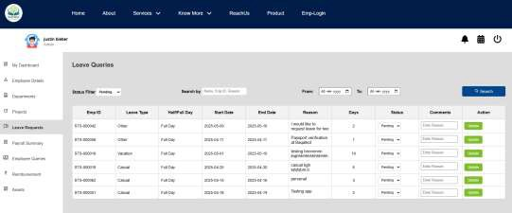
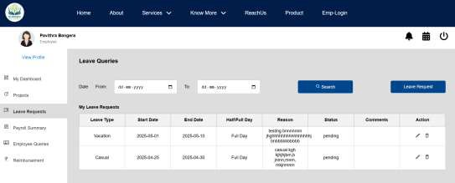
LEAVE REQUEST PAGE(ADMIN/EMPLOYEE)
ADMIN SIDE EMPLOYEE SIDE
Admin can view, filter, and manage all employee leave requests.
Displays key info: Employee ID, Leave Type, Duration, Reason, and Status.
Status can be updated directly (Pending/Approved/Rejected) with optional comments.
Includes search and date filter options for easy tracking.
to apply for leave with fields like leave type, date, reason, and duration (full/half day).
Leave History Table shows all previous requests with status (e.g., pending), reason, and actions (edit/delete).
Filter Option to search leave records by date range.
Quick Access Buttons to raise a new request or edit existing ones with just a click.

Slide 9
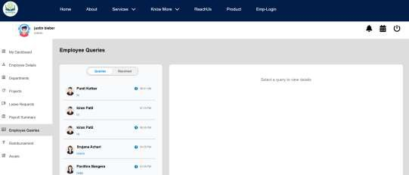
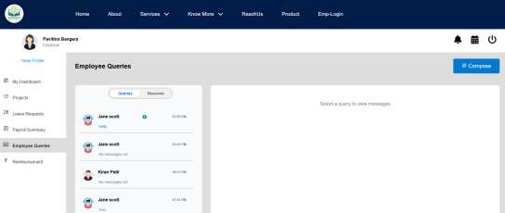
QUERY PAGE(ADMIN/EMPLOYEE)
ADMIN SIDE EMPLOYEE SIDE
All employee queries are organized in one central dashboard for easy management. Real-time notifications show message previews, unread counts, and timestamps so you stay updated.
Tabs make it easy to switch between active, pending, and resolved queries. The chat is simple and direct, and a quick access panel lets you respond instantly without leaving your screen.
It’s easy to ask and track questions with a simple interface. Just use the compose button to send a new query. You’ll see which messages are unread with clear indicators. All your queries are saved under active and resolved tabs. You can also chat directly with the admin for quicker help.

Slide 10
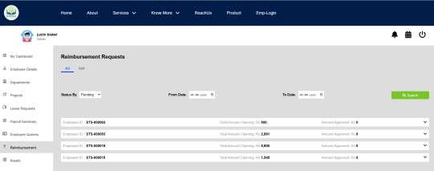
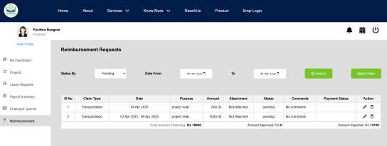
REIMBURSEMENT PAGE(ADMIN/EMPLOYEE)
ADMIN SIDE EMPLOYEE SIDE
View and manage all employee claims in one place.
Filter by status (Pending, Approved, etc.) and date range.
Check claim details with quick dropdown access.
Efficient approval workflow to track and process reimbursements.
Submit new reimbursement claims under categorized heads (Travel,
Meals, etc.).
Attach proof and mention purpose for each claim.
View claim history with real-time status updates.
Edit or delete pending claims before approval.

Slide 12
THANK YOU

