Slide 1
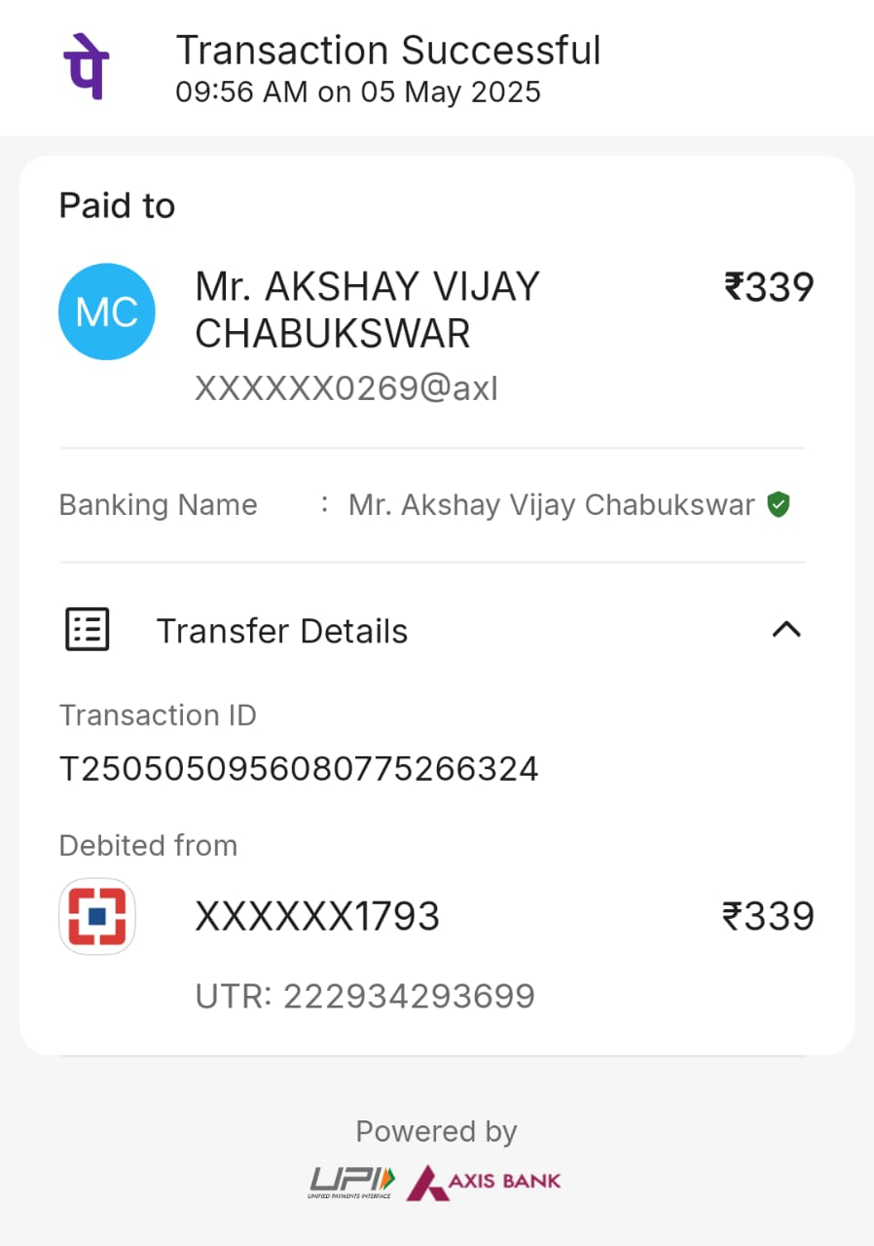
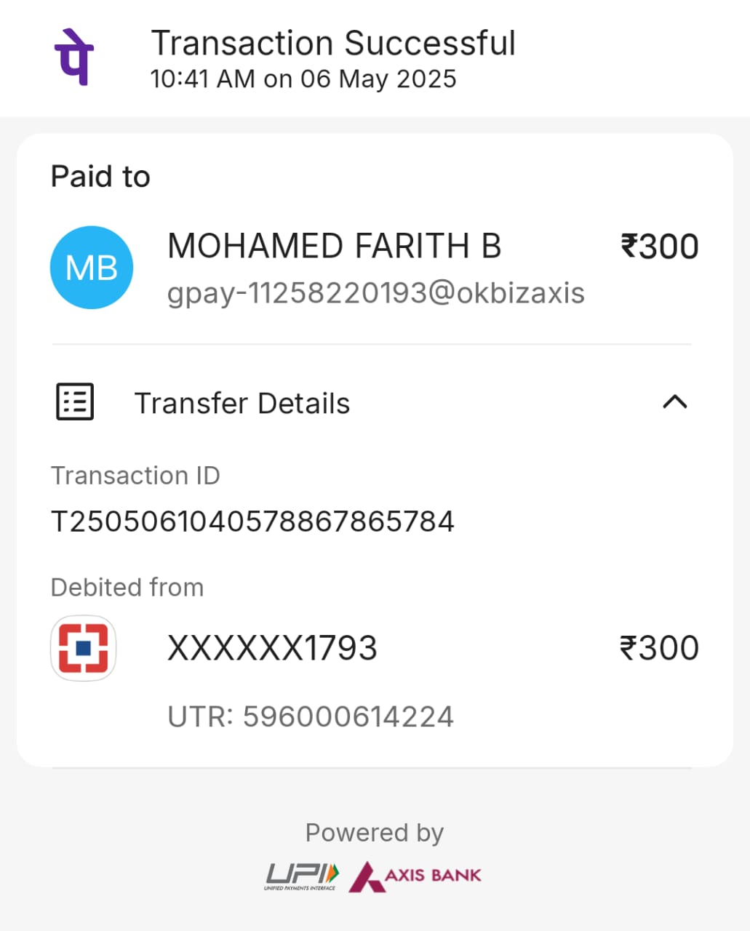
1. Pune to Katraj Bus Stand Cab Amount
2. Chennai to Villa 250 Autorickshaw

Slide 2
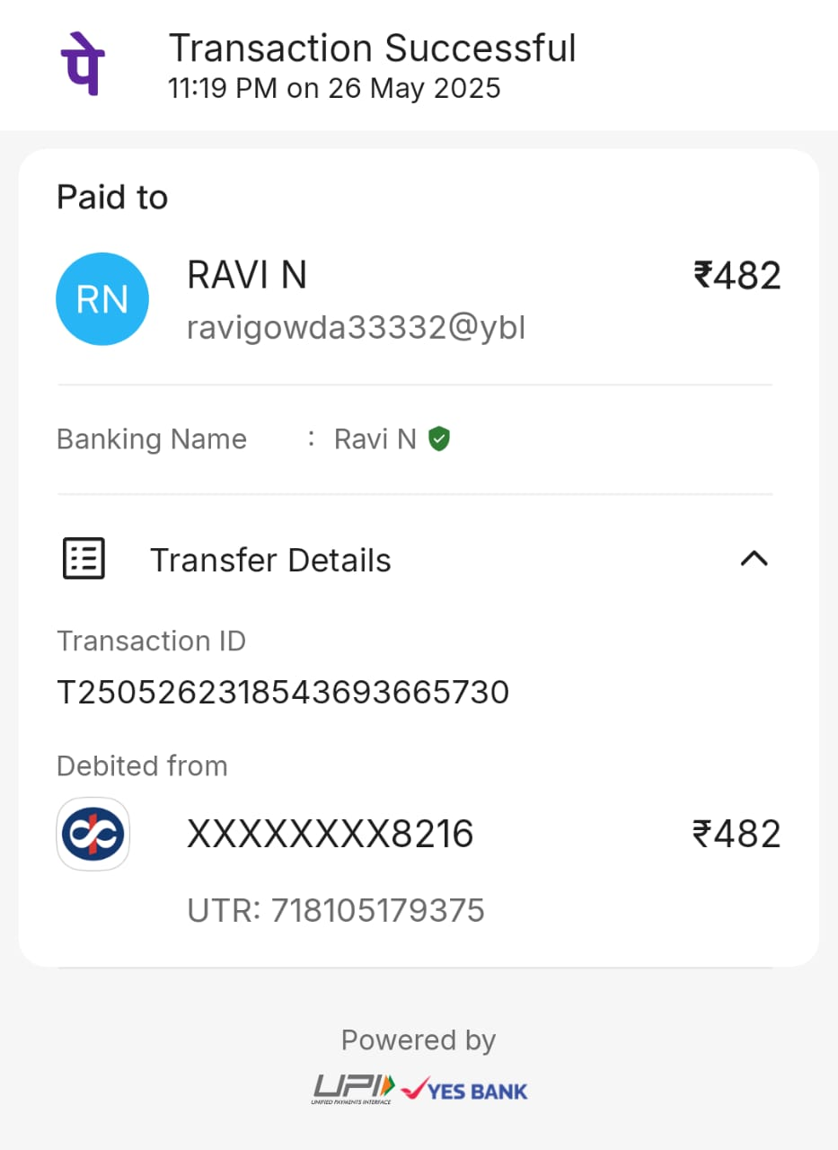
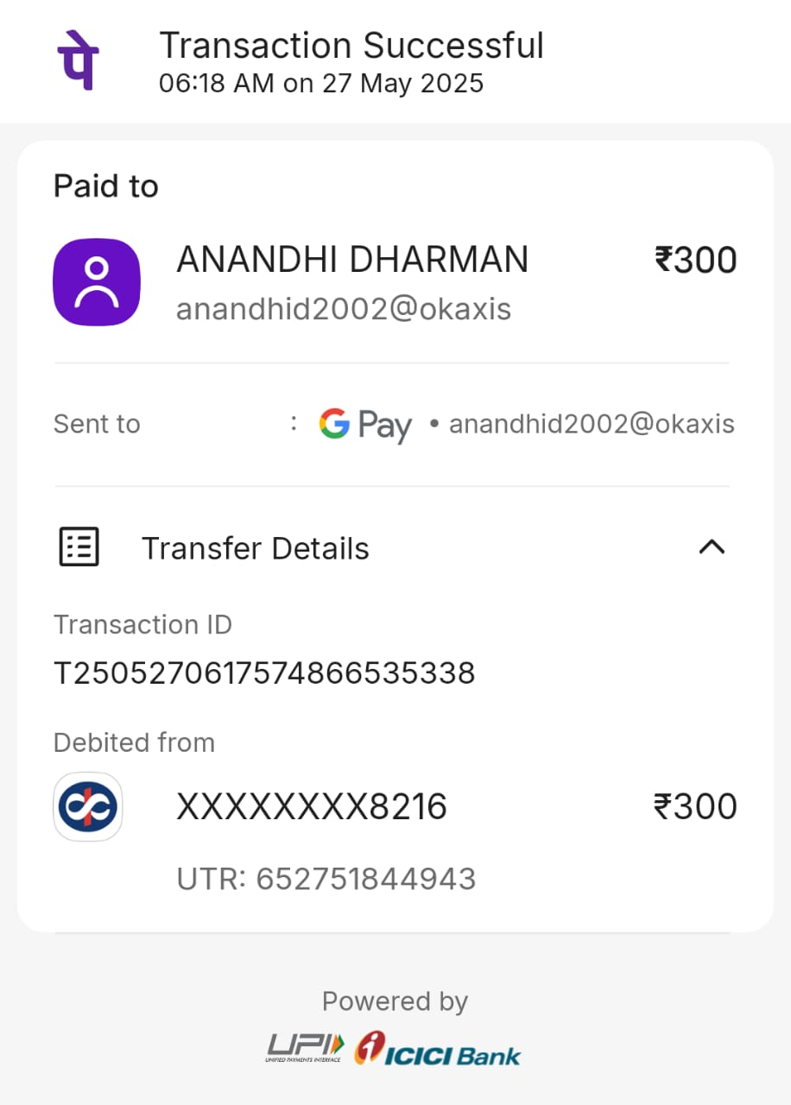
3. Bangalore (Bannerughatta) to Madivaliya circle Cab Amount
4. Chennai to Villa 250 Autorickshaw

Slide 3
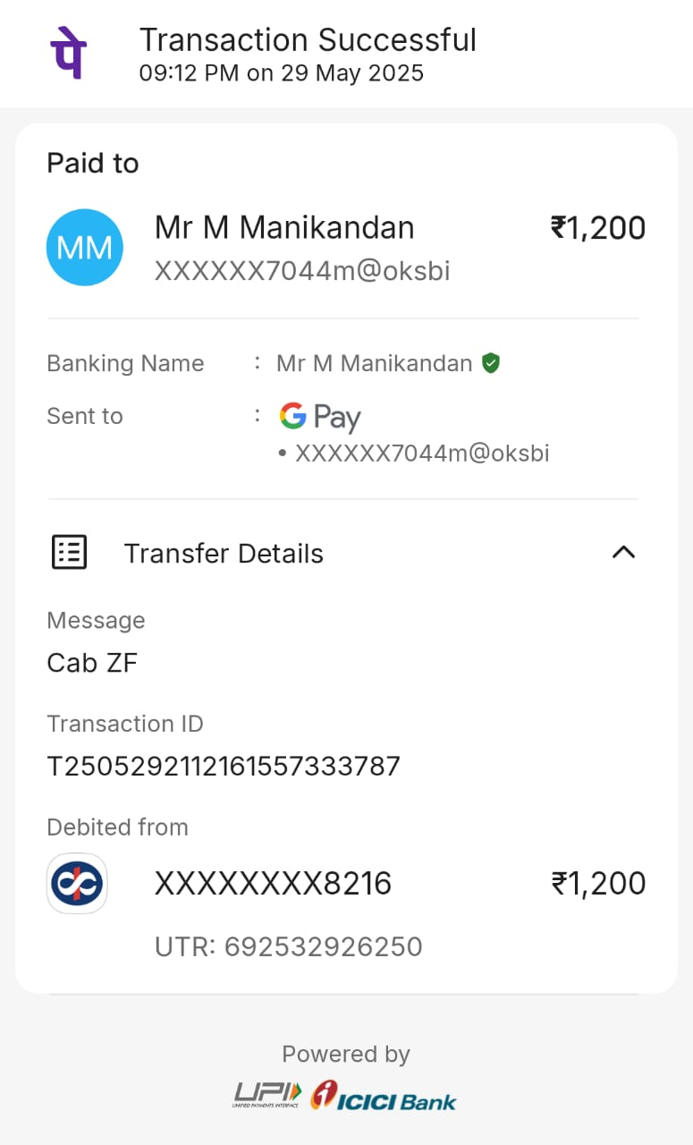
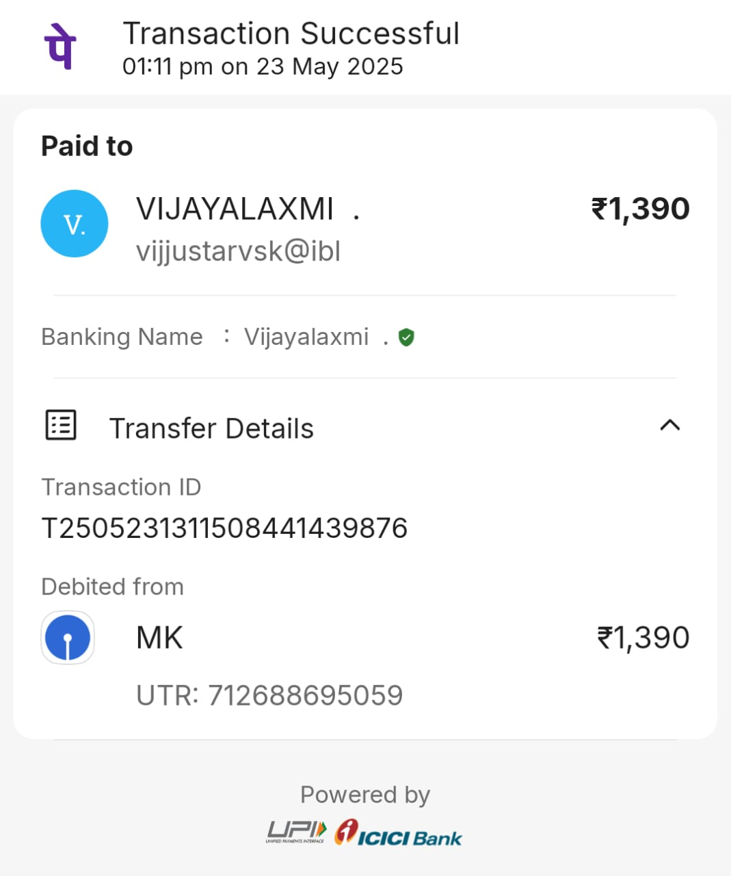
5. Villa 250 to ZF Cab Amount
6. Villa 250 Food Amount
Total Amount – Rs. 4011/-

