Slide 1
Performance analysis of a MIMO Visible Light Communication system under the influence of ambient light
National Institute of Technology Raipur
Department of Electronics and Communication Engineering
Presented by:
Rangabhatla Sriteja
20116084
Semester: VII
Supervised by:
Dr. Bijayananda Patnaik
Associate Professor

Slide 2
Contents:
Introduction.
Visible Light Communication VLC.
Multiple Input Multiple Output MIMO.
Influence of ambient light.
Literature review.
Simulation & Outputs.
Observation.
Conclusion.
Future Scope.
References.

Slide 3
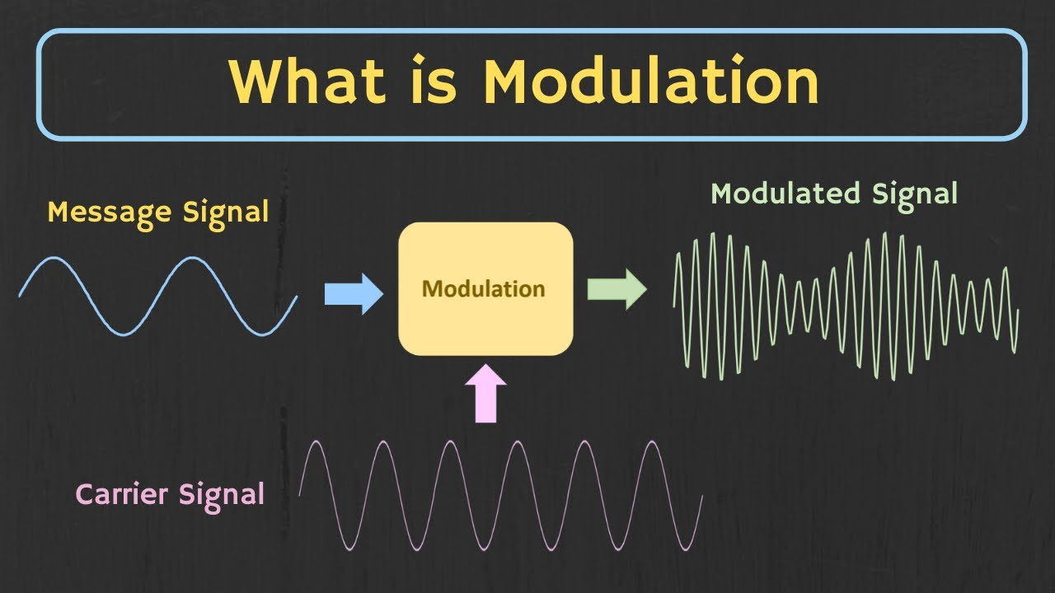
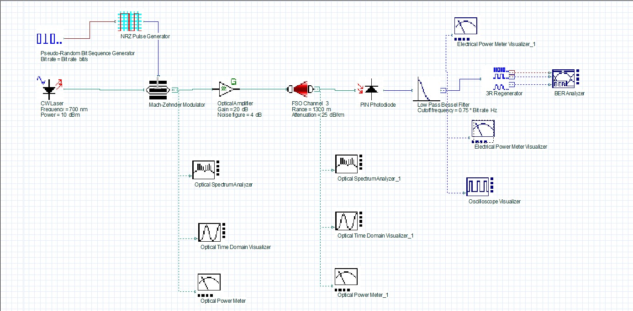
Introduction:
Modulation is a process used in communication systems to transmit information by varying properties of a high frequency carrier signal in accordance with the information being transmitted.
If high frequency continuous light wave is used as carrier then such communication system is called Optical Communication Systems.

Slide 4
Advantages:
Higher bandwidth due to high frequency carrier signal.
Immunity to Electromagnetic Interference.
Disadvantages:
Installation, maintenance and equipment are costly.
Detection and amplification is difficult.
Mobility is difficult.

Slide 5
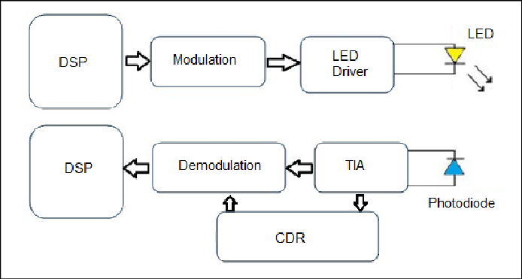
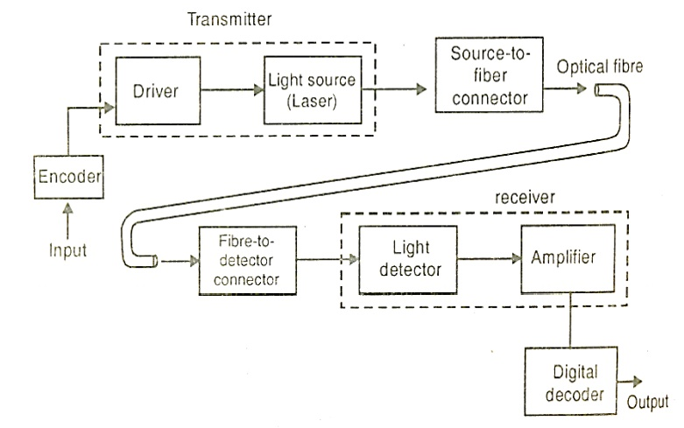
Introduction:
Depending on the medium of transmission Optical Communication is divided in to two types.
1. Optical Wireless Communication OWC
2. Fiber Optical Communication FOC

Slide 6
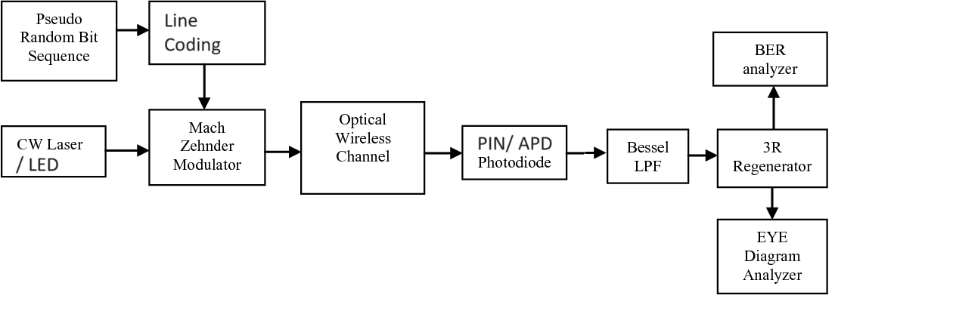
Visible Light Communication VLC:
It is a wireless mode of communication in which a light source, of visible region 380nm to 700nm (or 400THz to 750THz)is used as carrier wave in modulation.

Slide 7
Transmitter circuit of VLC:
Pseudo Random Bit Generator:
Generates random digital data
Line Coding:
NRZ, RZ are few techniques to convert digital data into electric pulses.
Mach-Zehnder Modulator:
Modulates electric pulse signal over continuous wave light signal and produces modulated light signal.
Channel:
As we are considering VLC, channel will be wireless.
Continuous Wave Light Source:
LASER or LED is used as light source to produce continuous light wave

Slide 8
Receiver circuit of VLC:
Channel
Photodetector:
PIN or APD are photodetectors are used widely.
Low Pass Filer:
Low pass filter has to be used to eliminate high frequency noises added in the channel and sidebands of Carrier frequency.
Output devices

Slide 9
Light Sources used in VLC:
Light sources converts electric energy into light energy.
LASERs and LEDs produces light in the range of visible light, hence they can be used as light sources in VLC.
Characteristics of LED and LASER are:
LED (Light Emitting Diode) | LASER (Light Amplification by Stimulated Emission Radiation)
Economic and Easily available | Costly and Hazardous
Limited range due to less power | Longer range due to high power
Lower data rate due to less frequency | Higer data rate due to higher frequency
Efficient situation to use: Indoor for both communication and lighting | Efficient situation to use: Point-to-Point link needed situation.

Slide 10
Photodetectors used in VLC:
Photodetectors converts light energy into electrical energy.
p-type/ intrinsic/ n-type PIN diode and Avalanche Photodiode APD are widely used as photodetectors.
Characteristics of PIN and APD are:
PIN | APD
Economic | Costly
High detection speed | Lower speed of detection
Lower sensitivity, not good for low light situations | High sensitivity, good for low light situations
No internal gain | Internal gain

Slide 11
Advantages of VLC: Disadvantages of VLC:
Secure link establishment due to strict line of sight (LOS).
When LED is used, it will be energy efficient and can be used for indoor lighting.
Obstructions and atmospheric effects LOS, thus quality of link.
Less range is achieved, due to less power of light sources.
Interference due to ambient light or outdoor light.

Slide 12
Factors effecting VLC:
Atmospheric conditions like dust, fog impact channel attenuation.
Light from other sources can effect the performance.
Light sources should not be transmitted at high power as they are hazardous to living cells, therefore range will reduced.
As it is a wireless transmission, it will face fading

Slide 13
Performance increasing techniques in VLC:
Using in indoor conditions with reduced power will increase its performance . As the atmosphere will spread evenly and presence of fog and dust is less probable.
To resist effect by ambient is by using filters, changing modulation techniques like PPM or using advanced modulation techniques like QAM, using equalization etc
To decrease fading there are various techniques like adaptive power control, better coding and modulation techniques, beamforming, spatial multiplexing etc

Slide 14
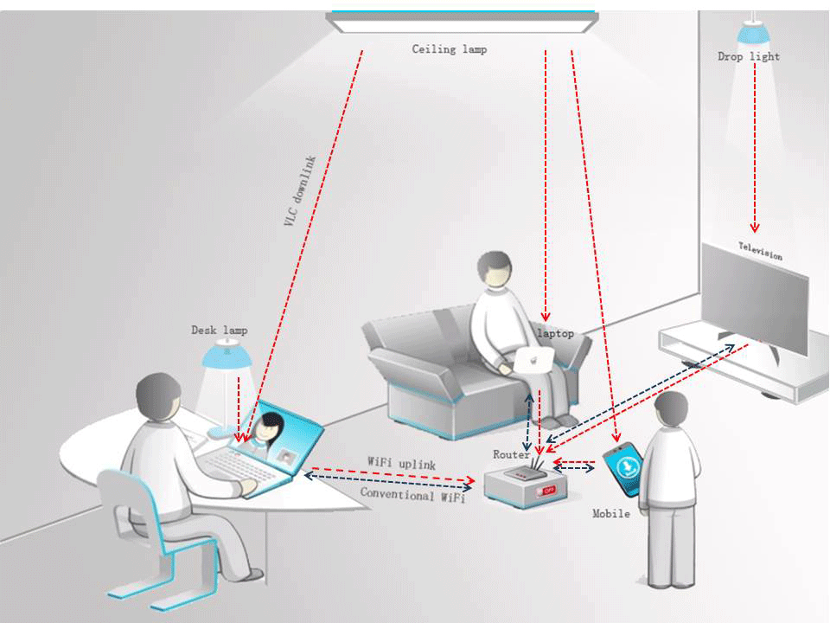
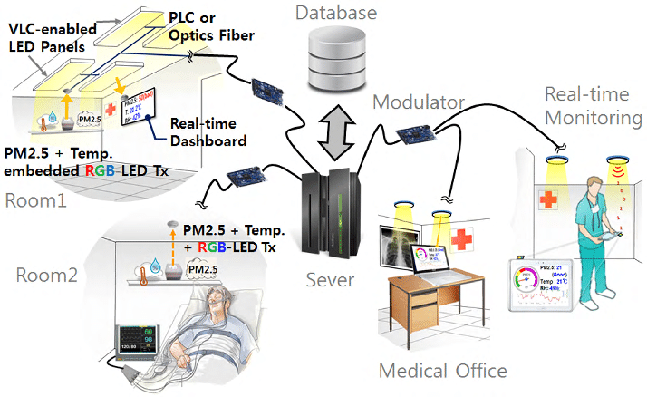
Application of VLC:
As immune to electromagnetic interference and operated at low power, it can be used in hospitals, airports.

Slide 15
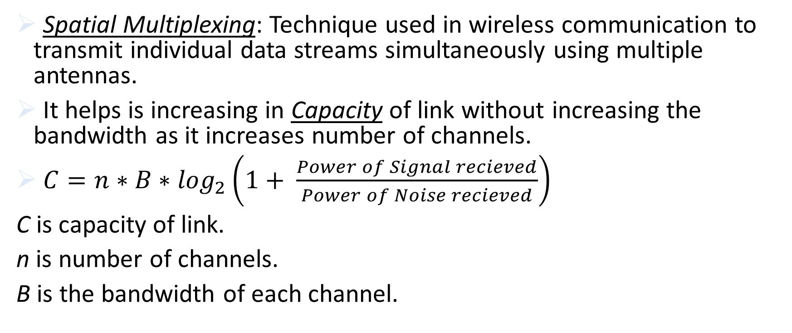
Multiple Input Multiple Output MIMO:
Spatial Multiplexing: Technique used in wireless communication to transmit individual data streams simultaneously using multiple antennas.
It helps is increasing in Capacity of link without increasing the bandwidth as it increases number of channels.
$C=n∗B∗\log_{2}\left(1+ \frac{Power of Signal recieved}{Power of Noise recieved}\right)$
C is capacity of link.
n is number of channels.
B is the bandwidth of each channel.

Slide 16
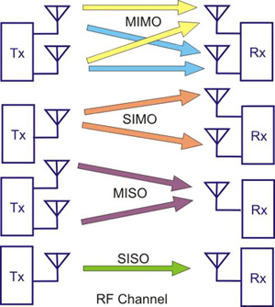
Simple diagram to understand various kinds of transmissions:

Slide 17
Advantages Disadvantages
Spatial Multiplexing: allowing multiple data streams to transmit at once, increases system capacity.
Improves Link Reliability: MIMO improves link reliability even in the presence of obstacles.
Alignment Issues: sensitive to variations of alignment of antennas.
Pre-requirement of Channel State Information: receiver needs CSI before hand to decode the received signal accurately, which is difficult in dynamic environment.
Power Consumption: more power will be used for transmission as individual transmissions increased.

Slide 18
Influence of ambient light:
Ambient light refers to the natural or existing light present in a given environment. It is the general, non-directional illumination that comes from sources such as the sun, moon, or artificial lighting within a space. Ambient light is not focused on a specific object or area but rather contributes to overall visibility and atmosphere.
It causes Interference, Signal attenuation, Diminished Coverage Range, etc.
Spatial Multiplexing can reduce the interference caused by ambient light.

Slide 19
Literature Review:
Title | Publisher | Author(s) | Year
Performance Analysis of an Indoor Visible Light Communication System Using Optisystem Software | ICAECT | Shivam, C. Sharma, S. Singh R. Kumar | 2023
Wireless Communication using VLC and MIMO Technology | IJIRMPS | Dr. Gupta | 2020
Medical healthcare M2M system using the VLC system | AIP Conference Proceedings | Aziz, N. Anuar, M.S. Rashidi, C.B.M. Aljunid, S. Endut, Rosdisham | 2020

Slide 20
Literature Review:
Title | Publisher | Author(s) | Year
Development of a Visible Light Communication (VLC) System with Noise Suppression and Differentiation between Combined Sequences | IBCAST | H. Ali S. Shahid | 2022
Simulation and Analysis of Indoor Visible Light Communication System | ICCSDET | S, Sruthi C, Unni. | 2018

Slide 21
Simulation:
Single Input and Single Output SISO and Multiple Inputs and Multiple Outputs transmission systems with different line coding techniques are simulated using OptiSystem v21.
Aim of the project:
Performance analysis of SISO and MIMO with different line coding techniques.
Performance analysis of SISO and MIMO with different line coding techniques under the influence of ambient light.

Slide 22
Outputs:
Parameters
Data rate | 1Gbps
Power of LASER | 10dBm
Wavelength of LASER | 700nm
Frequency of LASER | 428.275 THz, (700nm)
Channel attenuation | 25dB/km
Optical amplifier gain | 20dB
Optical amplifier Noise figure | 4dB
Wavelength of ambient noise | 550nm

Slide 23
SISO and MIMO Circuits without the interference of ambient light using NRZ, QPSK, RZ

Slide 24
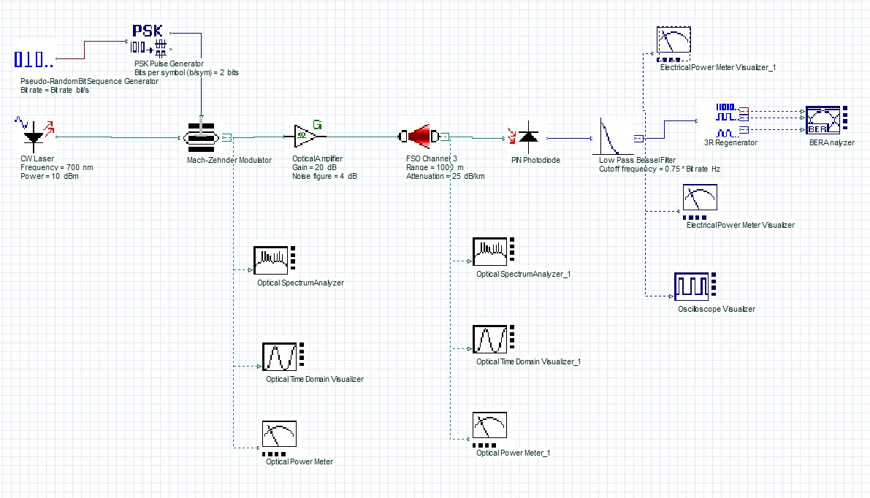
SISO - NRZ
SISO - QPSK

Slide 25
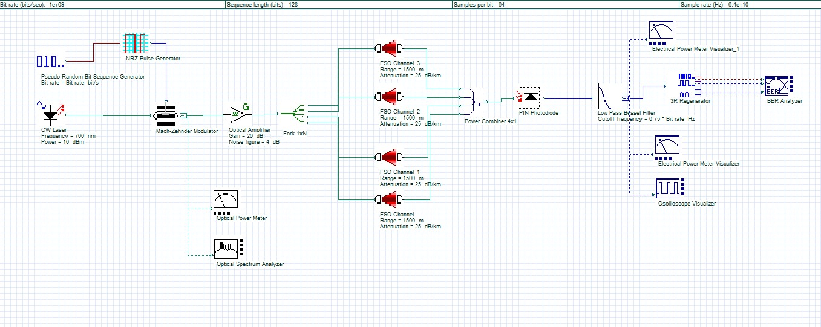
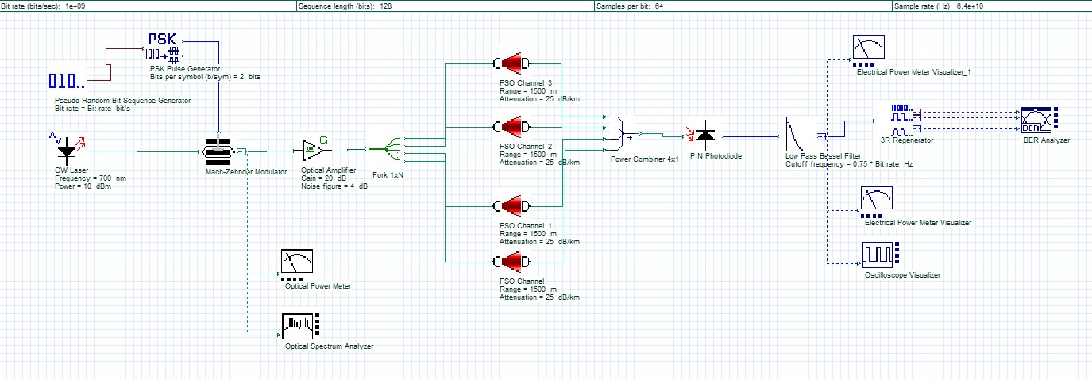
MIMO - NRZ
MIMO - QPSK

Slide 26
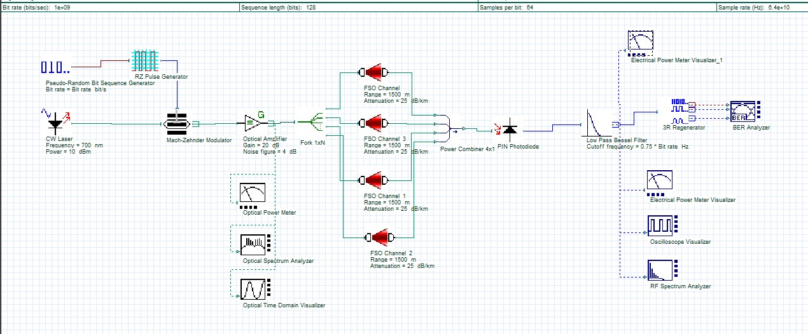
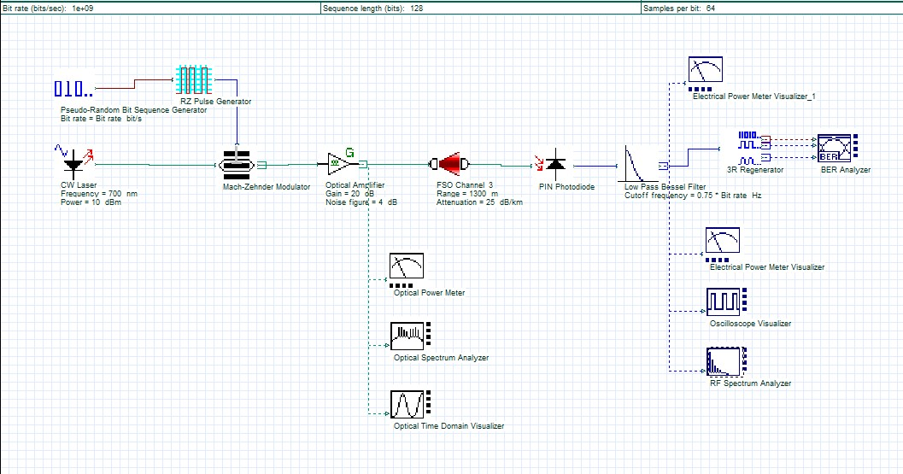
MIMO - RZ
SISO - RZ

Slide 27
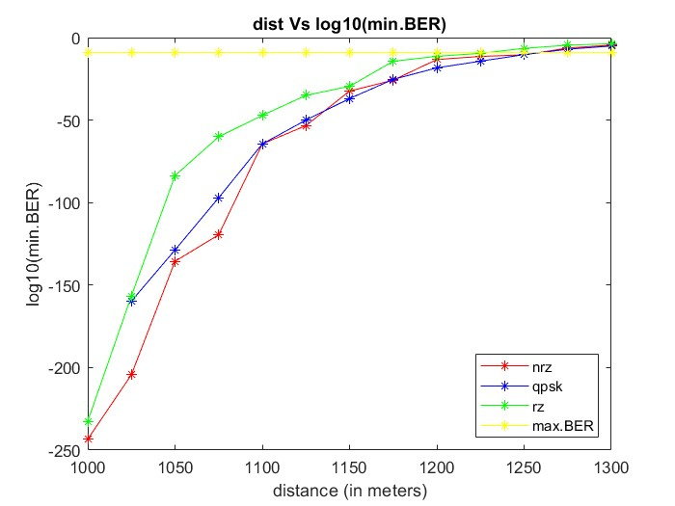
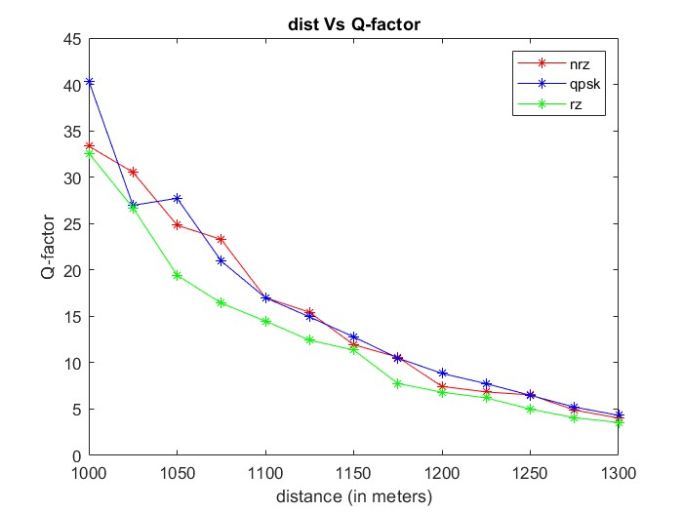
Left side figure depicts distance Vs log10(min.BER) for SISO system.
Right side figure depicts distance Vs Q-factor for SISO system.

Slide 28
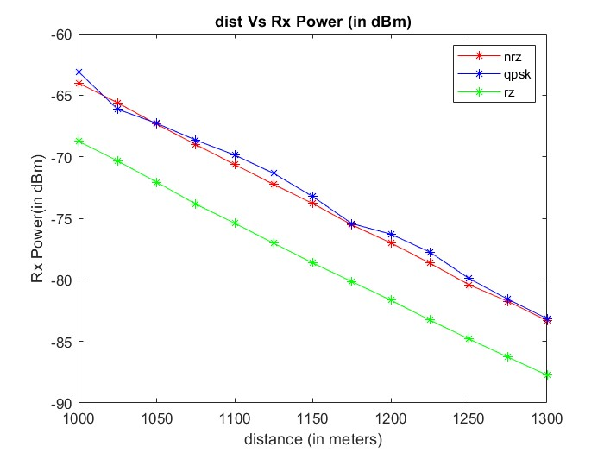
Figure above depicts the power received to the receiver circuit of SISO system.

Slide 29
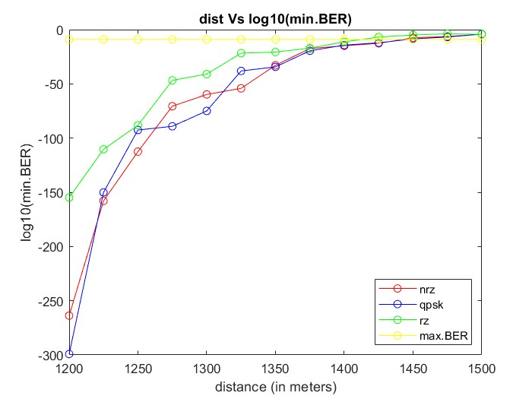
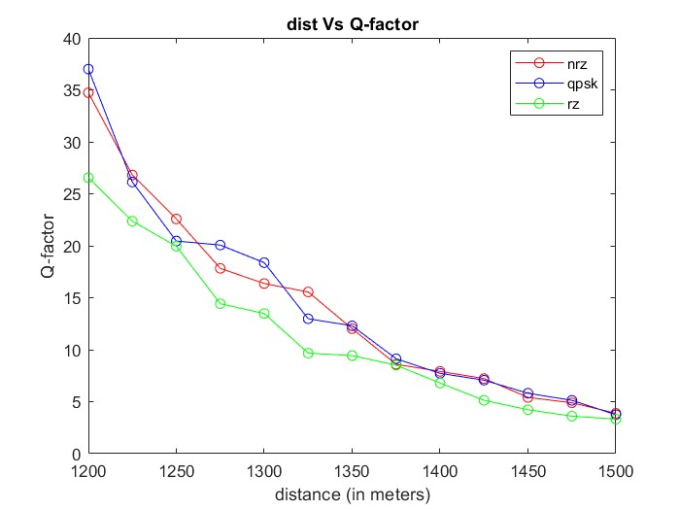
Left side figure depicts distance Vs log10(min.BER) for MIMO system.
Right side figure depicts distance Vs Q-factor for MIMO system.

Slide 30
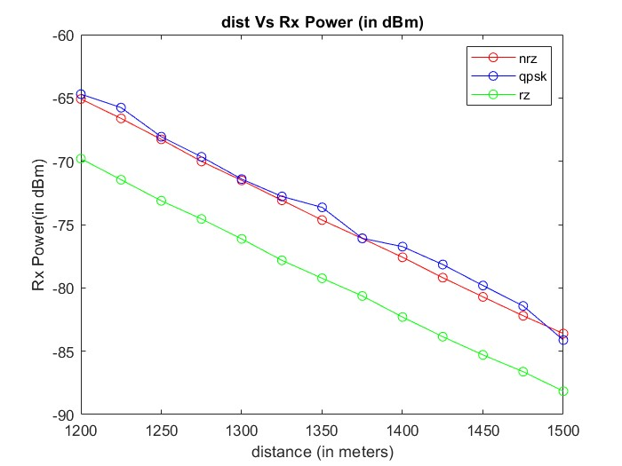
Figure above depicts the power received to the receiver circuit of MIMO system.

Slide 31
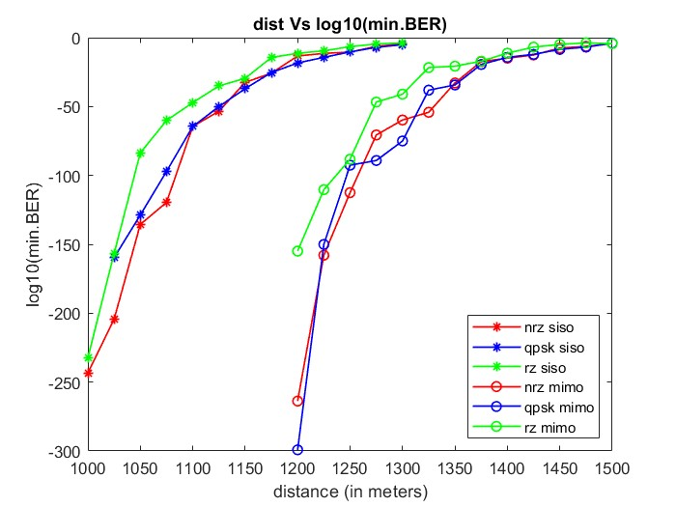

Slide 32
Achievable distance link without ambient Light:
SISO
Line Coding | Distance in meters
NRZ | >1250
RZ | <1250
QPSK | >1250
MIMO
Line Coding | Distance in meters
NRZ | ~1450
RZ | ~1425
QPSK | ~1425

Slide 33
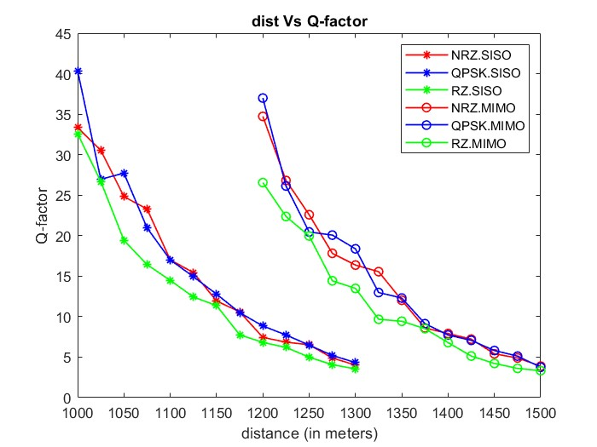

Slide 34
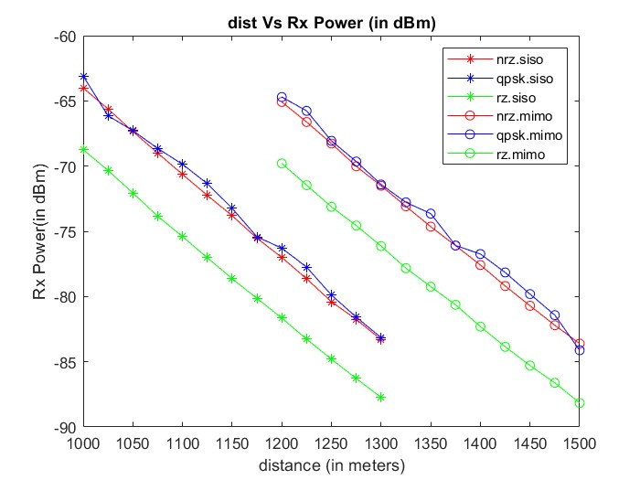

Slide 35
Observation:
QPSK almost outperforms NRZ and RZ in SISO and MIMO in all parameters.
MIMO can transfer farther than SISO.
RZ has very bad performance compared to NRZ and QPSK.

Slide 36
SISO and MIMO Circuits with the interference of ambient light using NRZ, QPSK, RZ

Slide 37
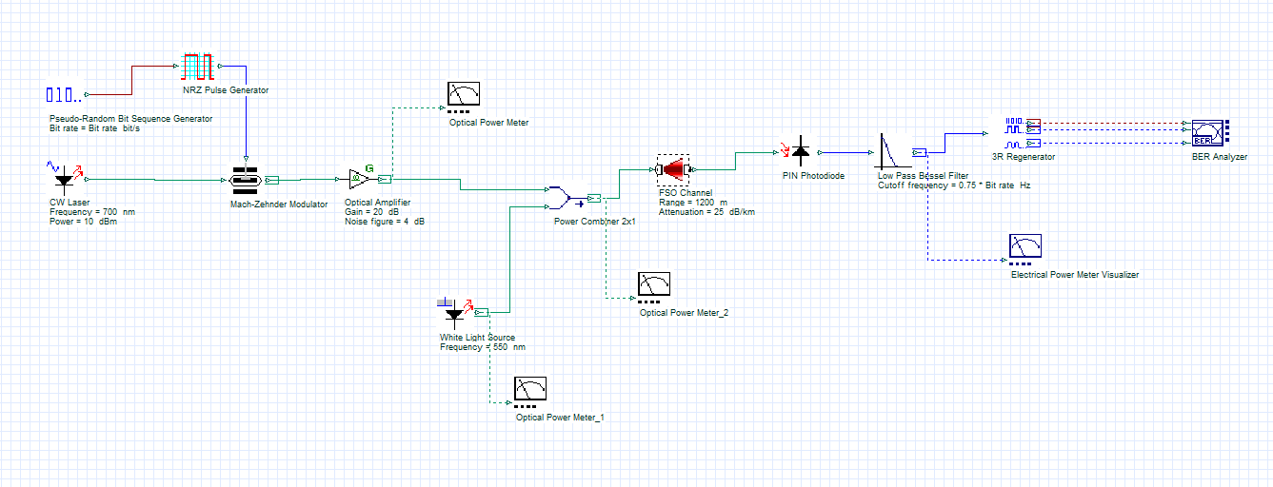
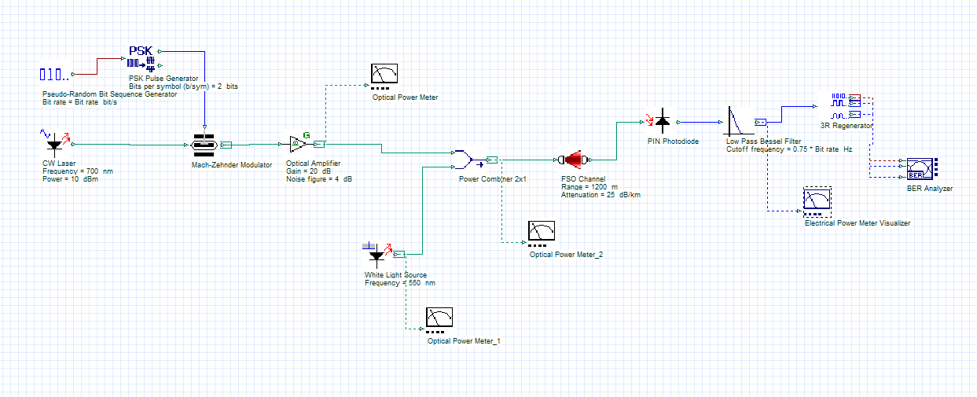
SISO - NRZ
SISO - QPSK

Slide 38
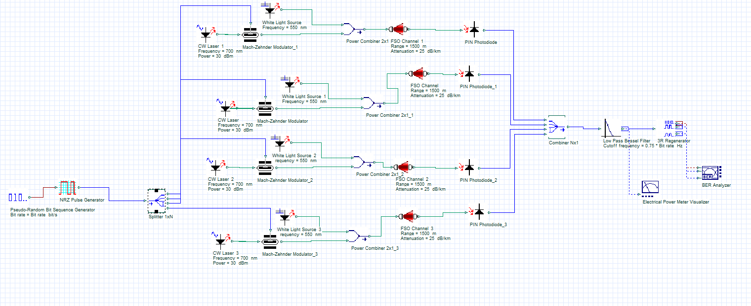
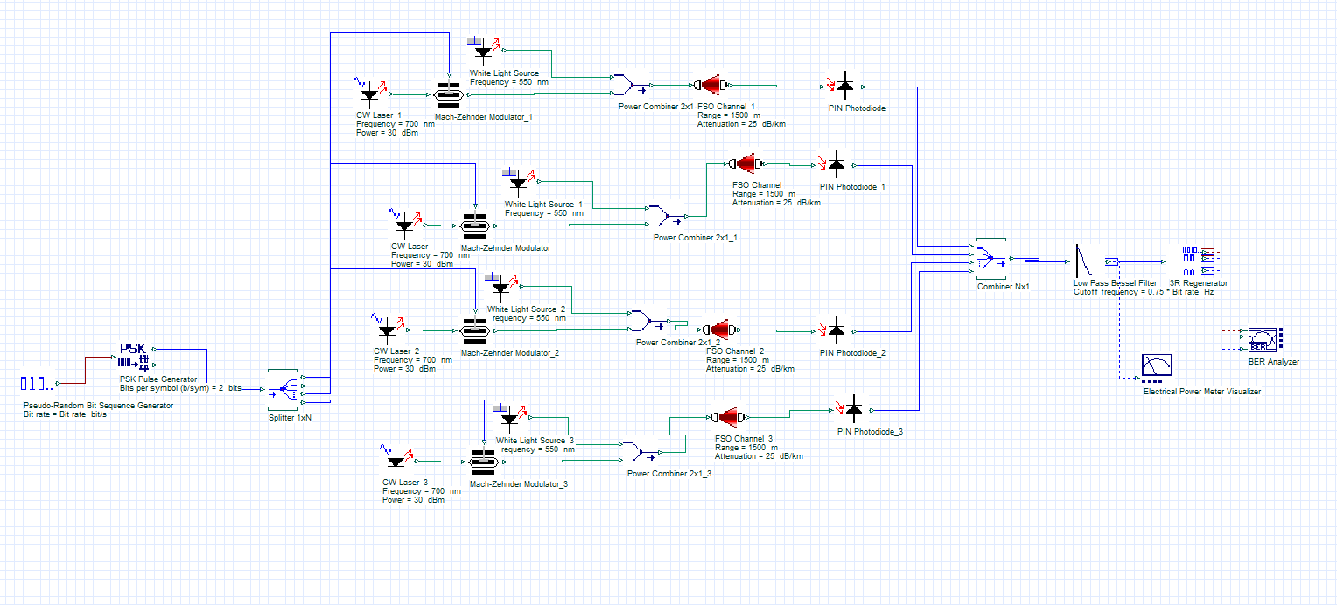
MIMO - NRZ
MIMO - QPSK

Slide 39
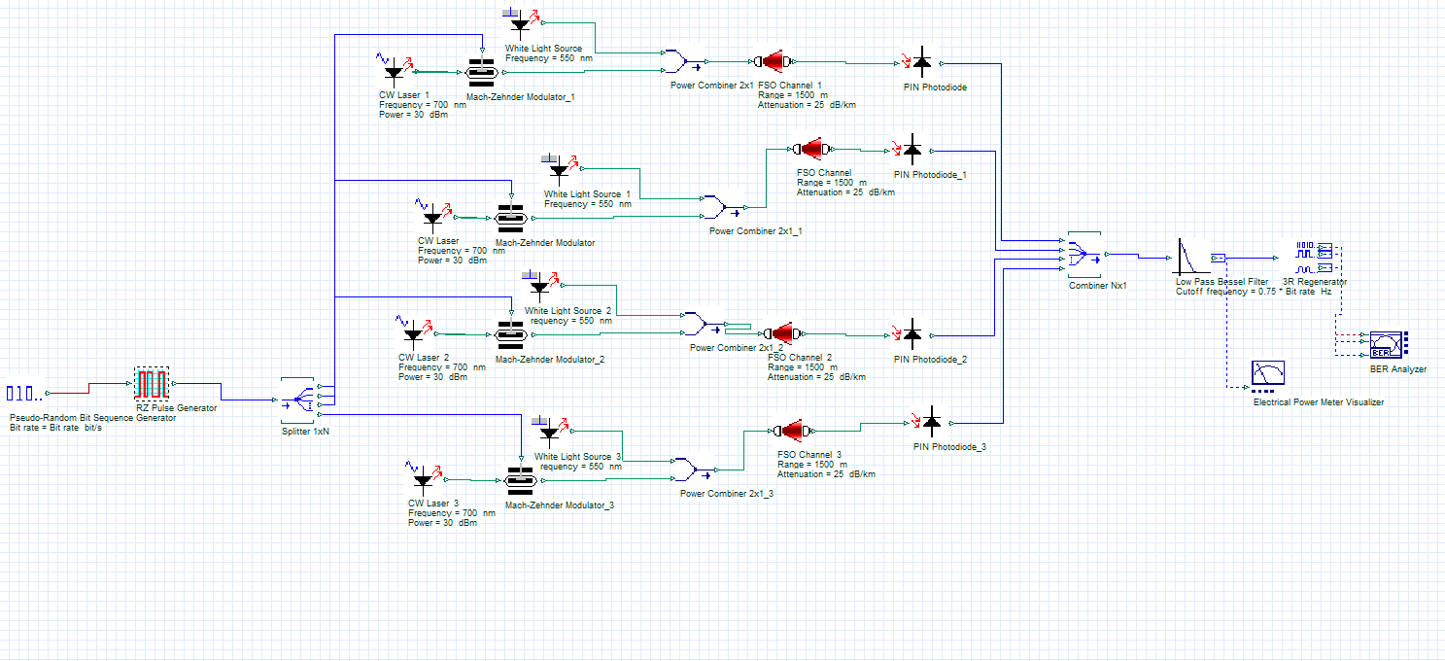
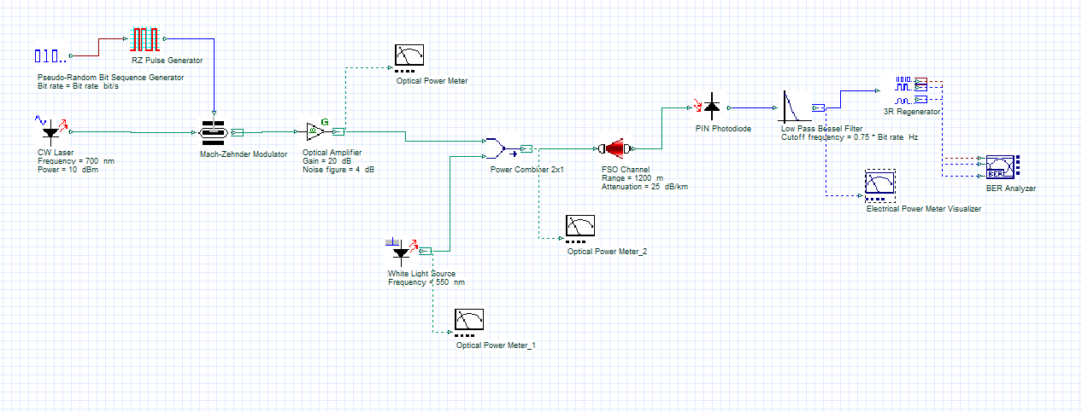
MIMO - RZ
SISO - RZ

Slide 40
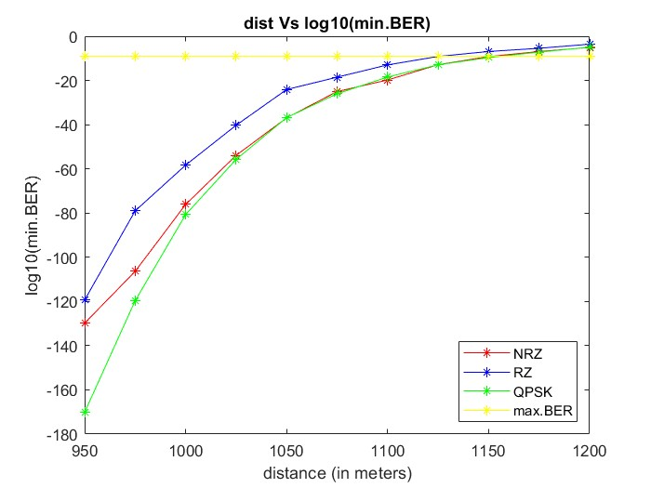
Figure above depicts the Bit Error Rates of SISO system under the influence of ambient light interference with different line coding techniques.

Slide 41
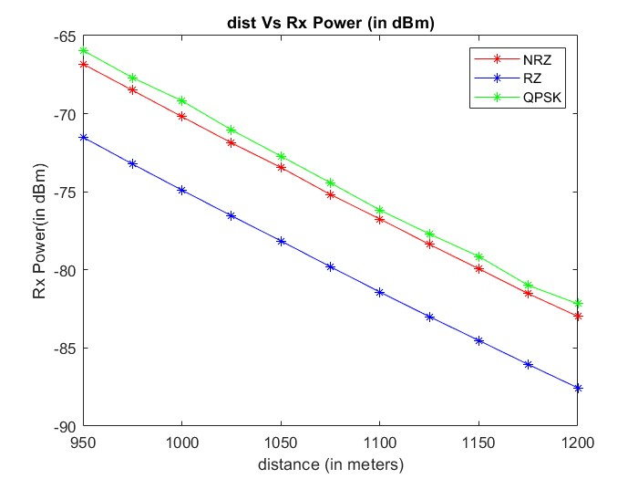
Figure above depicts the power received to the receiver circuit of SISO system under the influence of ambient light interference with different line coding techniques.

Slide 42
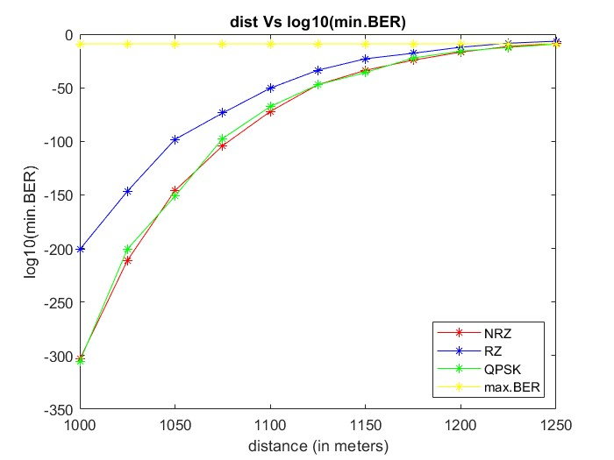
Figure above depicts the Bit Error Rates to the receiver circuit of MIMO system under the influence of ambient light interference with different line coding techniques.

Slide 43
Achievable distance link in presence of ambient Light:
SISO
Line Coding | Distance in meters
NRZ | ~1150
RZ | ~1125
QPSK | ~1150
MIMO
Line Coding | Distance in meters
NRZ | ~1250
RZ | ~1225
QPSK | ~1250

Slide 44
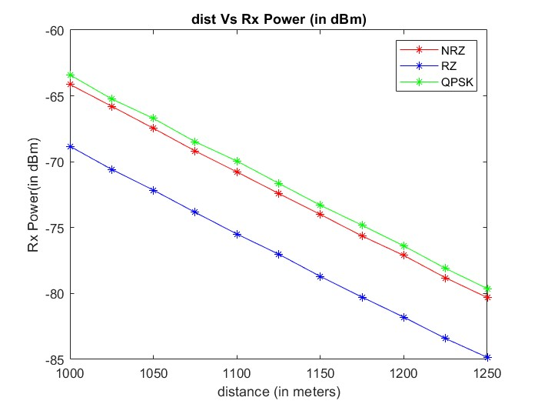
Figure above depicts the power received to the receiver circuit of MIMO system under the influence of ambient light interference.

Slide 45
Conclusion:
Higher modulation technique QPSK performs better in MIMO-VLC.
MIMO efficiently transmits longer distance, in terms of received power, q-factor and minimum BER.

Slide 46
Future Scope:
Verify the performance at higher data rates and higher modulation techniques.
Adopt both line of sight and non-line of sight links in SISO and MIMO systems.

Slide 47
References:
Shivam, C. Sharma, S. Singh and R. Kumar, ”Performance Analysis of an Indoor Visible Light Communication System Using Optisystem Software,” 2023 Third International Conference on Advances in Electrical, Computing, Communication and Sustainable Technologies (ICAECT), Bhilai, India, 2023, pp. 1-6, doi: 10.1109/ICAECT57570.2023.10117680
Gupta, Dr. (2020). Wireless Communication using VLC and MIMO Technology. International Journal of Innovative Research in Engineering & Multidisciplinary Physical Sciences.8.114-119.10.37082/IJIRMPS. 2020.v08i06.012
, N. & Anuar, M.S. & Rashidi, C.B.M. & Aljunid, S. & Endut, Rosdisham. (2020). Medical healthcare M2M system using the VLC system. AIP Conference Proceedings. 2203. 020058. 10.1063/1.5142150.

Slide 48
References:
H. Ali and S. Shahid, ”Development of a Visible Light Communication (VLC) System with Noise Suppression and Differentiation between Combined Sequences,” 2022 19th International Bhurban Conference on Applied Sciences and Technology (IBCAST), Islamabad, Pakistan, 2022, pp. 1031-1035, doi: 10.1109/IBCAST54850.2022.9990534. Gupta, Dr. (2020). Wireless Communication using VLC and MIMO Technology. International Journal of Innovative Research in Engineering & Multidisciplinary Physical Sciences.8.114-119.10.37082/IJIRMPS. 2020.v08i06.012
S, Sruthi & C, Unni. (2018). Simulation and Analysis of Indoor Visible Light Communication System. 1-4. 10.1109/ICCSDET.2018.8821097.

Slide 49


