Slide 1
Class mouseEvents {
sujanTamang.java
sujanTamang.class
String By = “Sujan Tamang”;
/* Keep Learnig, Keep Exploring*/
}
JAVA Programming Language

Slide 2
System.out.println(“Topic’s Today”);
whatWeWillCover.java
whatWeWillCover.class
public void Topics(String getMotivated) {
/*
Here’s what you’ll find in this presentation:
What is Events in Java?
What are MouseEvents?
What are MouseMotionListeners and MouseListeners?
*/
System.out.println(getMotivated);
}
JAVA Programming Language

Slide 3
public void Intro() {
01
02
03
Introduction.java
Introduction.java
What are Events?
/* Change in the state of object or source. */
What is Event Handling?
/* A mechanism which controls events.*/
Delegation Event Model
/* Sub-divided as Source and listener */
}
JAVA Programming Language

Slide 4
Class Events {
String = “Events”
Events.java
Events.class
/*
An event is a change in the state of an object triggered by some action such as Clicking a button, Moving the cursor, Pressing a key on the keyboard, Scrolling a page, etc.
In Java, the java.awt.event package provides various event classes to handle these actions.
*/
}
JAVA Programming Language

Slide 5
public void eventHandling() {
Events.java
Events.class
/* Event handling is a mechanism that allows programs to control events and define what should happen when an event occurs. */
}
public void eventModel(){
/* Java uses the Delegation Event Model to handle events. This model consists of two main components:
Source
Listeners
*/
}
JAVA Programming Language

Slide 6
Public void mouseEvents(){
mouseEvents.java
mouseEvents.class
/*
An event which indicates that a mouse action occurred in a component. mouseEvent is a class and there are so many methods here are some :
*/
int getX(); //returns position of mouse vertically
int getY(); //returns position of mouse horizontally
int getClickCount(); //counts how many times mouse is being clicked.
}
JAVA Programming Language

Slide 7
public void mouseEventWeHave()
mouseEventWeHave.java
mouseEventWeHave.class
{
mouseClicked();
mouseEntered();
mouseExited();
mousePressed();
mouseReleased();
mouseMoved();
mouseDragged();
}
JAVA Programming Language

Slide 8
public void mouseEventWeHave()
mouseEventWeHave.java
mouseEventWeHave.class
{
mouseClicked();
mouseEntered();
mouseExited();
mouseListeners
mousePressed();
mouseReleased();
mouseMoved();
}
mouseMotionListeners
mouseDragged();
JAVA Programming Language

Slide 9
interface mouseListeners{
mouseListeners.java
mouseListeners.class
/*
Mouse Listener is an interface in java.awt.event package.
Mouse Listener handles the events when the mouse is not in motion. */
void mouseReleased(MouseEvent e) // Mouse key is released
void mouseClicked(MouseEvent e) // Mouse key is pressed/released
void mouseExited(MouseEvent e) // Mouse exited the component
void mouseEntered(MouseEvent e) // Mouse entered the component
void mousepressed(MouseEvent e) // Mouse key is pressed
}
JAVA Programming Language

Slide 10
interface mouseMotionListeners{
mouseMotionListeners.java
mouseMotionListeners.class
/*
Mouse Motion Listener is also an interface in java.awt.event package.
Mouse Motion Listener handles the events when mouse is in motion.
*/
void mouseDragged(MouseEvent e)
/*
Invoked when a mouse button is pressed in the component and dragged. Events are passed until the user releases the mouse button.*/
void mouseMoved(MouseEvent e)
/*
invoked when the mouse cursor is moved from one point to another within the component, without pressing any mouse buttons.
*/
}
JAVA Programming Language

Slide 11
public class MouseEvents{
ExampleTime.java
ExampleTime.class
public static void main(String[] args){
new ExampleTime();
}
}
JAVA Programming Language

Slide 12
Class Quote { String = “With great codes often comes great confusion”
Quotes.java
Quotes.class
}
JAVA Programming Language

Slide 13
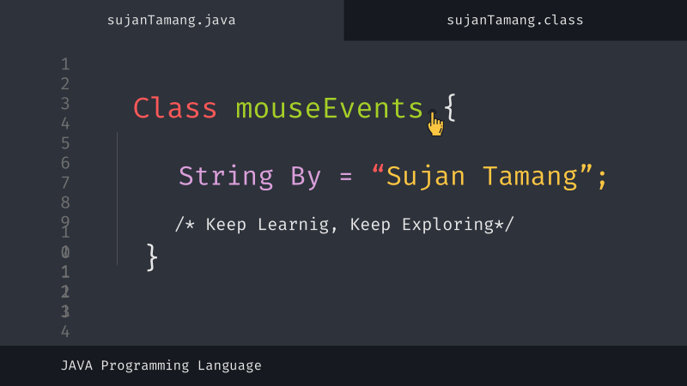
iterface ThatsMyTime{
thatsMyTime.java
thatsMyTime.class
void thankYou();
void feedBacks();
void anyQuestions();
}
JAVA Programming Language

