Slide 1
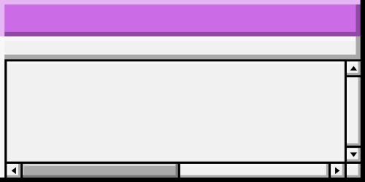




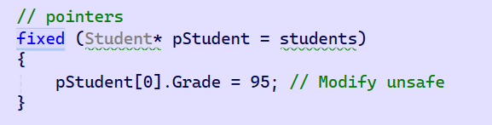

POINTERS
File
Edit
Format
View
Help
Pointer directly manipulates the student’s grade in memory.
fixed statement is logically fixing the variable in memory so it does not move around, allowing pointer manipulation.
Provides optimized memory access, which can be beneficial when dealing with large datasets. However, pointers in C# are considered unsafe, should only be used in performance critical applications.
Notes:
Pointers allow you to access and modify memory directly, which can lead to memory corruption if not handled correctly. C# uses a managed memory model with garbage collection to automatically manage memory allocation and deallocation. Pointers bypass this system, which can lead to memory leaks or dangling pointers if the memory is not managed properly. Code that uses pointers is often less portable because it depends on the underlying architecture (e.g., the size of data types may differ between platforms). The fixed statement tells the garbage collector not to move the memory location of the object you are working with for the duration of the fixed block. This ensures that the pointer remains valid and points to the correct memory location throughout its use. By pinning the memory, you can safely work with pointers to managed objects without worrying about the garbage collector relocating them during operations.

Slide 2

GENERICS
File
Edit
Format
View
Help
The StudentGroup<T> class is generic, allowing it to handle types that derive from the Student class. This makes the system capable of managing different student types, such as undergraduate, postgraduate, or part-time students.
Provide type safety while allowing code reuse.
However this implementation assumes that all students in a group are of the same type, e.g., Alternatively ensure that all student types (e.g., UndergraduateStudent, PostgraduateStudent) inherit from a common base class, such as Student/use an interface/polymorphism.
Notes:
Page 1: Pointers allow you to access and modify memory directly, which can lead to memory corruption if not handled correctly. C# uses a managed memory model with garbage collection to automatically manage memory allocation and deallocation. Pointers bypass this system, which can lead to memory leaks or dangling pointers if the memory is not managed properly. Code that uses pointers is often less portable because it depends on the underlying architecture (e.g., the size of data types may differ between platforms). The fixed statement tells the garbage collector not to move the memory location of the object you are working with for the duration of the fixed block. This ensures that the pointer remains valid and points to the correct memory location throughout its use. By pinning the memory, you can safely work with pointers to managed objects without worrying about the garbage collector relocating them during operations.
Page 2: Generics increase flexibility. You can create groups of different types of students without rewriting the StudentGroup class for each type.

Slide 3
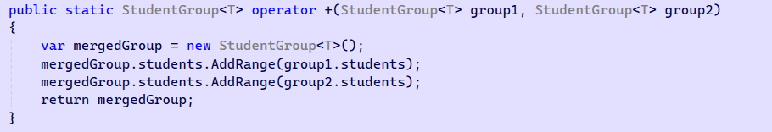

OPERATOR OVERLOADING
File
Edit
Format
View
Help
The code overloads the +, >, and < operators for the StudentGroup class.
+ is used to merge two student groups into one, more expressive than calling a method like MergeGroups(group1, group2).
> and < are used to compare the average performance of two groups.
Overloading operators can lead to code that is harder to understand if not used carefully.
Notes:
Page 1: Pointers allow you to access and modify memory directly, which can lead to memory corruption if not handled correctly. C# uses a managed memory model with garbage collection to automatically manage memory allocation and deallocation. Pointers bypass this system, which can lead to memory leaks or dangling pointers if the memory is not managed properly. Code that uses pointers is often less portable because it depends on the underlying architecture (e.g., the size of data types may differ between platforms). The fixed statement tells the garbage collector not to move the memory location of the object you are working with for the duration of the fixed block. This ensures that the pointer remains valid and points to the correct memory location throughout its use. By pinning the memory, you can safely work with pointers to managed objects without worrying about the garbage collector relocating them during operations.
Page 2: Generics increase flexibility. You can create groups of different types of students without rewriting the StudentGroup class for each type.

Slide 4

LISTS
File
Edit
Format
View
Help
The addStudent and getStudent methods make use of the lists.
In the + operator overloading, AddRange is used to merge the students lists from two StudentGroup<T> instances.
Readonly for encapsulation. Can modify but not replace.
Notes:
Page 1: Pointers allow you to access and modify memory directly, which can lead to memory corruption if not handled correctly. C# uses a managed memory model with garbage collection to automatically manage memory allocation and deallocation. Pointers bypass this system, which can lead to memory leaks or dangling pointers if the memory is not managed properly. Code that uses pointers is often less portable because it depends on the underlying architecture (e.g., the size of data types may differ between platforms). The fixed statement tells the garbage collector not to move the memory location of the object you are working with for the duration of the fixed block. This ensures that the pointer remains valid and points to the correct memory location throughout its use. By pinning the memory, you can safely work with pointers to managed objects without worrying about the garbage collector relocating them during operations.
Page 2: Generics increase flexibility. You can create groups of different types of students without rewriting the StudentGroup class for each type.

Slide 5
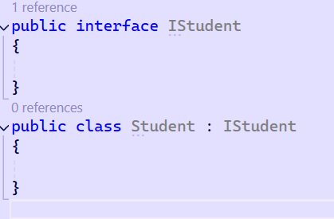
POLYMORPHISM/INTERFACE
File
Edit
Format
View
Help
public class StudentGroup<T> where T : IStudent can then be used
Student types can inherit from Student or implement IStudent
Use interfaces to define a contract that all student types should follow. This approach allows you to use a common StudentGroup<IStudent> to manage various types of students while ensuring that they adhere to a common set of properties and methods.
Use polymorphism to handle different types of students through a common base type or interface. This allows you to perform operations on student objects without needing to know their specific type, as long as they inherit from a common class or implement an interface.
Notes:
Page 1: Pointers allow you to access and modify memory directly, which can lead to memory corruption if not handled correctly. C# uses a managed memory model with garbage collection to automatically manage memory allocation and deallocation. Pointers bypass this system, which can lead to memory leaks or dangling pointers if the memory is not managed properly. Code that uses pointers is often less portable because it depends on the underlying architecture (e.g., the size of data types may differ between platforms). The fixed statement tells the garbage collector not to move the memory location of the object you are working with for the duration of the fixed block. This ensures that the pointer remains valid and points to the correct memory location throughout its use. By pinning the memory, you can safely work with pointers to managed objects without worrying about the garbage collector relocating them during operations.
Page 2: Generics increase flexibility. You can create groups of different types of students without rewriting the StudentGroup class for each type.

