Slide 1

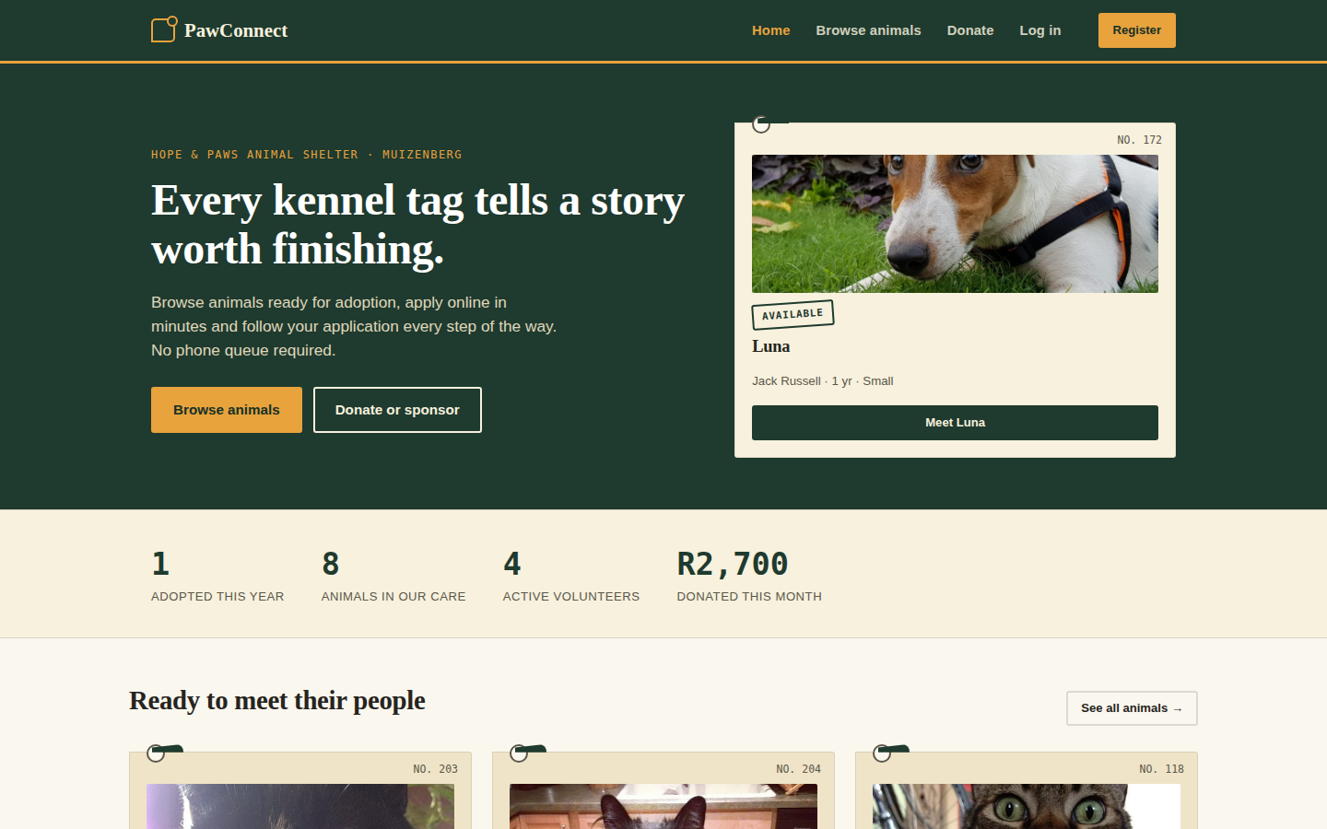
PawConnect
Adoption, volunteering and donations online for Hope & Paws Animal Shelter
Carson Norman · ST10285120 · INSY7315 EXPO · Task 3
Notes:
Good morning. I'm Carson Norman, and I built PawConnect on my own for Hope & Paws Animal Shelter, a small shelter in Muizenberg with five staff and about twenty volunteers. In the next fifteen minutes I'll show you the system working live, explain the main decisions behind it, and finish with what I'm asking for today: approval to put PawConnect into use at the shelter.

Slide 2




Four problems the shelter raised
Animals aren't visible online
Paper applications, retyped
Only by visiting or messaging Facebook, which the front desk can't keep up to date
Forms copied into a spreadsheet by hand: slow, and mistakes creep in
Medical history on a paper card
Shifts organised on WhatsApp
Easily lost or damaged, and the visiting vet can't check it remotely
Shifts get double booked or left uncovered
Notes:
These came from my requirements session with the shelter manager. Adopters can't see which animals are available without visiting or messaging Facebook. Applications are written on paper and retyped into a spreadsheet. Each animal's medical history is on a card in its kennel file. And the volunteer roster is a WhatsApp group, so shifts get double booked or missed. Everything PawConnect does traces back to one of these four problems. The shelter also needs proper reporting for its funders, which you'll see in the admin part of the demo.

Slide 3



One website, three kinds of user
Public and adopters
Volunteers
Shelter manager
Browse and filter animals
Apply online in 3 steps
Track the application
Donate or sponsor an animal
Review applications
Log vet visits and vaccinations
Sign up for shifts
Log volunteer hours
Record new arrivals
Publish shifts, approve hours
Manage staff accounts
Funder report + CSV export
Notes:
PawConnect is one website used in three ways. The public browses animals, applies online and donates. Volunteers review applications, record medical care, and sign up for shifts. The manager runs intake, the roster, accounts and reporting. What each person can do is enforced on the server for every page and API call, not just hidden in the menus.

Slide 4

Live demo: one adoption, end to end
1
Adopter
Filter animals, open a profile, apply (refresh to show the draft is saved), see the reference number
2
Volunteer
Start review, approve with a note, log a vaccination, sign up for a shift, try a clashing one
3
Manager
Record home visit and fee, mark adopted, confirm a donation, run the funder report and export CSV
Live on the hosted site. A recorded run-through is ready in case the network fails.
Notes:
Now the live demo, on the hosted site, with three browser windows signed in as an adopter, a volunteer and the manager. I follow one adoption from start to finish. As the adopter I filter the animals, open a profile and start an application. I refresh halfway to show the draft is saved, then submit and get a reference number. As the volunteer I start the review, approve it with a note, log a vaccination so the badge changes, sign up for a shift, then try an overlapping shift to show PawConnect refuses it. As the manager I record the home visit and fee, mark the animal adopted, confirm a pledged donation, and export the funder report. Before presenting: open the site five minutes early so it's awake, and have the backup recording open in another tab. I don't show passwords on screen.

Slide 5
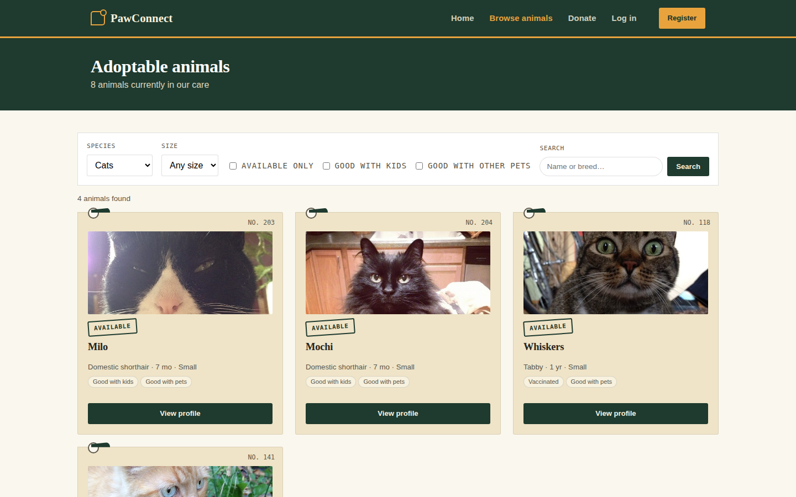
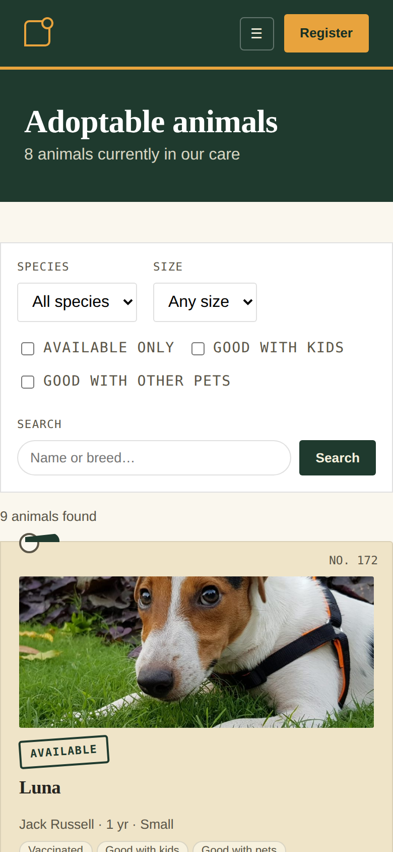
Adopters: find a match, apply in minutes
Live filters: species, size, kids, other pets
3-step form, pre-filled and autosaved
Track: Submitted → Review → Approved → Adopted
Works on any phone, no app needed
Notes:
This is what you saw in the demo. Filters update the list as you click, using the same API the website is built on. The application form is short, pre-filled from the account, and saves as you type, so a visitor can apply in well under the five minutes in our usability requirement. The same pages work on a phone, which is how most of the shelter's Facebook audience will arrive.

Slide 6
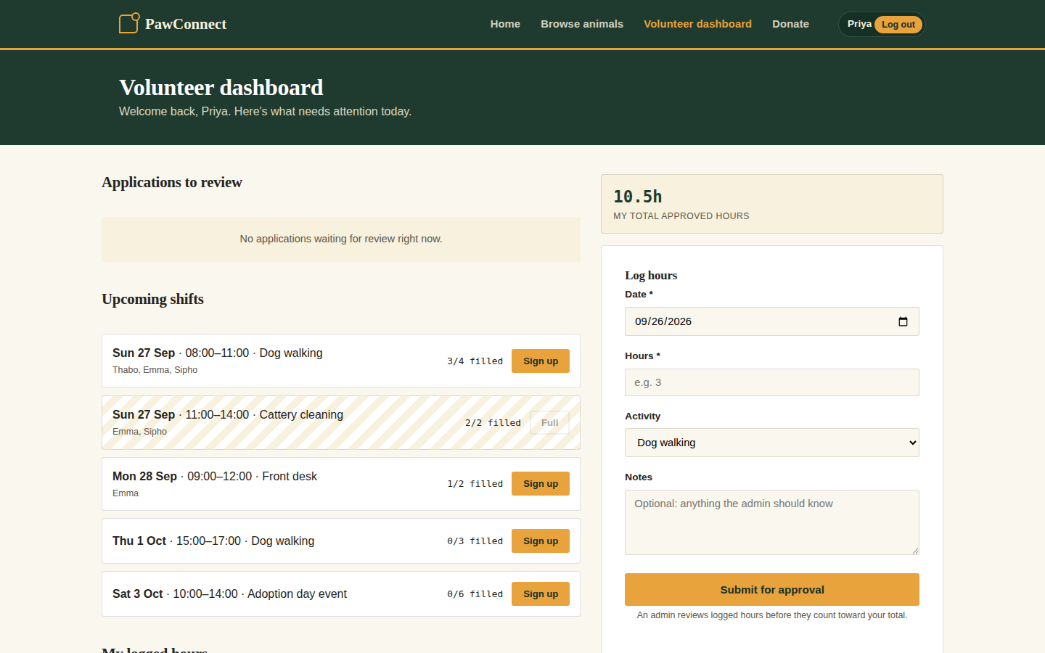
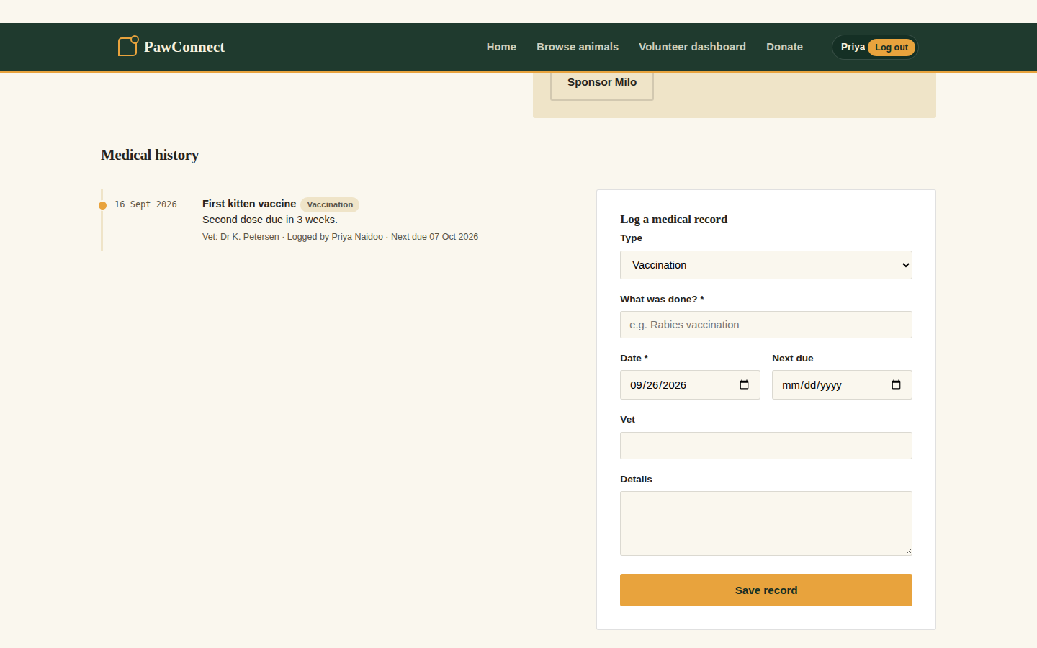
Volunteers: a roster that can't double book
Shift rules are checked twice: by the code and by a database constraint, so even two volunteers clicking at the same instant can't overbook.
Medical history in one place: staff and the visiting vet see every record. A vaccination updates the public badge.
Notes:
The volunteer dashboard replaces the WhatsApp group. Full shifts show as full, and the server refuses a sign-up that would overbook a shift, duplicate one, or clash with another shift. The database enforces the same rule, and an automated test has six volunteers racing for a two-place shift: exactly two get in. That meets the success criterion of zero double bookings. On the right is the medical history from the design document's second flow: staff load it through a staff-only API and add records, and a vaccination updates the badge the public sees.

Slide 7
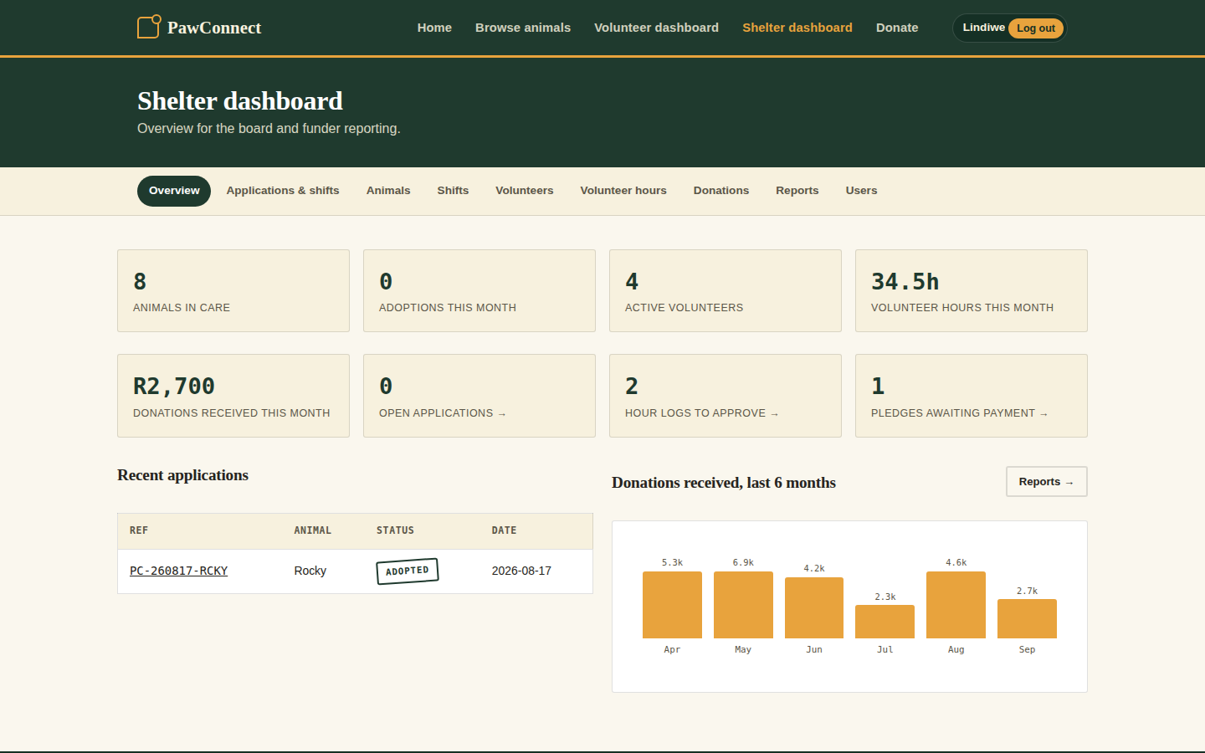
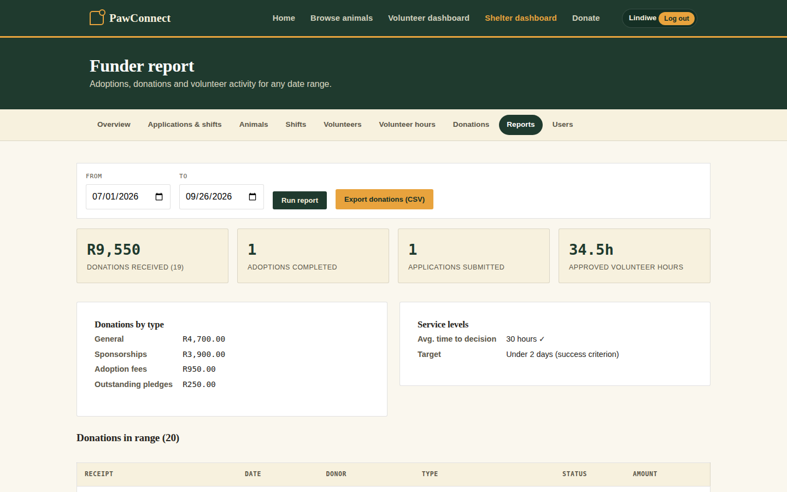
Manager: numbers the board can trust
Work queues: pledges to confirm, hours to approve, applications waiting.
Any date range in under a second: totals, average time to decision against the 2-day target, CSV for funders.
Notes:
For the manager, the dashboard shows what needs doing today, and each card links straight to the list. The funder report covers any date range. It returns well inside the ten-second success criterion and exports a CSV that opens in Excel for funding applications. It also shows the average time from application to decision against the two-day target from our success criteria, so the shelter can see whether the new process is working.

Slide 8
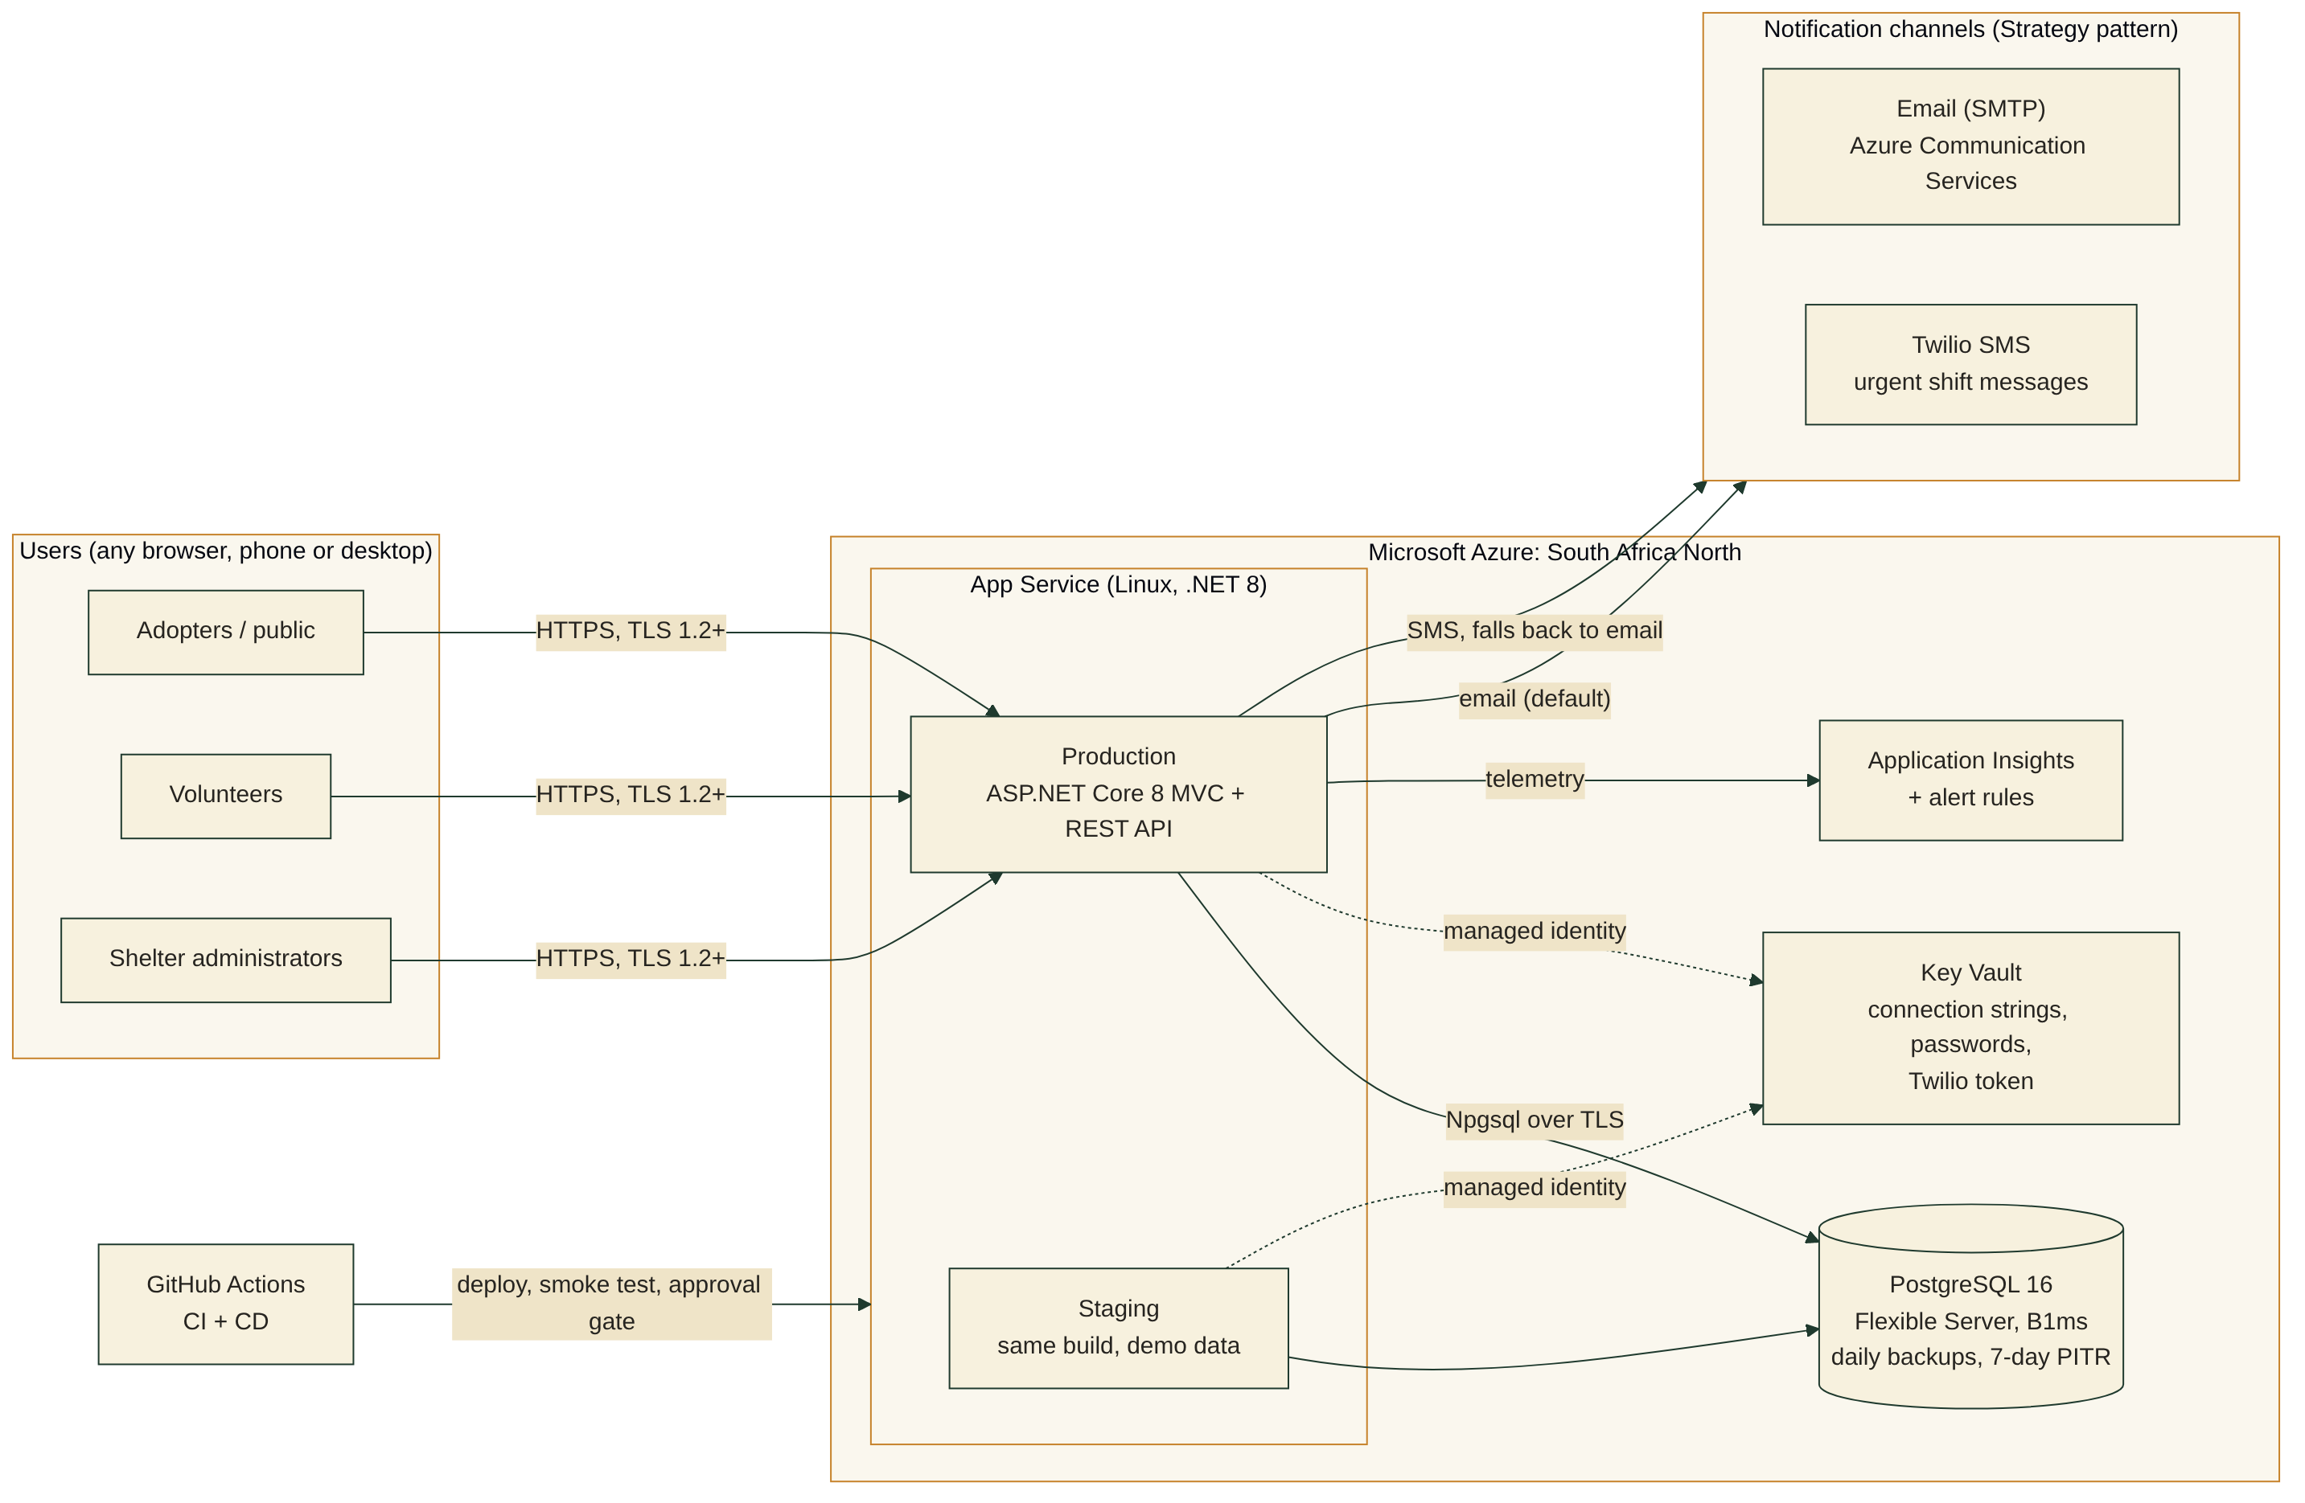
Built on Azure, sized for a small budget
ASP.NET Core 8
One app: pages and REST API
PostgreSQL 16
Integrity rules in the database
App Service
Managed hosting in South Africa
Key Vault
No secrets in the code
Notes:
This is how PawConnect runs. It is one ASP.NET Core application, holding both the web pages and the REST API, on Azure App Service in the South Africa North region. Data lives in PostgreSQL, and passwords and connection strings live in Key Vault. The app reads them with its own Azure identity, so no secret is ever stored in the code. I chose a layered monolith over microservices or serverless because it is the cheapest to run and the simplest to hand over, and it has no cold starts to break our 500-millisecond response target. Two plans changed from the Task 1 design: React and Express became ASP.NET Core, which the prototype already used, and Azure AD B2C became ASP.NET Core Identity, because Microsoft stopped selling AD B2C to new customers. Both changes are explained in the final report.

Slide 9




Safe with people's personal information
Two-step verification
OWASP Top 10
Required for administrators. New since Task 2.
Lockout, rate limits, CSRF tokens, strict security headers
Rules in the database
POPIA
No double applications, bookings or fees, even under race conditions
Consent, privacy notice, download my data, nothing shared
Notes:
PawConnect holds adopters', donors' and volunteers' personal information, so security and POPIA were requirements from day one. New since Task 2, administrators must use two-step verification with an authenticator app, so a stolen admin password alone can't open the system. Every request is checked for role and ownership: someone else's application simply returns 'not found', so ids can't be probed. The database itself refuses double applications, double bookings and double-recorded fees, even when two people click at the same moment. For POPIA, people consent when they register and can download all their data from their account.

Slide 10
Tested on every change
151
≥70%
0
109 ms
automated tests
coverage gate
accessibility violations
slowest p95
unit, service, API and real PostgreSQL
the build fails below it
WCAG 2.1 AA, every page, every role
target is under 500 ms
Response times measured locally (Release build, PostgreSQL 16, 10 concurrent users). Live Azure figures come from Application Insights.
Notes:
Quality is checked automatically on every pull request. There are 151 tests, including thirteen that run against a real PostgreSQL database to prove the integrity rules. The build fails if coverage drops below 70%, which is our maintainability requirement. Every page, for every role, is audited for accessibility at phone and desktop sizes, and the result is zero violations. The slowest page I measured responded within 109 milliseconds for 95% of requests, against a 500-millisecond target. Those timings are from my machine. Application Insights gives the live Azure figures.

Slide 11
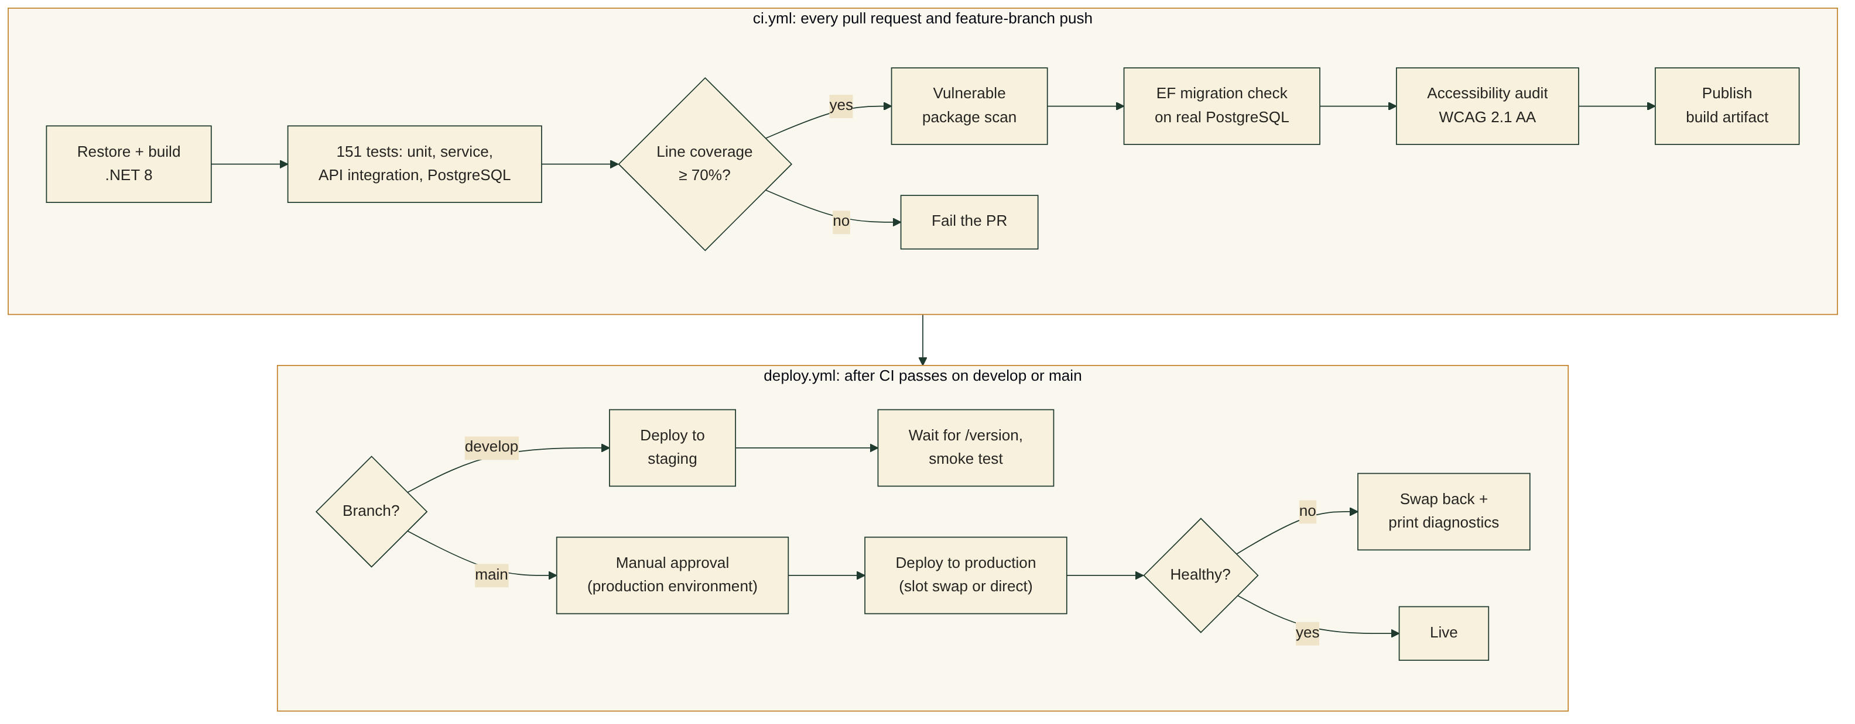

From a code change to the live site
Status today: staging deploys automatically from develop. Production: [confirm live before presenting].
Notes:
Every change goes through GitHub on its own branch. A pull request runs the build, the tests, the coverage gate, a scan for vulnerable packages, a migration check and the accessibility audit. Merging to develop deploys to staging automatically. Merging to main waits for my approval, then deploys to production and checks it is healthy. In Task 2 the production deploy was failing and I said otherwise. That was the main criticism of my last presentation, so here is the real status: [say exactly what /version on production shows today]. The pipeline now prints why a deploy failed, so a problem shows up in the run log straight away. This is a one-person project, so I review my own pull requests, and the automated checks are what block a bad change.

Slide 12




What changed after Task 2 feedback
Inline styles → shared CSS
One class per file
Real SMS
106 inline styles replaced with one stylesheet
20 grouped files split, no logic changed
Twilio for urgent shift messages, email as fallback
MFA for admins
Production deploy
Steady commits
Authenticator app + recovery codes
Failures now explain themselves in the log
Six focused branches, descriptive commits
Notes:
For Task 3 I worked through every comment from the Task 2 feedback. I moved over a hundred inline styles into the shared stylesheet, gave every class its own file, replaced the placeholder SMS sender with real Twilio messages, and added two-step verification, required for administrators. I also made the deploy pipeline explain its own failures. Each change was made on its own branch with small, descriptive commits, so the history shows the work as it happened rather than all on one day. I also wrote a full User Guide for each role, with annotated screenshots.

Slide 13
Success criteria from the design
Criterion (Task 1) | How PawConnect delivers it
70% of applications online | Apply from every profile. Phone applications captured in the same system.
Decision in under 2 days (from 5) | Review queue. Report shows average time to decision.
Zero shift double bookings | Enforced in code and database, proven under race conditions
Report in under 10 seconds | Any date range in under a second, CSV export
No critical defects at UAT | 151 tests, accessibility audit and smoke tests on every deploy
Hosting within R1,500/month | ~R1,200 at 500 users. SMS optional and capped.
Notes:
These are the six success criteria agreed in Task 1, and how the built system meets each one. Two can only be measured after go-live: the share of applications made online, and the decision time. PawConnect is built to measure both, and the decision time is already on the funder report. The cost criterion holds as long as SMS stays limited to urgent shift messages, which I'll show on the next slide.

Slide 14
Running costs inside the R1,500 budget
Budget
R1,500 / month
Without SMS
~R1,200 at 500 users
Nonprofit credit
Covers the Azure lines
Notes:
The budget is R1,500 a month. Azure hosting, the database, email and monitoring come to about R1,200 at the top of the estimate, even at five hundred users. SMS is the only cost that grows with use, at about R2.40 a message through Twilio, so it is used only for urgent shift messages and can be switched off with one setting. Once the shelter is registered for Microsoft's nonprofit programme, Azure credits are expected to cover the Azure lines. These estimates assume eighteen rand to the dollar, so re-check them before signing up.

Slide 15
Approval to go live
With approval, PawConnect replaces the paper cards, the spreadsheet and the WhatsApp roster
1
Acceptance test with the manager and two volunteers
2
1-hour training using the User Guide
3
Spreadsheet runs in parallel for two weeks
4
Handover: repository, docs and 30 days of support
Notes:
So this is my request: approval to put PawConnect into use at Hope & Paws. With approval, the next steps are an acceptance test with the manager and two volunteers, a one-hour training session using the User Guide, and two weeks of running the spreadsheet alongside PawConnect as a safety net. Then I hand over the repository, the documentation and the Azure setup to the shelter's technical volunteer, with thirty days of support.

Slide 16
Questions
Code, documentation and User Guide: github.com/ST10285120/st10285120.INSY7315.Part2.PAWCONNECT
Notes:
Thank you. I'm happy to take questions. Likely ones, with short answers. Why not microservices? Too costly and complex for one shelter, and the layers keep it modular. What if two people apply for the same animal at once? A partial unique index in the database lets exactly one through, and the other gets a clear message. What happens if email fails? It retries with backoff and logs every attempt, and the application is still saved. Card payments? Out of scope for now. Donations are EFT pledges confirmed by staff, and PayFast or Yoco can be added later. What if an admin loses their phone? Recovery codes, and failing that the technical volunteer can reset two-step verification.

