Slide 1

Random Apparel x
S-NEAKE-R
Application Presentation
The first step to fashion that lasts.

Slide 2
Table of contents
01
03
04
02
Application
Functional
Our Android Application Progress
Features that actually work.
Website App
Non Functional
Progress on our Website Application
Features that don’t work but will be implemented soon

Slide 3
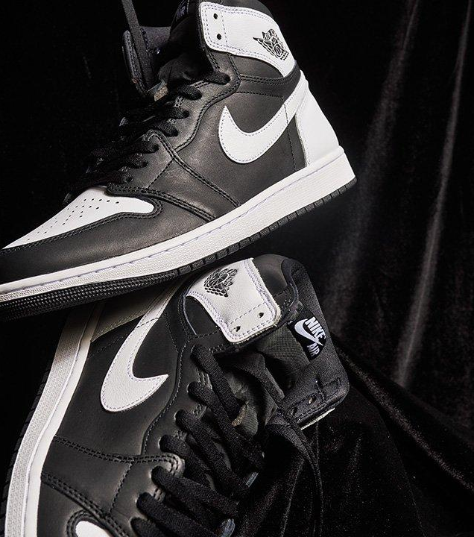
About us Random Aparrel x S-NEAKE-R
Where Passion Meets Pavement
At Random Aparrel, we believe every step tells a story. Born from a shared obsession with footwear culture, we've curated the world's finest sneakers for those who don't just wear shoes—they make statements.
Our journey began on the streets, where style meets substance. Today, we bridge the gap between iconic classics and cutting-edge innovation, bringing you exclusive drops, limited editions, and timeless designs that define generations.
Step with purpose. Walk with confidence.

Slide 4
Website Progress
Visuals
Membership
The Websites Visuals , and overall feel has been enhanced , transforming it to a user-friendly portal
hover effects, animation, JS to allow for interaction
Register and login pages
are also embedded into the website with sign in options to allow users to login and register with a diverse range of options

Slide 5
Android Application Progress
Interactive Pages
Results
Profile Page
The android applications has been amped up with robust features to allow user navigation effective interaction making it easier for the user to navigate through.
A gallery section has been implemented to allow users to add items to their cart, and also we have introduced cart page to track user orders
We introduced a Profile Page to allow users to login and logout of the application and they can update their information

Slide 6
Functional Features vs Non Functional
Website>
Login /Register
Home Page
Login and Register screen interactions , but no Validation code as yet.
Home Page visuals are interactive but minimal
App>
Gallery items
Cart/ Profile
App Logins in and Register with Firebase
Users can add items to the cart and store them
Carts works and calculates users added items , user can have quantity, delete options also before check out

Slide 7
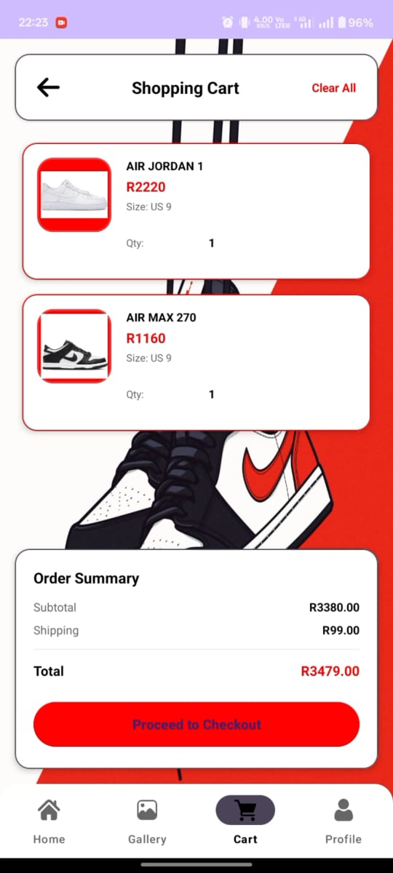
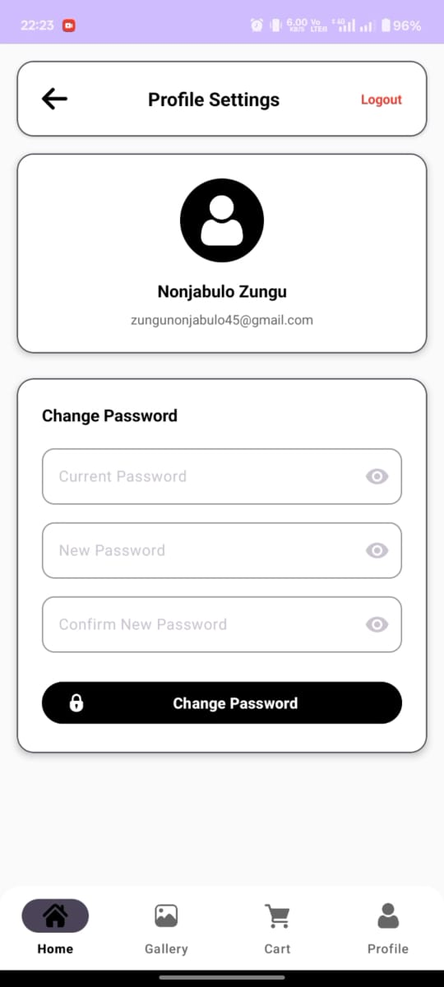
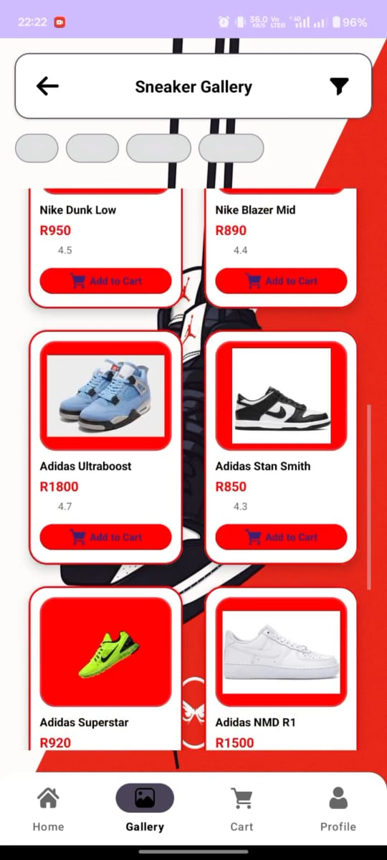
Live demo app
Now We will work you Through our App.

Slide 8
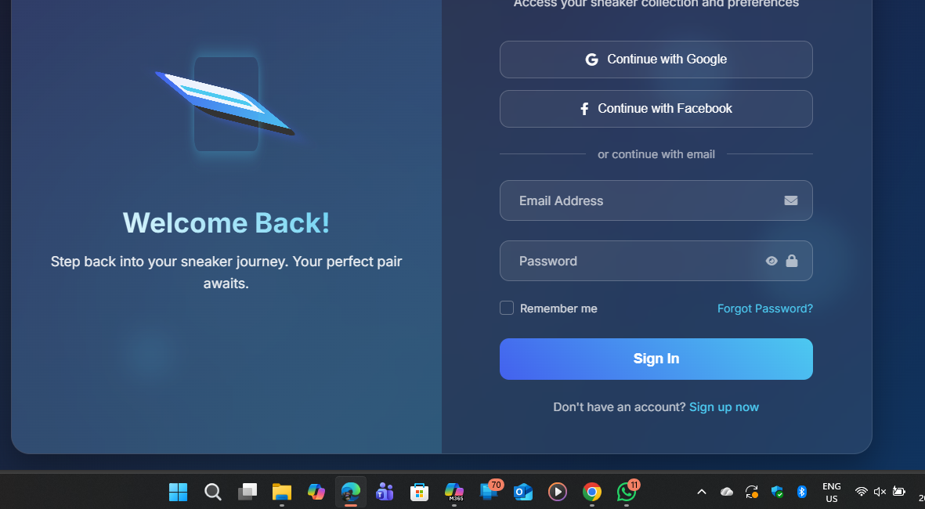
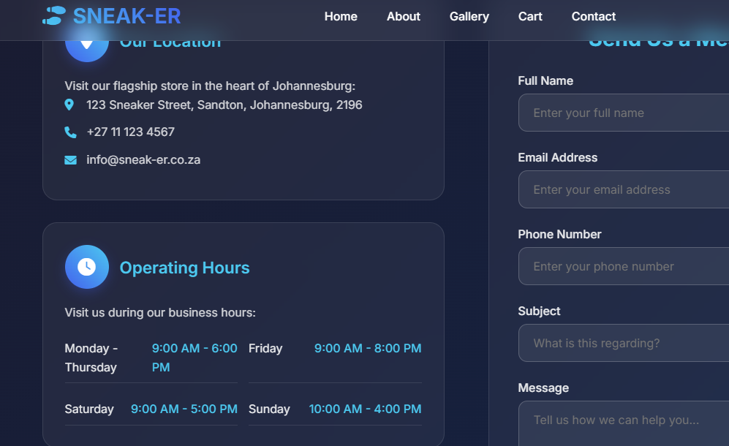
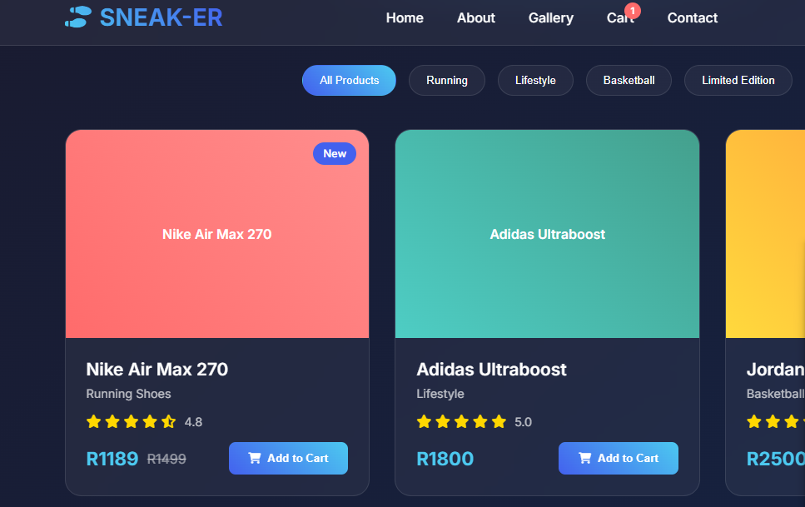
Live demo website
Now We will work you Through our website

Slide 9
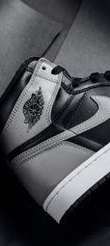
Thanks
Do you have any questions?

