Slide 1
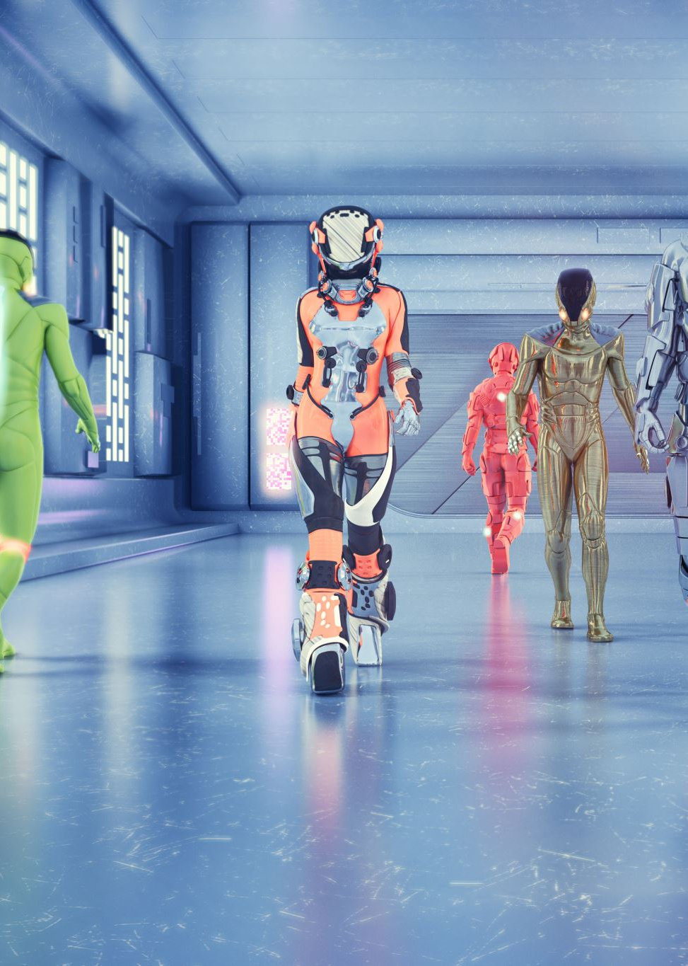
CYBERSECURITY AWARENESS CHATBOT
Developed Using C# Console Application
Presented By: Shaan Motsholane
Module: Programming 2A
Part 2

Slide 2
OVERVIEW
Objective: To develop an interactive chatbot that raises awareness about cybersecurity through natural conversations.
Features:
Voice greeting
ASCII art display
Recognizes user input related to cybersecurity
Provides tips and information
Remembers user’s name and interest

Slide 3
FUNCTIONALITIES
User Interaction: Accepts typed questions or keywords.
Memory: Stores user name and interest using a dictionary.
Keyword Detection: Recognizes words like “password,” “scam,” and “privacy.”
Phishing Tips: Random advice on avoiding phishing scams.
Random Replies: Makes the conversation feel natural and AI-like.

Slide 4
CODE STRUCTURE
Main Components:
Main() – Starts interaction
HandleUserInput() – Analyzes input and generates responses
DisplayAsciiArt() – Shows welcome art
PlayVoiceGreeting() – Plays sound
SimulatedTyping() – Displays typing animation

Slide 5
Keyword Recognition & Responses
Cybersecurity Keywords (Examples):
Password, Scam, VPN, Backup, Malware
Example Response:
"You're raising an important point.
Use two-factor authentication whenever possible."
Dynamic Detection:
Checks input against known keywords and generates smart responses

Slide 6
USER MEMORY FEATURE
Stores Information:
userMemory["name"] = userName
userMemory["interest"] = interest
Name Recall:
Responds to questions like “What’s my name?”
Interest Follow-Up:
Offers suggestions based on saved interests

Slide 7
AUDIO AND VISUAL ENHANCEMENT
Voice Greeting:
Uses System.Media.SoundPlayer to play a greeting
ASCII Art:
Displays a colorful welcome banner to engage users

Slide 8
Natural conversation
Uses List<string> of phrases to make replies feel unique
Example replies:
"Hmm, let me think..."
"That's interesting. Tell me more."

Slide 9
challenges
Parsing varied user input
Ensuring the bot could remember user information
Making responses feel natural, not robotic
Handling errors gracefully (e.g., missing audio files)

Slide 10
improvements
Add GUI (Graphical User Interface)
Connect to a real cybersecurity database
Add more topics and interactive games
Include speech-to-text functionality

