Slide 1
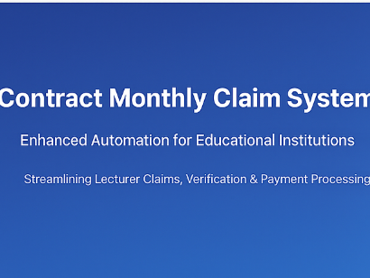
Contract Monthly Claim System (CMCS)
POE - Automation of Web Application

Slide 2
Overview
• Enhanced Contract Monthly Claim System
• Automation for Lecturer, Coordinator/Manager, and HR
• Built with ASP.NET MVC / ASP.NET Core MVC

Slide 3

Lecturer Automation
• Automated claim submission form
• Auto-calculation of payment: hours × rate
• Client-side validation with jQuery
• Entity Framework for storing claim data

Slide 4
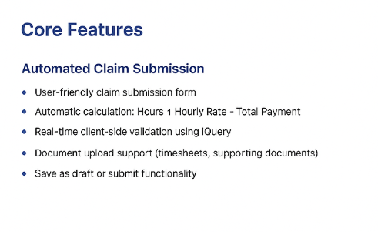

Slide 5
Coordinator & Manager Automation
• Automated verification workflow
• Validates hours, rates, policy compliance
• Approval system using ASP.NET Identity
• ASP.NET Web API for backend communication

Slide 6

HR Automation
• Automatic generation of invoices and payment reports
• Lecturer data management features
• Reporting via SSRS / Crystal Reports / LINQ
• Razor Pages / Web Forms for UI

Slide 7
Technologies Used
• ASP.NET MVC / ASP.NET Core MVC
• Entity Framework
• ASP.NET Identity
• jQuery + JavaScript validation
• Workflow automation libraries

Slide 8
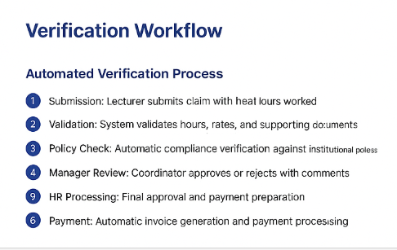

Slide 9
Benefits
• Faster claim processing
• Automated verification reduces errors
• Seamless approval workflow
• Accurate reporting for HR and Finance

