Slide 1
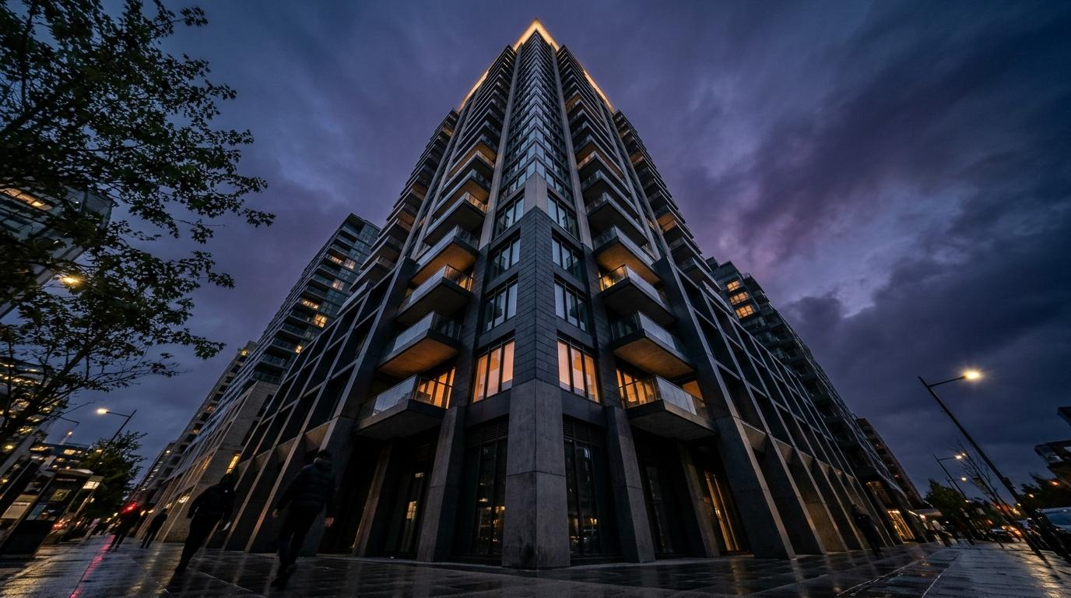
5BYTE
OBS REALTY GROUP · GROUP 2 · INSY7315 · EXPO PRESENTATION
Search...
PROPCARE
PROPERTY MANAGEMENT SYSTEM
INSY7315 · INFORMATION SYSTEMS 3E — WORK INTEGRATED LEARNING
Neville Kabamba · Zulfique Jattiem · Connor Bettridge · Ayakha Ntsomi · Kwanda Zulu
Client: Obs Realty Group | Live: https://propcare-sunx.onrender.com/
GitHub: https://github.com/ST10445479-ConnorBettridge/INSY7315_PROPCARE_2
LEARN MORE →
Notes:
Welcome to the PropCare Expo Presentation for Task 3, Group 2 (5ive Byte). This presentation outlines our comprehensive full-stack solution built for Obs Realty Group to modernize property maintenance.

Slide 2
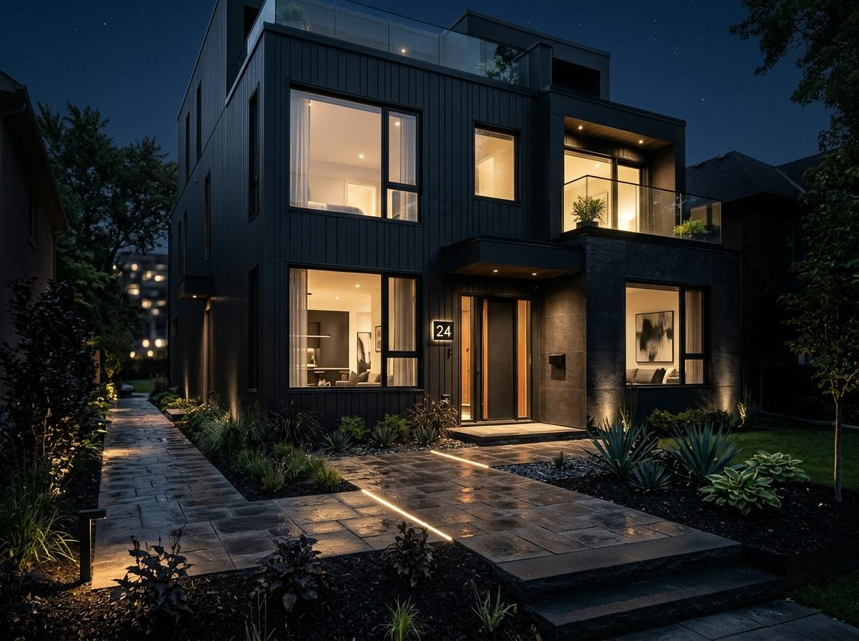
5BYTE
OVERVIEW · CLIENT · WORKFLOW · ANALYSIS
Search...
Introduction & Client Context
Obs Realty Group Operations
Obs Realty Group is an active property management enterprise overseeing an extensive portfolio of residential rental units. Historically, routine maintenance and emergency repairs arrived via an unmanaged tangle of direct telephone calls, individual WhatsApp chats, and disconnected emails.
Without a centralized management repository, incoming repair requests were routinely delayed, misrouted, or lost in transit. Technicians were deployed without diagnostic fault descriptions or photos, while property owners and tenants lacked any verifiable status visibility or completion accountability.
• High volume of inbound requests across disparate messaging channels
• Zero central ticketing ledger or request lifecycle tracking
• Average ticket resolution delayed by redundant communication hops
LEARN MORE →
Notes:
Slide 2 introduces our client Obs Realty Group and the operational bottlenecks that prompted this project: fragmented communication channels, delayed repairs, and zero tracking.

Slide 3
5BYTE
DIAGNOSIS · IMPACT · DATA · TARGETS
Search...
The Problem & Market Need
Through on-site discovery and workflow mapping with Obs Realty staff, our engineering team pinpointed systemic breakdown points across four distinct stakeholder personas. These friction points caused tenant frustration, contractor friction, and significant operational cost leakages.
01. Fragmented Records
02. Zero Prioritisation
03. Blind Contractor Dispatch
Requests scattered across calls, WhatsApp, and email with zero central audit log or chronological ticket ledger.
Managers could not distinguish between life-safety emergencies (water leaks, electrical faults) and low-urgency cosmetic tasks.
Technicians were sent to properties with no prior repair history, access codes, or photos of the actual damage.
04. Tenant Disconnection
05. Zero Executive Reporting
Tenants had no mechanism to track ongoing progress, rate completed work, or verify the job before ticket closure.
Leadership lacked visibility into recurring appliance failures, vendor performance, or unit-level expenditure trends.
EXPLORE SOLUTION →
Notes:
We identified 5 key operational bottlenecks that directly informed the core functional architecture of PropCare.

Slide 4

5BYTE
SOLUTION · ECOSYSTEM · ROLES · LIFECYCLE
Search...
The PropCare Solution
A Modern Full-Stack Property Maintenance Ecosystem
PropCare is a responsive, cloud-hosted progressive platform designed to unify tenants, property managers, maintenance technicians, and system administrators into one harmonious lifecycle. Built as a lightweight, framework-free single-page application with an Express REST API backend, it delivers instant load times on desktop, tablet, and mobile devices without requiring app store installation.
From the moment a tenant captures a photo of a plumbing leak to the final quality rating sign-off, every transition is validated, logged to an immutable history table, and communicated via real-time Observer events.
• Multi-Role Architecture: Dedicated, secure workspaces for all 4 user roles
• Zero-Install Responsive SPA: Operates seamlessly on mobile in the field
• End-to-End Governance: From incident report to verified completion and rating
VIEW ROLES →
Notes:
PropCare replaces fragmented channels with an end-to-end tracked lifecycle that works in any browser without app installation.

Slide 5
5BYTE
TENANT WIZARD · TIMELINE · FEEDBACK · MOBILE
Search...
Tenant Experience
The tenant portal eliminates phone tag by providing a step-by-step reporting wizard. Tenants can select maintenance categories (Plumbing, Electrical, Structural, HVAC), designate urgency tiers, upload fault photographs, and submit an issue in under 60 seconds.
A real-time progress timeline displays current ticket state, assigned technician credentials, and ETA. Built-in threaded comments facilitate direct communication with management, while mandatory tenant completion sign-off guarantees no job is closed prematurely.
• Step-by-step reporting wizard with image upload validation
• Interactive request timeline with transparent status milestones
• Direct communication channel between tenant, manager, and contractor
• Quality rating feedback mechanism upon job verification
Notes:
The tenant experience is designed to be frictionless, empowering residents to report leaks or electrical issues directly from their phone while standing in the room.

Slide 6
5BYTE
MANAGER · TECHNICIAN · ADMIN · GOVERNANCE
Search...
Operations & Management
Purpose-Built Consoles for Managers, Technicians & Admins
Property Manager
Field Technician
System Administrator
Runs the Portfolio
Executes the Work
Controls the System
Unified triage dashboard with multi-facet filtering (Urgency, Category, Status). Allows one-click contractor assignment, schedule dispatching, and instant CSV export for financial reconciliations.
Mobile-first queue of assigned work orders. Technicians accept jobs, update status (In Progress, On Hold for Parts, Completed), attach diagnostic notes, and upload before/after photographic proof.
Enterprise governance console for managing user roles, credentials, property complexes, unit mappings, and system-wide service settings with pre-seeded demo sandboxes.
• Full portfolio status overview
• One-click technician assignment
• Exportable CSV audit reports
• Personal priority job queue
• One-tap lifecycle status transitions
• Before & after photo uploads
• Granular RBAC user management
• Property unit hierarchy config
• System health and audit telemetry
SYSTEM ARCHITECTURE →
Notes:
Each role has its own dedicated workspace with strict role boundaries. Managers triage and dispatch, technicians execute in the field, and administrators manage platform settings.

Slide 7
5BYTE
TIERS · REST API · ISOLATION · DATA FLOW
Search...
System Architecture
PropCare implements a classical layered architectural pattern. Each layer is strictly decoupled and only communicates with the tier directly beneath it. This isolation provides deterministic execution, zero framework lock-in, and independent testability.
Notes:
Our 6-layer architecture ensures clean separation of concerns. The frontend has no build step, while the backend isolates business logic from raw database calls.

Slide 8
5BYTE
REPOSITORY · OBSERVER · DECOUPLING · UNIT TESTS
Search...
Design Patterns Applied
Architectural Decisions Driving Maintainability & Testability
1. Repository Pattern
2. Observer Pattern
Data Abstraction & Isolation
Event-Driven Decoupling
All database operations are encapsulated in specialized repository classes: BaseRepository, RequestRepository, UserRepository, and NotificationRepository. Controllers and services never execute raw SQL statements.
The notification subsystem is completely decoupled from core request processing. When critical domain events occur (request created, technician dispatched, status changed), events are broadcast to registered observers.
• Benefit: In-memory mock repositories enable lightning-fast unit tests without database I/O.
• Flexibility: Storage engines can be swapped from SQLite to PostgreSQL without modifying business rules.
• Centralized query optimization and constraint handling in a single dedicated layer.
• Benefit: Core request service logic remains clean and unpolluted by dispatching side-effects.
• Extensibility: New notification targets (SMS, Push, Slack, Email) can be added with zero regressions.
• Right stakeholders alerted immediately without synchronous thread blocking.
DATABASE SCHEMA →
Notes:
We applied two key design patterns: the Repository Pattern to isolate database interactions and allow in-memory testing, and the Observer Pattern to cleanly decouple notifications from core workflow logic.

Slide 9
5BYTE
SCHEMA · INTEGRITY · NORMALISATION · AUDIT LOG
Search...
Database Architecture
12 Normalised Tables with Enforced Referential Integrity
users
properties
units
categories
Auth, roles & profiles
Building complexes
Apartment inventory
Maintenance taxonomy
technicians
requests
request_photos
comments
Contractor roster
Core work orders
Fault & fix proof
Threaded ticket chat
history
notifications
ratings
settings
Immutable audit trail
User alert queue
Tenant satisfaction
System variables
SECURITY ARCHITECTURE →
Notes:
Our 12-table relational database enforces strict referential integrity. The history table ensures every single change is recorded in an immutable audit trail.

Slide 10
5BYTE
JWT AUTH · RBAC · VALIDATION · AUDIT: 0 VULNS
Search...
Security Architecture
Defense-in-Depth Engineered Across Every Operational Layer
JWT Authentication
bcrypt Hashing
Role-Based Access (RBAC)
Object-Level Checks
Cryptographic session tokens with expiration and signature verification.
Salted password hashes with high cost factor; passwords never stored plaintext.
Strict permission middleware isolating admin, manager, technician, and tenant endpoints.
Tenants can strictly only query their own requests, preventing IDOR vulnerabilities.
Input Validation
API Rate Limiting
Helmet Security Headers
CORS Configuration
Strict schema assertion preventing SQL injection, XSS, and payload tampering.
Protects authentication and submission endpoints against brute-force abuse.
Hardened HTTP response headers including CSP, HSTS, and X-Frame-Options.
Whitelisted origin access ensuring unauthorized domains cannot access API resources.
Request Size Limits
Photo Upload Validation
Secure Error Masks
npm audit: 0 Vulns
Enforced payload ceilings to prevent memory exhaustion and denial-of-service.
Strict MIME-type checking and file size bounds on all uploaded images.
Production error handlers sanitize internal stack traces from client responses.
Continuous automated dependency scanning with zero known security vulnerabilities.
TECH STACK →
Notes:
Security is built-in from the ground up: bcrypt hashing, JWT authentication, and object-level verification ensuring tenants cannot see tickets belonging to other units.

Slide 11
5BYTE
STACK · JEST · SUPERTEST · PUPPETEER
Search...
Tech Stack & Testing
129 / 129 Automated Tests Passing Across the Entire Pipeline
We chose a lightweight, robust technology stack that maximizes execution speed while eliminating compilation overhead. By pairing pure vanilla JavaScript on the frontend with Node.js and Express on the backend, the entire platform runs effortlessly across any environment.
Our rigorous QA suite covers all tiers: unit tests verify domain services and repositories in isolation, integration tests validate all REST endpoints via Supertest, and automated Puppeteer browser tests exercise full real-world user journeys end-to-end.
• Frontend: HTML5, CSS3, Vanilla ES6+ JavaScript — lightweight SPA with 0 build steps
• Backend: Node.js, Express REST API, JSON Web Tokens (JWT), bcrypt cryptographic hashing
• Database: Relational SQLite utilizing native node:sqlite engine
• 129 / 129 Automated Tests Passing: 100% green build status across Jest and Supertest
• Puppeteer E2E Automation: Headless browser journeys verifying complete multi-role flows
• Zero Security Flaws: Clean npm audit report with 0 vulnerabilities detected
CI/CD PIPELINE →
Notes:
We achieved 129 out of 129 automated tests passing across Jest and Supertest, backed by Puppeteer for end-to-end browser verification.

Slide 12
5BYTE
GITHUB ACTIONS · RENDER · PIPELINE · GITFLOW
Search...
CI/CD & Deployment
Automated GitHub Actions Pipelines to Cloud-Hosted Render
GitHub Actions Automated Gates
Live Cloud Hosting on Render
Three Automated Pipelines
Production Infrastructure
No code merges into main without passing all three quality gates:
Containerized deployment providing reliable uptime and rapid auto-deployments directly from the GitHub repository.
• ci.yml: Runs syntax linters, the complete 129-test Jest/Supertest suite, and dependency security audits.
• build.yml: Verifies frontend static bundles and automatically publishes the Task 1 prototype to GitHub Pages.
• deploy.yml: Triggers automated post-deployment smoke tests against the live Render production cluster.
• Auto-Deploy: Automatic redeploy triggered on each verified merge to the main branch.
• Cold Start Mitigation: Optimized boot scripts initialize Node.js in seconds.
• Ephemeral Reseeding: Automatic demo dataset rehydration on startup guarantees presentation readiness.
• Health Probing: Active /api/health monitoring endpoint for continuous uptime verification.
LIVE DEMO →
Notes:
Our CI/CD pipeline guarantees high reliability: every pull request is validated by GitHub Actions before auto-deploying to Render.

Slide 13
5BYTE
LIVE APP · CREDENTIALS · WALKTHROUGH · RESOURCES
Search...
Live Demonstration
1 · Tenant reports
2 · Manager reviews
3 · Assign tech
4 · Tech fixes
5 · Tenant rates
Role | Email Account | Password | Live Operational View
Tenant | sarahwilliams@example.com | PropCare123! | Wizard issue reporting & live status timeline
Property Manager | michael.jacobs@obsrealty.co.za | PropCare123! | Triage list, 1-click dispatch, CSV exports
Technician | johan.vdm@obsrealty.co.za | PropCare123! | Assigned task queue, before/after photo logs
Administrator | admin@obsrealty.co.za | PropCare123! | User administration, RBAC controls, system reports
Live Application: propcare-wil-task2.onrender.com | API Index: /api | Health Check: /api/health
Flow: Report Issue → Review & Triage → Dispatch Tech → Complete Work → Verify & Rate (Under 3 mins)
TEAM CONTRIBUTIONS →
Notes:
Here are the demo credentials and live URLs for testing each of the 4 roles. The full lifecycle takes under 3 minutes to demonstrate.

Slide 14
5BYTE
DELIVERABLES · TEAM · METHODOLOGY · SUCCESS
Search...
Requirements Met & Team
Group 2 (5ive Byte) Engineering Contributions & Client Deliverables
Client Deliverables (7/7)
5ive Byte Engineering Team
Engineering Methodology
100% Requirement Coverage
Student Contributions
Collaborative Discipline
All functional specifications requested by Obs Realty Group delivered and verified:
Dedicated specialization across all project dimensions:
How the team coordinated execution:
• ✓ Photo-enabled guided issue reporting wizard
• ✓ Priority triage and 1-click contractor dispatch
• ✓ Real-time status workflow (Accept, Hold, Complete)
• ✓ Direct comments, notifications and 5-star ratings
• ✓ Portfolio management dashboard and CSV export
• ✓ Cryptographic JWT auth and role-based permissions
• ✓ Responsive SPA accessible on mobile, tablet, and desktop
• Zulfique Jattiem (ST10403582) — Project Lead · Introduction & Closing
• Neville Kabamba (ST10404539) — Backend & Architecture · Design Patterns
• Connor Bettridge (ST10445479) — Solution Overview · Feature Walkthrough
• Ayakha Ntsomi (ST10283036) — Database Design · Cybersecurity & RBAC
• Kwanda Zulu (ST10439005) — Testing & QA · CI/CD & Live Demonstration
• Strict Gitflow workflow with isolated feature/* branches and conventional commit standards.
• Peer review pull requests with mandatory passing CI test suites before merging.
• Weekly client syncs with Obs Realty Group to validate user workflows.
CONCLUDING SLIDE →
Notes:
All 7 core client requirements have been completely delivered. Each member of 5ive Byte had a clear, defined technical role in bringing PropCare to production.

Slide 15
5BYTE
QUESTIONS · DISCUSSION · LINKS · CONTACT
Search...
THANK YOU
FOR YOUR ATTENTION
5ive Byte (Group 2): Neville Kabamba · Zulfique Jattiem · Connor Bettridge · Ayakha Ntsomi · Kwanda Zulu
Client: Obs Realty Group | Live: https://propcare-sunx.onrender.com/| Repo: https://github.com/ST10445479-ConnorBettridge/INSY7315_PROPCARE_2
Notes:
Thank you for your time and attention. We now welcome questions and discussion regarding the PropCare system, architecture, or live deployment.

