Slide 1
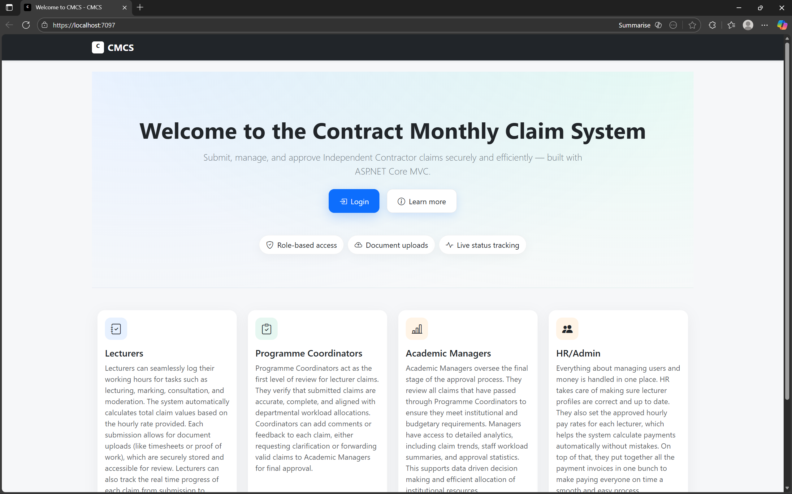
Contract Monthly Claim System
PROG6212
ST10453511
Moegammad Alexander
Group 1
Poe part 3 final presentation

Slide 2
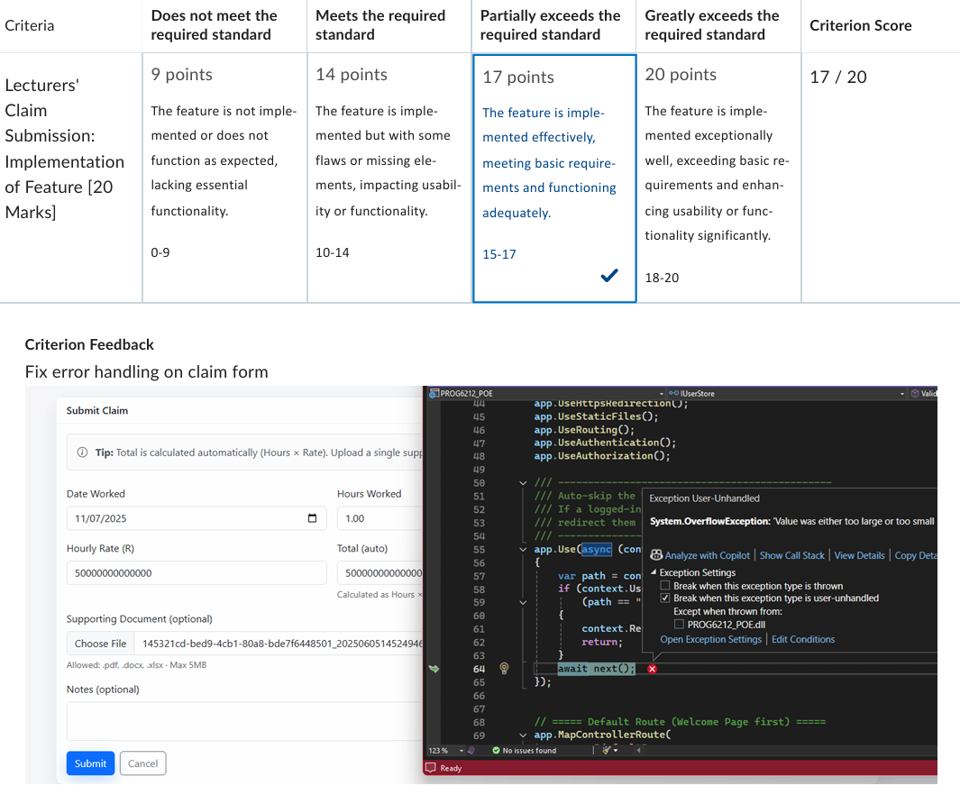
Detail Updates from Part 2 to Part 3 (Based on Feedback)
1. Error handling on claim form:
Feedback: "Fix error handling on claim form" (MArk: 17/20)
THE ISSUE: The screenshot in the feedback showed a System.OverflowException when a user entered a massive number (5000000000...) into the Rate field.
The Fix: In Part 3, I HAVE Automated the Rate.
Lecturers cannot type in the HOURLY rate anymore; it is pulled from the database and locked (readonly). THE HR TYPES OUT THE HOURLY RATE WHEN EDITING THE LECTURER'S INFORMATION.
I also added explicit validation in DashboardController.cs (if (model.HoursWorked > 24)) and ModelState.IsValid checks to catch errors before they crash the app. Validation: Server-side checks were added to ensure HoursWorked does not exceed logical limits (24h).

Slide 3
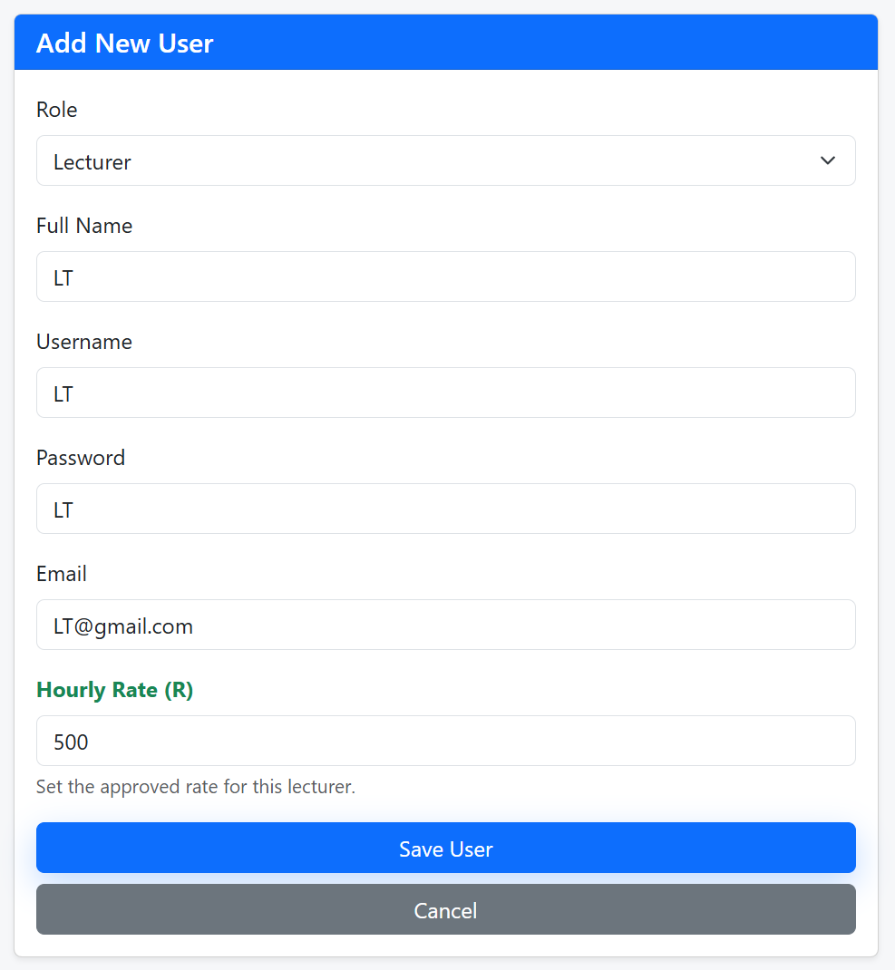
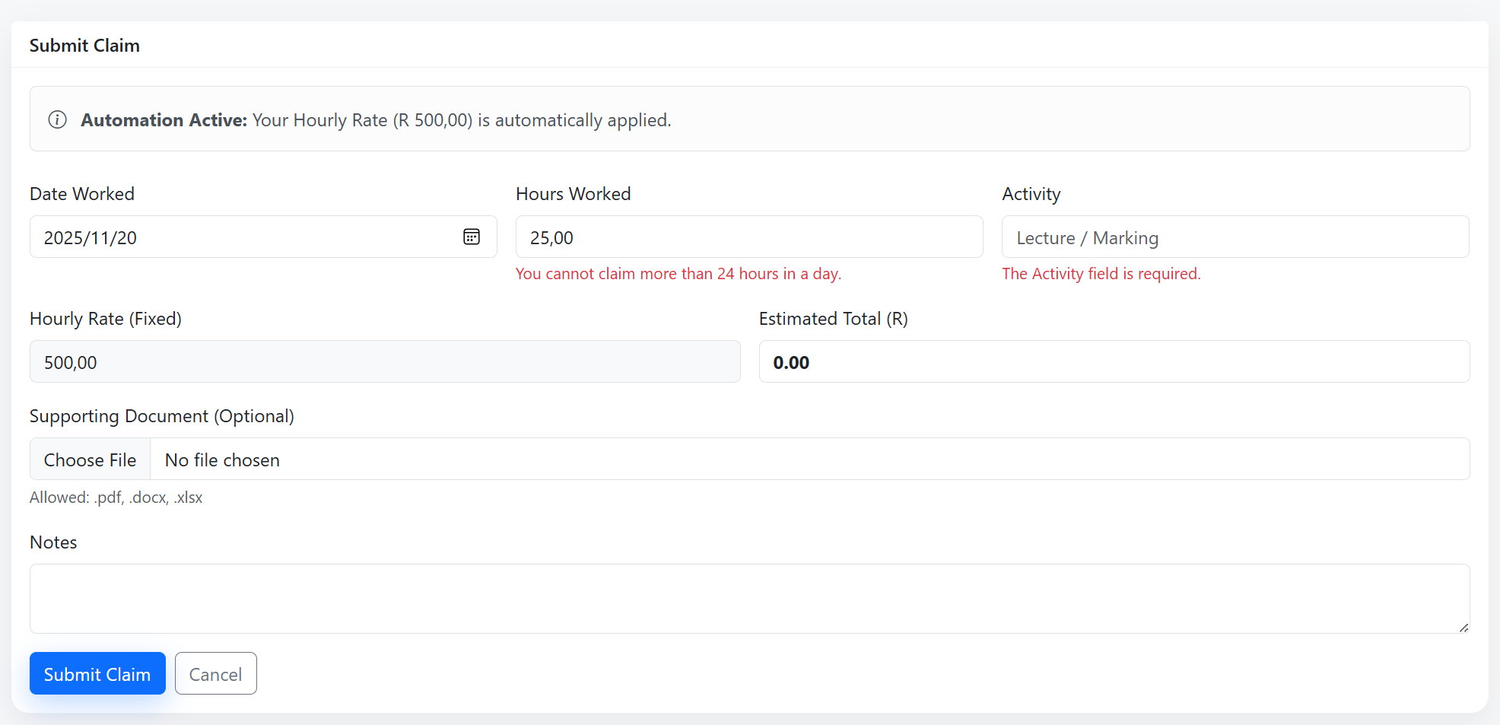
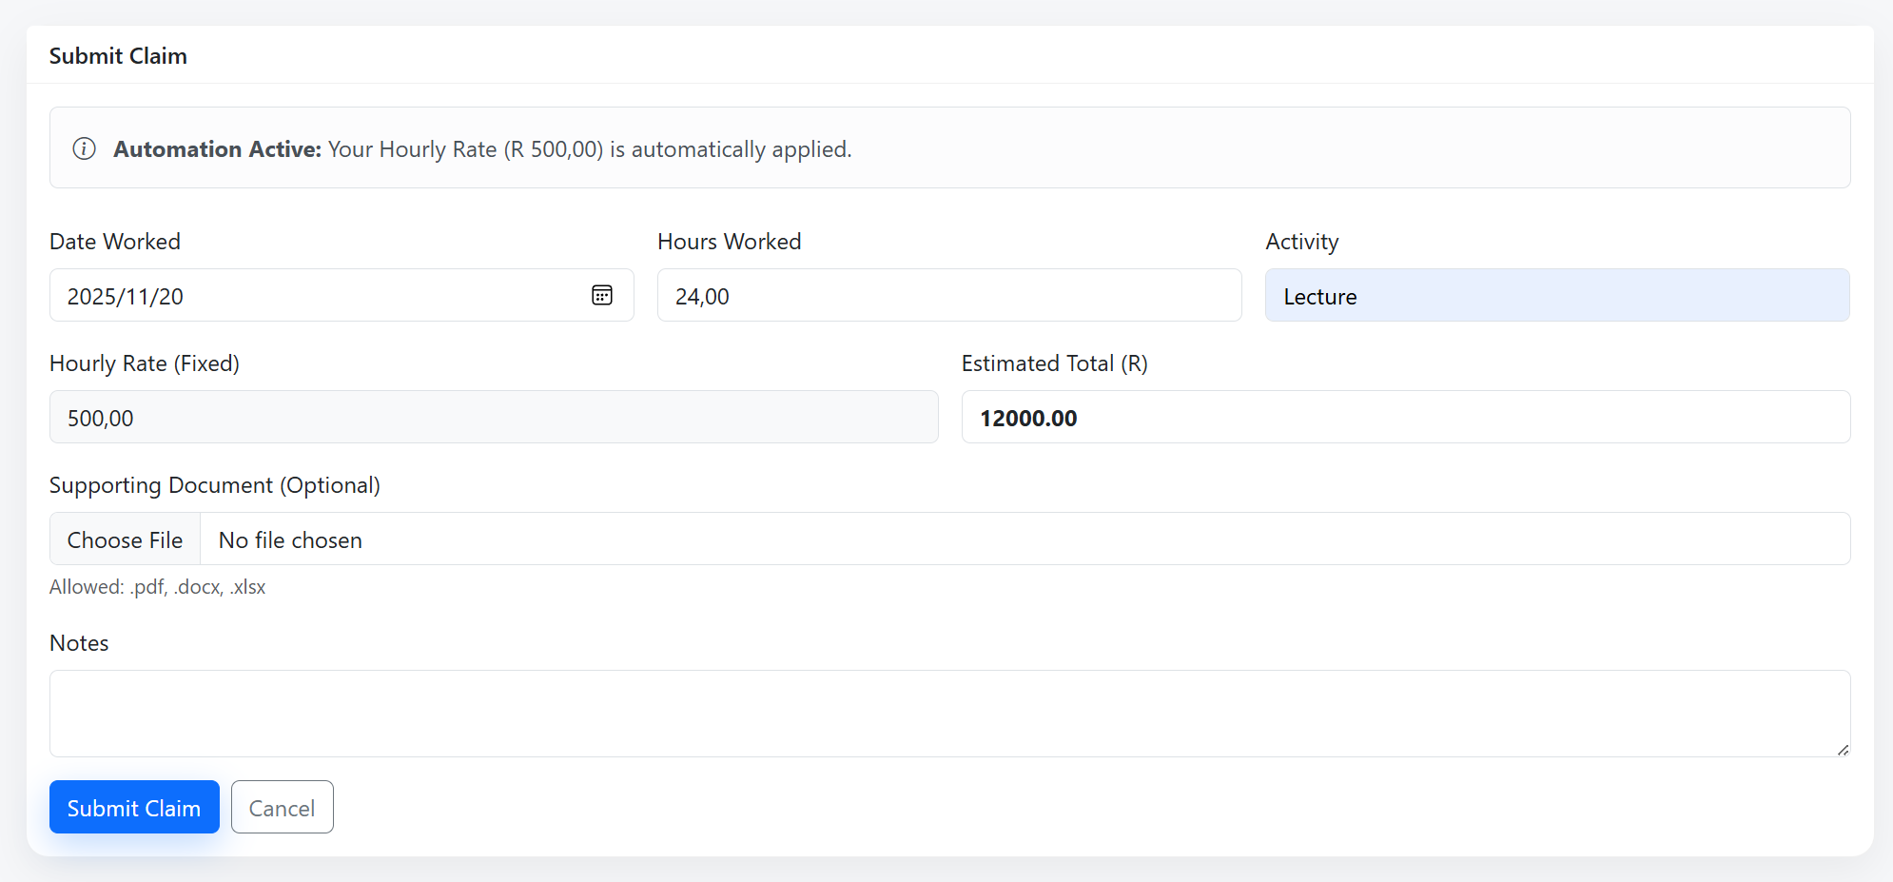
< HR FUNCTION ONLY ALLOWED TO EDIT HOURLY RATE FOR LECTURER
>
added explicit validation in DashboardController.cs (if (model.HoursWorked > 24

Slide 4
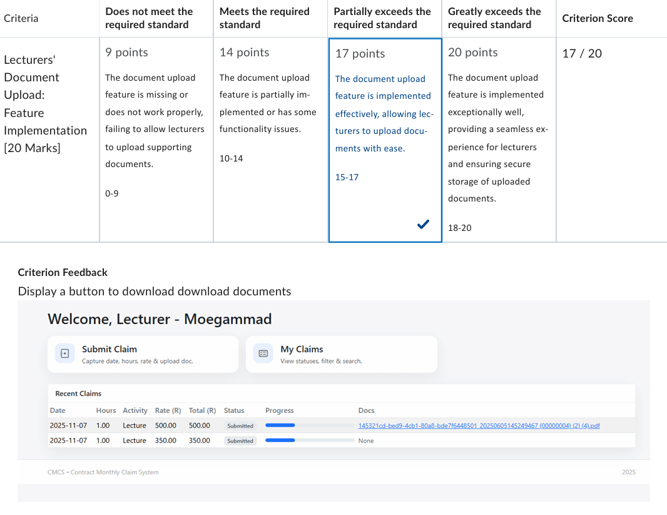
2. Document Upload FeedbacK:
Feedback: "Display a button to download documents“ (MArk: 17/20)
THE ISSUE: MY previous version just listed the file name as text. It wasn't obvious how to open it.
The Fix: A dedicated "Download" button was added to the My Claims grid. This button calls a new secure Controller Action DownloadFile which retrieves the file from the database and serves it to the user.

Slide 5
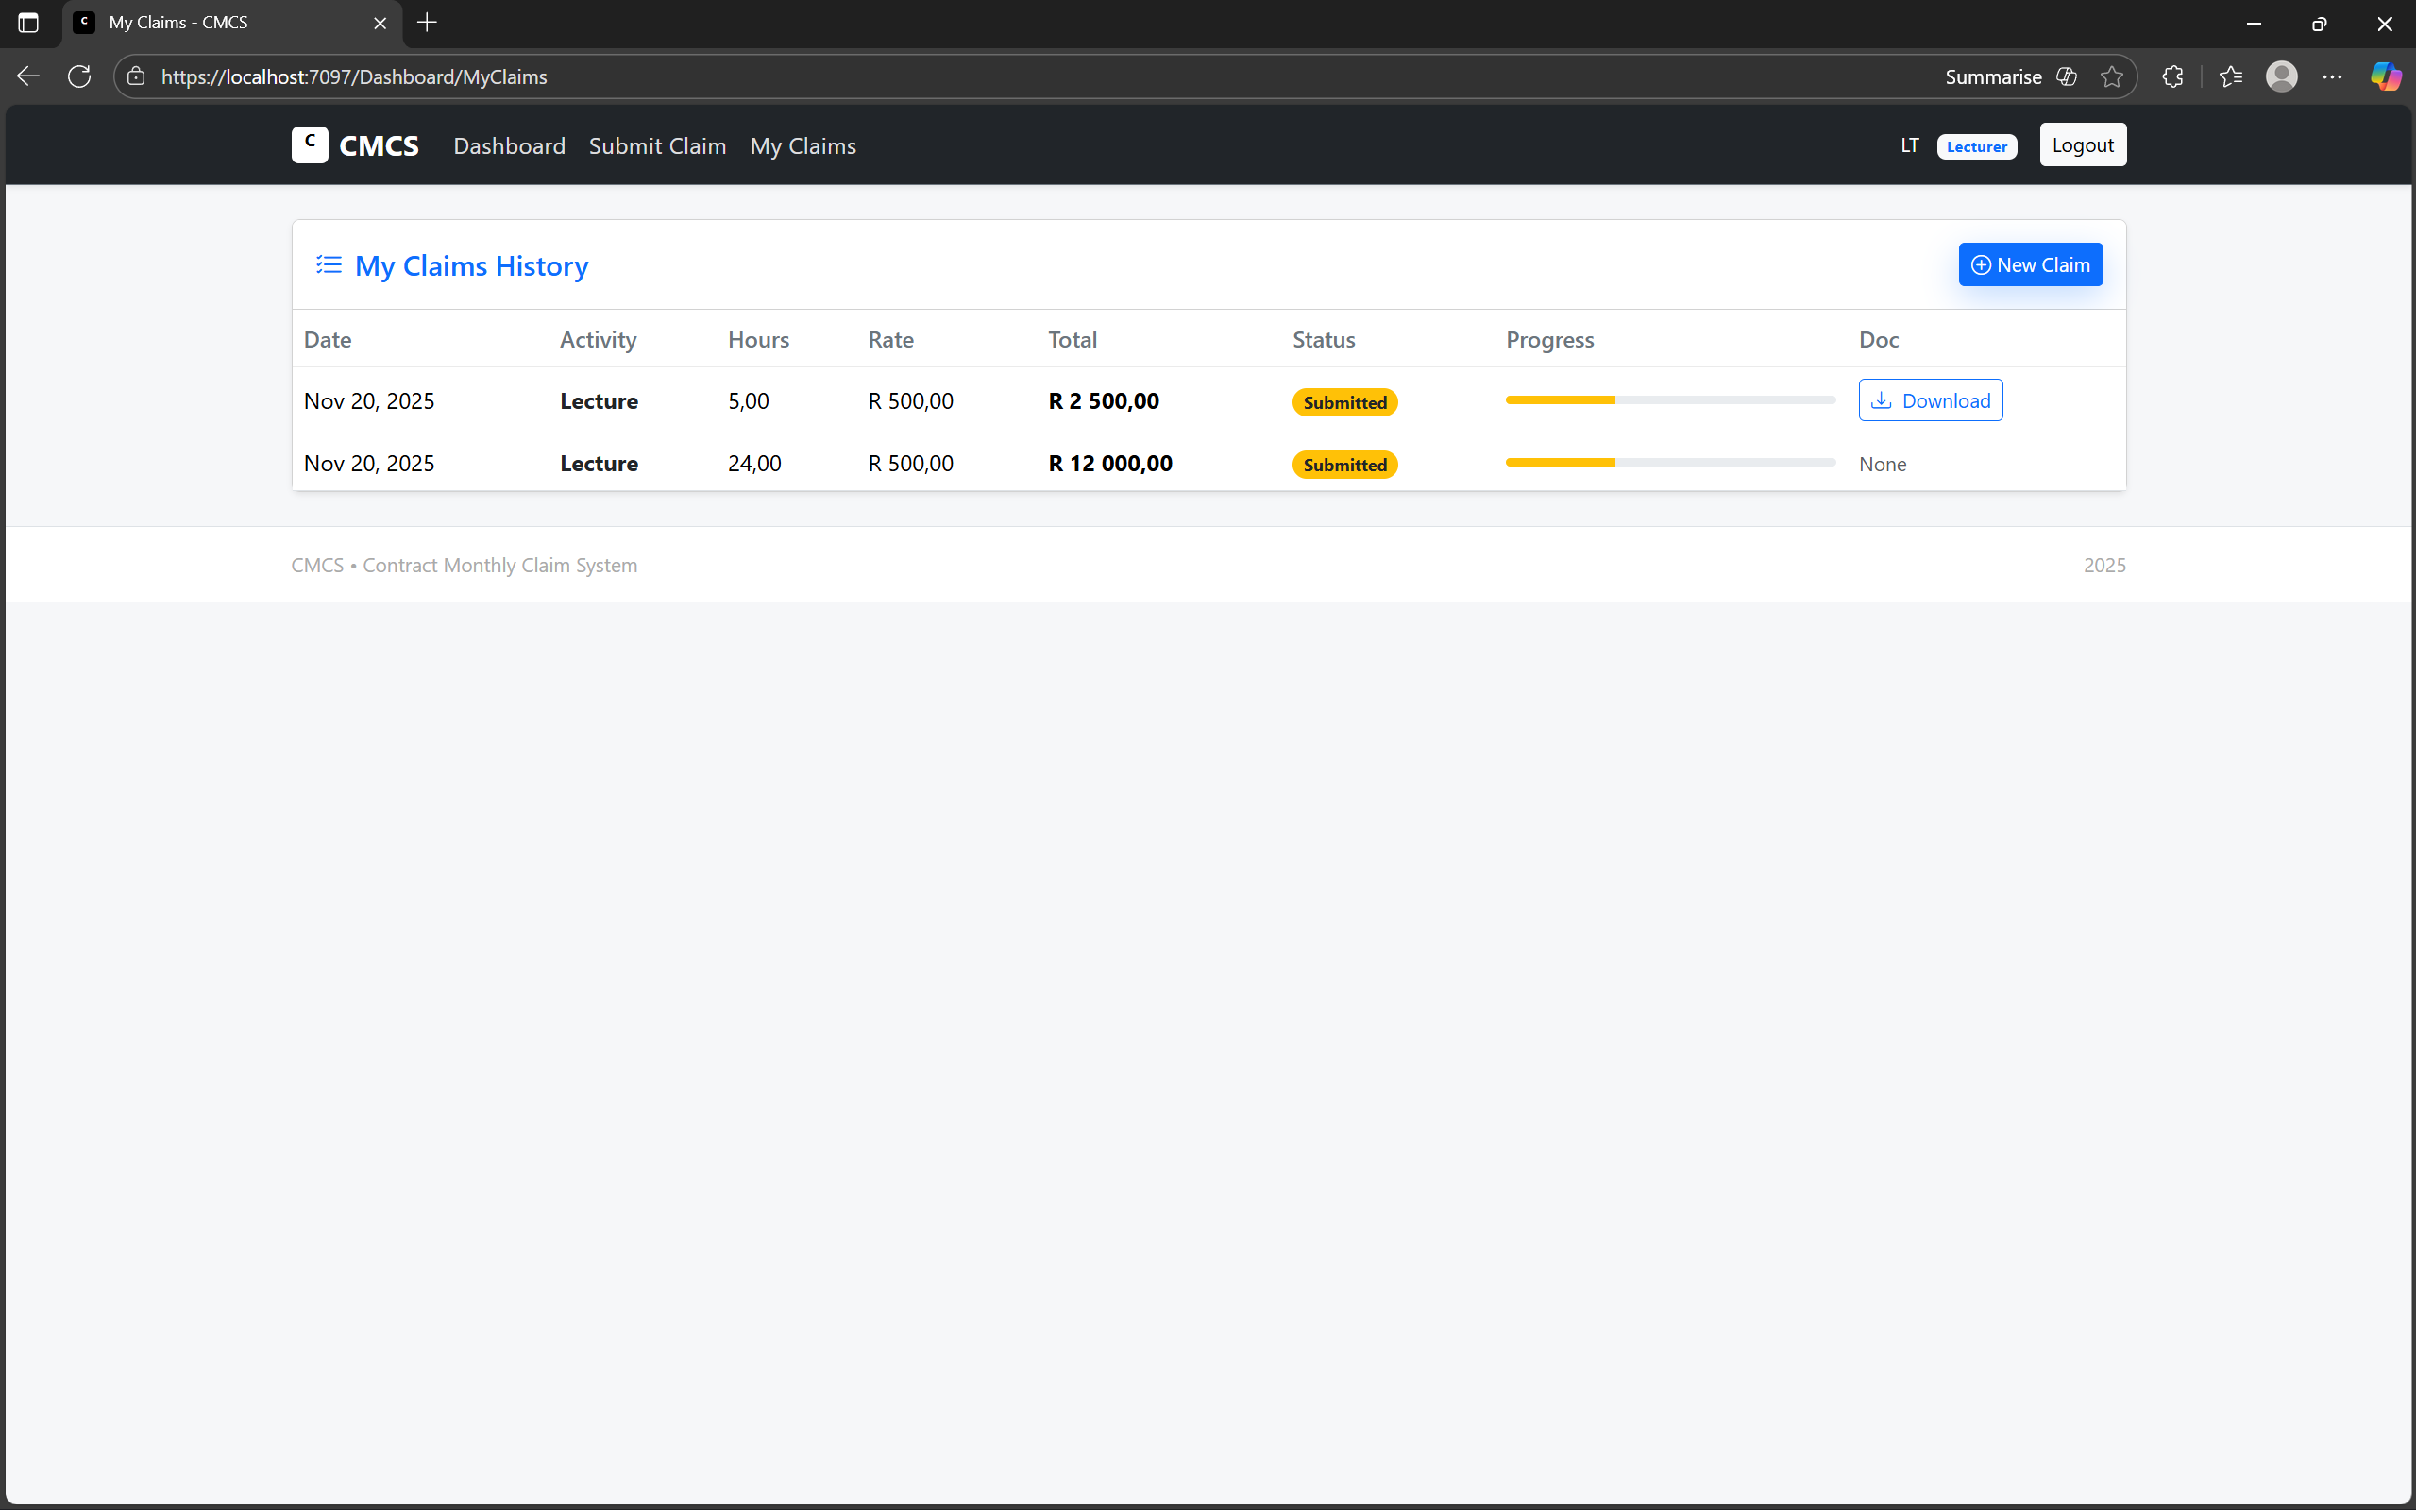
< A dedicated "Download" button was added to the My Claims grid. This button calls a new secure Controller Action DownloadFile which retrieves the file from the database and serves it to the user.
< There is now a download button underneath the document if there is one which also highlights when hovered over.

Slide 6
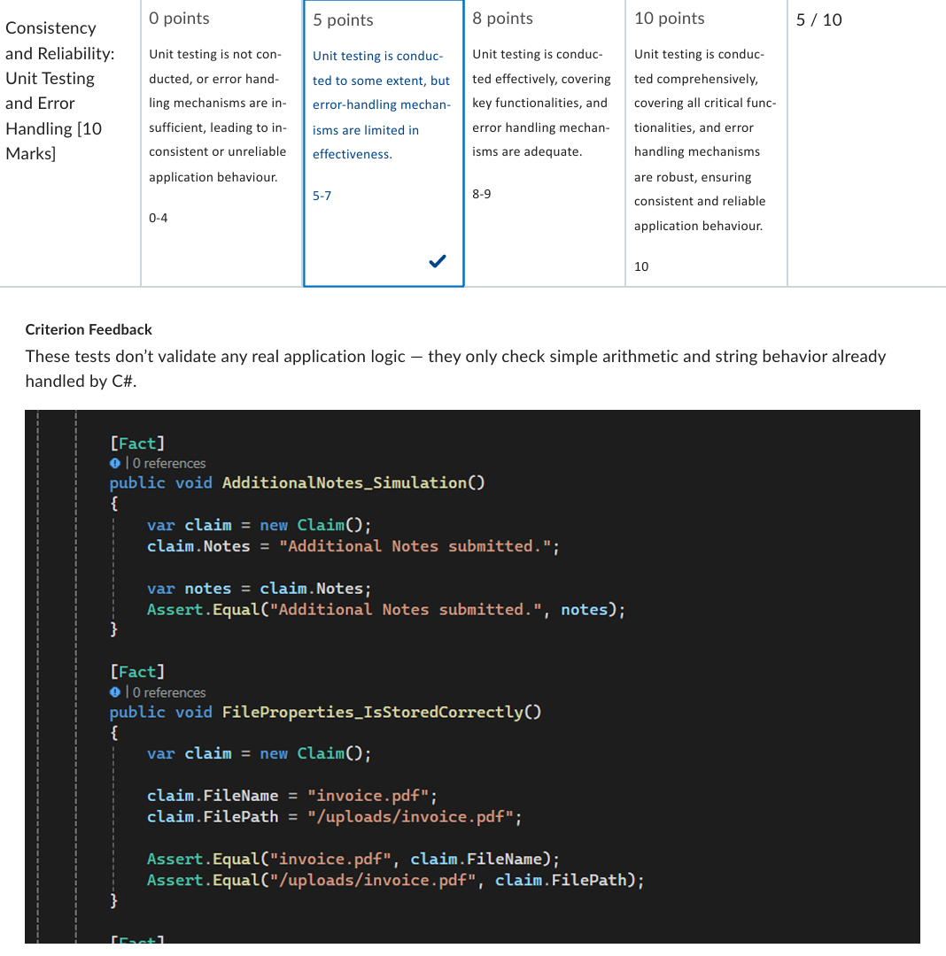
3. Unit Testing Feedback:
Feedback: "These tests don't validate any real application logic – they only check simple arithmetic and string behaviour already handled by C#." (mark: 5/10)
THE ISSUE: My old tests just checked if 20 * 670 = 13400. This is basic math, not testing my app's rules.
The Fix: The Unit Testing suite was completely rewritten to test Business Rules rather than basic math. i added validation logic to the Claim model to throw exceptions for invalid data and then wrote tests to verify these exceptions are thrown.

Slide 7
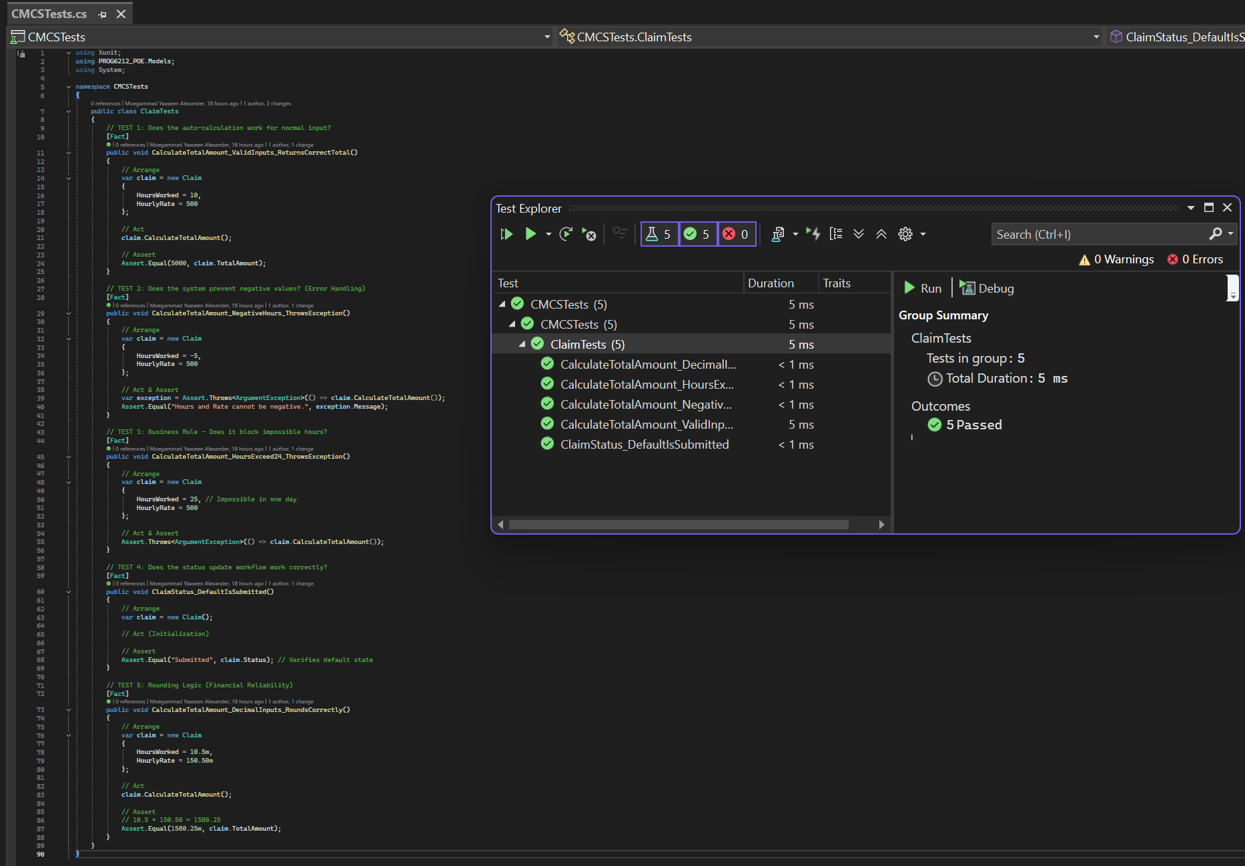
Test 1. Test to see Does the auto-calculation work?
Test 2. test to ensure Negative Values throw an error.
TEST 3. test to ensure Hours > 24 throws an error.
Test 4. Test to ensure that status update works correctly
Test 5. Test to see if the rounding off logic works for financial reliability

Slide 8
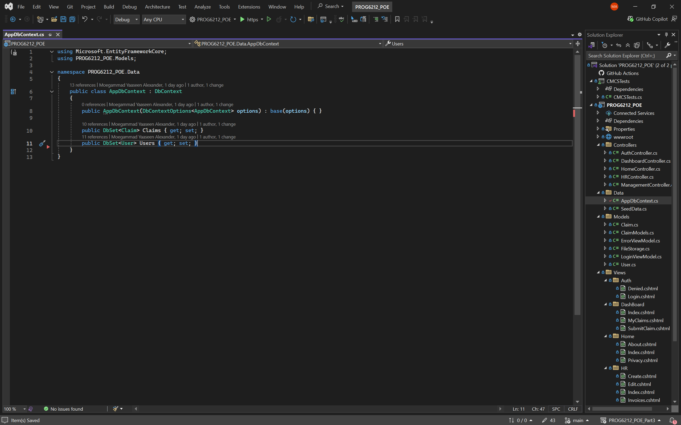
Design and Key Features of web app (Part 3 of Poe)
Code SNIPPET: APPDBCONTEXT.CS
1. SQL Server Integration (Entity Framework Core):
The system migrated from temporary In Memory lists (USERS, DOCUMENTS, ETC) to a persistent SQL Server Database. I used Entity Framework Core (Code-First) to map MY C# models directly to database tables.
Key Design Decision: The Claim entity is linked to the User entity via a Foreign Key (LecturerId), ensuring referential integrity.

Slide 9
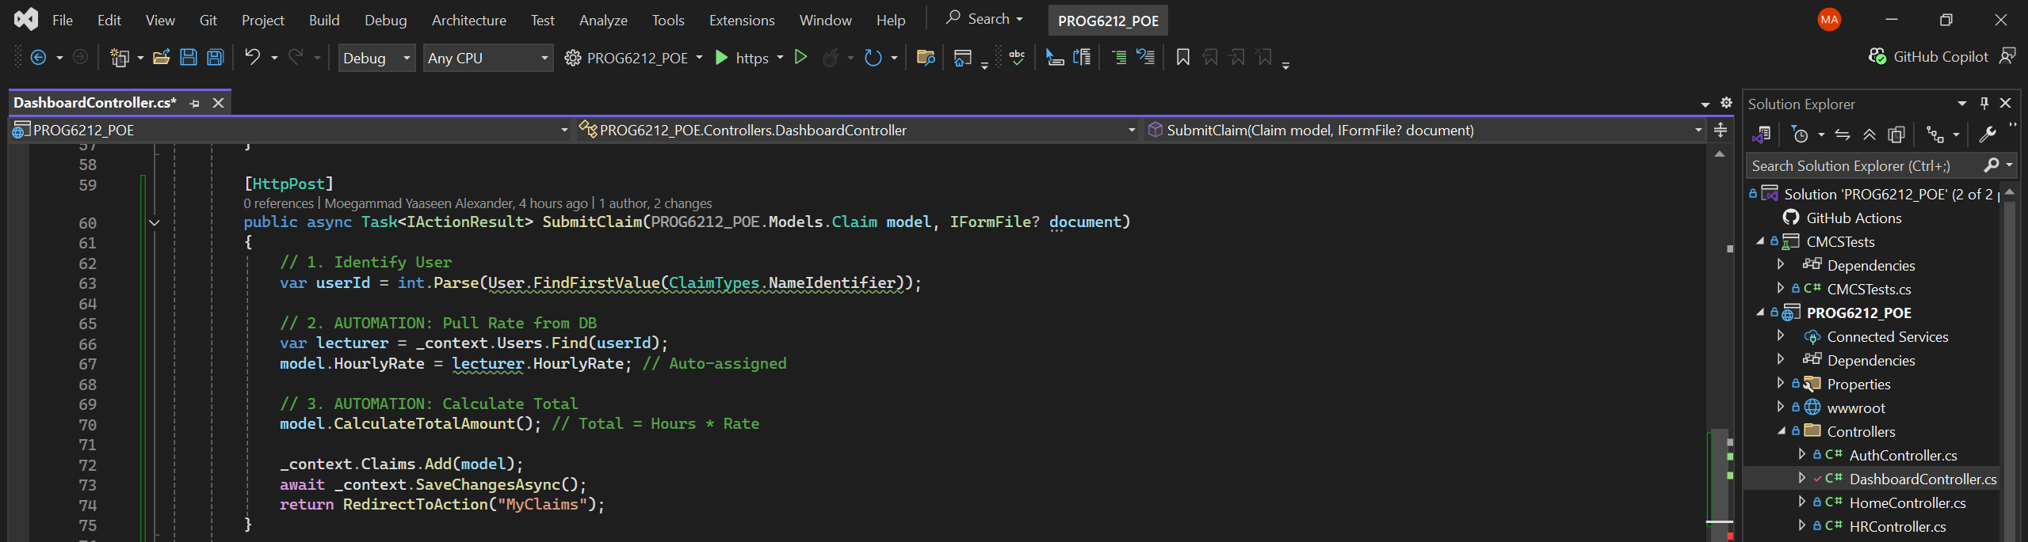
2. Automated Rate Calculation:
To prevent fraud and human error, the "Hourly Rate" is no longer a manual input field for Lecturers. The system automatically looks up the logged-in user's approved rate from the database.
Workflow: When a claim is submitted, the Controller looks up the User ID, finds their specific HourlyRate, and applies it to the claim calculation server-side.
Code Snippet (DashboardController.cs):

Slide 10
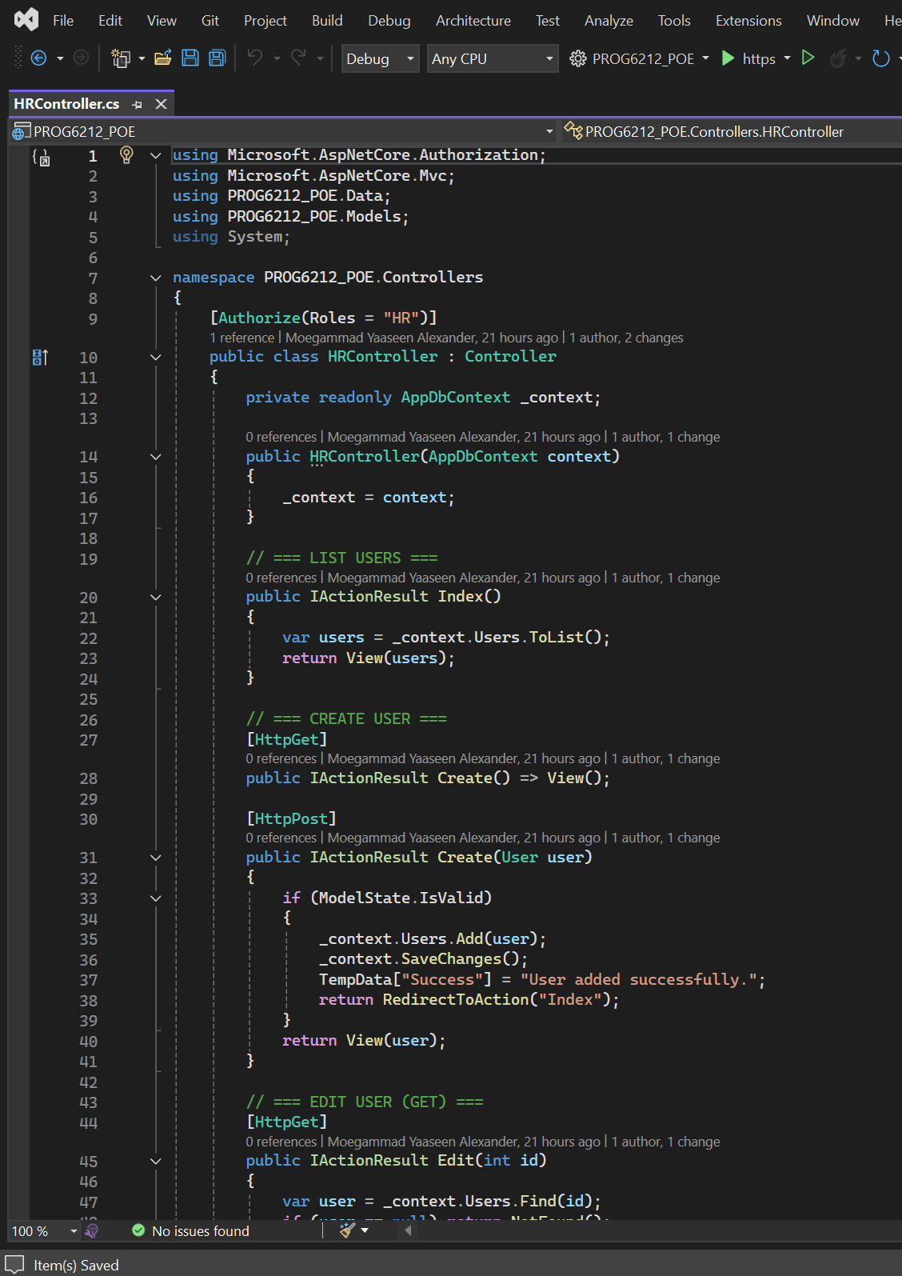
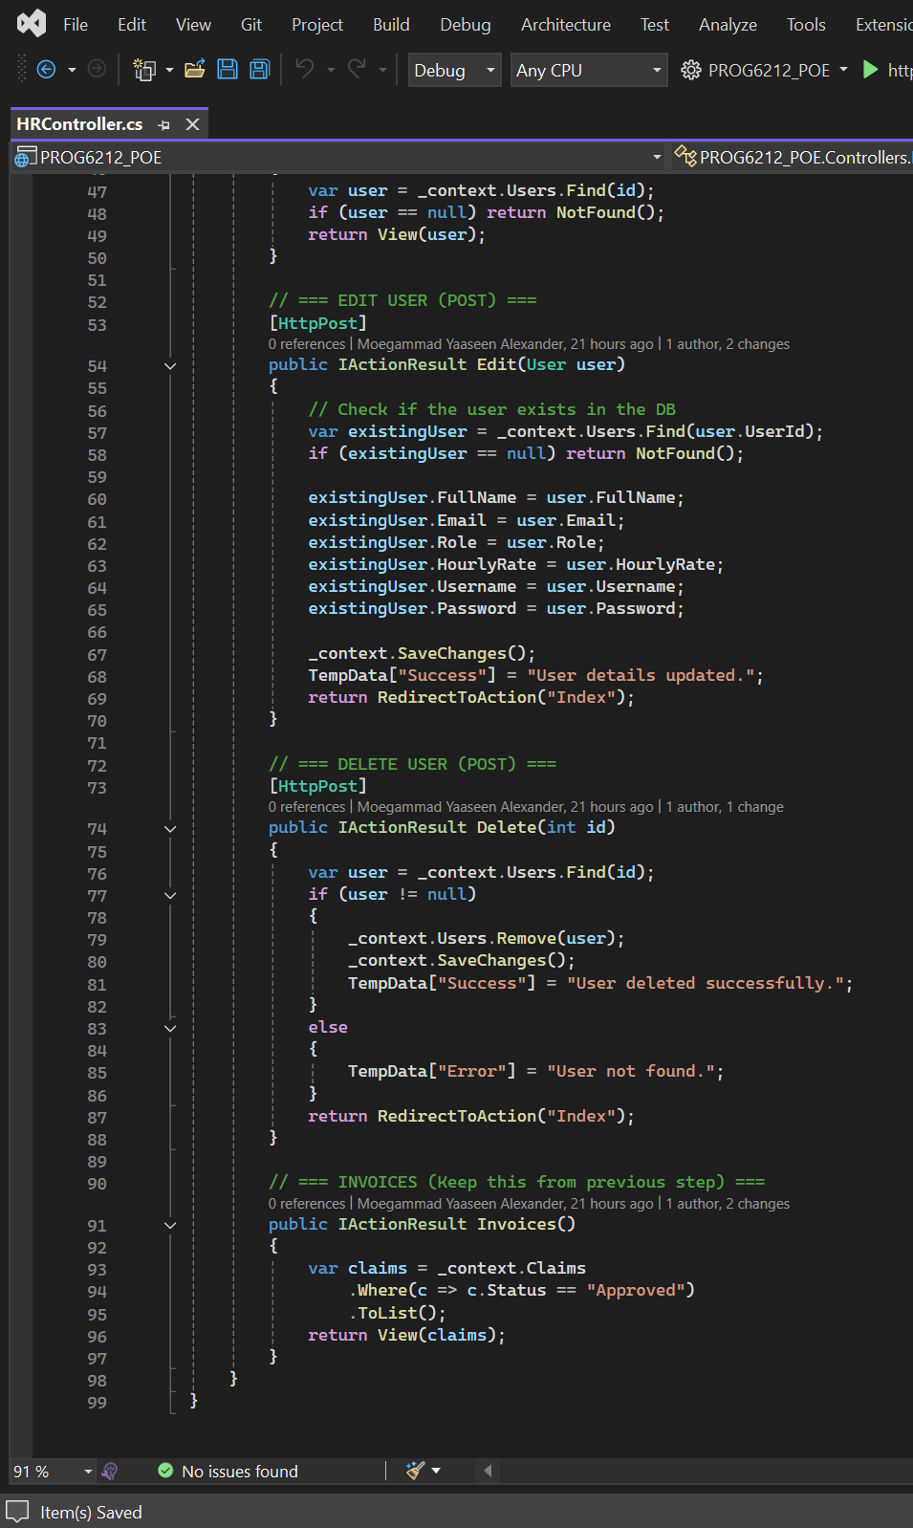
3. The HR "Super User“ (ADMIN):
A new Role (HR) was introduced to manage the system. The HR Controller provides full CRUD (Create, Read, Update, Delete) capabilities for system users.
Design: This allows the COMPANY to centrally manage approved rates and user access without touching the database directly.
Code Snippet (HRController.cs):

Slide 11
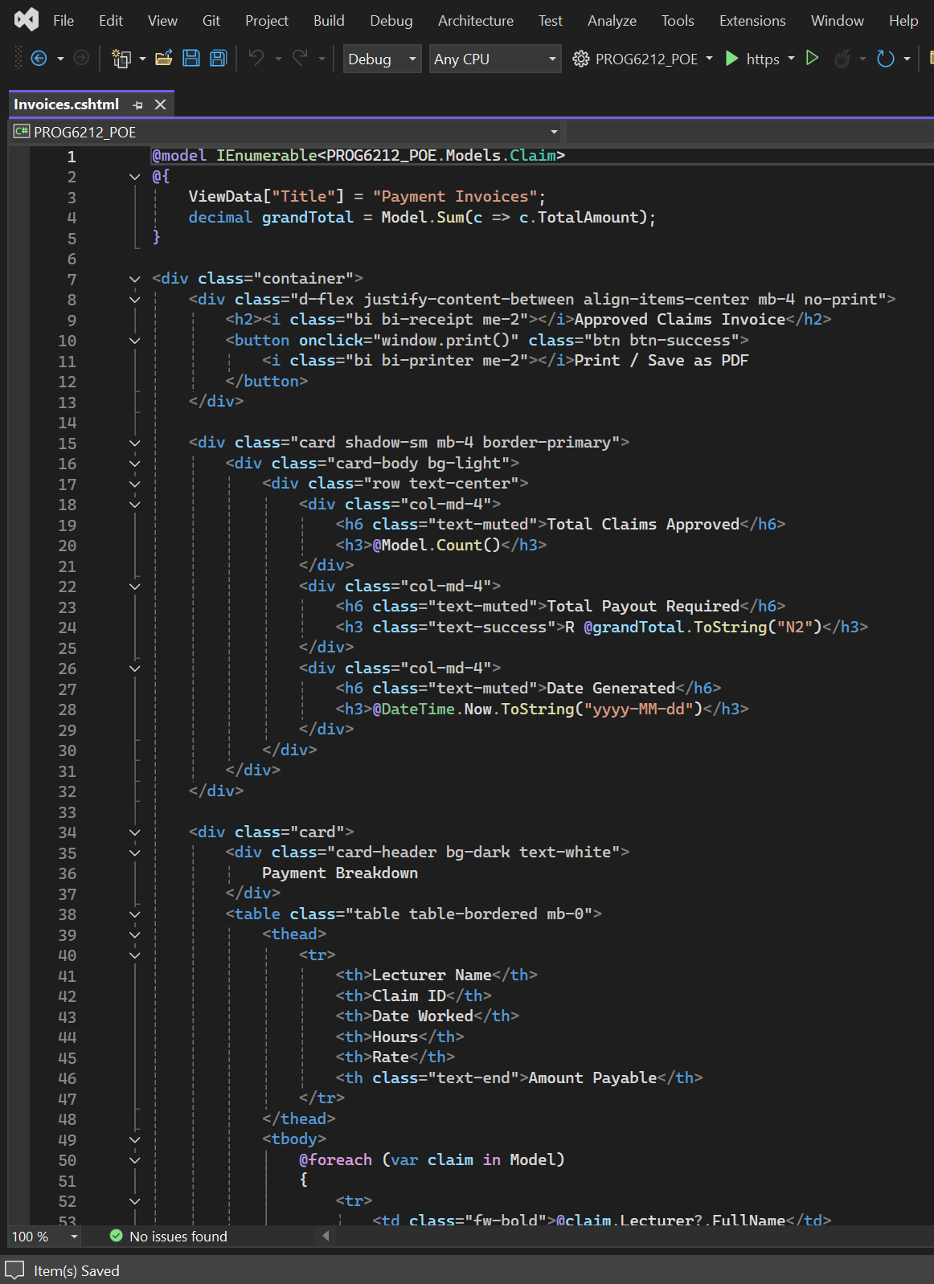
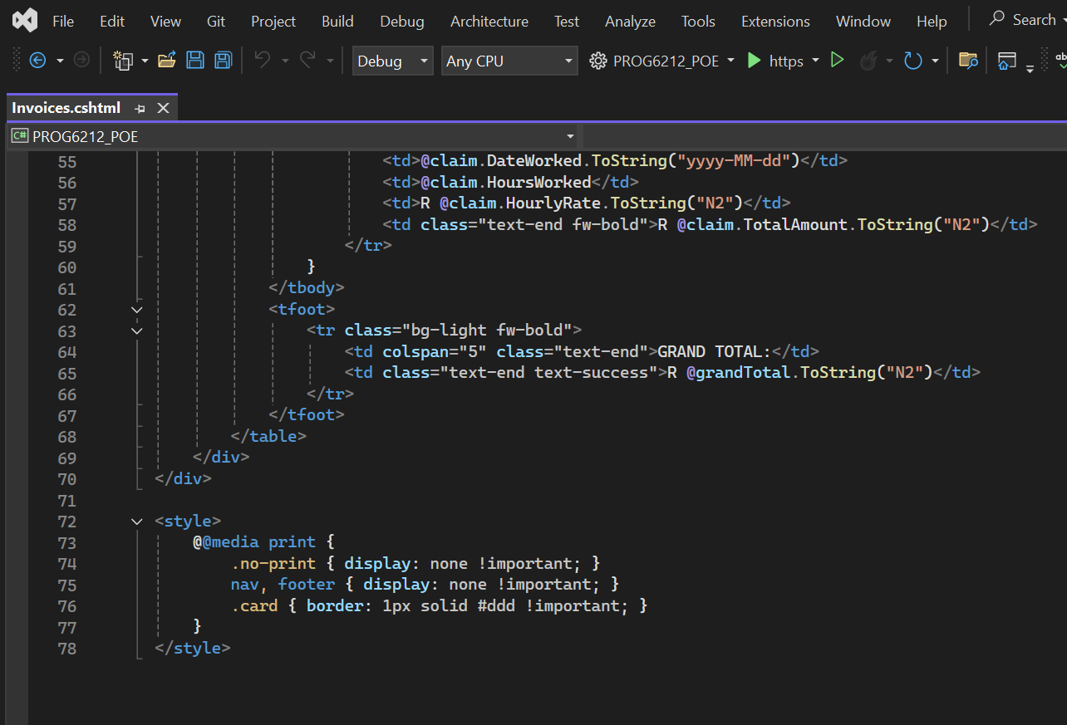
4. Invoice Generation:
The final requirement was a reporting feature. I implemented an "Invoices" view that aggregates all Approved claims and calculates the total payout required.
Design: The view uses specific CSS @media print queries to ensure the report prints cleanly to PDF without navigation bars or buttons.
Code Snippet (Invoices.cshtml):

Slide 12
Thank YOU

