Slide 1

Mobile Application and Website Solution
XHAW5112 G2: POE Adventure Escape SA

Slide 2
Group Members
The following are the group members for the module XHAW5112 Group 2
Project Overview
Adventure Escape SA is an outdoor adventure tourism business operating in the Western Cape. The company required a digital platform to showcase adventure packages, calculate fees, manage booking requests, and improve customer engagement through both a website and mobile application.
Asiphe Zondeka | ST10476655
Emily Maramani | ST10482946
Sisonke Miya | ST10494718
Nice Mtsweni | ST10501158
Ntombifuthi Mdlalose | ST10501620

Slide 3
Problem Statement
Adventure Escape SA previously lacked a centralized digital solution for promoting adventure activities and managing customer booking enquiries. Customers experienced difficulties accessing package information, obtaining quotations, comparing activities, and contacting the business efficiently. The organisation required a user-friendly platform that would simplify package browsing, automate fee calculations, support booking requests, and improve communication with customers.

Slide 4
Proposed Solution
To address the challenges faced by Adventure Escape SA, the team designed and developed an integrated mobile application and responsive website that provide customers with an easy and convenient way to explore adventure packages and activities, view detailed package information, calculate fees and discounts, request quotations, submit booking requests, and contact the business. Both platforms were developed with the same functionality and branding to ensure a consistent user experience across devices. The solution improves accessibility for customers, promotes the business online, reduces administrative workload, and enables users to quickly calculate costs and interact with the company from anywhere and at any time.

Slide 5
Functional Requirements
The system was developed to provide the following functionality for both the Mobile App and the Website: - Home Screen
- About Us Page
- Overview Page
- Package Detail Screens
- Fee Calculator
- Contact Us Page
Additional Features
- Navigation menu
- Quote requests
- Booking requests
- Discount calculations
- VAT calculations

Slide 6
Non-Functional Requirements
Usability
Accessible on different devices
Performance
Fast loading pages
Responsive layouts
Reliability
Form validation
Security
Input validation
Safe user interaction

Slide 7
Technologies Used
Website
HTML5
CSS3
JavaScript
Visual Studio Code
GitHub
Mobile Application
Android Studio
Kotlin
XML
Design Tools
Figma
GitHub

Slide 8
Mobile Application Demonstration
The mobile application was developed using Android Studio and follows a modern user-centred design approach. Consistent colours, navigation, and layouts were applied throughout the application.
Below are the screenshots of the following screens from the App.
    Home Screen
    About Us
    Overview

Slide 9
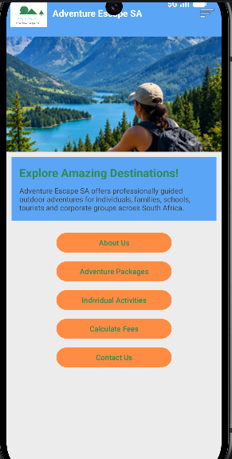
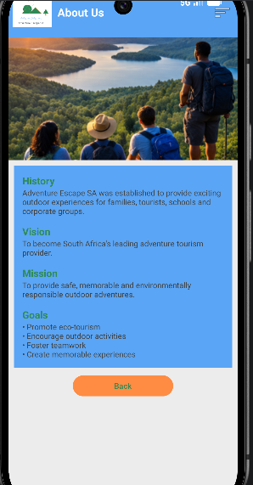
Screens

Slide 10
Mobile Application Features
Users can view package details, prices, purposes, activities included, and access booking functionality.
Below are the screenshots of the following screens from the App:
    Ultimate Adventure Day
    Family Explorer Package
    Mountain Adventure Package

Slide 11
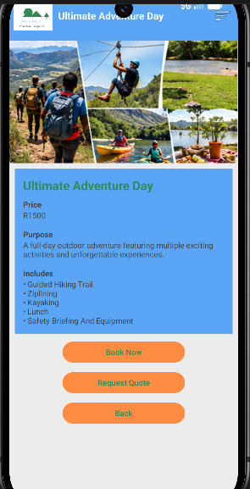
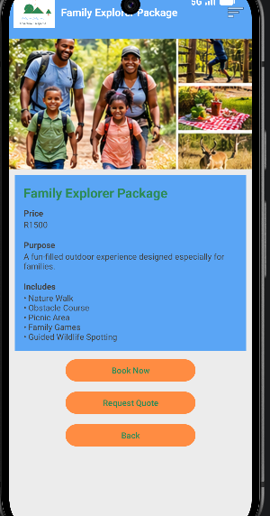
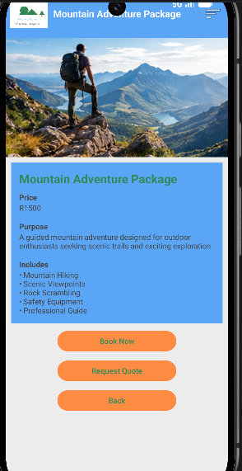
Package Screens

Slide 12
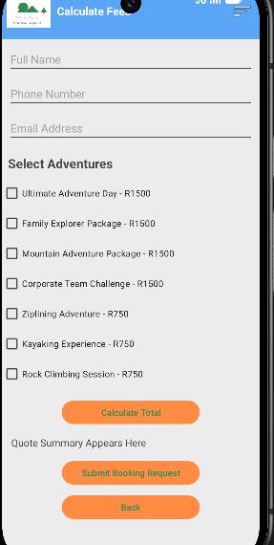
Mobile App Fee Calculator
Features include:
Customer information
Adventure selection
Discount calculations
VAT calculations
Quote summary generation
Booking request submission
Discount Structure:
  Bookings Discount
  2 5%
  3 10%
  More than 3 15%

Slide 13
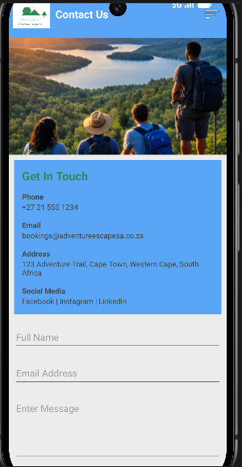
Mobile Contact Page
Users can:
View contact information
Access social media links
Submit enquiries
View location information

Slide 14
Website Design Demonstration
The website follows the same branding and user experience principles as the mobile application.
Below are the screenshots of the following screens from the Website:
      Website Home Page
      About Us Page

Slide 15
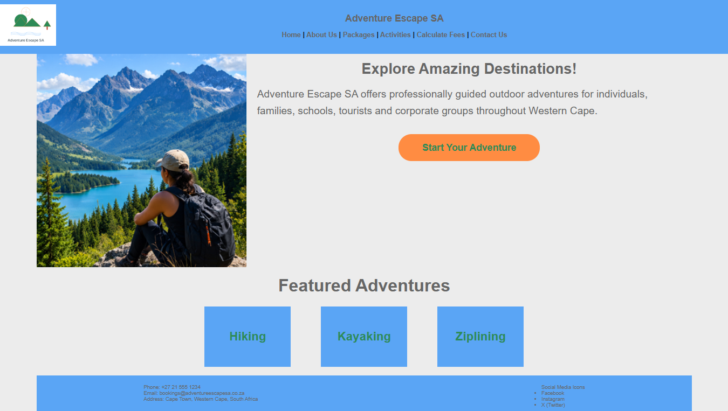
      Website Home Page

Slide 16
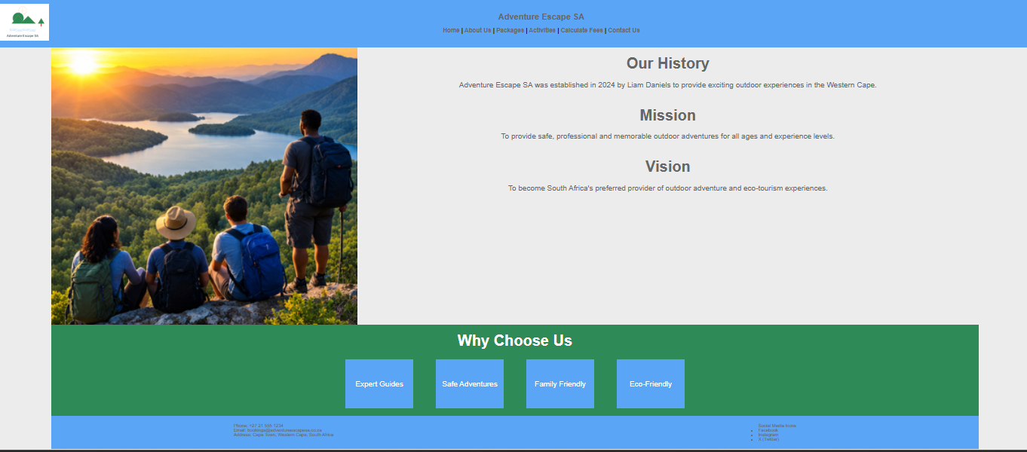
      About Us Page

Slide 17
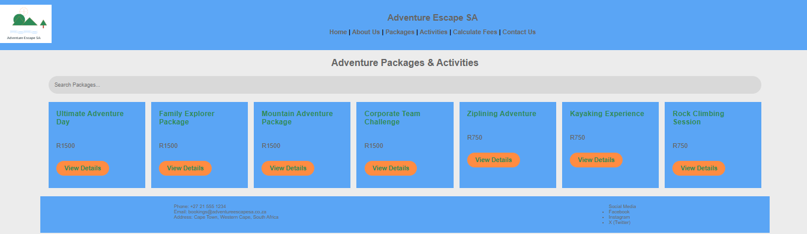
Website Overview Page
Users can:
Browse adventure packages
Search packages
Access detailed package pages
Compare offerings

Slide 18
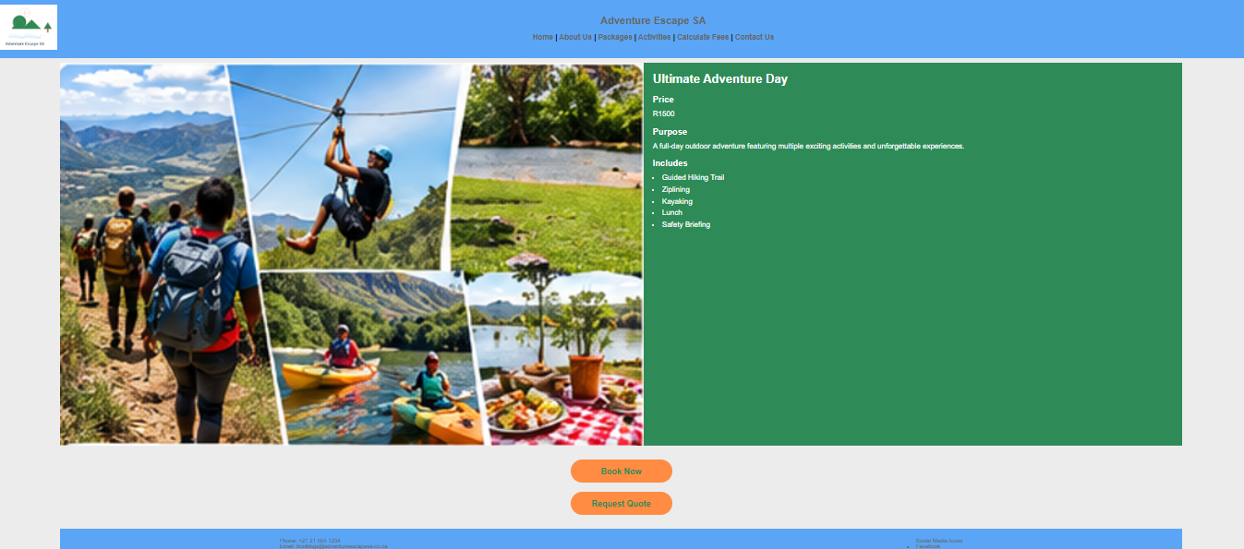
Website Package Pages
Each package page provides:
Pricing
Purpose
Included activities
Booking options
Quote request functionality

Slide 19
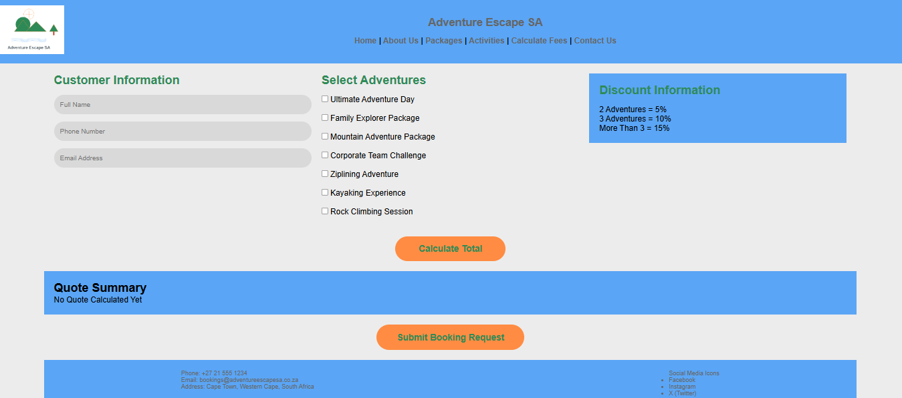
Website Fee Calculator
The calculator performs:
Subtotal Calculation
Discount Calculation
VAT Calculation (15%)
Total Fee Calculation

Slide 20
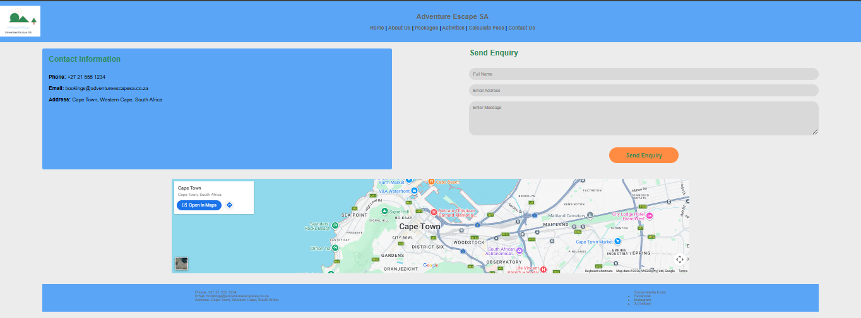
Contact Us Page
Features:
Contact information
Enquiry form
Google Maps location
Communication channels

Slide 21
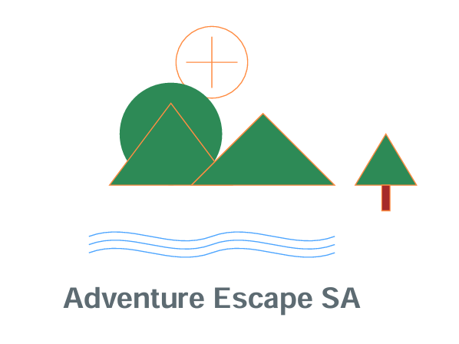
Logo Design
What each element means
Mountains: hiking, climbing and the Mountain Adventure package
Sun with compass point: exploring outdoors and finding your direction
Tree: nature and the Western Cape outdoors
Water lines: kayaking and water activities
Why this design: flat, simple shapes stay clear when shrunk to an app icon or website header, and the green matches our brand colours.
Notes:
Hi, I'm Emily Maramani, and I'll explain the design choices behind Adventure Escape SA, starting with the logo. Every part of the logo links to what the business offers. The mountains stand for hiking, climbing and our Mountain Adventure package. The sun with the compass point represents exploring and finding your direction outdoors. The tree shows nature, and the water lines represent kayaking and water activities. We kept the logo flat and simple so it stays clear when it is small, for example as the app icon or in the website header, and we used green so it matches the rest of our branding.

Slide 22
Colour and Typography Choices
Sky blue
#5AA5F5
Header and footer
Calm and trustworthy, like an open sky
Forest green
#2E8B57
Headings and logo
Nature and the outdoors
Adventure orange
#FF7A1A
Buttons and calls to action
Energy; makes Book Now stand out
Light grey
#EAEAEA
Page background
Keeps photos and text easy to read
Typography: Arial on both the website and the app. It is clear on small phone screens and available on every device, so the text looks the same everywhere.
Shapes: rounded buttons and cards look friendly and are easy to tap on mobile.
Notes:
Next, our colour and typography choices. We used the same palette on the website and the mobile app so customers recognise the brand on any device. Sky blue is used for the header and footer because it feels calm and trustworthy. Forest green is used for headings and the logo to connect to nature. Orange is our action colour: every Book Now, Request Quote and Calculate button is orange so it stands out, because those are the actions we want customers to take. A light grey background keeps the photos and text easy to read. We chose Arial because it is clear on small phone screens and works on every device, and we used rounded buttons and cards because they look friendly and are easy to tap.

Slide 23
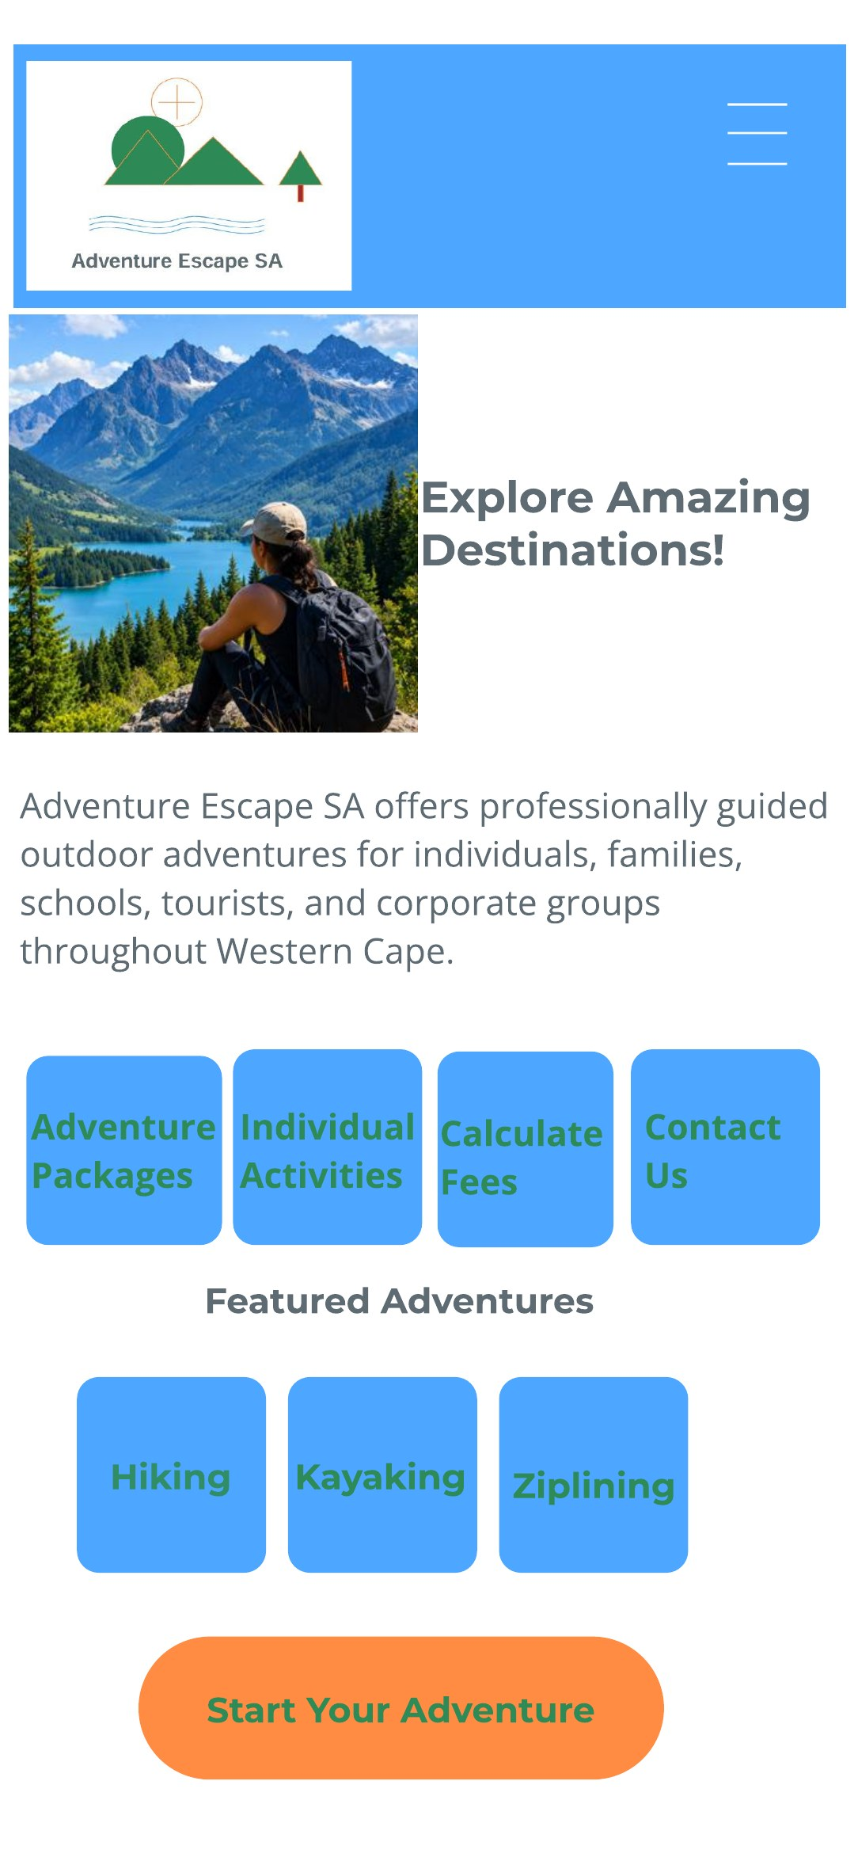
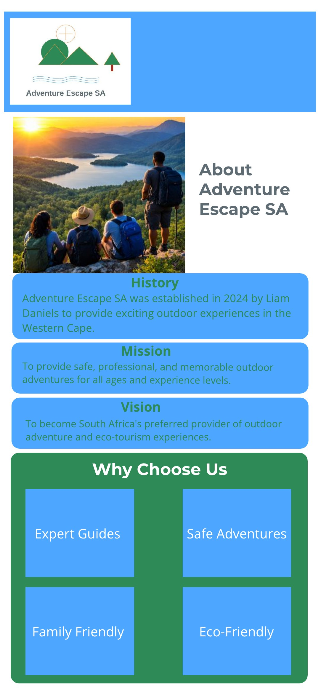
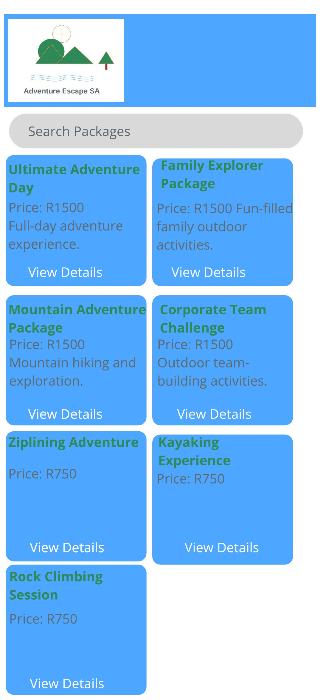
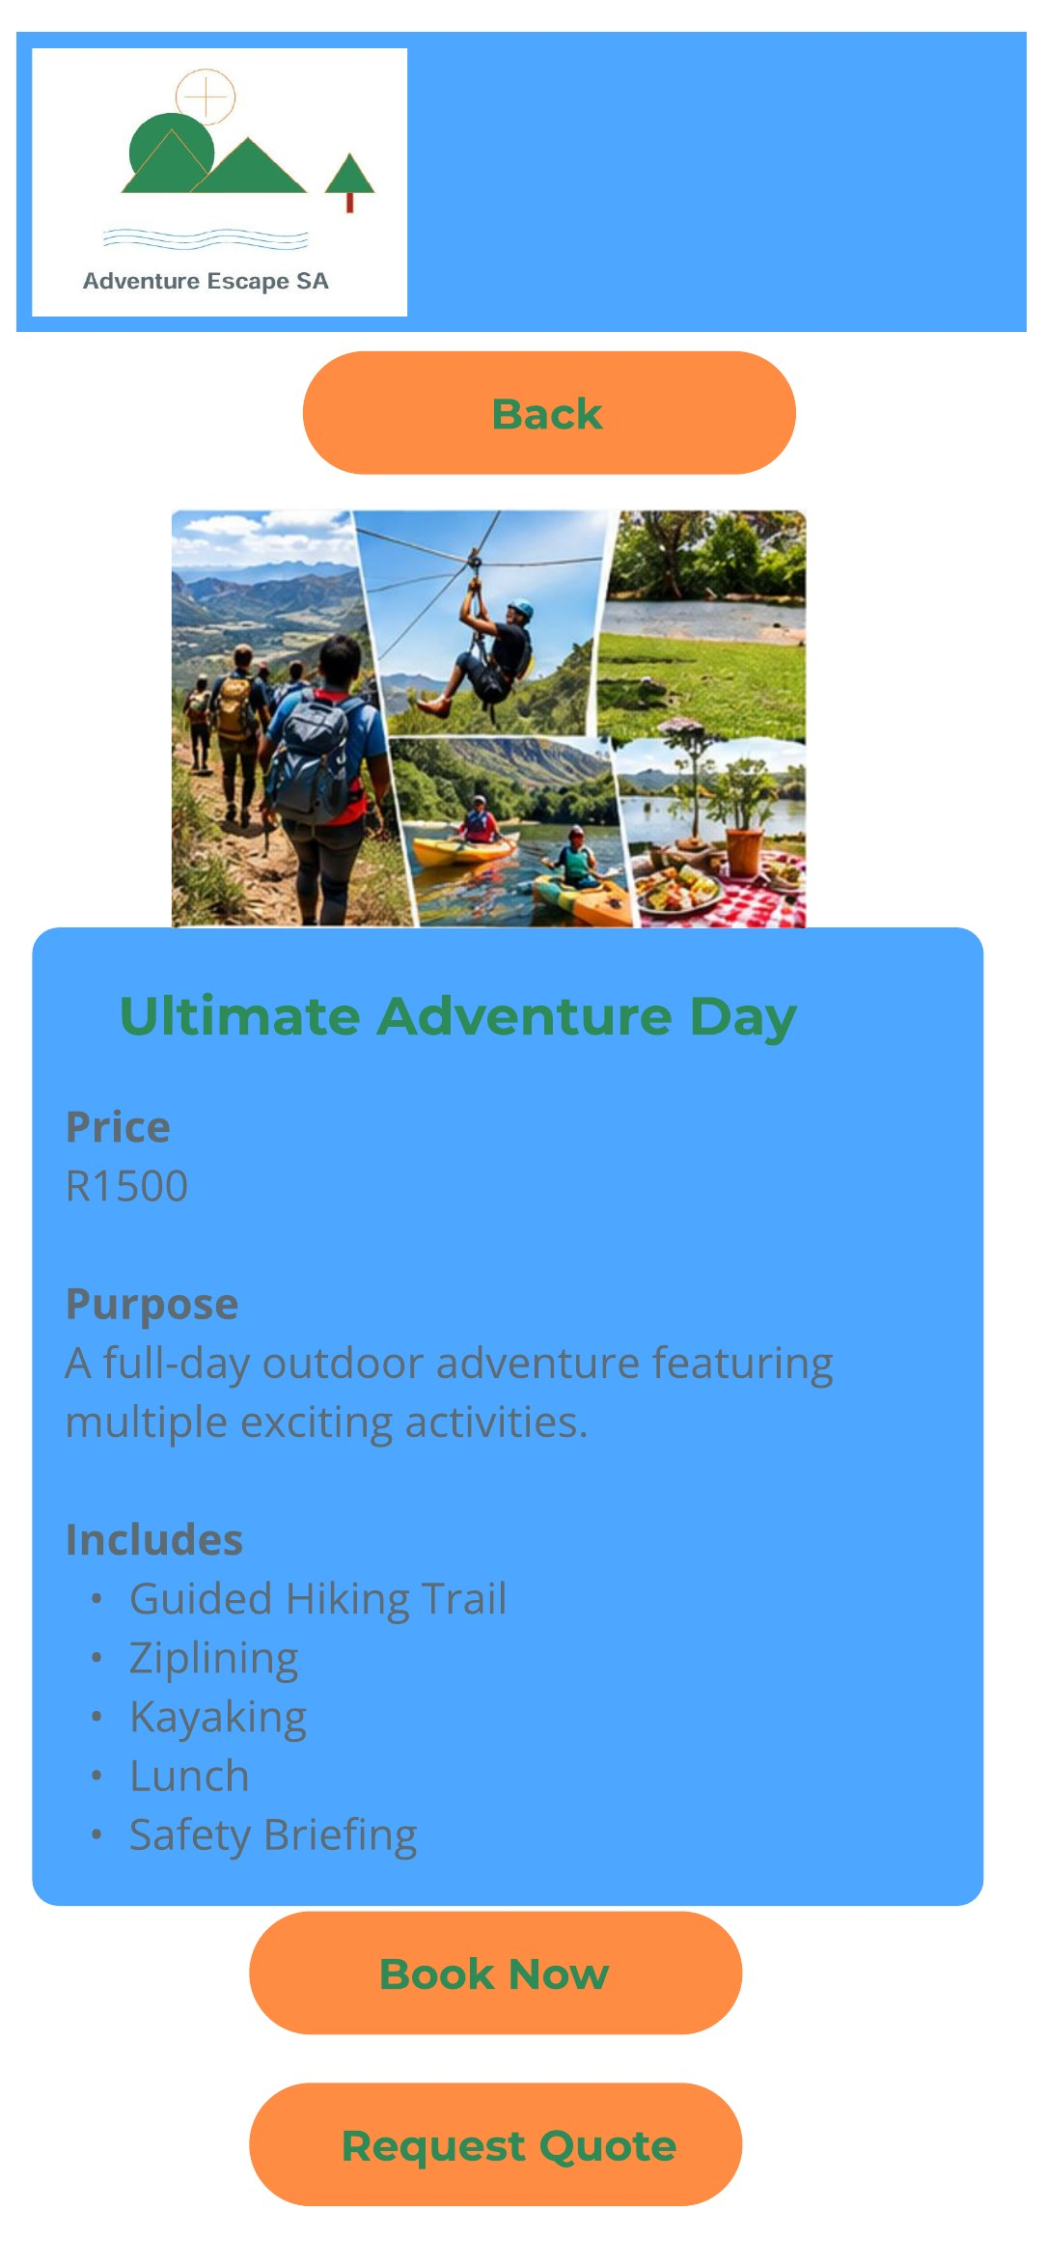
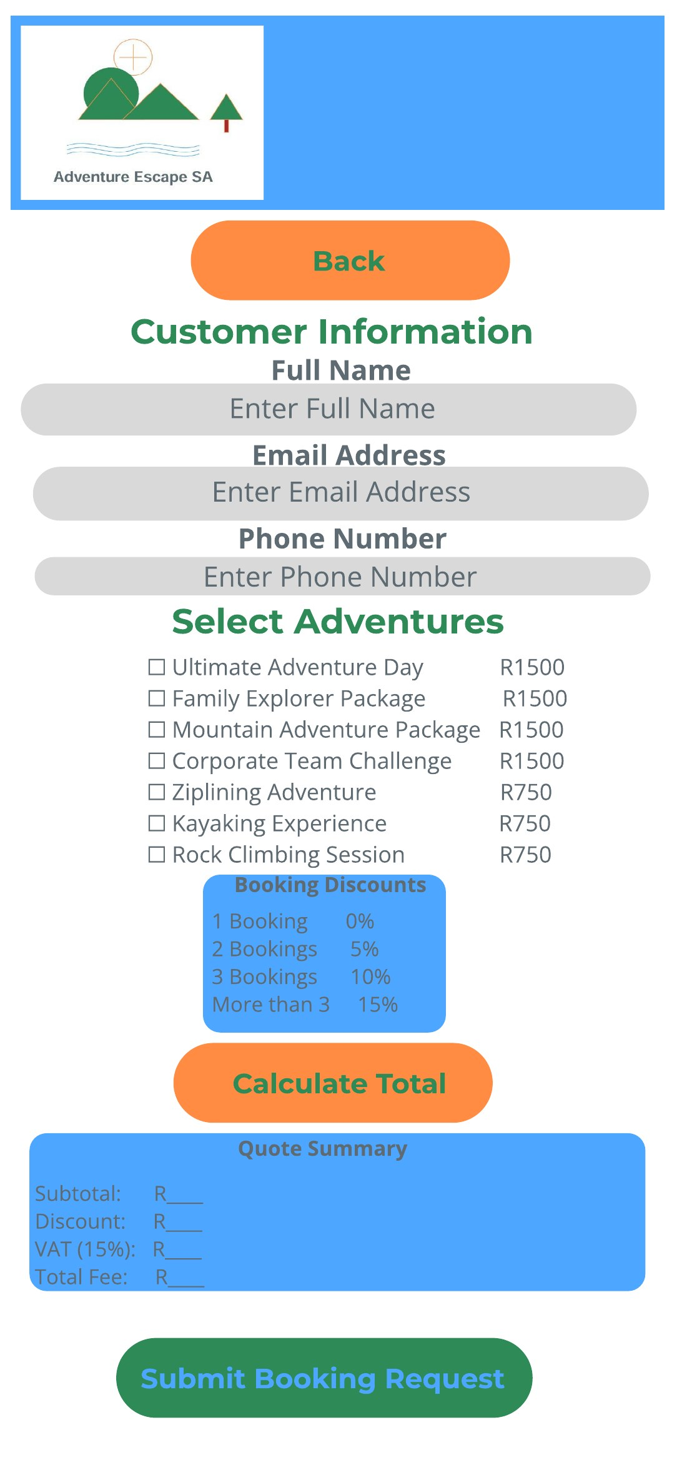
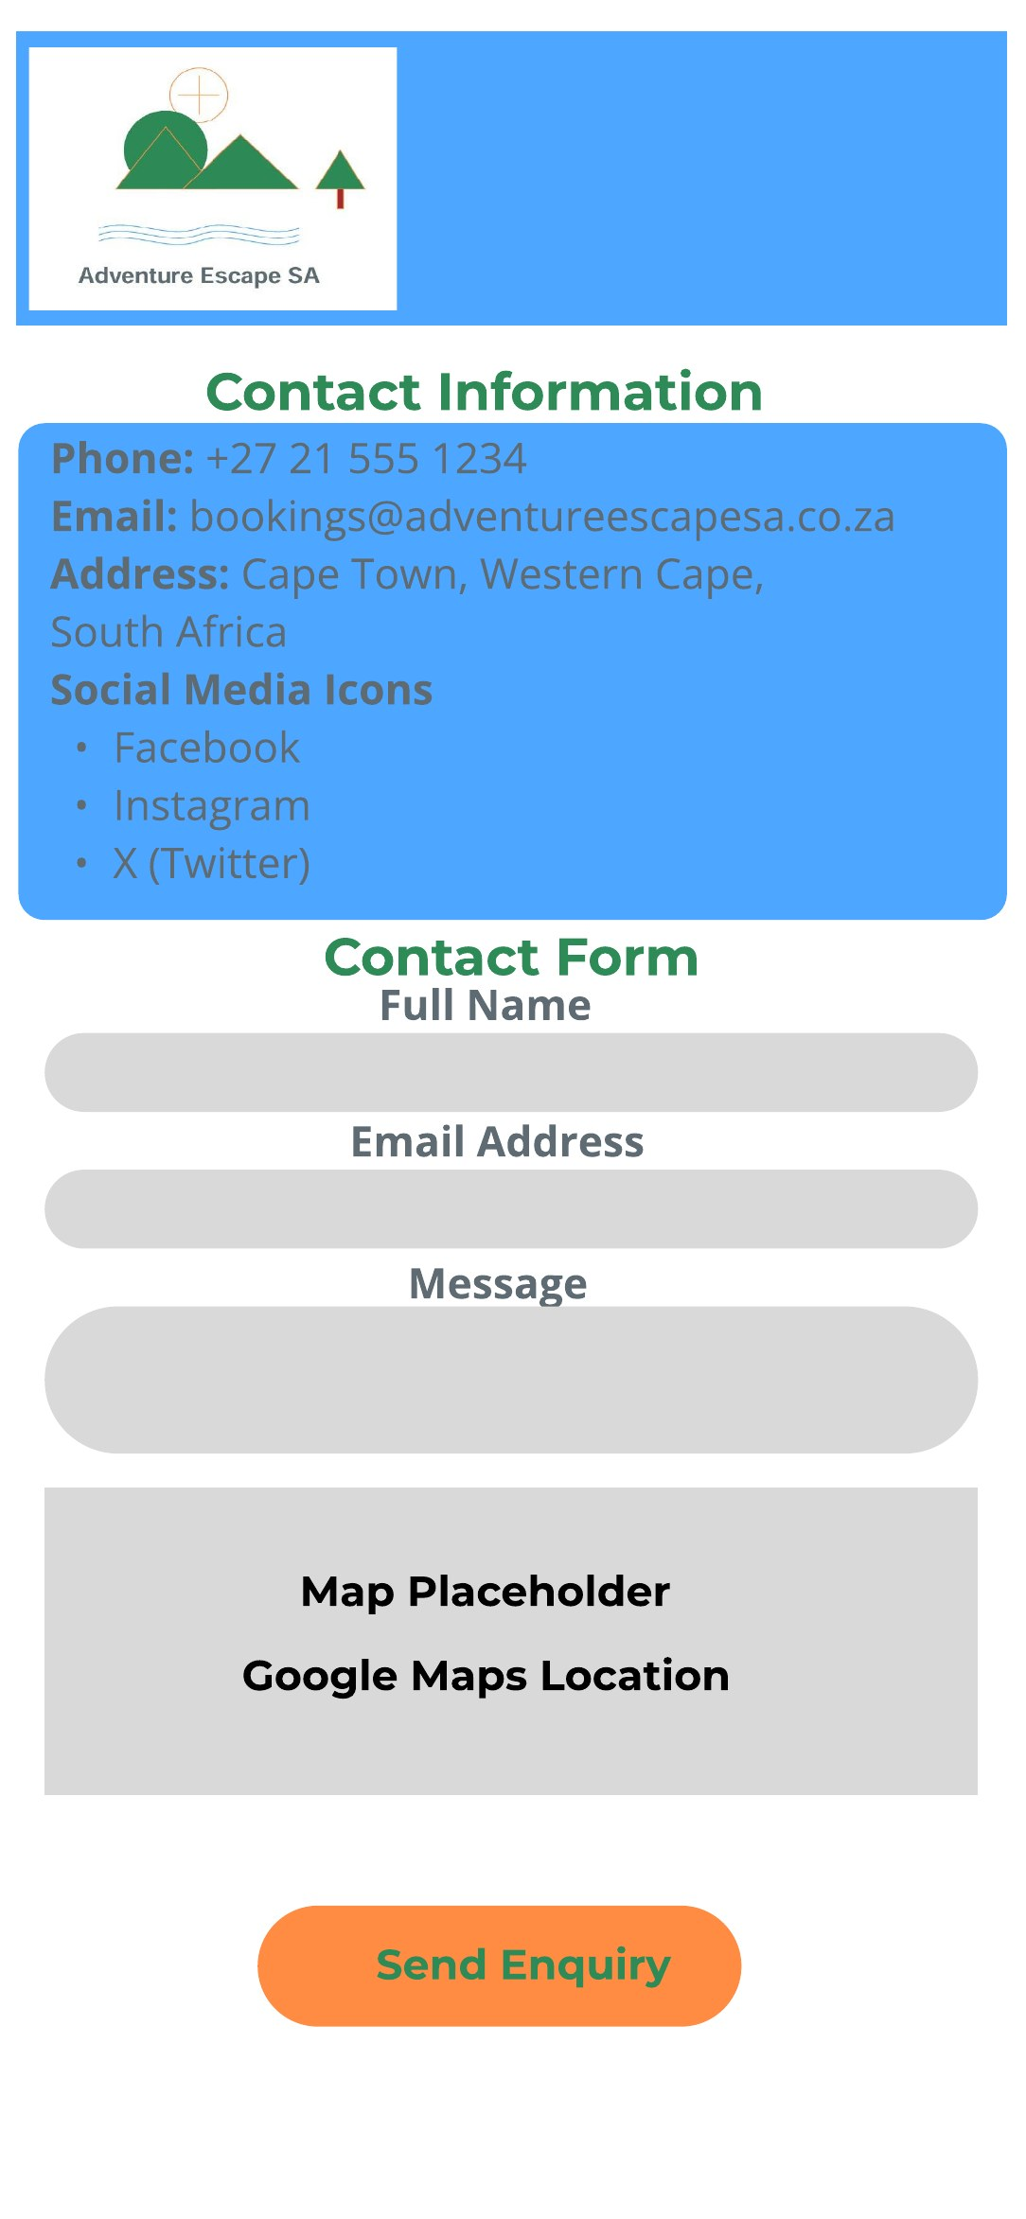
Wireframes: Mobile App
Home
About Us
Overview
Package Detail
Calculate Fees
Contact Us
One column, large tap-friendly buttons, and a Back button on detail screens.
Notes:
Before we built anything, we planned every screen as a wireframe in Figma. These are the mobile app wireframes. Every screen starts with the logo at the top so users always know where they are. The Home screen leads with a large image and four quick buttons to Packages, Activities, Calculate Fees and Contact Us. The Overview screen shows each package as a card with its price and a View Details button, and each package screen lists the price, purpose and included activities, with orange Book Now and Request Quote buttons. The Calculate Fees screen takes the customer's details, lets them tick adventures, shows the discount table and builds a quote summary. Because phone screens are narrow, everything sits in one column with large buttons that are easy to tap, and detail screens have a Back button so users don't get lost.

Slide 24
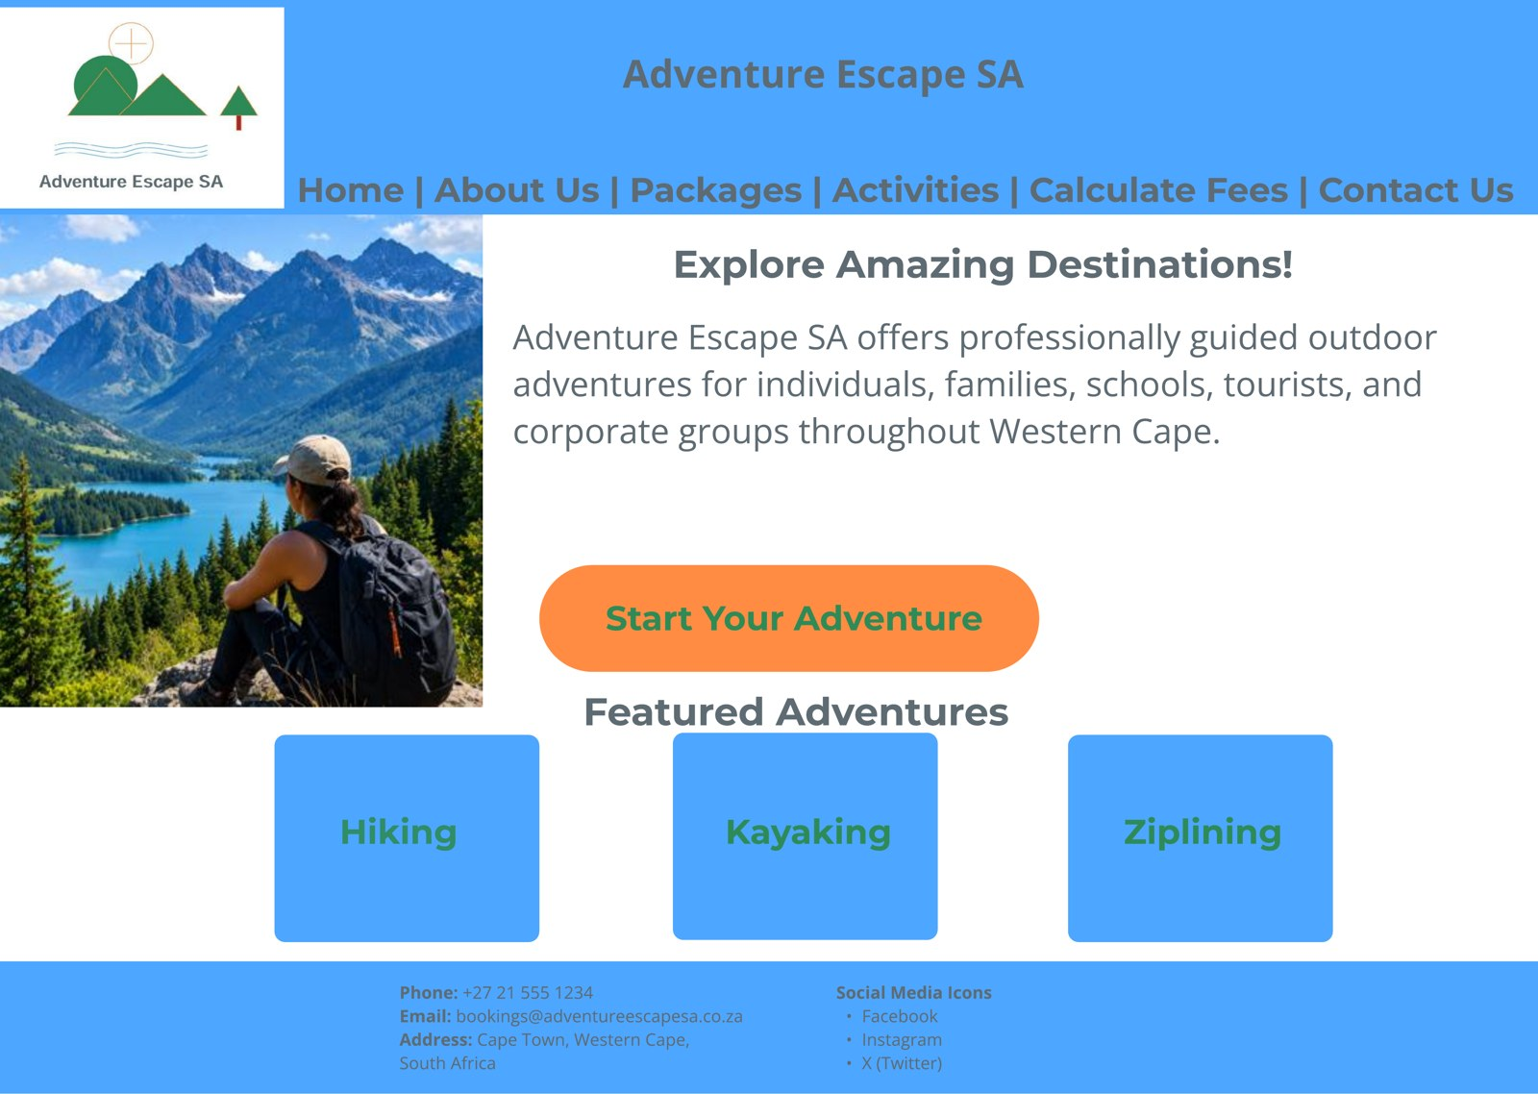
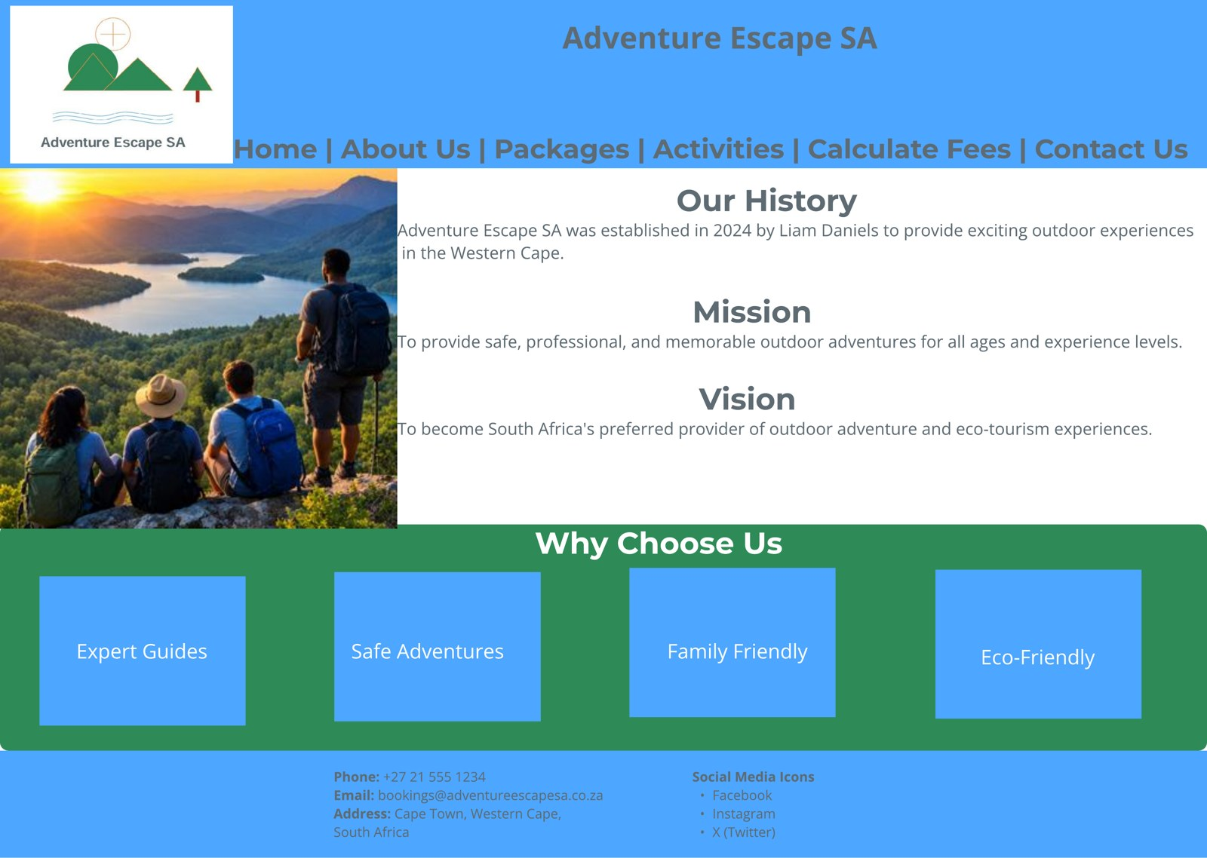
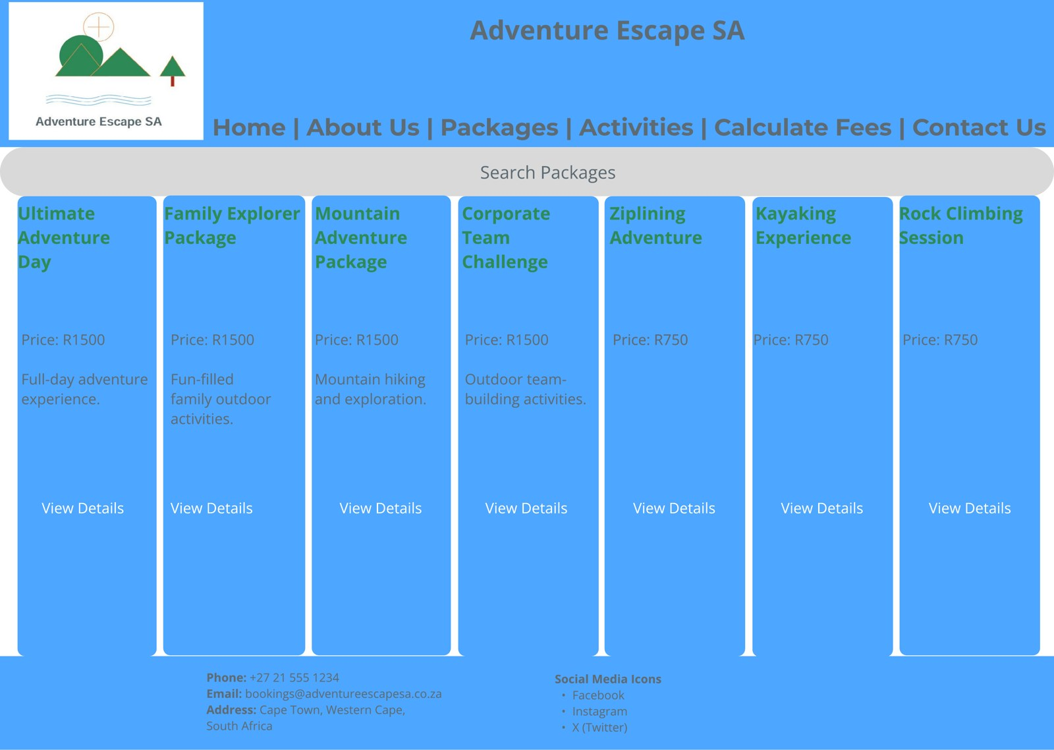
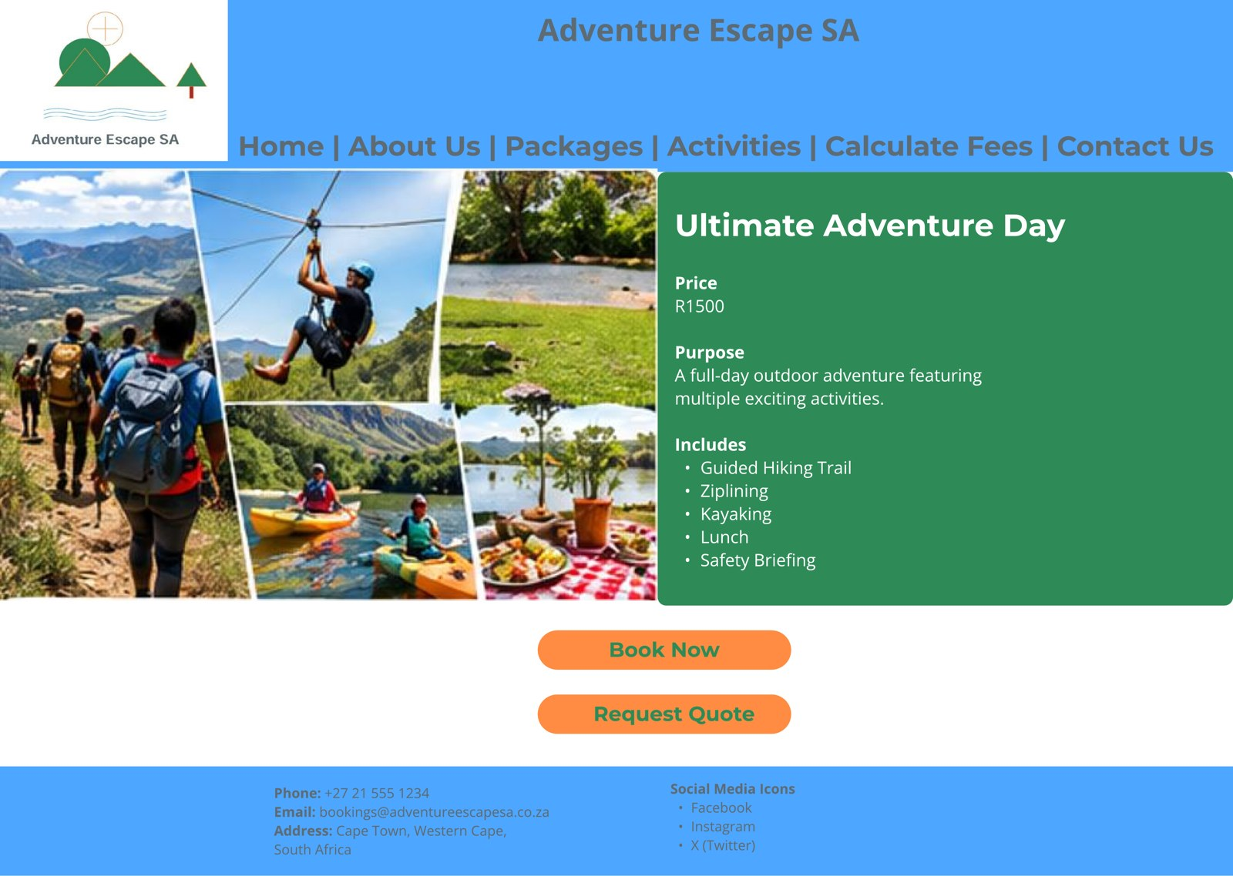
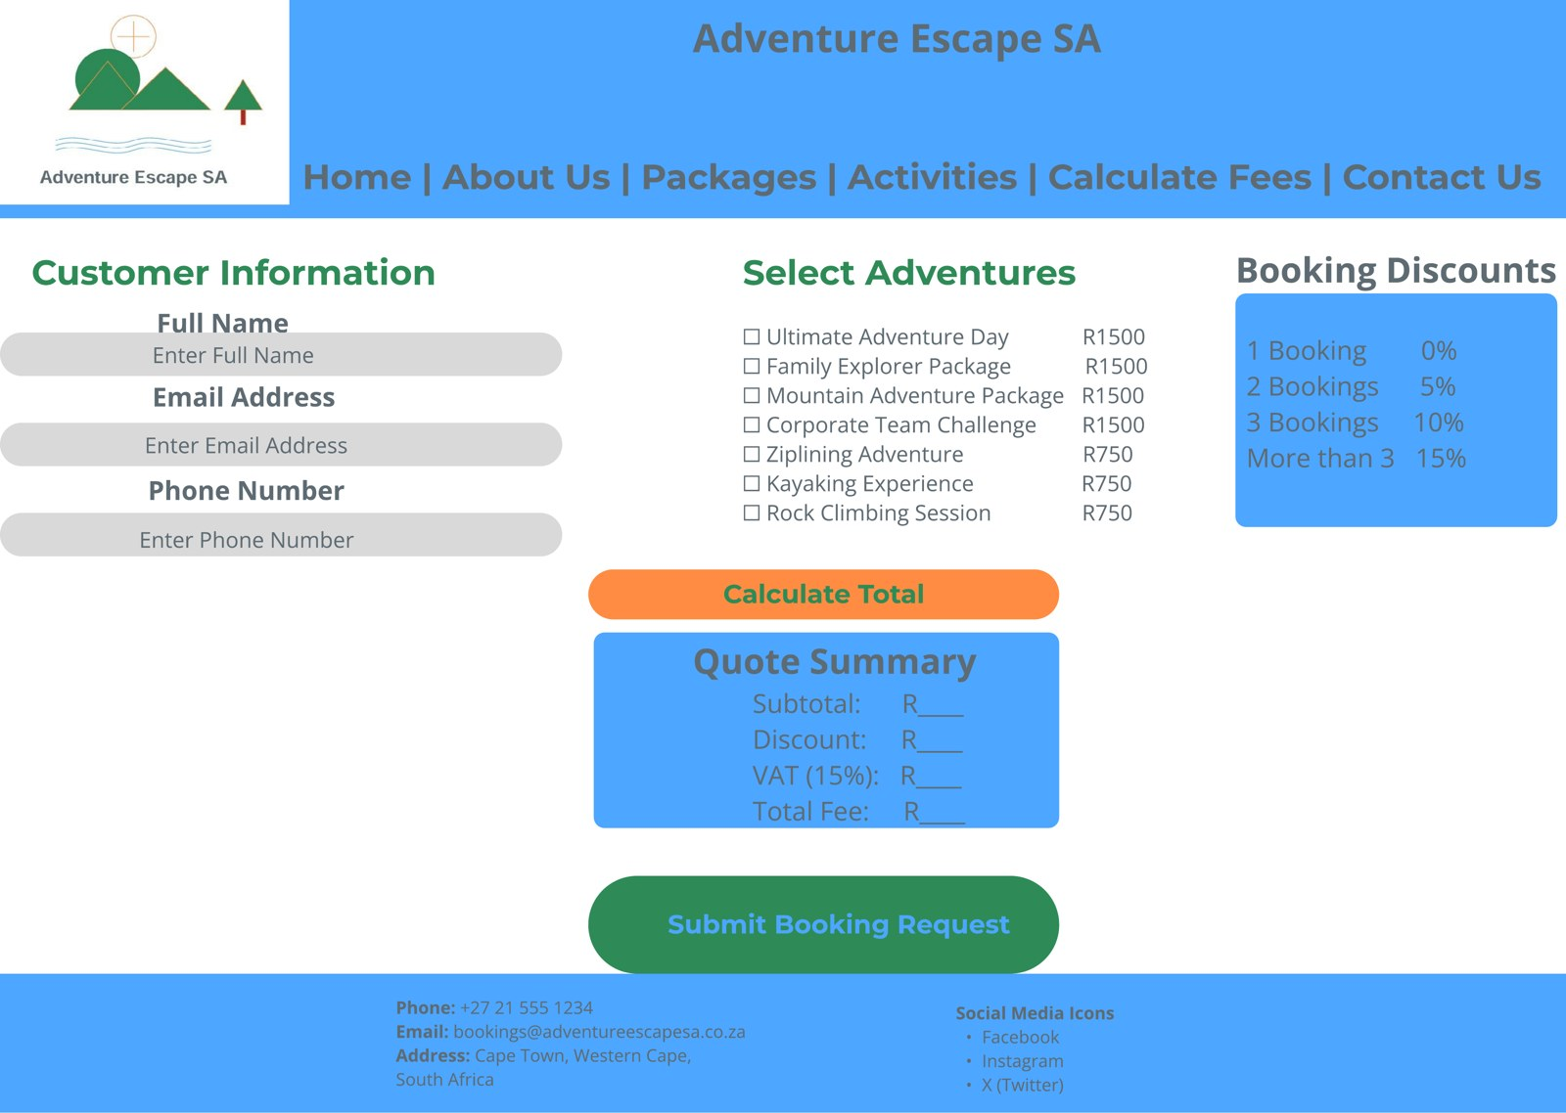
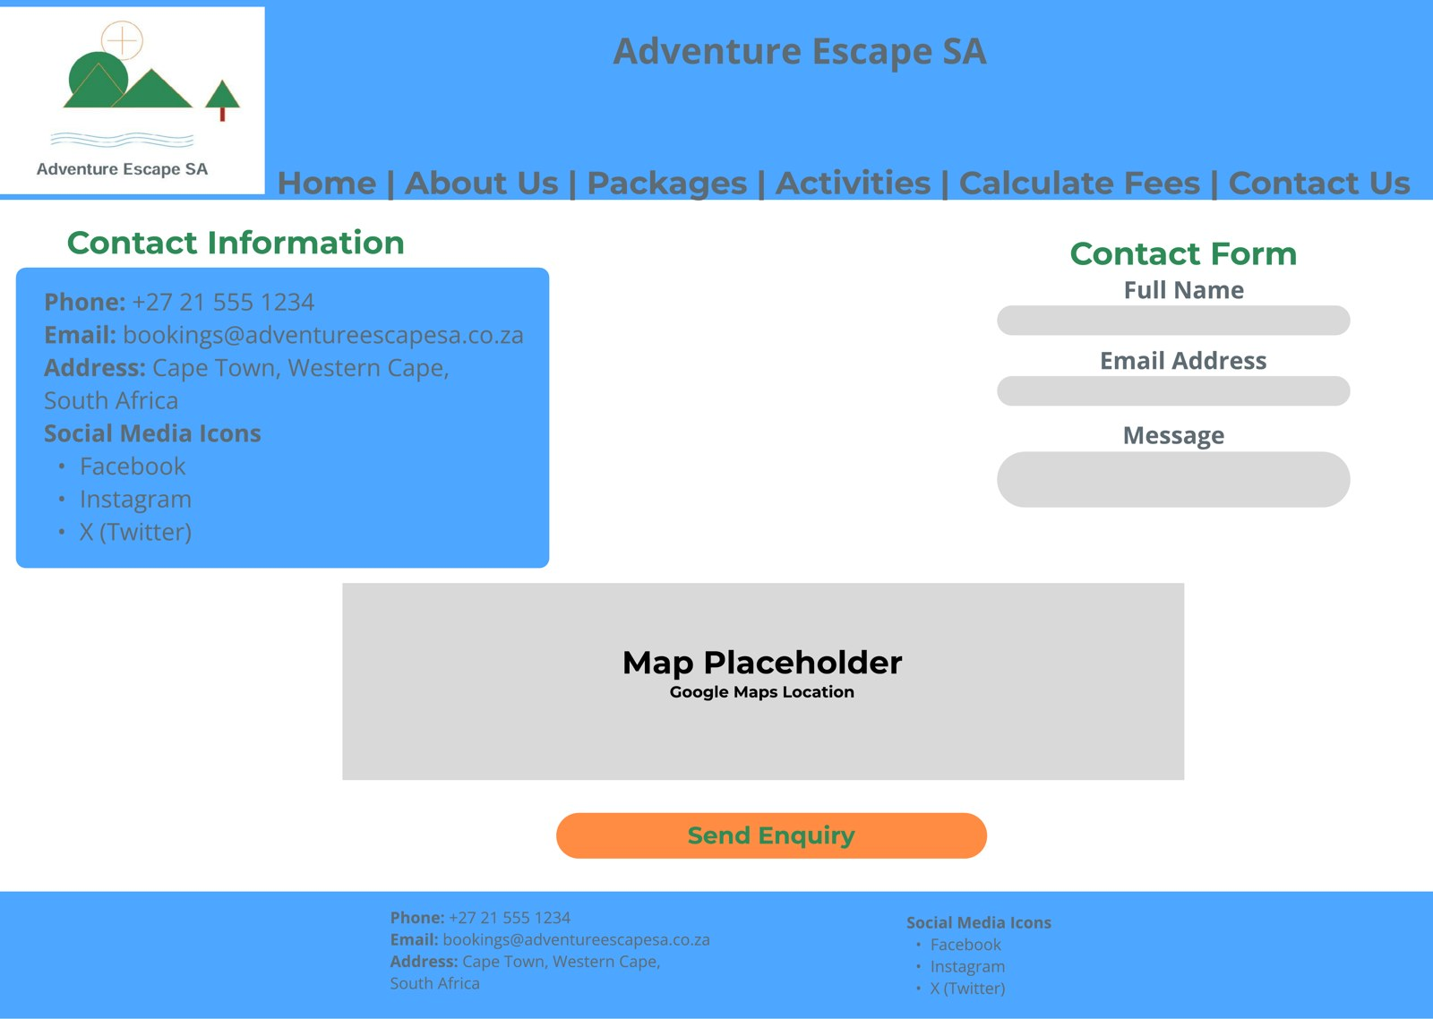
Wireframes: Website
Home
About Us
Overview
Package Detail
Calculate Fees
Contact Us
Notes:
These are the website wireframes for the same pages. The structure matches the app, so a customer who knows one already knows the other. On a wide screen we have more space, so the logo and full navigation menu run across the top of every page and the contact details sit in the footer. Images and text are placed side by side instead of stacked. The Overview page shows all seven adventures in one row of cards, and the Calculate Fees page fits customer details, adventure selection and booking discounts into three columns, with the quote summary underneath. We kept the same colours and orange action buttons as the app. Planning these wireframes first meant the developers could build the website and the app to match exactly. Thank you.

Slide 25
Conclusion
The Adventure Escape SA solution successfully satisfies the client's requirements by providing both a mobile application and website that enable users to explore adventure packages, calculate fees, and submit booking enquiries efficiently. The system improves customer accessibility, enhances the organisation's online presence, and creates a modern digital platform for future growth.

