Slide 1
IBSU LUNCH ORDERING SYSTEM
IT0206 Advanced Computer Programming 2C • Assessment 2C
Team Members
Johannesh Pesh -- ST240723
Gunther Darius — ST240158

Slide 2
1. Problem, Aim and Objectives
Problem: manual cafeteria ordering can make menu, stock and order tracking inefficient.
Aim: deliver a persistent, role-based Python lunch-ordering application.
Objectives: authentication, roles, CRUD, transactional ordering, search, reporting, file handling, logging and testing.

Slide 3
2. Requirements and Scope
Menu-driven console application with authenticated role-based access.
SQLite persistence with six related tables.
Core workflow: menu management → order → status → reporting.
Out of scope: online payments, mobile app and cloud production deployment.

Slide 4
3. Technology Stack
Python 3.11+ • SQLite • pytest • pytest-cov
pandas for data processing and reporting
matplotlib for user-facing visualisation
requests for a genuine external HTTP interaction
tabulate for console presentation

Slide 5
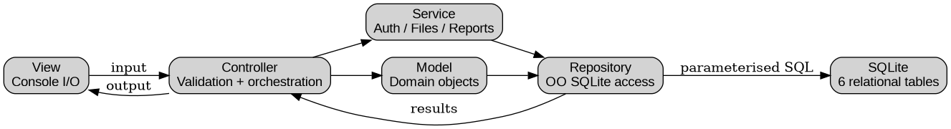
4. MVC Architecture
View → Controller → Service/Model → Repository → SQLite
Views handle console I/O; controllers validate and orchestrate.
Services handle authentication, files and reports.
Repositories isolate SQL and transactions.

Slide 6
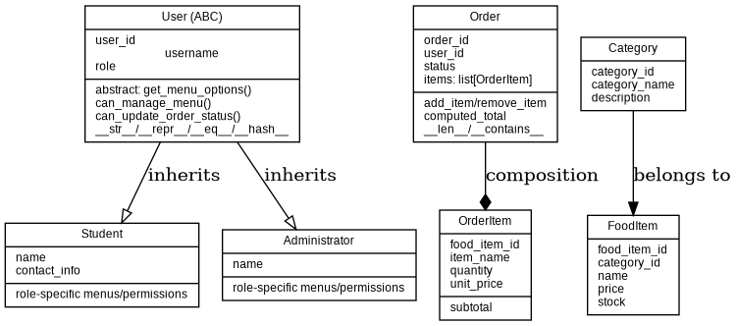
5. Object-Oriented Design
42 classes across models, repositories, services, controllers, views and exceptions.
User is an abstract base class; Student and Administrator inherit from it.
Polymorphism and overriding provide role-specific permissions.
Order composes OrderItem objects; properties and dunder methods are demonstrated.

Slide 7
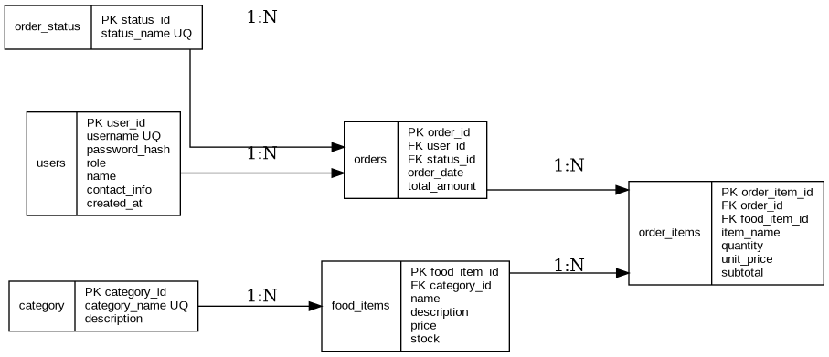
6. Database Design
users, category, food_items, orders, order_items, order_status
Foreign keys enforce relationships and referential integrity.
CRUD uses parameterised SQL.
Order creation, cancellation and deletion use transactions.

Slide 8
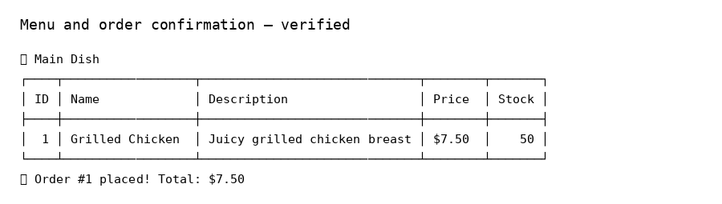
7. Student Workflow
Login as student / student123.
Browse menu and check stock.
Place an order and confirm total.
View order history.
Cancel Pending/Confirmed order and demonstrate stock restoration.

Slide 9
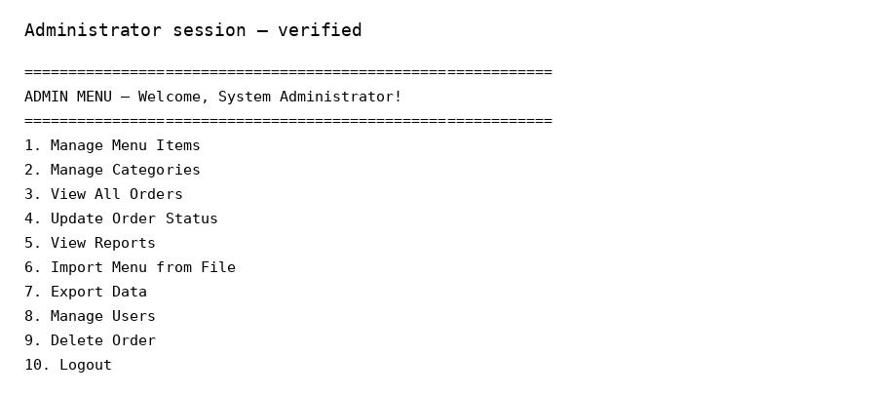
8. Administrator Workflow
Login as admin / admin123.
Manage menu items and categories.
View, update and delete orders.
Generate reports, charts and exports.
Demonstrate role-based access.

Slide 10
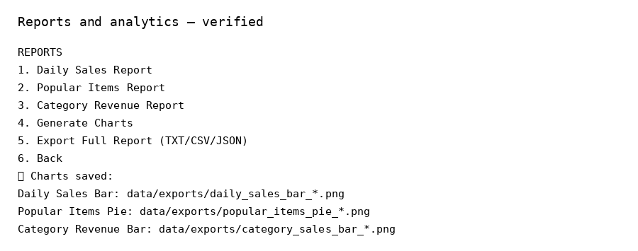
9. Reporting, Files and API
CSV/JSON import supports menu-data interoperability.
TXT/CSV/JSON report exports are generated.
pandas creates report DataFrames.
matplotlib creates three report charts.
requests fetches a daily quote with an offline fallback.

Slide 11
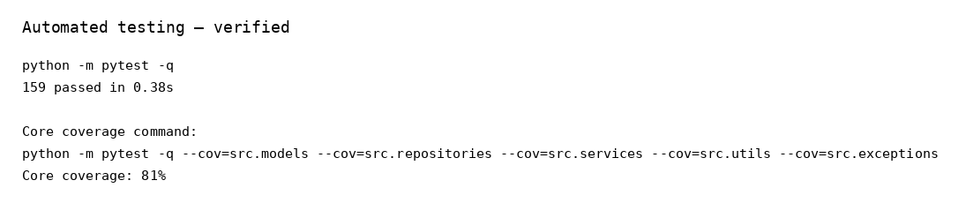
10. Testing
160 automated tests passed with 0 failures.
81% coverage across core models, repositories, services, utilities and exceptions.
Negative-path tests cover invalid input, missing records, stock limits and invalid states.
Manual end-to-end tests verify interactive workflows.

Slide 12
11. Professional and Ethical Practice
Application-wide logging and custom exception hierarchy.
Parameterised SQL and role-based permissions.
Privacy and production password-hashing limitation documented.
AI assistance disclosed transparently.
UAT requires genuine tester sign-off before submission.

Slide 13
12. Fixes Completed During Final Review
Reconciled standalone schema.sql with the live application schema.
Fixed runtime repository dependency wiring so cancellation restores stock.
Corrected README/user-manual launch commands and paths.
Added public-method docstrings and schema/validation regression tests.
Added explicit order deletion for CRUD completeness.

Slide 14
13. Limitations and Future Work
Use Argon2/bcrypt for production password storage.
Build a GUI/web presentation layer while preserving MVC services/models.
Add online payment and notifications.
Consider cloud database/deployment and richer analytics.

Slide 15
14. Conclusion and Q&A
The system demonstrates delivery from requirements and design through implementation, database integration, testing, documentation and presentation.
Core workflows are verified and the assessment package is prepared.
Questions?

