Slide 1
Taylor Swift – A Data-Driven Musical Journey
Exploring Trends, Popularity, and Musical Patterns
Meet our team behind the data insights:
Abhijeet : abhijeet.k@adypu.edu.in
Sahil Singh : sahil.k@adypu.edu.in
Ashish Singh Naruka : ashish.naruka@adypu.edu.in
Aman Kumar : aman.kumar01@adypu.edu.in
aa
Notes:
1

Slide 2

Key Findings: A Statistical Overview
Global Success
200M+ album sales worldwide with 11 albums hitting #1.
Streaming Domination
26.1 billion Spotify streams in 2023, ranked #1 globally.
Hit Single
"Anti-Hero" topped Billboard for 8 weeks straight.
Social Media Reach
Over 550 million followers across major platforms.
Notes:
2

Slide 3
Album Evolution: Sales and Critical Reception
Early Years
Recent Success
Shift from country to pop by "1989" boosted sales and reviews.
"Folklore" & "Evermore" revived acclaim and sales.
Re-recordings under "Taylor's Version" have strong commercial success.
"Reputation" saw sales decline and mixed reviews.
Notes:
3

Slide 4

Song Structure and Lyrical Analysis
Common Words
"Love," "time," "never," and "always" feature most often.
Song Length
Average track duration is about 3 minutes 45 seconds.
Lyrical Themes
Romance, heartbreak, revenge, and self-discovery dominate lyrics.
Lyrical Density
Early albums have denser lyrics compared to later releases.
Notes:
4

Slide 5
Musical Patterns and Genre Exploration
Genre Shift
Musical Analysis
Evolution spans country, pop, alternative, and folk genres.
Key signatures and tempo vary widely across albums.
Instrument use shifted from acoustic dominance to electronic blends.
Collaborations influenced style and expanded listener reach.
Notes:
5

Slide 6
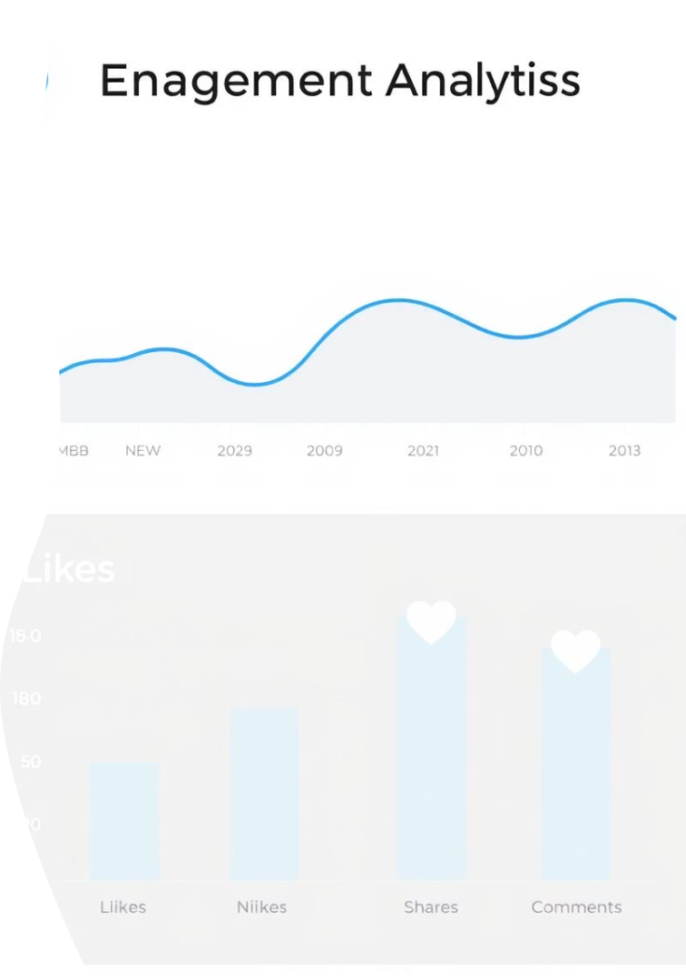
Social Media and Fan Engagement
1
Follower Growth
Major releases and events cause follower count spikes.
2
Engagement Rates
Likes, comments, and shares quantify fan interaction.
3
Sentiment Trends
Public opinion shifts track with career moments.
4
Hashtag Usage
Popular hashtags reveal trending themes in fanbase.
Notes:
6

Slide 7
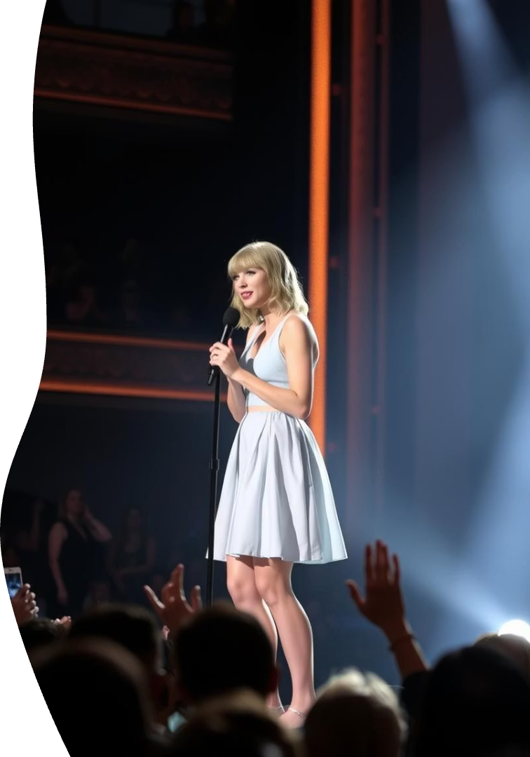




Cultural Impact and Influence
Record Breaking
Awards
Philanthropy
Multiple Grammy wins and MTV VMA accolades.
Holds multiple Billboard Hot 100 records.
Advocate and donor for diverse social causes.
The Eras Tour
Sparks major economic boosts in tour cities.
Notes:
7

Slide 8
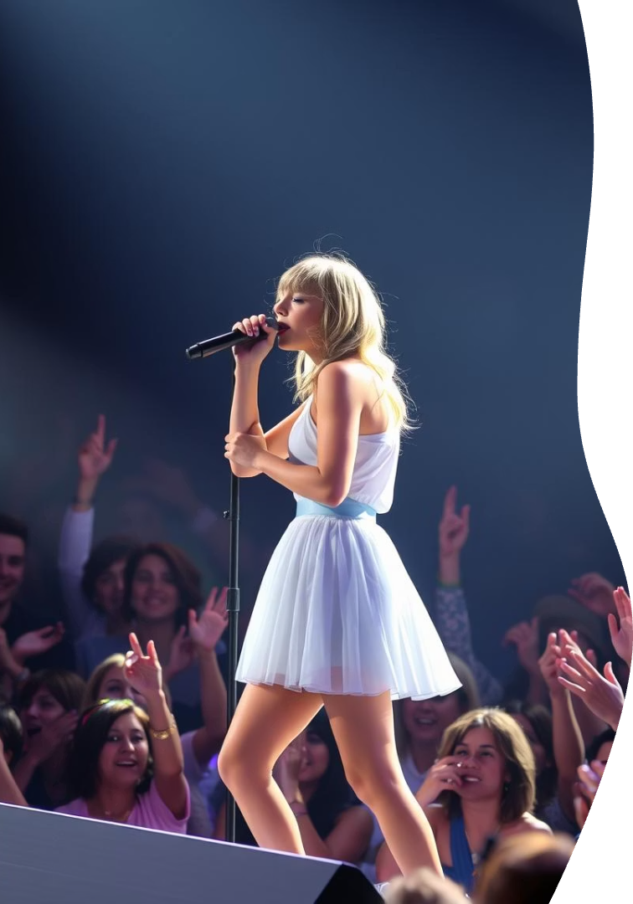
Conclusion: The Enduring Legacy of Taylor Swift
1
Data Insights
Comprehensive analysis of career trends and achievements.
2
Musical Evolution
Continuous stylistic growth and fan engagement deepen connection.
3
Cultural Impact
Influences music industry and societal trends widely.
4
Future Outlook
Expected to evolve further and sustain her influence.
Notes:
8

