Slide 1

Using Google Searches to Predict Restaurant Guests
Anthony Lusardi

Slide 2
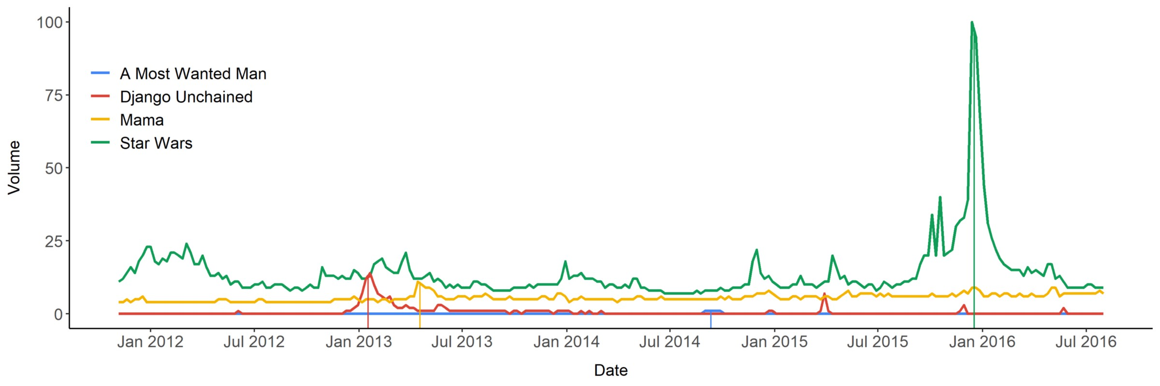
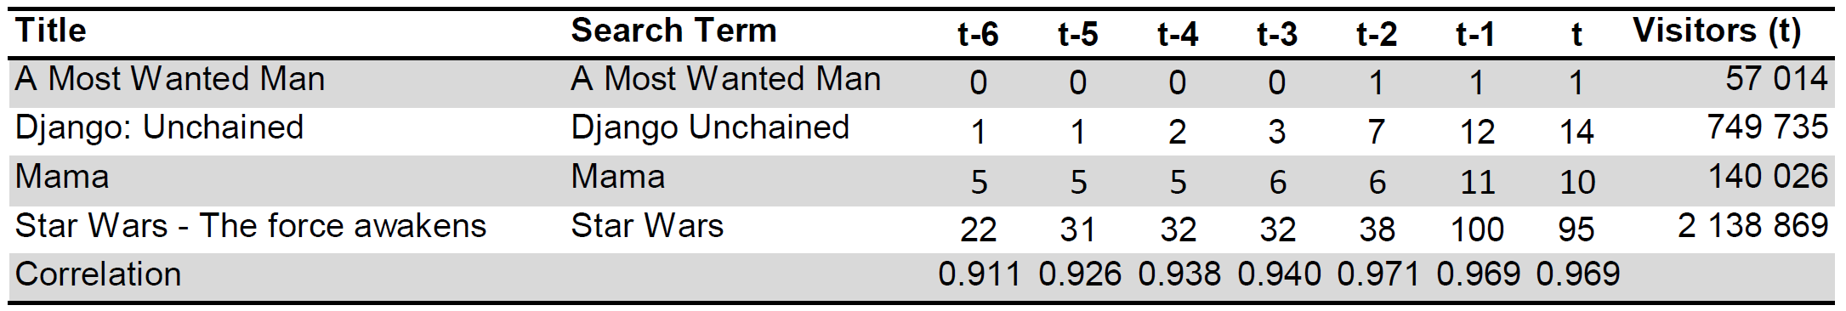
Previous research

Slide 3
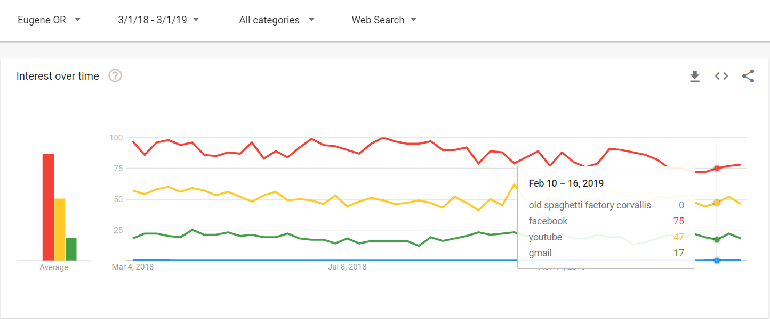
My interpretation

Slide 4
Process and analysis How is it done?
Anchor terms-The idea behind this is to create a relation for every search term to one single value

Slide 5
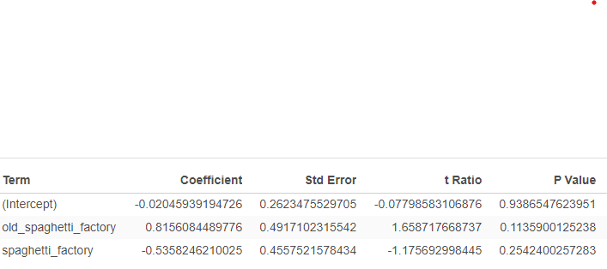

Results

Slide 6
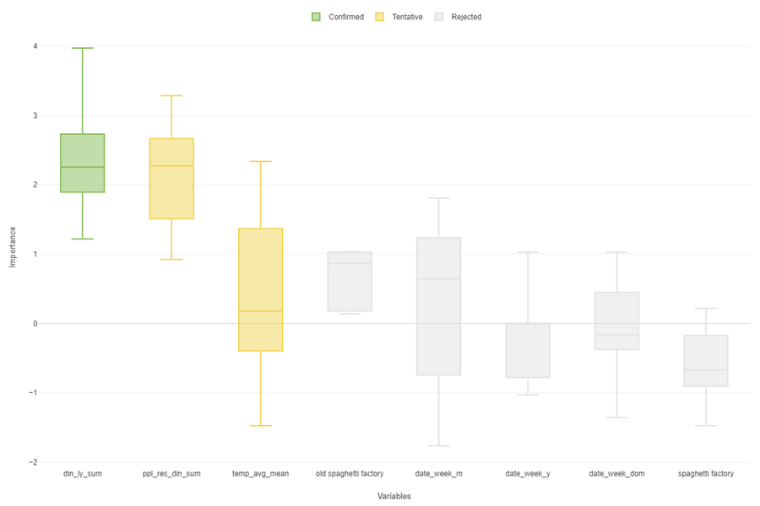
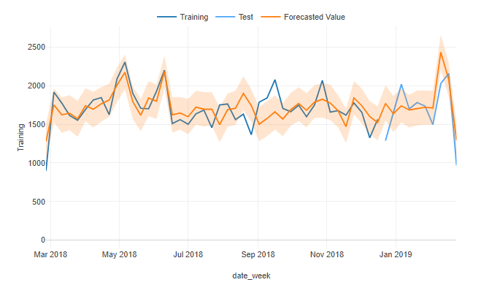
Further Research

