Slide 1
STA220
Health data and questionnaires
Anna Grimby ekman and erik Bülow

Slide 2

Anna Grimby-Ekman
Professor in health science statistics
PI for the Biostatistics research group
PI for Gothenburg Chronic Research Group (GothPain)
Examiner for the course

Slide 3
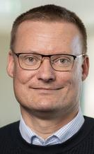
Erik Bülow
Statistician (PhD in basic medicine)
Research in register epidemiology
Background in quality register organisations
Course responsible teacher

Slide 4

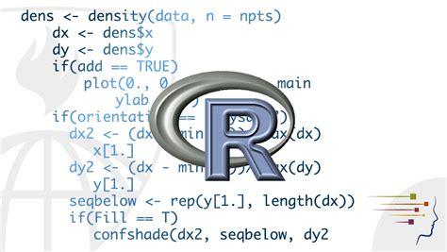
Your background
Familiar to statistical/mathematical notation and concepts
Single use program R-atuthours

Slide 5
We now add
Questionaire data (analysis, interpretation …)
Health care registers as data sources
Tooling for more complex data and analysis projects
Ethics and legals concerning sensitive data

Slide 6
Schedule
Weeks | Teacher | What
4-5 | AGE+EB | Introductions to both parts
5-8* | AGE | In-depth questionaire part
9-12* | EB | In-depth register and tooling part
13 | AGE+EB | Recap and exam (2026-03-25)
*With some sesions moved between
Always Mondays and Wednesdays
Often lectures before lunch and seminairs/computer sessions in the afternoon

Slide 7
Please note!
Complete schedule in Canvas
Not all schedueled activities include presense of a teacher
We have most activites at HVC but some at Medecinaregatan!
Bring your own computer to the computer sessions

Slide 8
Activities
Lectures
Seminairs (most are mandatory!)
Computer sessions
  Some are mandatory
  Some of them concern a mini-project
Self-studies
Quizes (Canvas)
DISA-exam (mandatory)

Slide 9
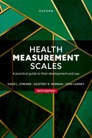


Cairney, J., Norman, G. R., Streiner, D. L. (2024, 6:e utgåvan).
Health Measurement Scales, A practical guide to their development and use.
Oxford University Press. ISBN: 9780192869487.
Nguyen, A., (2022).
Hands-On Healthcare Data.
O’Reilly Media.
Mair, P., (2018).
Modern Psychometrics with R. Use R!
Springer International Publishing AG. ISBN: 9783319931753.

Slide 10
Additional resources
We will use some additional software (open source and free)
Additional reading material (articles and web links) will be provided

Slide 11
Examination
Written DISA exam: 4 credits
Seminairs and computer sessions
  1.5 credits for AGEs part
  2 credits for EBs part

Slide 12
AI-policy
Use responsibly for self-studies and some computer exercises but be transparant if you do …
When working with sensitive data, technical restrictions often applies to secure working environment. Don’t get dependent on tools you can not use in your future work!

Slide 13
Canvas
https://canvas.gu.se/courses/97348
Where you will also find links to schedule etc.
Navigate the modules!

