Slide 1




Extracting Intersection Coordinates Between Images
We developed a novel method to extract the pixel coordinates of the geographical intersection between two images, OHRC and TMC2, based on their known intersection coordinates. This allows us to precisely cut out the common region of interest from the TMC2 image.
by Ankur Rathore

Slide 2




Algorithm for Intersection Extraction
1. Obtain Intersection Coordinates
Use the known geographical intersection coordinates between the OHRC and TMC2 images.
2. Convert to Pixel Coordinates
Develop a mathematical model to convert the geographical coordinates to pixel locations in each image.
3. Extract Intersection Region
Use the computed pixel coordinates to precisely crop the common region of interest from the TMC2 image.
This algorithm allows us to accurately isolate the shared area between the two images, enabling further analysis and processing.

Slide 3
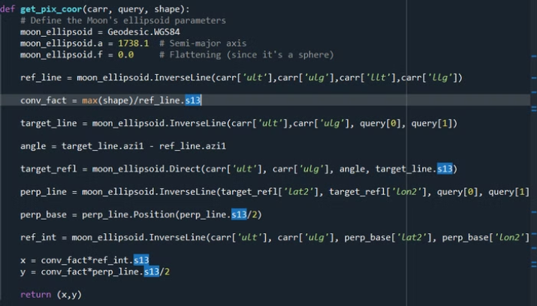
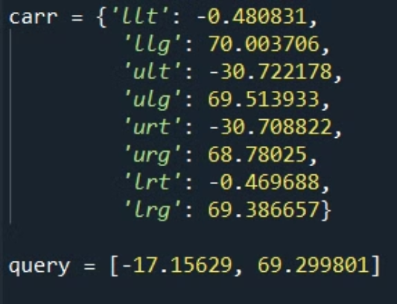
Algorithm Explained
The mathematical model uses reflection geometry on lunar geodesics to calculate the coordinates of the query within the image and then use conversion factors to convert the geographical coordinates into pixel coordinates.

