Slide 1
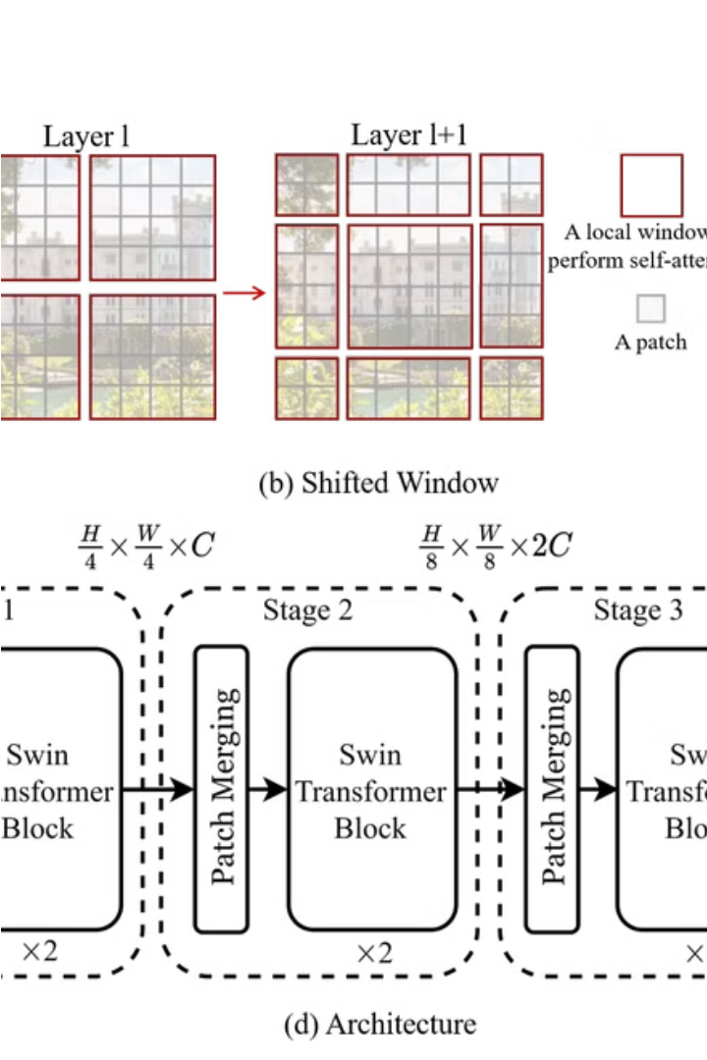

Introduction to SWIN Transformers
SWIN Transformers are a powerful deep learning model that have revolutionized image recognition and reconstruction tasks. They leverage the strengths of both convolutional neural networks and transformers to capture both local and global image features.

Slide 2
Architecture of SWIN Transformers
Hierarchical Structure
Shifted Windows
Self-Attention
SWIN Transformers have a multi-scale hierarchical design, allowing them to efficiently process images of varying resolutions.
The model uses a shifted window approach to capture both local and global contextual information.
SWIN Transformers leverage self-attention mechanisms to model long-range dependencies in the image.

Slide 3
Advantages of SWIN Transformers over CNNs
1
Improved Accuracy
2
Efficient Computation
3
Flexibility
SWIN Transformers can be easily adapted to different image sizes and resolutions, making them versatile for various applications.
SWIN Transformers demonstrate state-of-the-art performance on various image recognition benchmarks.
The hierarchical design and shifted window approach make SWIN Transformers computationally efficient compared to CNNs.

Slide 4
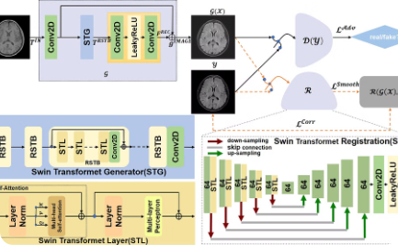
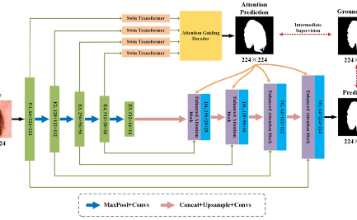
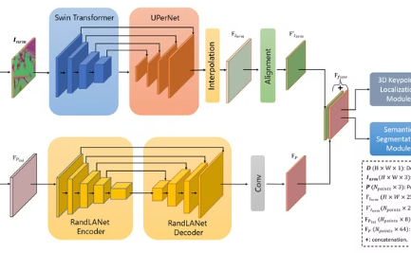
Applications of SWIN Transformers in Image Reconstruction
Super-Resolution
Semantic Segmentation
Depth Estimation
SWIN Transformers excel at upscaling low-resolution images to high-quality, high-resolution outputs.
SWIN Transformers can estimate the depth information of an image, enabling 3D reconstruction and augmented reality applications.
SWIN Transformers can accurately segment images into semantically meaningful regions, enabling advanced computer vision tasks.

Slide 5
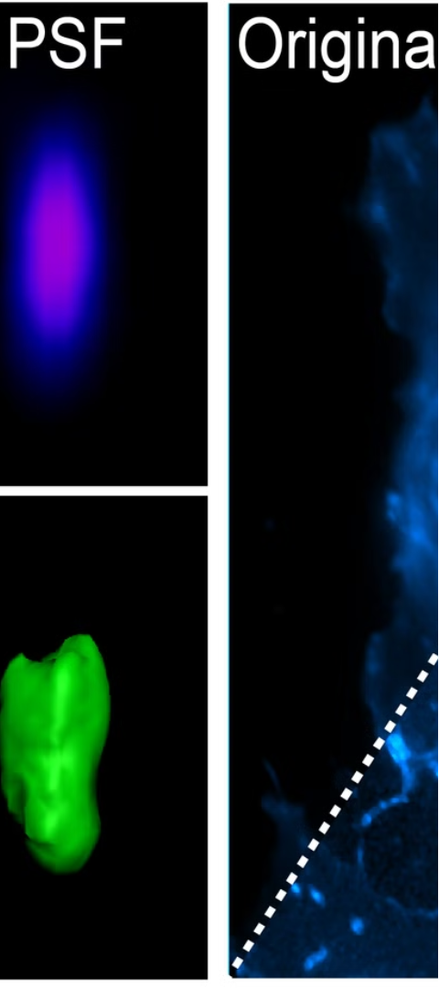
Deconvolutions: Concept and Importance
Upsampling
Inverse of Convolution
Deconvolutions are a type of upsampling operation that can increase the spatial resolution of feature maps in neural networks.
Deconvolutions are the inverse of convolution operations, allowing for the reconstruction of input-like representations from feature maps.
Image Reconstruction
Deconvolutions play a crucial role in image reconstruction tasks, such as super-resolution, segmentation, and depth estimation.

Slide 6
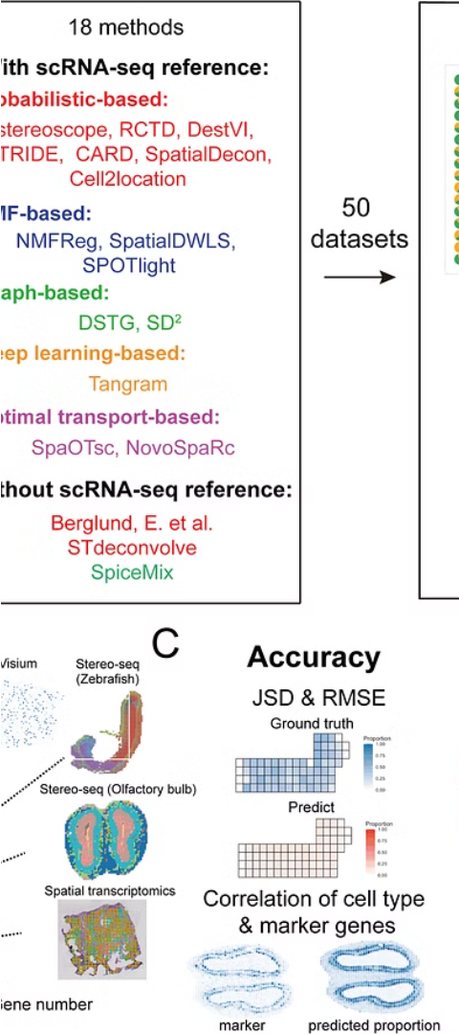
Deconvolution Techniques for Image Reconstruction
1
Transposed Convolution
This is the most common deconvolution technique, which performs a learnable upsampling operation.
2
Resizing + Convolution
This approach first upsamples the feature maps using a resize operation, followed by a convolution layer.
3
Subpixel Convolution
This technique rearranges the output channels of a convolution layer to create an upsampled feature map.

Slide 7
Comparison of SWIN Transformers and Deconvolution Methods
SWIN Transformers
Deconvolution Methods
Synergy
Leverage self-attention mechanisms and a hierarchical design to capture both local and global image features.
SWIN Transformers and deconvolution techniques can be combined to achieve state-of-the-art performance in image reconstruction tasks.
Perform upsampling and reconstruction of feature maps to restore high-resolution image details.

Slide 8
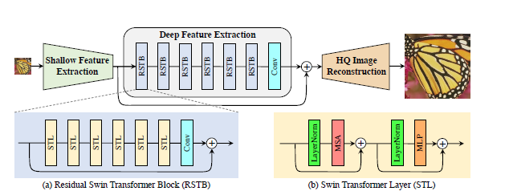
Pipeline of the Models used and tested
We have also used various loss functions such as SSIM loss along with Perceptual loss and L1, MSE losses. On pretrained models with fine tuning we were able to achieve till 0.3 loss and from scratch training we were able to achieve 1.03 loss.

