Slide 1
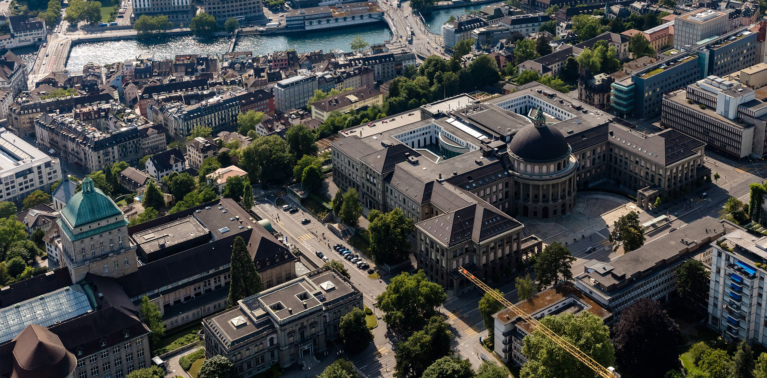
STACK for Chemistry
Dr. Jan Cvengros,
Melanie Brandl,
Alexander Pitzer

Slide 3
What STACK needs for Mathematics
What STACK needs for
Databases
Ra
Data Generation
Chemistry Functions
CAS + Feedback
Data Analysis

Slide 4
What STACK needs for Chemistry
What STACK needs for
Randomization
Databases
Data Generation
CAS + Feedback
C
Data Analysis
STACK needs chemistry-specific data tools for efficient question generation
First Steps: Calculating the Molar Mass of Simple Molecules
CLL:[
[["H",2],["O",1]], /* Water */
[["C",1],["O",2]], /* Carbon dioxide */
];
/* Choose one of these. */
CL:rand(CLL);
/* The CL list written as a single string. */
CN:apply(sconcat, map(lambda([ex], if is(second(ex)=1) then first(ex) else sconcat(first(ex),string(second(ex)))), CL));
/* Calculate the final answer. */
ta1:stackunits(dispsf(apply("+",map(lambda([ex],second(ex)*chem_data(first(ex),"AtomicMass")), CL)),3), chem_units("AtomicMass"));
/* Create a table of atomic masses of the elements used. */
/* Get unique elements in the formula CL. */
tt:setify(map(first, CL));
/* Make a list of list of values. */
tt:map(lambda([ex], [ex, dispsf(chem_data(ex,"AtomicMass"),3)]), listify(tt));
tt:apply(table, append([["Element", "Atomic Mass"]], tt));
Chris Sangwin‘s implementation showed that chemistry databases can be utilized

Slide 5
First Steps: Automated Molar Mass Calculation
What STACK needs for Chemistry
What STACK needs for
Randomization
Databases
Data Generation
CAS + Feedback
Chemistry Functions
CAS + Feedback
Chemistry Functions
Data Analysis
STACK needs chemistry-specific data tools for efficient question generation
STACK needs chemistry-specific data tools for efficient question generation
CLL:[
[["H",2],["O",1]], /* Water */
[["C",1],["O",2]], /* Carbon dioxide */
];
/* Choose one of these. */
CL:rand(CLL);
/* The CL list written as a single string. */
CN:apply(sconcat, map(lambda([ex], if is(second(ex)=1) then first(ex) else sconcat(first(ex),string(second(ex)))), CL));
/* Calculate the final answer. */
ta1:stackunits(dispsf(apply("+",map(lambda([ex],second(ex)*chem_data(first(ex),"AtomicMass")), CL)),3), chem_units("AtomicMass"));
/* Create a table of atomic masses of the elements used. */
/* Get unique elements in the formula CL. */
tt:setify(map(first, CL));
/* Make a list of list of values. */
tt:map(lambda([ex], [ex, dispsf(chem_data(ex,"AtomicMass"),3)]), listify(tt));
tt:apply(table, append([["Element", "Atomic Mass"]], tt));
Chris Sangwin showed that databases can power automated chemistry questions

Slide 6
First Steps: Automated Molar Mass Calculation
What STACK needs for Chemistry
What STACK needs for
Core Components of a STACK Chemistry Module
Chemical Databases
%_CHEM_ELEMENTS: [
["H", [1, "Hydrogen", 1, 1, 1, 1.01, "1s1", 2.20, 120, 13.598, 0.754, "+1, -1", "Gas", 13.81, 20.28, 0.00008988, "Nonmetal", 1766]
], ... ]
Randomization
Databases
Data Generation
Data Retrieval
Functions
chem_electron_config(element) := block([config_str],
config_str: chem_data(element, "ElectronConfiguration"),
if is(config_str = false) then return(false),
chem_electron_config_formatter(config_str))$
CAS + Feedback
Chemistry Functions
Data Analysis
Data Manipulation
Functions
chem_molar_mass(formula) := block([parsed, total_mass, elem_data],
parsed: chem_parse_formula(formula),
...
return(stackunits(total_mass, g*mol^(-1))))$
STACK needs chemistry-specific data tools for efficient question generation
The module’s data handling enables intuitive & scalable question design
CLL:[
[["H",2],["O",1]], /* Water */
[["C",1],["O",2]], /* Carbon dioxide */
];
/* Choose one of these. */
CL:rand(CLL);
/* The CL list written as a single string. */
CN:apply(sconcat, map(lambda([ex], if is(second(ex)=1) then first(ex) else sconcat(first(ex),string(second(ex)))), CL));
/* Calculate the final answer. */
ta1:stackunits(dispsf(apply("+",map(lambda([ex],second(ex)*chem_data(first(ex),"AtomicMass")), CL)),3), chem_units("AtomicMass"));
/* Create a table of atomic masses of the elements used. */
/* Get unique elements in the formula CL. */
tt:setify(map(first, CL));
/* Make a list of list of values. */
tt:map(lambda([ex], [ex, dispsf(chem_data(ex,"AtomicMass"),3)]), listify(tt));
tt:apply(table, append([["Element", "Atomic Mass"]], tt));
Chris Sangwin showed that databases can power automated chemistry questions

Slide 7
Core Components of a STACK Chemistry Module
What STACK needs for Chemistry
What STACK needs for
Chemical Databases
%_CHEM_ELEMENTS: [
["H", [1, "Hydrogen", 1, 1, 1, 1.01, "1s1", 2.20, 120, 13.598, 0.754, "+1, -1", "Gas", 13.81, 20.28, 0.00008988, "Nonmetal", 1766]
], ... ]
Randomization
Databases
Data Generation
Data Retrieval
Functions
chem_electron_config(element) := block([config_str],
config_str: chem_data(element, "ElectronConfiguration"),
if is(config_str = false) then return(false),
chem_electron_config_formatter(config_str))$
CAS + Feedback
Chemistry Functions
Data Analysis
Data Manipulation
Functions
chem_molar_mass(formula) := block([parsed, total_mass, elem_data],
parsed: öööchem_parse_formula(formula),
...
return(stackunits(total_mass, g*mol^(-1))))$
STACK needs chemistry-specific data tools for efficient question generation
The module’s data handling enables intuitive & scalable question design

Slide 8
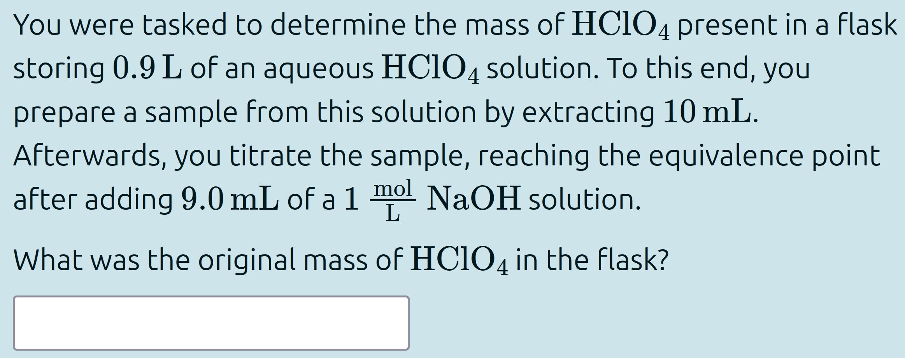
Combining Chemistry Modules
Acid-Base Module
PSE Module
Modules & native STACK features enable diverse, randomized chemistry questions

Slide 9
Constraints and Open Challenges
Error messages lack line references for stack_include()imports
Random functions are disabled, forcing full database imports per question
Support for complex molecular structures is limited

Slide 10
Just the Tip of the Iceberg...
Shown Today
PSE
Acid-Base
Work in Progress
Nuclide Chart
Thermodynamic Data
Reactions
Electrochemistry
Complex Formation
Solubility & Miscibility
Potential Additions
Material Properties
Crystal Structures
Biochemistry
Database modules enable efficient question generation across applied sciences

Slide 11
Prof. Dr. Beat Muster
Funktion des Präsentierenden
beat.muster@abcd.ethz.ch
ETH Zürich
D-CHAB HCI H102
Strasse Hausnummer 0000 Ort
www.abcd.ethz.ch

