Slide 1


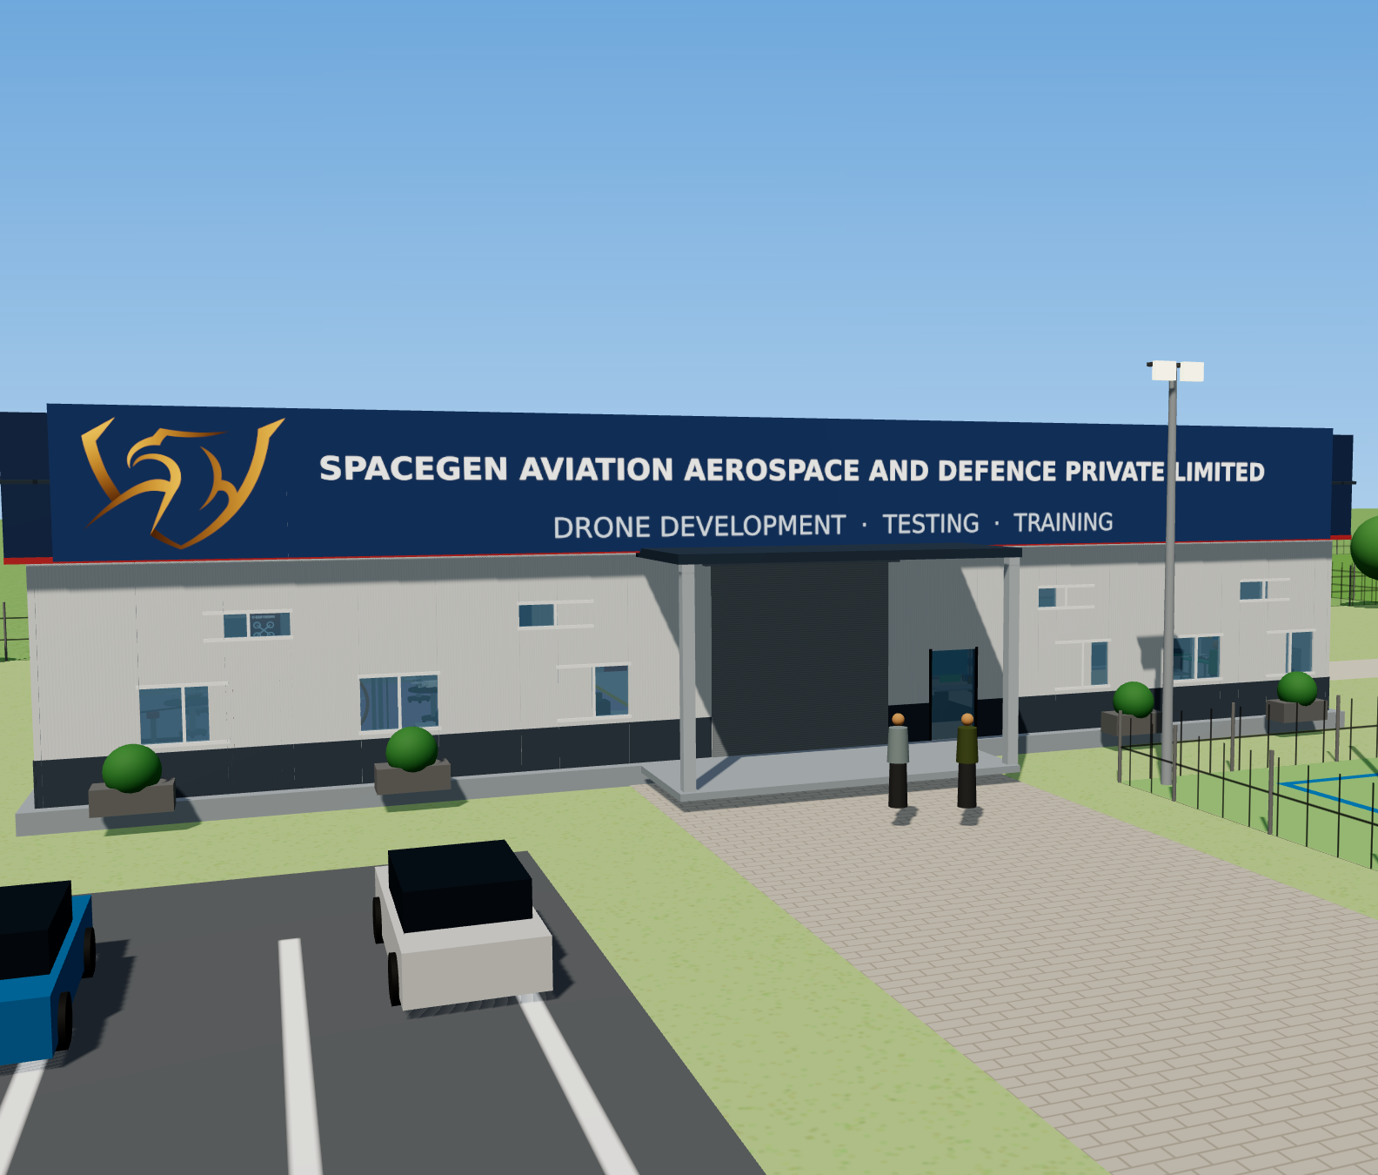
Securing India’s skies:
drones & counter-UAS growth plan
Co-developed as a joint venture with Metlonics
CHANDIGARH DRONE FACILITY · OCTOBER 2026
Market, budget allocation and 10-year sales plan – Defence · Paramilitary · Civil
SpaceGen Aviation Aerospace and Defence Private Limited · Hyderabad
Notes:
Open with the one-line story: India is buying drones and counter-drone systems faster than ever, and SpaceGen already has the products, the Army customers and the people to take a growing share.

Slide 2
A fast-growing market, and a company already selling into it
THE OPPORTUNITY AT A GLANCE
₹12,300 Cr
₹65,750 Cr
18+
India drone + counter-drone spend, FY 2026-27 (estimate)
Projected annual spend by FY 2036-37 – more than 5×
Army units already supplied, plus BSF and state police
₹21.8 → ₹140 Cr
23.0%
1.4% → 2.0%
Chandigarh facility sales, Year 1 to Year 10 (Base case)
10-year Chandigarh sales CAGR (Base case)
Share of the northern-sector segment the Chandigarh facility addresses
Year 1 = FY 2027-28 · ₹ crore, excluding GST · SpaceGen Aviation Aerospace and Defence Private Limited · Confidential
2
Notes:
The market estimate is triangulated from published reports and MoD/MHA budgets. Even at Year 10 SpaceGen needs only about 1.4% of its addressable segment to reach 371 crore.

Slide 3
Since Operation Sindoor, India is buying drones and C-UAS at record pace
WHY NOW
₹1,85,467 Cr
≈ ₹30,000 Cr
≈ ₹20,000 Cr
Defence modernisation budget FY27, +24.6%; 75% reserved for Indian industry
Emergency and fast-track buys incl. drones, loitering munitions, C-UAS, EW
Army plan for drones & surveillance; a further tactical-drone order of over ₹20,000 Cr expected
≈ ₹52,000 Cr
≈ 380
44,000+
DAC approvals (Jul 2026) incl. anti-drone and kamikaze drones – RFPs to follow
Infantry battalions with an ‘Ashni’ drone platoon; ~5,000 drones per command
DGCA remote-pilot certificates issued – training demand keeps rising
Sources: MP-IDSA, Indian Express, Reuters / DFI, Channel IAM, IANS, DGCA data (2026)
3

Slide 4
Defence and Home Affairs budgets, FY 2026-27
BUDGET ALLOCATION
Ministry of Defence (₹ crore)
Home Affairs – PMF (₹ crore)
Head | FY26 BE | FY27 BE | Change
Total MoD budget | 6,81,210 | 7,84,678 | +15.2%
Capital outlay | 1,80,000 | 2,19,306 | +21.8%
Modernisation | 1,48,839 | 1,85,467 | +24.6%
– for Indian industry | — | 1,39,100 | 75%
Services revenue | 3,11,732 | 3,65,479 | +17.2%
Head | FY26 RE | FY27 BE
Total MHA | 2,41,485 | 2,55,234
All CAPFs | 1,12,636 | 1,16,789
BSF | 29,568 | 29,568
Police modernisation | 3,280 | 4,061
Border infrastructure | 5,472 | 5,577
Border states add their own spend: Punjab sanctioned ₹51.4 Cr for 9 ‘Baaz Akh’ anti-drone systems from Chandigarh to Fazilka.
Sources: MP-IDSA (MoD BE 2026-27); PRS Legislative Research (MHA Demand for Grants 2026-27); PTI (Aug 2025)
4

Slide 5
Counter-drone is the fastest-growing slice – ≈38% a year in India
MARKET SIZE AND GROWTH
Market | Size | Forecast | CAGR | Source
India drone (UAV) market | US$0.47 bn (2025) | US$1.39 bn (2030) | 24.4% | MarketsandMarkets
India anti-drone market | US$197.5 mn (2025) | US$983.7 mn (2030) | 37.9% | MarketsandMarkets
– military & defence | US$163.8 mn | US$783.1 mn | 36.7% | MarketsandMarkets
– homeland security | US$13.6 mn | US$75.5 mn | 41.0% | MarketsandMarkets
India drones + anti-drones | ≈ US$1.27 bn (2026) | — | — | DroneIntelligence
India C-UAS addressable, 5 yrs | ≈ ₹12,000 Cr (≈1,200 systems) | — | ≈28% | Motilal Oswal / DD News
Indian drone industry turnover | ₹60 Cr (2021) → ₹3–4k Cr (2025) | ₹19–20k Cr | — | Drone Federation of India
Global military drones | US$34.9 bn (2026) | US$109.2 bn (2031) | 25.7% | MarketsandMarkets
Global counter-UAS | US$9.2 bn (2026) | US$29.7 bn (2031) | 26.5% | MarketsandMarkets
Published third-party estimates; definitions differ between sources
5

Slide 6
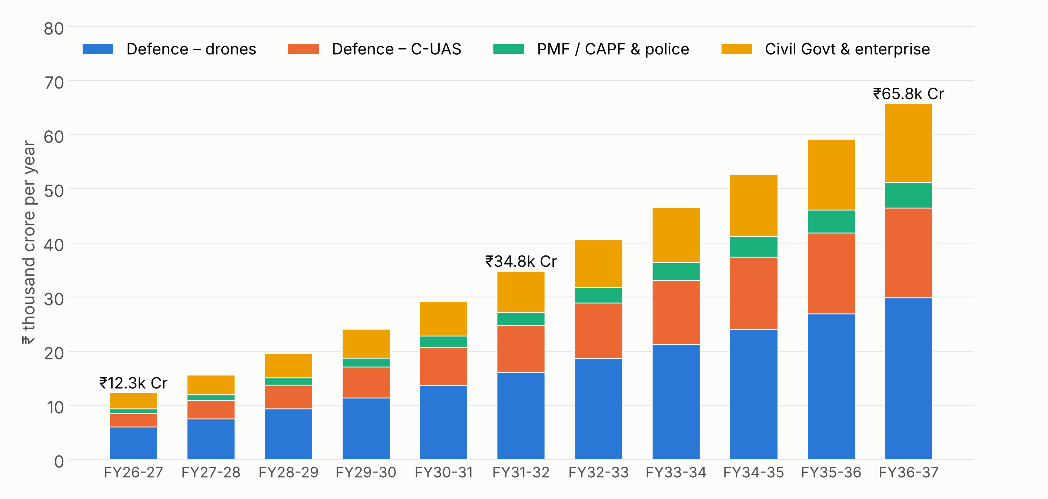
Annual spend grows from ₹12,300 Cr to ≈₹65,750 Cr in ten years
YEAR-ON-YEAR BUDGET BY DOMAIN
₹8,500 → ₹46,400 Cr
Defence drones + C-UAS
₹800 → ₹4,700 Cr
PMF / CAPF & police
₹3,000 → ₹14,600 Cr
Civil Govt & enterprise
SpaceGen estimate, triangulated from published market reports and MoD / MHA budgets – not an official allocation
6
Notes:
FY26-27 anchored on the ~US$1.27 bn combined market estimate and the post-Sindoor emergency buys; growth starts near the published CAGRs and tapers as the market matures. Defence drones plus C-UAS rise from about 4.6% to 9.7% of the modernisation budget.

Slide 7
Defence, PMF and Civil – & the part the Chandigarh facility addresses
YEAR-ON-YEAR BUDGET TABLE (₹ CRORE, ESTIMATE)
Year | Defence drones | Defence C-UAS | PMF & police | Civil | Total | YoY | Chandigarh addr.*
FY26-27 | 6,000 | 2,500 | 800 | 3,000 | 12,300 | — | 1,220
FY27-28 | 7,500 | 3,375 | 1,040 | 3,660 | 15,575 | 26.6% | 1,578
FY28-29 | 9,300 | 4,455 | 1,331 | 4,465 | 19,551 | 25.5% | 2,011
FY29-30 | 11,346 | 5,702 | 1,664 | 5,358 | 24,070 | 23.1% | 2,508
FY30-31 | 13,615 | 7,128 | 2,030 | 6,430 | 29,203 | 21.3% | 3,068
FY31-32 | 16,066 | 8,696 | 2,436 | 7,587 | 34,785 | 19.1% | 3,678
FY32-33 | 18,637 | 10,261 | 2,874 | 8,801 | 40,573 | 16.6% | 4,307
FY33-34 | 21,246 | 11,800 | 3,334 | 10,121 | 46,501 | 14.6% | 4,938
FY34-35 | 24,008 | 13,334 | 3,801 | 11,538 | 52,681 | 13.3% | 5,586
FY35-36 | 26,889 | 14,934 | 4,257 | 13,038 | 59,118 | 12.2% | 6,256
FY36-37 | 29,847 | 16,577 | 4,725 | 14,603 | 65,752 | 11.2% | 6,945
*Chandigarh-addressable = northern-sector part (30% / 30% / 25%) of SpaceGen’s addressable defence drone, C-UAS and PMF segments; civil is HQ-led
7

Slide 8
Lead with defence C-UAS and Army tactical drones
WHERE TO INVEST
Sector | Growth | Fit with SpaceGen products | Priority
Defence C-UAS (Army AD, IAF bases) | Very high (30%+) | Sentinel, Scout, Shield, MITYA, interceptors, net / foam drones | 1 – lead
Army tactical drones | High (20–25%) | FPV range, Aniketra / Samharak VTOL, transport drones, payloads | 1 – lead
Training & simulation | High | Chandigarh RPTO, Sky Commander simulator, FPV training | 2 – steady cash
PMF / CAPF / border-state police | High (25%+) | Tethered drones, handheld detectors, jammers, VTOL ISR | 2
Civil – roads, power, oil & gas | Medium-high (18–22%) | Fixed-wing / VTOL mapping, LiDAR, inspection; C-UAS for refineries | 3 – diversify
Exports (friendly countries) | Medium, lumpy | C-UAS, interceptors, FPV | 3 – from Year 3
SpaceGen Aviation Aerospace and Defence Private Limited · Confidential
8

Slide 9
A full drone and counter-drone range, already in service
SpaceGen TODAY · PRODUCT PORTFOLIO
FPV & strike
VTOL ISR
Interceptors
Counter-UAS
4" & 5" attack and grenade-dropper FPV, 150 km/h
ANIKETRA, SAMHARAK – 4 h, 60+ km, 2.5 kg payload
LAKSHYA, ARJUNA, ARJUN VYUHA, ARJUN KAVACH – up to 500+ km/h
Scout, Sentinel (35 km), Shield, MITYA GNSS spoofer, jammers
Capture
Tethered
Logistics & payloads
Training
Net-thrower and foam-spraying drones – intact for forensics
24×7 EO/IR surveillance at 120 m; 5 kg payload variant
70–150 kg transport drones, smoke launchers, portable helipad
Sky Commander fixed-wing simulator; FPV military training
Source: SpaceGen product brochures
9
Notes:
Key specs: MITYA covers 4 GNSS constellations, MIL-STD-461E, IP67. Sentinel detects to 35 km with a 450-model AI library, 400 MHz to 6 GHz, friend or foe classification.

Slide 10
Trusted by Army units – led by an Army drone instructor
TRACTION AND CREDENTIALS
18+ Army units and security forces supplied
CEO
20 Bihar
16 Bihar
13 Dogra
12 JAK LI
23 Rashtriya Rifles
Ex-Army; 3 years as instructor in drones, counter-drones and SDR at MCEME. Former students serve in Northern, Western and Central Commands.
68 Medium Regt
93 Medium Regt
94 Medium Regt
293 Medium Regt
173 Infantry Brigade
17 BSF
TN Police – CM Security
TN Police Intelligence
GITAM University
Ready to sell
Registered on GeM (ID 4RRO250013676721). Investor plan: ₹30 Cr Year-1 target at 40% gross margin, team 15 → 35.
SpaceGen Aviation Aerospace and Defence Private Limited · Confidential
10

Slide 11
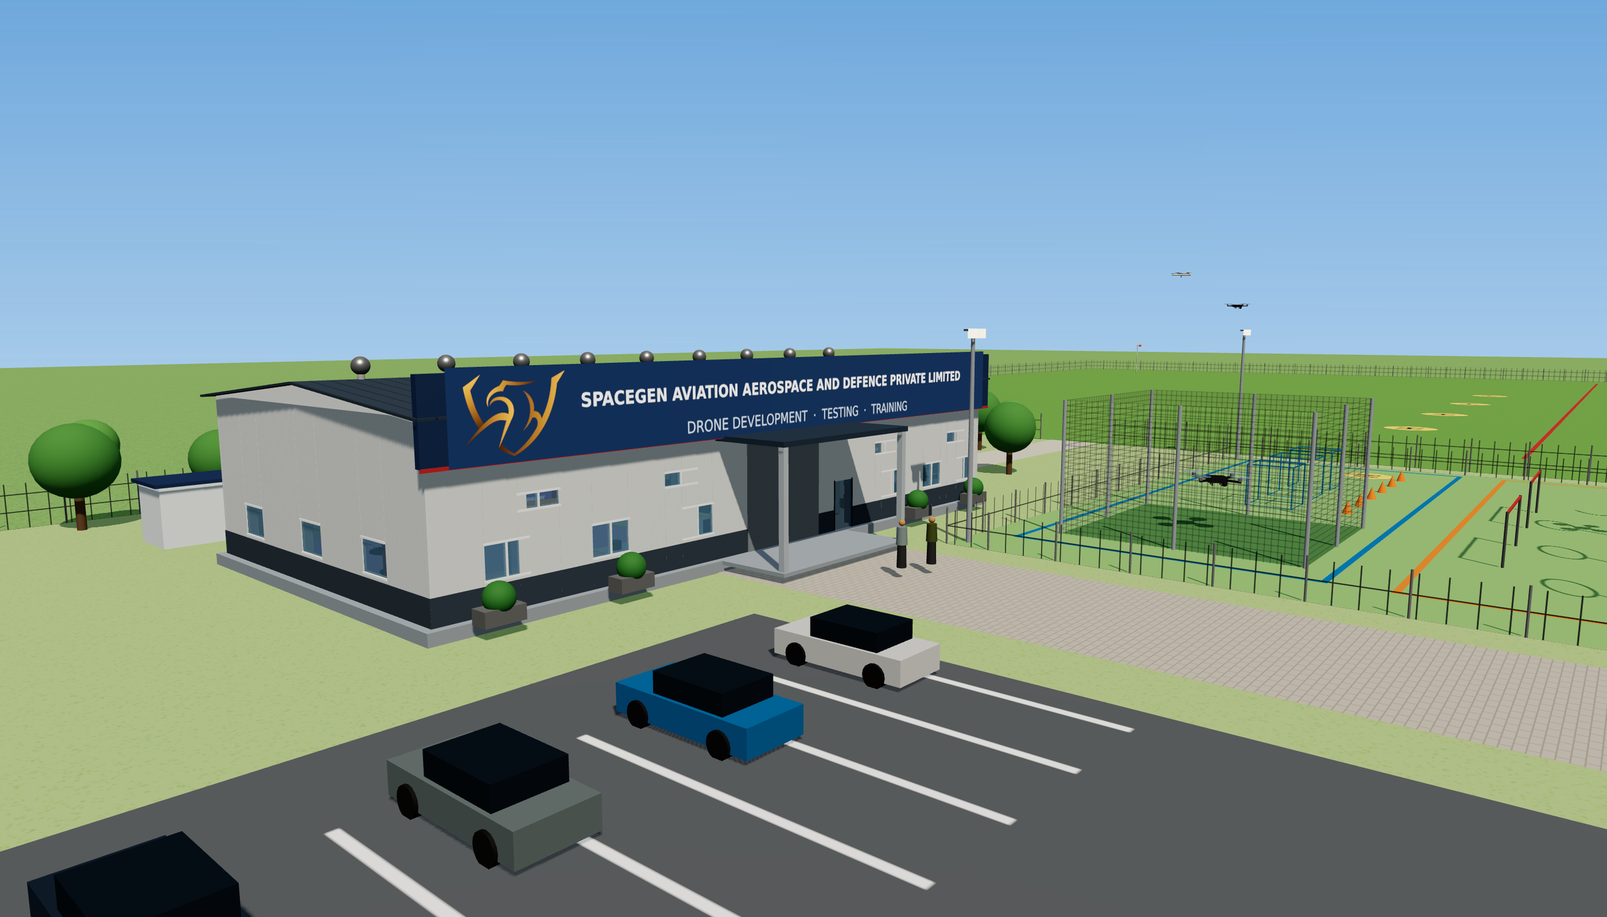
A demo, test and training base next to the most drone-active theatres
THE CHANDIGARH HUB
₹1.74 Cr
capital cost, incl. ₹15 lakh simulator zone
5,000 sq ft
technical hall: display, test lab, development
3-level course
obstacle course + 5-acre flying field + RPTO
Purpose: bring Northern & Western Command formations to see, fly and buy
3D impression of the Chandigarh facility · SpaceGen Aviation Aerospace and Defence Private Limited
11

Slide 12
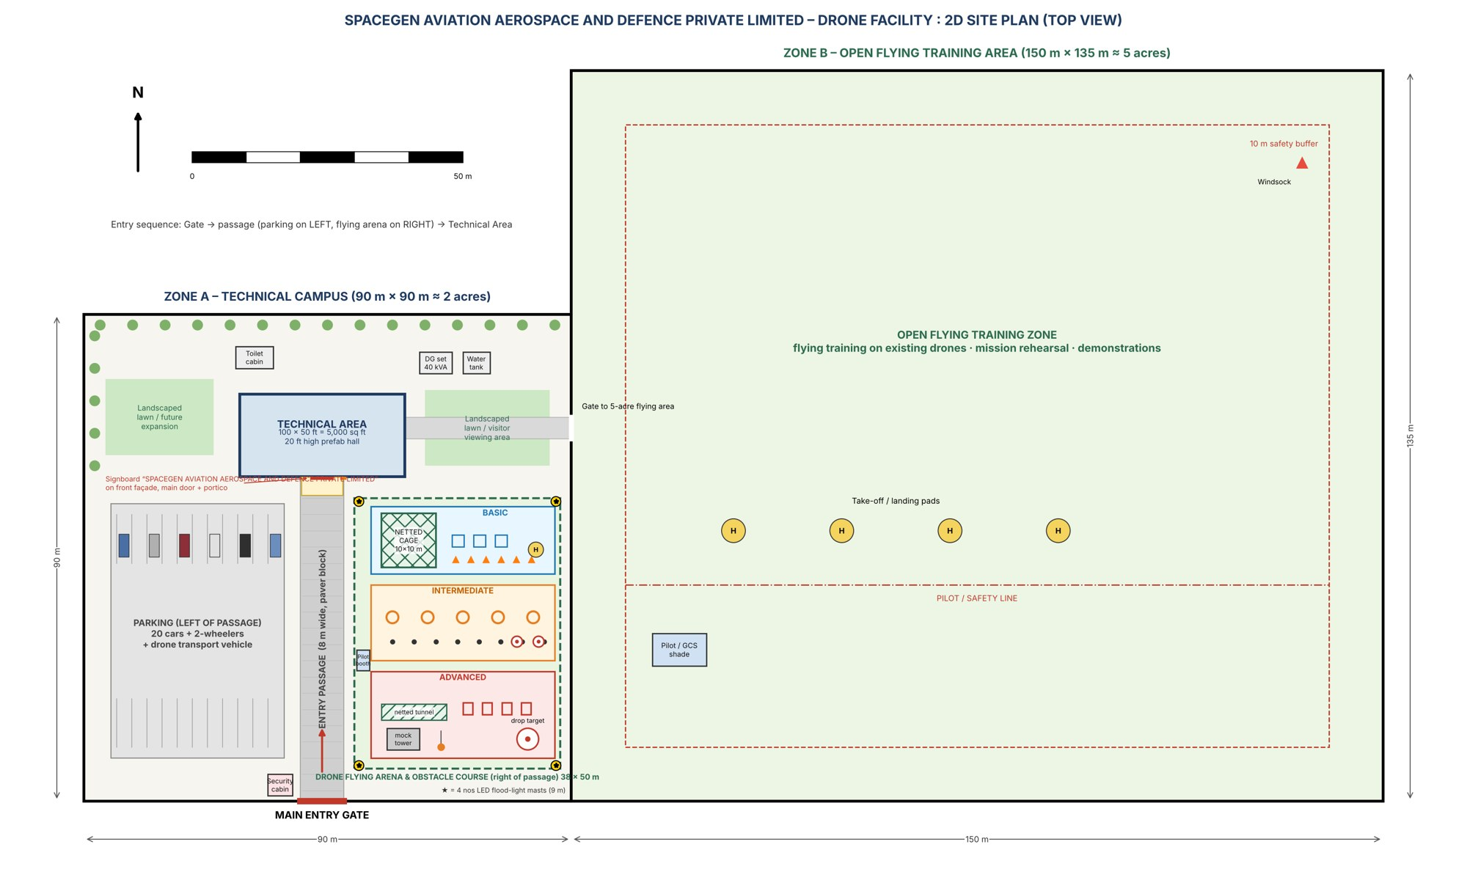
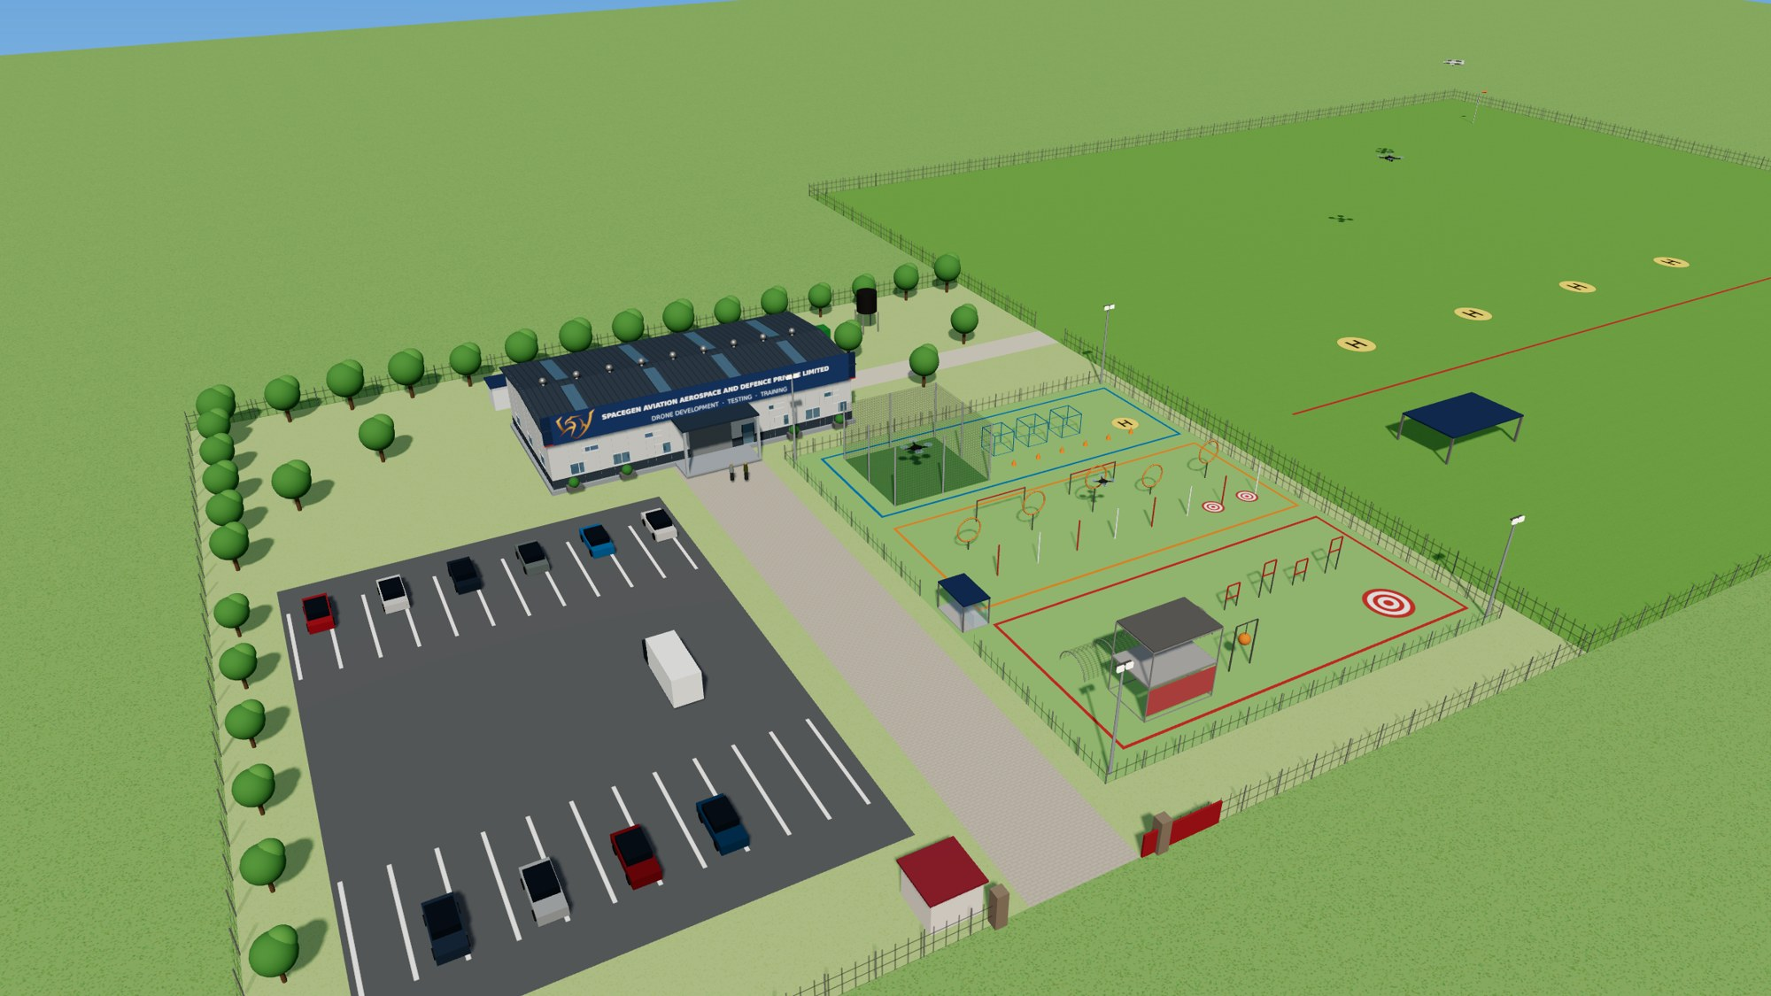
SITE LAYOUT · 2-ACRE CAMPUS + 5-ACRE FLYING FIELD
Gate → passage: parking on the left, flying arena on the right
Figure 1 – 2D site plan (top view)
Figure 3 – 3D aerial view of the technical campus
Figures 1 and 3 of the facility design report · SpaceGen Aviation Aerospace and Defence Private Limited
12

Slide 13
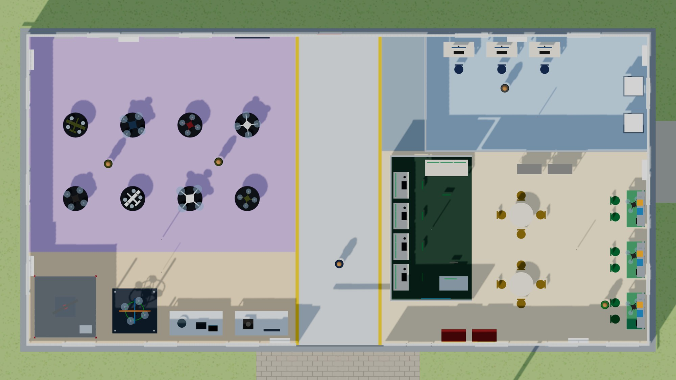
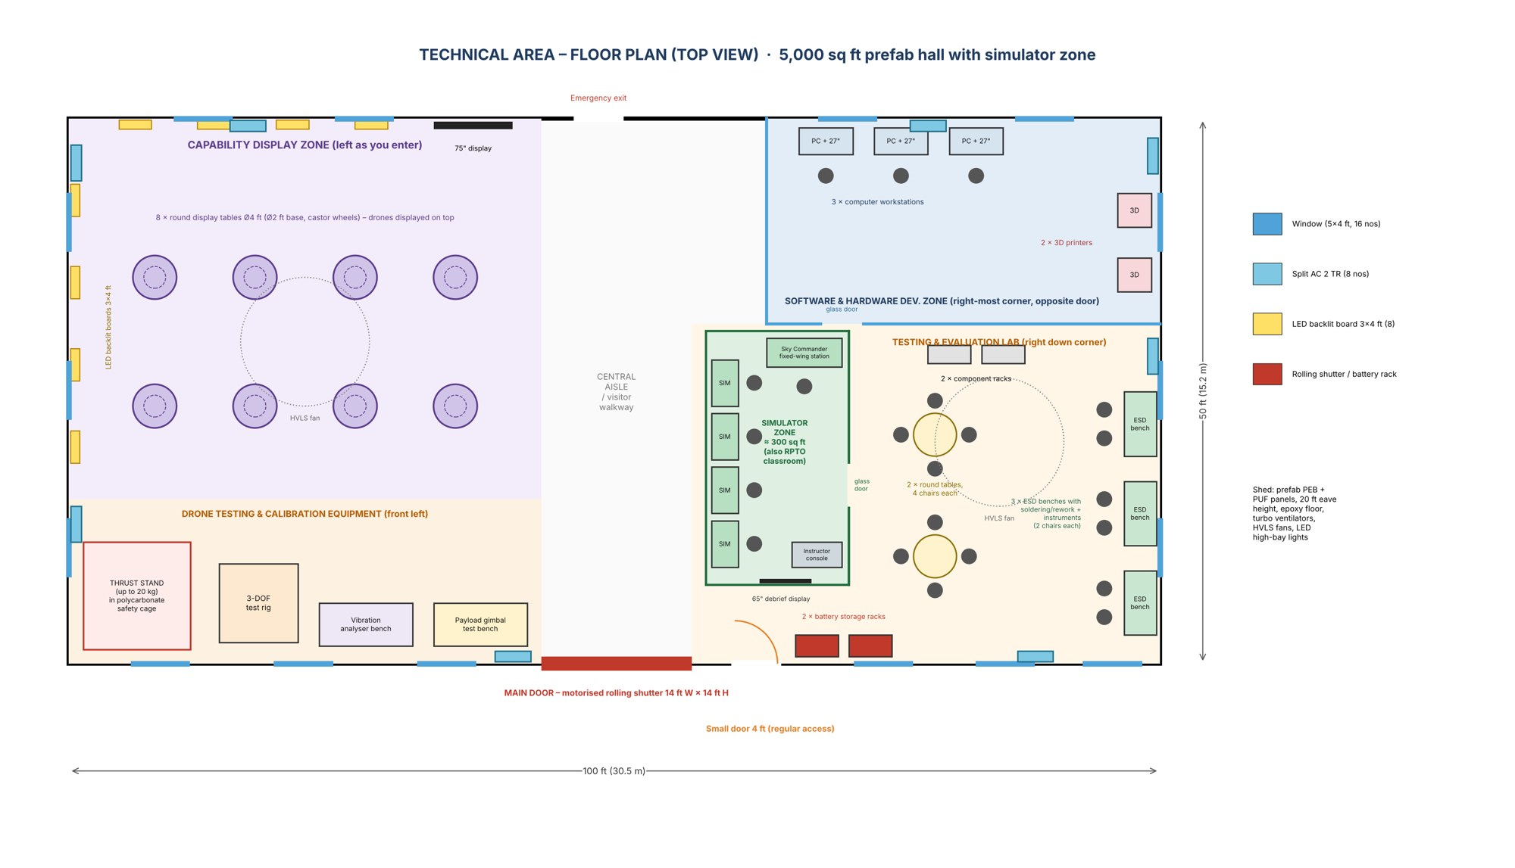
TECHNICAL AREA · 5,000 SQ FT PREFAB HALL, 20 FT HIGH
Five zones under one roof – now with a simulator zone as you enter
Figure 5 – 3D top view (roof removed)
Left: capability display (8 tables, 8 LED boards)
Front left: thrust stand, 3-DOF, vibration, gimbal
Right of aisle: simulator zone (new, ≈300 sq ft)
Right: testing lab; S/W & H/W zone at rear
Figure 4 – Floor plan with simulator zone (right of the aisle as you enter)
Figures 4 and 5 · SpaceGen Aviation Aerospace and Defence Private Limited
13

Slide 14
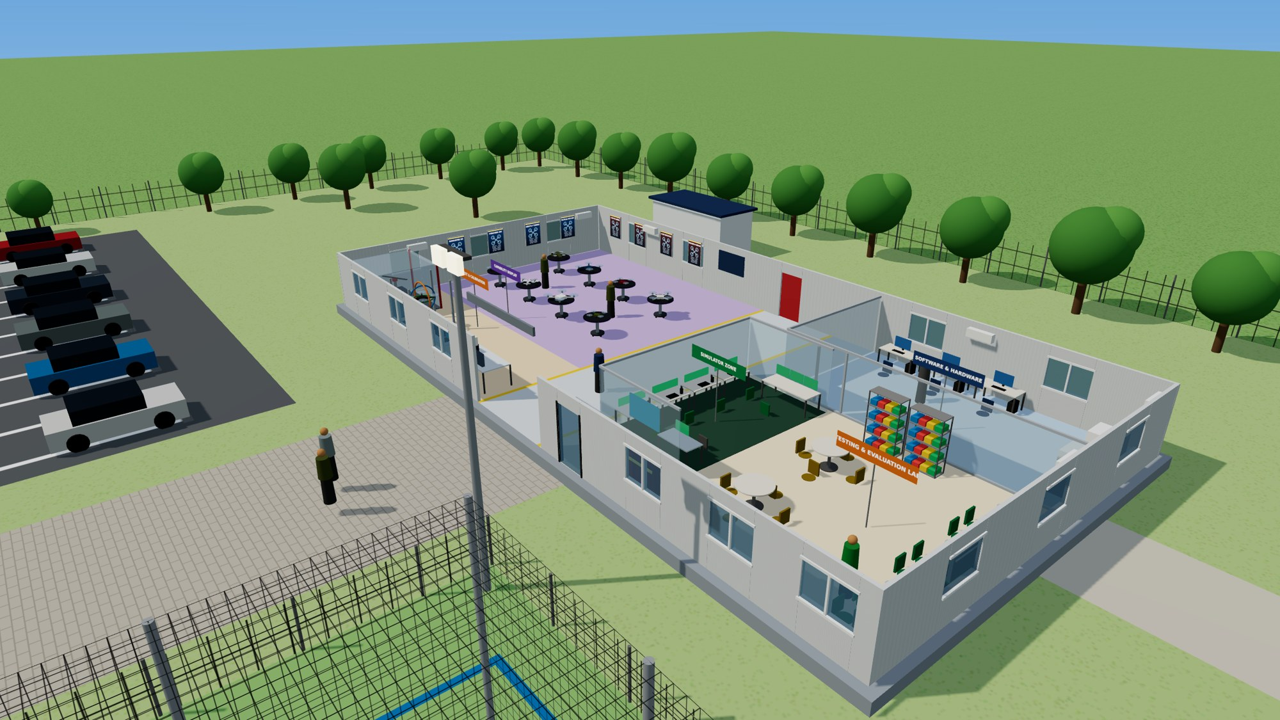
TECHNICAL AREA · 3D VIEW
Inside the hall – display, test, simulator and development zones
Capability display
8 revolving Ø4 ft tables with drones on top; 8 backlit 3×4 ft boards; 75" display
Test & calibration
20 kg thrust stand in safety cage, 3-DOF rig, vibration analyser, payload gimbal bench
Simulator zone (new)
4 flight-simulator stations, Sky Commander station, instructor console, 65" debrief display – doubles as RPTO classroom
Testing & evaluation lab
3 ESD benches, 2 round tables, component and battery racks
Software & hardware
3 workstations and 2 × 3D printers behind glass at the rear right
Figure 7 – 3D panoramic view from front-right (cut-away) · SpaceGen Aviation Aerospace and Defence Private Limited
14

Slide 15
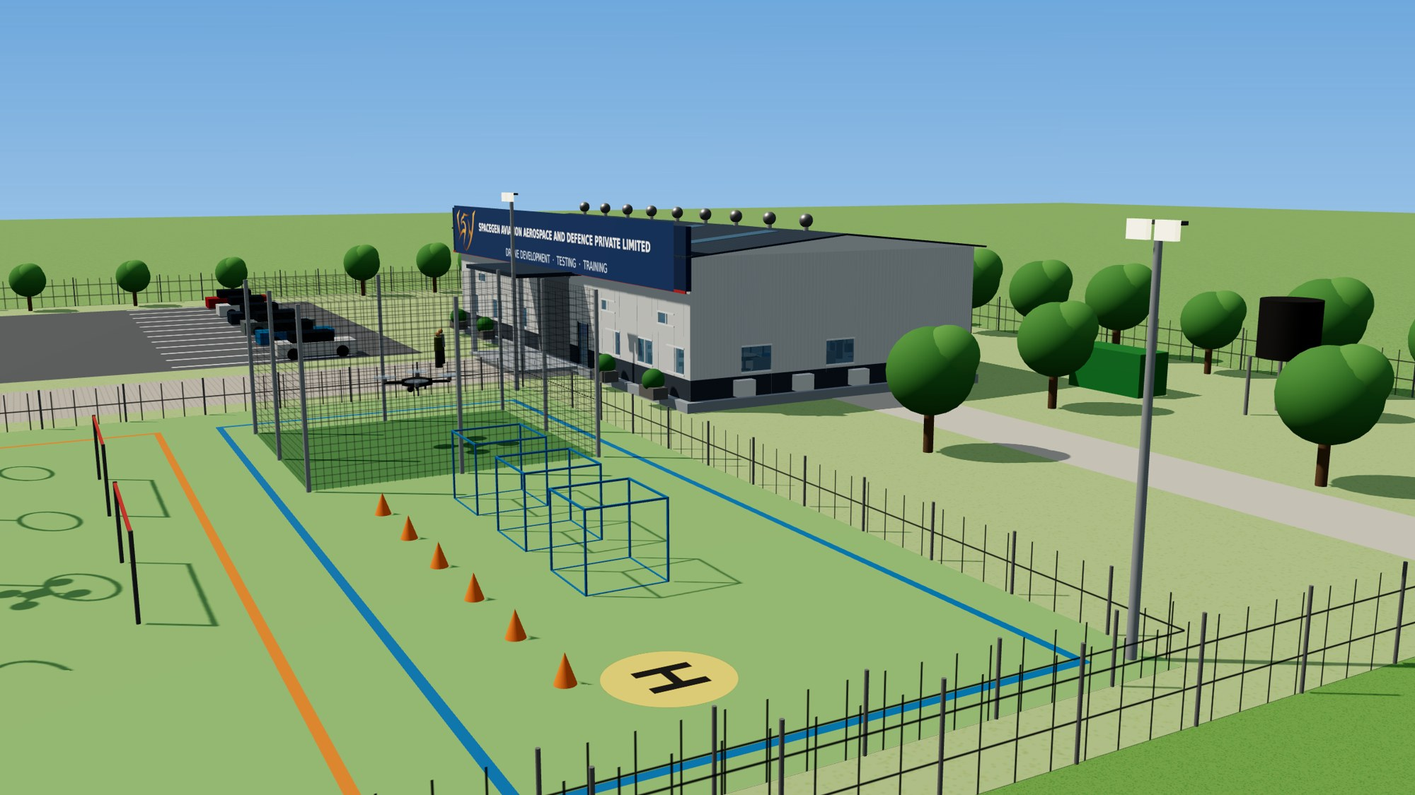
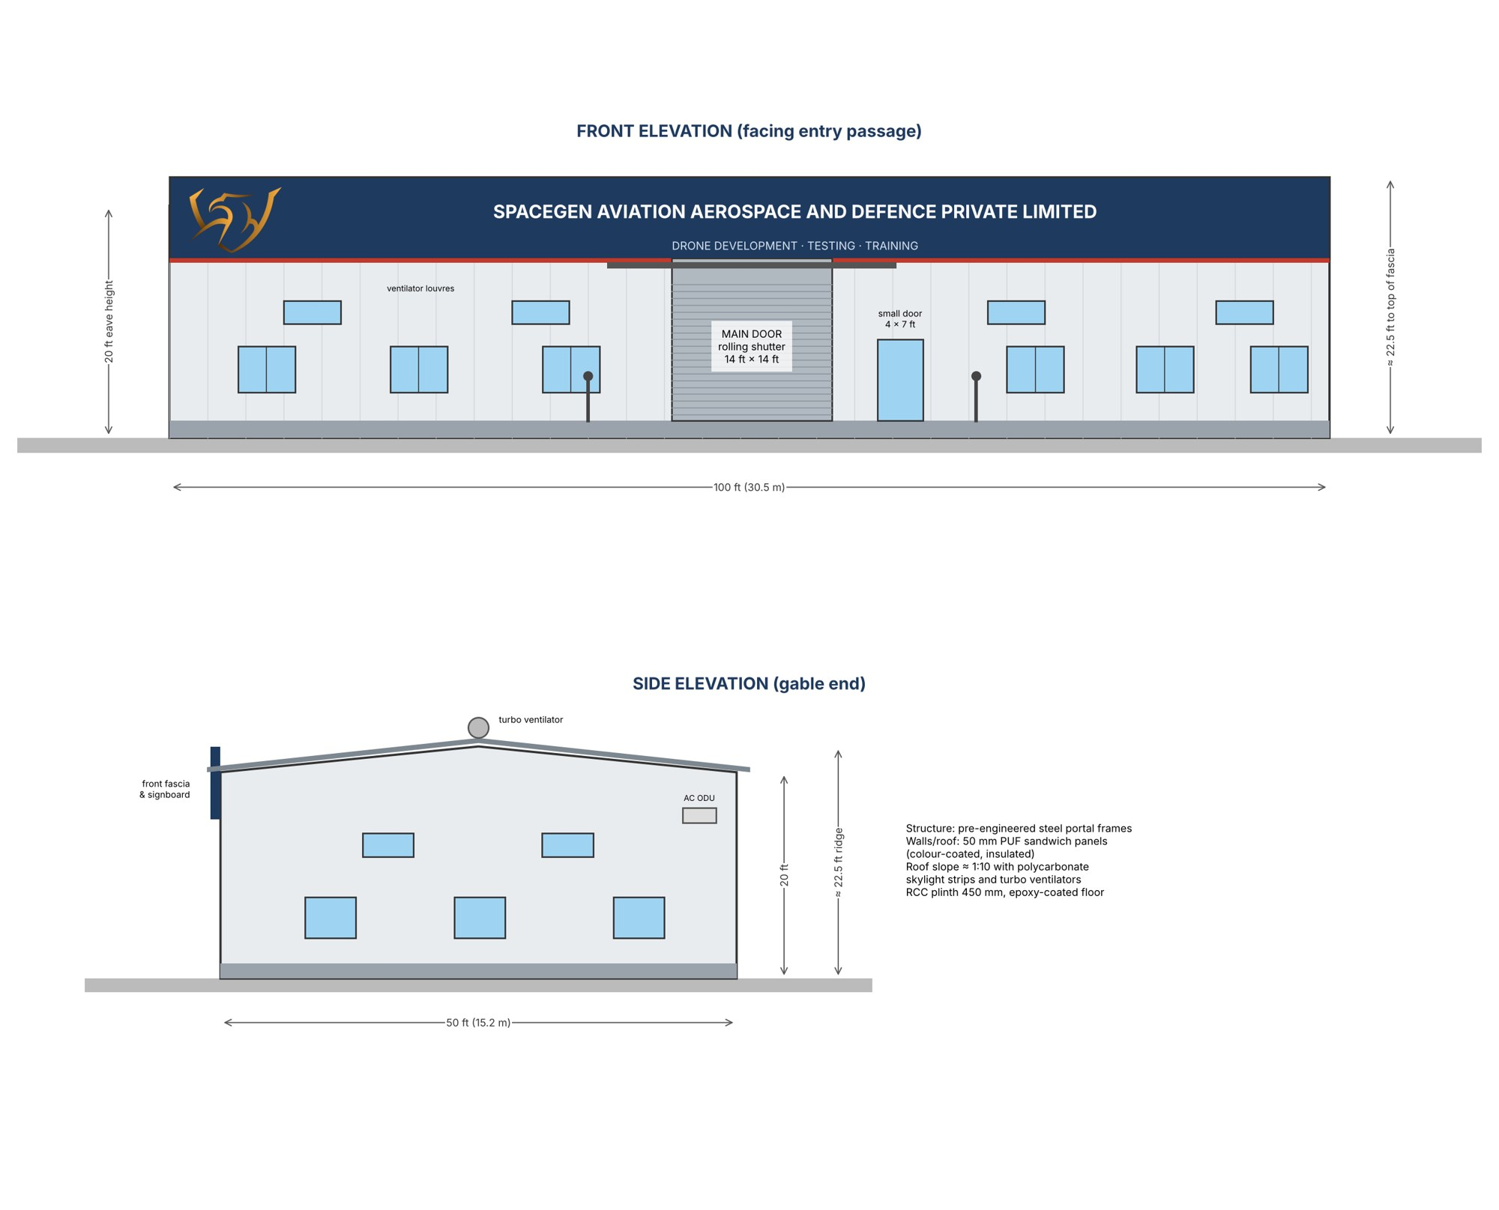
ELEVATIONS AND SIDE VIEW
A 20 ft prefab shed with the SpaceGen signboard on the front fascia
20 ft / 22.5 ft
PEB + PUF
eave height / top of fascia
steel portal frames, 50 mm insulated panels
Figure 8 – Front and side elevations (2D)
Figures 8 and 9 · SpaceGen Aviation Aerospace and Defence Private Limited
15

Slide 16
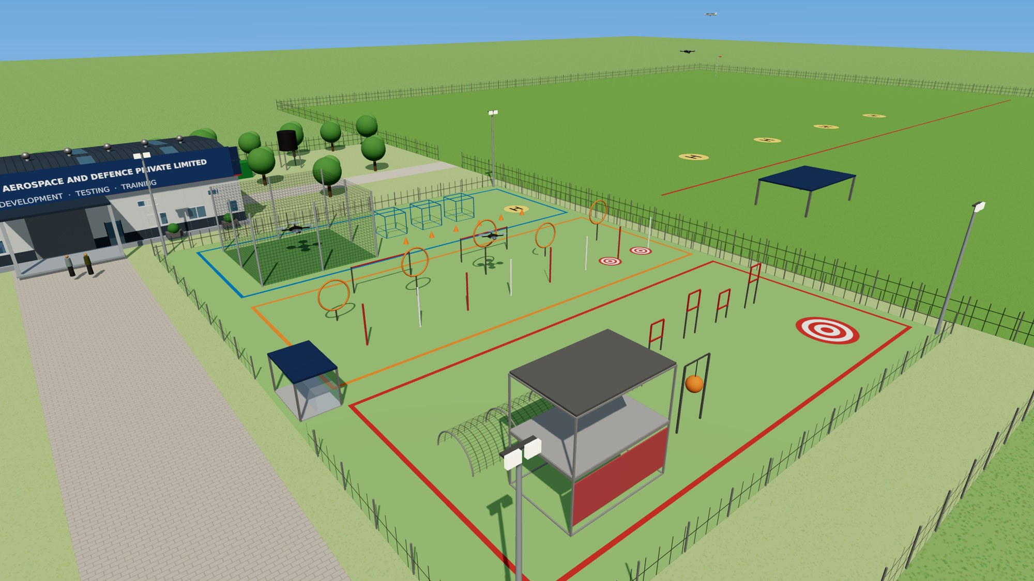
DRONE FLYING ARENA & OBSTACLE COURSE
Three lanes take trainees from basic hover to urban-style missions
Level | Elements | Training objective
Basic | Netted cage 10 × 10 × 6 m, 3 hover boxes, cone slalom, H-pad | Take-off / landing, hover, yaw, orientation
Intermediate | 5 hoop gates, 8 slalom poles, 2 altitude bars, 2 landing targets | Precision, speed, altitude control, spot landing
Advanced | Netted tunnel Ø3 × 12 m, 4 window frames, 2-level mock tower, swinging obstacle, payload-drop target | Confined-space, urban / ISR scenarios, payload drops
Lighting & safety | 4 × 400 W LED flood lights on 9 m masts, pilot booth, fence, windsock | Evening / low-light training, safe operations
38 × 50 m
5 acres
₹13.67 lakh
arena in three colour-coded lanes
open flying field for range and BLOS training
complete obstacle course incl. netted cage and 4 flood lights (head F)
Arena 38 × 50 m, right of the passage · ₹13.67 lakh incl. 4 flood lights · SpaceGen Aviation Aerospace and Defence Private Limited
16

Slide 17
UPDATED BILL OF QUANTITIES · NEW HEAD H
A simulator zone on the right as you enter the shed – ₹15 lakh
Item (head H – Simulator zone) | Qty | Rate ₹ | Amount ₹
Flight simulator stations – PC, 3 × 24" monitors, RC transmitter, sim software | 4 | 1,50,000 | 6,00,000
Sky Commander fixed-wing / VTOL simulator station | 1 | 2,00,000 | 2,00,000
FPV goggle training kits with radios | 4 | 40,000 | 1,60,000
Instructor console with 65" debrief display | 1 | 1,50,000 | 1,50,000
Simulator desks and ergonomic seats | 5 | 20,000 | 1,00,000
Glass partition, door and acoustic panels (≈300 sq ft) | lot | 1,20,000 | 1,20,000
Split AC 2 TR (inverter) | 1 | 55,000 | 55,000
UPS 3 kVA online with batteries | 1 | 60,000 | 60,000
Electrical points, LAN and Wi-Fi | lot | 55,000 | 55,000
Sub-total H – Simulator zone |  |  | 15,00,000
≈ 300 sq ft
glass-partitioned room right of the central aisle, next to the main door
RPTO-ready
DGCA asks for a ~300 sq ft classroom and 2 simulators – this zone provides both
Train before flying
trainees and Army units practise on simulators, then move to the arena
Items 81–89 added to the BoQ · amounts in ₹, excluding GST · SpaceGen Aviation Aerospace and Defence Private Limited
17

Slide 18
COST SUMMARY · CHANDIGARH FACILITY
Total budget ₹1.74 Cr with the simulator zone
Head | Description | Amount ₹ | ₹ lakh
A | Technical area – prefab shelter & building services (5,000 sq ft, 20 ft) | 81,74,000 | 81.74
B | Software & hardware development zone | 8,02,000 | 8.02
C | Drone testing & evaluation lab | 6,85,000 | 6.85
D | Capability display zone | 5,76,000 | 5.76
E | Drone testing & calibration equipment | 11,90,000 | 11.90
F | Flying arena & obstacle course | 13,67,000 | 13.67
G | Site works & utilities | 31,10,000 | 31.10
H | Simulator zone | 15,00,000 | 15.00
 | TOTAL (excl. GST) | ₹ 1,74,04,000 | 174.04
₹1.59 Cr
facility heads A–G – unchanged, inside the earlier ₹1.50–1.65 Cr band
+ ₹15 lakh
simulator zone (head H) for RPTO and unit training
= ₹1.74 Cr
total infrastructure budget; ₹85.6 lakh a year to run (6-person team)
Concept-level estimate, 2026 prices, excluding GST · SpaceGen Aviation Aerospace and Defence Private Limited
18

Slide 19
ELEVEN ENABLERS · WHO DRIVES EACH
Chandigarh drives five enablers; Hyderabad HQ leads six
1 · High · now
2 · High · now
3 · High · now
4 · High · Year 1
Existing customers & referrals
Demos at Chandigarh facility
Demos to forward Army units
RPTO – DGCA certification & unit training
5 · High · Year 1
6 · Medium · Year 2–3
7 · Med-high · Year 1–2
8 · Medium · Year 2–3
GeM listing & regular RFPs
Central procurement via RFI → RFP
PMF & civil fixed-wing (roads, power, oil & gas)
DPSU partnering – BEL, HAL, BDL
9 · Medium · Year 3+
10 · Med-high · Year 1–2
11 · Long-term high · Year 3+
Format
number · practicality · when revenue starts
Expos & seminars → exports
Joint development & joint IP with Army
MUM-T, zone protection, swarm defence
1 – 5 · Chandigarh facility
6 – 11 · Hyderabad HQ
Led and booked at Chandigarh – the basis of all Chandigarh sales and operating-cost figures.
6, 10, 11 and now also 7, 8, 9 (PMF & civil, DPSU partnering, exports) are led and booked at Hyderabad HQ; Chandigarh supports with demos.
Basis of the Chandigarh year-on-year sales targets · SpaceGen Aviation Aerospace and Defence Private Limited
19

Slide 20
ENABLER REVIEW · CHANDIGARH ENABLERS 1 TO 5
Fast revenue from the facility’s own enablers
# | Enabler | Practicality | Starts | What it needs | Main risk | Y5 ₹Cr | Y10 ₹Cr
1 | Existing customers & referrals | High | Now | Field-trial experts, demo kit | Units’ local budgets | 21 | 36
2 | Chandigarh facility demos | High | Facility opening | 6-person team, demo fleet | Visitor security procedures | 17 | 28
3 | Forward-area demos | High | Now | SUV, 3-person team, permissions | Weather, budget timing | 14 | 24
4 | RPTO & unit training | High | Year 1 | 2 instructors, simulator zone (4 + 1 sims) | Approval time; price | 6.5 | 14
5 | GeM & regular RFPs | High | Year 1 | Full GeM listing, bid desk | L1 pricing; EMD / PBG cash | 18 | 38
 | Sub-total – Chandigarh enablers 1–5 |  |  |  |  | 76.5 | 140
The CEO’s former MCEME students in Northern and Western Command, demos at the facility and the RPTO give the quickest and cheapest orders. All five run from the Chandigarh team from Year 1 and are the only enablers counted in the Chandigarh plan.
Revenue figures from the Chandigarh Base-case sales model · SpaceGen Aviation Aerospace and Defence Private Limited
20

Slide 21
ENABLER REVIEW · HYDERABAD HQ ENABLERS 6 TO 11
Long-cycle and partner enablers stay with Hyderabad HQ
# | Enabler | Practicality | Starts | Hyderabad HQ role | Chandigarh support | HQ Y10 ₹Cr
6 | Central procurement via RFI → RFP (FTP / EP / capital) | Medium | Year 2–3 | Trials, certifications, bank guarantees | Field trials in the north | 95
7 | PMF & civil departments – fixed-wing / VTOL (roads, power, oil & gas) | Med-high | Year 1–2 | Sales, payloads, DGCA type certificates | Demos on request | 34
8 | DPSU partnering – BEL, HAL, BDL sub-systems | Medium | Year 2–3 | Vendor registration, QA, design | Integration trials | 22
9 | Expos & seminars → exports | Medium | Year 3+ | Expos, SCOMET licences, partners abroad | Demos for delegations | 18
10 | Joint development & joint IP with Army | Med-high | Year 1–2 | Problem statements, iDEX, IP agreements | User feedback | 16
11 | Integrated MUM-T, zone protection, swarm defence | Long-term high | Year 3+ | Systems engineering, C2 software | Test support | 46
Moved to Hyderabad HQ: enablers 7, 8 and 9 are now led and booked at Hyderabad HQ together with 6, 10 and 11. They need more expertise, dedicated technical teams and long cycles, so none of their sales or costs are counted at Chandigarh.
Not counted in Chandigarh sales or operating cost · HQ Y10 = company-wide plan figure
21

Slide 22
TEN-YEAR SALES PLAN · CHANDIGARH · BASE CASE
₹21.8 Cr to ₹140 Cr in ten years – a 23% CAGR
Years 1–3
Sales ₹21.8 Cr → ₹47.5 Cr; operating cost ₹2.9 Cr → ₹5.7 Cr. Army network, Chandigarh demos, RPTO, GeM.
Years 4–6
Sales ₹62 Cr → ₹90 Cr; operating cost ₹7.4 Cr → ₹10.7 Cr. GeM, forward demos and repeat Army orders grow.
Years 7–10
Sales ₹102.5 Cr → ₹140 Cr; operating cost ₹12.4 Cr → ₹17.7 Cr. MRO and refresher training add to a mature hub.
Year 1 = FY 2027-28 · net sales, ₹ crore, excluding GST · numbers in brackets = enabler
22

Slide 23
SALES BY ENABLER · ₹ CRORE · Y1 = FY27-28 … Y10 = FY36-37
Sales by enabler, and the facility’s operating cost
Enabler | Y1 | Y2 | Y3 | Y4 | Y5 | Y6 | Y7 | Y8 | Y9 | Y10
1 Existing customers | 9 | 12 | 15 | 18 | 21 | 24 | 27 | 30 | 33 | 36
2 Chandigarh facility demos | 5 | 8 | 11 | 14 | 17 | 20 | 22 | 24 | 26 | 28
3 Forward-area demos | 3 | 5 | 8 | 11 | 14 | 16 | 18 | 20 | 22 | 24
4 RPTO & training | 0.8 | 2 | 3.5 | 5 | 6.5 | 8 | 9.5 | 11 | 12.5 | 14
5 GeM & RFPs | 4 | 7 | 10 | 14 | 18 | 22 | 26 | 30 | 34 | 38
Total sales – Chandigarh (1–5) | 21.8 | 34 | 47.5 | 62 | 76.5 | 90 | 102.5 | 115 | 127.5 | 140
YoY growth | — | 56% | 40% | 31% | 23% | 18% | 14% | 12% | 11% | 10%
Operating cost – Chandigarh facility | 2.9 | 4.2 | 5.7 | 7.4 | 9.1 | 10.7 | 12.4 | 14.1 | 15.8 | 17.7
Increase in operating cost | — | 1.3 | 1.5 | 1.7 | 1.7 | 1.7 | 1.6 | 1.7 | 1.8 | 1.8
Enablers 6–11 (central procurement, PMF & civil, DPSU partnering, exports, joint development, integrated solutions) are Hyderabad HQ’s and are not included.
Base case · net sales excluding GST · operating cost = running cost of the Chandigarh facility (excl. depreciation)
23

Slide 24
YEAR-ON-YEAR SCALE-UP · YEARS 1–5
What grows sales and operating cost each year
Year | Sales | Op. cost | Team | Key growth drivers | Facilities at Chandigarh | Investment
Y1 FY27-28 | ₹21.8 Cr | ₹2.9 Cr | 6 | Re-orders & referrals from 18+ units; Chandigarh demos; first GeM orders; RPTO starts | Facility live (₹1.74 Cr) incl. simulator zone; RPTO application | ₹2–3 Cr seed
Y2 FY28-29 | ₹34 Cr +56% | ₹4.2 Cr +1.3 | 8 | RPTO DGCA-authorised; repeat GeM orders ₹7 Cr; forward demos ₹5 Cr | 2nd demo vehicle; spares & repair bay | Accruals + HQ bank line
Y3 FY29-30 | ₹47.5 Cr +40% | ₹5.7 Cr +1.5 | 10 | Northern-sector drones moved to Chandigarh (Technical Ownership Transfer); GeM ₹10 Cr | Local integration & QA | Accruals
Y4 FY30-31 | ₹62 Cr +31% | ₹7.4 Cr +1.7 | 12 | Forward demos ₹11 Cr; existing customers ₹18 Cr; demos reach South Western Command | ₹1.0 Cr integration & MRO shed | ₹1.0 Cr from accruals
Y5 FY31-32 | ₹76.5 Cr +23% | ₹9.1 Cr +1.7 | 14 | 2nd RPTO batch line (training ₹6.5 Cr); GeM ₹18 Cr | C-UAS demo range tie-ups | Accruals
Team = Chandigarh headcount · op. cost = running cost of the Chandigarh facility, excl. depreciation · ₹ crore
24

Slide 25
YEAR-ON-YEAR SCALE-UP · YEARS 6–10
What grows sales and operating cost each year
Year | Sales | Op. cost | Team | Key growth drivers | Facilities at Chandigarh | Investment
Y6 FY32-33 | ₹90 Cr +18% | ₹10.7 Cr +1.7 | 16 | MRO & sustainment across J&K, Punjab, HP; existing customers ₹24 Cr | MRO for installed base | Accruals
Y7 FY33-34 | ₹102.5 Cr +14% | ₹12.4 Cr +1.6 | 18 | GeM ₹26 Cr; Chandigarh demos ₹22 Cr; growth settles near 11–14% | ₹1.5 Cr C-UAS test & integration bay | ₹1.5 Cr from accruals
Y8 FY34-35 | ₹115 Cr +12% | ₹14.1 Cr +1.7 | 20 | Product-refresh demos; existing customers ₹30 Cr | Next-gen interceptor & C-UAS demos | Accruals
Y9 FY35-36 | ₹127.5 Cr +11% | ₹15.8 Cr +1.8 | 22 | Refresher training for Ashni platoons in the sector; GeM ₹34 Cr | Mature northern hub | Accruals
Y10 FY36-37 | ₹140 Cr +10% | ₹17.7 Cr +1.8 | 24 | Full-service northern hub – sales, training and MRO | 24-person team | Accruals
Team = Chandigarh headcount · op. cost = running cost of the Chandigarh facility, excl. depreciation · ₹ crore
25

Slide 26
PROCUREMENT SIGNALS THAT MATTER FOR SPACEGEN
Buyers move fast – and the northern sector is where they buy
Signal | What it means for Chandigarh
≈ ₹30,000 Cr emergency / fast-track buys after Op Sindoor (drones, loitering munitions, C-UAS, EW) | Formations buy quickly from vendors with field-proven kit – Chandigarh demos show it
Army plans ≈ ₹20,000 Cr for drones & surveillance; ₹1,577 Cr loitering-munition contracts (Aug 2026) | Large central orders are HQ-led; Chandigarh supports trials in the north
DFI: next tactical-drone order may exceed ₹20,000 Cr (US$2 bn), delivery in 18–24 months | Tier-2 roles with primes and DPSUs – HQ-led (enabler 8)
DAC ≈ ₹52,000 Cr AoN incl. anti-drone (AKASH TARANG), kamikaze drones (Jul 2026) | RFPs follow; HQ partners DPSUs, Chandigarh runs field trials
Ashni drone platoon in every infantry battalion; ~5,000 drones per command | Recurring demand for FPV drones, spares, training and simulators
BEL IDDIS ≈ ₹572 Cr; Zen ₹332 Cr C-UAS order; BSF Drone Warfare School (Aug 2025) | C-UAS buying is recurring across Army, IAF and BSF
44,000+ Remote Pilot Certificates, 39,000+ drones registered; 145 RPTOs | Few RPTOs in J&K / north Punjab – room for the Chandigarh RPTO
Punjab ‘Baaz Akh’ – ₹51.4 Cr for 9 anti-drone systems from Chandigarh to Fazilka | State police C-UAS demand right on Chandigarh’s doorstep
Section 3.4 of the market and sales plan · SpaceGen Aviation Aerospace and Defence Private Limited
26

Slide 27
OPERATING COST · CHANDIGARH FACILITY · BASE CASE
Operating cost grows from ₹2.9 Cr to ₹17.7 Cr a year
₹ crore | Y1 | Y2 | Y3 | Y4 | Y5 | Y6 | Y7 | Y8 | Y9 | Y10
Salaries | 0.46 | 0.67 | 0.90 | 1.17 | 1.47 | 1.81 | 2.21 | 2.65 | 3.14 | 3.70
Admin & facility running | 0.26 | 0.31 | 0.37 | 0.44 | 0.51 | 0.59 | 0.68 | 0.77 | 0.88 | 0.99
HQ support visits | 0.05 | 0.05 | 0.06 | 0.06 | 0.07 | 0.07 | 0.07 | 0.08 | 0.08 | 0.09
Demonstration tours | 0.08 | 0.09 | 0.11 | 0.12 | 0.14 | 0.16 | 0.18 | 0.21 | 0.24 | 0.28
One-time induction move | 0.03 | — | — | — | — | — | — | — | — | —
Selling & marketing (3% of sales) | 0.65 | 1.02 | 1.43 | 1.86 | 2.29 | 2.70 | 3.08 | 3.45 | 3.83 | 4.20
HQ technical support (4% of sales) | 0.87 | 1.36 | 1.90 | 2.48 | 3.06 | 3.60 | 4.10 | 4.60 | 5.10 | 5.60
Warranty & field support (2%) | 0.44 | 0.68 | 0.95 | 1.24 | 1.53 | 1.80 | 2.05 | 2.30 | 2.55 | 2.80
Total operating cost | 2.85 | 4.19 | 5.71 | 7.37 | 9.07 | 10.74 | 12.37 | 14.06 | 15.82 | 17.66
Increase in operating cost | — | 1.34 | 1.52 | 1.66 | 1.70 | 1.67 | 1.63 | 1.69 | 1.76 | 1.84
Operating cost as % of sales | 13.1% | 12.3% | 12% | 11.9% | 11.9% | 11.9% | 12.1% | 12.2% | 12.4% | 12.6%
Headcount (Chandigarh) | 6 | 8 | 10 | 12 | 14 | 16 | 18 | 20 | 22 | 24
₹0.89 Cr fixed
₹99.8 Cr
13.1% → 12.6%
Year-1 fixed running cost – team, admin, HQ visits, demos, move (Rev 2)
total operating cost over ten years (Base case)
operating cost as a share of Chandigarh sales
₹ crore · running cost of the facility, excl. depreciation and GST · Year 1 = FY 2027-28
27

Slide 28
SCENARIOS · CHANDIGARH
Conservative ₹91 Cr · Base ₹140 Cr · Upside ₹182 Cr by Year 10
10-year total | Sales | Op. cost
Conservative | ₹531 Cr | ₹74.1 Cr
Base | ₹816.8 Cr | ₹99.8 Cr
Upside | ₹1,053.6 Cr | ₹121.2 Cr
Conservative: slower demos, RPTO approval delayed, fewer GeM orders.
Upside: northern-sector products transferred early; more GeM and repeat Army orders.
Fixed running cost is the same in every case; only the sales-linked 9% changes.
Conservative = 65% of Base · Upside = Base +15% in Y1–2, +30% from Y3 · ₹ crore
28

Slide 29
MARKET SHARE · CHANDIGARH
The plan needs only about 2% of the northern market it serves
Year 1 · FY27-28
Year 5 · FY31-32
Year 10 · FY36-37
1.4%
2.1%
2%
₹21.8 Cr sales of ₹1,578 Cr Chandigarh-addressable market
₹76.5 Cr sales of ₹3,678 Cr Chandigarh-addressable market
₹140 Cr sales of ₹6,945 Cr Chandigarh-addressable market
₹ crore | FY27-28 | FY31-32 | FY36-37
India drone + C-UAS spend (all domains) | 15,575 | 34,785 | 65,752
SpaceGen-addressable (national) | 6,293 | 14,443 | 27,351
Chandigarh-addressable (northern sector) | 1,578 | 3,678 | 6,945
Chandigarh sales (Base) | 21.8 | 76.5 | 140
Chandigarh-addressable = northern-sector part of SpaceGen’s addressable segment (Northern & Western Command, BSF Punjab/Jammu, J&K & Punjab police; civil is HQ-led)
29

Slide 30
PRODUCT MIX · CHANDIGARH
C-UAS, interceptors and VTOL ISR grow as FPV share falls
Product family (share of Chandigarh sales) | Year 1 | Year 5 | Year 10
FPV attack / grenade-dropper drones & payloads | 37% | 26% | 20%
Counter-UAS – detectors, jammers, MITYA spoofer, Shield | 32% | 30% | 30%
Interceptor drones – Lakshya, Arjuna, Arjun Kavach | 8% | 13% | 15%
VTOL ISR – Aniketra, Samharak (Army ISR) | 9% | 13% | 16%
Tethered surveillance, transport drones, helipad | 8% | 10% | 11%
Simulators & training (RPTO, Sky Commander) | 6% | 8% | 8%
Note
Drones specific to the Northern sector will be considered for shifting to the Chandigarh facility. Their names will be explained by Capt Vego, and they will be transferred to the Chandigarh facility on Technical Ownership Transfer, at transfer cost.
Integrated MUM-T / zone & swarm-defence packages stay with Hyderabad HQ · SpaceGen Aviation Aerospace and Defence Private Limited
30

Slide 31
FUNDING PLAN · CHANDIGARH
A ₹2–3 Cr seed builds the facility; growth funds expansion
Now · Year 1
Years 4 and 7
Milestones investors can track
Y1: facility, simulator zone & RPTO live; ₹21.8 Cr sales; ₹2.9 Cr op. cost
Y2: RPTO authorised; ₹34 Cr sales
Y3: northern-sector products transferred to Chandigarh
Y5: ₹76.5 Cr sales; ₹9.1 Cr op. cost
Y10: ₹140 Cr sales; ₹17.7 Cr op. cost
₹2–3 Cr seed
₹2.5 Cr expansion
Facility incl. simulator zone ₹1.74 Cr
Year-1 fixed running cost ≈ ₹0.89 Cr
Demo fleet & training drones ≈ ₹0.30 Cr
(Technical Ownership Transfer cost of the products is not included, will be discussed separately)
₹1.0 Cr integration & MRO shed (Y4)
₹1.5 Cr C-UAS test & integration bay (Y7)
Both funded from internal accruals
Order working capital from SpaceGen’s ₹5 Cr bank line · SpaceGen Aviation Aerospace and Defence Private Limited
31

Slide 32
RISKS AND MITIGATION · CHANDIGARH
Known risks, each with a plan
Risk | Effect | Mitigation
Slow transfer of northern-sector products | Longer delivery; fewer orders | Agree product list (Capt Vego) and Technical Ownership Transfer terms in Year 1; keep demo stock
RPTO approval delay | Training revenue slips | Apply as soon as the simulator zone is ready; run unit training packages meanwhile
Visitor permissions & security | Fewer facility demos | Pre-cleared visitor programme with formations; forward-area demos in parallel
Working capital for orders | Cannot take larger GeM / PMF orders | HQ’s ₹5 Cr bank line; 20–30% milestone advances
Fast-changing threat | C-UAS products date quickly | SDR-based, software-upgradable designs from HQ; user feedback loop
Concentration on Army in one sector | Budget swings hit sales | Grow training, GeM, CAPF and police sales; PMF, civil and export work sits with HQ
Key-person dependence | Demos and conversion slow | Field-trial team of ex-defence experts; deputy Centre Head from Year 3
Weather & terrain | Fewer flying days | Indoor simulator zone and netted arena; seasonal demo calendar
SpaceGen Aviation Aerospace and Defence Private Limited · Confidential
32

Slide 33
PARTNER WITH US
A ready facility, customers next door,
and a northern market growing 4× in ten years.
Basis of the numbers
Contact
Chandigarh facility only: enablers 1–5 (6–11 are Hyderabad HQ’s)
Year 1 = FY 2027-28; ₹ crore, excluding GST, 2026 prices
Products at HQ transfer price; costs from the Rev 2 operating budget
Market spend is an estimate from published reports and budgets
SpaceGen Aviation Aerospace and Defence Private Limited
Chandigarh Drone Facility – Chandigarh, Punjab
HQ: Terminal Building, Begumpet Airport, Hyderabad 500016
+91 93929 91904 · spacegenaviation@gmail.com
www.spacegenaviation.com · GeM ID 4RRO250013676721
Planning document – projections are indicative and depend on funding, approvals and procurement outcomes; not investment advice
33

