Slide 1
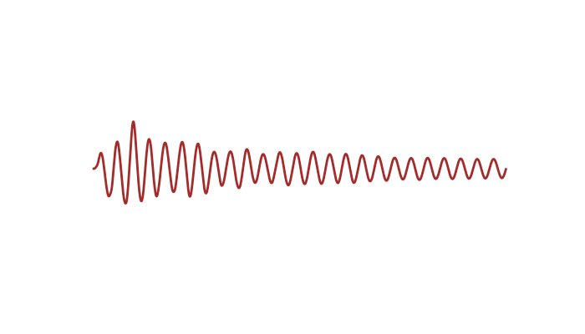
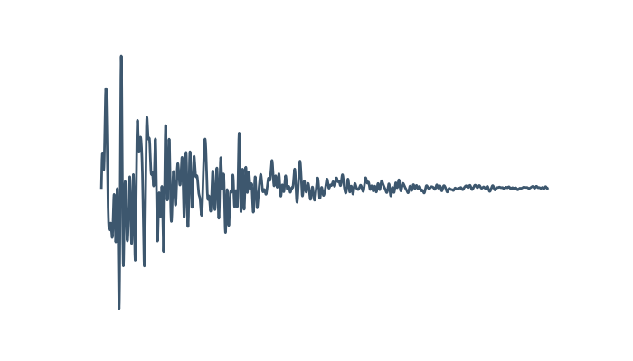
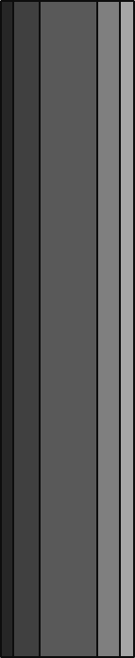

Slide 2
$$M\ddot{u}\left(t\right)+C\dot{u}\left(t\right)+Ku\left(t\right)=−Mι{\ddot{u}}_{g}\left(t\right)$$

Slide 3
mdof

