Slide 1
WP 6 Dissemination, Exploitation and Communication
Cedric Thomas, Olivier Bouzereau - OW2
STAMP Project Final Review
Brussels, 6 February, 2020

Slide 2
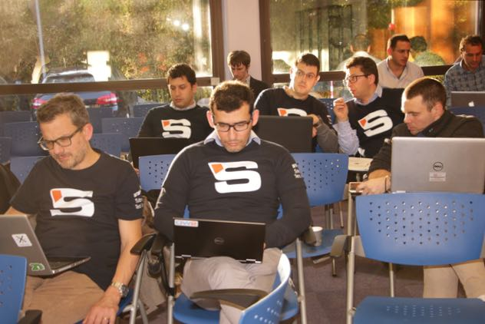

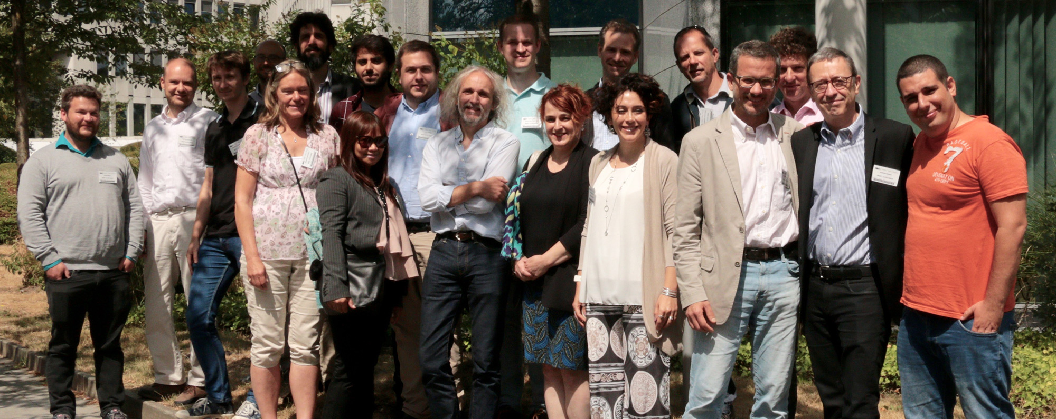
Agenda
WP6 Overview
Objective and Achievements
Dissemination Activities
Exploitation Models
Business Plan
WP6 KPIs
Lessons Learned

Slide 3
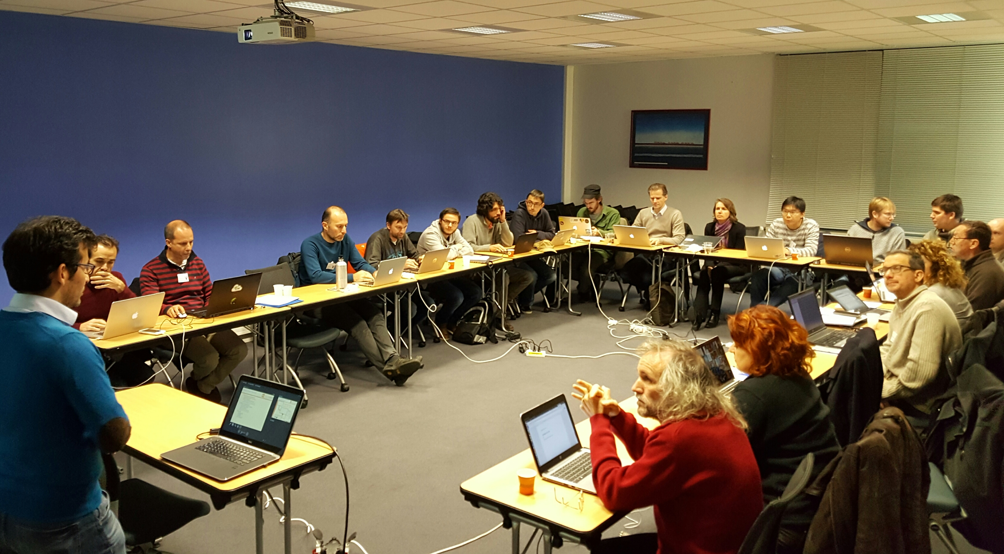
WP6 Overview
Overview
Duration: M1-M36
WP Lead: OW2
Partners: INRIA, KTH, SINTEF, TUD, ENG, TellU,
ATOS, AEon
Structure
Task 6.1: Communication infrastructure and material
Task 6.2: Dissemination (scientific publications, OSS & industry conferences)
Task 6.3: Exploitation
Task 6.4: Market analysis and business modeling

Slide 4
WP6 Deliverables
D6.1 | Dissemination and Communication Plan | OW2 | M3
D6.2 | Communication Material | OW2 | M4
D6.3 | Market Analysis | AEon, Atos, OW2 | M18
D6.4 | Exploitation Plan | AEon, Atos, OW2 | M30
D6.5 | Business Plan | AEon, Atos, OW2 | M36

Slide 5
WP6 Objectives
+1,000 Devs Devoxx, Fosdem, EclipseCon
7 Publications in top Research journals
195 actions (publications, events, workshops, etc., 1.35 per week) and 600 tweets
Generate awareness by developing appropriate communication messages, material and initiatives targeting our key audiences: IT industry, Research communities, EU-projects and developers.
Ensure the sustainability of the project’s results beyond the actual duration of the project through pragmatic exploitation plans and commercialization strategies.
Grow a community of early adopters around the project's concepts and tools by positioning STAMP as a recognized solution for software quality and testing in relevant industry media including websites, events and conferences.
Commercially exploitable results and commercial business model identifed
Elaborated and quantified potential business plan
320 followers on tweeter
15 industry talks, incl. Orange,Ericsson, Saab
300 workshop participants

Slide 6
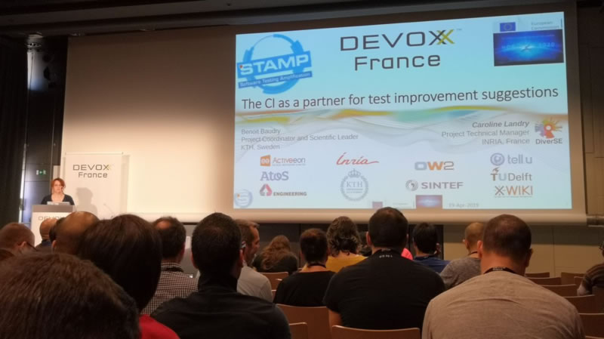
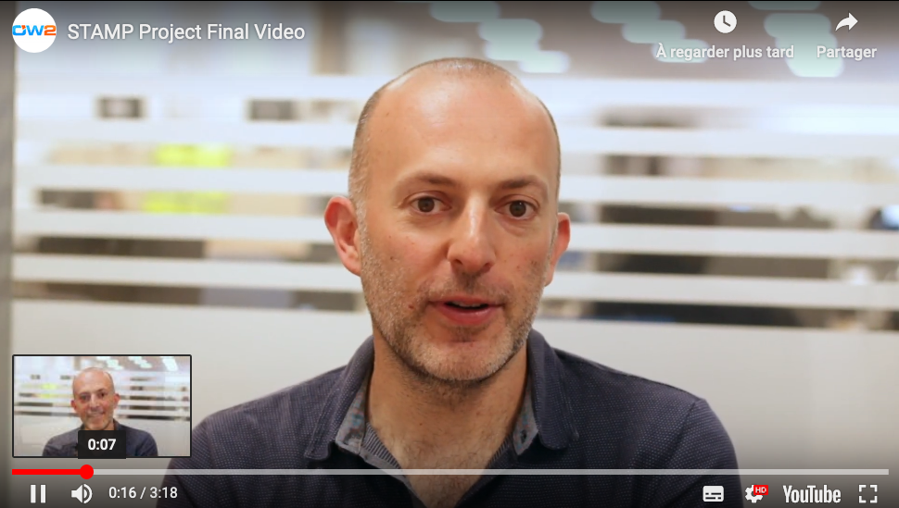
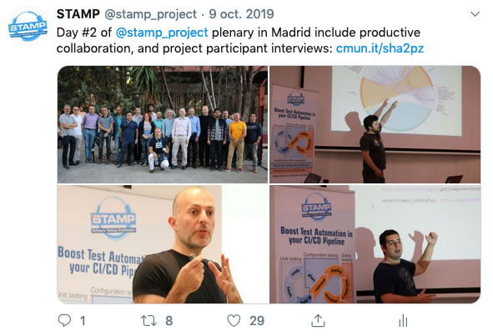
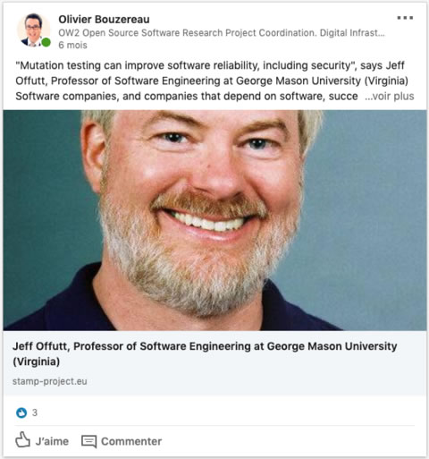
Dissemination Exploitation Summary
Implementation and maintenance of a full fledged collaborative infrastructure
  Public website, private wiki, mailing lists, CI/CD
Production of a full range of communication material
  Roll-up totem, poster, leaflets, flyers, USB keys, strip, newsletters, web curation, social networks, stickers
Fast-paced communication initiatives
  Industry and academic event, scientific publications, workshops, social media, videos,
Comprehensive coverage of exploitation potential
  Market analysis, beta-testing campaign, partner exploitation plans and SaaS start-up business plan

Slide 7
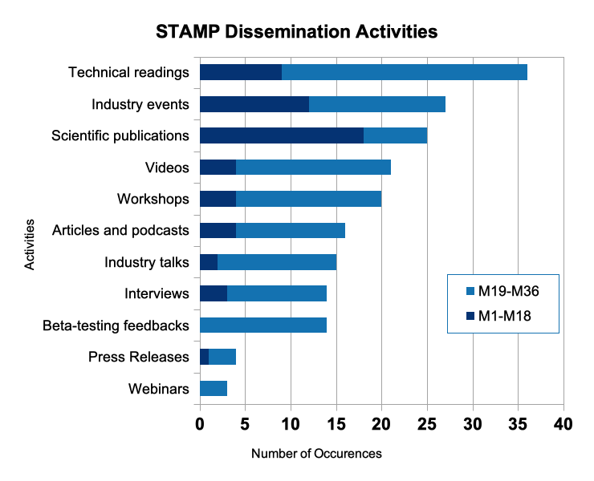
Summary of Dissemination Initiatives
 | M1-M18 | M19-M36 | Total
Webinars | 0 | 3 | 3
Press Releases | 1 | 3 | 4
Beta-tester feedbacks | 0 | 14 | 14
Interviews | 3 | 11 | 14
Industry talks | 2 | 13 | 15
Articles, podcast | 4 | 12 | 16
Workshops | 4 | 16 | 20
Videos | 4 | 17 | 21
Industry events | 12 | 15 | 27
Scientific publ.° | 18 | 7 | 25
Tech readings | 9 | 27 | 36
Total | 57 | 138 | 195

Slide 8
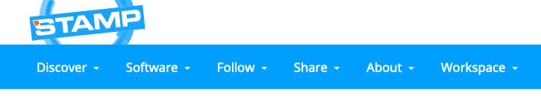
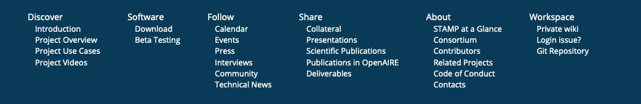
Public Website: 25 Editorial Sections
25 editorial sections, 111 documents, 65 Events, 36 technical readings, 24 publications,
21 videos, 18 press mentions, 14 collateral, 14 interviews.

Slide 9
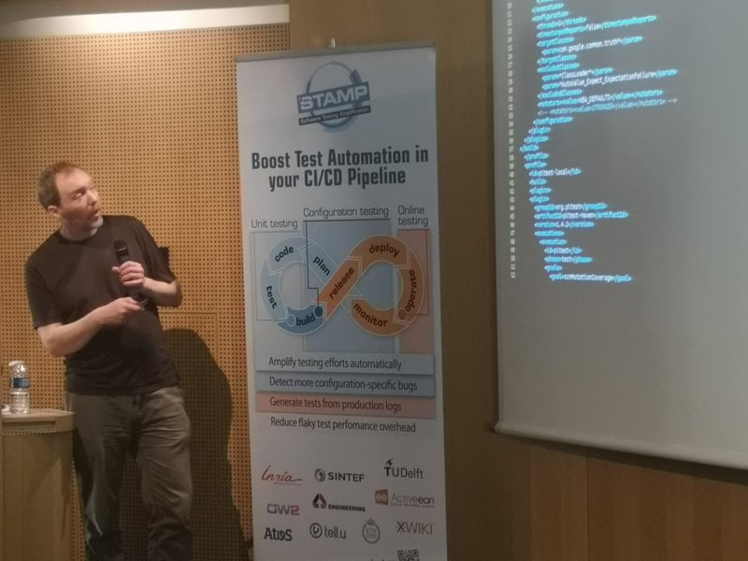
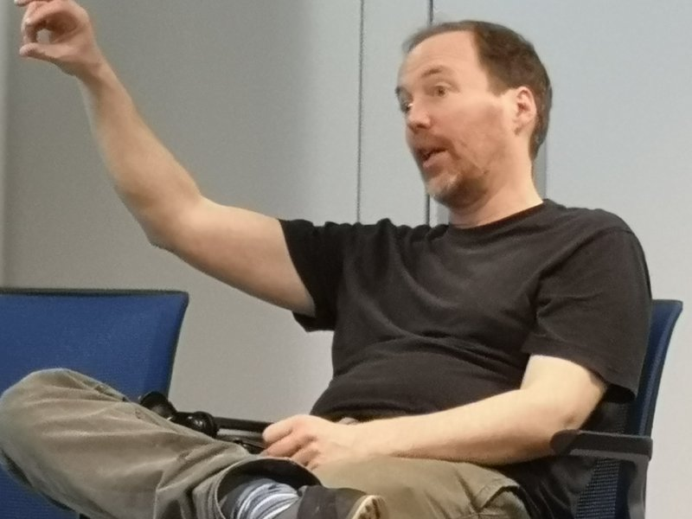
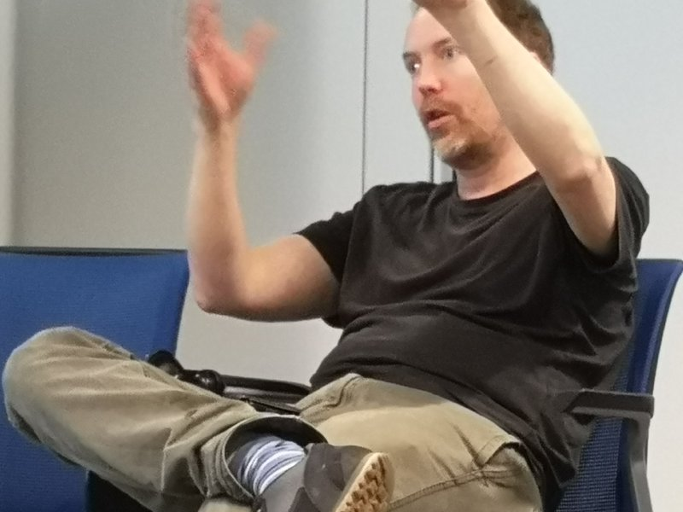
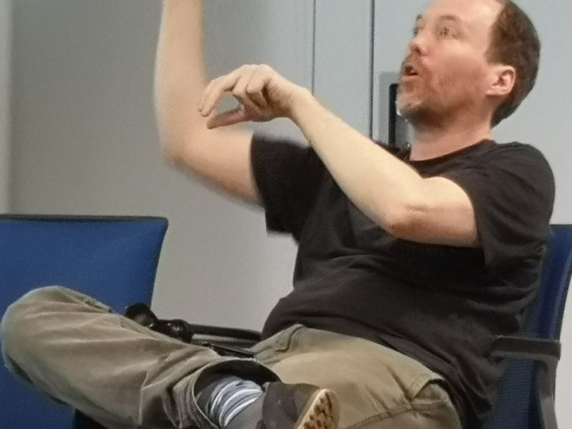
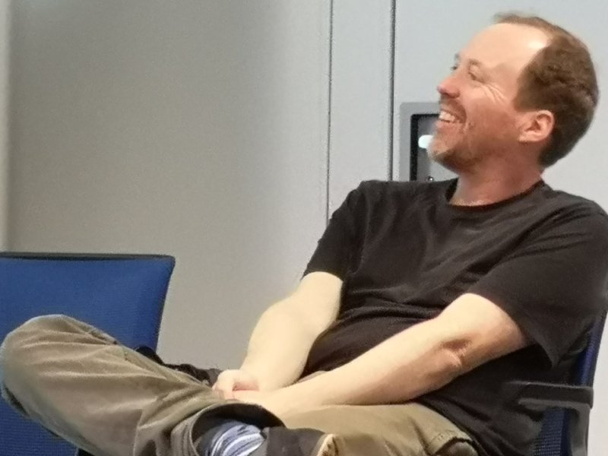
“I would love to be involved in the STAMP project and its partners”
Henry Coles
Pitest developer,
STAMP Advisory Board

Slide 10
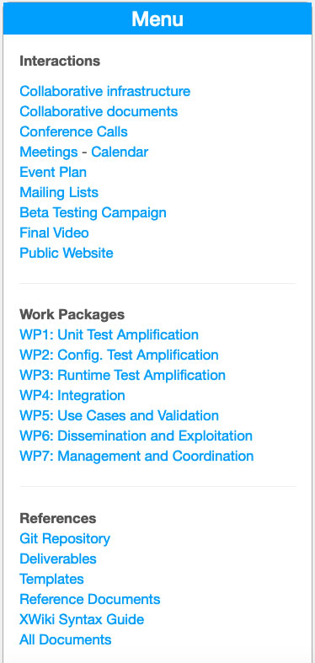








Private Wiki: 23 Collaboration Sections
SlideShare
LinkedIn
XWiki
Mailing Lists
Twitter
4 OSS and 4 SaaS
39 contributors, 87 pages, 1 456 files
36 calls minutes, 13 meetings
5 mailing lists, 5 reference documents
STAMP team collaboration entry point

Slide 11
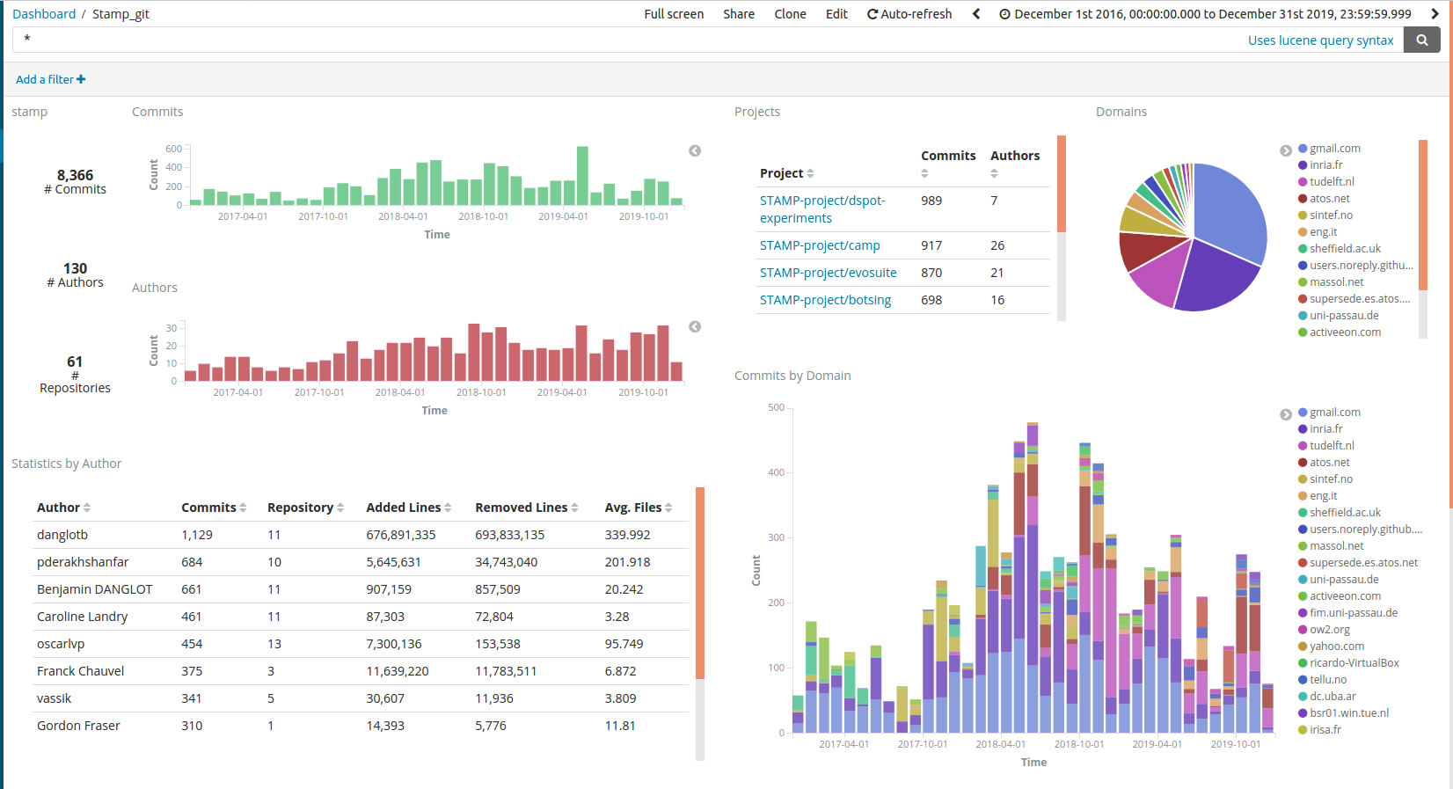
Collaboration Stats Dec 2016 – Dec 2019

Slide 12
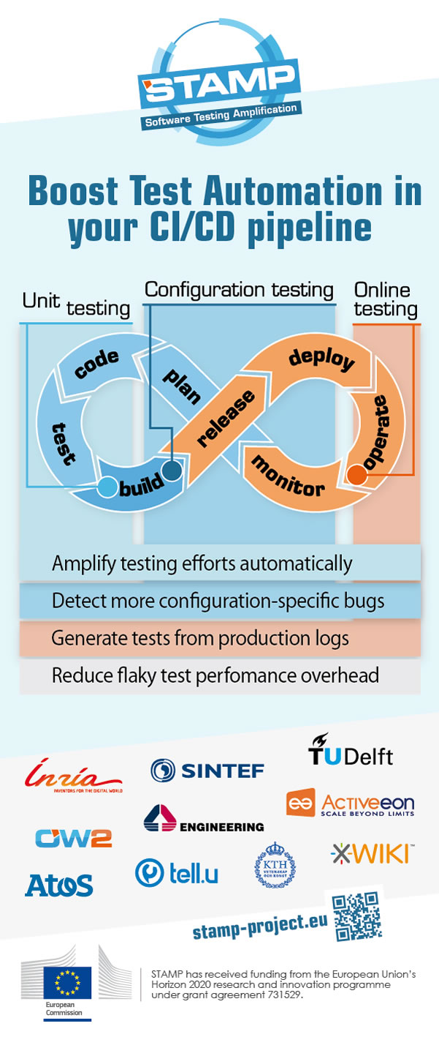
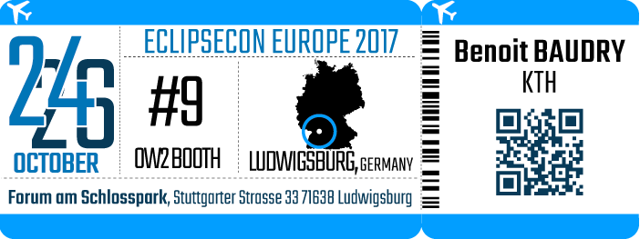
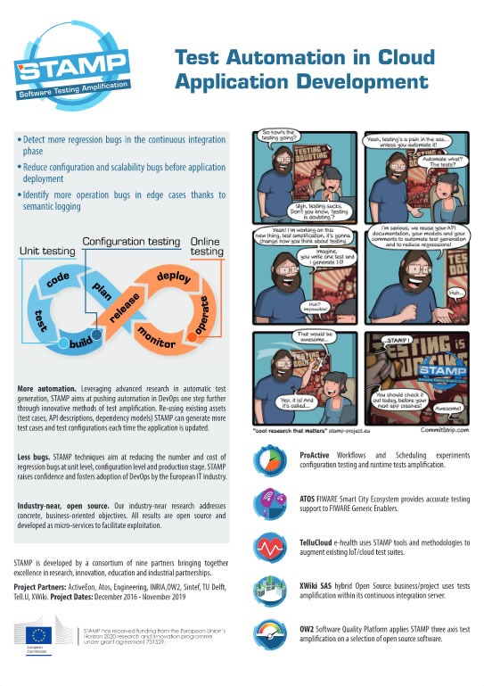

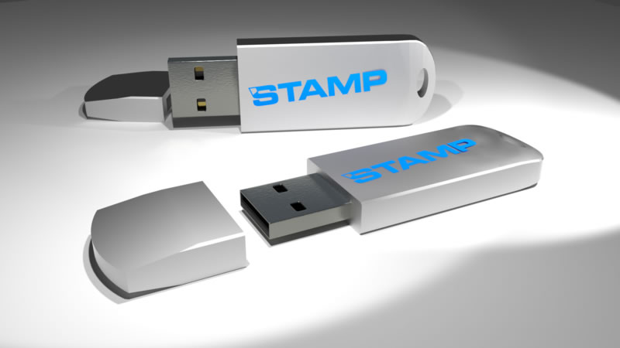
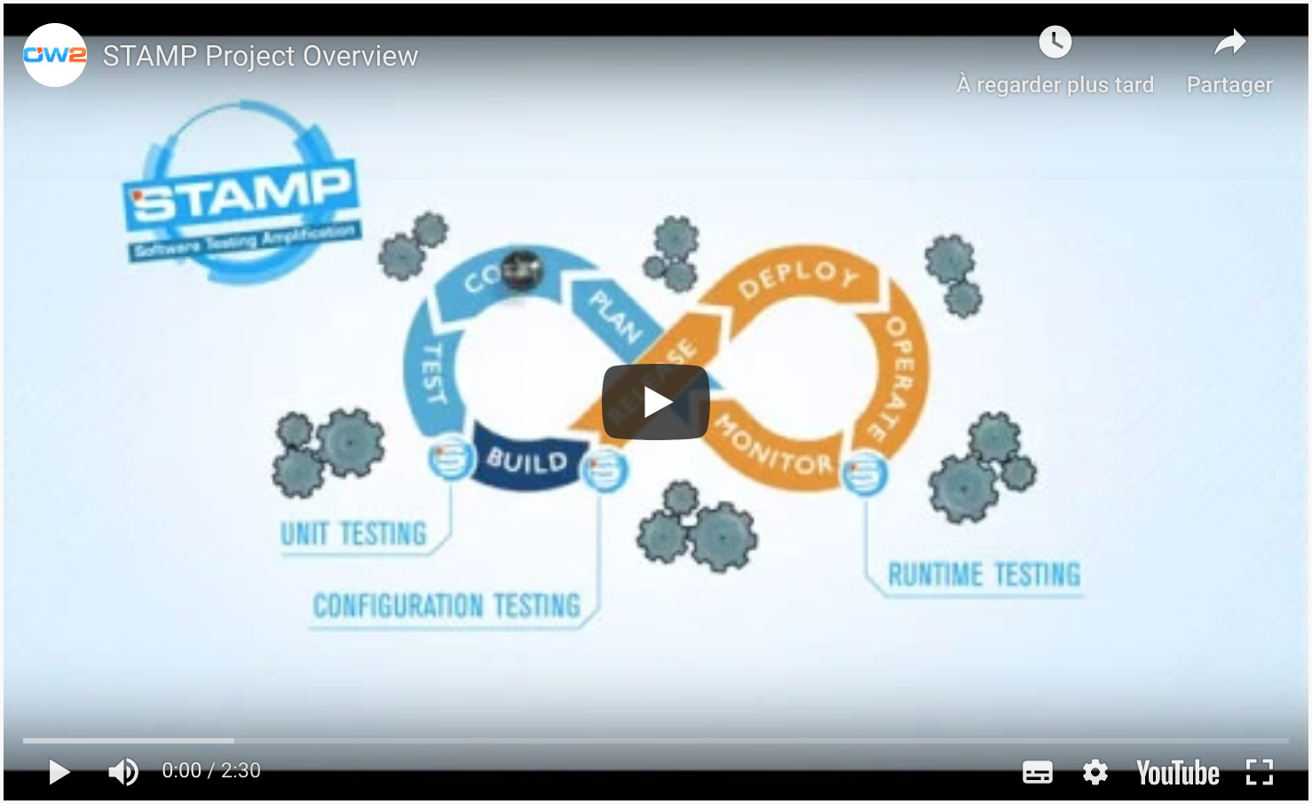
STAMP Collateral

Slide 13




Online Presence
Twitter
  600 Tweets
  370 Followers
  350 Following
LinkedIn
  27 members
  22 discussions
SlideShare
  12 Presentations
  313 views in Y3
Website
  1 429 unique visitors
  22 488 unique pageviews
Most visited pages
  Download / Beta-testing
  Events
Countries
  France,
  Italy,
  Spain,
  Norway,
  Netherlands,
  USA, Sweden, Germany, Belgium, India

Slide 14
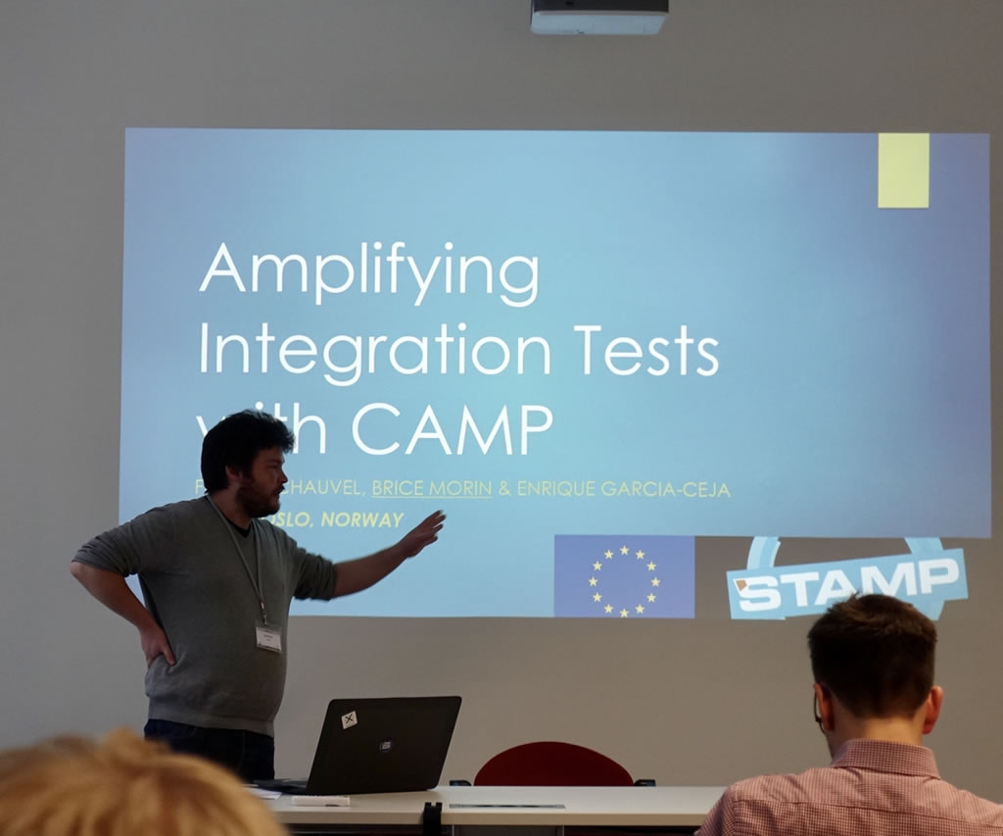
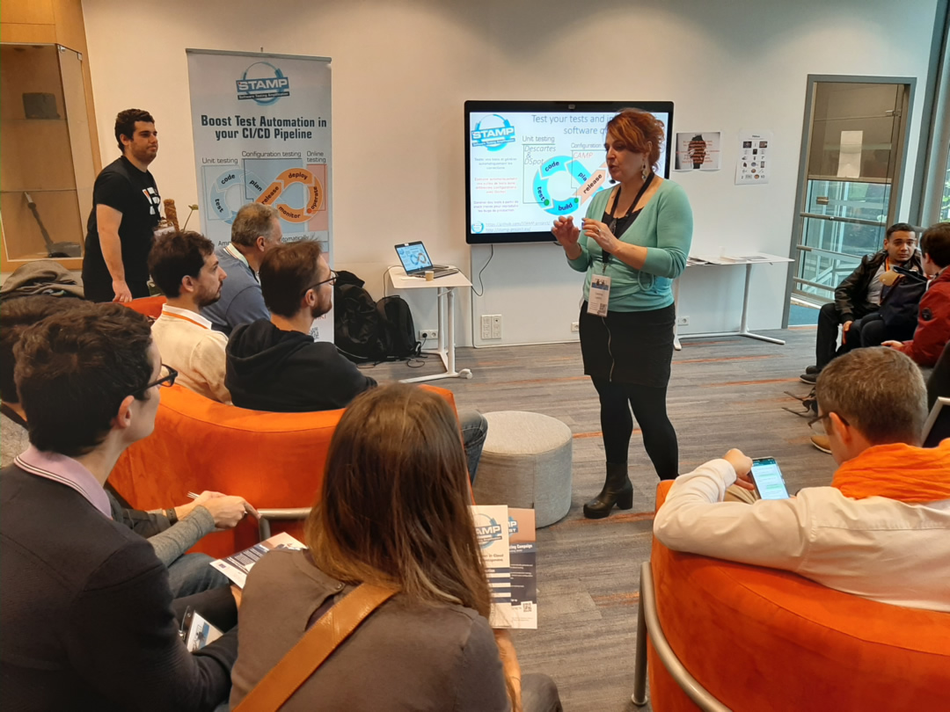
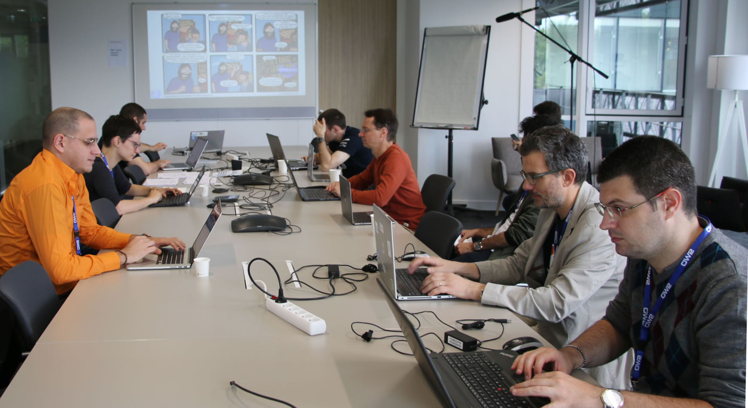
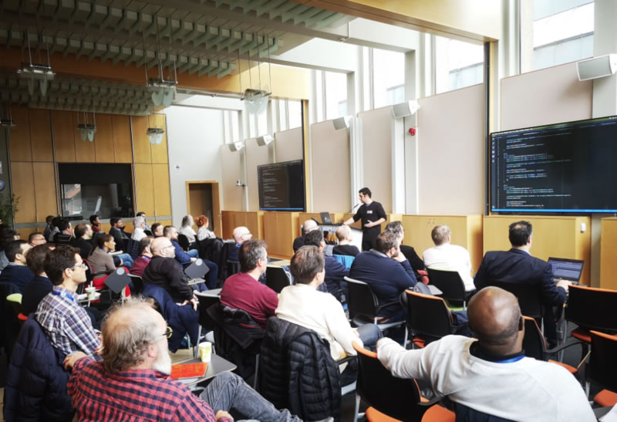
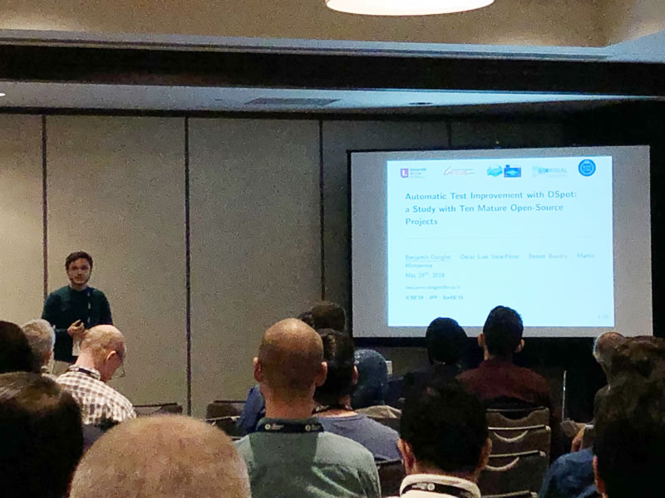
Physical Presence
Scientific dissemination
  12 conferences including: ISSRE, ISSTA, ICSE, ICST
  20 workshops
Industry & OSS events
  27 conferences including: OpenStack, Fosdem, Devoxx, POSS, OW2con
Industry outreach
  15 meetings including: EC-DGIT, Station-F, Orange, CGI, Spotify, etc.
Details in Annex 1

Slide 15
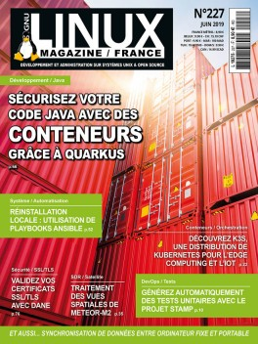
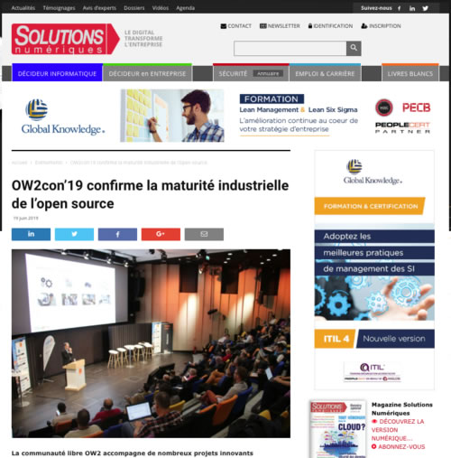
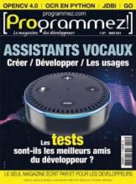
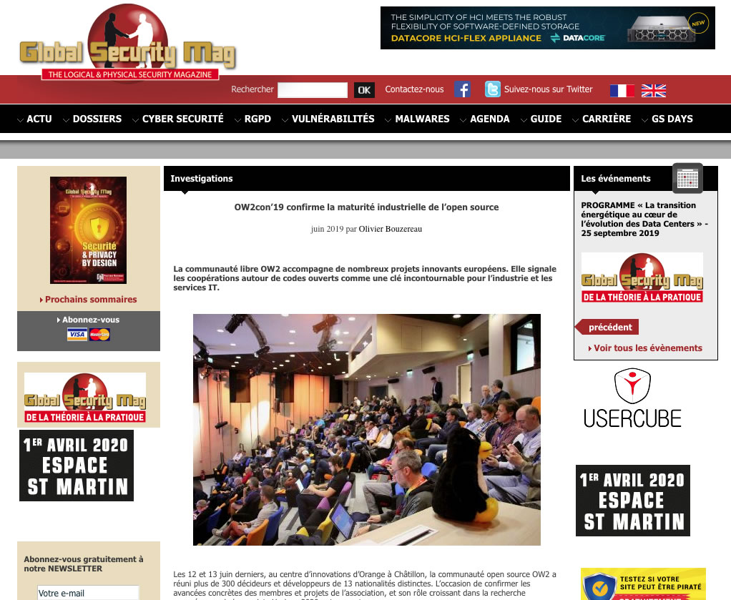
Press Releases and Mentions
4 Press Releases about STAMP
  12/3/2018 STAMP at Cloud World Expo
  15/11/2018 STAMP Beta-testing campaign
  13/2/2019 STAMP at Paris Station-F
  12/6/2019 STAMP Tools at OW2con’19
12 Press Mentions including
  Programmez, Linux Magazine, CastCodeurs,
  Global Security Mag, Solutions Numériques
2 Online News
  Inria, Wikipedia

Slide 16
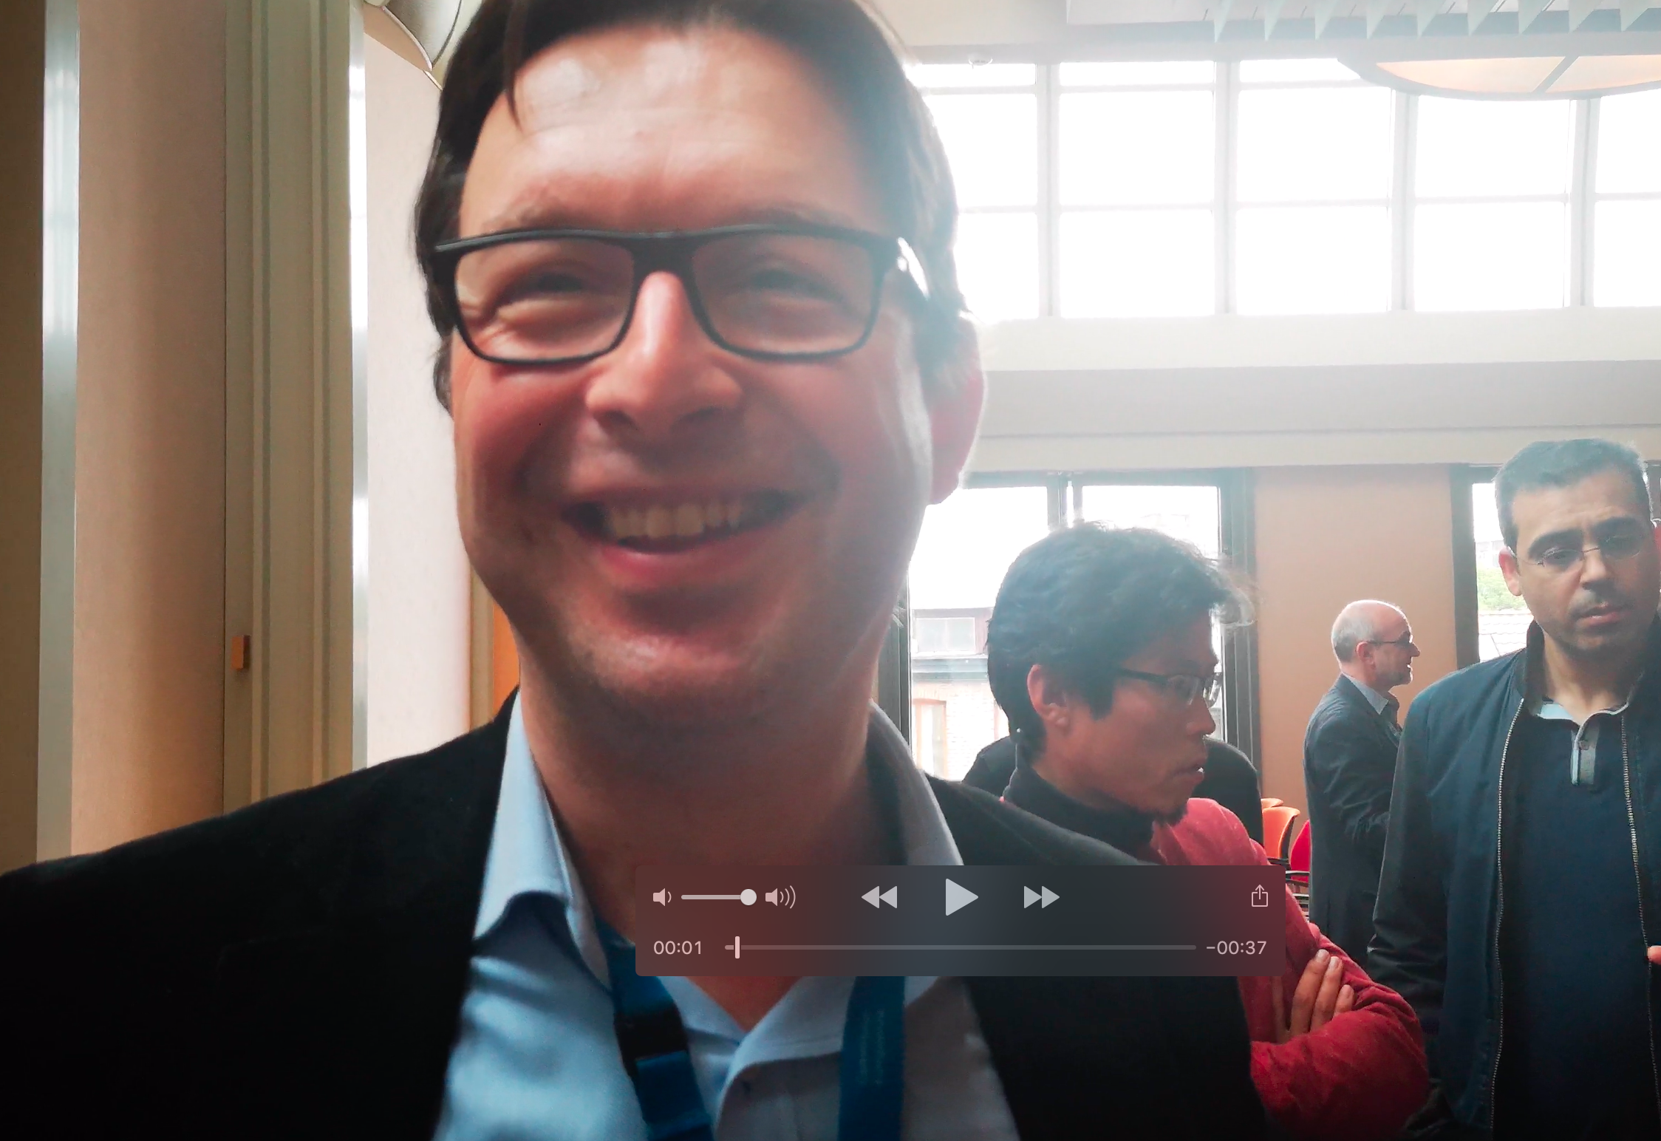
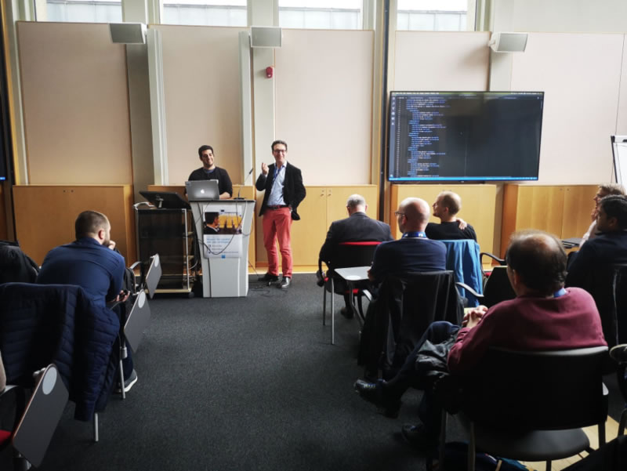
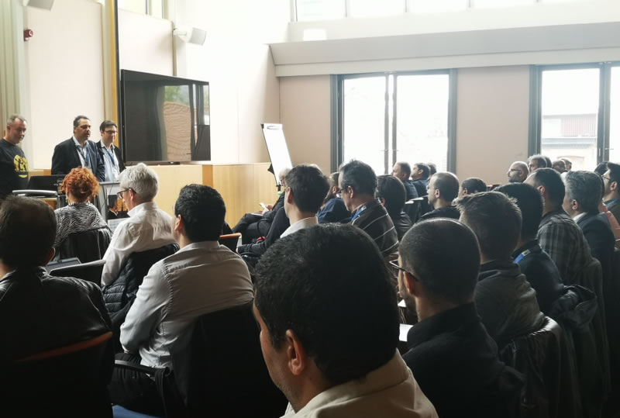
“Very interest presentation. We will these tools to improve the quality of our code.”
Grégoire Boulet
Head of Sector SW Development
European Commission

Slide 17
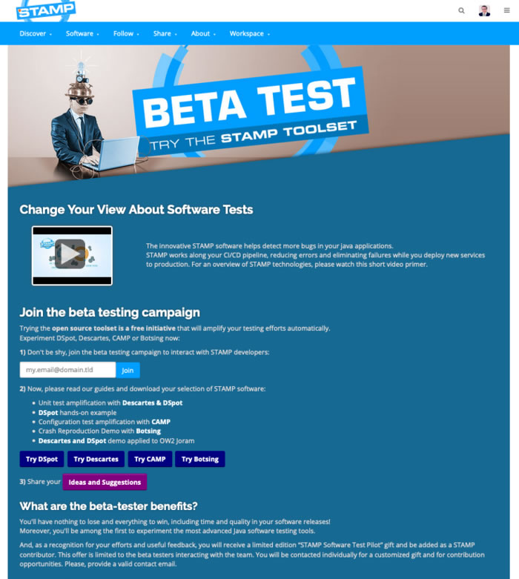
Beta-Testing Campaign
Short link: https://l.ow2.org/stpbeta
Video Primer
Sign-up to stamp-users Mailing List
Download and Try 1-to-4 tools
Feedback Questionnaire
Use STAMP tools on Github
Support Contact
Phase 1, October 2018: Unit testing tools (DSpot, Descartes)
Phase 2, April 2019: Configuration testing tools (+ CAMP)
Phase 3, July 2019: Production testing tools (+ Botsing)
Details in Annex 2

Slide 18

“Mutation can help develop excellent tests. I am hoping for the day when fully automated testing integrates directly with compiling inside IDEs.”
Jeff Offutt
Professor of Software Engineering at George Mason University (Virginia)

Slide 19


WP6 KPIs
KPI
Planned
Achieved
Ratio
#13 External
contributions 15 from 3 org. 59 from 23 org.
#14 Twitter followers 200 322
#15 Website visitors 2 250 1 420
#16 STAMP technologies at 5 27
important OSS forums
#17 Scientific papers accepted 10 31
in conf. & journals

Slide 20
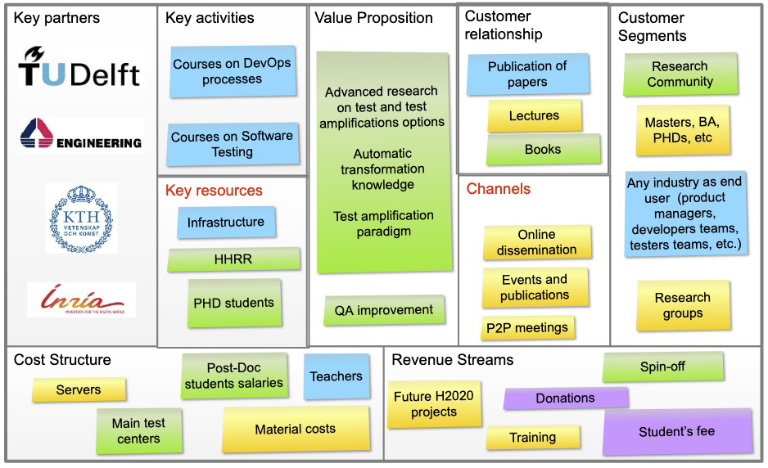
Knowledge Transfer Exploitation Model
KTH plans to offer courses based on DevOps and advanced techniques.
The DiverSE team in Inria/Rennes offers training based on software testing considering the two tools DSpot and Descartes.
TUDelft aims at offering courses based on advanced software testing (Bosting) and mutation testing (Descartes).
And for the industrial partners, Engineering plans to provide courses in their “Engineering Academy”. These courses are offered to Engineering’s customers.

Slide 21
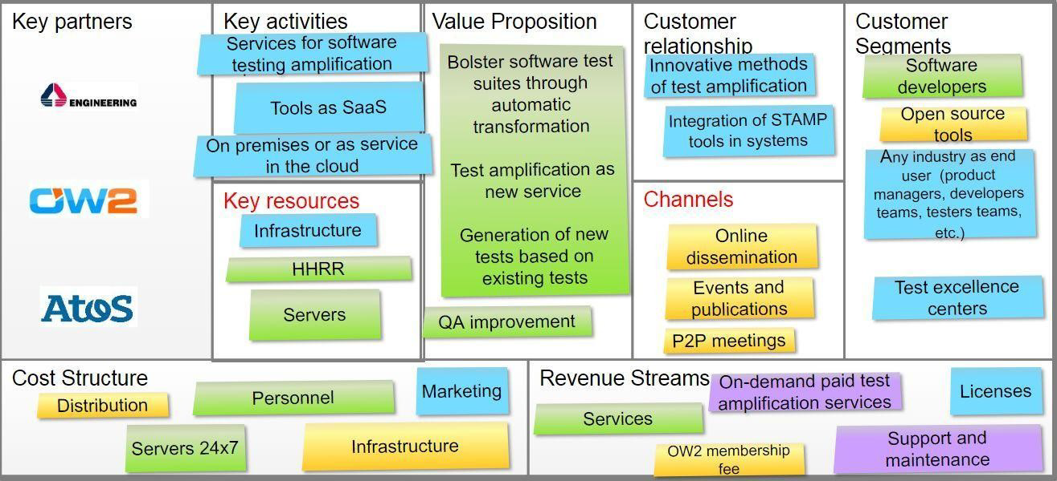
SaaS Exploitation Model
Most adequate partners to drive the SaaS business model are the service and consulting companies such as Atos and Engineering and the OW2 consortium.

Slide 22
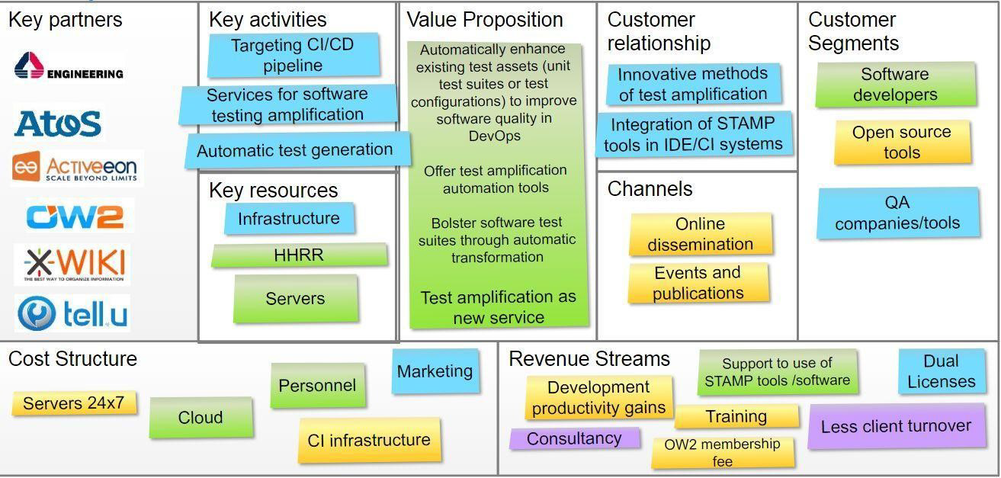
Open Source Exploitation Model
Propositions based on integration or service and support are well suited for service and consulting company (Atos and Engineering).

Slide 23
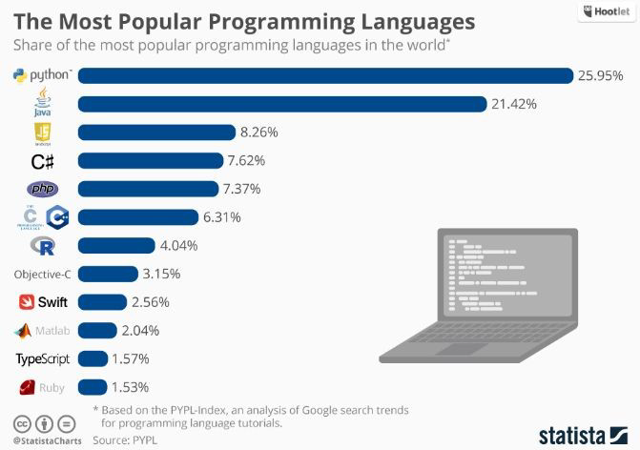
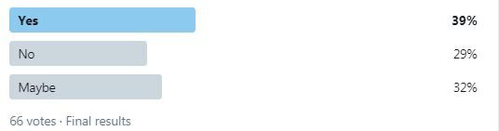
Market Opportunity
Java comes second with >21%
Market trends
Digital transformation calls for testing everywhere.
DevOps and resource shortage call for automation.
Specific Context
Testing automation only beginning to mature.
STAMP is for companies with testing assets.
GitHub and Java are well established dominant players in software engineering.
Market triggers
GitHub offers third-party software engineering tools on its marketplace.
One in four software developers could pay for using STAMP.
Market sweet spot
GitHub users X Java developers
Companies having already invested in QA
Looking to improve quality of current tests
Wanting to generate new test automatically
One in four would pay for STAMP

Slide 24
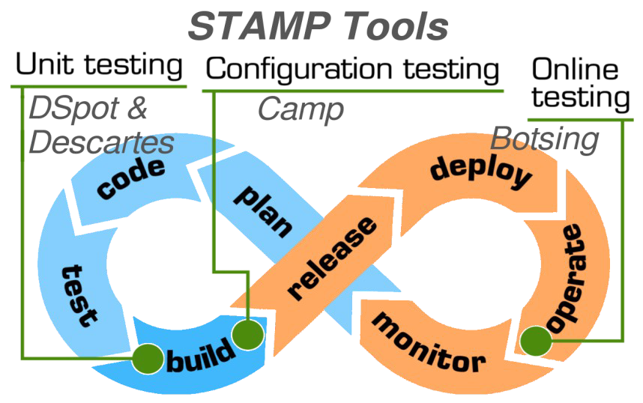
Mission and Value Proposal
Unique technology
Set of complementary tools
Mission
Unit testing: DSpot, Descartes
Configuration testing: CAMP
Production testing: Botsing
Improve the quality of testing in DevOps environments
Test amplification
And do it cost efficiently:
High ROI of fixing defaulting tests
Close to 10x less expensive with STAMP than manually

Slide 25
Key Exploitable Results
Tool
TRL
License
IP Lead
Unique selling poipnt
Resources
DSpot
6
LGPL v3.0
Inria
Automatic generation of missing test assertions for better test coverage within CI/CD.
Inria, KTH, TellU, Eng.
8
LGPL v3.0
Inria
Computes a mutation score faster than comparable tools, and finds pseudo-tested and partially-tested methods
Inria, KTH, TellU, Eng. XWiki, OW2
Descartes
CAMP
6
MIT
SINTEF
Allows test of a maximum of possible configurations for exhaustive system testing.
SINTEF, Inria, KTH, TellU, Eng. Atos
Botsing
6
APL 2.0
TUDelft
Finds root-cause of in-production crash and automatically generates relevant test cases.
TU Delft, XWiki
Plugins
• Integrated development environment
• Build tools
• CI system
• Issue tracking
Eclipse IDE plugin
Maven and Gradle plugins
Jenkins plugin,
Jira plugin for Botsing,
EPL
Same license as tool
MIT
APL 2.0

Slide 26
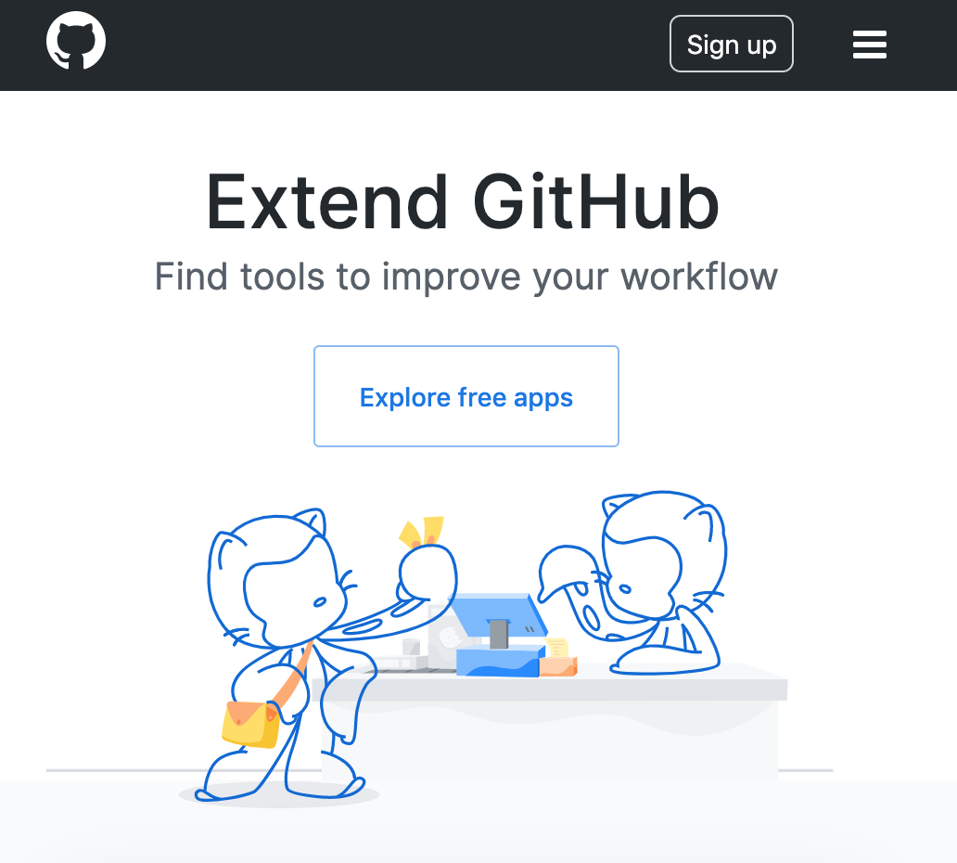
Go-to-Market: the GitHub Marketplace
GitHub Apps
Add functionalities to GitHub
SaaS delivery model
Revenue model
App provider: 75%
GitHub: 25%
Pricing: per user, per repository or per organization
Process
Publication and verification.
Verified apps are showcased on the market place and can propose paid plans.
Advantages
For developers: additional functionalities well integrated with GitHub
For app providers:
  immediate access to millions of developers
  limited integration effort.

Slide 27
Competition
Market competition
GitHub competition
DSPOT
Closest competitors on GitHub.
App categories: Code Quality, Code Review, Testing
Selenium, CABlazeMeter, Ranorex, Testplant, Taurus, IBM Rational Test Workbench, Silk Test, Xamarin, Parasoft
SOAtest, Smart Bear, Tricentis Tosca
Descartes
Codacy
CAMP
Tox: Python version; Testen: NodeJS
Chef: decrire configuration;
Mobile test: e.g. Xamarin
CI: Travis (diff conf) wercker
IBM, Accenture, Capgemini, Wipro, TCS, Computer Sciences Corporation (CSC), Cigniti Technologies, Gallop Solutions, Infosys, NTT Data, Steria, Tech Machindra, UST Global
They do not support testing tests. Tests can show 100% coverage and still do nothing.
Same positioning as STAMP for code quality
Coveralls
LGTM
Not in the same domain as STAMP. They focus on test plans and test execution
Botsing
TestQuality
Root Cause Analysis : OverOps
Stack trace analysis - STAT CRAY
EvoSuite, Sapienz, log analysis tools ?

Slide 28
Pricing
 | Plan 0 Open source | Plan 1 Individual | Plan 2 Team | Plan 3 Corporate
Average number | 1 | 1 | 5-10 | 100 -Unlimited
Average monthly € | 0 | 11 | 38 | 71.4
GitHub pricing plans
- Monthly subscriptions
- Plans represent levels of consumption: number of repositories covered by contract.
- Usually three pricing levels
- Plus one free for oen source projects.
Descartes pricing plans
 | Plan 0 Open source | Plan 1 Individual | Plan 2 Team | Plan 3 Corporate
Average | 1 | 1 | 10 | Unlimited
STAMP | 0 | 5 | 15 | 50
- Aggressive pricing.
- To be adapted depending on market reaction

Slide 29
SaaS Start-Up
Key Partners
Key Activities
Value
Proposition
Customer
Relationship
Customer
Segments
Reference plan for a stand alone start-up
Initial offering: Descartes tool in SaaS mode.
Baseline = Pure play model with no additional service
STAMP partners available for support
Use case partners help with marketing (testimonials)
Go-to-market 100% through GitHub marketplace
SaaS infra.
Web site
Inria
SINTEF
TUDelft
Automated GitHub service
Java x GitHub developers
Organisations and projecs with test assets
Improve the quality of testing in DevOps environ-ments
Key Resources
Channels
GitHub marketplace
Servers
Cost Structure
Revenue Stream
GitHub share
Personnel
Computing resources
Marketing
Pure play model: GitHub revenue sharing.
Extended model: Training, Support, Consulting

Slide 30
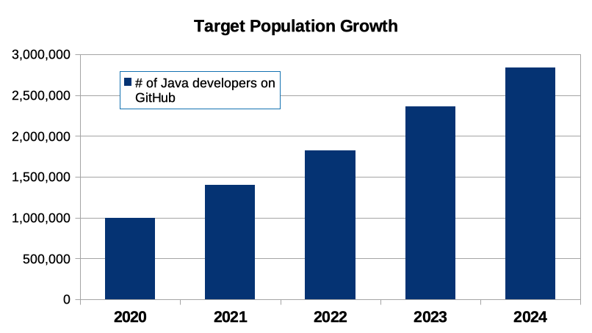
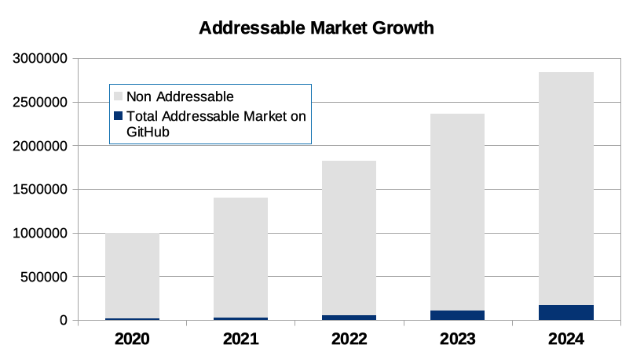
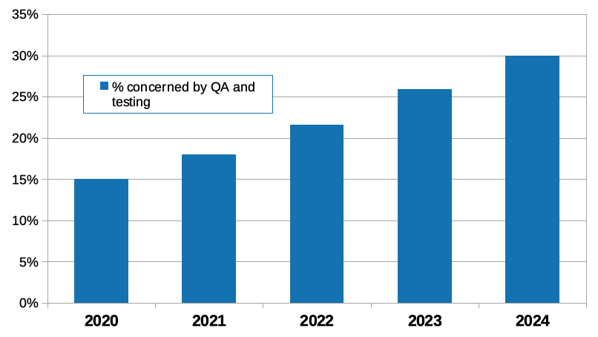
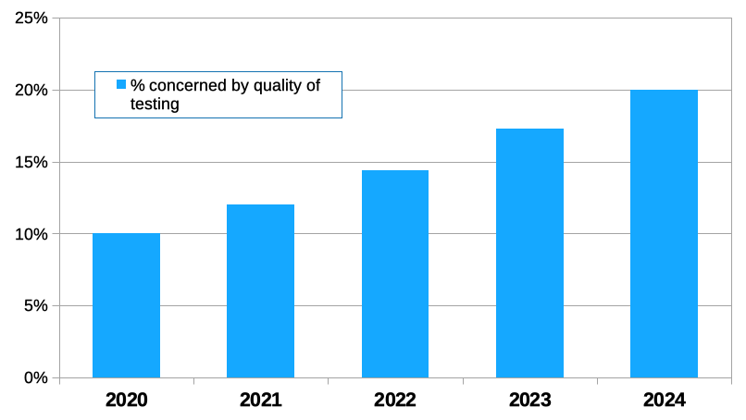
Addressable Market
Java project population on GitHub
→ grows from 1m to 2.8m
Of which concerned by QA and testing
→ grows from 15% to 30%
Of which concerned by quality of testing
→ grows from 10% to 20%
Total addressable market on GitHub (# of projects)
2020 = 15,000
2024 = 170,000

Slide 31
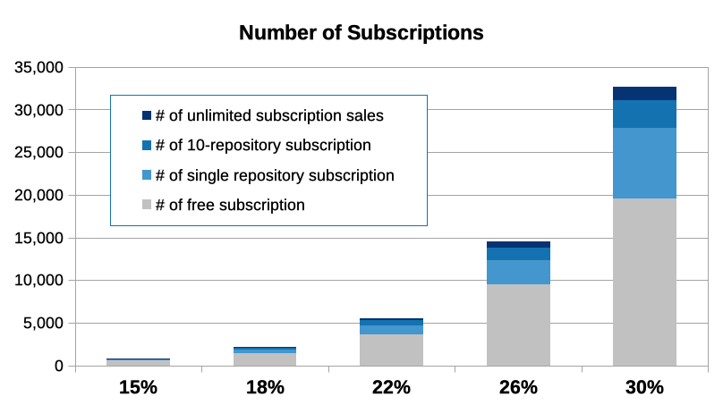
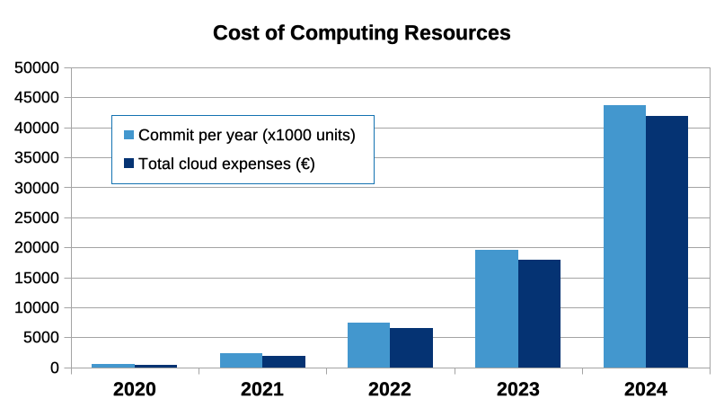
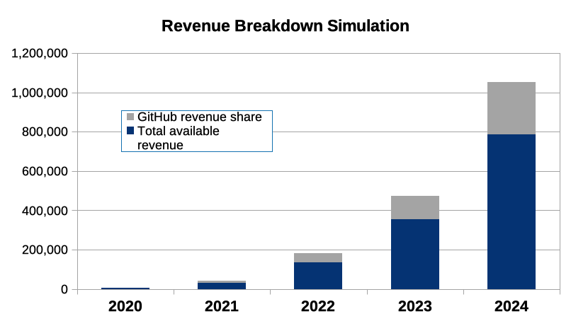
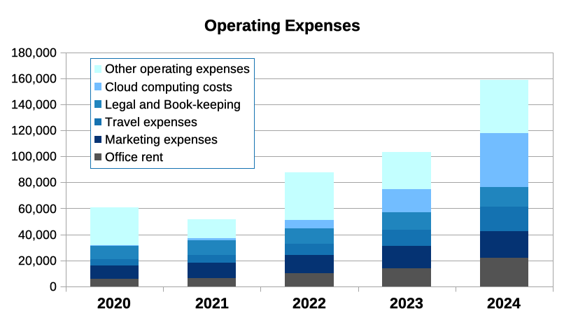


Key Figures
Number of subscriptions
Cost of computing resources
Operating costs
Available revenue
Operating results
Funding needs

Slide 32
Activity Volumes
Subscriptions grow from 750 to 32700.
Number of Java projects on GitHub grow 40% per year from 1m in 2020.
Expect an increase in interest in QA, testing and quality of testing of 20% per year (especially in new projects).
More than half will be free open-source subscriptions.
32700
750

Slide 33
Production costs
Annual cost grows from <1k€ to 50k€
Amazon AWS cost taken as reference cost.
Activity level determines required computing resources.
Activity level and related necessary computing resources evaluated from XWiki experience.

Slide 34
Available Revenue
Available revenue grows from ±7K€ to 767k€
After 25/75% revenue sharing with GitHub
Considering subscriptions signed evenly along the year.
Pure play SaaS model without services as reference baseline.

Slide 35

Operating Expenses
Personnel grows from 150k€ to 527K€
Start-up personnel exclusively technical.
Marketing and general in third year only.
Technical staff growth as from year four.
Operating expenses grow from 31k€ to 120k€
Year one higher because of set-up costs.
Marketing includes PR and analyst endorsement

Slide 36


Operating Result
Four years of negative results for the pure play SaaS model.
Model with most leverage at profitable fifth year.
Adding service revenue brings profitability earlier.
Additional service revenue based on .5 to 1 FTE per year.
Shows revenue with service is preferable.

Slide 37
Financing
Required funding to profitability:
  Pureplay: 900k€
  With service: 600k€
Strategies
  Bootstrapping on a shoe string unlikely.
  A team of academics with financial support could do it.
(euros) | Pure Play | With Service
Cumulated five-year result | -472,200 | -113,200
1st round: bootstrapping. | 594,000 | 344,000
2nd round: bridging to profitability. | 323,000 | 237,000
Total required funding | 917,000 | 581,000

Slide 38
The STAMP project has received funding from the European Union’s Horizon 2020 research and innovation programme under grant agreement No 731529.
More information: https://www.stamp-project.eu
The opinions expressed in this document reflects only the author`s view and in no way reflect the European Commission’s opinions.
The European Commission is not responsible for any use that may be made of the information it contains.

Slide 39
ANNEX 1: STAMP Workshops, Publications, Conferences and Industry Meetings

Slide 40
STAMP Workshops
28-31/10/2019 - Berlin, Germany - ISSRE'19
14-16/10/2019 - Stockholm, Sweden - Castor Software Days
2/10/2019 - Grenoble, France - STAMP Webinar with Orange
2/10/2019 - Stockholm, Sweden - Descartes at SAST
1/10/2019 - Rennes, France - STAMP Meeting with Harmonic
26/9/2019 - Rennes, France - STAMP Meeting with Veonum
3/9/2019 - Madrid, Spain - ElasTest-STAMP Collaboration
27/8/2019 - Tallinn, Estonia - MaLTeSQuE'19 Workshop
26/8/2019 - Tallinn, Estonia - A-Test'19 Workshop
26/8/2019 - Tallinn, Estonia - EASEAI'19 Workshop
31/7/2019 - India (remotely) - Descartes Webinar with Sopra-Steria
3/7/2019 - Chessy, France - STAMP at Eastern Paris Dev Meetup
29-30/5/2019 - Montreal, Canada -ICSE'19
17/5/2019 - Brussels, Belgium - EC DGIT Workshop
13/5/2019 – Cesson-Sévigné, France - Hands-on Workshop at OrangeLabs
12/4/2019 - Stockholm, Sweden - STAMP Mutation Testing Workshop
28/3/2019 - Rennes, France - STAMP Meeting with Solocal and Kereval
12/3/2019 - Paris, France - STAMP Webinar with CGI
27/2/2019 - Paris, France - Station F STAMP Workshop
30/1/2019 - Sophia-Antipolis, France - STAMP Workshop in Sophia-Antipolis
6/11/2018 - Delft, Netherlands - Dutch Testing Day
24/10/2018 - Paris, France - STAMP Workshop with Henry Coles
17/9/2018 - Leide, Netherlands - In-Vivo Analytics Workshop
8/9/2018 - Montpellier, France - SSBSE'18
3/9/2018 - Montpellier, France - MASES'18
28/5/2018 - Göteborg, Sweden - ICSE'18
17/5/2018 - Stockholm, Sweden - Spotify Talks
13/4/2018 - Västerås, Sweden - A-MOST ICST'18
19/3/2018 - Schloss Dagstuhl, Wadern, Germany - Dagstuhl'18
8/2/2018 - Remotely with OW2 project leaders - STAMP OW2 Workshop
14/12/2017 - Madrid, Spain - STAMP Workshop

Slide 41
Scientific Publications in OpenAire (1/2)
# | Title
1 | An Investigation of Compression Techniques to Speed up Mutation Testing
2 | A Journey Among Java Neutral Program Variants
3 | Correctness Attraction: A Study of Stability of Software Behavior Under Runtime Perturbation
4 | The Maven Dependency Graph: a Temporal Graph-based Representation of Maven Central
5 | A Comprehensive Study of Pseudo-tested Methods
6 | Test them all, is it worth it? Assessing configuration sampling on the JHipster Web development stack
7 | A Tale of CI Build Failures: An Open Source and a Financial Organization Perspective
8 | Descartes: a PITest engine to detect pseudo-tested methods - Tool Demonstration
9 | Uniform Sampling of SAT Solutions for Configurable Systems: Are We There Yet?
10 | TravisTorrent: Synthesizing Travis CI and GitHub for Full-Stack Research on Continuous Integration
11 | Does Refactoring of Test Smells Induce Fixing Flaky Tests?
12 | A systematic literature review of how mutation testing supports quality assurance processes
13 | A Test-Suite Diagnosability Metric for Spectrum-Based Fault Localization Approaches

Slide 42
Scientific Publications in OpenAire (2/2)
# | Title
14 | Exhaustive Exploration of the Failure-oblivious Computing Search Space
15 | Detection and analysis of behavioral T-patterns in debugging activities
16 | A spoonful of DevOps helps the GI go down
17 | Correctness Attraction: A Study of Stability of Software Behavior Under Runtime Perturbation
18 | A Guided Genetic Algorithm for Automated Crash Reproduction
19 | The Emergence of Software Diversity in Maven Central
20 | Search-based test data generation for SQL queries
21 | Deep customization of multi-tenant SaaS using intrusive microservices
22 | Oops, My Tests Broke the Build: An Explorative Analysis of Travis CI with GitHub
23 | Model-based mutant equivalence detection using automata language equivalence and simulations
24 | Single-objective Versus Multi-objectivized Optimization for Evolutionary Crash Reproduction
+ 3 PhD defenses

Slide 43
STAMP Conferences
21/6/2018 - Rennes, France - BreizhJUG'18
13-14/6/2018 - Toulouse, France - EclipseCon France'18
7-8/6/2018 - Paris, France - OW2con'18
18-20/4/2018 - Paris, France - Devoxx Paris'18
21-22/3/2018 - Paris, France - Cloud World Expo'18
3-4/2/2018 - Brussels, Belgium - Fosdem'18
6-7/12/2017 - Paris, France - POSS'17
24-26/10/2017 - Luwigsburg, Germany - EclipseCon Europe'17
20-21/9/2017 - Amsterdam, Netherlands - CloudWatchHub_Summit
19/9/2017 - Amsterdam, Netherlands - CloudWatch Europe
28-29/6/2017 - Brussels, Belgium - Net_Futures'17
26-27/6/2017 - Paris, France - OW2con'17
8-11/5/2017 - Boston, Mass. - OpenStack Summit'17
8-11/5/2017 - Austin, Texas - OSCON'17
22-23/3/2017 - Paris, France - Cloud World Expo'17
4-5/2/2017 - Brussels, Belgium - Fosdem'17
19/11/2019 - Grenoble, France - Orange Test and Dev Day
10-11/12/2019 - Paris, France - POSS'19
23-25/10/2019 - Ludwigsburg, Germany - EclipseCon Europe'19
7/10/2019 - Madrid, Spain - Madrid JUG Meetup'19
12-13/06/2019 - Paris, France - OW2con'19
6/5/2019 – Stockholm - STAMP DSpot Meetup'19
17-19/04/2019 - Paris, France - DeVoxx Paris'19
11/4/2019 - Stockholm, Sweden - Test Automation Research for Industry
20/3/2019 - Rennes, France - BreizhCamp'19
2-3/2/2019 - Brussels, Belgium – FOSDEM'19
6/12/2018 - Sophia-Antipolis, France - Telecom Valley'18
5-6/12/2018 - Paris, France - POSS'18
27-28/11/2018 - Paris, France - CloudExpoEurope'18
24/10/2018 - Paris, France - Paris JUG Mutation Testing'18
4/7/2018 - Sophia-Antipolis, France - SophiaConf'18

Slide 44






15 Industry talks
SPOTIFY HQ, Stockholm, Sweden, 17 May 2018 (KTH)
ParisJUG Mutation Testing meeting, 24 Oct. 2018 (ALL)
Sophia-Antipolis Workshop with 9 external dev. 30 Jan 2019 (ALL)
Paris Station-F, Start-ups dev, 29 Febr 2019 (Inria)
CGI Webinar with 25 DevOps from CGI, 12 March 19 (OW2, Inria)
Test Automation Research for Industry Workshop in Stockholm, 11 April 2019 (KTH)
Ericsson Mutation Testing Workshop, Kista, with Saab. 12 April 2019 (Inria)
Dspot: Improved software testing using AI, 6 May 2019 (KTH)
EC-DGIT Workshop for 70+ DevOps, 17 May 2019 (KTH/Inria)
STAMP breakout Session at OW2Con’19, 12/06/2019 (KTH, Inria)
Sopra-Steria Descartes Webinar 31 July 2019 (Inria)
Orange Grenoble on Descartes & Dspot 02/10/2019 (KTH)
Swedish Association for Software Testing (SAST) Descartes talk 03/10/2019 (KTH)
Castor Software Day, Stockholm, 14/10/2019 (KTH)
Orange Test & Dev Day, Grenoble, 19/11/2019 (Inria, OW2)

Slide 45
ANNEX 2: STAMP Beta-testing campaign

Slide 46

STAMP Beta Tester Feedbacks (14 answers)

Slide 47

STAMP Beta Tester Feedbacks (14 answers)
Using the software guides, DSpot and Descartes were simple to install according to the beta-testers. Descartes allowed 88% of beta testers to check their unit tests effectiveness. DSpot allowed 55% of beta testers to amplify their unit tests. 67% of testers could amplify their configuration tests with CAMP and 60% of beta testers could improve their crash tests with Botsing.
2. Following the steps provided in the Getting Started guide, were you able to:

Slide 48



Beta Tester Feedbacks on User Experience
A total of 64.2% of beta testers found the STAMP toolbox easy to understand, while 35.7% found it difficult to understand.
4. Would you be interested in exploring further STAMP with one of the developers or in a personalised demonstration?
Yes, I want to
know more
about STAMP:
100% Yes

Slide 49

Beta Tester Origin
Beta testers working in an industrial company represent the largest group of early users (43.9%). They are followed SME IT professionals (21.4%), Academic testers (14.3%), and local government (7.1%).

