Slide 1
Source: https://docs.google.com/presentation/d/1fYe_HNR42YaiORQvTBtJ85ZZXC-lRq79rCjpTNuA8AU/edit?usp=sharing

Slide 2
STAMP WP1
Unit Test Amplification
Presenter: Martin Monperrus
Professor, KTH Royal Institute of Technology

Slide 3
WP1 Overview
Task 1.1 State of the art
Task 1.2 Measurement tool for test suites
Task 1.3 Automatic generation of test cases variants
Task 1.4 Test execution
Task 1.5 Industrialization

Slide 4
WP1 Task 1.1 State of the art document
Snowballing literature study
83 references
Co-authors Inria / TU Delft / KTH
Published in top journal “Journal of Systems and Software”

Slide 5
WP1 Task 1.2 Measurement tool
1 PhD Oscar Luis Vera-Pérez (defense Dec 18 2019)
2 papers accepted, one under review
  Incl. at top journal Springer Empirical Software Engineering
2 tools
  https://github.com/STAMP-project/pitest-descartes
  https://github.com/STAMP-project/descartes-reneri
Outreach to industry with talks
Collaboration with Uni. Stuttgart

Slide 6
WP1 Task 1.2 Key concept
“Pseudo-tested method”
  Covered but not specified
  Can be emptied without being noticed
abstract class AbstractHashedMap<K, V> {
protected void ensureCapacity(final int newCapacity) {
final int oldCapacity = data.length;
if (newCapacity <= oldCapacity) {
return;
}
...
threshold = calculateThreshold(newCapacity, loadFactor);
data = newEntries;
}
}
...
}
Executed by 38 test cases
Invoked 11593 times

Slide 7
WP1 Task 1.3 Generation of test cases variants
1 PhD Benjamin Danglot (defense: Nov 14 2019)
2 top journal papers in Springer Empirical Software Engineering
One professional repository: https://github.com/STAMP-project/dspot
  700+ commits
  3 modules, incl. 1 Maven plugin
  Kubernetes support
  Demo website

Slide 8
WP1 Task 1.3 Key concept
Input amplification, observation amplification
@Test
public void html() {
Attribute attr = new Attribute("key", "value &");
assertEquals("key=\"value &\"", attr.html());
assertEquals(attr.html(), attr.toString());
}
@Test
public void html_add33() throws Exception {
Attribute attr = new Attribute("key", "value &");
Assert.assertEquals("key=\"value &\"", attr.html());
Assert.assertEquals("key=\"value &\"", attr.toString());
Assert.assertEquals("key", attr.getKey());
Assert.assertEquals("value &", attr.getValue());
}

Slide 9
WP1 Task 1.2 -1.3 Novelty & Impact
Very strong scientific novelty:
  DSpot
    Reviewer: “Rather than working with tests written purely manually or tests generated purely [...] , the authors of this paper posit a third route - enhancing existing manually-written test cases through the use of automation [...] . The core idea is interesting, and not something I have seen explored very thoroughly before.”
  Descartes
    Reviewer: “Coverage is considered to be a proxy for high testedness. Pseudo tested methods run counter to that wisdom by indicating that the method body does not matter!”
Impact in the project: successes in use cases

Slide 10
WP1 Task 1.4 Test execution
Performance engineering and optimization for DSpot
Tool used: Netbeans profiler and telemetry
Highlights:
  Caching for cloned test methods #701 (42% test execution time reduction)
  Performance analysis and optimization for Java streams #719 (30% reduction)
  Parallel test execution #775, #815 (20%-30% reduction)

Slide 11
WP1 Task 1.5 Industrialization
Support for Maven multi-module projects
Integration of Descartes in the XWiki production CI pipeline
Development of Jenkins plugins for DSpot and Descartes
Support for DSpot execution focused on a change

Slide 12
WP1 Collaboration
TU Delft: Joint publication Inria / KTH / TU Delft
Atos: Joint engineering on optimization
XWiki: selection of test cases to be amplified
Engineering: extension for advanced functionalities
External research collaborations: Uni. Stuttgart & Uni Kyushu
Pilot deployments at SAAB & Spotify

Slide 13
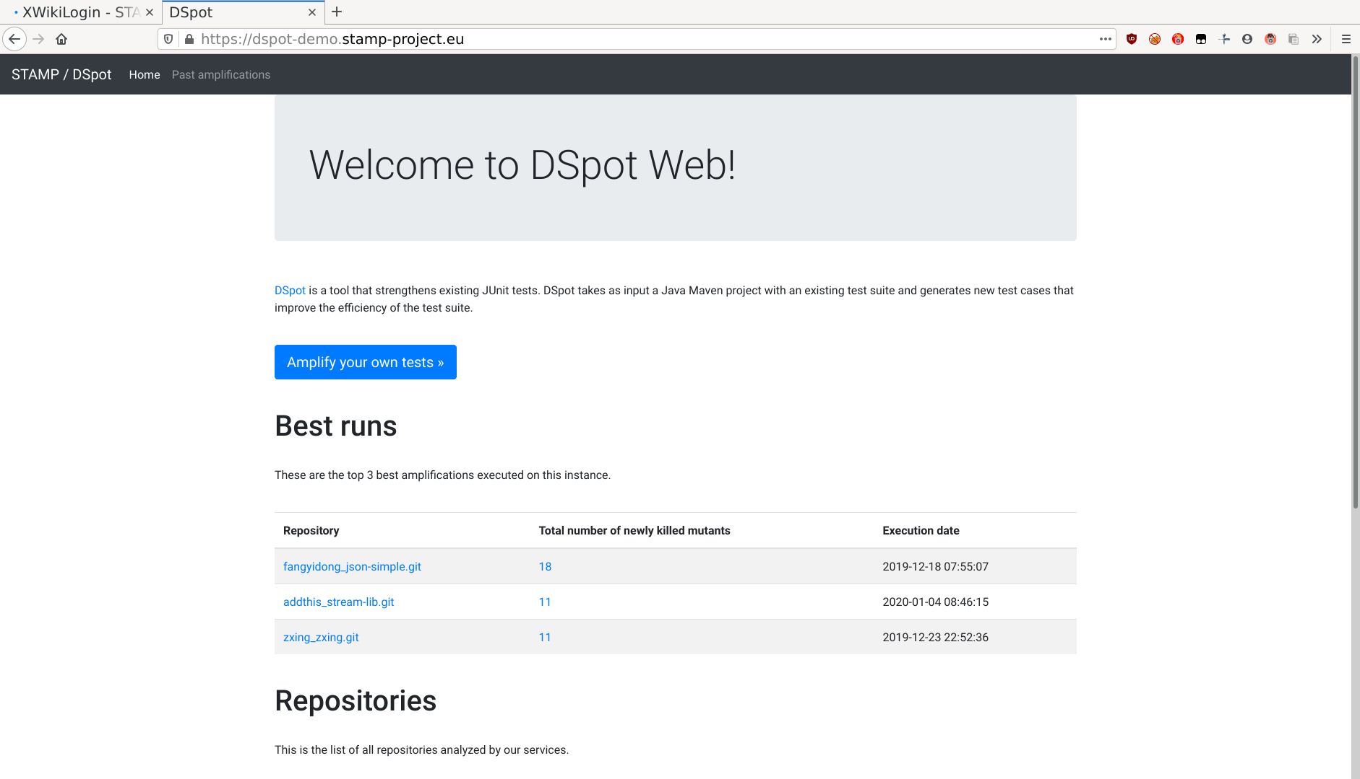

Slide 14
WP1 Summary
Task 1.1 State of the art
Task 1.2 Measurement tool
Task 1.3 Automatic generation of test cases variants
Task 1.4 Test execution
Task 1.5 Industrialization
✓
✓
✓
✓
✓
DoA Objective: Provide an approach to automatically amplify unit test cases when a change is introduced in a program
✓

