Slide 1
WP2: Configuration Tests Amplification
Franck Chauvel (SINTEF)
STAMP Project Final Review
Brussels, 6 February, 2020

Slide 2

Recalling Configuration Testing
Test
1. Arrange
Program
DB
2. Act
MQ
3. Assert
Libraries
Application Server
Runtime
OS

Slide 3
WP2 Overview

Slide 4
Task 2.1: State-of-the-Practice
Survey, documented in D2.1
Multiple Understanding
Libraries / Configuration Files
Products / Environments
SaaS / Architecture & Scaling
Conclusions
No standard process
No tool support
Coupled to other type of testing

Slide 5
Task 2.2 Abstract Configuration Model
Documented in D2.2, D2.3 & D2.4
Services
Connections outside the "container"
Remote services, DB, etc.
Features
Connections within the container
Libraries, OS, frameworks etc.
Variables
Provided Feature
Provided
Service
Component
Variable: {V1, V2, V3}
Required
Service
Required Feature

Slide 6
Task 2.3 Automatic Configuration Generation
App
App
Oracle
Deb. 8
JRE
App
Oracle
Deb. 9
JRE
JRE
App
Oracle
Deb. 10
Oracle JDK
OpenJDK
App
Oracle
Ubu. 16
Linux
Linux
Linux
Linux
Debian
Ubuntu
Ver: {8, 9, 10}
Ver: {16, 18, 19}

Slide 7



CAMP Overview
Constraint Solver
(Z3)
Variation Model
CAMP
Configuration tests
Amplification
Report
Test Template
Container Engine
Test
Test
Test

Slide 8
Task 2.4: Configuration Assessment & Selection
 | JRE |  | Linux
 | Oracle | OpenJDK | Debian |  |  | Ubuntu
Configuration |  |  | v8 | v9 | v10 | v16 | v18 | v19
C1 | X |  | X
C2 |  | X |  | X
C3 | X |  |  |  | X
C4 |  | X |  |  |  | X
C5 | X |  |  |  |  |  | X
C6 |  | X |  |  |  |  |  | X

Slide 9
Task 2.5 Configuration Execution & Instrumentation
Language Agnostic
JUnit, JMeter
3.a Generic Executor
1. Find
2. Build
Java/JUnit Dedicated
IDE Integration
3.b JUnit Executor
T2.2, 2.3, 2.4
T2.5

Slide 10
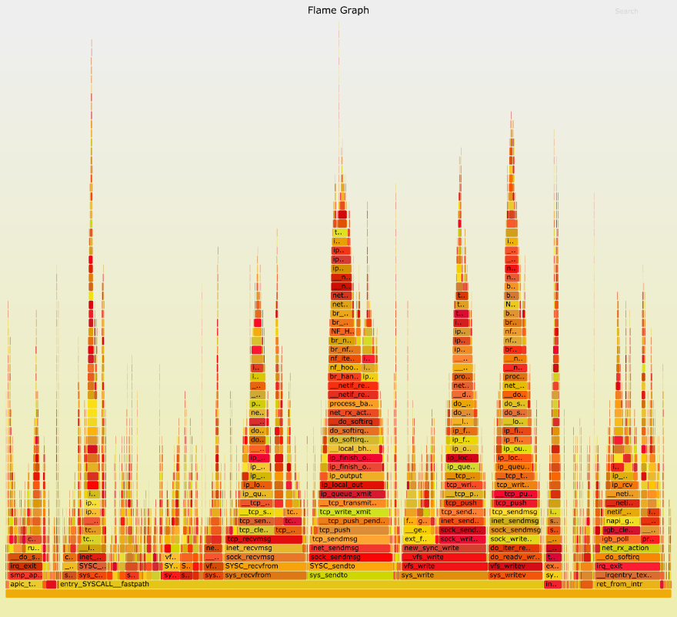
Configuration Instrumentation
Observe how alternative configuration exercise the SUT
2 Approaches
Generic approach: Monitoring System calls.
Java-based agent capturing Java Stacks

Slide 11
CAMP Roadmap
~ 7 500 LoC Python
~ 250 tests
11 contributors
30 releases
45/65 issues closed
Online documentation
Open source (MIT License)
Python + Z3 + Docker
Oct 18
Nov 18
Mar. 19
May. 19
June. 19
Aug. 19
Oct. 19
Nov. 19
Nov. 19
v0.1
v0.2
v0.3
v0.4
v0.5
v0.6
v0.7
v0.8
v0.9
First
integrated
version
Integrated
input
files
JUnit
Integration
New
Realization
operators
New
Realization
operators
JMeter
Integration
Selective
Execution
Retry
Capabilities
Gather
Log files

Slide 12
Configuration Testing on OSS
Sphinx v2.0.1
Atom v1.36.1
Python
2k downloads / month
7 open-ended dependencies
402 300 configurations
Covering arrays
22 configurations
3 pass all tests
JavaScript
35 open-ended dependencies
150 000 000 configurations
Covering arrays
21 configurations
12 failed some tests

Slide 13
WP2 Key Contributions
SINTEF: CAMP Development
ENG: CAMP Integration with JMeter
XWiki: CAMP integration with TestContainer Execution engine
Activeon: CAMP instrumentation to obtain FlameGraphs

Slide 14
Conclusions
All tasks completed
Tool: CAMP
Configuration testing
Platform Agnostics
Orchestrations, stacks, and local configuration
Multiple Type of Testing
Functional
Performance
Dissemination:
1 Journal (4 p. / tool) + 2 conferences
1 Keynote
4 tutorials
1 videos
Further research on Configuration Testing SINTEF

Slide 15

Thank you! Questions, Comments & Discussion

Slide 16
Dissemination
1 Journal (4-page / tool)
Franck Chauvel, Brice Morin, Enrique Garcia-Ceja, CAMP: A tool to amplify software configuration tests, Software Impacts, 2019, 100013, ISSN 2665-9638
2 International Conferences
Vasilevskiy, Anatoly; Song, Hui; Morin, Brice, "TECOR: Automate the Testing of One Product on Many Configurations", 11th IEEE Conference on Software Testing, Validation and Verification (ICST 2018), IEEE.
Franck Chauvel, Brice Morin, Enrique Garcia-Ceja, Amplifying Integration Tests with CAMP in Proceedings of the 30th International Symposium on Software Reliability Engineering (ISSRE 2019), IEEE, to be published.
1 Keynote
Brice Morin, Configuration testing of Docker-based Microservices, Keynote at A-MOST workshop at ICST 2018
4 Live Tutorials:
Tutorial at the STAMP workshop, Sophia Antipolis, France, Jan. 2019, by Franck Chauvel
Tutorial at Station-F, Paris, France, February 2019, by Enrique Garcia-Ceja
Tutorial at OW2Con 2019, Paris, France by Franck Chauvel
Tutorial at the A-Test workshop at ESFEC Aug. 2019, Germany, by Franck Chauvel
1 video tutorial available at: https://youtu.be/81_2H7GOQwg

